Slide 1
HOG Methodology for Pedestrian Detection
CS512: Computer Vision
Fall 2018
Aditya yaji Pallavi Chandrashekar
A20426486 A20427289

Slide 2
Contents
Introduction to pedestrian detection
Problem statement
Histogram of oriented gradient (HOG)
Support vector machine (svm)
Proposed solution
Implementation details
Discussion of the obtained results
references
Demo

Slide 3

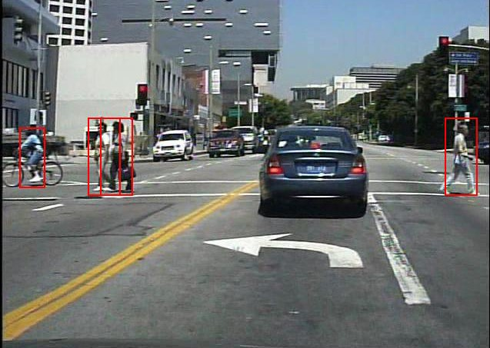
Introduction to pedestrian detection
Pedesn detection is essential and significant task in any intelligent system.
Pedestrian detection is used by many car manufactures like Audi, Toyota, Audi, BMW etc.

Slide 4
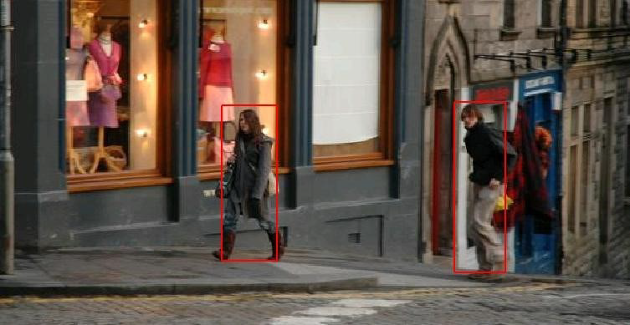
Problem statement
Pedestrian Detection is widely used for intelligent control, intelligent transportation driving auxiliary, advanced human computer interaction and so on.
Nevertheless, Pedestrian Detection is a challenging problem

Slide 5
Continued....
Challenges faced are :
i. Various styles in appearance i.e. clothing and trousers.
ii. Non-rigid objects i.e. various bodies and actions.
iii. Background environment.
iv. Frequent occlusion between pedestrians.
Despite challenges, pedestrian detection remains as active research in computer vision.
There are numerous approaches like Holistic based, part based, patch based, motion based detection, detection using multiple cameras and so on.
Of all this, one of the typical and effective framework applies histogram of oriented gradient (hog) as descriptor and linear svm to train the pedestrian detection.

Slide 6
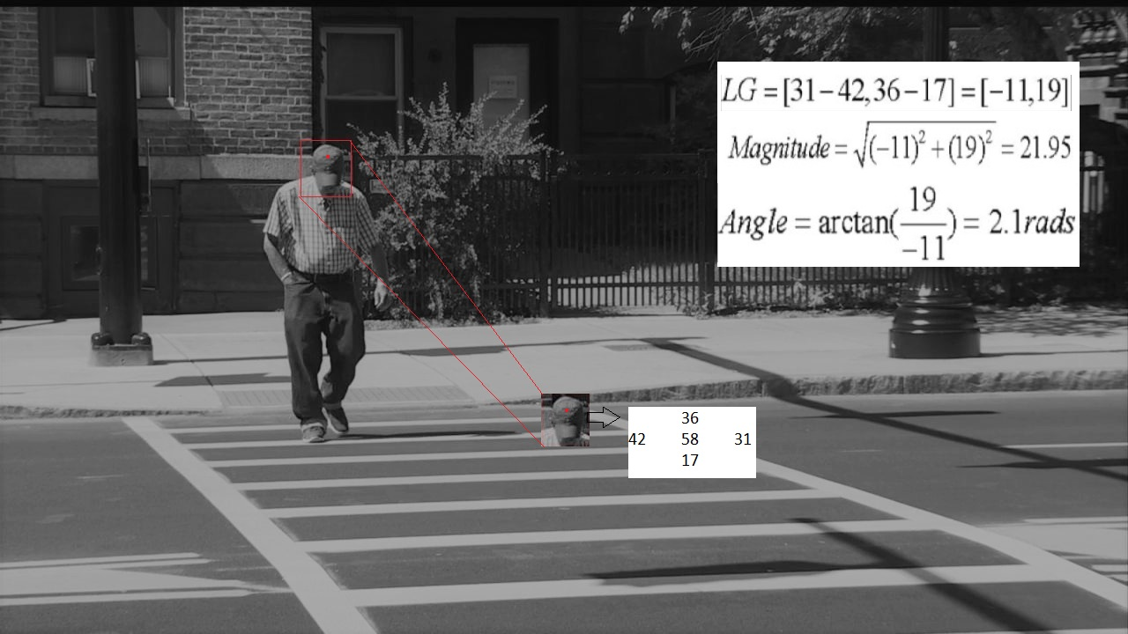
Histogram of oriented gradient (HOG)
HOG descriptor captures edge or gradient structure that is very characteristic of local space.
To construct hog descriptor, we do it in 2 steps.
Laplacian gradient (LG) :
take a patch from an image and mark certain pixel within this patch as red. For example, if the pixel value is 58.
We can access 4 neighbors and their pixel values as 42, 31, 36 and 17.
LG of the selected pixel consists of the gradients of horizontal (31-42) and vertical (36-17) directions, which is LG=[-11,19]. It’s magnitude is 21.95 and angle is 2.1 rads.

Slide 7

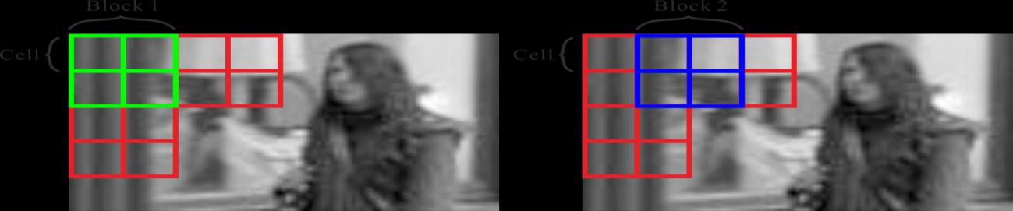

Continued..
2. Constructing HOG descriptor :
Given an image patch, which we call it a "cell" in the rest of this specification, we can obtain angles of all the pixels within the cell by following the above-mentioned computation.
We accumulate the calculated magnitudes into a 9-bin histogram according to the corresponding angles which ranges from −𝜋 to 𝜋, i.e. the interval is 40 degrees.
The histogram is the HOG of a cell.
Obtained Hogs are concatenated into a vector and then normalized v by its l2-form i.e, ,where 𝜖, a small residual for avoiding "division by zero" in practice.
The normalized vector ‘v’ is the HOG descriptor of a block.

Slide 8
Continued....
For example, assume we have a 256x128 gray scale image and set the cell to cover 8x8 pixels. Then this image can be divided into 256/8=32 cells vertically and 128/8=16 cells horizontally. We also enforce each block contain 2x2 cells.
Following the strategy of overlapping the blocks by 50%, we can group the cells into 32-1=31 blocks vertically and 16-1=15 blocks horizontally. Totally there are 31x15=465 blocks in this image.
Since the dimensionality of the HOG descriptor for a block is 9 bins x (2x2) cells = 36, then dimensionality of final descriptor of this 256x128 image is 36 x 465 blocks = 16,740.
In the rest of this specification and the implementation, we fix the number of bin to 9. We also fix the size of a cell to cover 8 x 8 pixels and block to contain 2 x 2 cells.

Slide 9
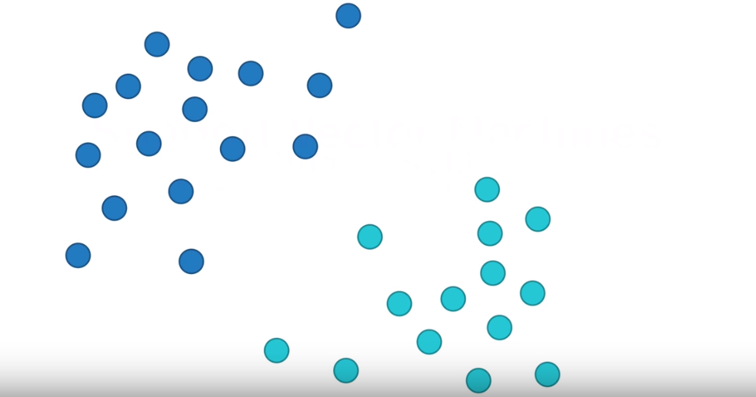
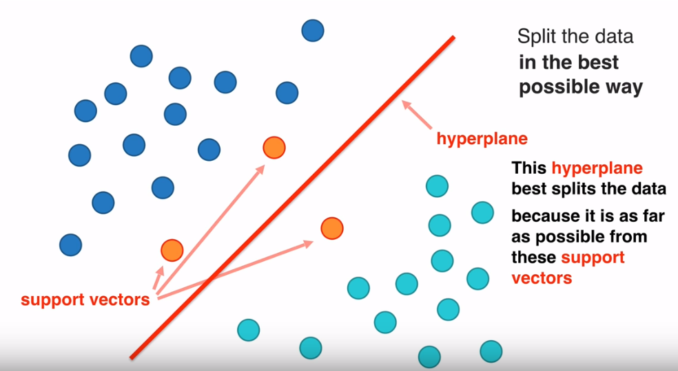
Support vector machine (SVM)
SVM is supervised learning models with associated learning algorithms that analyze data used for classification and regression analysis.
in svm, data point is viewed as p dimensional vector and we want to know whether we can separate such points with a (p – 1) dimensional hyperplane. This is called linear classifier.
Data set before applying SVM
Data set after applying SVM

Slide 10
Linear svm
Linear svm is extremely fast algorithm for solving multiclass classification problems from ultra large data sets.
Features of linear svm
Efficiency in dealing with extra-large data sets.
Solution of multiclass classification problems with any number of classes.
No need for expensive computing resources.
Ideal for contemporary applications like e-commerce, Object classification, banking service and many more.

Slide 11
Proposed solution
In this section, we describe how to train a linear detector and use the detector to detect pedestrian within a given image.
Pedestrian Detection Using HOG is divided into mainly three steps:
1. Train linear detector
2. sliding window strategy
3. Multiple scale manner

Slide 12
Train Linear detector :
Given a set of training images, we divide it into positive samples and negative
samples.
The positive samples are the images containing only one pedestrian While, the negative ones contain no human.
resizing the sample to fixed size of i.e. 128 x 64.
Then, We will extract the hog descriptor for each training sample.
Descriptors are fed into two-class linear svm to train human detector.
Finally, We reshape the detector to a 3d matrix, for the convenience of detection.

Slide 13
2. Sliding window strategy:
In the above step, we train a linear pedestrian detector.
here, we will convolve the detector on the 3d.
We enforce a threshold to select the position where the score of convolution is above the threshold as hypothesis.
we used “filter2d” to implement the sliding window strategy.

Slide 14
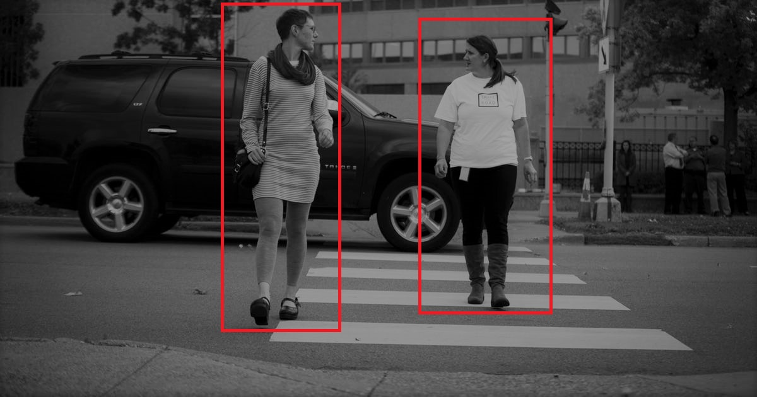
3. Multiple Scale Manner:
Scales of human varies.
the scale of the detector is fixed.
For better performance, we perform detection on multiple scales of a given image.
To achieve this, we simple resize the images by several fixed factors e.g. 0.21,0.27, 0.3
The threshold for these scales are 3.0,3.5 and 4.5 respectively.

Slide 15
Implementation Details
We have implemented the project in 7 steps:
Step 1: Compute angle and magnitude of gradient for each pixel
Compute gradient vector, angle and magnitude for each pixel in the Image.
range of angle should be from – 𝜋 to 𝜋.
the vertical and horizontal gradient can be computed by convoluting the kernel [1,0,-1]’ and [-1,0,1] using filter2d function on the input image.
angle is computed by ‘aRctan2’ which returns the angle ranges from – 𝜋 to 𝜋.

Slide 16
Step 2: Construct HOG for each cell
fix the size of cell to make it cover 8 x 8 pixels and the bin of HOG to be 9.
quantize the range of angle (−𝜋 to 𝜋) to 9 bins.
Then, Accumulate the pixel’s magnitude to 9-bin histogram according to its angle.
for each cell, we construct a 9-bin histogram.
Step 3: Construct the normalized HOG for each block
We fix the size of block to make it cover 2 x 2 cells.
the neighboring blocks overlap with each other by 50%.
hog block is constructed by concatenating 4 hogs of the 4 cells within the block.
Lastly, normalize the concatenated vector by its l2-norm by using ‘normalize’ OpenCV function.

Slide 17
Step 4: Convolute the learned detector on the HOG descriptor of the novel image
once we have hog descriptor, we have to train detector.
Firstly, set number of components ‘n’
then apply k-means to cluster the hog descriptors of positive samples into n-clusters.
Step5: Select the convolution above the threshold and compute its bounding box
after step-4, we have ‘n’ clusters. Here, we are going to train ‘n’ detectors.

Slide 18
Step 6: Build image pyramid
here we will build image pyramid, which contains the same image in different scales.
The OpenCV function "resize" is well-designed for this purpose.
Step 7: Perform detection on multiple scales of image
once we have Image pyramid, we will perform the detection on the images in the pyramid by calling the function implemented in step-6.

Slide 19
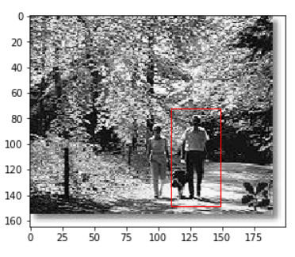
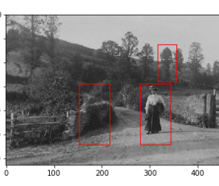
Discussion of the obtained results
In order to successfully detect all the pedestrians in every image in valid set, we have to set a low threshold which means, we suffered a high false positive rate (As shown in the figure).
consequently, there were many mistaken bounding boxes in the result.
In order to modify it, I try to set a higher threshold in order to have lower false positive rate, while my project failed to detect any human in some validation images.
Later, we set it to a moderate threshold where it helped by performing better.

Slide 20

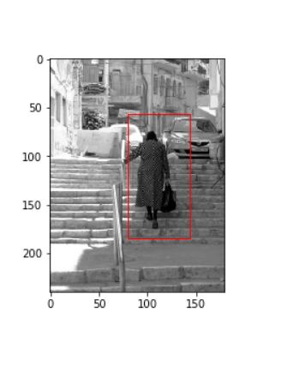
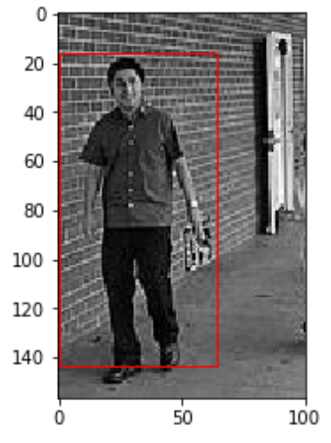
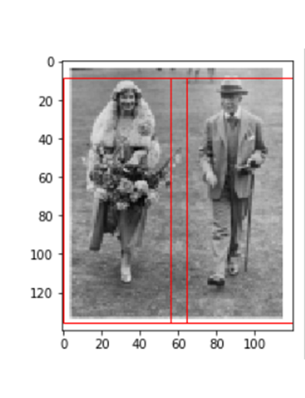
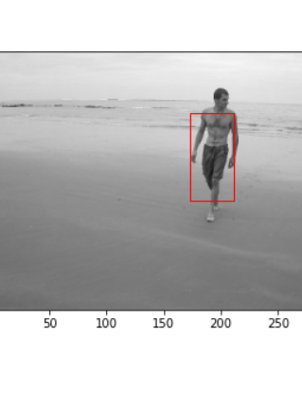
FinaL Results

Slide 21
references
Pedestrian detection: https://en.wikipedia.org/wiki/Pedestrian_detection
HOG introduction: http://en.wikipedia.org/wiki/Histogram_of_oriented_gradients
N.Dalal and B.Triggs: Histograms of Oriented Gradients for Human Detection, CVPR, 2013
Average precision: https://en.wikipedia.org/wiki/Information_retrieval#Average_precision

Slide 22
Thank you

