Slide 1


File System API and Disk I/O
SE3331-1 (2023 Fall)
IPADS, Shanghai Jiao Tong University
https://www.sjtu.edu.cn

Slide 2
Review: Large-scale websites on distributed systems
While distributed systems are built from components on a single node
File system runtimes, etc.
Caching server
Caching server
Caching server
…
Caching
Caching
Caching
Distributed caching
Database server
Database server
CDN
Users
Application #1
generate the page
Database
user, price
…
Database
user, price
Application server
Distributed database
Internet
Load
Balance
Application #2
add the order
File server
File server
File server
File:
image
File:
image
…
File:
image
Application server
…
…
Message queue
Distributed file system

Slide 3
Review: Large-scale websites on distributed systems
While distributed systems are built from components on a single node
File system runtimes, etc.
Caching server
Caching server
Caching server
…
Caching
Caching
Caching
Distributed caching
Database server
Database server
CDN
Users
Application #1
generate the page
Database
user, price
…
Database
user, price
Application server
Distributed database
Internet
Load
Balance
Application #2
add the order
File server
File server
File server
File:
image
File:
image
…
File:
image
Application server
…
…
Message queue
Distributed file system

Slide 4
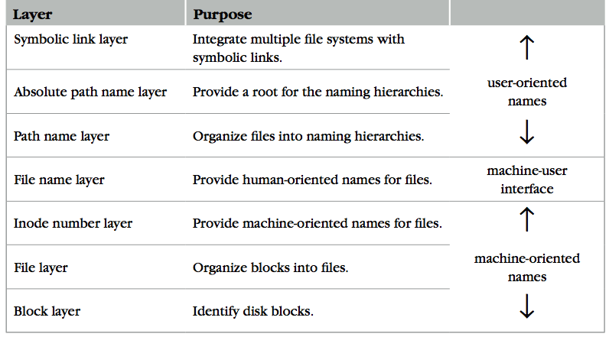
Review: The Naming Layers of the UNIX FS (version 6)
Notes:
TODO: redraw

Slide 5
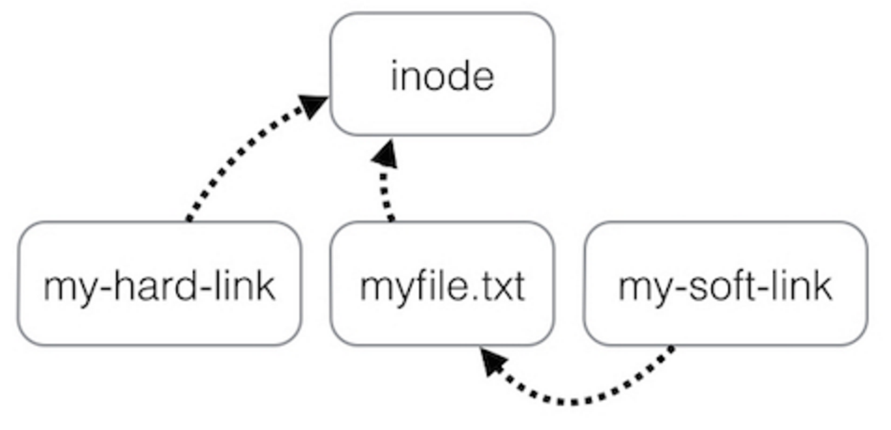
Review: Two Types of Links (Synonyms)
By inode number
By inode number
By file name

Slide 6
Summary of File System's 7 Layers
File name is not part of a file
Name is not a part of an inode
Name is data of a directory, and metadata of a file system
One inode can have several names (hard links)
Hard links are equal
If a file has two names, both are links (instead of "a link and a name")
Directory size is small
Only mapping from name to inode number
The term "folder" is somewhat misleading

Slide 7
Implementing the file system API

Slide 8
Implementing the File System API
API
CHDIR, MKDIR
CREAT, LINK, UNLINK, RENAME
SYMLINK
MOUNT, UNMOUNT
OPEN, READ, WRITE, APPEND, CLOSE
SYNC
Implemented as system calls to user applications
Kernel has many sets of function pointers implementing the API
Each set is specific to a FS (chose at mount point)

Slide 9
Sidebar: open() vs. fopen()
Difference between open() and fopen()?
open() returns an fd; fopen() return a FILE*
open() is a system call of OS; fopen() is an API of libc
Questions
Which one can be used on both Windows and Linux?
Which one has better performance?
fopen() provides you with buffering I/O that may turn out to be a lot faster than what you're doing with open()
Notes:
What is the difference between FILE* and fd? Fopen and open?

Slide 10
File Meta-data -- inode
Owner ID
User ID and group ID that own this inode (can be changed by chown)
Types of permission
Owner, group, other
Read, write, execute
Time stamps
Last access (by READ)
Last modification (by WRITE)
Last change of inode (by LINK)
struct inode
integer block_nums[N]
integer size
integer type
integer refcnt
integer userid
integer groupid
integer mode
integer atime
integer mtime
integer ctime
Notes:
There are three more mode bits: setuid, setgid, stick_bit

Slide 11
OPEN a File
Check user's permission
Update last access time
Return a short name for a file
File descriptor (fd)
fd is used by READ, WRITE, CLOSE, etc.

Slide 12
File Descriptor
Each process starts with three default open files
Standard in(stdin): fd = 0, standard out(stdout): fd = 1, standard error(stderr): fd = 2
Can also use fd to name opened devices
Keyboard, display, etc.
Allow a designer not to worry about input/output
Just read from fd 0 and write to fd 1
Each process has its own fd name space
Notes:
What is the different between fd and inode?
More details on device as a file

Slide 13
Why File Descriptor?
Other options
Option-1: OS returns an inode pointer
Option-2: OS returns all the block numbers of the file
Reasons and considerations
Security: user can never access kernel's data structure
Non-bypassability: all file operations are done by the kernel
Aka., complete mediation

Slide 14
File Cursor
File cursor
Keep track of operation position within a file
Can be changed by the SEEK operation
Case-1: Sharing file cursor
Parent passes its fd to its child
In UNIX, a child process inherits all open fds from its parent
Allow both parent and child to share one output file
Case-2: Not sharing file cursor
Two processes open the same file
Cursor

Slide 15
fd_table & file_table
One file_table for the whole system
Records information for opened files
inode num, file cursor, ref_count of opening processes
Children can share the cursor with their parent
One fd_table for each process
Records mapping of fd to index of the file_table

Slide 16
File Cursor Sharing
Note: this refcnt is not the refcnt of inode!
fd_table
file_table
fd
index
index
inode num
file cursor
refcnt
Process A
3
115
115
23
128
1
116
23
240
2
fd
index
Process B
3
116
...
fd
index
C is B's child
3
116
Process A, B and C all open just one file with inode number 23
Process A and B open the same file, not share file cursor
Process B and C share the file cursor

Slide 17
OPEN Implementation
procedure OPEN(string filename, integer flags, integer mod)-> integer
0 inode_number ← PATH_TO_INODE_NUMBER(filename, wd)
if inode_number = FAILURE and flags = O_CREATE then // Create the file?
inode_number ← CREATE(filename, mode) // Yes, create it.
if inode_number = FAILURE then
return FAILURE
inode ← INODE_NUMBER_TO_INODE(inode_number)
if PERMITTED(inode, flags) then // Does this user have the required permissions?
file_index ← INSERT(file_table, inode_number)
fd <- FIND_UNUSED_ENTRY(fd_table) // Find entry in file descriptor table
fd_table[fd] ← file_index // Record file index for file descriptor
return fd // Return fd
else return FAILURE // No, return a failure

Slide 18
READ Implementation
procedure READ(integer fd, character[] &buf, integer n)-> integer
0 file_index ← fd_table[fd]
cursor ← file_table[file_index].cursor
inode ← INODE_NUMBER_TO_INODE(file_table[file_index].inode_number)
m ← MINIMUM(inode.size – cursor, n)
atime of inode ← now()
if m = 0 then return END_OF_FILE
for i from 0 to m – 1 do
b ← INODE_NUMBER_TO_BLOCK(cursor + i, inode_number)
COPY(b, buf, MINIMUM(m-i, BLOCKSIZE)
i ← i + MINIMUM(m – i, BLOCKSIZE)
file_table[file_index].cursor ← cursor + m
return m

Slide 19
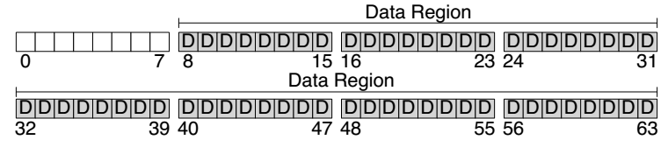
Disk Layout of a Simple File System

Slide 20
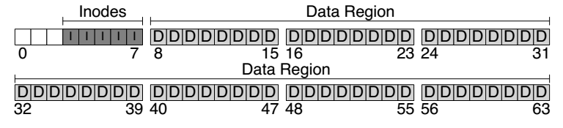
At the Head of a Disk Partition
S
i
d
i: inode free block bitmap
d: data free block bitmap
S: super-block
How many inodes: 80
How many data blocks: 56
Where the inode table begins: block 3
…
A magic number to identify the file system type
The super-block is used when
the file system is mounted

Slide 21
Questions
How many read and write in a OPEN?
How many read and write in a READ?
How many read and write in a CREATION?

Slide 22
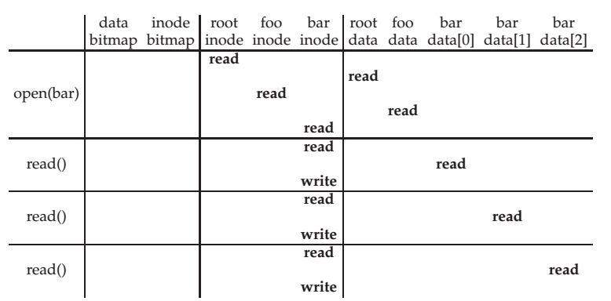
File Open & Read Timeline
open("/foo/bar", O_RDONLY)
Why "write" on bar inode in a read operation? Why no "write" on foo inodes?

Slide 23
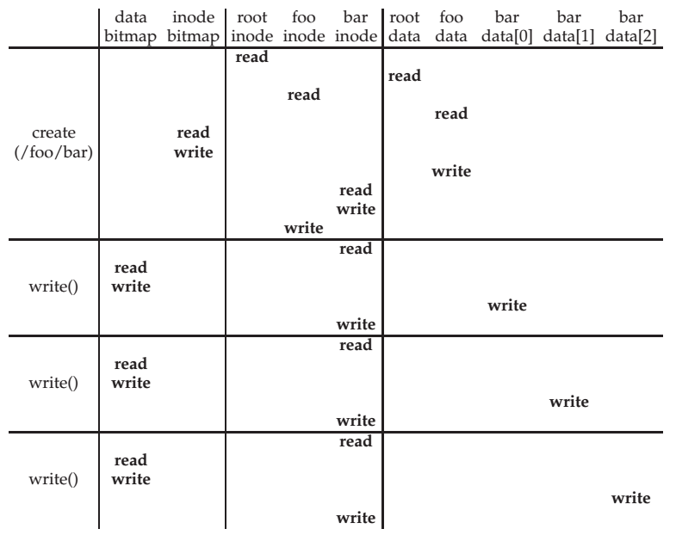
File Creation Timeline

Slide 24
WRITE, APPEND & CLOSE
WRITE is similar to READ
Allocate new block if necessary
Update inode's size and mtime
APPEND
Similar to write, directly write to the end of the file
CLOSE
Free the entry in the fd_table
Decrease the reference counter in file table
Free the entry in file table if counter is 0
Failures in the middle may cause inconsistency!

Slide 25
Questions
When writing, which order is preferred?
Update block bitmap, write new data, update inode (size and pointer)
Update block bitmap, update inode (size and pointer), write new data
Update inode (size and pointer), update block bitmap, write new data

Slide 26
SYNC
Block cache
Cache of recently used disk blocks
Read from disk if cache miss
Delay the writes for batching
Improve performance
Problem: may cause inconsistency if fail before write
SYNC
Ensure all changes to a file have been written to the storage device

Slide 27
Delete after OPEN but before CLOSE
One process has OPENed a file
Another process delete the file
By removing the last name pointing to the file
The reference counter is now 0
The inode is not freed until the first process calls CLOSE
On Windows, it may forbid to delete an opened file

Slide 28
Review: Renaming
1 UNLINK(to_name)
2 LINK(from_name, to_name)
3 UNLINK(from_name)
❌
Text edit usually save editing file in a temp file
Edit in .a.txt.swp, then rename .a.txt.swp to a.txt
What if the computer fails between 1 & 2?
The file to_name will be lost, which will surprise the user
Need atomic action (in later lectures)

Slide 29
Review: Renaming
1 LINK(from_name, to_name)
2 UNLINK(from_name)
Weaker specification without atomic actions
1. Changes the inode # for to_name to the inode # of from_name
2. Removes the directory entry for from_name
If fails between 1 & 2
Must increase reference count of from_name's inode on recovery
If to_name already exists
The to_name file will always exist, even if the machine fails between 1 & 2
Need to revoke the resource on recovery

Slide 30
Rename between different directories
$ ls -il dir1
40978804 -rw-r--r-- 1 xiayubin wheel 6 9 26 08:50 from.txt
$ ls -il dir2
40978827 -rw-r--r-- 1 xiayubin wheel 7 9 26 08:51 to.txt
$ mv dir1/from.txt dir2/to.txt
$ ls dir1
$ ls -il dir2
40978804 -rw-r--r-- 1 xiayubin wheel 6 9 26 08:50 to.txt
inode number

Slide 31
Renaming
1 UNLINK(to.txt)
2 LINK(from.txt, to.txt)
3 UNLINK(from.txt)
1 LINK(from.txt, to.txt)
2 UNLINK(from.txt)
If to.txt exists and fails between 1 & 2
The file to.txt will be lost,
which will surprise the user
If to.txt exists and fails between 1 & 2
It will always exist even if the machine fails between 1 & 2
Must increase reference count of from.txt's inode on recovery

Slide 32
Other file systems (not inode)

Slide 33
Other Choices instead of inode
Method-1: use continue blocks
Re-allocate if the file expands
E.g., data in memory
Why not?
Method-2: use a linked list
Each block links to its next block
Use special one as EOF (End of File)
E.g., FAT32
Why not?
How to integrate different FS?
vnode (will discuss later)
Interface is similar with inode

Slide 34
FAT (File Allocation Table) File System
File is a collection of disk blocks
FAT is a linked list 1-1 with blocks
File Number is index of root of block list for the file
File offset (o = < B, x > )
Follow list to get block #
Unused blocks ⬄ FAT free list
FAT
Disk Blocks
file number
0:
0:
31:
File 31, Block 0
File 31, Block 1
free
File 31, Block 2
N-1:
N-1:
memory

Slide 35
FAT Properties
File is a collection of disk blocks
FAT is a linked list 1-1 with blocks
File Number is index of root of block list for the file
File offset (o = < B, x > )
Follow list to get block #
Unused blocks ⬄ FAT free list
Ex: file_write(31, < 3, y >)
Grab blocks from free list
Linking them into file
FAT
Disk Blocks
file number
0:
0:
31:
File 31, Block 0
File 31, Block 1
File 31, Block 3
free
File 31, Block 2
N-1:
N-1:
memory

Slide 36
FAT File System
File allocation table (FAT)
Organize files as linked lists
No inode
File metadata: name & size
Metadata are saved in dirs

Slide 37
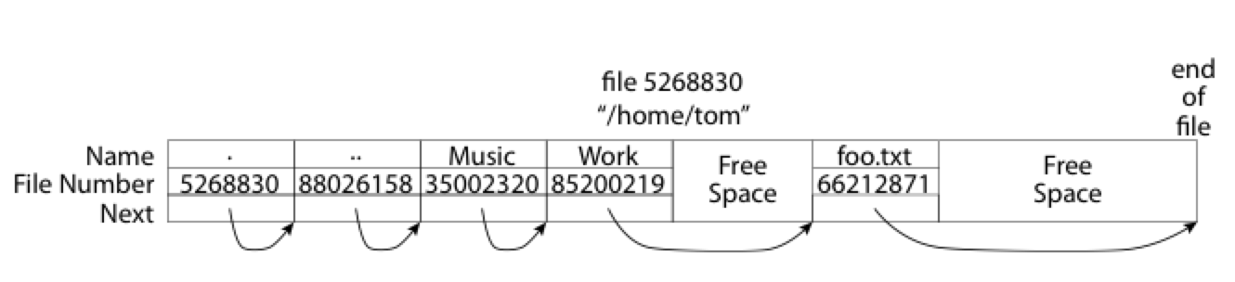
What about the Directory in FAT?
Directory: essentially a file containing <file_name: file_number> mappings
Free space for new entries
File attributes (metadata) are kept in directory
Each directory is a linked list of entries
Question: Where to find root directory ( "/" )?
Root dir at sector 0

Slide 38
Question: inode vs. FAT
What are the differences between inode and FAT?
Support hard link? Soft link?

