Slide 1

Spring, 2022
Lecture 5: Expectation – Part 1

Slide 2
Contents
1
Expectation
2
Variance
3
Moments
4
Summary

Slide 3
The expectation of a random variable

Slide 4

Why?
The distribution of variable contains everything about the probabilistic properties of
.
However, when we want to summarize quickly the distributrion of in a few numbers
There are some discriptive quantities:
Mean (Expectation)
Median, Moments.
Variance, Interquarile Range (IQR), Covariance, Correlation.

Slide 5

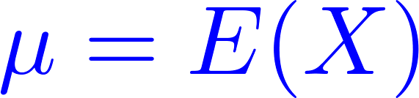
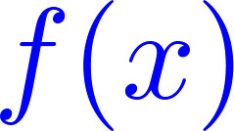
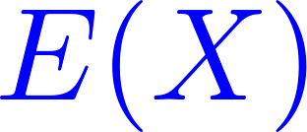
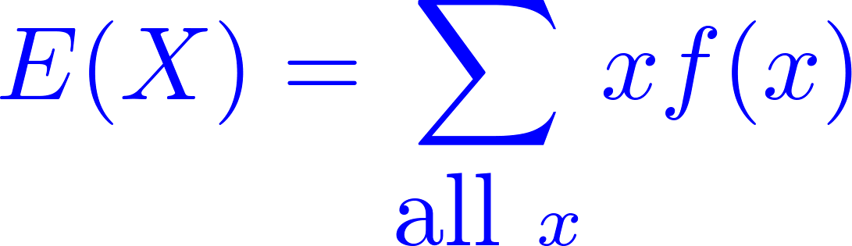
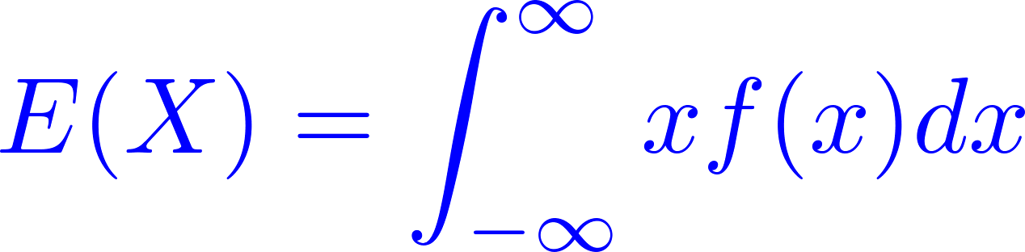
Expectation
Use to denote an expectation of variable .
Let be a random variable with m.f. or p.d.f. function . The mean, or expected value of , denoted , is defined as follows:
If is a discrete random variable
If is a continuous random variable

Slide 6
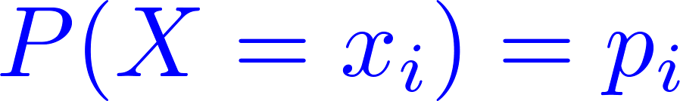
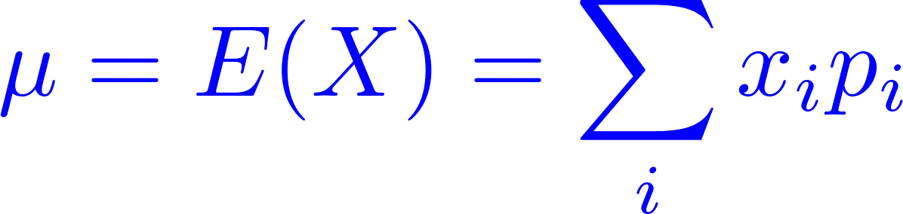
Expected value of a discrete random variable
The expected value or expectation of a discrete random variable with probability mass function is
provides a summary measure of the average value taken by the random variable and is also known as the mean of the random variable.

Slide 7
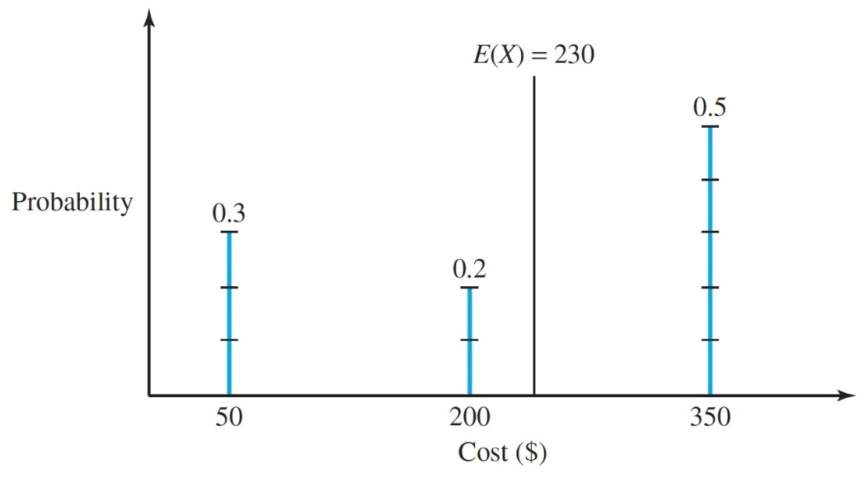
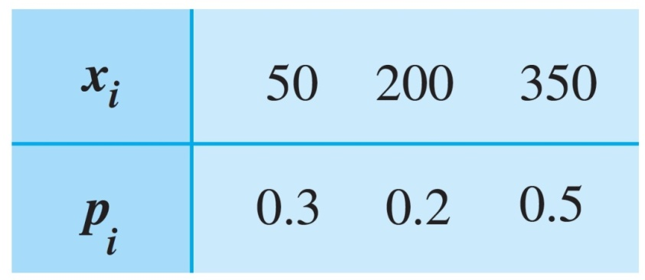

Expected value of a discrete random variable
Expected value of the machine breakdown costs
Recall the example of machine breakdown. The expected repair cost is
Over a long period of time, the repairs will cost an average of about each.

Slide 8
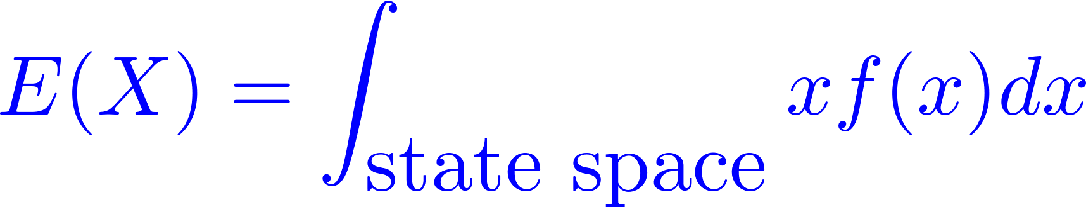
Expected value of a continuous random variable
The expected value or expectation of a continuous random variable with a probability density function
The expected value provides a summary measure of the average value take by the random variable, and it is also known as the mean of the random variable.

Slide 9
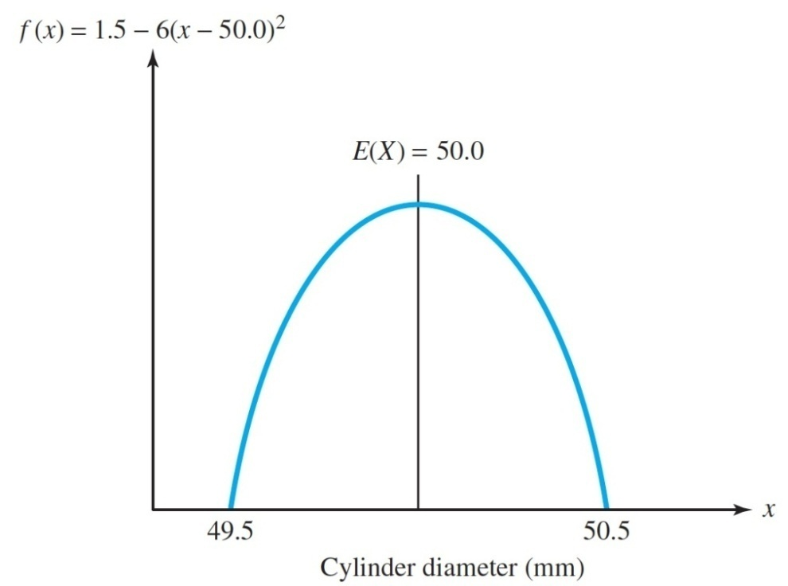
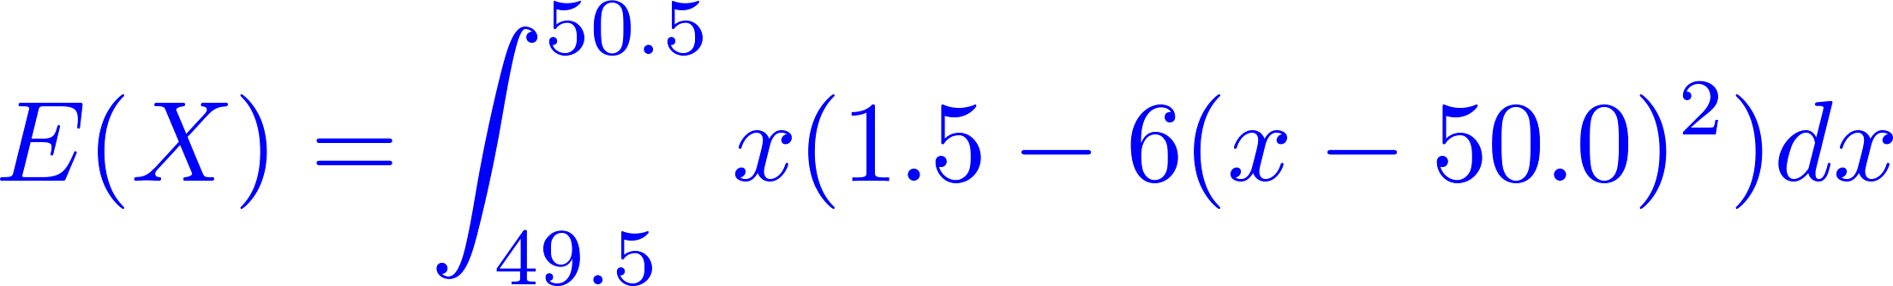
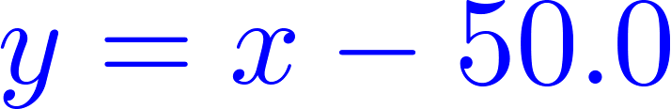
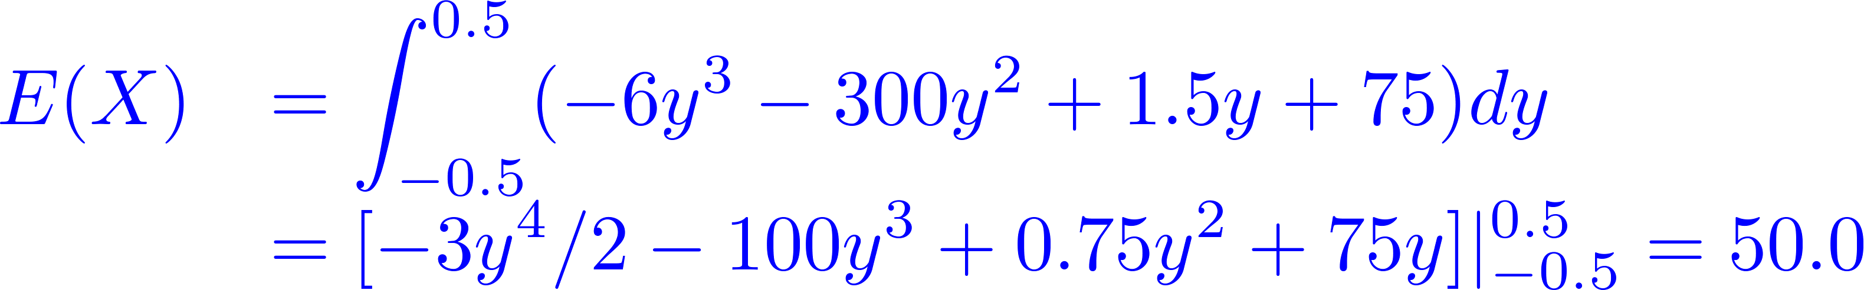
Expected value of a continuous random variable
Recall the example of metal cylinder production. The expected diameter of a metal cylinder is
change variable
average diameter

Slide 10

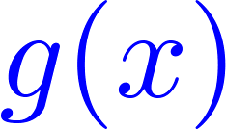
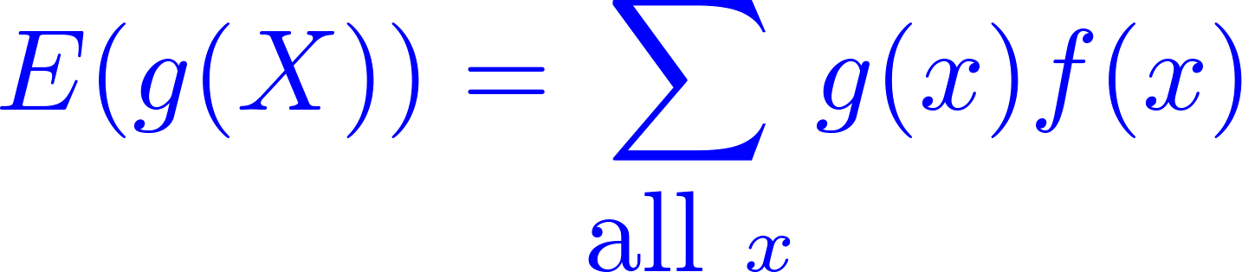
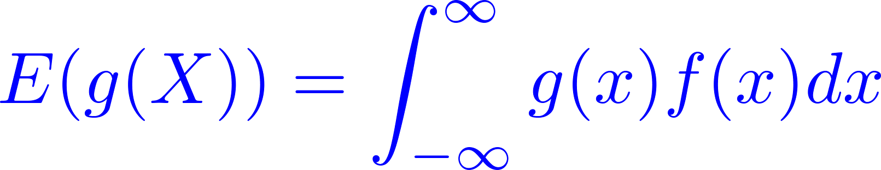
Expectation of
Theorem: Let be a random variable with m.f. (p.f.) or p.d.f. , be a real-valued function. Then
is discrete
is continuous

Slide 11


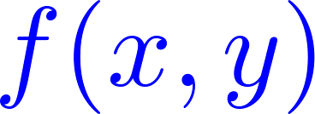
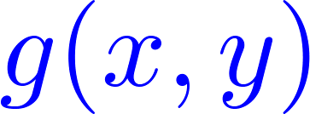
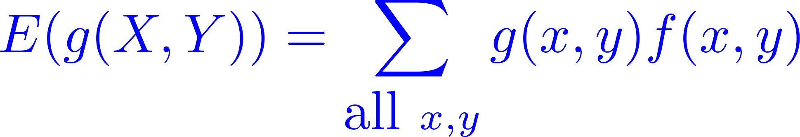
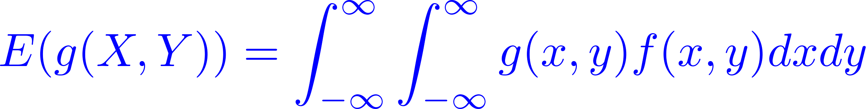
Expectation of
Theorem: Let and be random variables wit joint p.d.f. , and let be a real-valued function. Then
and are discrete
and are continuous

Slide 12
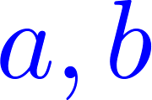
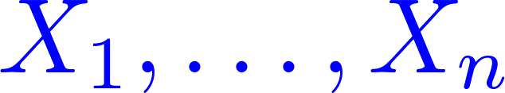
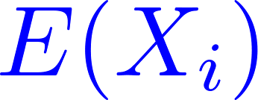
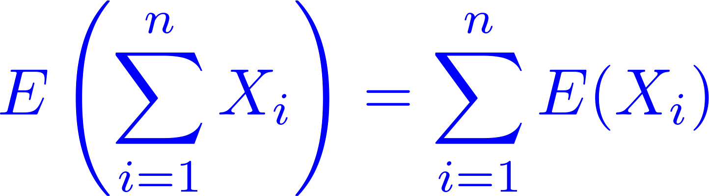
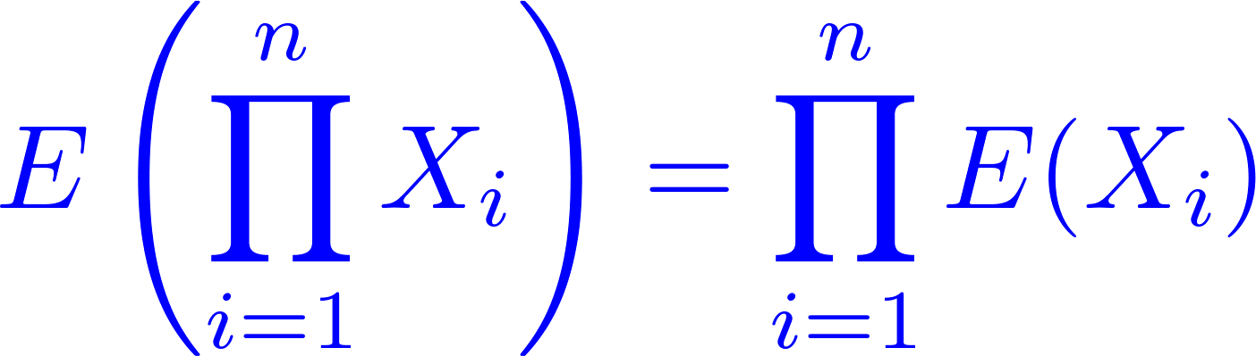
Properties of Expectation
for constants
Let be n random variables and
are all finite. Then
Let be n independent random variables and and are all finite. Then

Slide 13
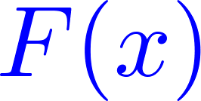

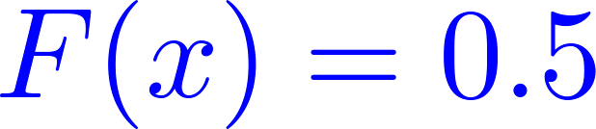

Median of Random Variables
The median of a continuous random variable with a cumulative distribution function is the value in the state space for which
The random variable is hence equally likely to fall above or below the median value.
Example: Recall the Metal cylinder production example, the median value of the metal cylinder diameters is the solution to
then

Slide 14
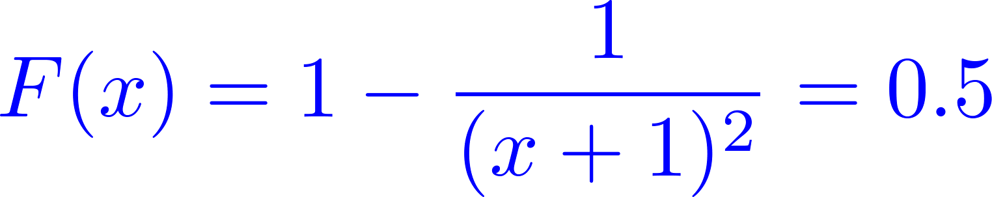
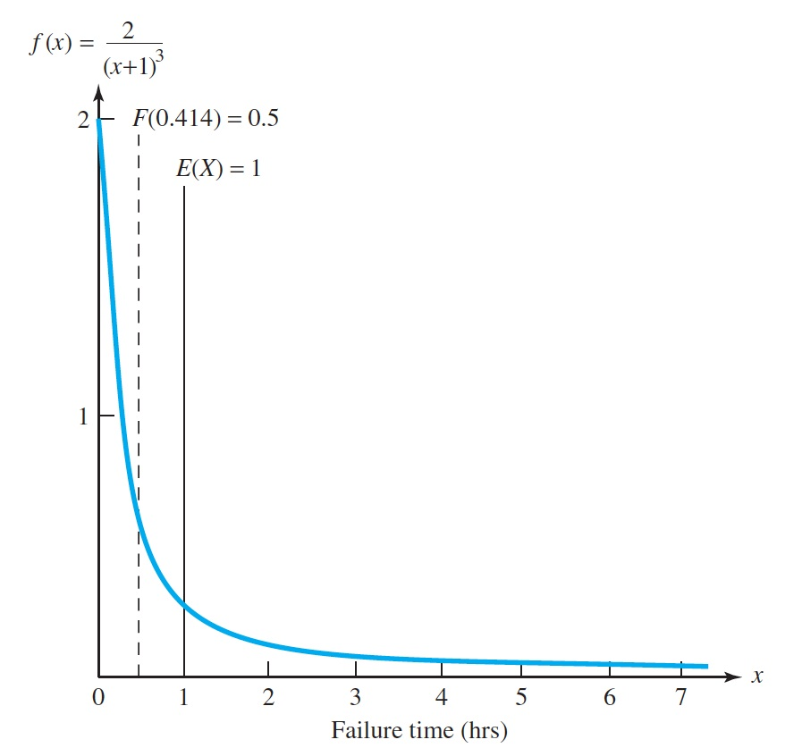
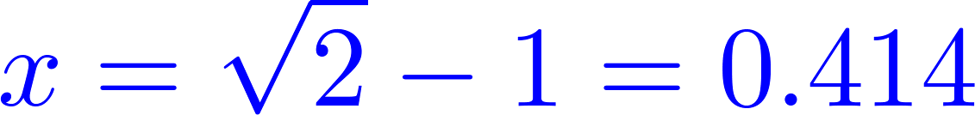
Median of Random Variables
Example: Battery Failure Times. The median of the battery failure times is the solution to
which is

Slide 15
variance

Slide 16

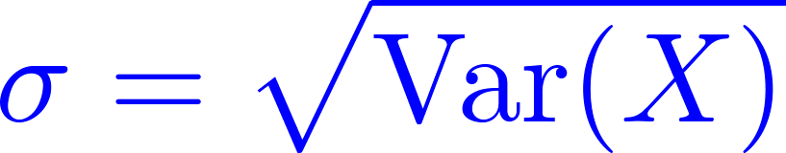
Definition of Variance
Definition: Let be a random variable (discrete or continuous) with a finite mean
. The variance of is defined as
The standard deviation of is defined as
Theorem. For any random variable
Expectation measure the average value of
Variance measures the deviation of about

Slide 17
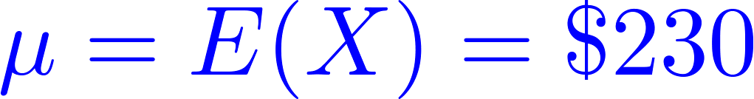
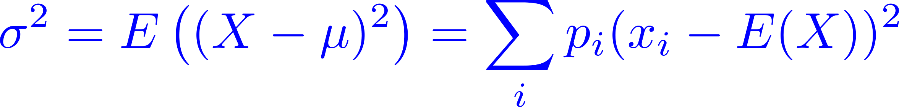
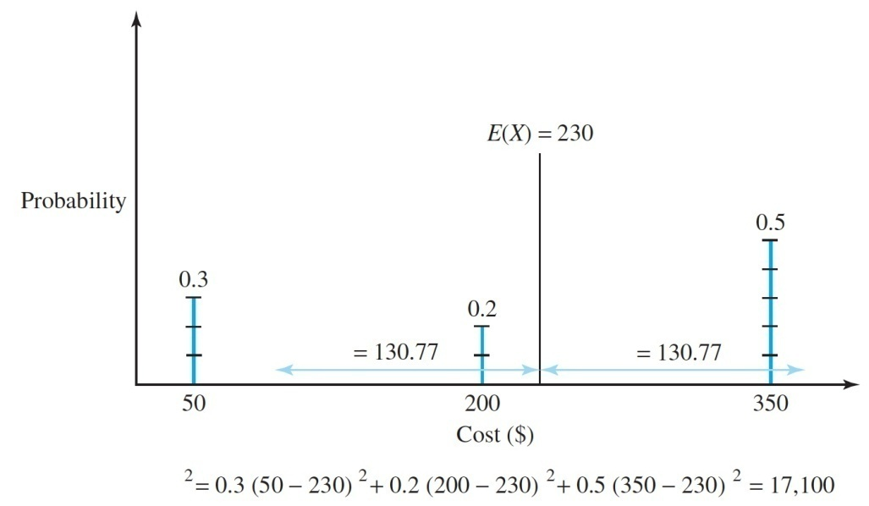
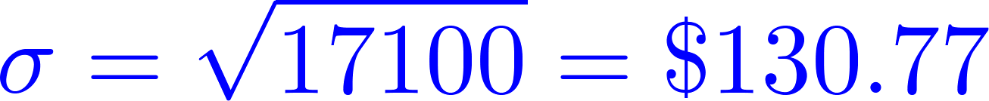
Example of Variance Calulations
Machine Breakdowns. Recall that the repair cost are $50, $200, and $350 with respecively probability values of 0.3, 0.2, 0.5, and that the expected repair cost is . The variance of the repair cost can be calculated from
and the calculations are shown
The variance is 17100 so the

Slide 18
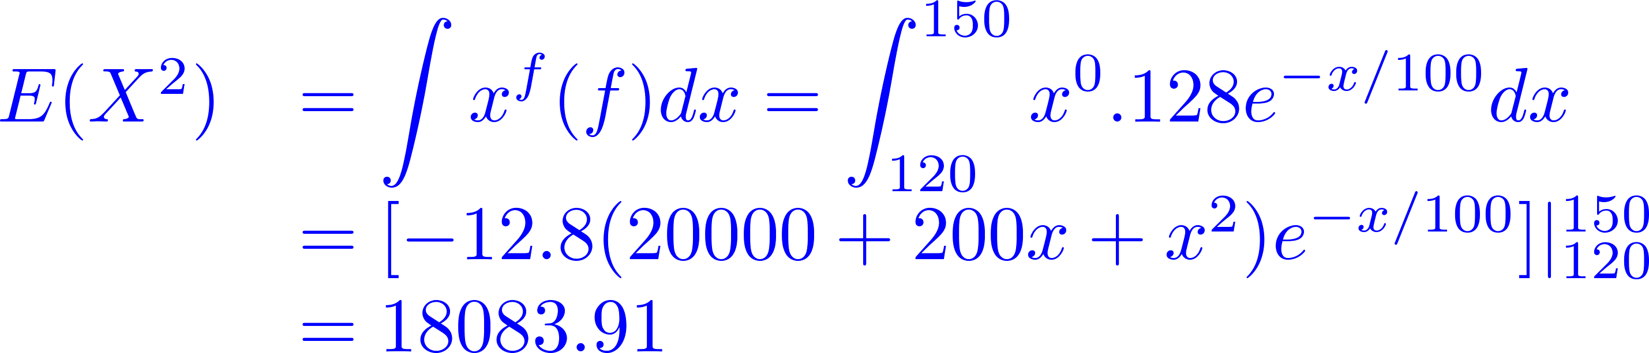
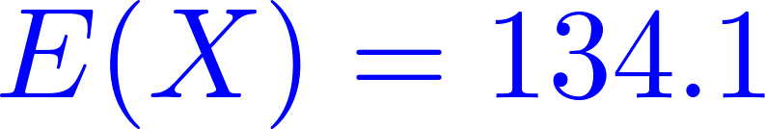
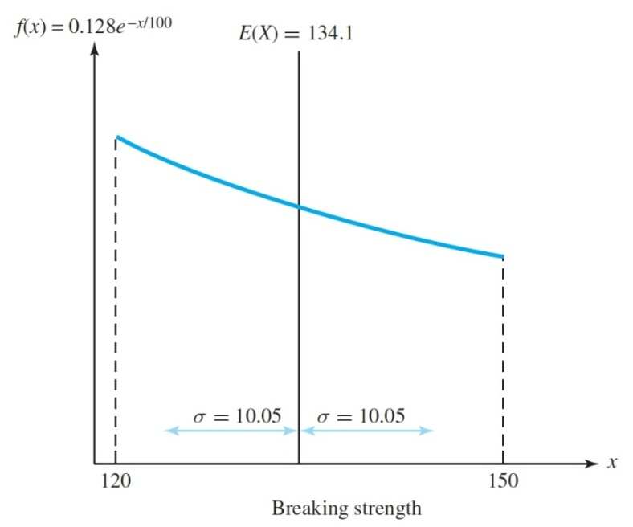
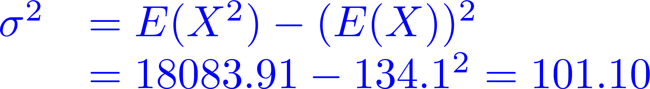
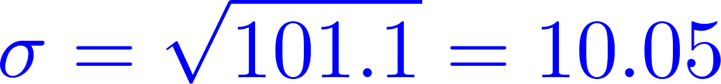
Example of Variance Calulations
Concrete slab breaking strength. The expected squared breaking strength is
Since the mean breaking strength is
The variance of the breaking strength
the standard deviation is

Slide 19
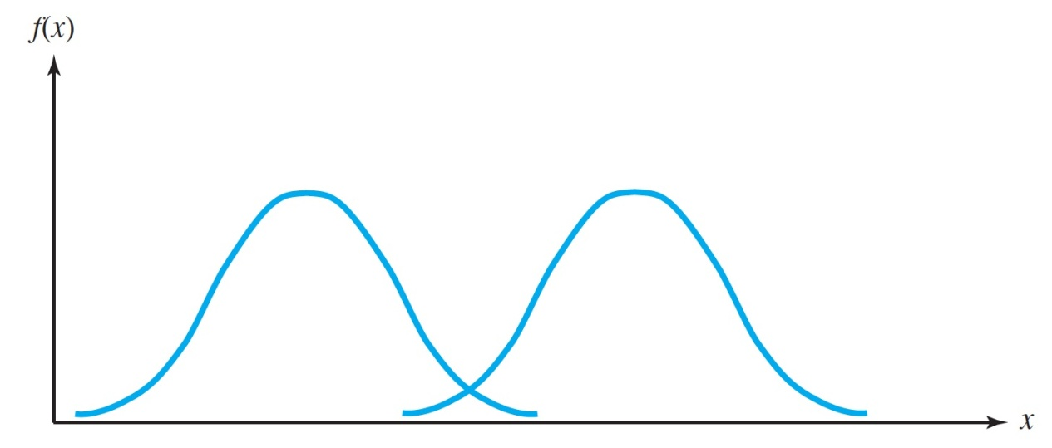
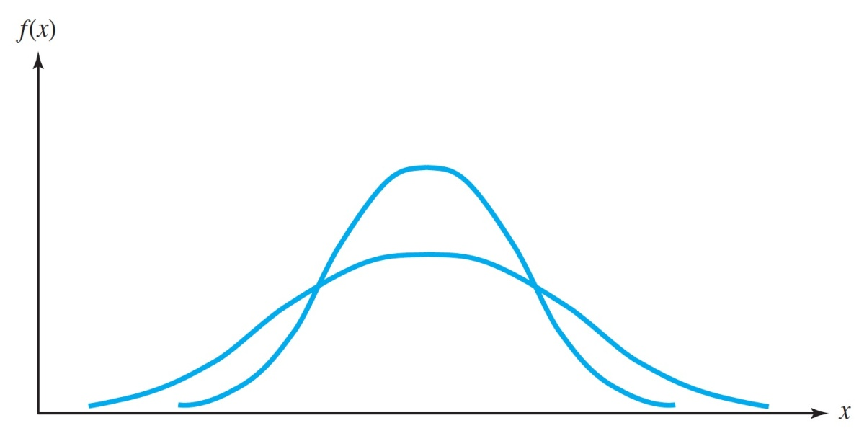
Measures of location and scales
The mean is a measure of location, and the variance is a measure of scale.
Different mean, same variance
Same mean, different variance

Slide 20
moments

Slide 21

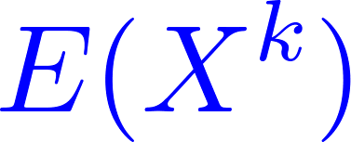
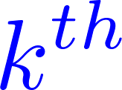
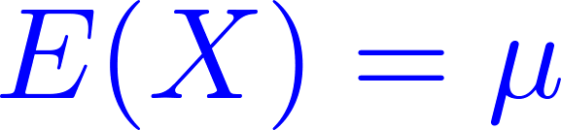
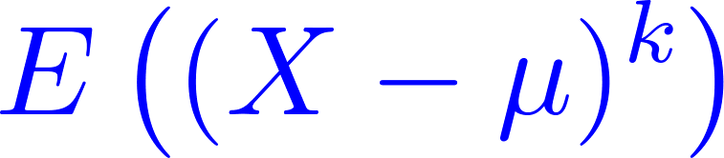
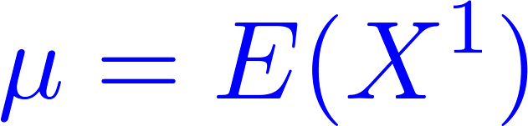
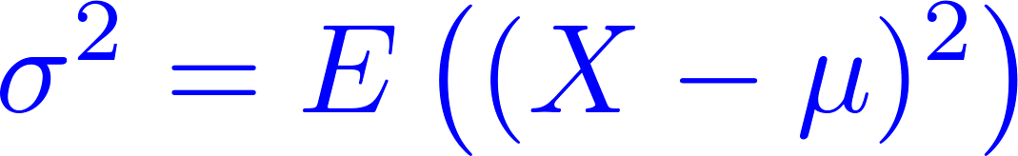
Moments and Central Moments
Definition: Let be a random variable and be a positive integer.
The expectation is called the moment of .
Let . The expectation
is called the central moment of .
The first moment is the mean:
The first central moment is zero:
The second central moment is the variance

Slide 22
Summary
1
Expectation
2
Variance
3
Moments
4
Summary

