Slide 1

Spring, 2022
Lecture 6: Expectation – Part 2

Slide 2
Contents
1
Covariance
2
Correlation
3
Conditional Expectation
4
Large Random Samples
5
Summary

Slide 3
Covariance
&
Correlation

Slide 4





Covariance
Let and be random variables with finite means and . The covariance of and
is defined as
if the expectation exitsts.
Another way of calculating the covariance:
A measure of how much and depend (linearly) on each other.
Magnitude of depends on the magnitude of and .

Slide 5
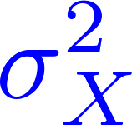
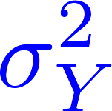
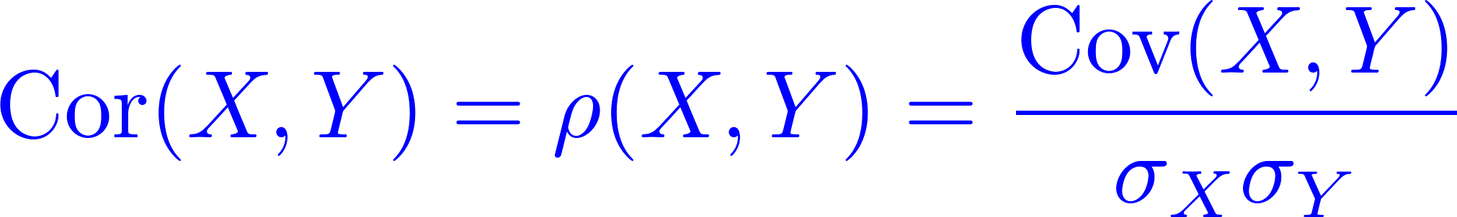
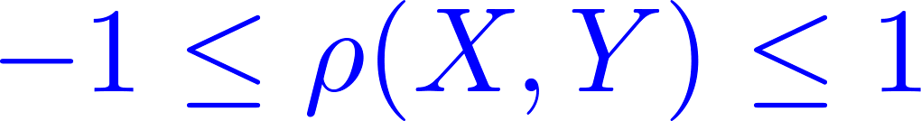
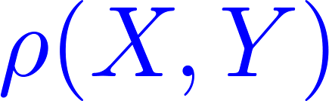
Correlation
Let and be random variables with finite variences and . The correlation of and is defined as
A measure of how much and depend (linearly) on each other.
The correlation is depends on the scale of and .

Slide 6
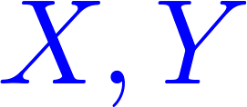
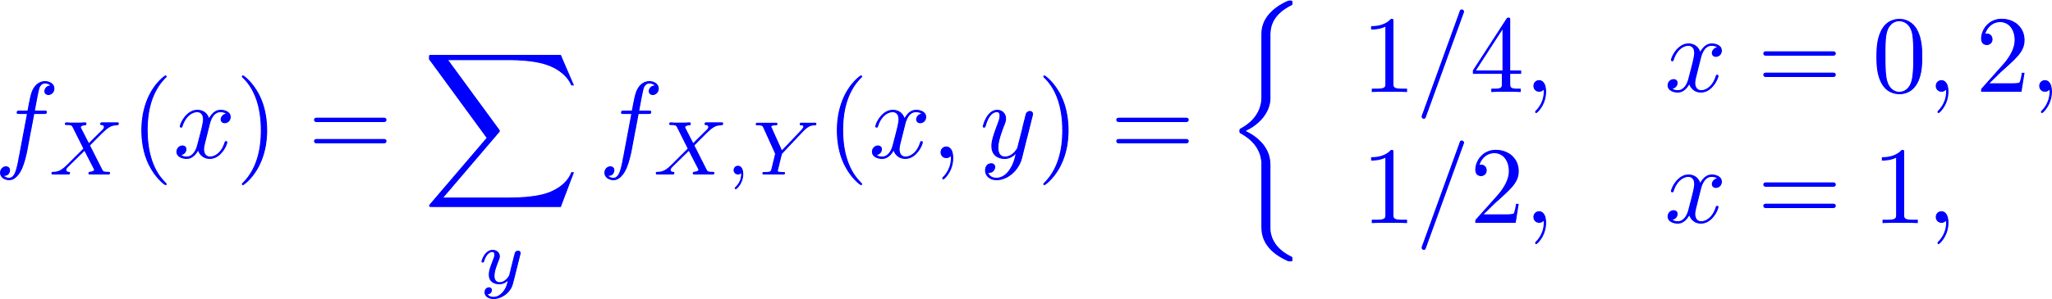
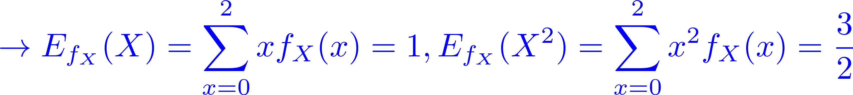
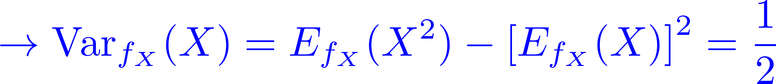
Discrete Case
Example 1: Let and be discrete random variables with joint mass function defined by
and zero otherwise. The marginal mass functions, expectations and variances of

Slide 7
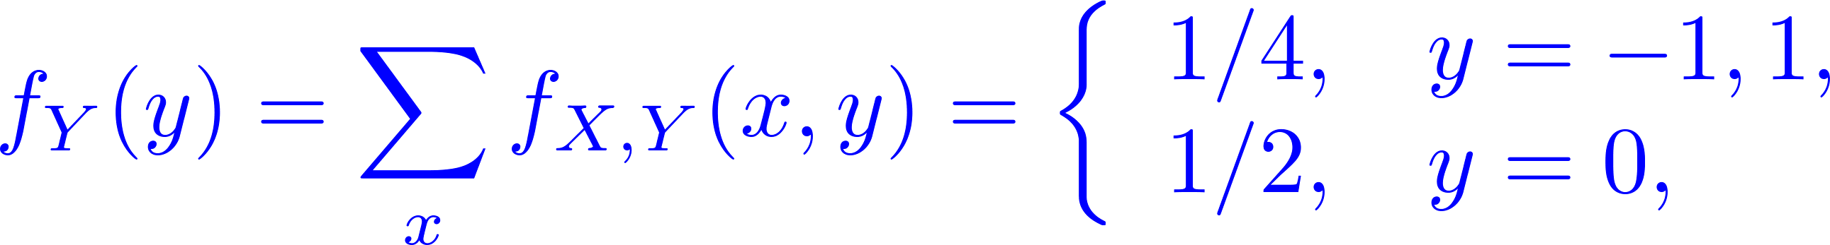
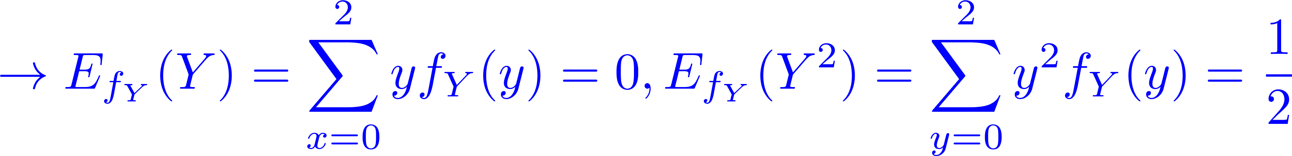
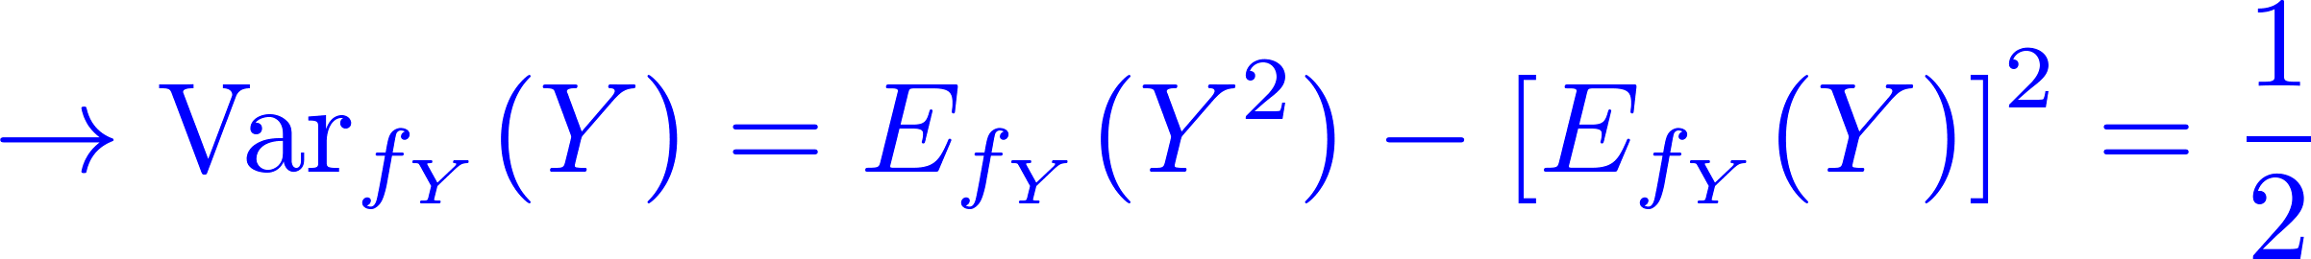
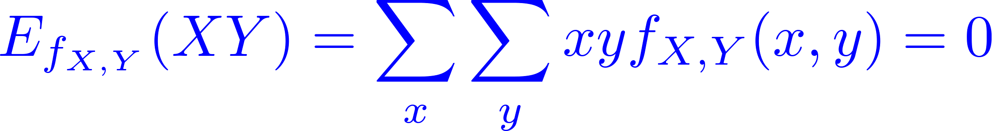
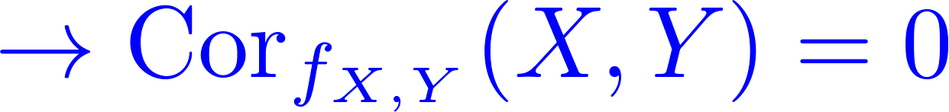
Discrete Case
and to compute the covariance, we need to compute
But note that and are not independent.

Slide 8
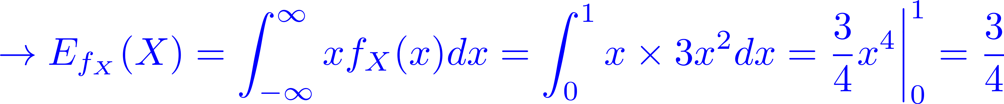
Continuous Case
Example 2: Let and be continuous random variables with joint p.d.f. defined by
and zero otherwise.
The marginal pdfs, expectations and variances of are

Slide 9
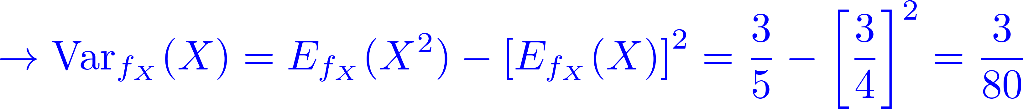
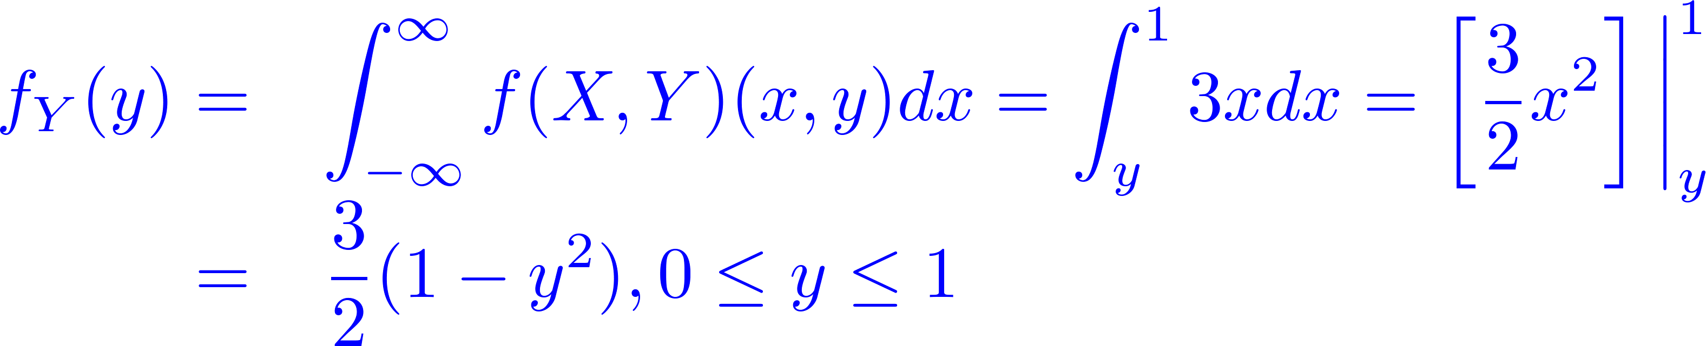
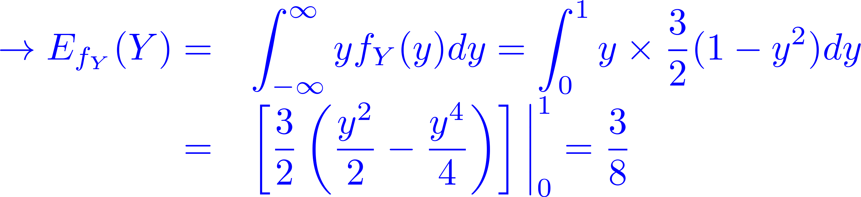
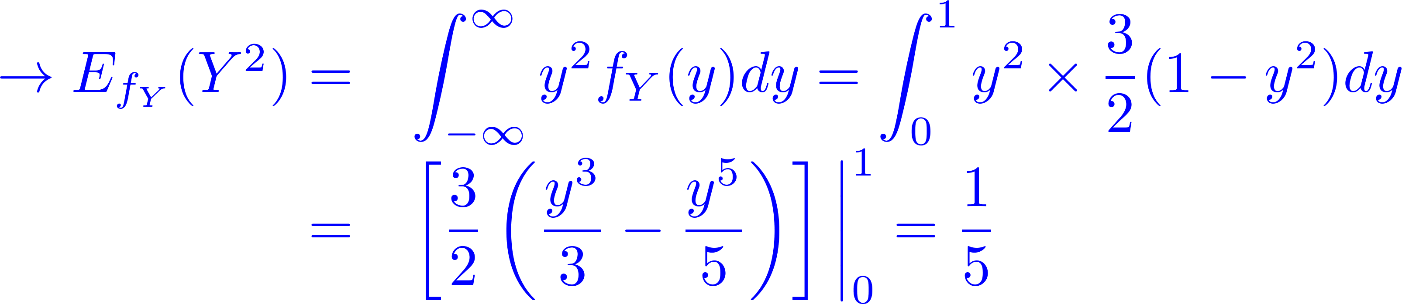
Continuous Case

Slide 10
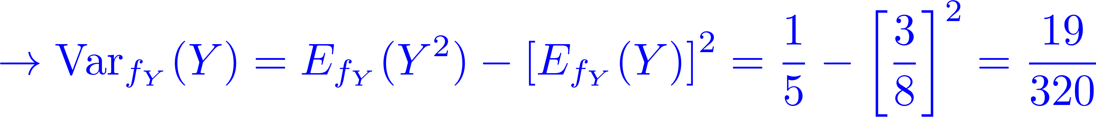
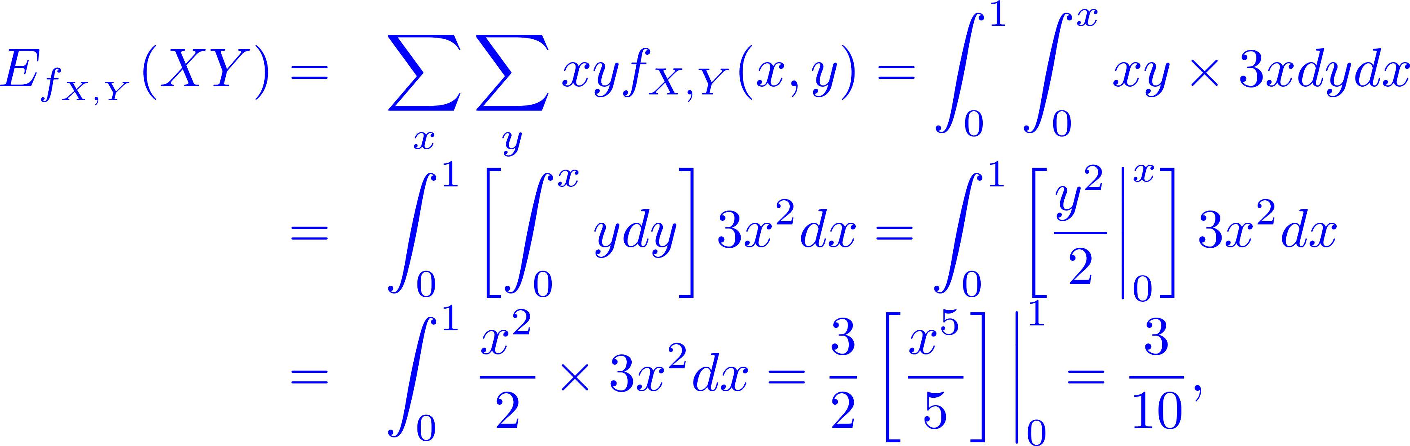
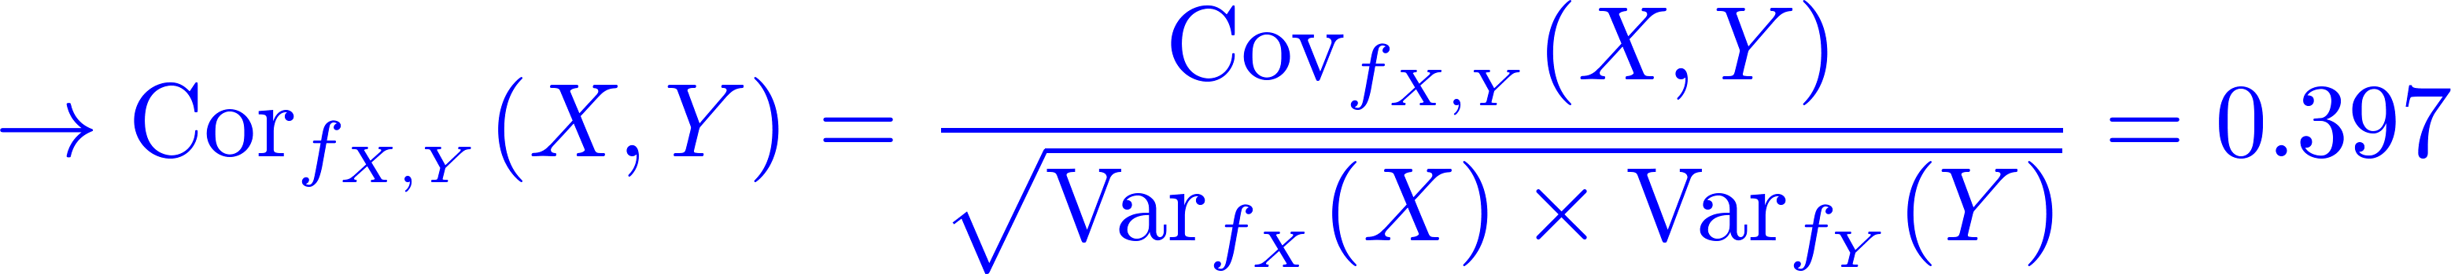
Continuous Case
and to compute the covariance, we need to compute

Slide 11
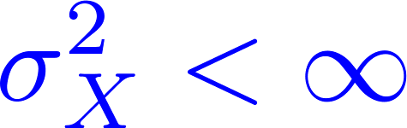
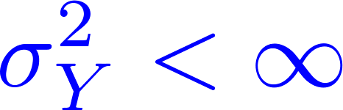
Properties of Covariance and Correlation
Theorem 1: If and have finite variances,
and , then the covariance
exists.
Theorem 2: If and are independent random variables with finite variances then
Note that: the opposite is not true. Two random variables can be uncorrelated without being independent.

Slide 12
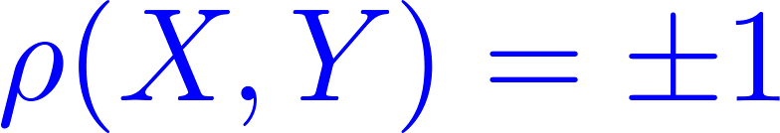

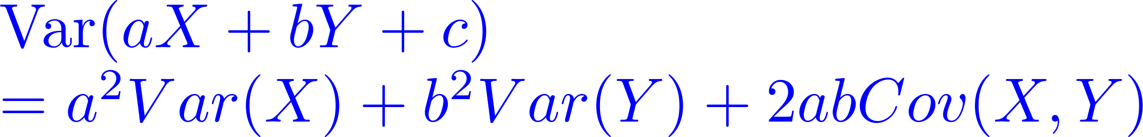
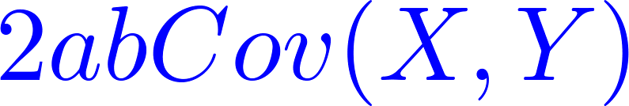
Properties of covariance and correlation
Other properties:
If is a linear function of then and are perfectly correlated,
Note that the term is zero if
and are independent.

Slide 13
conditional expectation

Slide 14

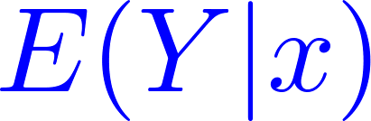
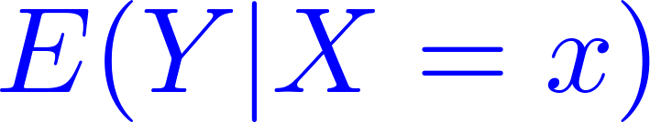
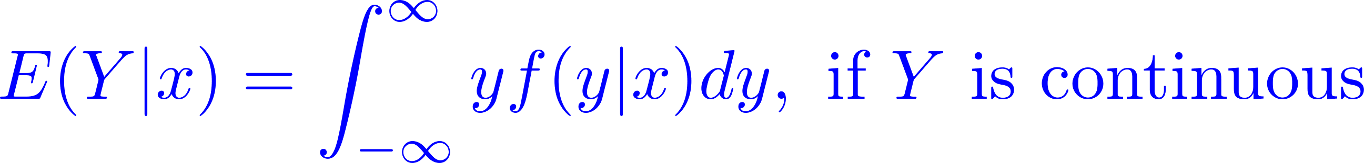
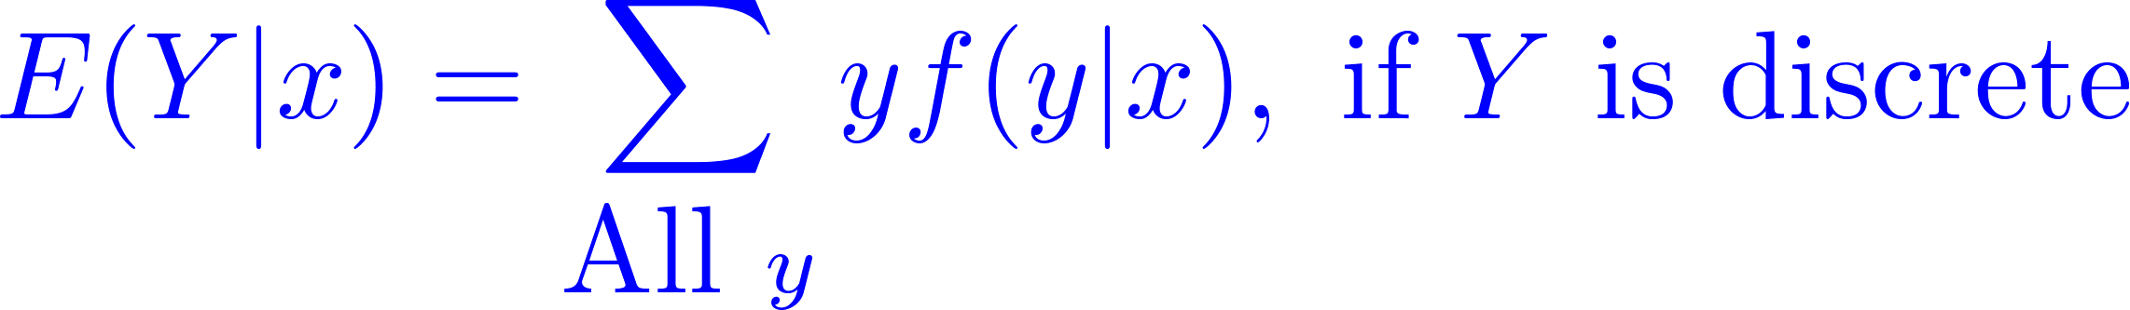
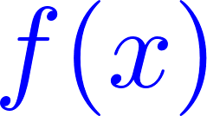
Conditional Expectation
Definition: Conditional Expectation/Mean
Let and be random variables where has a finite mean. The conditional expectation of given , denoted or
, is the mean of the conditional distribution of given . More explicitly:
is a , is a random variable.

Slide 15
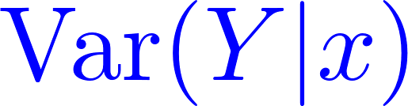
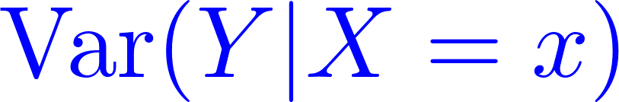
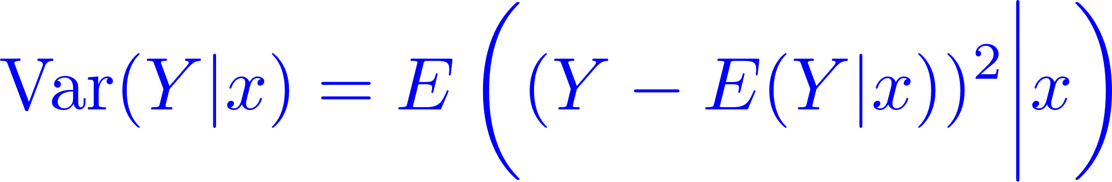


Conditional Variance
Definition: Conditional Variance
Let and be random variables. The conditional variance of given , denoted or , is the variance of the conditional distribution of given .
is a function of
is a random variable.

Slide 16
large random samples

Slide 17
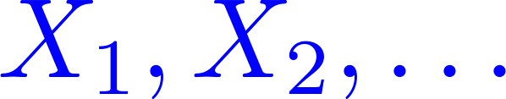

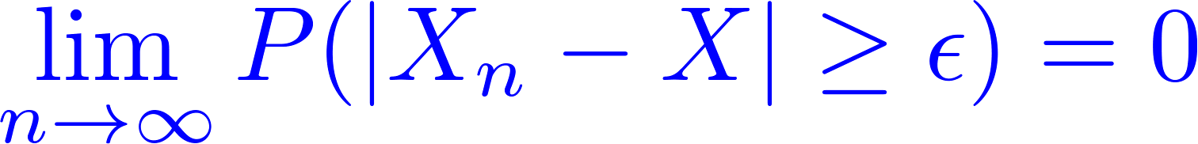
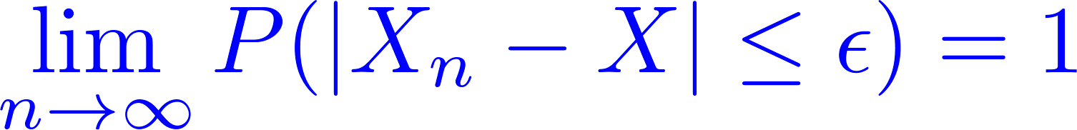
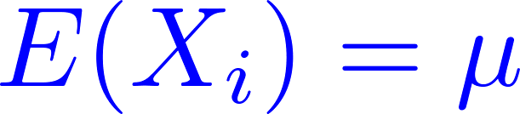

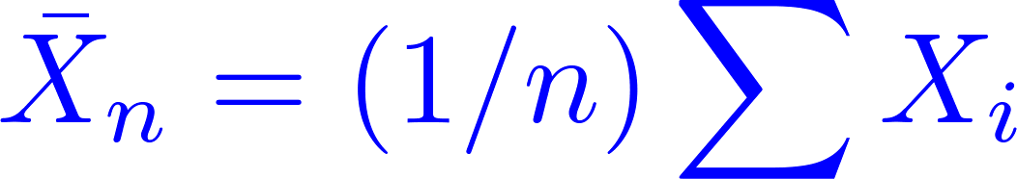
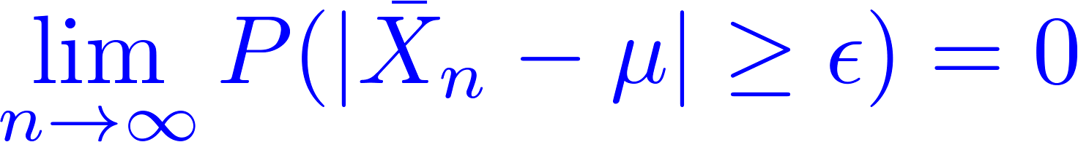
Convergence Concepts
Convergence in Probability: A sequence of random variables converges in probability to a random variable if, for every
,
or equivalently .
Weak Law of Large Numbers: Let be a random sample (i.i.d.) with and . Then, for every
satisfies
iid: Independent and identically
distributed random variables

Slide 18
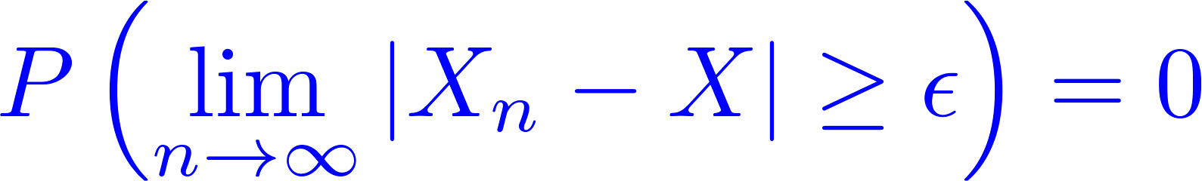
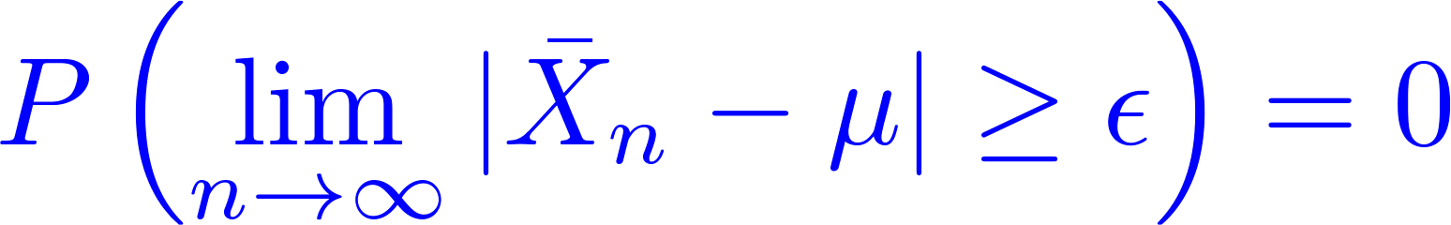
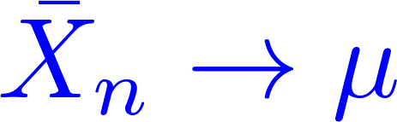
Almost Sure Convergence
Almost surely: A sequence of random variables converges almost surely to a random variable if, for every
Strong law of large numbers: Let be a random sample with and
. Then, for every ,
where . Hence .

Slide 19
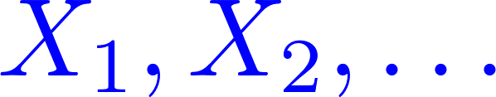
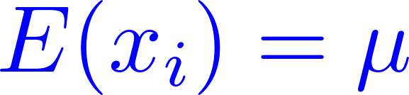

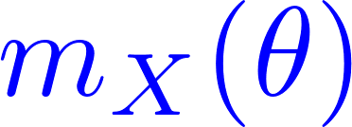

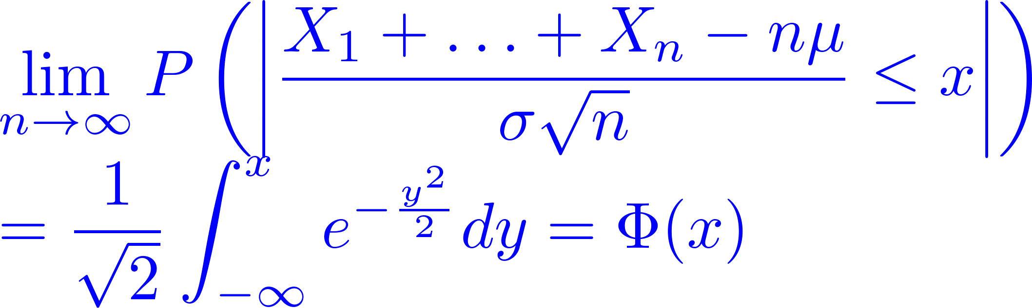
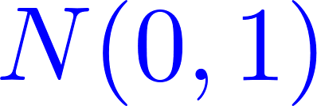
Central Limit Theorem
Let be a random sample (iid) with
and . Suppose
that the m.g.f. exists in a neighborhood of zero
(i.e. exists for some ).
Theorem 3: The sample mean converges in distribution to a normal random variable
which is the d.f. of a standard .

Slide 20
Summary
1
Covariance
2
Correlation
3
Conditional Expectation
4
Large Random Samples
5
Summary

