Slide 1
Sensors and Platforms
Multispectral scanners
(RS textbook, chapters 3 and 5)
Presentation by Dr. A. A. Duker

Slide 2
Terms and concepts: sensors and platforms
Passive versus active sensors
Airborne – Spaceborne RS
Satellite orbits:
  Period
  Inclination angle
Satellite orbits:
  Polar – near polar orbit
  Sun-synchronous
  Geo-stationary
Path and row
Repeat cycle
Revisit time

Slide 3
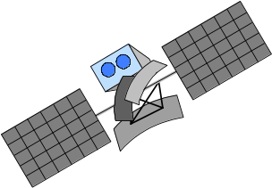
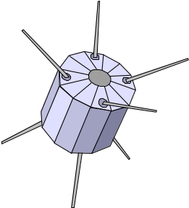
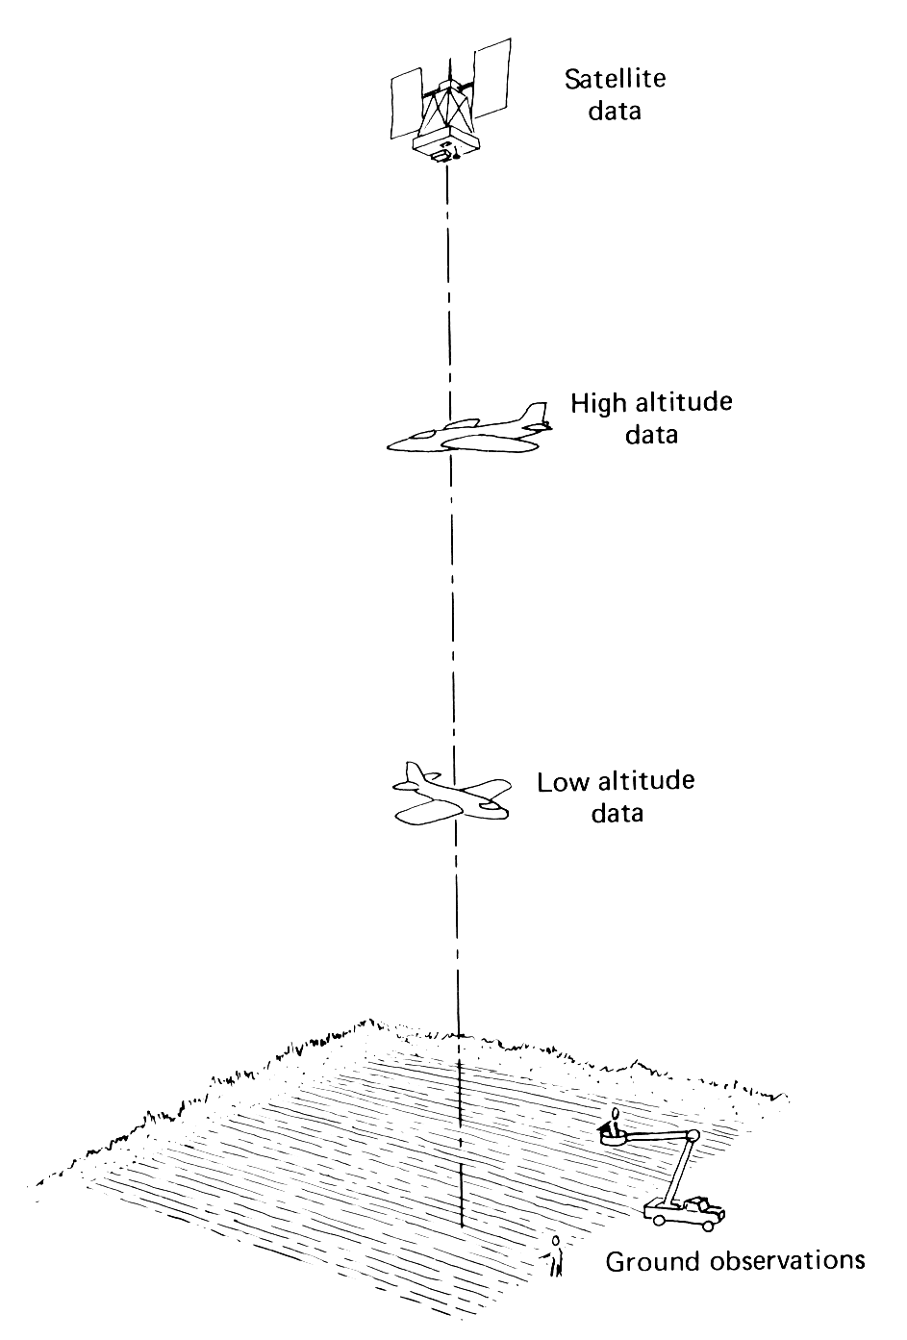
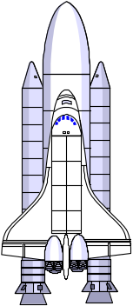


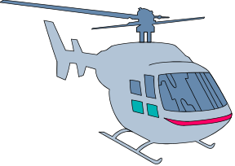
Platforms
Sensing from 1m to 36,000 km height
Platforms may be:
  Ground based
  Airborne
  Spaceborne

Slide 4
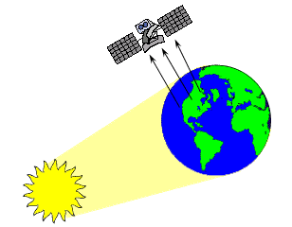
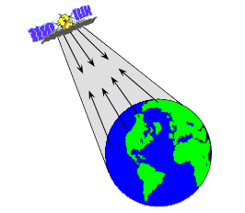
Sensors and Platforms – chapter 3
Passive Sensors
Active Sensors

Slide 5
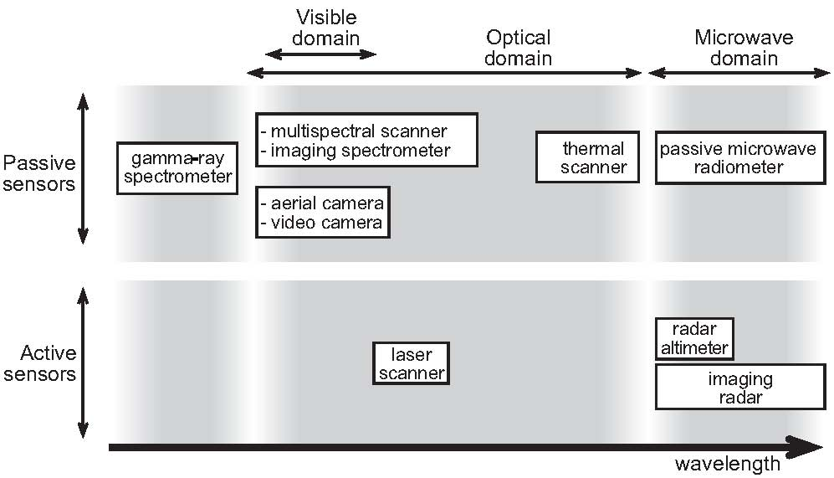
Sensor overview

Slide 6
Passive vs. active RS
Passive systems depend on other energy sources (daylight, heat)
aerial camera
thermal scanners
Active systems generate their own source of energy (“illumination”)
  radar (micro waves)
  laser scanners (1μm -1.5μm usually)

Slide 7
Passive sensors
Gamma ray spectrometer:
  Portable
  radioactive decay (mineralogy)
Aerial camera:
  planes and low satellites
  many applications
Video camera:
  Analog and digital
  Low cost data for qualitative purposes

Slide 8
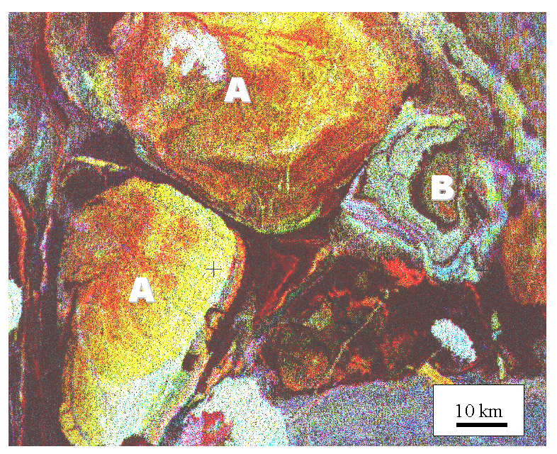
Passive sensors: gamma ray spectrometer
measures the amount of
  gamma rays emitted by the
  upper soil or rocks due to
  radioactive decay
emission depend on the
  specific mineral

Slide 9
Passive sensors
Multispectral scanner
  scans reflected light in several selected wavelengths.
  works in atmospheric windows.
Image spectrometer
  similar to MSS, but very narrow wavelength ranges.
  continuous reflectance curve.
Thermal scanner
  10-14 μm, range of emission of Earth objects.
Radiometer
  1-100 cm, emission is related to water content.

Slide 10
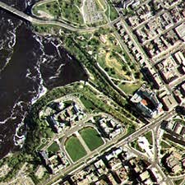
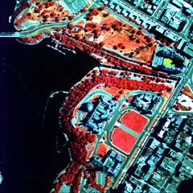
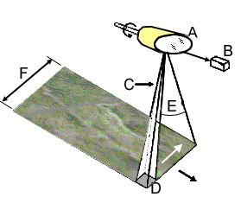
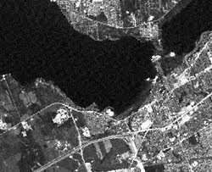
Examples
Multispectral scanners
Thermal

Slide 11
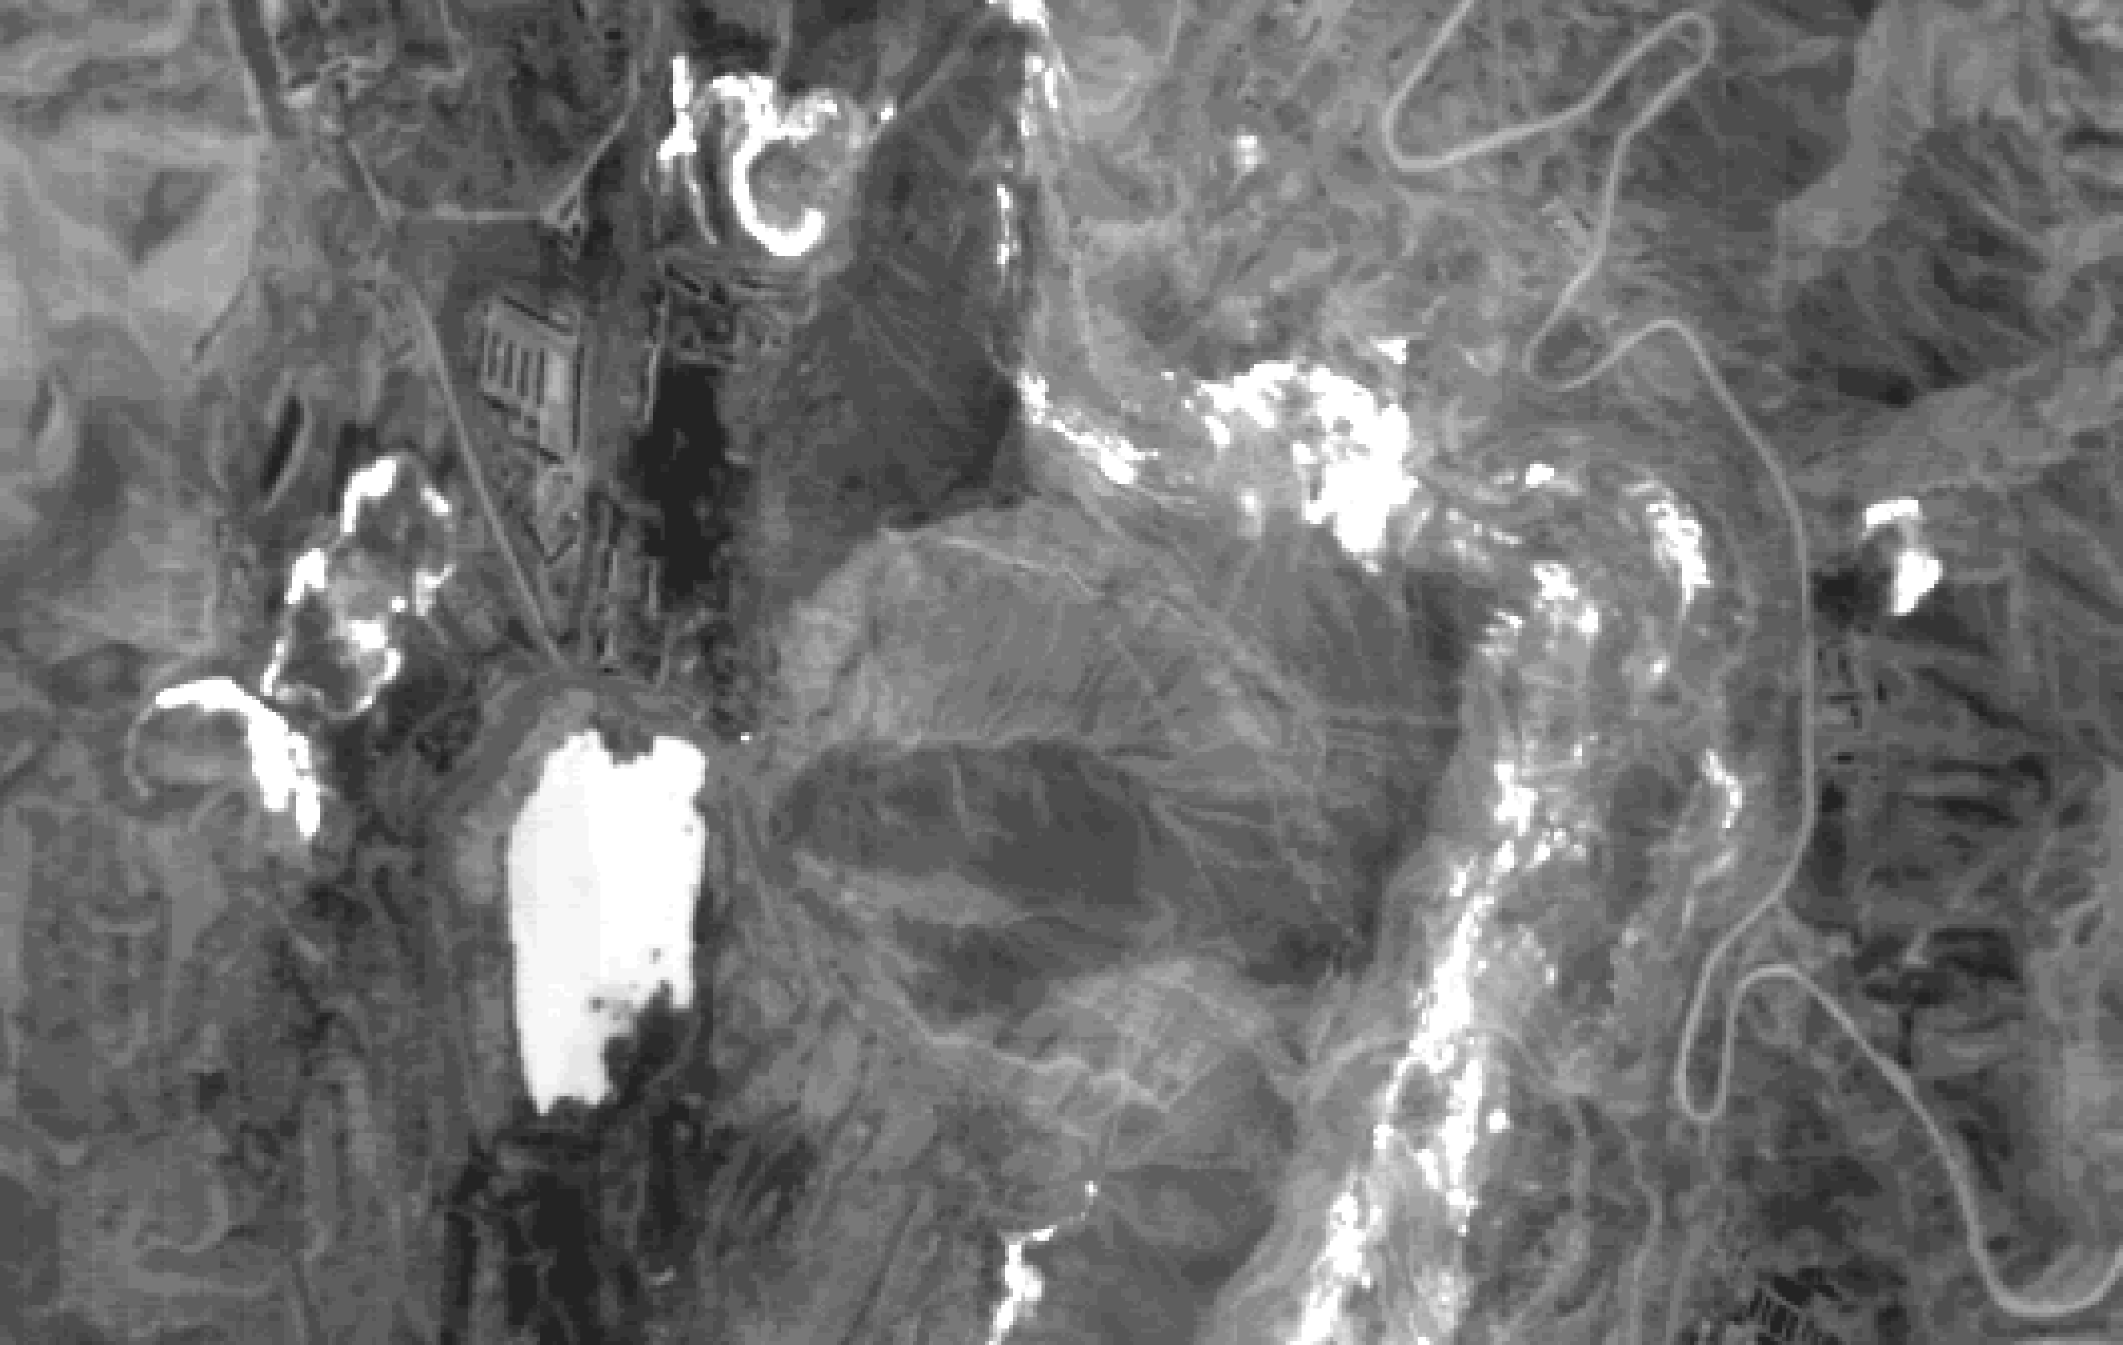
Multispectral scanner - Thermal scanners
MSS
Reflected sunlight in the optical domain
Various wave length bands
Land surface studies
Thermal scanners
Measures thermal emission (8-14 micrometer)
Evapotranspiration - forest fires - coal fires

Slide 12
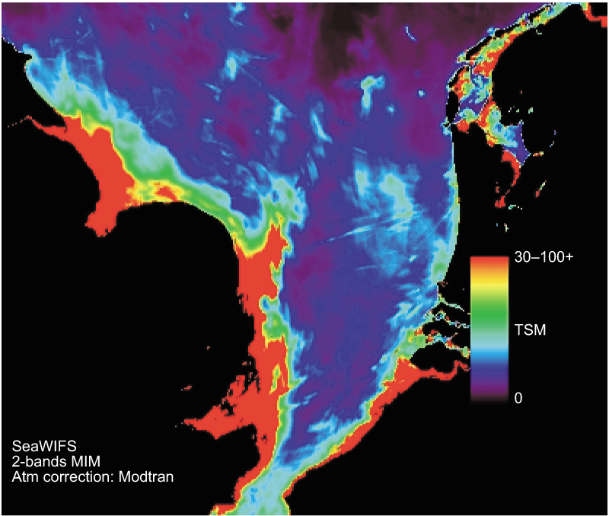
Imaging spectrometer
similar to multispectral scanner
measures only very narrow spectral bands
(5-10nm)
continuous reflection
curves
application: chlorophyll
content and mineral
composition

Slide 13
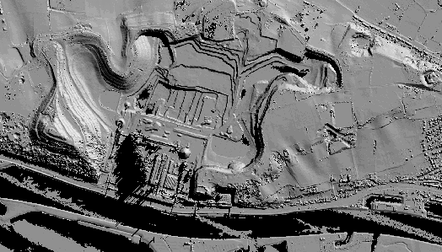
Active sensors: laser scanner
laser beam measures distance from point to aircraft used to calculate terrain elevation

Slide 14
Active sensors: radar
Radar altimeter
  single lines of measurements
  2-4 cm precision
  altitude variations of smooth surfaces (oceans)
Imaging radar
  operates in 1-100 cm domain
  backscatter is influenced by signal and surface
  all weather day and night acquisition capability

Slide 15
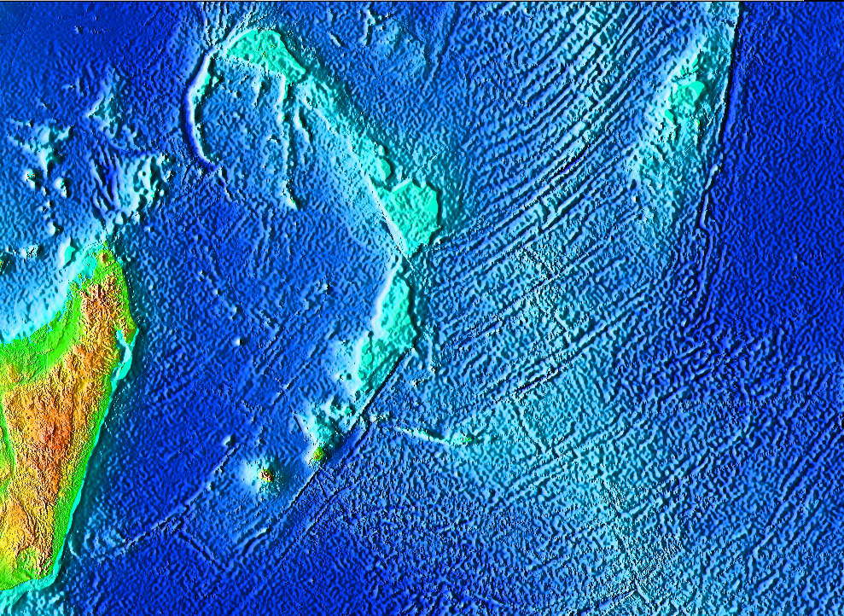
Active sensors: radar
GEOSAT image (radar altimeter) of sea floor topography

Slide 16
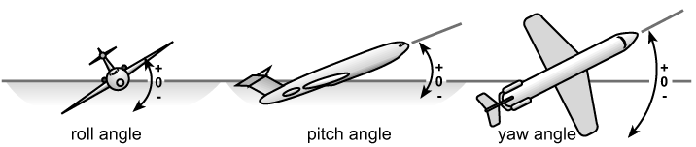
Platforms
Ground-based (hand-held and mast/tower)
Airborne
  100 meter up to 30-40 km
  navigation improved with satellite navigation
  aircraft rotations
Spaceborne
  150 -36000 km altitude

Slide 17
Airborne RS
From aircraft, balloons.
  distortions are caused by aircraft movement during flight.
Aerial photography
  films, digital data.
Topic of separate lecture (Chapter 4)

Slide 18
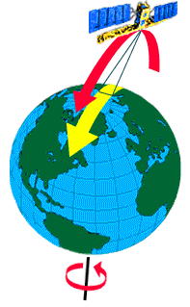
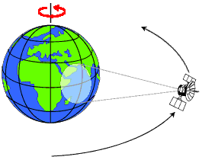
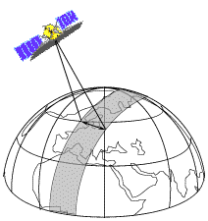
Spaceborne RS

Slide 19
Orbit characteristics
altitude
inclination angle
period
repeat cycle

Slide 20
Orbits
Low earth orbits (LEO)
  150-300km: spy satellites, space shuttle
Near earth orbit (NEO)
  300-6400km above atmosphere for earth observation
Geo stationary (GEO)
  35680km above the equator
  view 45% of the earth
  over one fixed point

Slide 21
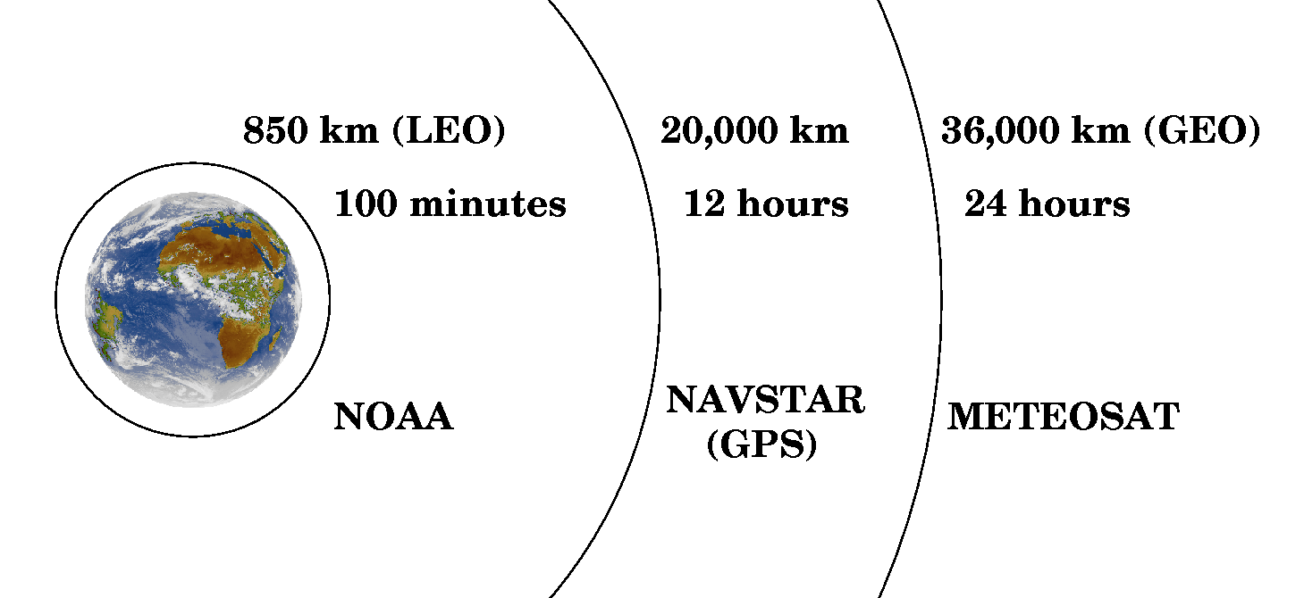
Orbits: heights on scale

Slide 22
Orbits types
(near) polar orbits
sun-synchronous orbits
geo-stationary orbits

Slide 23
(Near polar) sun synchronous orbit
passes at same local solar time
passes equator mid-morning (10:30) at low sun-angles (shadow)
14 orbits per day
ascending (night) and descending (day) passes

Slide 24
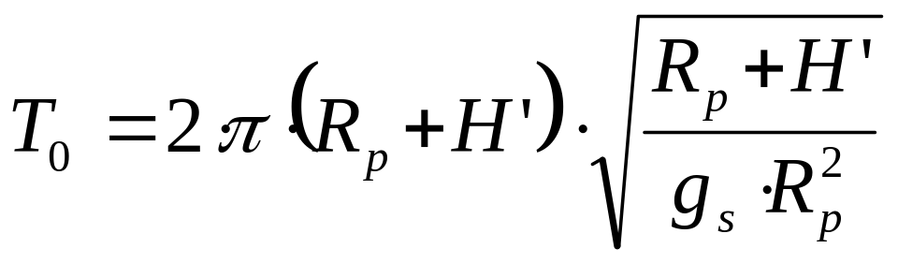
Orbit characteristics
Satellite altitudes and orbital periods are related
The centrifugal force and the force of gravity should be in equilibrium. This results in:
  T₀ = Orbital period, sec
  R_{p} = Planet radius (about 6380 km for earth)
  H’ = Orbit altitude, km
  G_{s} = Gravitational acceleration (0.00981 km/s²)

Slide 25
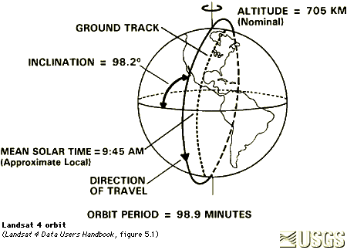
Sun synchronous orbit

Slide 26
Inclination angle

Slide 27
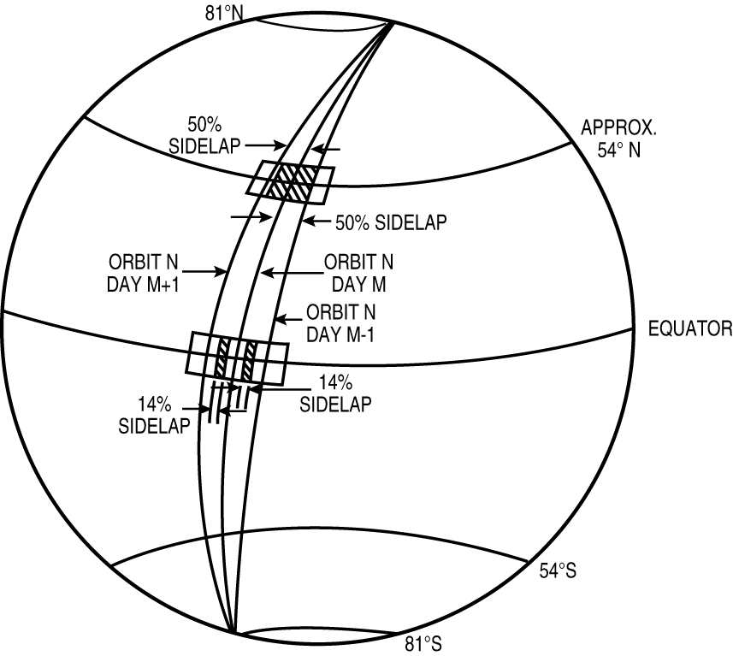
Scene overlap at various latitudes

Slide 28
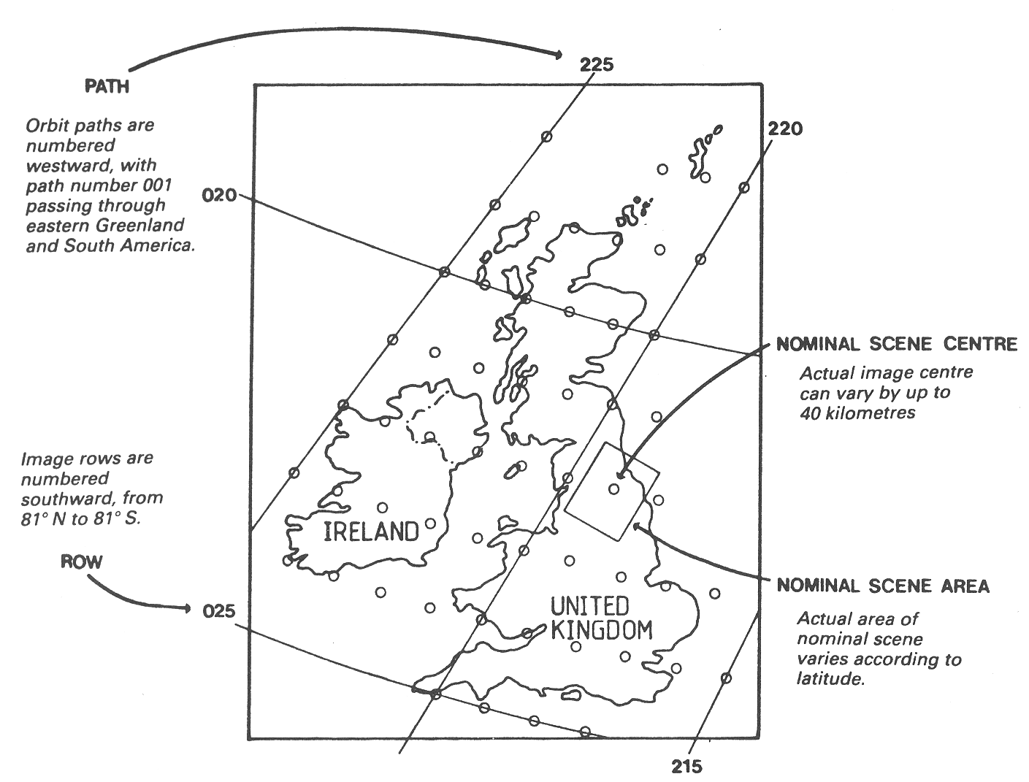
Scenes: Path/Row numbers
Path/Row numbers of the World Reference System 1 (WRS-1) of Landsat 1, 2, & 3.
United Kingdom and Ireland

Slide 29
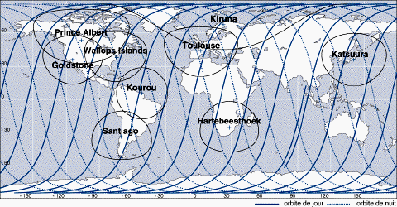
SPOT orbit and receiving stations

Slide 30
Geo stationary orbits
always above the same location
distorted view of polar regions
weather satellites

Slide 31
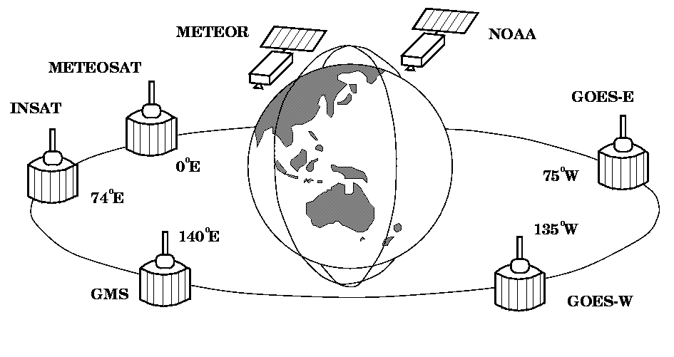
Orbits: LEO and GEO

Slide 32
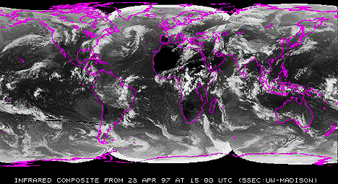
Geostationary satellites - combination

Slide 33
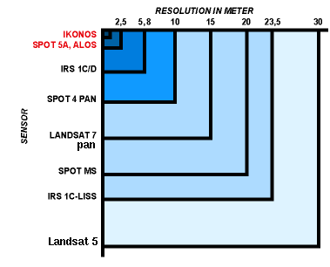
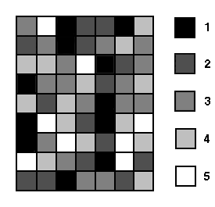
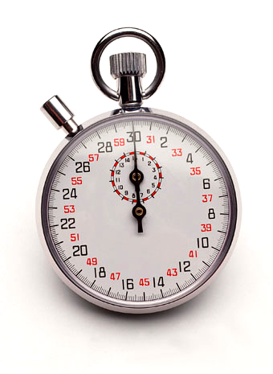
Image characteristics: Resolutions
Spatial resolution
Spectral resolution
Radiometric resolution
Temporal resolution (revisit time)
λ
1/

Slide 34
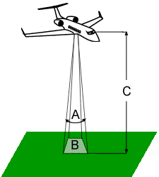
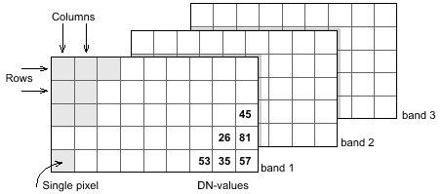
Spatial resolution
IFOV

Slide 35




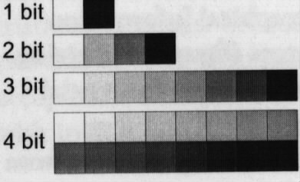
Radiometric resolution
1 bit
2 bit
3 bit
8 bit

Slide 36
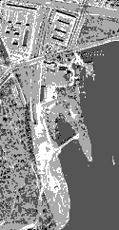
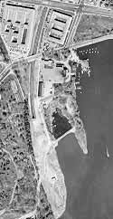
Radiometric resolution
2 bits
8 bits

Slide 37
Temporal resolution
Period
  time required to complete one orbit
  800 km is about 90 minutes
Repeat cycle
  time between two subsequent images of the same area

Slide 38
Comparison of system resolutions

Slide 39
Characteristics of image data
Coverage
Number of bands
Quantization (radiometric resolution)
Ground pixel size
Calculating image size for storage
  N°bands * N°rows * N°columns * N°bytes

Slide 40
Data selection criteria
Spatial resolution (city? continent?)
Static or dynamic processes?
Costs (between free of charge and 150 euro/km²⁾
Bands vs. application.
Periodicity vs. application.
Application
Cloudiness

Slide 41
Multi spectral scanning – Chapter 5
Sensing in selective bands
Dynamic range 0.3-14 micron
Digital data ready for processing

Slide 42
Main recording systems
Across track scanning
Whiskbroom
Along track scanning
Push broom

Slide 43
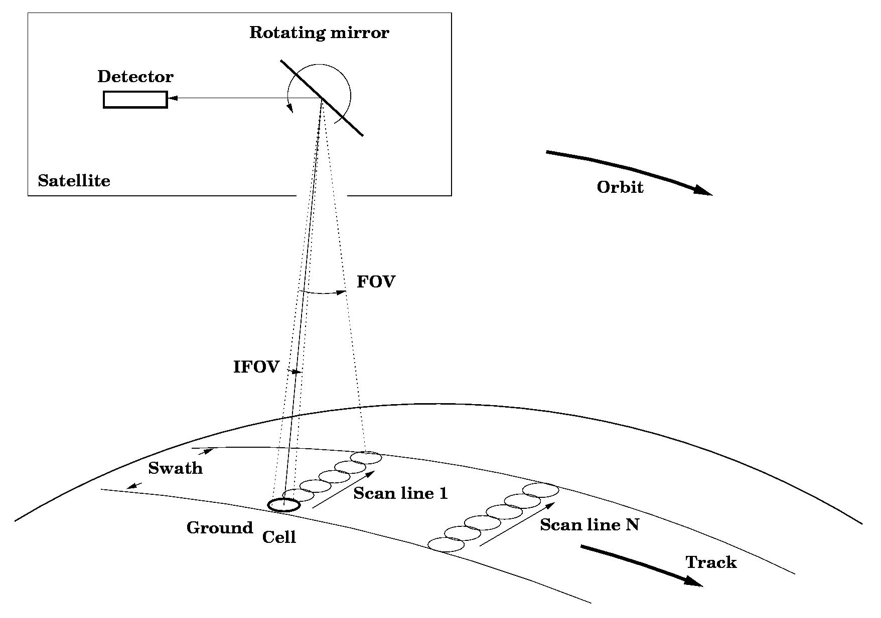
Whiskbroom scanner

Slide 44
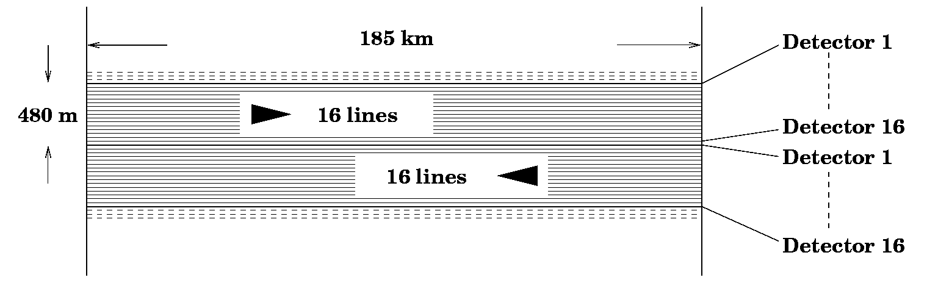
Landsat-TM scanning pattern
16 detectors scan the scene alternating from left to right and back by use of an oscillating mirror
100 detectors are operating simultaneously (6x16 VNIR plus 1x4 TIR)

Slide 45
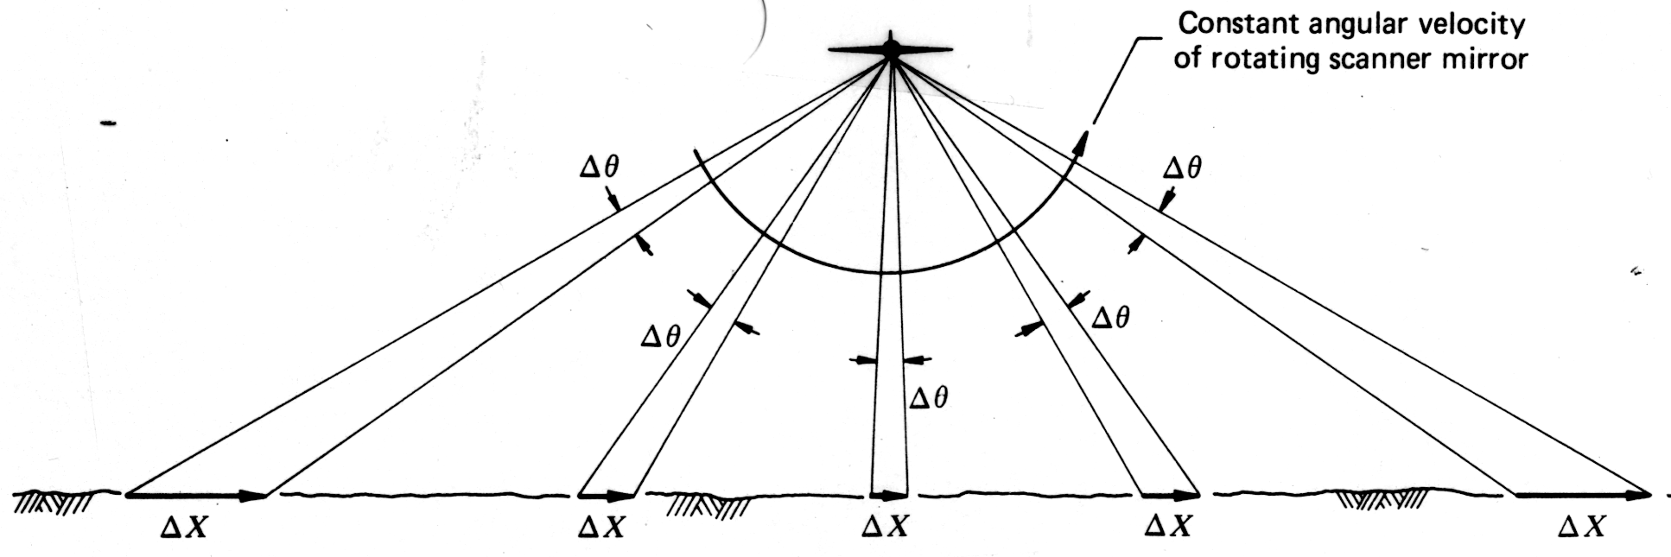
Tangential scale distortions

Slide 46
Whiskbroom: Sigmoid curvature
straight lines occur curved
away from nadir larger areas imaged in the same time
can be corrected

Slide 47
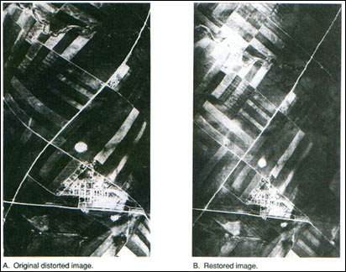
Whiskbroom: Sigmoid curvature

Slide 48
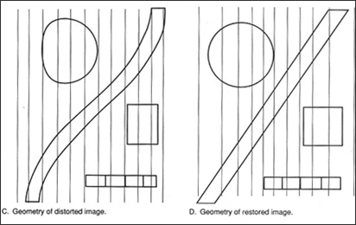
Whiskbroom: Sigmoid curvature

Slide 49
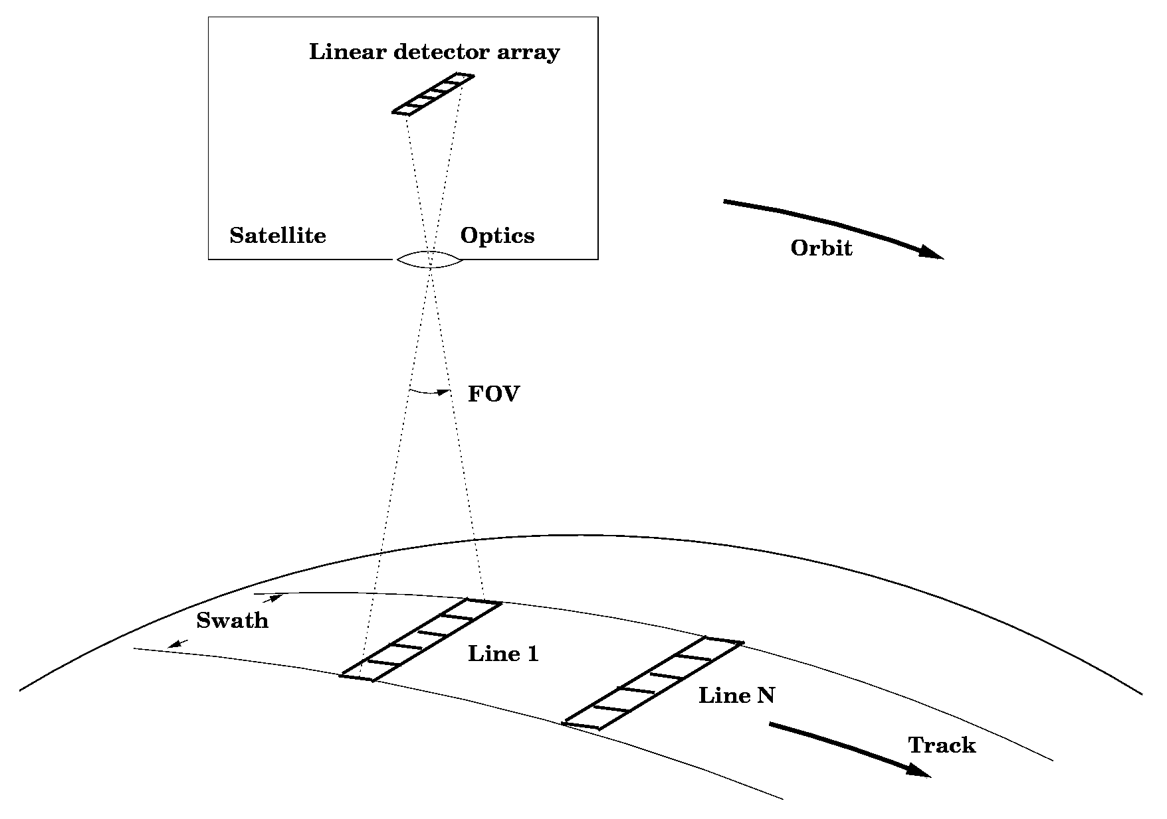
Pushbroom sensor

Slide 50
Pushbroom scanners
Along track scanners
Linear array of detectors
Numerous charge coupled devices (ccd)
Each detector for one ground cell
Each spectral band has one array

Slide 51
Pushbroom scanners
Advantages
Longer residence time per ground cell resulting in a stronger signal
Better spatial and radiometric resolution
Higher geometric integrity
Light equipment / no moving parts

Slide 52
Pushbroom scanners
Disadvantages
Calibration of many detectors (3000 +)
Limited sensitivity beyond near-infrared

Slide 53
Resolution types
Spectral resolution
Radiometric resolution
  Number of levels applied in conversion
Spatial resolution
  Minimal separation between 2 objects (size of pixel)
Spatio-temporal resolution
  Revisit time over the same area

Slide 54
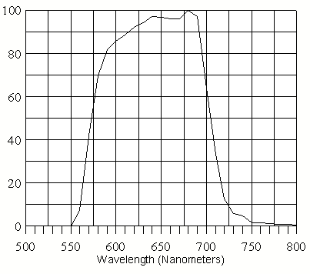
Spectral Response Function (SRF)
NOAA 14
AVHRR band 1
Normalised Spectral Response Function

Slide 55
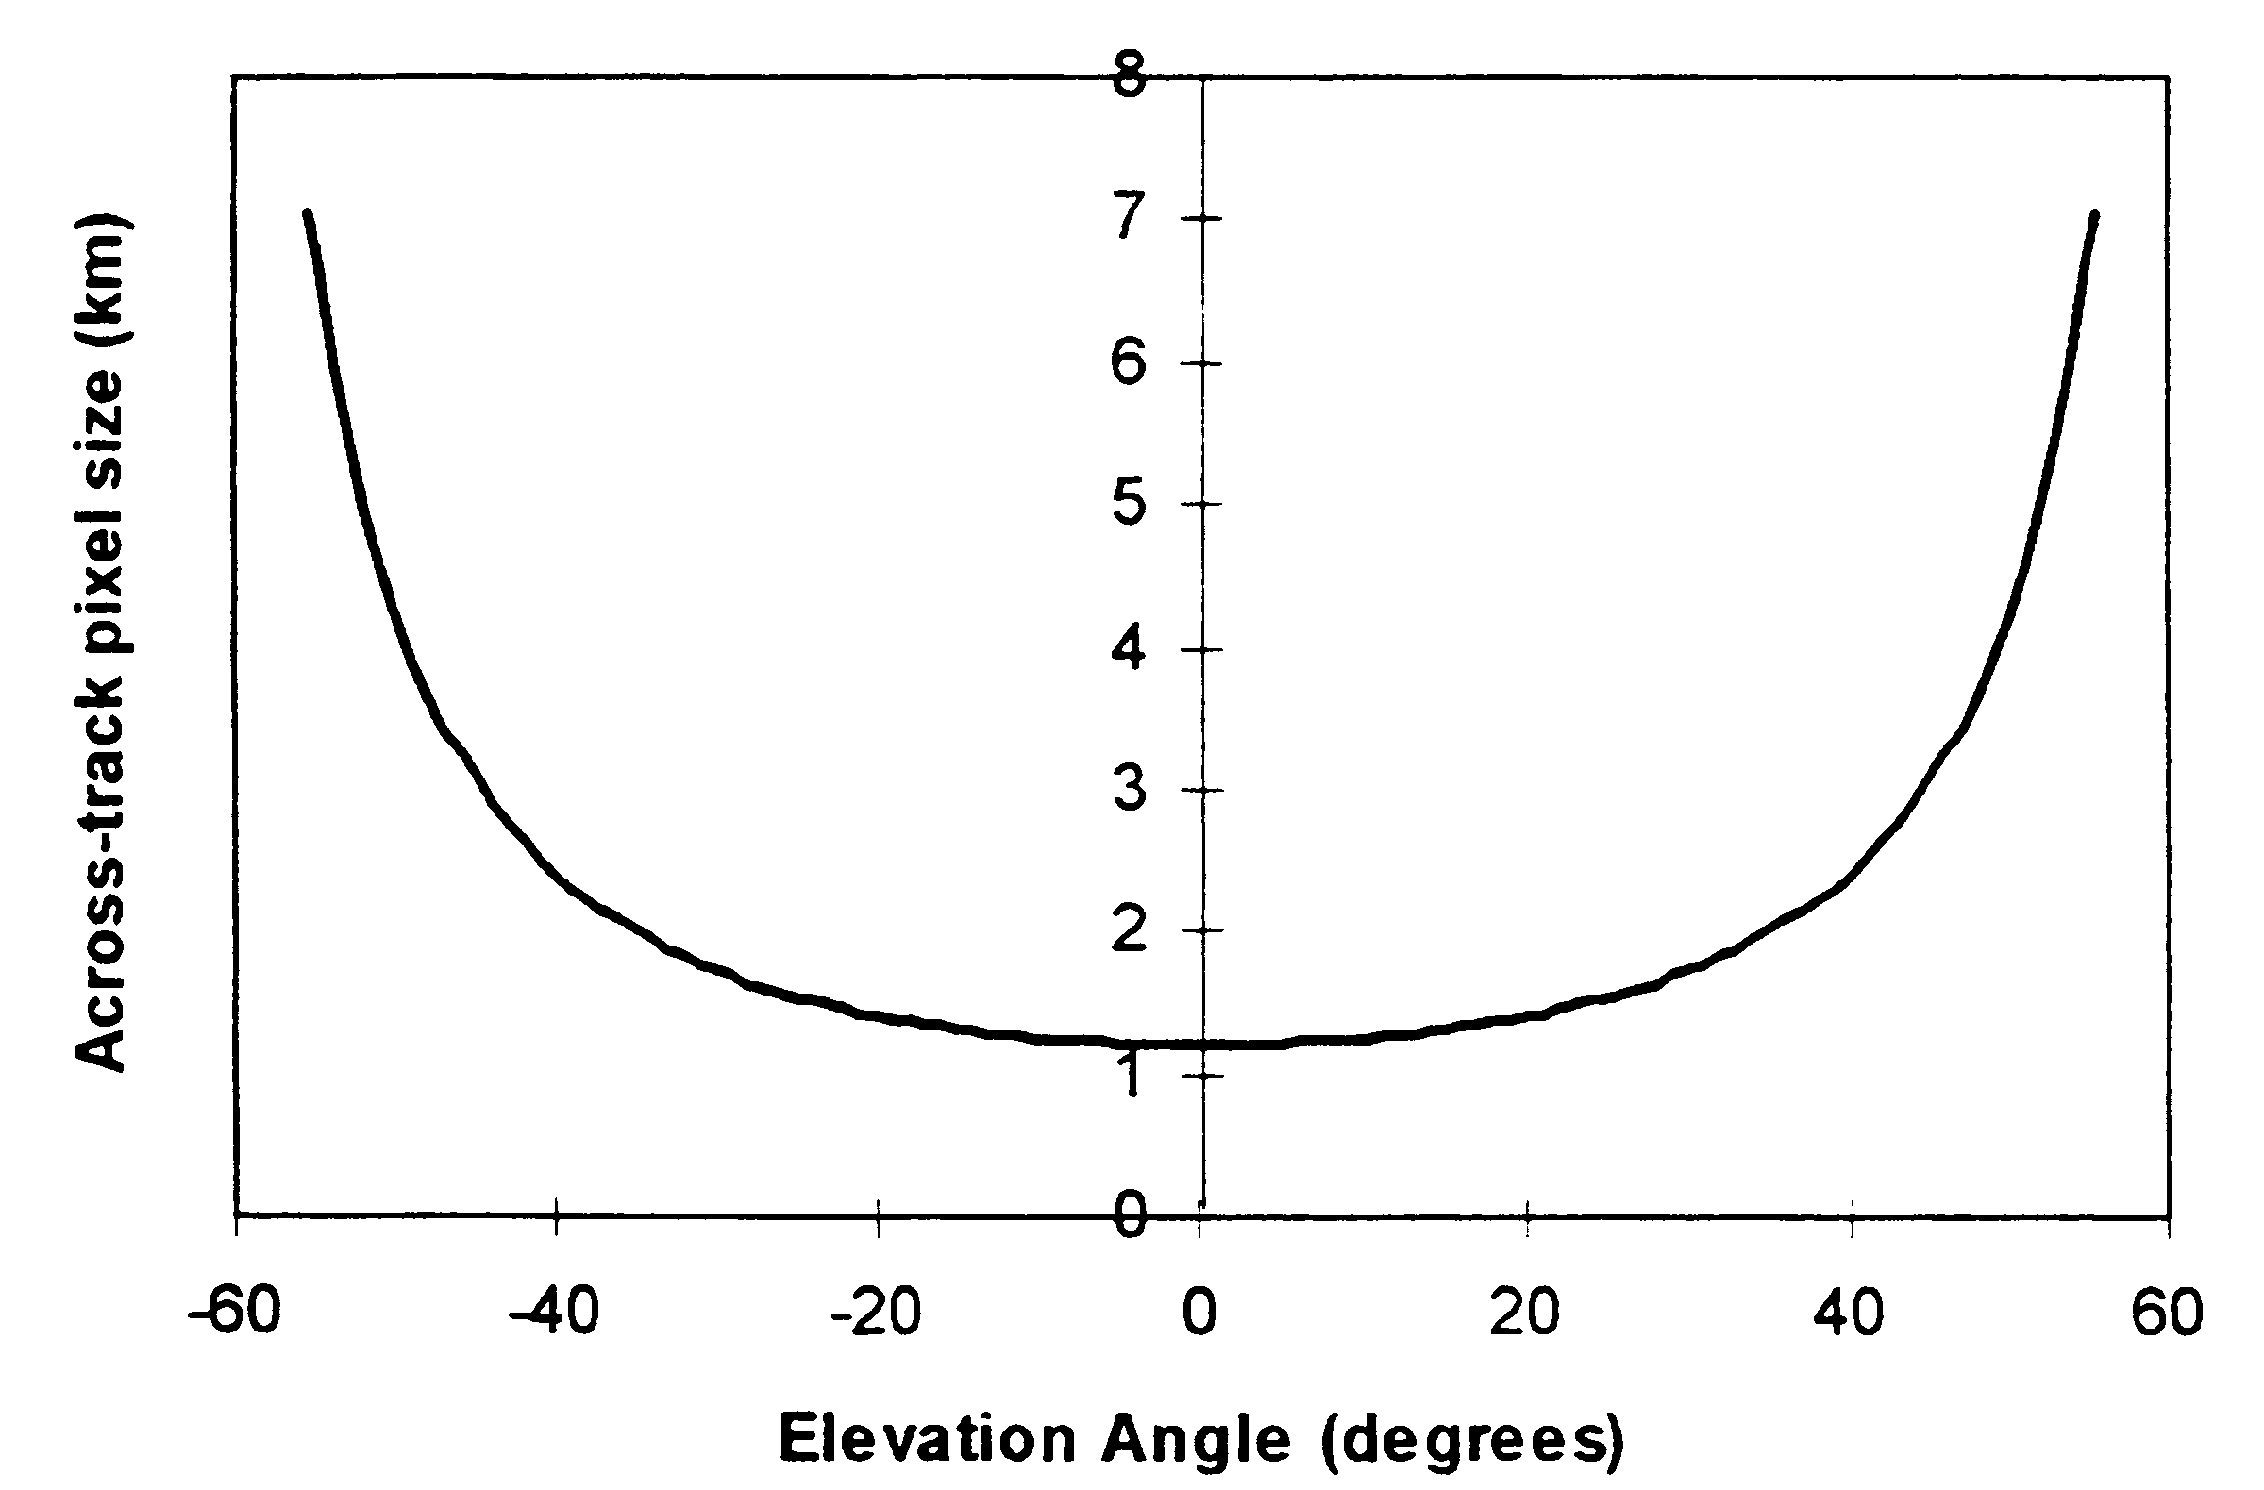
Whiskbroom: across-track pixel size
Degradation of resolution across one scan-line of the AVHRR sensor of the NOAA satellite.

Slide 56
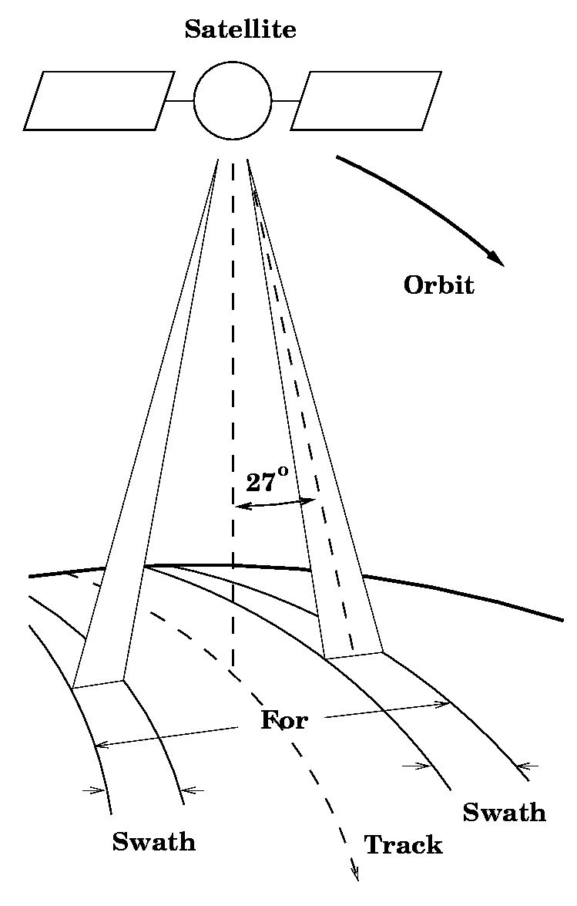
Stereo capability
Off-nadir viewing enables the creation of stereo image-pairs.
The larger field-of-regard (FOR) also enables a more frequent revisit time.

