Slide 1

Customer Shopping Behavior Analysis
Uncovering insights from 3,900 purchases to guide strategic business decisions
AL KADIRI AYA
Notes:
1

Slide 2
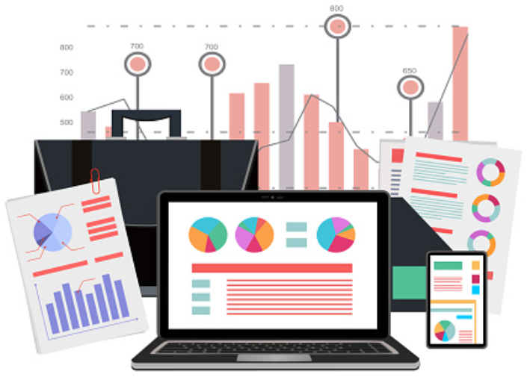
Dataset Overview
3,900
18
37
Total Purchases
Data Columns
Missing Values
Comprehensive transaction data
Customer demographics & behavior
Only in Review Rating column
Notes:
2

Slide 3

Data Preparation Process
01
02
03
Data Loading
Initial Exploration
Missing Data Handling
Imported dataset using pandas
Structure check and summary statistics
Imputed Review Rating with median values
04
05
Feature Engineering
Database Integration
Created age groups and purchase frequency
Connected to PostgreSQL for analysis
Notes:
3

Slide 4
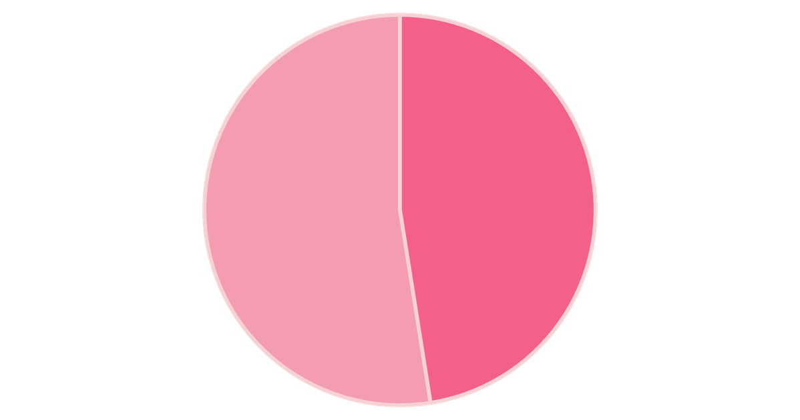

Revenue by Gender Analysis
Key Insight
Female customers generate slightly higher total revenue than male customers
Gender-based marketing strategies could optimize revenue streams
Male
Female
Notes:
4

Slide 5

High-Value Discount Users
Customers using discounts while spending above average
Smart Shoppers
High spenders who maximize value with discounts
Strategic Opportunity
Target premium customers with exclusive offers
Notes:
5

Slide 6
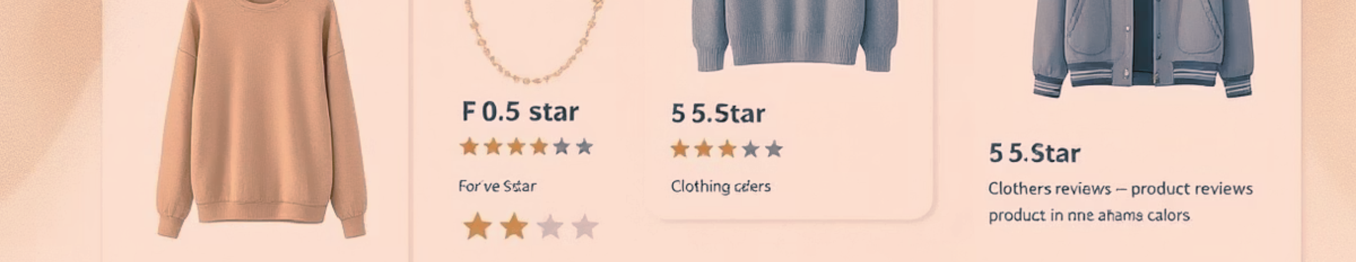


Top-Rated Products
5
5
4
Blouse
Dress
Shirt
Highest customer satisfaction
Consistently excellent reviews
Strong customer approval
Notes:
6

Slide 7


Shipping Preferences Impact
Express Shipping
Standard Shipping
$65
$58
Average purchase amount
Average purchase amount
Express shipping customers spend 12% more per transaction
Notes:
7

Slide 8
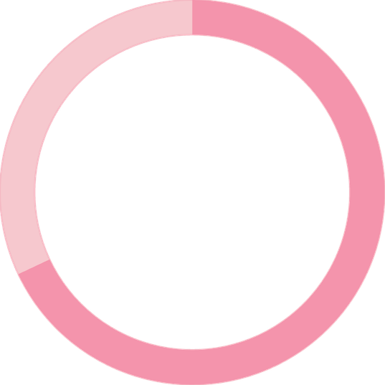
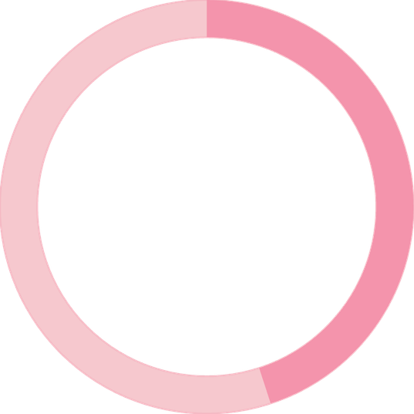
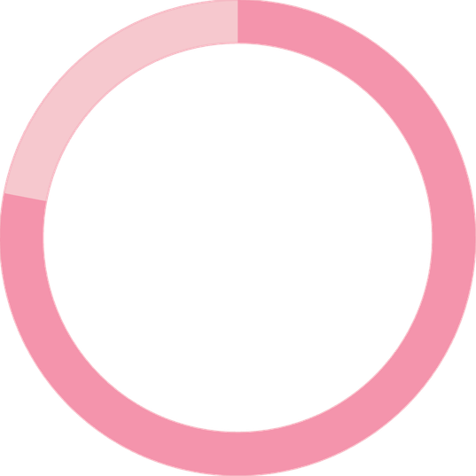
Subscription Impact
68%
45%
78%
Higher Spend
Revenue Share
Loyalty Rate
Subscribers vs non-subscribers
From subscription customers
Repeat purchase frequency
Notes:
8

Slide 9



Customer Segmentation
Loyal
1
15% - High value customers
2
Returning
35% - Regular shoppers
3
New
50% - First-time buyers
Focus on converting New to Returning, Returning to Loyal
Notes:
9

Slide 10





Strategic Recommendations
Boost Subscriptions
Promote exclusive benefits for subscribers
Loyalty Programs
Reward repeat buyers to increase retention
Targeted Marketing
Focus on high-revenue segments and express users
Product Positioning
Highlight top-rated products in campaigns
Notes:
10

