Slide 1
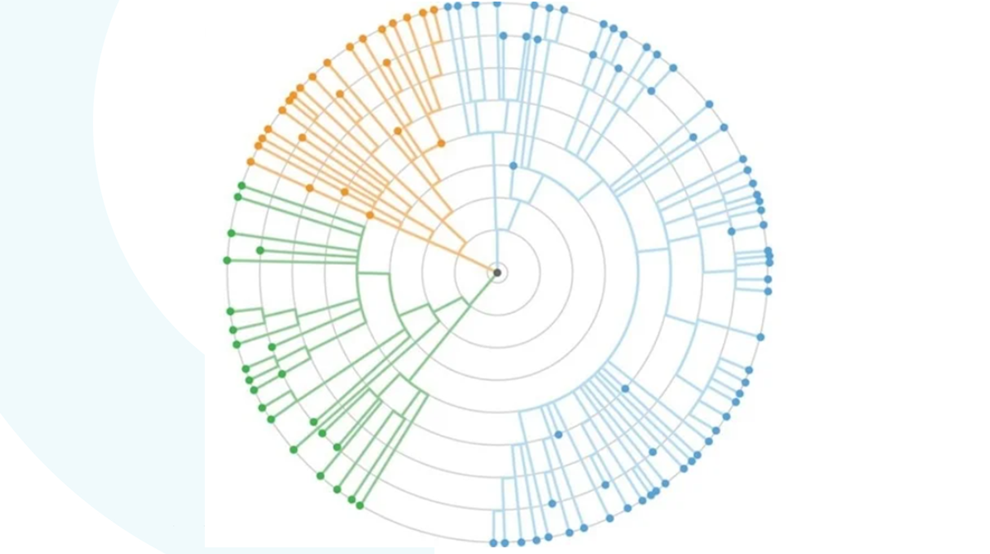
COMPUTATIONAL PIPELINE

Slide 2
Identification of Toxins
Identification of AMR
Input Nucleotide Sequence
Convert to Peptide Sequence
Blasting Peptide Sequence against Database of Anti-Microbial Resistance
Blasting Peptide Sequence against Database of Bacterial Toxins
Selecting Toxins with E value less than e^-11
Selecting AMR with E value less than e^-11
Output Toxins secreted by Bacteria
Output AMR present in Bacteria
Relative Measure of the Toxicity of Bacteria

Slide 3
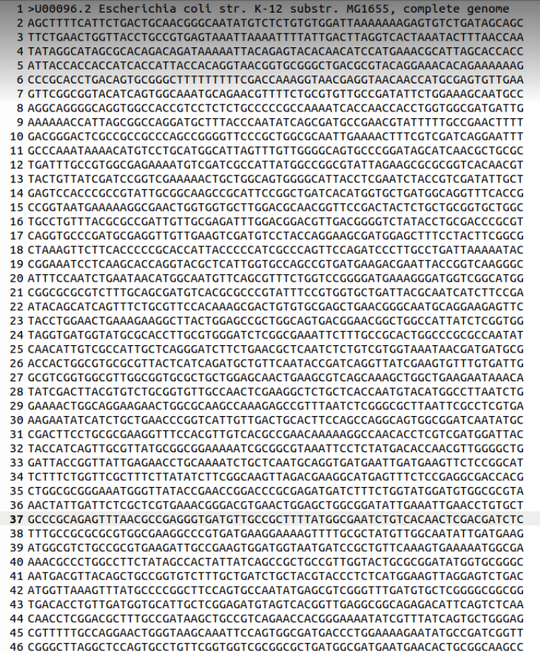
Genome Sequence
Already Identified
We took E coli as a model bacteria

Slide 4
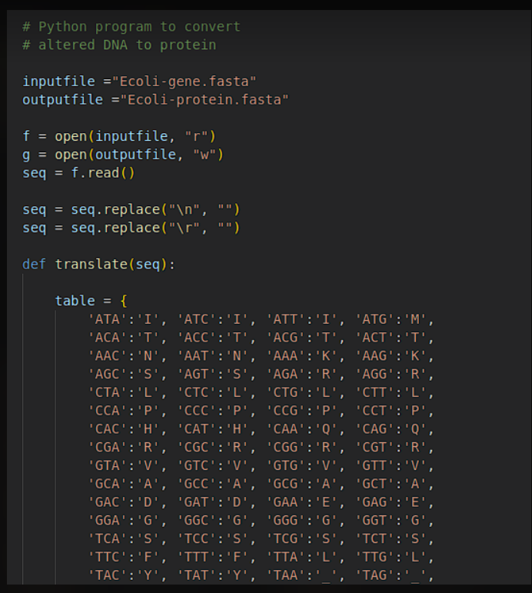
Generating Peptide Sequence

Slide 5
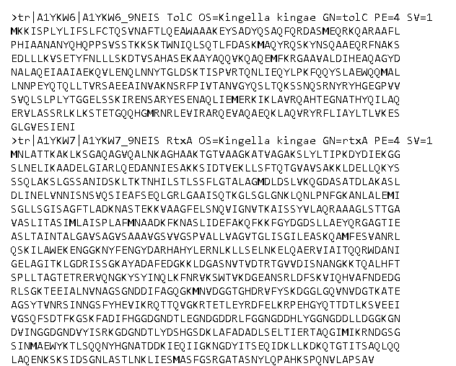
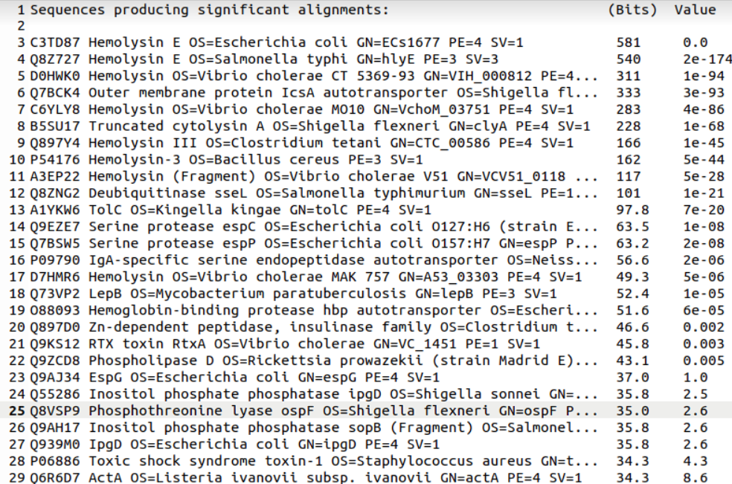
Blasting Peptide Sequence against Toxin Database

Slide 6
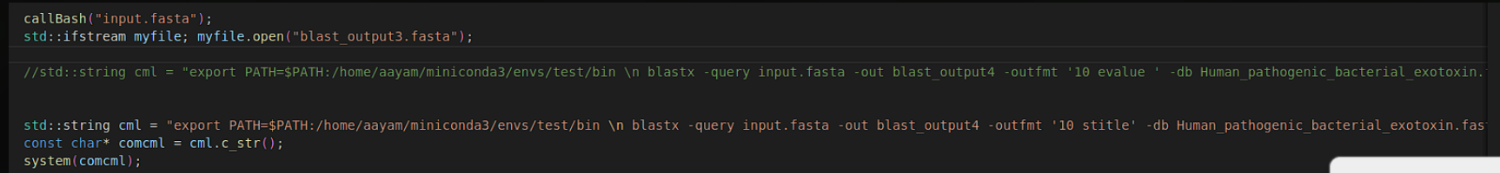
Filtering Toxins
An E-value of e^ -11 would be considered as borderline similar, so E value grater than that are filtered out

Slide 7
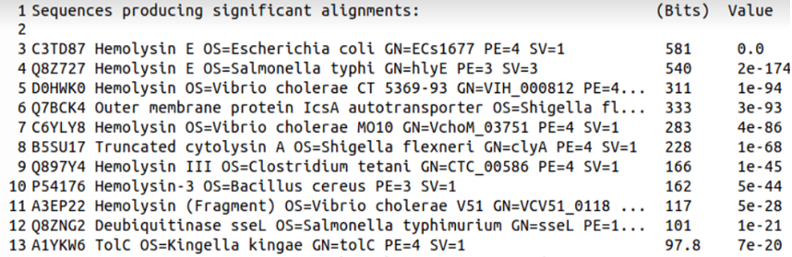
Relevant Toxins are presented

Slide 8
Salient Features
Can identify 259 different toxins present on bacterial genome
Average runtime of 15 seconds
For quality control, toxins with E value greater than e^-11 are filtered out

Slide 9
Shortcomings
No statistical analysis performed
Only chromosomal DNA considered for the genomic sequence, not plasmid
No account of endotoxins secreted by Gram –ve bacteria
Limited number of exotoxins can be identified

Slide 10
Add-ons
Expanding the program to include for antibiotic resistance which would further clarify its virulence factors
Tracing the toxins back to the bacteria so as to identify it (MicroBIGG-E at beta stage employed by NCBI to identify pathogens)
Creating database of bacteria and their corresponding toxins (which can show phylogenetic evolution in bacteria)
Use of relevant statistical tool to ensure the quality of results

