Slide 1
String Matching dengan Regular Expression
Masayu Leylia Khodra
Referensi:
Chapter 2 of An Introduction to Natural Language Processing, Computational Linguistics, and Speech Recognition, by Daniel Jurafsky and James H. Martin
15-211 Fundamental Data Structures and Algorithms, by Ananda Gunawardena

Slide 2
String Matching: Definisi
Diberikan:
T: teks (text), yaitu (long) string yang panjangnya n karakter
P: pattern, yaitu string dengan panjang m karakter (asumsi m <<< n) yang akan dicari di dalam teks.
Carilah (find atau locate) di dalam teks yang bersesuaian dengan pattern.

Slide 3
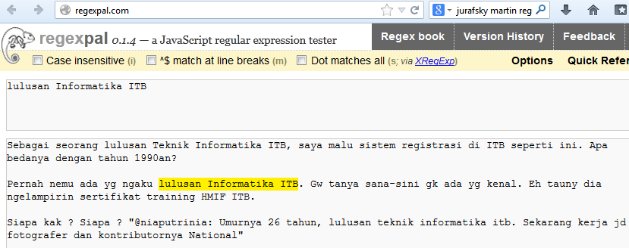
Contoh 1: Exact Matching

Slide 4
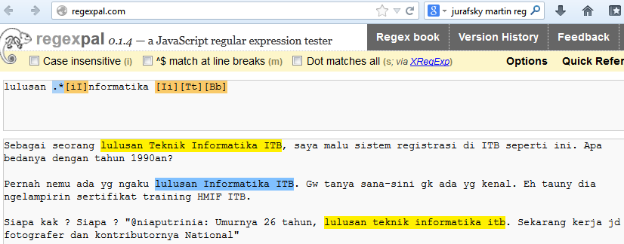
Contoh 2: Regex Matching

Slide 5
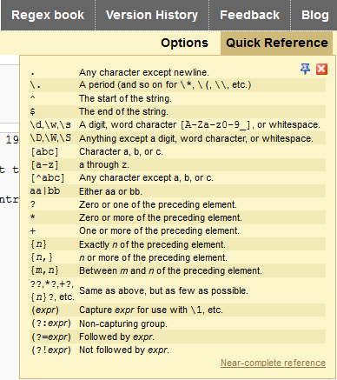
Notasi Umum Regex

Slide 6
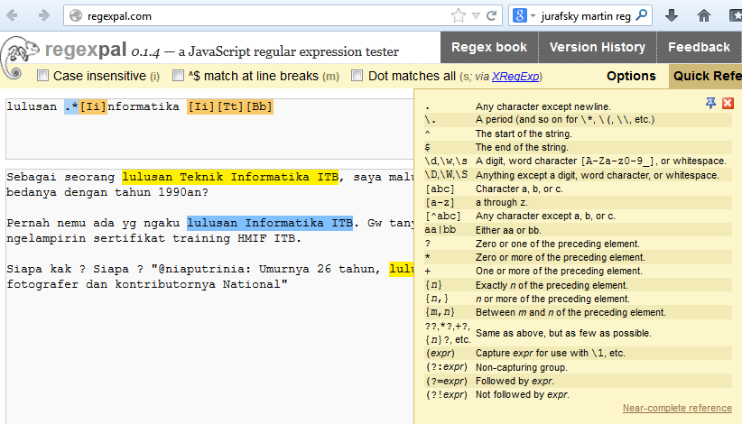
Notasi Regex

Slide 7
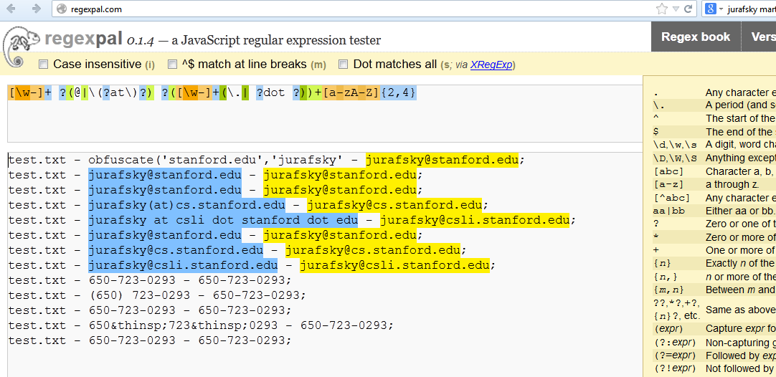
Contoh 3: Regex for Email
Tentukan regexnya untuk semua email yang diwarnai

Slide 8
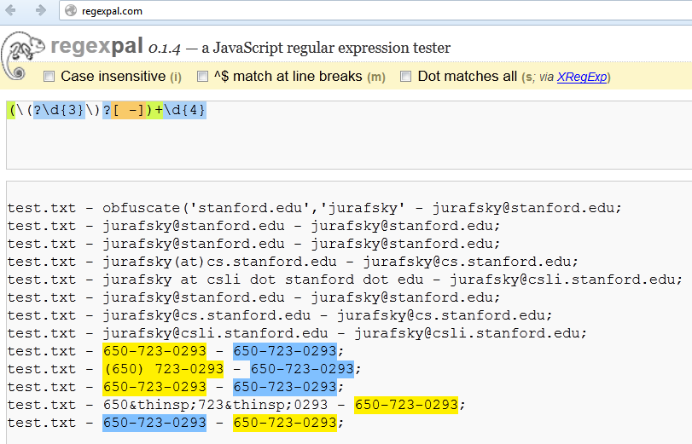
Contoh 4: Regex for Phone Number

Slide 9
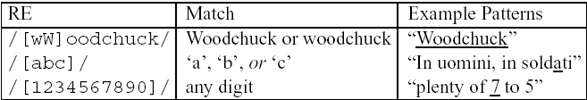
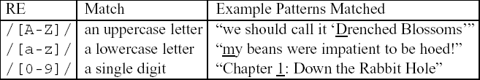
Basic Regular Expression Patterns
The use of the brackets [] to specify a disjunction of characters.
The use of the brackets [] plus the dash - to specify a range.

Slide 10
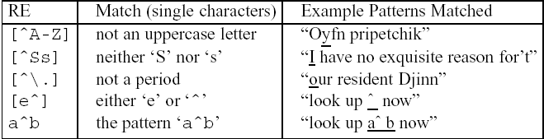

Basic Regular Expression Patterns
Uses of the caret ^ for negation or just to mean ^
The question-mark ? marks optionality of the previous expression.
The use of period . to specify any character

Slide 11
Finite State Machines (FSM)
FSM is a computing machine that takes
A string as an input
Outputs YES/NO answer
That is, the machine “accepts” or “rejects” the string
Input String
FSM
Yes / No
Referensi: Gunawardena, 2006

Slide 12

FSM Model
Input to a FSM
Strings built from a fixed alphabet {a,b,c}
Possible inputs: aa, aabbcc, a etc..
The Machine
A directed graph
Nodes = States of the machine
Edges = Transition from one state to another
Special States
Start (q0) and Final (or Accepting) (q2)
Assume the alphabet is {a,b}
Which strings are accepted by this FSM?
Referensi: Gunawardena, 2006

Slide 13
FSM untuk String Matching
Alphabet {a,b,c}
Pattern “aabc”
String: aaaaaaaaaaaabcddddddddddddddd
a
b|c
a
Start
a
a
b
c
4
0
1
2
3
4
c
b|c
b
Referensi: Gunawardena, 2006

Slide 14
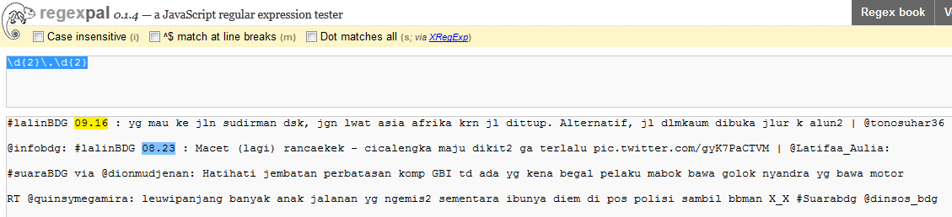
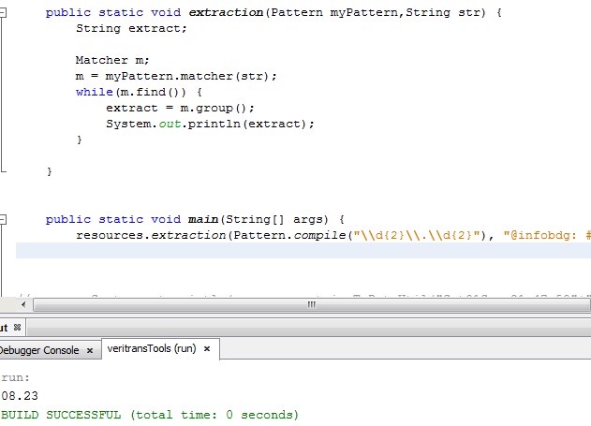
Regex di Java

