Slide 1
Class Diagram

Slide 2
Class Diagram
Class diagram is UML STRUCTURE diagram which shows structure of the designed system at the level of classes and interfaces, shows their features (attributes and methods), constraints and relationships - associations, generalizations, dependencies, etc.

Slide 3
The following points should be remembered while drawing a class diagram:
The name of the class diagram should be meaningful to describe the aspect of the system.
Features of each class should be clearly identified.
Use notes when ever required to describe some aspect of the diagram. Because at the end of the drawing it should be understandable to the developer/coder.

Slide 4
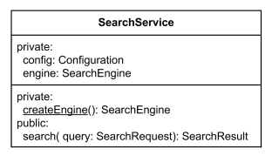
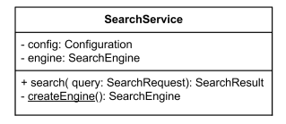
Class Features
Specify the visibility of the class features (+, #, -)
Attribute declaration general form: name : attribute type = default value
Operation declaration general form: name(arg1: arg1 type, …) : type of value returned

Slide 5
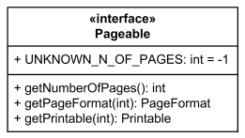
Interfaces
Class diagrams may contain Interfaces

Slide 6
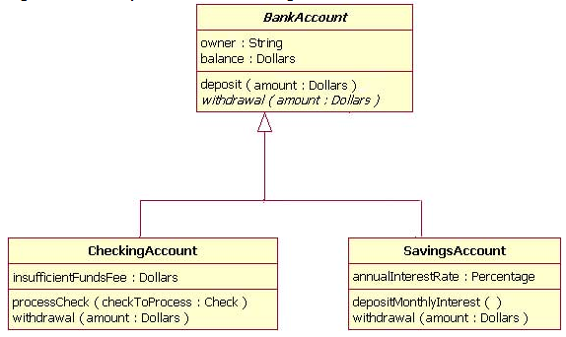
Inheritance
Super class
Child class

Slide 7

Association
Associations denote a relationship between two classes (binary) or more (n-ary)
Includes :
Association name: The Name of the relation
Direction: One or two directional
Multiplicity
Aggregation
Composition

Slide 8
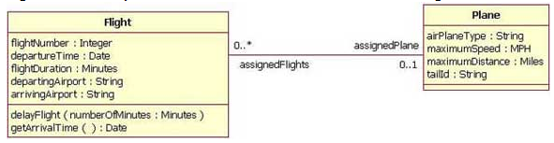
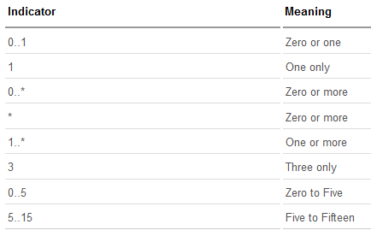
Multiplicity

Slide 9

Aggregation
Indicates that one class is a part of another class.
The child class instance can outlive its parent class.
When the Parent instance (object) is deleted, the Child instance is not necessarily deleted.

Slide 10

Composition
The child class's instance lifecycle is dependent on the parent class's instance lifecycle.
When the Parent instance (object) is deleted, the Child instance is automatically deleted as well.
Note: The part (child) class can only be related to one instance of the parent class

Slide 11
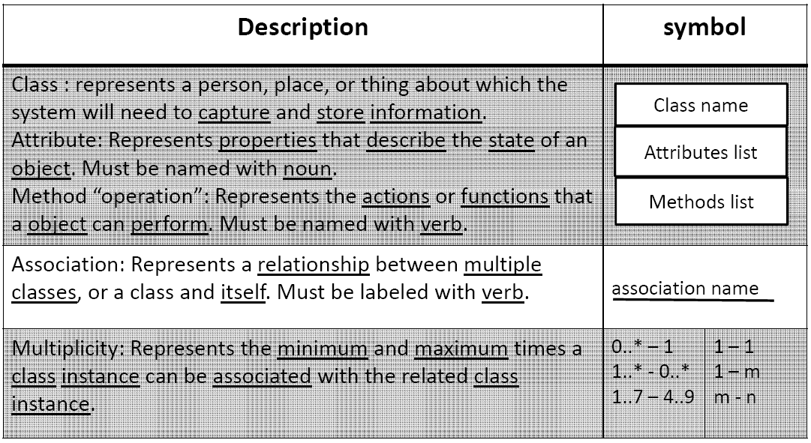
Class diagrams symbols

Slide 12
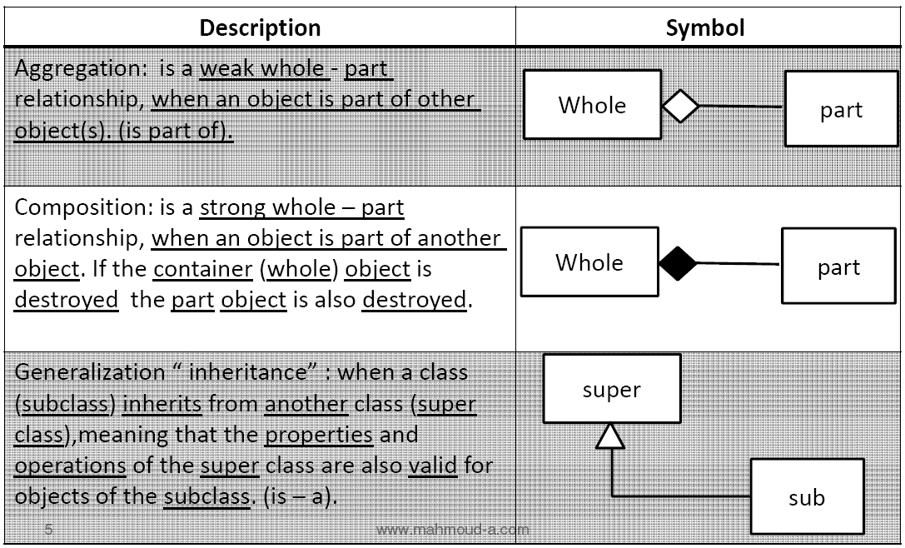
Class diagrams symbols

Slide 13
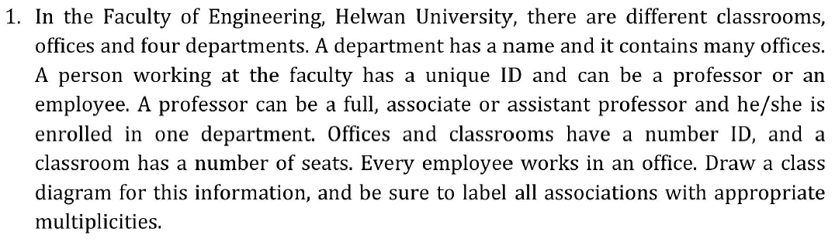
Question 1

Slide 14
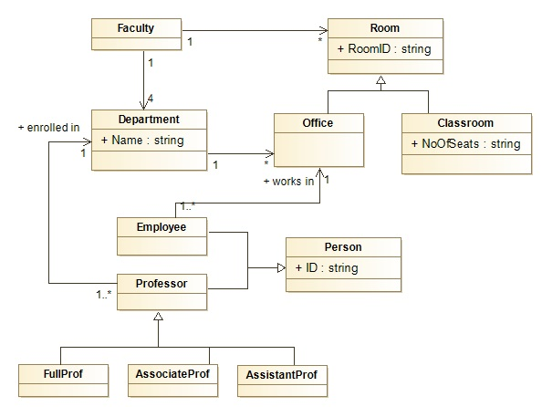
Solution

Slide 15
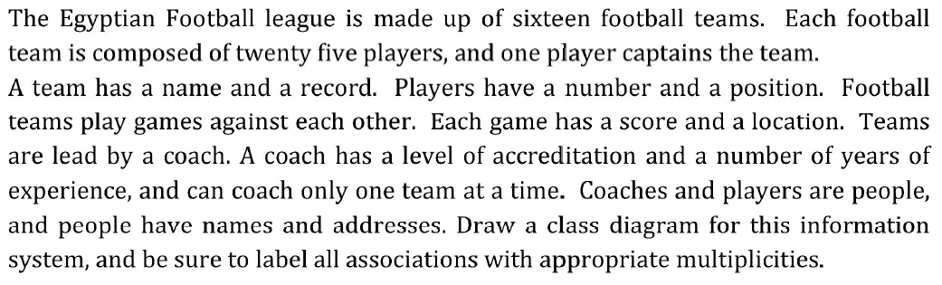
Question 2

Slide 16
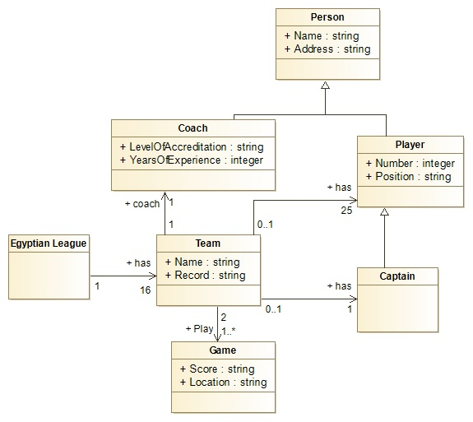
Solution

Slide 17
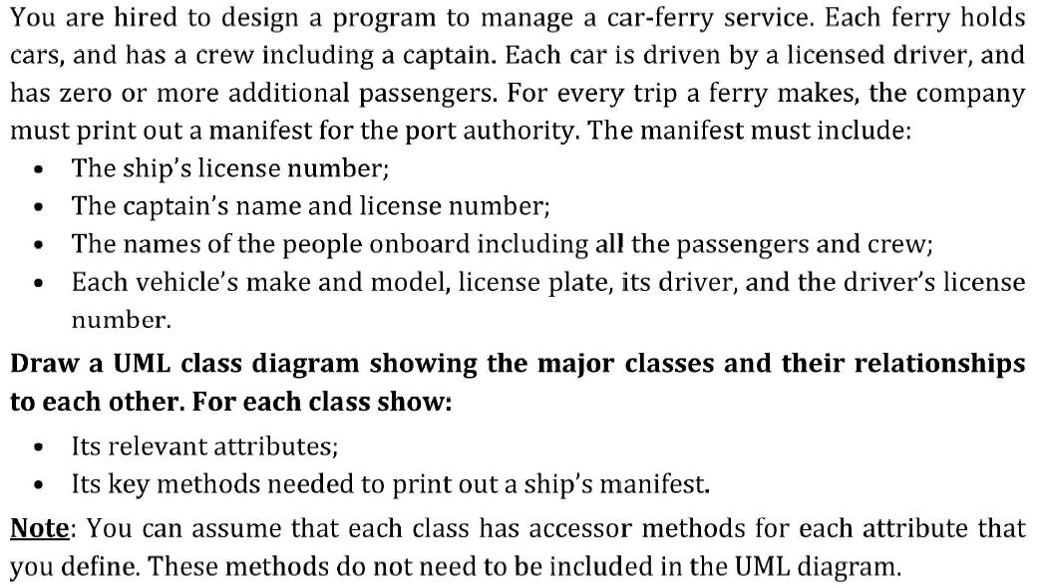
Question 3

Slide 18
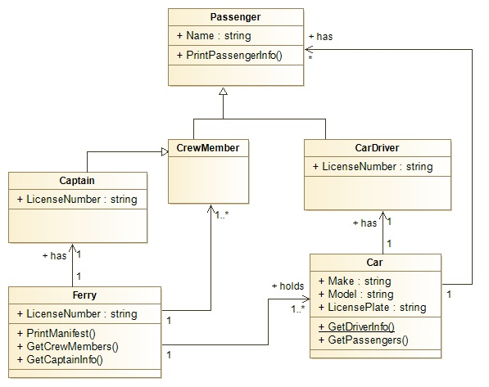
Solution

Slide 19
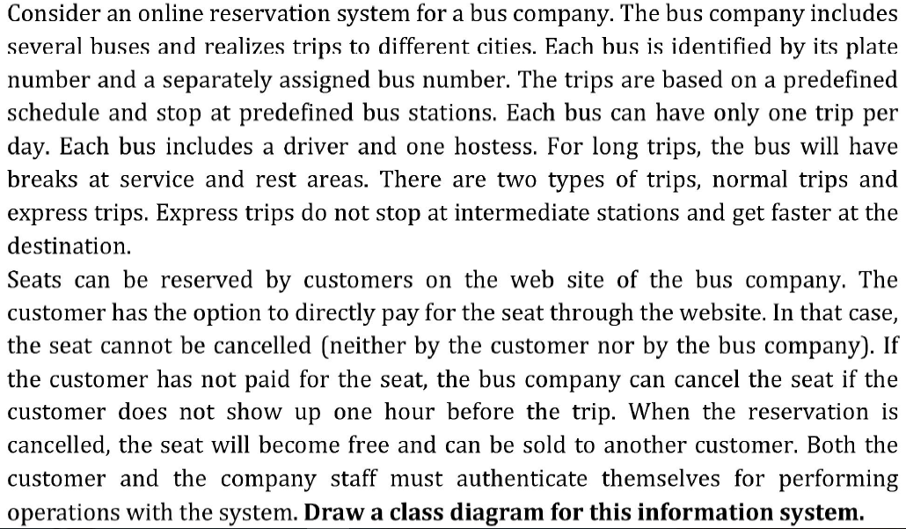
Question 4

Slide 20
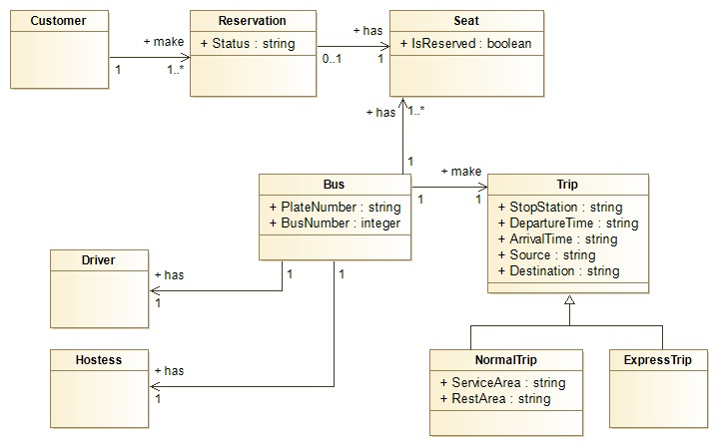
Solution

Slide 21
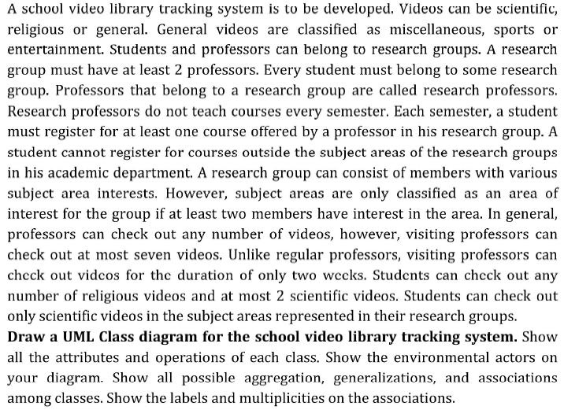
Question 5

Slide 22
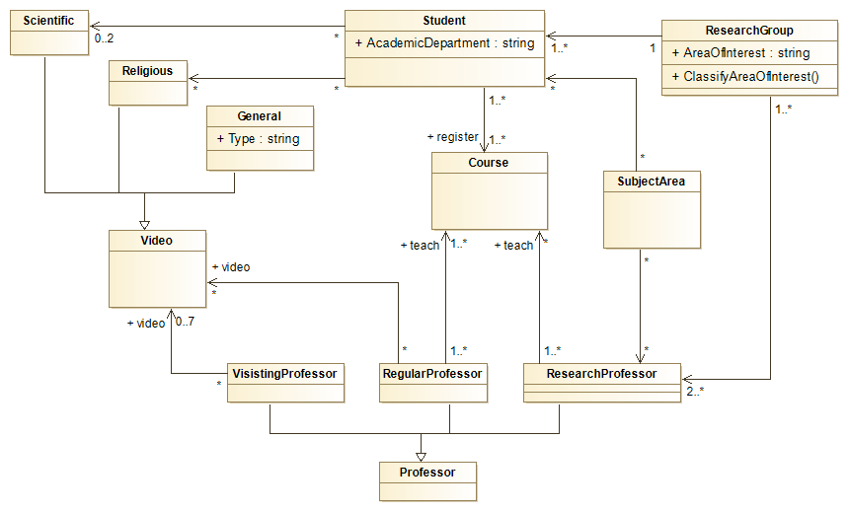
Solution

Slide 23


Tools
https://www.modelio.org/
http://www.eclipse.org/papyrus/

