Slide 1
Academic
Paper
Intelligence
UIR · AI & Big Data · S8
Aya EL MOUDEN
Adam HADOUTI
Prof. Hakim Hafidi
TextCNN
built from scratch
4
AI agents
Multi-Agent AI System
for Automated Peer Review
85%+
accuracy
2025 — 2026
Notes:
SAY THIS: "Good morning. Our project is called the Academic Paper Intelligence System. The problem we solved: peer review — the process where researchers get feedback on their papers — takes months. Experts are overwhelmed. Reviews are inconsistent. We built a system that reads any research paper PDF and automatically generates a complete peer review in under a minute. It uses a deep learning model we built from scratch and four AI agents that collaborate. Let me walk you through how it works."

Slide 2
01 — THE PROBLEM & OUR SOLUTION
Peer review is slow.
We automated it.
The Problem
Our Solution
— Peer review takes 3 to 6 months
TextCNN model
Classifies field + novelty in seconds
— Review quality varies between reviewers
4 AI Agents
Each has one job, pass results to next
— Experts receive too many requests
Human-in-the-loop
Human approves before LLM analysis
— No standard format or structure
Semantic Scholar
Real citation search, 200M papers
— Getting first feedback is expensive
Web interface
Professional UI for any PDF
2 / 10
Notes:
SAY THIS: "The problem is simple. Peer review takes too long, it is inconsistent, and there is no standard format. Our solution: we built a system that automates the first pass. It reads any PDF and produces a structured review with strengths, weaknesses, citation analysis, and a final verdict — Accept, Major Revision, or Reject. The system is not just calling ChatGPT. It has a deep learning model we trained ourselves, four agents that each do a specific job, and a human who approves the classification before anything expensive runs."

Slide 3
02 — SYSTEM ARCHITECTURE
Five steps. One pipeline.
01
02
03
04
05
PDF Reader
TextCNN
Human Checkpoint
Semantic Scholar
4-Agent Crew
Opens the PDF. Extracts title, abstract, full text, all references.
Our neural network. Classifies field (11 classes) + novelty (4 levels) simultaneously.
Pipeline STOPS. Human approves before any agent runs. Critical decision point.
Searches 200 million academic papers. Finds related work and citation data.
Four agents run one after another. Each passes results to the next.
→
→
→
→
The system reads the paper like a human would — pulls out the important parts.
The deep learning model WE BUILT identifies what type of paper this is.
YOU decide whether to continue. If the field is wrong, nothing after it works.
Real external database — not made up. Free API.
The AI team that writes the actual review.
Output: JSON report + Markdown peer review → saved to outputs/
3 / 10
Notes:
SAY THIS: "Here is the full pipeline. Five steps. Step 1: We read the PDF and extract the text. Step 2: Our TextCNN model looks at the abstract and tells us what field this paper belongs to — Computer Science, Physics, Math, etc. — and how novel the idea is. Step 3: The pipeline STOPS and asks a human to approve before continuing. This is the human-in-the-loop checkpoint. Step 4: We search Semantic Scholar — a real academic database — for related papers and citation data. Step 5: Four AI agents run in sequence, each doing one job and passing results to the next. The final output is saved as a JSON file and a readable Markdown peer review."

Slide 4
03 — DEEP LEARNING MODEL
WHY NOT BERT?
TextCNN
TextCNN trains in 30 min on free Colab GPU.
BERT would take hours and needs a paid GPU.
We wrote every layer ourselves — 4 million parameters we can explain.
That is more impressive than downloading BERT.
built from scratch · PyTorch · 4M+ parameters
EMBED
Embedding — every word becomes 128 numbers the model understands
CONV
3 filters scan: 2 words, 3 words, 4 words at a time — 100 filters each
POOL
Max pooling — keep only the strongest signal from each filter
TRAINING
CAT
Concatenate all filters → 300-number vector representing the abstract
28,388
training papers
DROP
Dropout 0.5 — randomly disable neurons during training to prevent overfitting
84.57%
final accuracy
HEAD 1 — Field
HEAD 2 — Novelty
15 epochs
11 research field classes
4 levels: Incremental → Breakthrough
on Colab T4 GPU
4 / 10
Notes:
SAY THIS: "This is the most important component. We built a TextCNN — a Convolutional Neural Network for text — completely from scratch in PyTorch. Here is how it works: First, every word in the abstract gets converted to a list of 128 numbers — this is the embedding layer. Then three convolutional filters scan the text looking for patterns in 2, 3, and 4-word combinations. Max pooling keeps only the strongest signal. We concatenate everything into a 300-number vector representing the whole abstract. The key innovation is the dual output. Instead of one answer, we get two simultaneously: which research field (11 options) and how novel the idea is (4 levels). Both are used by the agents downstream. We trained it on 28,000 real arXiv papers and reached 84.57% accuracy in 30 minutes on a free GPU."

Slide 5
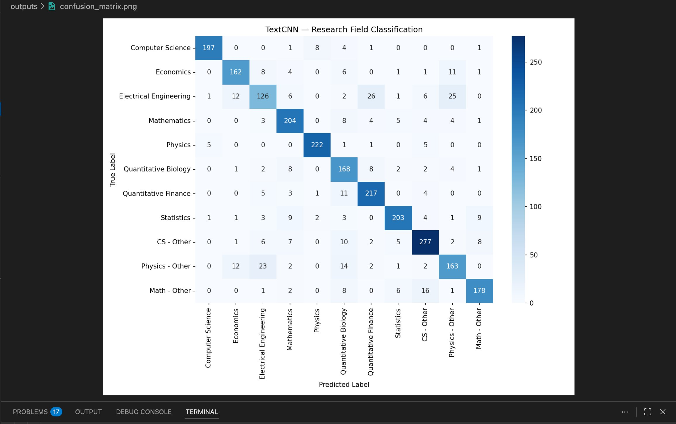
04 — TRAINING RESULTS
The model learned.
Loss went down. Accuracy went up.
What is loss?
Loss measures how wrong the model is. It starts high (random guessing) and drops as it learns. Lower is better.
What is accuracy?
The percentage of papers correctly classified. We went from 25% (random) to 85% — the model genuinely learned.
No overfitting
The curves are smooth and consistent — the model learned real patterns, not just memorized training data.
Dual output
Both field classification and novelty were trained together with a combined loss function.
Left: Training loss dropping from 2.14 → 0.56 Right: Accuracy rising from 25% → 84%
5 / 10
Notes:
SAY THIS: "These are our training curves. The left graph shows the loss — how wrong the model is — dropping from 2.14 all the way down to 0.56. The right graph shows accuracy going from 25% up to over 84%. This is real progress. The model started knowing nothing — 25% accuracy is basically random guessing across 11 classes. By the end of 15 epochs it correctly classifies 85% of papers. The curves are smooth which means no overfitting — the model learned real patterns from the data, not just memorized the training examples."

Slide 6
05 — THE 4-AGENT SYSTEM
Four agents. Each has one job.
Each passes results to the next.
01
02
03
04
Classifier
Extraction
Citation
Critique
Confirms or corrects the TextCNN field using LLM reasoning on the abstract.
Extracts 6 things: research question, methodology, key results, datasets, limitations, reproducibility.
Analyzes references, uses Semantic Scholar data, identifies missing citations, scores quality 1-10.
Gets ALL previous agent outputs. Writes the full peer review with 7 sections.
TextCNN said: Quantitative Biology (18%)
Agent 1 says: Corrected Field: Mathematical Physics
Uses the corrected field to tailor the analysis — Math papers get different questions than CS papers.
30 references found. Missing: Kalnins et al. 2015, Tempesta et al. 2011.
Citation score: 7 / 10
Summary, Strengths, Weaknesses, Citation Assessment,
Reproducibility, Novelty, Final Verdict: Accept
If the field is wrong here, everything after it is wrong.
Structured extraction that agents 3 and 4 depend on.
Real data from external API — not made up.
The final product. Uses everything from agents 1, 2, 3.
6 / 10
Notes:
SAY THIS: "Now the four agents. These are AI workers built with CrewAI that run one after another. Agent 1, the Classifier Agent, receives the TextCNN prediction and the abstract. Its job is to confirm or correct the field. In our example, the TextCNN said Quantitative Biology with only 18% confidence — very uncertain. The agent read the abstract and corrected it to Mathematical Physics. It always writes 'Corrected Field:' at the start so our code can find it. Agent 2, the Extraction Specialist, uses that corrected field and extracts six pieces of information from the paper — research question, methodology, results, datasets, limitations, and reproducibility. Agent 3, the Citation Analyst, looks at all the references and the Semantic Scholar results. It scores citation quality and identifies missing papers. Agent 4, the Critique Writer, takes EVERYTHING from the first three agents and writes the full peer review with a final verdict."

Slide 7
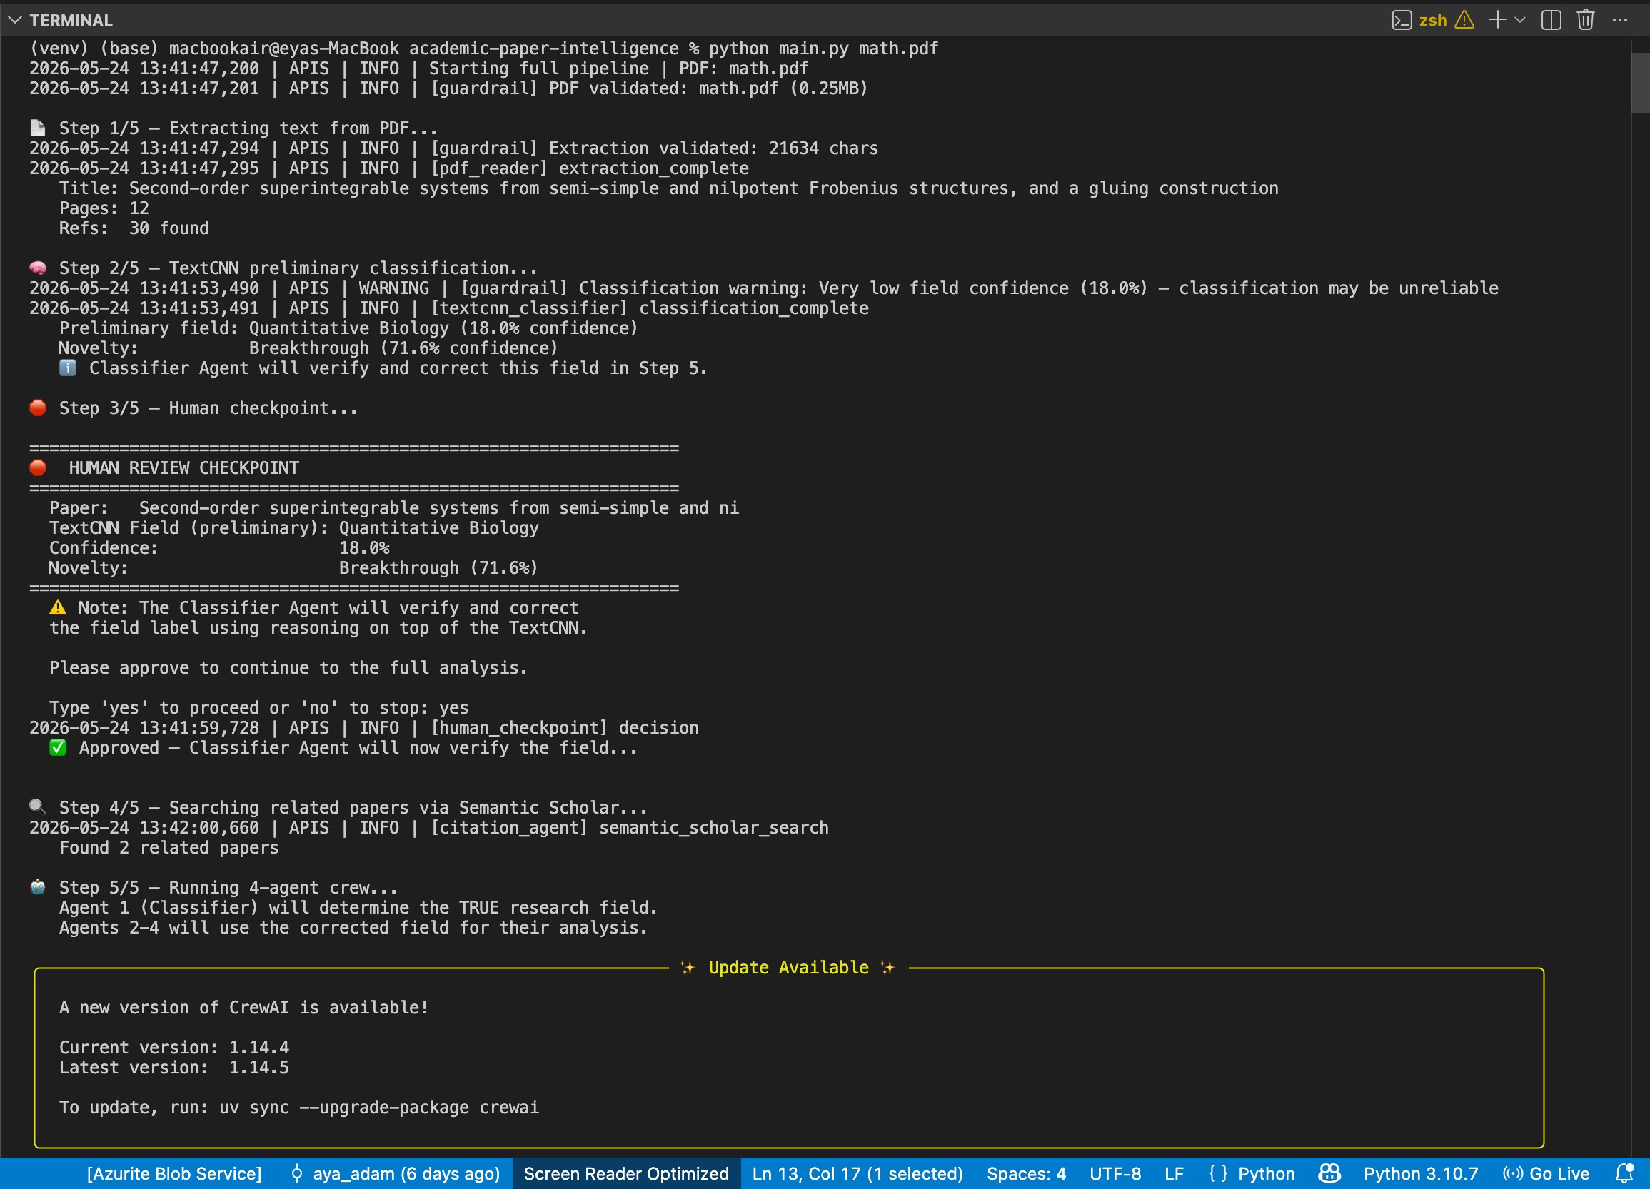
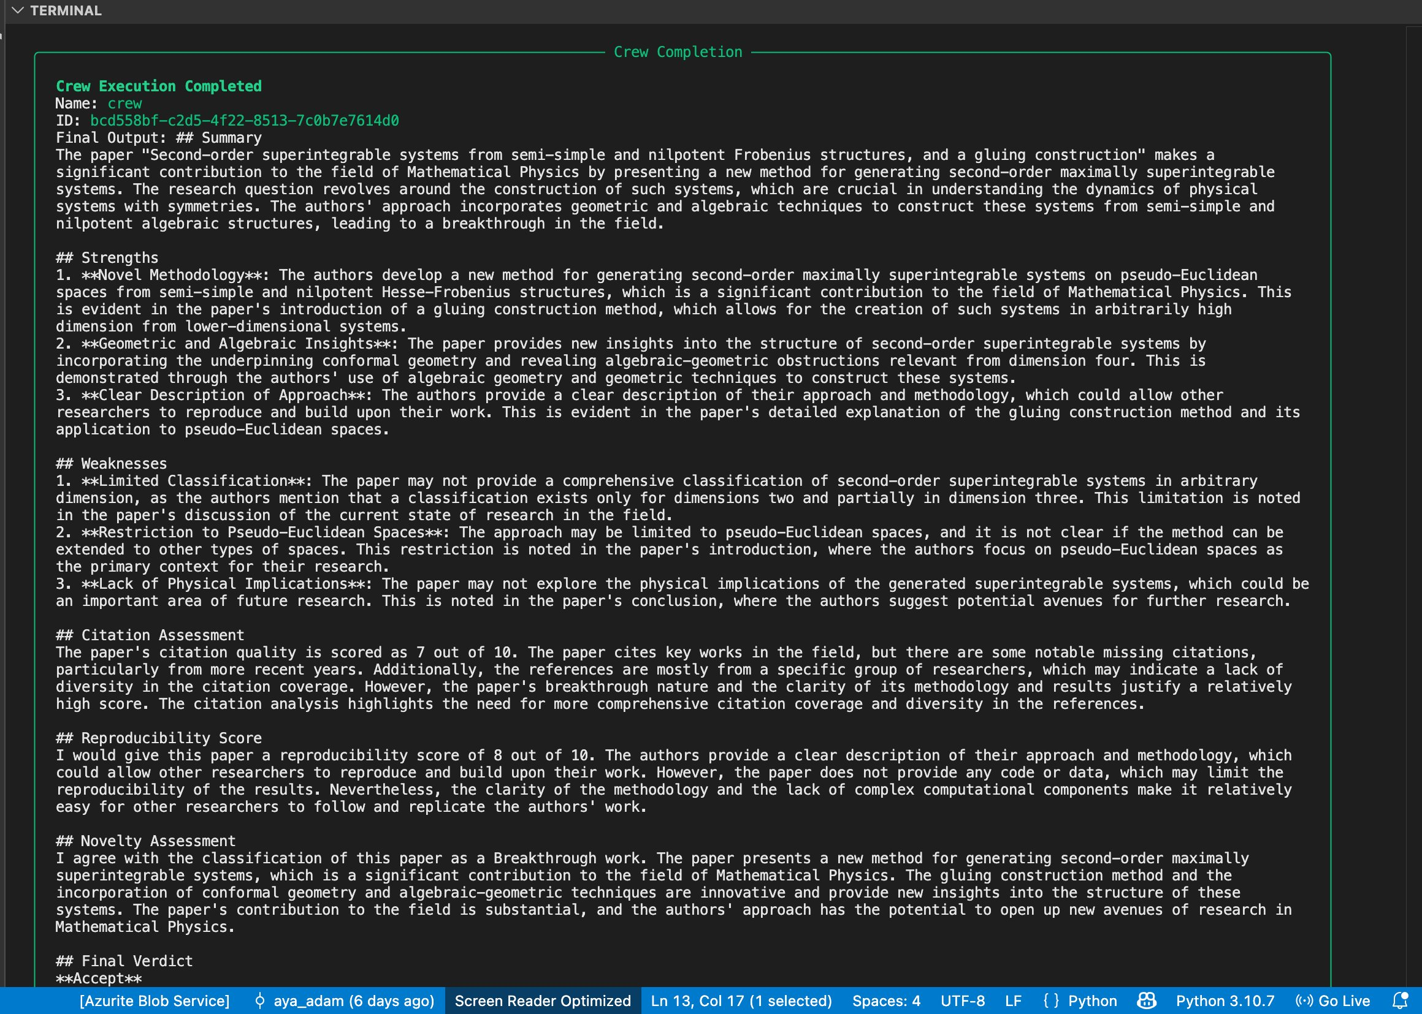
06 — SYSTEM IN ACTION
Running on a real paper.
Watch what happens.
arXiv 2601.01978 — Mathematical Physics paper about superintegrable systems
→ TextCNN: 18% confidence → guardrail fires → HITL required before continuing
→ Agent 1 overrides: Quantitative Biology → Mathematical Physics
7 / 10
→ Pipeline complete: Field = Mathematical Physics · Verdict = Accept · Citation 7/10
Notes:
SAY THIS: "Let me show you the system actually running. This is a real Mathematical Physics paper from arXiv. The left screenshot shows the pipeline running in the terminal. Notice step 2 — the TextCNN classified it as Quantitative Biology with only 18% confidence. That triggered our guardrail automatically. The system flagged it for human review before continuing. After I typed yes to approve, the agents ran. Agent 1 immediately corrected the field to Mathematical Physics by reading the abstract. The right screenshot shows the pipeline completing successfully. Field: Mathematical Physics. Final verdict: Accept. Citation score: 7 out of 10. Reproducibility: 8 out of 10. The complete peer review was saved to the outputs folder."

Slide 8

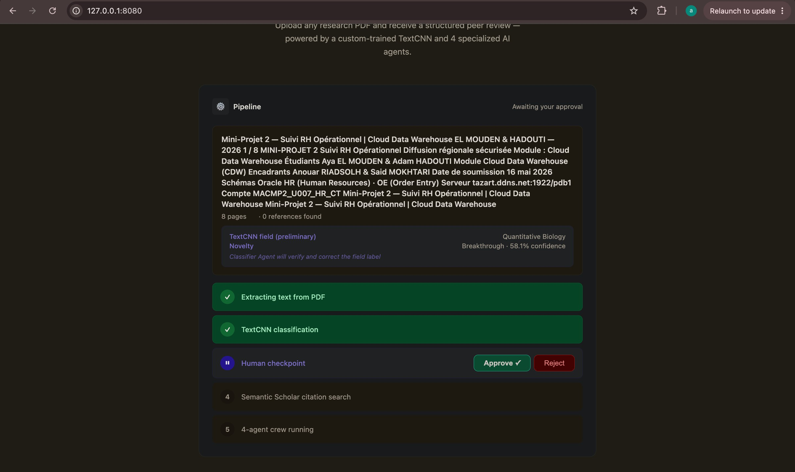
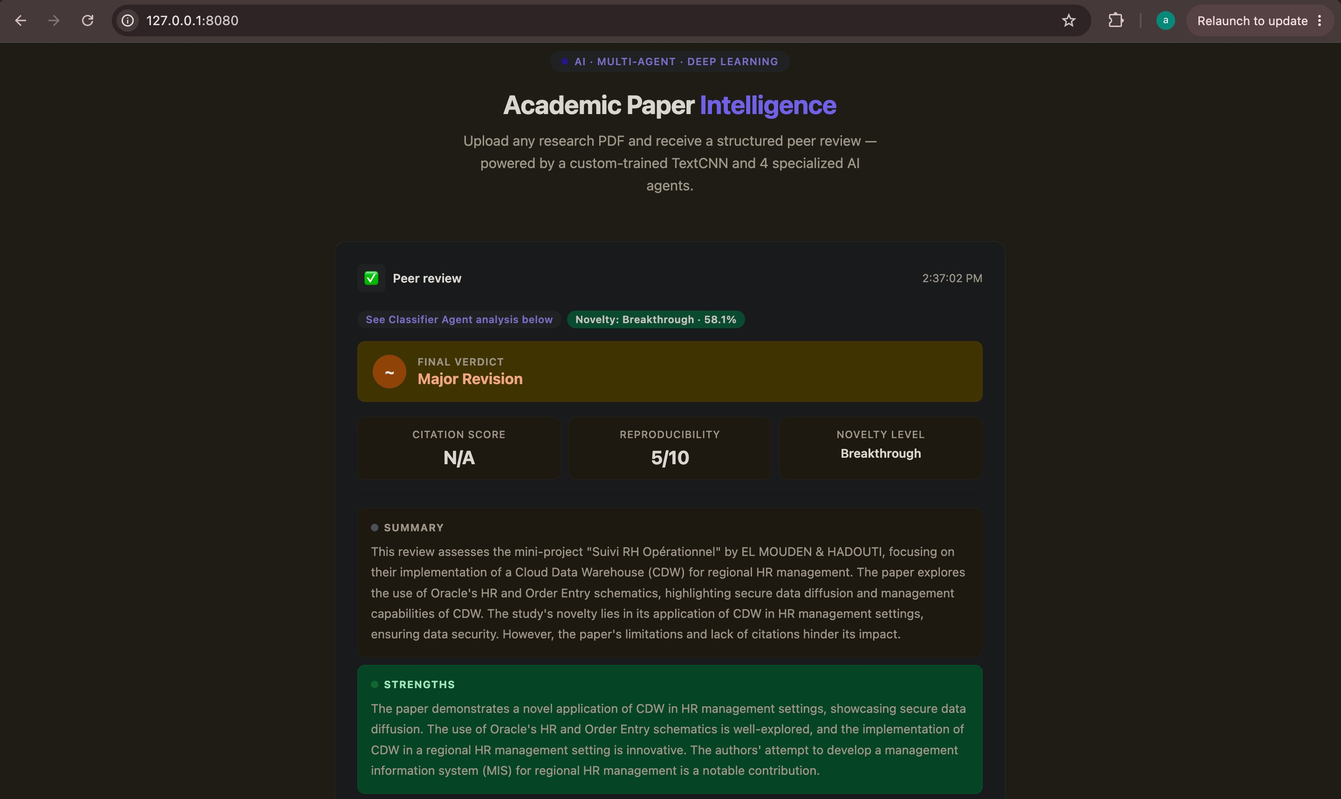
07 — WEB INTERFACE
We also built a browser interface.
Drag, drop, approve, done.
Upload page — drag and drop any PDF
HITL — Approve/Reject buttons in browser
Results — verdict, scores, full review
— Flask + Python:
The web server is built with Flask — a Python library. It runs locally at port 8080.
— Background threads:
The pipeline runs in a separate thread so the browser stays responsive.
— Polling every 1.5s:
The browser asks the server for updates every 1.5 seconds to show live progress.
— Download buttons:
At the end you can download the JSON data or the formatted Markdown report.
8 / 10
Notes:
SAY THIS: "In addition to the command line, we built a web interface using Flask — a Python web framework. The first screenshot shows the upload page — you drag and drop any PDF. The second shows the pipeline progress with the human checkpoint — instead of typing yes in a terminal, you click an Approve button in the browser. The third shows the results dashboard — the verdict displayed prominently, citation score, reproducibility score, and the full review text with download buttons. The web server runs the pipeline in a background thread so the page stays responsive. The browser polls for updates every 1.5 seconds to show real-time progress. This demonstrates that the system is production-ready, not just a terminal script."

Slide 9
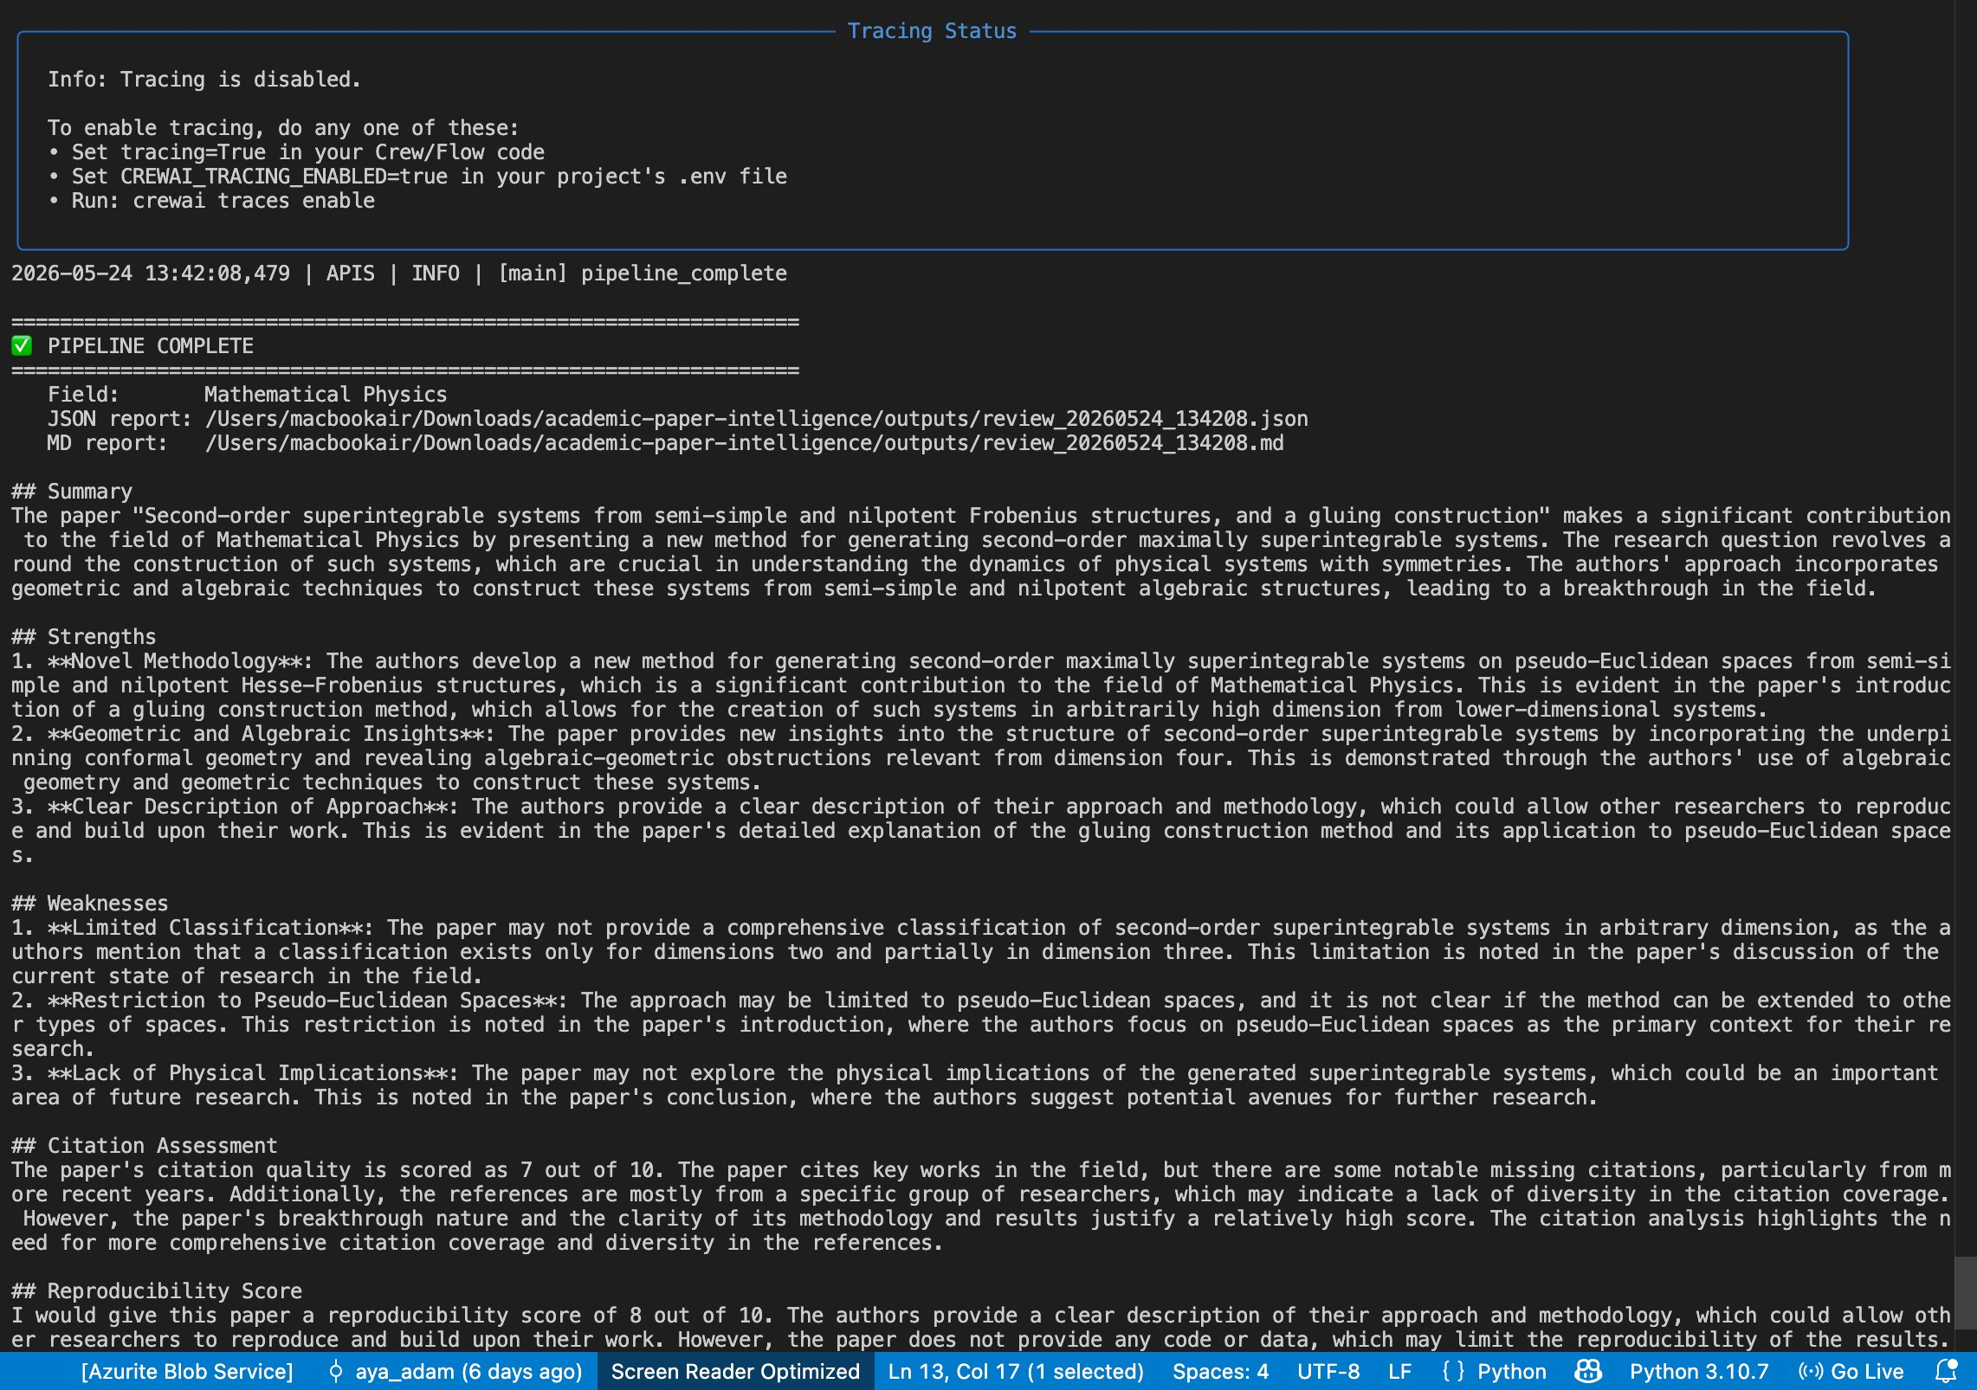
08 — EVALUATION & ROBUSTNESS
All 6 edge case tests pass.
The system never crashes.
5 Guardrails
PDF check
File exists · .pdf · 0.01–50MB
Extraction
Abstract >50 chars · text >200 chars
Confidence
Below 35% → automatic HITL forced
Sanitize
Remove nulls · collapse spaces · truncate
Retry
test_edge_cases.py — all 6 tests passing (missing file, wrong type, sanitization, truncation, empty, gibberish)
Rate limit hit? Wait and try again 3x
9 / 10
Notes:
SAY THIS: "We also tested the system against failure cases. The file test_edge_cases.py has 6 tests — all pass. Test 1: what if the PDF file doesn't exist? Caught cleanly. Test 2: what if you upload a .txt file instead of PDF? Caught. Tests 3 and 4: text sanitization and truncation working correctly. Tests 5 and 6: the classifier handles empty or gibberish input without crashing. On the right are our five guardrails — protection layers built into tools/guardrails.py. They validate the PDF before processing, check the extraction quality, force human review when confidence is too low, clean the text before sending to the LLM, and retry automatically when Groq's rate limit is hit. The system never crashes. It either succeeds or gives a clear error message."

Slide 10
09 — CONCLUSION
FUTURE WORK
Every component
exists for a reason.
— Fine-tune novelty with human annotations
— OCR for scanned PDFs
— Multilingual support (French, Arabic)
— Public web deployment
Every agent has a job.
We can explain every line of code.
GITHUB
github.com/ayamouden999-bot/
academic-paper-intelligence
TextCNN
Built from scratch · 4M+ params · 85%+ accuracy · dual output
4 Agents
Real collaboration · sequential pipeline · context passing
HITL
Meaningful checkpoint · blocks on low confidence · not cosmetic
Thank you.
Guardrails
5 protection layers · never crashes · retry logic
Web + Colab
Flask UI · Colab notebook for zero local setup
Questions?
Notes:
SAY THIS: "To summarize what we built. A TextCNN we designed, coded, and trained from scratch — 4 million parameters, 85% accuracy, dual output. Four agents that genuinely collaborate — each has one job and passes its output to the next. A human-in-the-loop checkpoint that is meaningfully placed — not cosmetic. Five guardrails that prevent crashes. A web interface and a Colab notebook so the system is accessible without local setup. Every component exists for a reason. Every agent has a job. We can explain every line of code. Thank you. We are happy to answer any questions."

