Slide 1
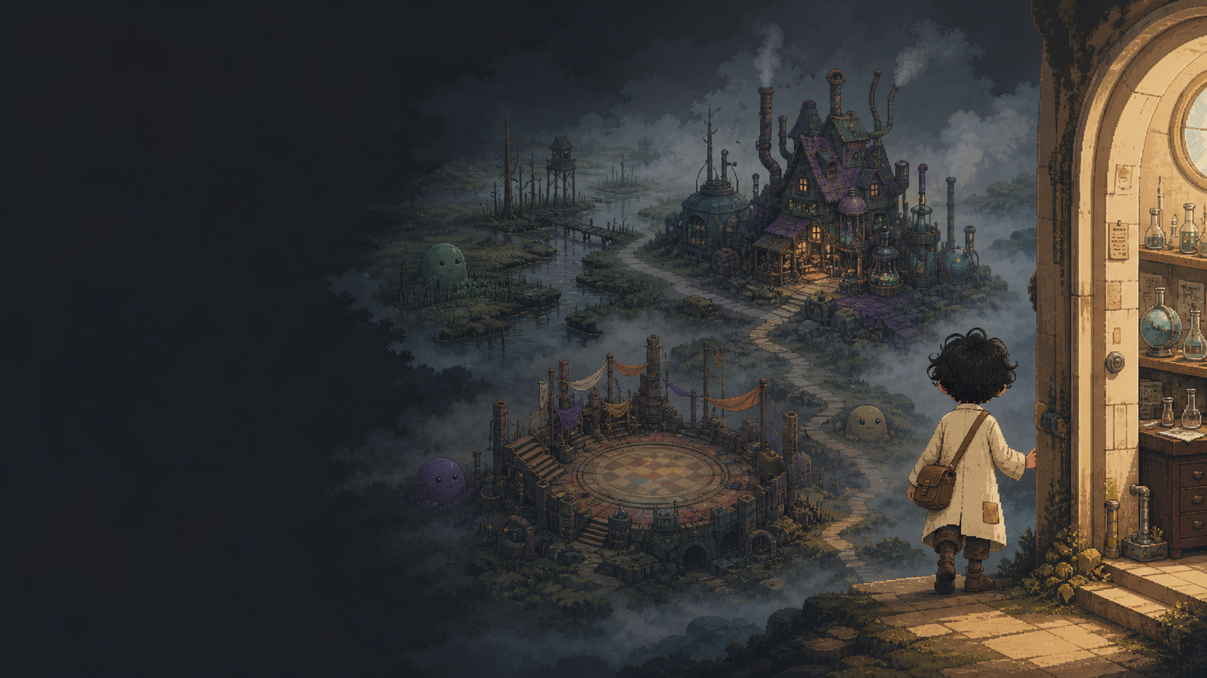
UDYAAN
A playable layer
for the idea-to-business course
Course Design Proposal
Version 1.0 · August 2026
The world can be weird. The learning must stay real.

Slide 2
COURSE DESIGN PROPOSAL
UDYAAN / PLAYABLE COURSE LAYER
The playable layer makes real course work easier to start and continue
A serious course experience with a strange, motivating world around it.
Map-based course layer
Shows current phase and next action
Calm lesson mode
Protects reading, practice, and focus
Real-world missions
Moves students into customer-facing work
Evidence-based progression
Unlocks progress through artifacts and reflection
Pilot approach
Tests one complete vertical slice first
02

Slide 3
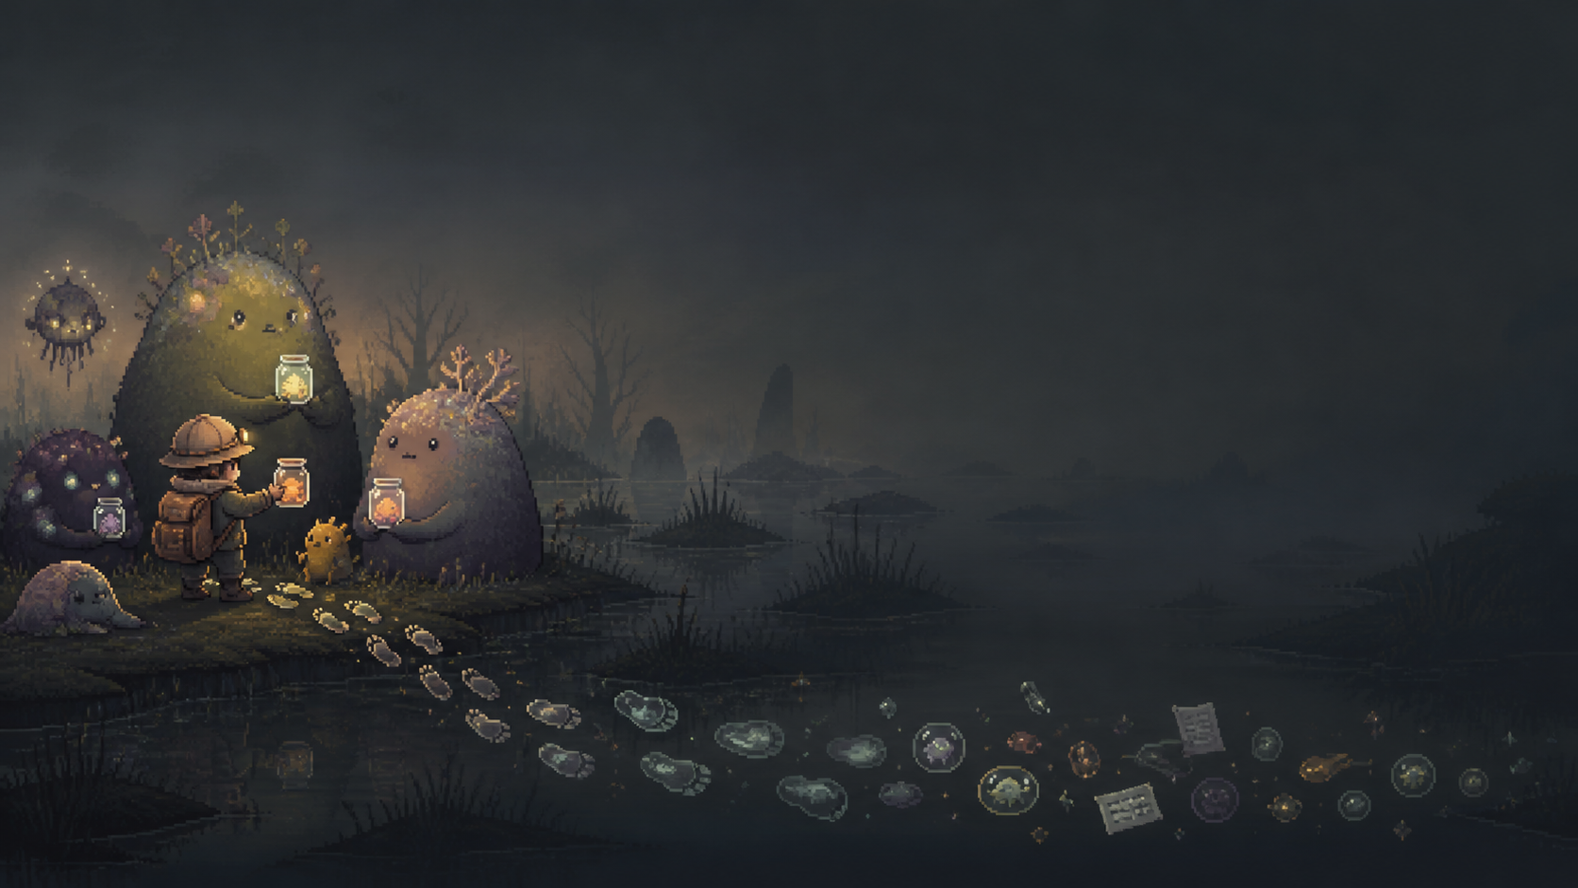
THE STUDENT PROBLEM
UDYAAN / PLAYABLE COURSE LAYER
Students understand lessons and still avoid the work that creates learning
Unclear orientation
Students cannot identify the next meaningful action.
Action avoidance
Conversations and outreach feel socially risky.
Rejection sensitivity
A “no” is interpreted as a verdict, not information.
Invisible progress
Work feels disconnected and repetitive.
Weak reflection
Feedback is collected without a next decision.
03

Slide 4
THE PROPOSED SYSTEM
UDYAAN / PLAYABLE COURSE LAYER
The game frames the work, then sends students back into reality
Map node
Calm lesson
Guided practice
Real mission
Evidence
Reflection
Next decision
Progress depends on real action and usable evidence. Decorative clicks do not count.
04

Slide 5
THE LEARNING CASE
UDYAAN / PLAYABLE COURSE LAYER
The layer earns its place through four learning behaviours
Orientation
Momentum
Emotional safety
Social energy
Identify current phase, next action, and expected submission.
Begin difficult work with a clear mission and completion rule.
Interpret rejection and confusion as evidence.
See meaningful cohort progress and contribute to peers.
MAP SIGNAL
MISSION
DATA, NOT DEFEAT
TEAM PULSE
05

Slide 6
CURRICULUM ARCHITECTURE
UDYAAN / PLAYABLE COURSE LAYER
Every course phase becomes a visible action, artifact, and decision
Proposed first-iteration draft. Validate the 13 subphases and eight major artifacts against course material.
Region
Student action
Evidence / artifact
Feedback question
Unlock
Foglands
Customer conversations
Notes + observations
What pattern appeared?
Problem hypothesis
Foglands
Synthesize findings
Pattern summary
Is the problem specific?
Evidence standard met
Workshop
Build the offer
Offer / sales kit
Can a person understand it?
Field-ready offer
Chaos Arena
Test through outreach
Response log
What did reality say?
Next action selected
Chaos Arena
Revise and retry
Iteration record
What changes now?
Region progress
06

Slide 7
REGION 01 / FOGLANDS
UDYAAN / PLAYABLE COURSE LAYER
Foglands helps students identify a problem outside their imagination
Learning objective
Separate assumptions from observed customer problems.
Student actions
Choose a customer group, conduct conversations, record language and patterns.
Artifacts
Conversation notes, observation log, pattern summary, problem hypothesis.
Mission example
Five customer conversations with relevant people.
Completion
Five attempts, useful notes, and a sharper hypothesis.
07

Slide 8
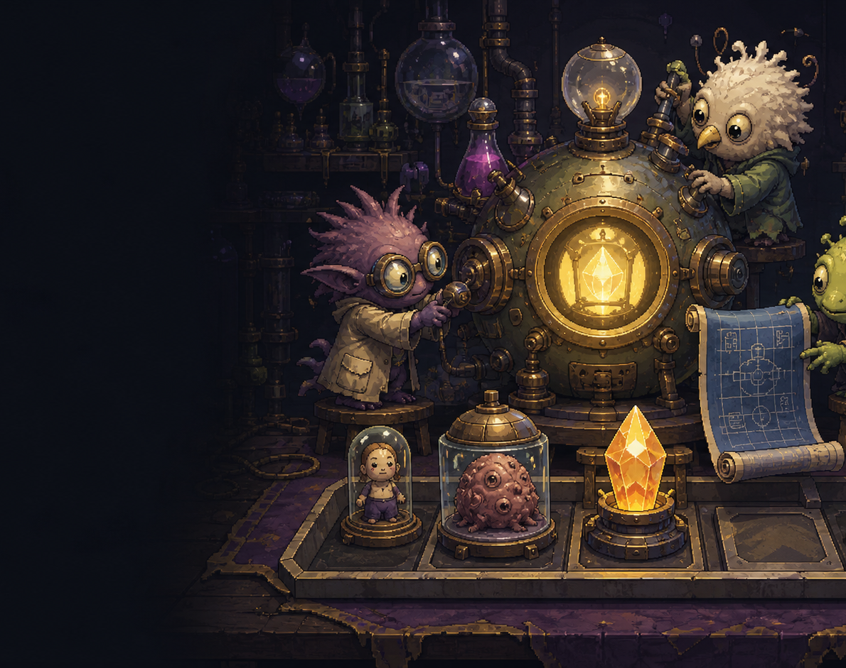
REGION 02 / SUPERWEAPON WORKSHOP
UDYAAN / PLAYABLE COURSE LAYER
The Workshop turns evidence into an offer specific enough to test
Inputs
Customer · documented problem · desired result · promise · delivery · price logic
Major artifact
Field-ready offer and sales kit
Feedback question
Can a real person understand who it is for, what changes, and what happens next?
Completion
Offer is specific enough for outreach and testing.
Guardrail
Visual polish never substitutes for a clear value proposition.
08

Slide 9
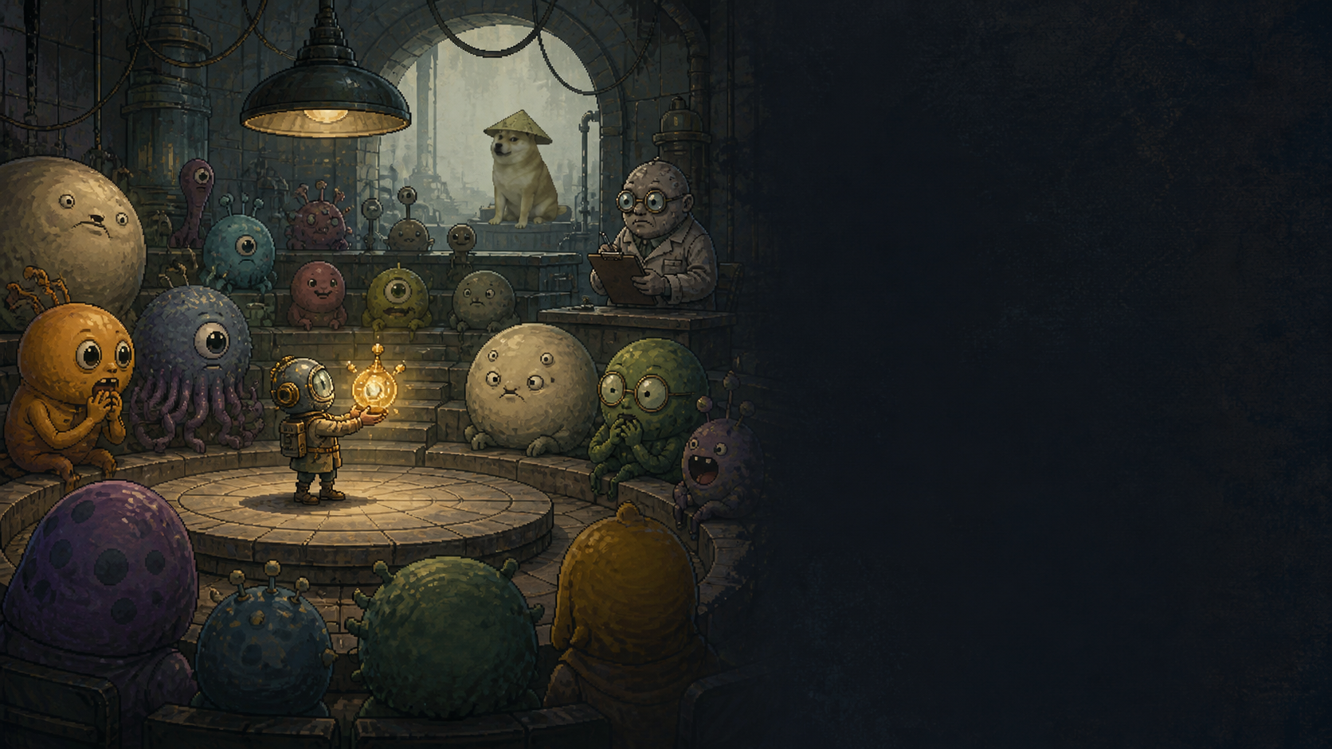
REGION 03 / CHAOS ARENA
UDYAAN / PLAYABLE COURSE LAYER
The Chaos Arena converts market response into the next decision
Student actions
Outreach, present the offer, log response, classify signals, decide what changes.
Artifacts
Outreach log, objection / signal record, revised offer or next-action decision.
Response types
Interest · confusion · objection · no response · rejection · commitment
Completion
A documented attempt plus a reasoned next decision.
Reward logic
Attempts, interpretation, and iteration receive credit.
09

Slide 10
CALM MODE
UDYAAN / PLAYABLE COURSE LAYER
The lesson view keeps the course readable when concentration matters
What counts as a real problem?
The map creates momentum. The lesson screen creates concentration.
Lesson objective
Identify a specific problem experienced by a defined group, using observed language and behaviour.
Practice prompt: write the strongest pattern from your conversations.
No character animation enters the core reading and practice area.
START REAL-WORLD MISSION
10

Slide 11
PROGRESSION SYSTEM
UDYAAN / PLAYABLE COURSE LAYER
Progress is earned through evidence, reflection, and the next decision
Student completes
System captures
Student receives
Progress change
Mission
Evidence or artifact
Feedback prompt / review
Node state changes
Reflection
Interpretation of result
Next-decision guidance
Next node revealed
Iteration
Revised offer or plan
Recognition / reward
Region progress advances
Peer support
Useful collaboration
Team recognition
Contribution recorded
Validated progress = action + reviewed evidence + reflection + iteration. Visual rewards remain cosmetic.
11

Slide 12
PROPOSED REWARD & SOCIAL SYSTEMS
UDYAAN / PLAYABLE COURSE LAYER
Proposed reward and social systems make persistence visible
Map unlocks
Verified milestones
Cosmetic rewards
Consistent action and recovery
Team recognition
Useful peer support
Leaderboard
Evidence, action, reflection, iteration
Surprise events
Completion moments
EXAMPLE: “SKIBIDI TOILET ATTACK” = RARE EVENT
12

Slide 13
PROPOSED FIRST VERTICAL SLICE
UDYAAN / PLAYABLE COURSE LAYER
One complete Foglands loop can test whether the layer adds value
Included in the proposed slice
Decision enabled
• Map region and selected nodes
Does the playable layer improve action and evidence enough to justify expansion?
• Calm lesson screen
• Guided practice
• Customer-conversation mission
• Evidence submission
• Reflection prompt
Excluded for now: full world, complex combat, advanced leaderboard, automated scoring, broad infrastructure.
• Progress update and one reward moment
• Basic cohort visibility
13

Slide 14
PRODUCTION MODEL
UDYAAN / PLAYABLE COURSE LAYER
A small cross-disciplinary course lab can build the first slice
Workstream
Output
Validation
Course design
Node objectives, mission briefs, artifact standards
Curriculum owner
Interaction design
Progress states, feedback loop, reward rules
Learning-design review
Visual design + animation
Map, characters, UI, transitions
Design review
Engineering
Functional slice and evidence flow
Technical review
Testing / research
Student sessions and findings
Pilot lead
Status each resource as: confirmed · to confirm · required for expansion.
14

Slide 15
PILOT EVALUATION
UDYAAN / PLAYABLE COURSE LAYER
The pilot is judged by student behaviour, not visual novelty
PLAYFUL MAP
MORE ACTION
MORE EVIDENCE
BETTER DECISIONS
Orientation
Where am I, what is next, what must I submit?
Action
Do students complete the real-world mission?
Evidence
Are artifacts specific, grounded, and usable?
Reflection
Can students explain what changed?
Iteration
Do next actions change after feedback?
Persistence
Do students return after rejection?
15

Slide 16
DECISION REQUEST
Approve the specification
and the Foglands vertical slice
1
Confirm the detailed course mapping.
2
Confirm available people and time.
3
Approve Foglands as the first slice.
4
Agree the pilot cohort, timeline, and evidence-review process.
5
Review results before expansion.
Build the smallest strange world that proves students do better real work inside it.

