Slide 1
📄
DocuTrack
Document Tracking & Management System
A comprehensive DSA-powered console application in Java
Java SE 21 • Console Application • 6 CO Modules • 20+ DSA Implementations

Slide 2
Project Overview
DocuTrack is a Java SE 21 console application that demonstrates the practical application of Data Structures & Algorithms to a real-world document management problem.
CO | Focus Area | Data Structures & Algorithms
CO1 | Document Indexing | BST, AVL Tree
CO2 | Analytics | Fenwick Tree, Segment Tree, B-Tree, B+ Tree
CO3 | Document Network | Graph (Adjacency List), BFS, DFS, MST
CO4 | Path Optimization | Dijkstra, Bellman-Ford, Floyd-Warshall, Topological Sort
CO5 | Sorting & Ranking | Merge Sort, Quick Sort, Heap Sort, Radix Sort
CO6 | Storage Optimization | Activity Selection, Fractional Knapsack, 0/1 Knapsack, LIS
🔑 All modules share a single, unified document pool — inserting in BST makes data available to Graph, Path, Analytics, and all COs.

Slide 3
Project Structure & Data Model
DocuTrack/src/ ├── app/Main.java ← Entry point & menus ├── models/Document.java ← Core data model └── modules/ ├── indexing/bst/ (BST, BSTNode) ├── indexing/avl/ (AVLTree, AVLNode) ├── analytics/ (Fenwick, Segment, BTree, B+Tree) ├── graph/ (Graph, BFS, DFS, MST) ├── path/ (Dijkstra, BellmanFord, FloydWarshall, TopologicalSort) ├── sorting/ (MergeSort, QuickSort, HeapSort, RadixSort) └── optimization/ (ActivitySelection, FractionalKnapsack, Knapsack01, LIS)
models.Document
Fields:
• documentId : int
• title : String
• author : String
Methods:
• Document(id, title, author)
• toString()
Output Format:
"ID: 101, Title: Report Q1,
Author: Alice"
Authentication & Roles
Admin (admin / admin123) → Full access to all 6 CO modules + document CRUD | User (user / user123) → Read-only: Search & View documents only

Slide 4
CO1
Document Indexing — BST & AVL Tree
Binary Search Tree (BST)
AVL Tree (Self-Balancing BST)
Classes: BST.java, BSTNode.java
Insert — O(h) iterative walk-down
Search — O(h) iterative lookup
Delete — 3 cases: leaf, one child, two children
→ Two children uses in-order predecessor
Traversals: Inorder, Preorder, Postorder
Min / Max — leftmost / rightmost node
Menu: Insert, Search, Delete, Inorder,
Minimum, Maximum, Back
Classes: AVLTree.java, AVLNode.java
Insert — O(log n) recursive + rotations
Search — O(log n) recursive lookup
Guarantees balanced tree (height tracked)
Rotation Cases:
LL → Right Rotate
RR → Left Rotate
LR → Left Rotate child, then Right Rotate
RL → Right Rotate child, then Left Rotate
Menu: Insert, Search, Inorder, Back

Slide 5
CO2
Analytics — Fenwick, Segment, B-Tree, B+ Tree
Fenwick Tree (BIT)
Segment Tree
Point update + Prefix sum
update(i, v) — O(log n)
sum(i) — O(log n)
rangeSum(l, r)
Use: Cumulative doc access counts
Range sum queries — O(log n)
build() — O(n)
query(node, s, e, l, r)
Use: Sum of doc IDs in a range
e.g. "Total IDs from index 2–5"
B-Tree
B+ Tree
Multi-level key storage
insert(key) — recursive
display() — inorder traversal
Stores document IDs as keys
Use: Demonstrate multi-level indexing
Range search over doc IDs
insert(key)
rangeSearch(start, end)
Use: Find all doc IDs in [100, 200]
Sequential scan of stored data

Slide 6
CO3
Document Network — Graph, BFS, DFS, MST
Graph (Adjacency List)
Traversals & MST
Undirected graph — each vertex = document
addEdge(src, dst) — bidirectional
resize(n) — grows/shrinks with doc pool
removeVertex(v) — removes + re-indexes
display() — prints adjacency list
displayDocuments() — with titles
Menu: View Docs, Add Relationship,
Display Graph, BFS, DFS, MST, Back
BFS (Breadth-First Search):
• Queue-based level-order traversal
• Visits all reachable vertices
• Complexity: O(V + E)
DFS (Depth-First Search):
• Recursive depth exploration
• Uses boolean[] visited array
• Complexity: O(V + E)
MST (Minimum Spanning Tree):
• Placeholder demonstration
• Infrastructure ready for Prim/Kruskal

Slide 7
CO4
Path Optimization — Shortest Path Algorithms
Dijkstra
Bellman-Ford
Single-source shortest path (greedy)
Input: cost[][], source, destination
Output: min cost + full path
Tracks parent[] for path reconstruction
Complexity: O(V²)
Single-source (handles negatives)
Input: cost[][], source
Output: distances to ALL vertices
V-1 relaxation iterations
Complexity: O(V³) with matrix
Floyd-Warshall
Topological Sort
All-pairs shortest path (DP)
Input: cost[][]
Output: full N×N distance matrix
Triple nested loop via intermediate k
Complexity: O(V³)
DFS-based linear ordering (DAG)
Input: cost[][] as directed graph
Output: ordered vertex sequence
Uses Stack for reverse post-order
Complexity: O(V + E)

Slide 8
CO5
Sorting & Ranking — 4 Sorting Algorithms
Algorithm | Sorts By | Stable? | Avg Time | Technique
Merge Sort | Document ID | ✅ Yes | O(n log n) | Divide & Conquer
Quick Sort | Title (A-Z) | ❌ No | O(n log n) | Partition-based
Heap Sort | Author (A-Z) | ❌ No | O(n log n) | Max-Heap
Radix Sort | Document ID | ✅ Yes | O(d × n) | Non-comparative (LSD)
All algorithms operate on a COPY of the document list — original data is never modified.
Merge Sort — Classic divide-and-conquer: split, recurse, merge by documentId comparison.
Quick Sort — Lomuto partition using title.toLowerCase().compareTo() as comparator.
Heap Sort — Builds max-heap using author.compareToIgnoreCase(), then extracts max iteratively.
Radix Sort — LSD (Least Significant Digit) approach with counting sort per digit position.

Slide 9
CO6
Storage Optimization — Greedy & DP
Activity Selection (Greedy)
Fractional Knapsack (Greedy)
Input: documents + start/finish times
Selects non-overlapping activities
Sorted by finish time (greedy choice)
Use: Schedule doc review sessions
Input: docs + value/weight + capacity
Picks by value-to-weight ratio
Can take fractional portions
Use: Partial storage allocation
0/1 Knapsack (DP)
LIS — Longest Increasing Subseq (DP)
Input: docs + value/weight + capacity
DP table: dp[i][w] = max value
Backtrack to find selected docs
Use: Optimal subset selection
Input: array of document IDs
Classic O(n²) DP approach
Tracks parent[] for reconstruction
Use: Find increasing ID pattern

Slide 10
CO1 Deep Dive
Indexing Algorithm Implementation
Data Handling & Document Mapping
The models.Document objects are explicitly wrapped inside BSTNode and AVLNode. The algorithms route strictly on document.documentId as the primary numeric key. When addSharedDocument(doc) triggers, it cascades the insert sequentially to bst.insert(doc) and avl.insert(doc).
Algorithm Logic Implementation
BST Logic: The insert algorithm performs an O(h) iterative walk-down, comparing document IDs, and instantiates a new BSTNode containing the exact Document reference in memory.
AVL Logic: Similar to BST, but explicitly tracks subtree heights. On insertion, getBalance() checks for violations (>1 or <-1) and automatically triggers LL, RR, LR, or RL rotations to guarantee O(log n) tree shape.
Retrieval: Searching traverses the numeric IDs. Upon finding a match, the algorithm returns the literal Document object reference, enabling O(1) attribute access without duplicating data.

Slide 11
CO2 Deep Dive
Analytics Trees Processing Logic
Data Handling & Document Mapping
Unlike the persistent indexing trees, the Analytics modules (Fenwick, Segment, B-Tree) map to the central documents ArrayList dynamically. They are reconstructed on-the-fly via build() methods to guarantee data consistency.
Algorithm Logic Implementation
Fenwick Tree (BIT): Iterates through documents using an implicit 1-indexed array. The update(i, val) function uses bitwise operations (i & -i) to add values to subsequent nodes, granting O(log n) prefix sums.
Segment Tree: Allocates a 1D tree[] array of size 4N. A recursive build(node, start, end) calculates the aggregate values (e.g. sums of document IDs) for localized segments of the document pool.
B+ Tree: Distributes keys across nodes with a set 'order'. The keys are explicitly documentIds. Leaf nodes retain an ArrayList<Integer> data buffer which enables direct linear rangeSearch(start, end) without recursing up the tree.

Slide 12
CO3 Deep Dive
Network Graph & Traversal Mapping
Data Handling & Document Mapping
The Graph maps relationships using an adjacency list ArrayList<Integer>[] adj. Crucially, the vertices are NOT the Documents themselves, but their integer indices (0 to N-1) inside the main documents array list.
Algorithm Logic Implementation
Dynamic Resizing: When a Document is appended globally, graph.resize(n) allocates a larger adjacency array, copying existing edges intact. Deletion triggers a complex re-indexing of all edges > deletedIndex.
BFS Execution: A standard Queue pushes the starting index, exploring immediate network neighbors in O(V+E). Discovered indices are passed back to documents.get(i) to print the associated Document Title.
DFS Execution: A recursive function passes a boolean[] visited array, driving deep into the network connections to map long-range document dependencies.

Slide 13
CO4 Deep Dive
Path Optimization Matrices
Data Handling & Document Mapping
The system maintains a 2D integer matrix routeCosts[u][v]. Similar to the Graph, 'u' and 'v' represent document array indices. Disconnected documents hold Dijkstra.INF (999999), and self-loops are explicitly 0.
Algorithm Logic Implementation
Matrix Scaling: resizeRouteCosts() triggers on new document creation. It allocates a new (N+1)x(N+1) array, copies prior routing costs, and sets all new row/col bounds to INF.
Dijkstra Logic: A greedy algorithm employing a boolean[] sptSet. It minimizes path costs by iterating the matrix, relaxing cost[u][v] if path(source..u) + cost(u..v) < current path(source..v).
Floyd-Warshall Logic: A dynamic programming triple-nested loop (k, i, j). It evaluates if routing document 'i' through an intermediate document 'k' to reach 'j' offers a cheaper total weight.

Slide 14
CO5 Deep Dive
Sorting & Ranking Data Handling
Data Handling & Document Mapping
To strictly prevent mutating or corrupting the global documents list order, all sorting algorithms generate a fresh, detached deep-copy Document[] array using getDocumentArray() before executing.
Algorithm Logic Implementation
Merge Sort: Recursively divides the array. Merges using standard numeric comparison on doc.documentId.
Quick Sort: Employs Lomuto partition scheme. Pivot element logic is driven purely by doc.title.toLowerCase().compareTo() for clean alphabetical title sorting.
Heap Sort: Transforms the cloned array into a Max-Heap structure using heapify(). The heap property is strictly dictated by doc.author.compareToIgnoreCase().
Radix Sort: Implements counting sort recursively for every digit position based on documentId, applying (id / exp) % 10 math for robust non-comparative sorting.

Slide 15
CO6 Deep Dive
Storage DP & Greedy Processing
Data Handling & Document Mapping
Storage algorithms map the generic document structures into isolated primitive integer arrays (weight[], value[], start[], finish[]) to efficiently perform intensive math without object overhead.
Algorithm Logic Implementation
Activity Selection: Binds start/finish arrays alongside a custom Integer[] index array. Sorting indices based on finish times allows an optimal greedy extraction of non-overlapping tasks.
0/1 Knapsack: Constructs a massive DP table dp[i][W]. If weight > capacity, it pulls dp[i-1][w]. Else, it calculates Math.max(val + dp[i-1][w-weight], dp[i-1][w]).
Backtracking (DP Reconstruction): Instead of just returning max value, 0/1 Knapsack loops backward from dp[n][W]. When the value shifts, it identifies the exact document chosen and prints it via documents.get(i-1).

Slide 16
Execution Flow
LOGIN
ROLE CHECK
ADMIN MENU
CO MODULE
SHARED DATA
admin/admin123 user/user123
Admin → Full User → View Only
CO1–CO6 Sub-menus
DSA Operations & Queries
documents, BST, AVL, Graph, Costs
Shared Data Architecture
addSharedDocument(doc):
1. Check duplicate ID → add to ArrayList
2. rebuildIndexes() → reconstruct BST + AVL
3. graph.resize() → expand adjacency list
4. resizeRouteCosts() → expand cost matrix
deleteSharedDocument(id):
1. Find & remove from ArrayList
2. rebuildIndexes() → reconstruct BST + AVL
3. graph.removeVertex() → remove & re-index edges
4. removeRouteCost() → shrink cost matrix
Static Fields in Main.java (single source of truth):
documents : ArrayList<Document> → master list
bst : BST → binary search tree index
avl : AVLTree → self-balancing tree index
graph : Graph → document relationship network
routeCosts : int[][] → weighted cost matrix

Slide 17
Complexity Analysis
Algorithm | Avg Time | Worst Time | Space
BST Insert/Search | O(log n) | O(n) | O(n)
AVL Insert/Search | O(log n) | O(log n) | O(n)
Fenwick Update/Query | O(log n) | O(log n) | O(n)
Segment Tree Query | O(log n) | O(log n) | O(4n)
BFS / DFS | O(V + E) | O(V + E) | O(V)
Dijkstra (matrix) | O(V²) | O(V²) | O(V)
Bellman-Ford | O(V³) | O(V³) | O(V)
Floyd-Warshall | O(V³) | O(V³) | O(V²)
Merge Sort | O(n log n) | O(n log n) | O(n)
Quick Sort | O(n log n) | O(n²) | O(log n)
Heap Sort | O(n log n) | O(n log n) | O(1)
Radix Sort | O(d × n) | O(d × n) | O(n)
0/1 Knapsack | O(n × W) | O(n × W) | O(n×W)
LIS | O(n²) | O(n²) | O(n)

Slide 18
How to Compile & Run
Command Line
> cd "E:\Apps\Java Projects\DocuTrack" > javac -d bin src/**/*.java > java -cp bin app.Main
IntelliJ IDEA
Prerequisites
1. Open "E:\Apps\Java Projects" as project
2. Mark DocuTrack/src as Source Root
3. Right-click Main.java → Run 'Main.main()'
4. Interact via the console terminal
• JDK 21 or higher
• javac & java on system PATH
• No external dependencies
• No build tool (Maven/Gradle) needed
• Pure Java SE — zero libraries

Slide 19
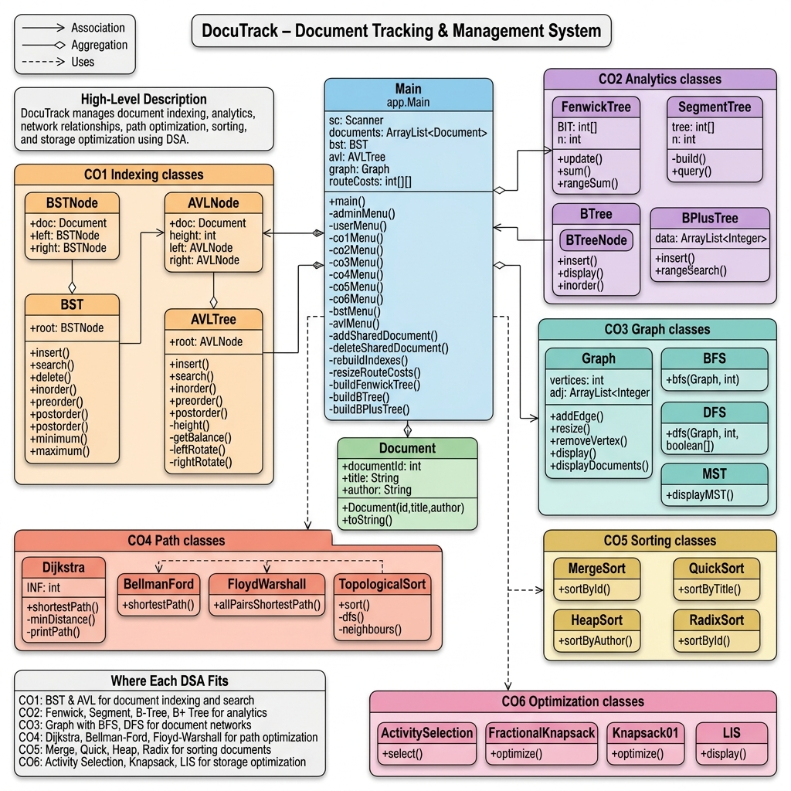
Class Diagram

Slide 20
✅
Thank You!
DocuTrack — Where Data Structures Meet Document Management
6 CO Modules • 20+ Algorithms • Java SE 21 • Console Application

