Slide 1
Module: Software Engineering
Project Title:
Investigate and Implement KNN Classifier
Presented by Team KNN
Ankush Laxman Patil - 1448072
Ayan Borthakur - 1455214
Nasir Ishaq - 1444979
Guided by Prof. Damir Dobric

Slide 2
Agenda
Problem Statement
Introduction
Working Principle of KNN
Design parameters of the KNN Algorithm
Building blocks of the model
KNN Model Construction and Unit Testing
Results
Conclusion

Slide 3
1. Problem Statement
Design the KNN Classifier that can work with the neocortex API and classify if the predicted sequence has a match or mismatch with the input sequence
Investigate the model with Unit Test

Slide 4
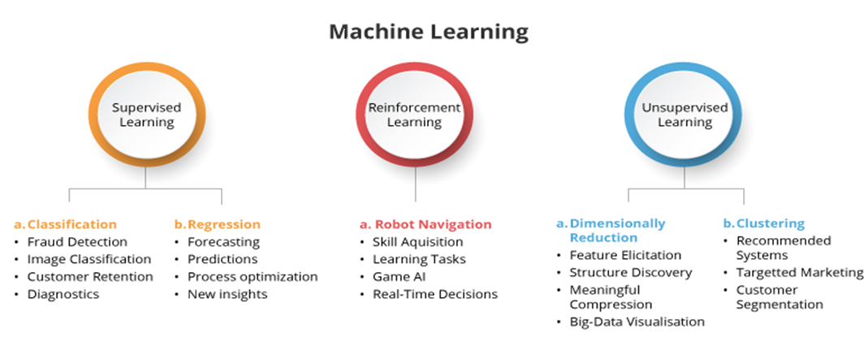
2. Introduction
Machine learning helps to create statistical models and algorithms that generate the "learn" method, which helps the computer in making predictions about the future based on data. Supervised learning, unsupervised learning, and reinforcement learning are the three main types of machine learning.
Figure 2.1 : Machine learning types and its applications

Slide 5
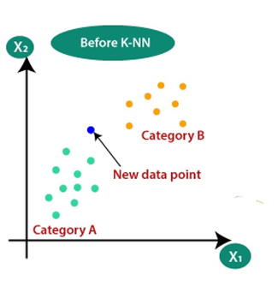
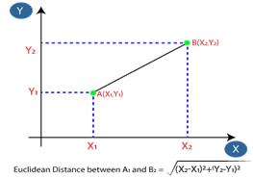
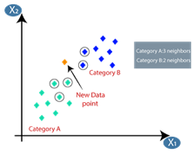
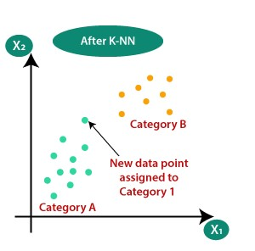
3. Working Principle of KNN
Step-1: Select the number K of the neighbors
Step-2: Distance calculation & distance matrix table
Figure. 1: Plotting the input data and select the value of k
Figure. 2: Euclidian Distance Calculation
Step-3:vote calculation for prediction of new point
Step 4: Predicting the category for new datapoint
Figure. 3: Voting Calculations based on labels
Figure. 4: Predicting the Output labels

Slide 6
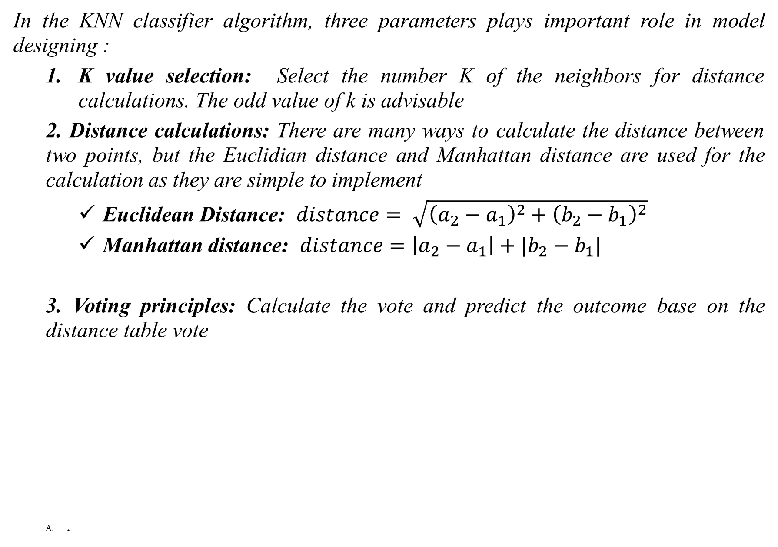
4. Design parameters of KNN Algorithm

Slide 7
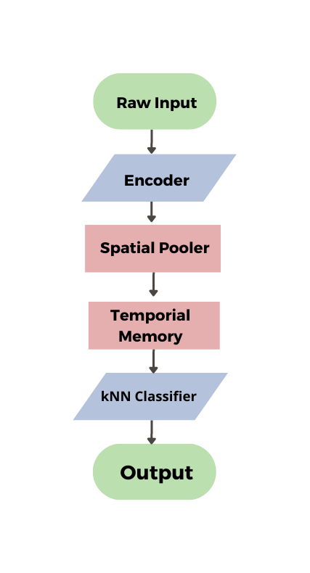
5. Building blocks of the model
Sequence of integer/float values
Sequence of integer/float values
Converts the Binary input patterns into sparse distributed representations
classifying if its matching or not matching with input sequence
Match or Mismatch!
Figure 3.1: Building blocks of the model

Slide 8
6. KNN Model Construction and Unit Testing
Learning
Prediction
Input
Check for other similar inputs
Include existing/add new
Input
Compare with Model
Get Similarities (Distance)
Calculate the similarities
Give the output
Figure. 6.1: KNN Learning Phase
Figure. 6.1: KNN Predicting Phase

Slide 9
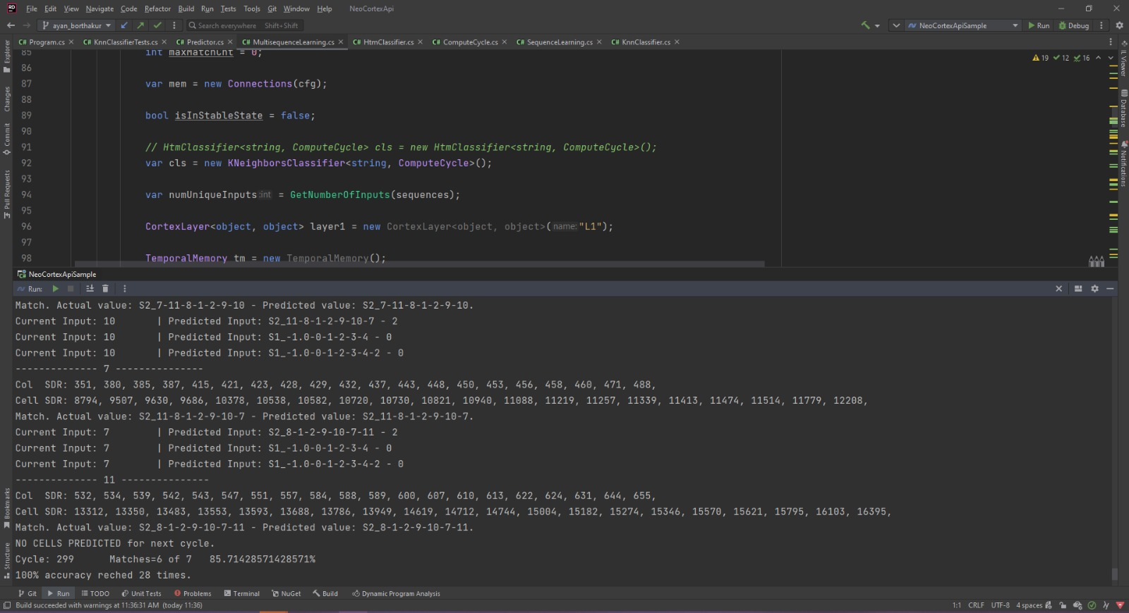
7. Results from Program.cs
Figure. 7.1: KNN Classification Output
The model takes in Input data from MultisequenceLearning and predicts the match if the output
sequence has match with input sequence or it will predict that it is not matching with input sequence.

Slide 10
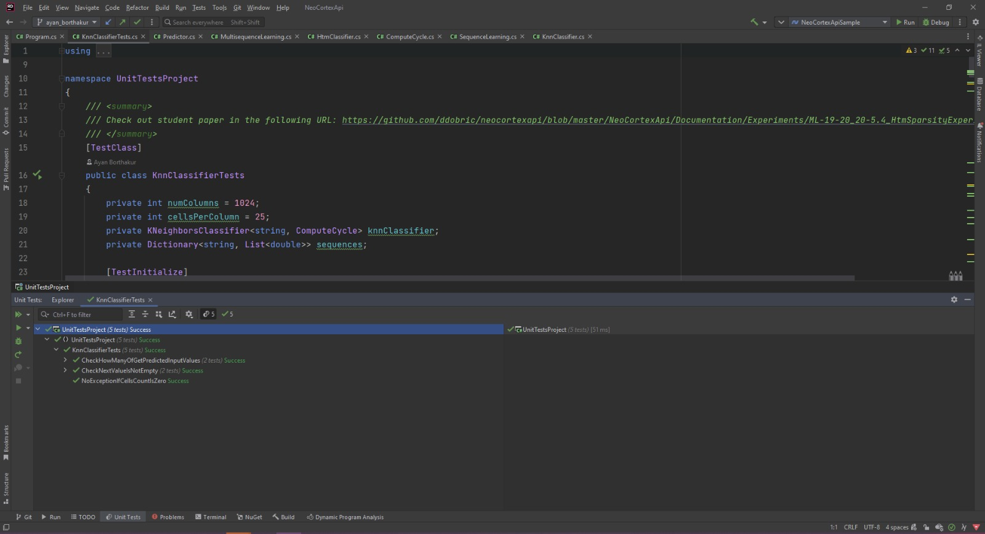
7. Results from Unit Test
Figure. 7.2: Unit Testing Of The KNN Algorithm
Unit tests have also been implemented to handle special cases. All the unit tests that have been implemented for the HTM Classifier were implemented for this classifier, and in the testing phase of the model we have not observed any occurrence of failed tests.

Slide 11
8. Conclusion
We started with the designing of the KNN prototype which was more generic and got the desired outcomes. Then based on the same model the KNN model is developed and then it is integrated with the Neocortex API. The model is successfully integrated and gets the stream of data sequences to predict the outcome. KNN classifier is classifying the output sequence as a match or mismatch with the input sequence. The model gives an accuracy of 100% in most of the input data sequences. Unit test is implemented to handle special cases. All the unit tests that have been implemented with reference to HTM Classifier and satisfactory results are achieved.

Slide 12
7. References
R.B.S. Aiman Moldagulova, “Using KNN Algorithm for Classification of Textual Documents,” in 8th International Conference on Information Technology(ICIT), 2017
D. Dobric, “Influence of Input Sparsity to Hierarchical Temporal Memory Spatial Pooler Noise Robustness” 2019
G. K. V. K. Eui-Hong(Sam) Han, “Text Categorization Using Weight Adjusted k-Nearest Neighbor Classification,” Department of Computer Science and Engineering University of Minnesota, USA, Minnesota, 1999
J. H. a. D. George, “Hierarchical Temporal Memory Concepts, Theory and Terminology,” Numenta, Redwood City, CA, USA
S. D. S. V. A. S. Kashvi Tanuk, “A Brief Review of Nearest Neighbor Algorithm for Learning and Classification,” in Proceedings of the International Conference on Intelligent Computing and Control Systems, 2019
X. L. Y. &. C. Z. Yu, “Weighted k-nearest Neighbor Algorithm based on Gaussian Kernel Function,” Journal of Ambient Intelligence and Humanized Computing, 11(5), 1985-1993

Slide 13
Thank You!

