Slide 1
DG INTERNS HUB · CYBERSECURITY INTERNSHIP
Week 6: Web Security Basics
OWASP Top 10, tools and prevention
Ayan Ansari · Intern ID DG/SEPTEMBER/CYBER/014

Slide 2
Why web security, and what is OWASP?
VAPT in one line
Vulnerability Assessment finds weak spots. Penetration Testing proves they can be used, only with permission. Together they let owners fix problems before attackers find them.
OWASP Top 10
A free list from the Open Worldwide Application Security Project of the most serious and common web risks, built from real data. Testers and developers use it as a shared checklist. This week covers four of them: SQL Injection, XSS, Broken Authentication and Security Misconfiguration.
Ayan Ansari · DG/SEPTEMBER/CYBER/014 · DG Interns Hub
2

Slide 3
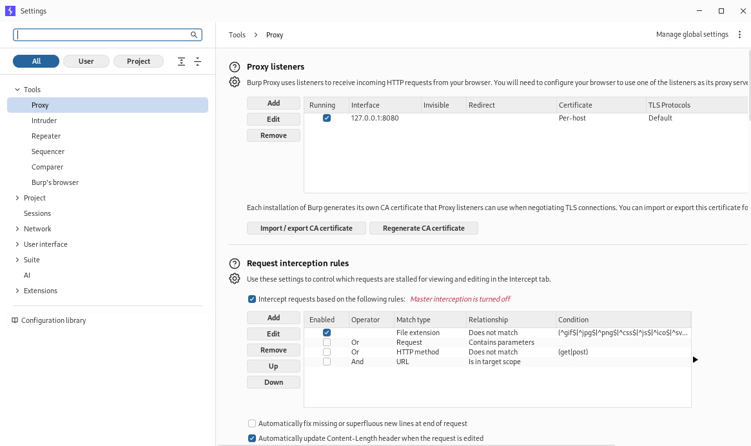
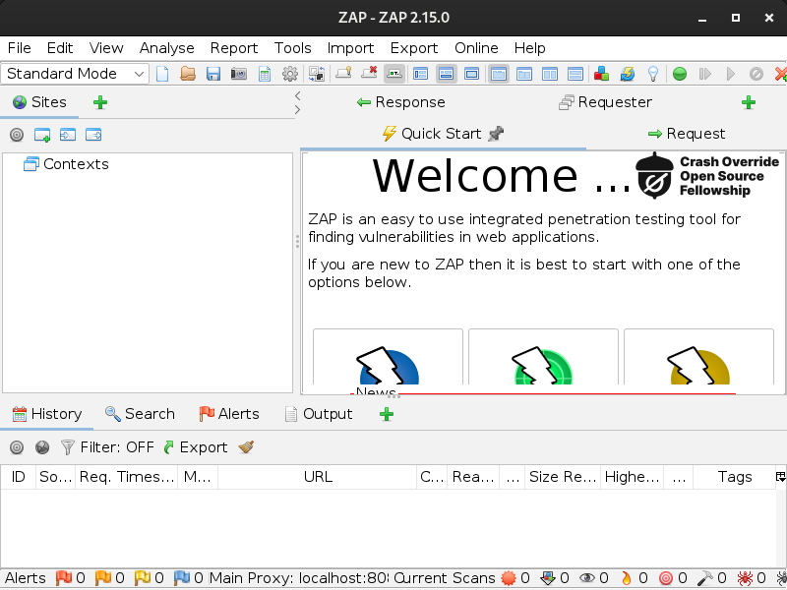
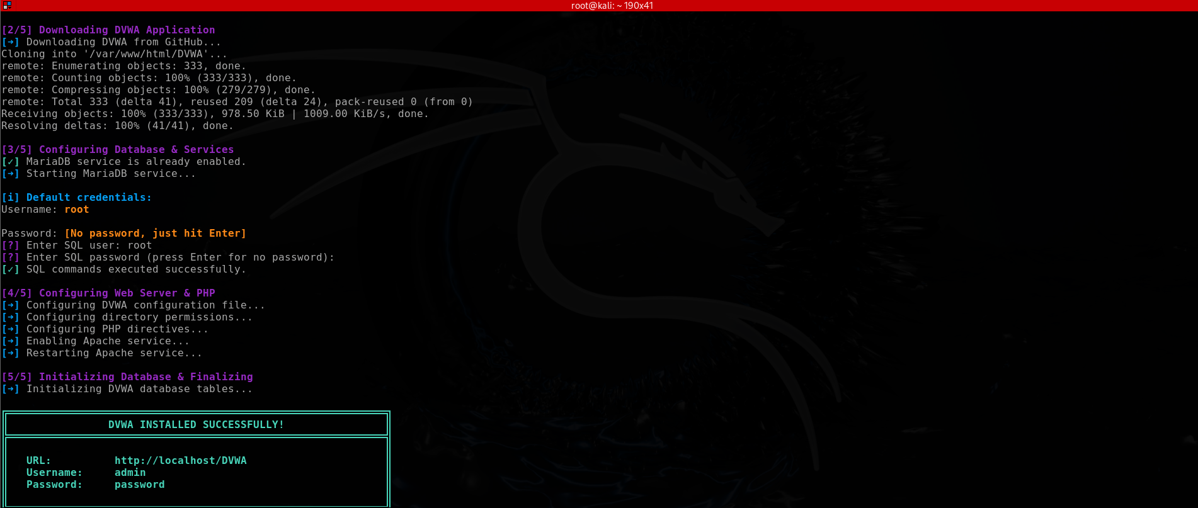
Tools set up
DVWA: a deliberately weak practice app, installed on my own machine only
Burp Suite: proxy listener on 127.0.0.1:8080
OWASP ZAP 2.15.0: scanner and proxy
Ayan Ansari · DG/SEPTEMBER/CYBER/014 · DG Interns Hub
3

Slide 4
SQL Injection
What it is
User input is mixed into a database question, so the database cannot tell data from commands. It is a flaw in the app, not in the database.
How it happens
The app builds queries by joining text. Any field, URL parameter or cookie that reaches a query can be the way in. Result: data theft, changed records or login without a password.
How to prevent it
Parameterised queries (the main fix), safe database libraries, input validation, least-privilege database accounts, and generic error messages.
Ayan Ansari · DG/SEPTEMBER/CYBER/014 · DG Interns Hub
4

Slide 5
Cross-Site Scripting (XSS)
What it is
A site shows untrusted input as live page code, so a script runs in a visitor's browser with the site's trust.
How it happens
Reflected: the input comes back in a single response. Stored: it is saved and runs for every visitor. DOM-based: the page's own script writes it in. Risks: stolen sessions, fake content, actions in the victim's name.
How to prevent it
Encode output for the right context, use frameworks that escape by default, add a Content Security Policy, and set cookies HttpOnly and Secure.
Ayan Ansari · DG/SEPTEMBER/CYBER/014 · DG Interns Hub
5

Slide 6
Broken Authentication
What it is
Weak ways of proving identity or keeping a session alive let someone act as another user.
How it happens
No limit on login attempts, weak or default passwords, predictable or never-expiring session IDs, poor password storage and abusable reset flows.
How to prevent it
Strong passwords checked against leaked lists, multi-factor authentication, attempt limits, random session IDs with expiry, and salted slow hashing such as bcrypt or Argon2.
Ayan Ansari · DG/SEPTEMBER/CYBER/014 · DG Interns Hub
6

Slide 7
Security Misconfiguration
What it is
Safe software set up in an unsafe way: defaults left on, features not needed, details shown to visitors.
How it happens
Default accounts, open admin pages, detailed error messages, missing security headers, directory listing, public cloud storage and out-of-date software.
How to prevent it
A hardened baseline, remove unused features, change defaults, add security headers and HTTPS, patch regularly and re-check after changes.
Ayan Ansari · DG/SEPTEMBER/CYBER/014 · DG Interns Hub
7

Slide 8
Summary
Vulnerability | Root cause | Main fix
SQL Injection | Input joined into a query | Parameterised queries
XSS | Input shown as live code | Output encoding and CSP
Broken Authentication | Weak login or session handling | MFA, strong sessions, rate limits
Misconfiguration | Insecure defaults left in place | Hardened baseline, regular review
Takeaway: most of these come from trusting input or trusting defaults. Practice only on systems you own or have permission to test.
Ayan Ansari · DG/SEPTEMBER/CYBER/014 · DG Interns Hub
8

