Slide 1
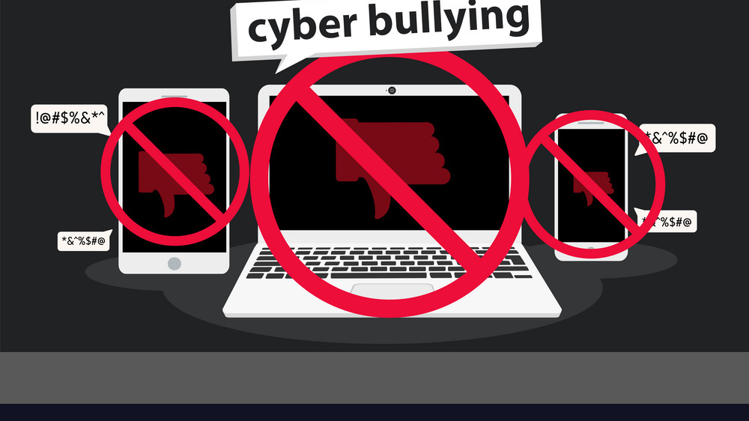
Cyber Bullying
Cyberbullying or cyberharassment is a form of bullying or harassment using electronic means.

Slide 2

What is Cyberbullying?
Cyberbullying is electronic bullying . Instead of people bullying others in person they’re doing it online.

Slide 3




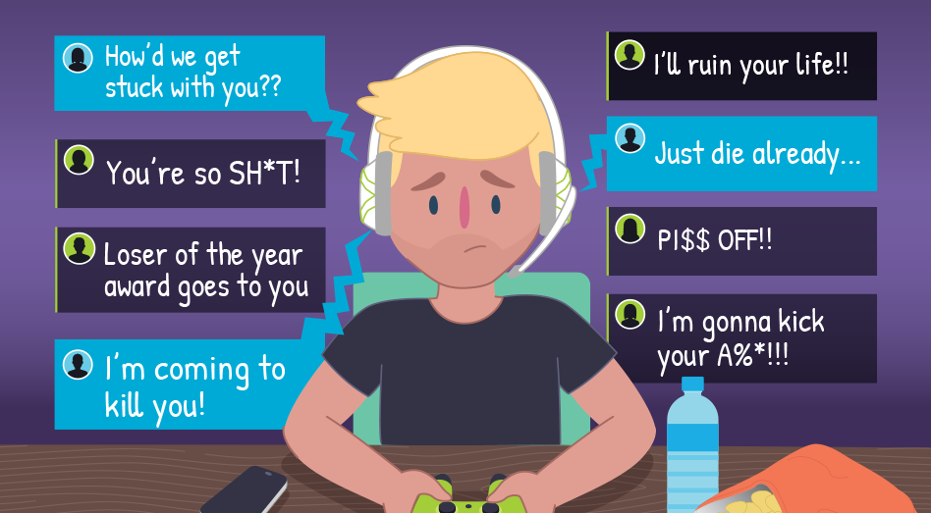
Where can Cyberbullying take place?
It can take place anywhere that involves an electronic device and internet . The people doing the bullying can use- their phones or computers on websites like .
Facebook
Instagram
Twitter
Myspace
Any kind of online games

Slide 4

Case Study
So this is the case study about Amanda tord, she was a teenager who committed suicide because of cyberbullying .So there is the site called Myspace and Amanda met a person on Myspace ,they became good friends and a person ended up asking Amanda for obscene picture of herself and Amanda without thinking ofcourse send the pictures .This person then decided to make those pictures viral which let a great deal of humiliation for Amanda in her school as well , so she decided to change school twice and that guy somehow manage to do in her reputation in those schools as well . Really disheartened by whatevers is happening , Amanda decided to stay at home though when she did get out of the house there was a last group of people waiting their and then they decided to push her in a ditch. This let to some mental stress for her so she decided to make her youtube video where using flashcart she described how she has been bullied and she fails which she uploaded this video got about 80 million hits and within a next 20 to 27 minutes and Amanda committed a suicide using a rope.

Slide 5

Effects of Cyberbullying
Some major effects of cyberbullying that can occur often are :-
Anxiety
Depression
Loneliness
Unhappiness
Poor sleep
In really bad cases some are lead to killing themselves because they feel worthless when people tell them they are.
Most of the times when its happening the child feels they need to hide, or conceal the problem.

Slide 6
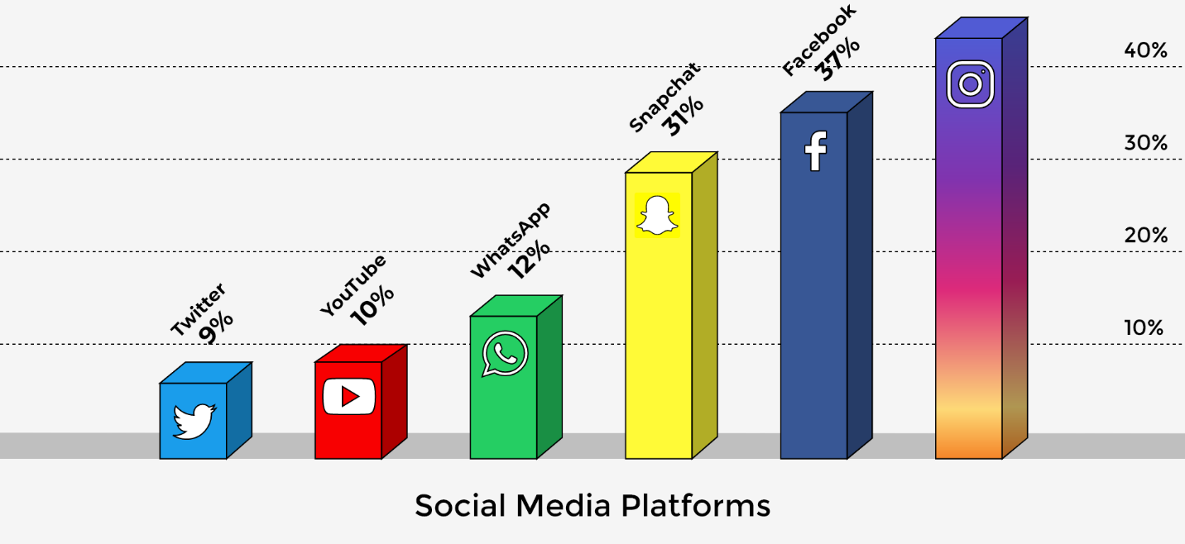
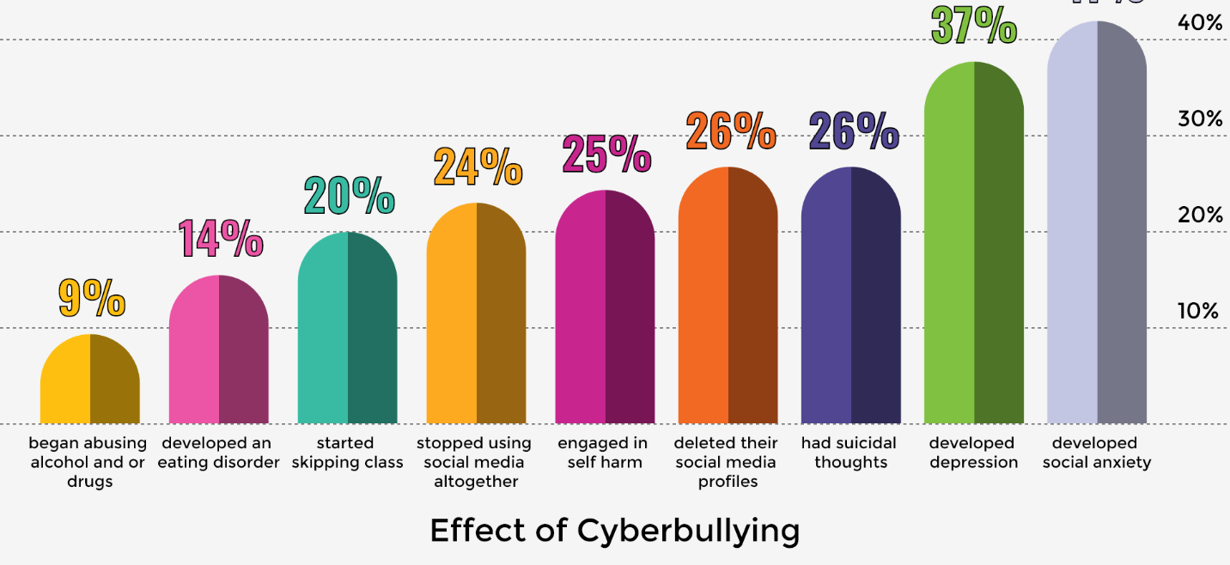
Cyber Statistics
These facts might be shocking to you and can be very very depressing,
In india ,the survey indicated that 22% of children reported mean or unfriendly treatment , 29% were made fun of or teased and 25% were called mean names.
The survey also found that 70% of children said that they know a lot or something about online bullying , while 79% were very or something worried about the phenomenon 77% reported being bullied online- or offline

Slide 7
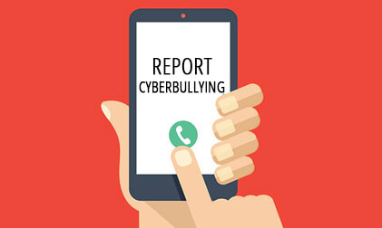
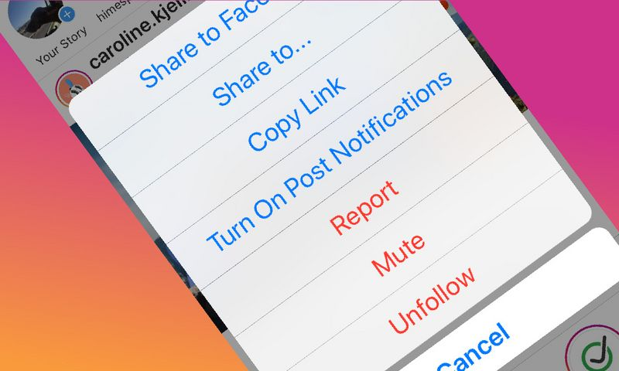
How to Report
If someone were to be cyberbullying you, you should not respond to any of the messages even try to tell them just to stop. Staying out of the situation will help.
Don’t delete any evidence that you might have on your computer or phone. Having proof that you were bullied can be useful for when you are trying to report them.
If you can , try to block the bully on all websites as possible.

Slide 8

Cyber Bullying Facts
Some people who do cyber bullying sometimes forward any message to bully another kid and it can hurt to many other people also.
Kids on the internet report some people as fake account , a page, or spam.
Between ages 9-16 years old can send hurtful and nasty comments or messages to other people.

Slide 9

Message
If you wouldn’t say it in person, why say it online?

Slide 10

Stop Cyberbullying
Delete Cyberbullying.
Don’t Write it.
Don’t forward it.

