Slide 1
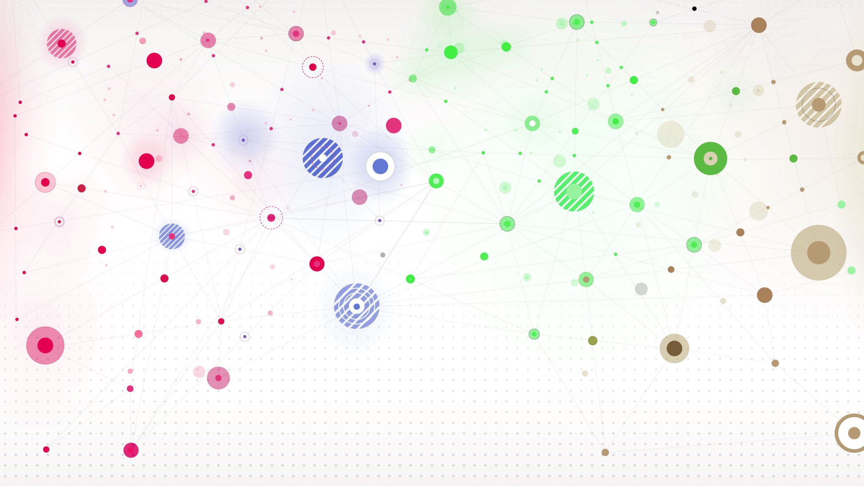
PyTest
PyTest is a testing framework that allows users to write test codes using Python programming language.

Slide 2
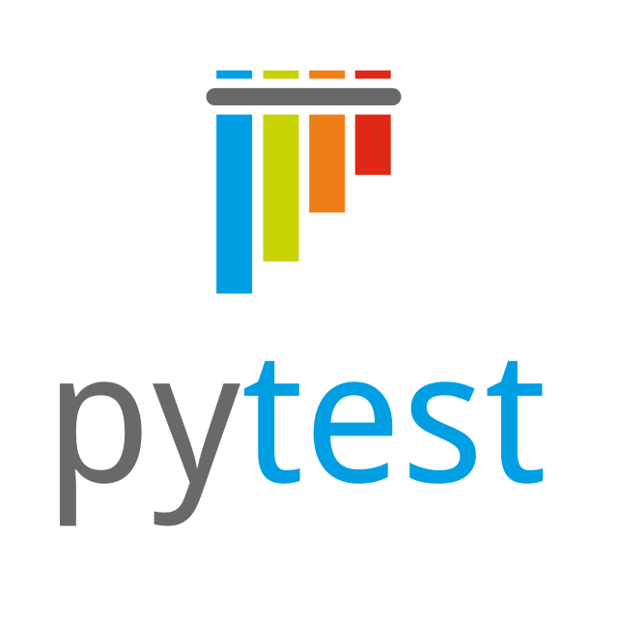
Agenda
What is a pytest?
Getting Started
Create your first test with Pytest
Multiple Test
Group Multiple Tests
API Tests

Slide 3
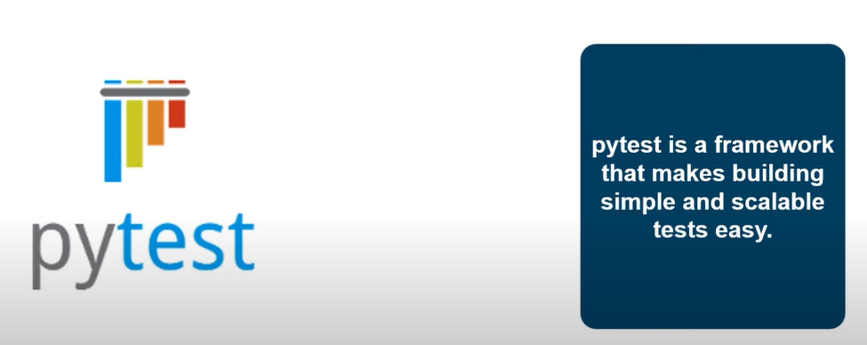
What is pytest? PyTest is mainly used for writing tests for APIs.

Slide 4

How to install PyTest?
pip install –U pytest
Once the installation is complete you can confirm it with by
py.test -h
How to check the pytest Version?
any pytest file should start with test_ or end with _test

Slide 5
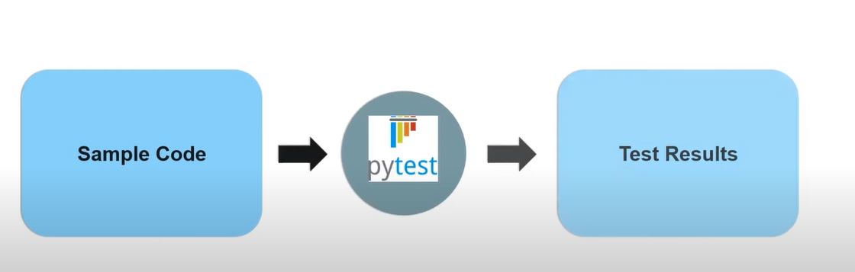
Create your first test with pytest

Slide 6
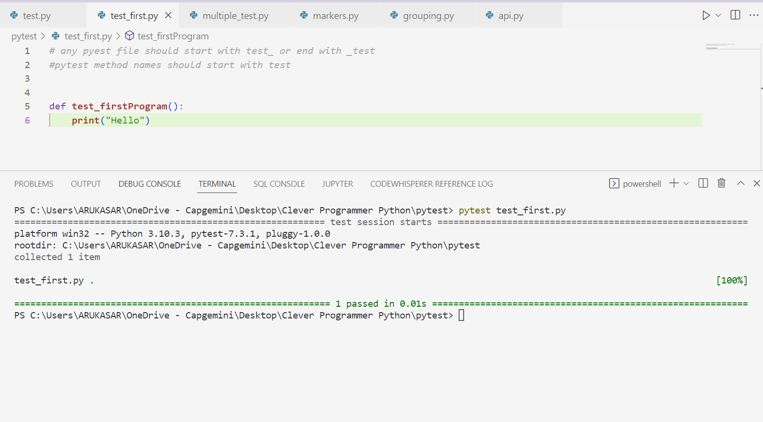

Slide 7
Command to run pytest
pytest <filename>.py

Slide 8
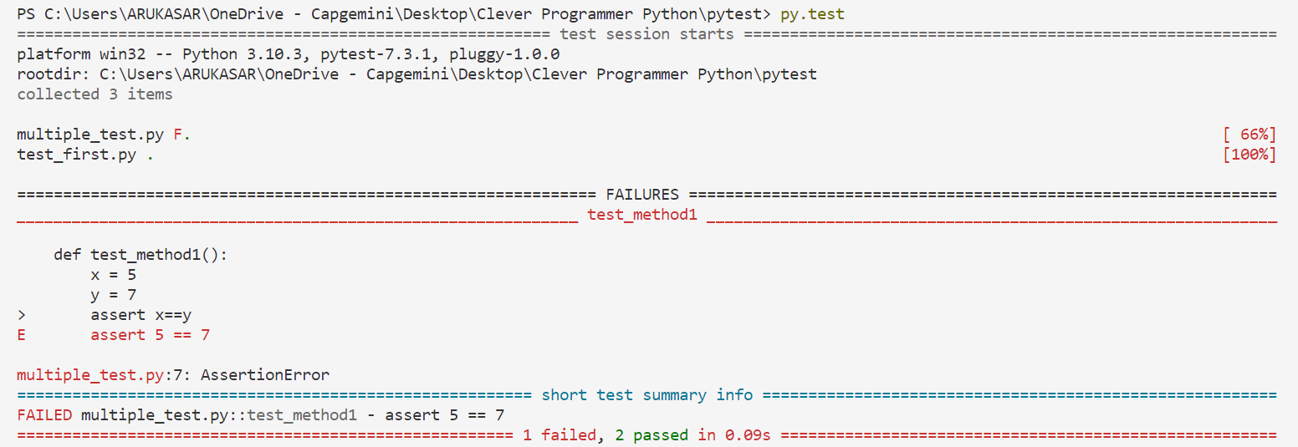
py.test

Slide 9
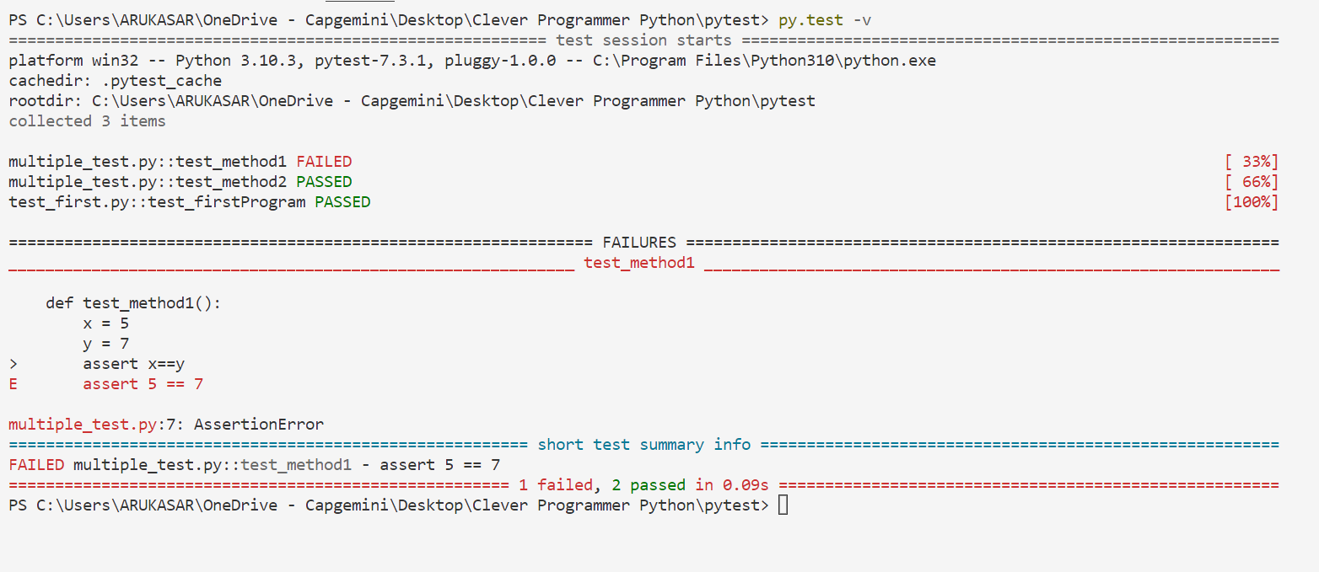
py.test -v

Slide 10
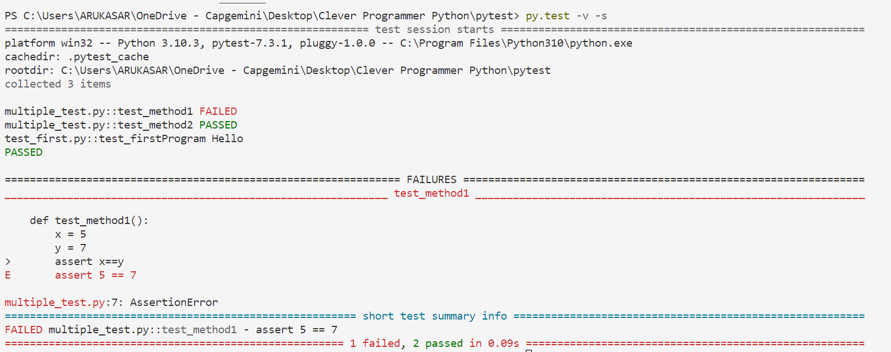
py.test –v –s
Print output in console, to see the “Logs”

Slide 11
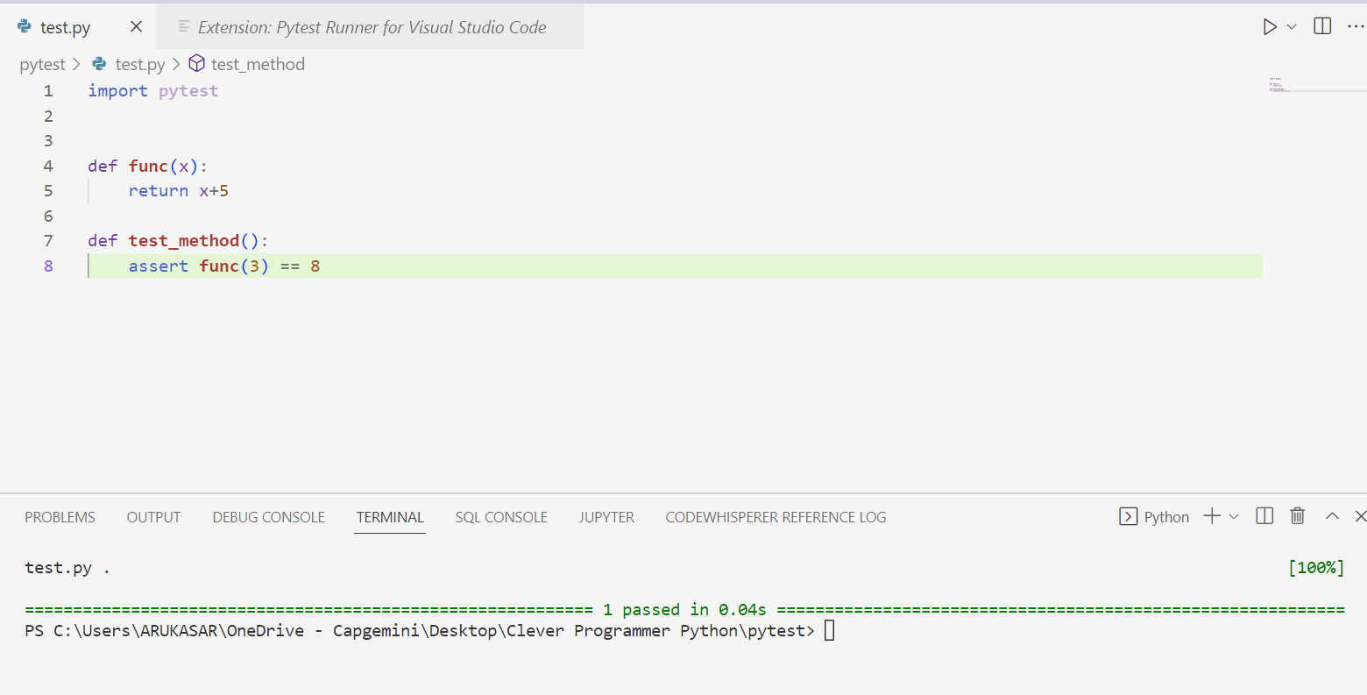

Slide 12
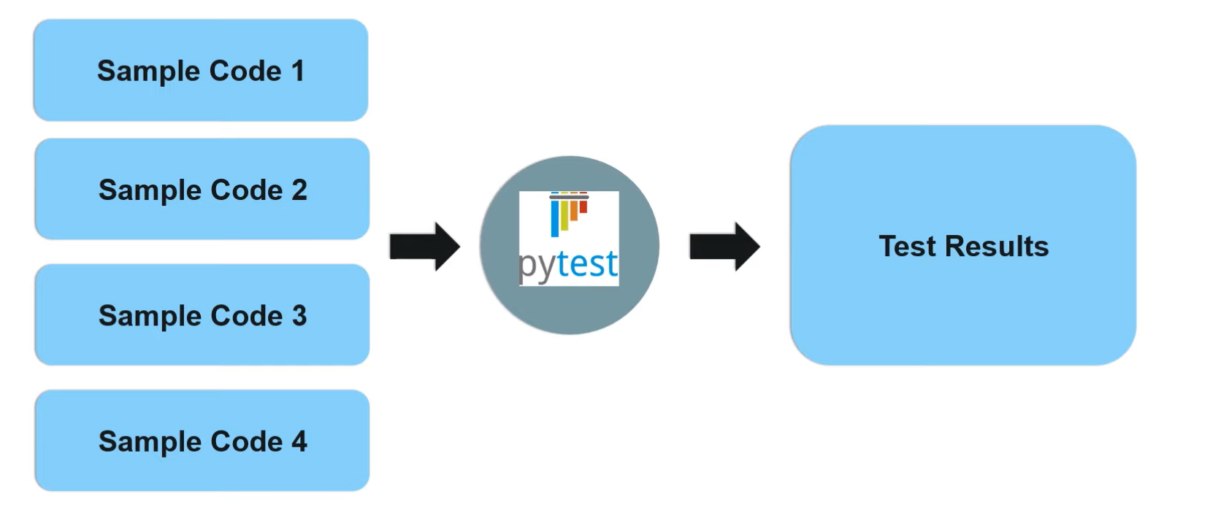
Multiple Test

Slide 13
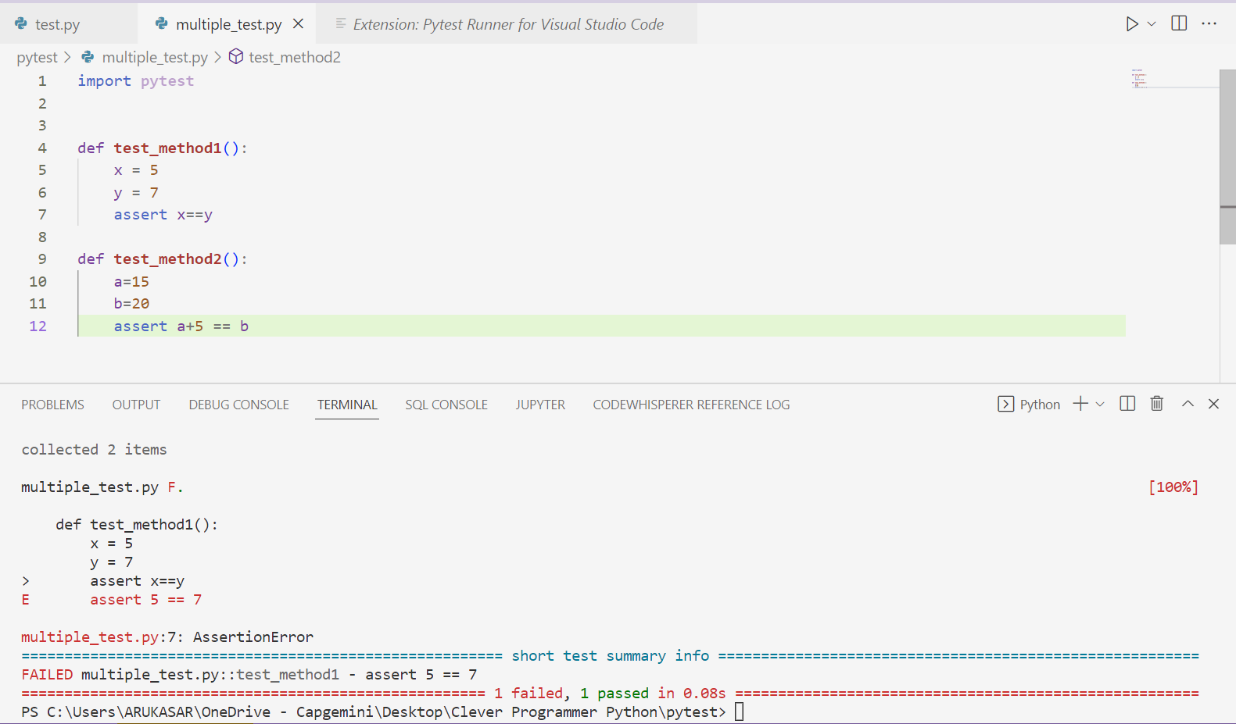

Slide 14
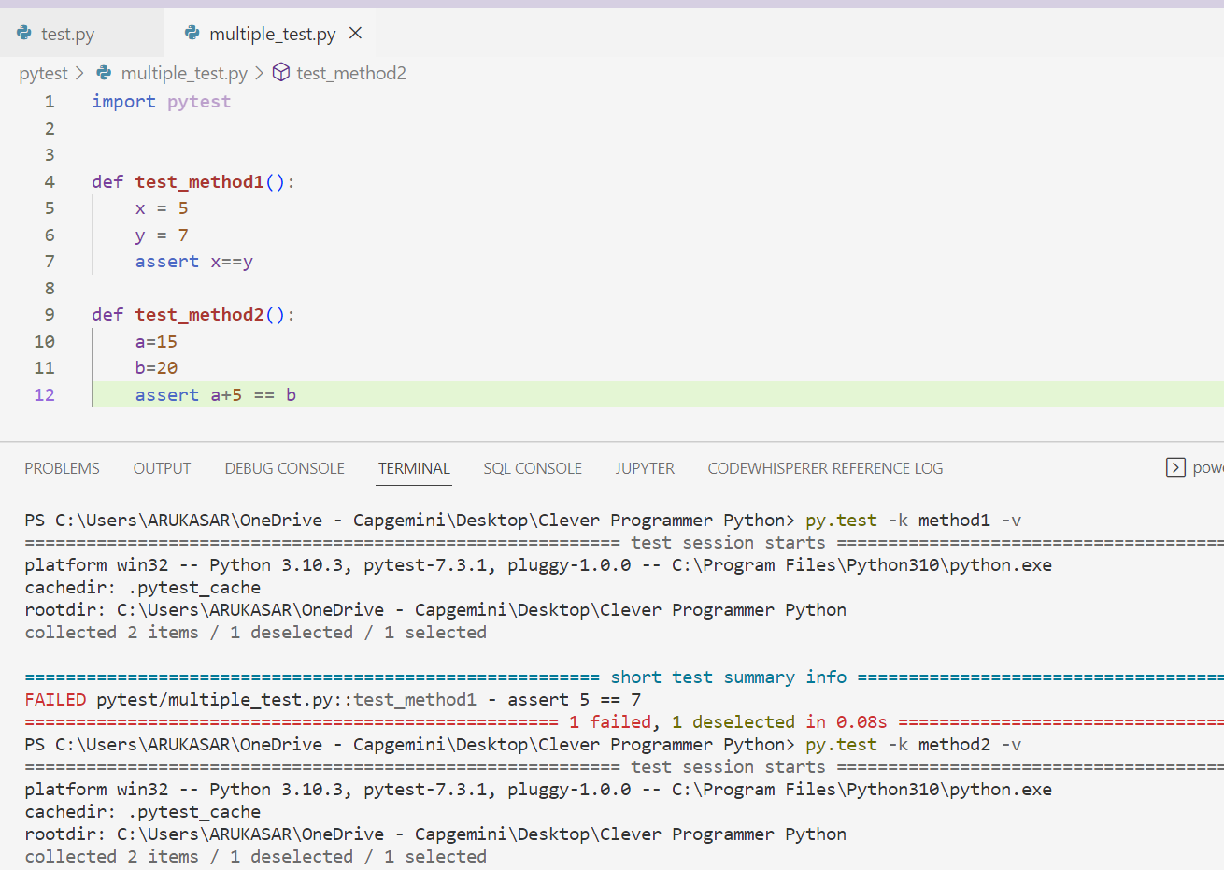
Group Multiple Test - py.test -k <method_name> -v

Slide 15
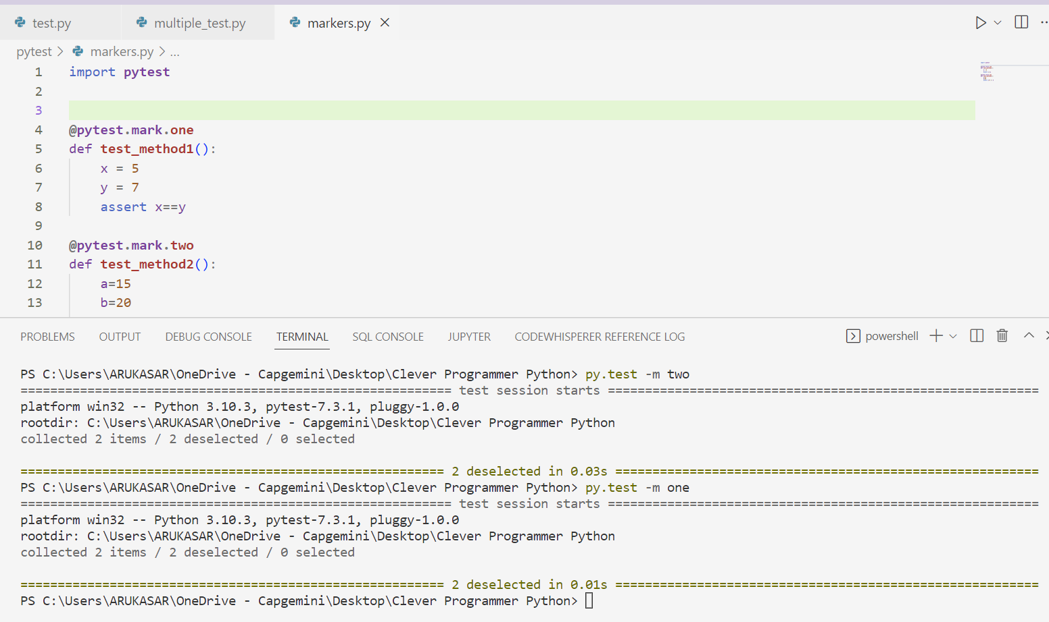
Run test using markers – py.test –m <mark_name>

Slide 16
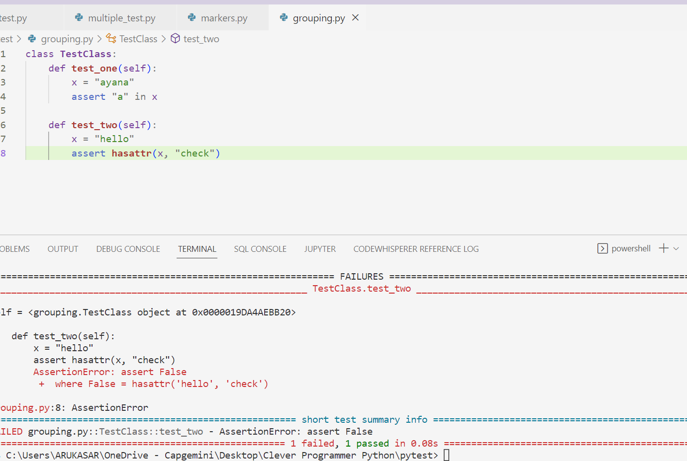
Group multiple tests

Slide 17
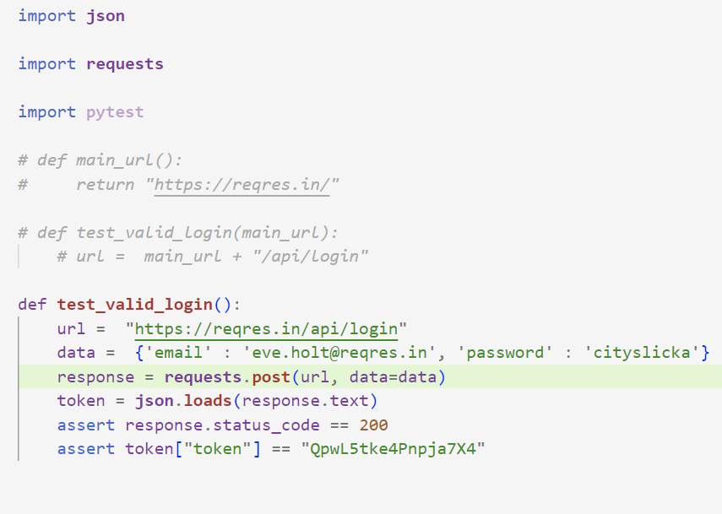
API’s
https://reqres.in/

Slide 18
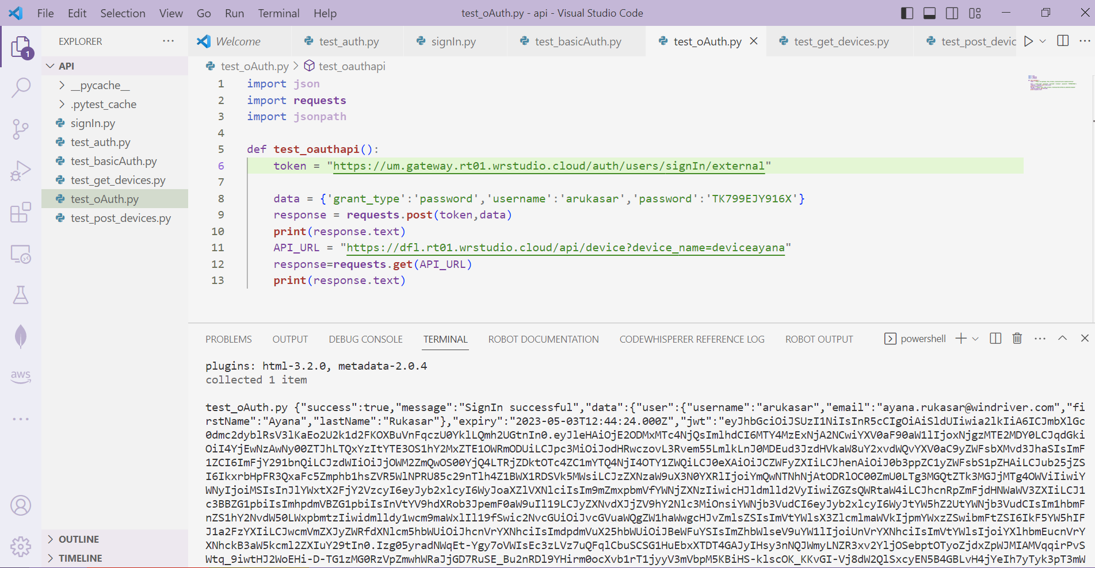
Authenticate With DFLAdmin

Slide 19

Thank You

