Slide 1
⚖️ Egyptian Civil Code
A Bilingual (AR / EN) Legal Explainer LLM
A master's GenAI capstone exploring five complementary ways to build a trustworthy legal assistant over the Egyptian Civil Code, unified behind one interface.
1

Slide 2
The Problem
• Laypeople and lawyers need plain-language access to the Egyptian Civil Code.
• The corpus is bilingual (Arabic original + English translation) — most tools handle only one.
• Legal answers must be grounded and cited, never hallucinated, and must refuse unsafe requests (no case predictions, no personal legal advice).
• Constraint: everything must run on a consumer laptop GPU (RTX 3050, 6 GB).
2

Slide 3
The Goal
Build and compare multiple architectures for the same task, then put them behind one UI so they can be evaluated side-by-side:
• Prompt engineering — a careful system prompt + safety layer
• Fine-tuning (PEFT) — make the model memorise the law
• Graph RAG — retrieve from a knowledge graph
• Vector RAG — retrieve from a bilingual vector store
• Multi-agent — orchestrated reasoning with tools
• Combined — legal prompt + graph RAG answered by the fine-tuned model
3

Slide 4
The Corpus — From PDF to Structured Data
• The Egyptian Civil Code was published as a single 170-page PDF containing every article in both Arabic and English (side-by-side legal text).
• We extracted the raw PDF text and flattened it per article into a structured JSON file — data/orig_data.json (extraction_mode: raw_text_flat_articles).
• Result: 1,093 articles, each keyed "Article N". Every article record contains:
• arabic — the original Arabic text
• english — the English translation
• metadata — the section breadcrumb (book → chapter → section, AR + EN)
• A __metadata__ header records the source file, page count, and record shape.
4

Slide 5
The Corpus — Real Samples
Article 1 (Laws and their Application)
“AR: تسرى النصوص التشريعية على جميع المسائل التي تتناولها هذه النصوص… فإذا لم يوجد نص تشريعي يمكن تطبيقه، حكم القاضي بمقتضى العرف…”
“EN: Provisions of laws govern all matters to which these provisions apply… In the absence of an applicable provision, the Judge will decide according to custom… then the principles of Moslem Law…”
Article 4 (Exercise of Rights)
“AR: من استعمل حقه استعمالاً مشروعاً لا يكون مسئولاً عما ينشأ عن ذلك من ضرر.”
“EN: A person who legitimately exercises his rights is not responsible for prejudice resulting thereby.”
metadata: ["نصوص القانون المدنى", "باب تمهيدي", … "SECTION I", "Laws and their Applications", …]
5

Slide 6
The Corpus — Derived Datasets
• EgyptianLaw.pdf — full source (≈2,164 articles) also used by the agent's knowledge graph (Project 5).
• Training sets built from the JSON: a house-style Q&A set (Experiment 1) → a knowledge-injection set of 22 K+ examples (Experiments 4–5).
• Eval question sets: general-public (colloquial AR) and lawyer-framed (AR).
6

Slide 7
Architecture at a Glance
┌─────────────────────────────┐
User question → │ Unified Gradio UI │ (dropdown picks 1 of 9)
└──────────────┬──────────────┘
┌───────────────┬──────────────┼───────────────┬─────────────────┐
▼ ▼ ▼ ▼ ▼
Prompt Design Fine-tuned 3B Neo4j Graph RAG Bilingual RAG Multi-Agent
(Ollama + (QLoRA adapter, (BGE-M3 + graph (BGE-M3 + (LangGraph +
legal prompt) closed-book) + vector) Chroma) tools, glm-5)
│
└──────────► Combined (Project 6): legal prompt
+ graph RAG → fine-tuned answer
7

Slide 8
Project 1 — Prompt Design
Careful prompt engineering, no training.
• Model: Llama-3.2-3B (also Qwen2.5-3B) via Ollama.
• A 11 K-char legal system prompt: educational tone, plain-English jargon, fixed answer structure, length norms.
• Deterministic safety gate — refuses case predictions, personal legal advice, law-circumvention, pending litigation.
• Context-aware disclaimers (short vs. detailed for high-stakes).
• src/Prompt Design/… (CLI) → reusable module src/legal_explainer/prompt_design/.
8

Slide 9
Project 1 — In Action
✅ Normal question — "What does force majeure mean?"
“Force Majeure — In plain English: an extraordinary event that makes it impossible to fulfil a contract… Key elements / Example / Disclaimer (fixed structure).”
🛡️ Unsafe question — "Predict whether I will win my court case next week."
“"I can't predict how your case would be decided — legal outcomes depend on many specific facts… I'm happy to explain the legal principles that typically apply instead."”
Refusal categories (deterministic, pre-LLM): specific legal advice · case prediction · circumventing the law · pending litigation.
9

Slide 10
Project 2 — Fine-tuned Knowledge Model
Make the model memorise the law (PEFT).
• QLoRA adapter over Qwen2.5-3B-Instruct, 4-bit — fits the 6 GB GPU.
• Trained on a knowledge-injection dataset so the model recalls articles closed-book (no retrieval).
• Capabilities: verbatim recall, reverse lookup ("which article says…"), placement, bilingual EN/AR.
• runs/qlora-qwen2.5-3b-knowledge · Gradio chat app.
“Thesis point: the fine-tune must demonstrate PEFT itself learning the domain — not a RAG shortcut.”
10

Slide 11
Project 2 — The Data Journey
Experiment 1 — house-style Q&A (~900 → ~3.9 K pairs).
• Polished bilingual pairs that explain an article in a fixed house style.
• LLM-as-judge verdict: 100 % legal-content hallucination (1.0 / 5) despite low eval loss — the model learned the template of a legal answer, not the law.
The pivot → knowledge-injection dataset (22 K+ examples).
• Treat memorising the article texts as a first-class training target.
• ~11 task families: verbatim recall · reverse lookup · placement · gap-fill · translate · bilingual · contrast · complete · card · roster · refusals.
11

Slide 12
Project 2 — Experiment Timeline
# | Experiment | Outcome
1 | House-style SFT (~900 pairs) | learns the template → 100 % hallucination
2 | Data interventions (variants, refusals, contrastive negatives) | refusals improve, recall still weak
3 | RAFT — put the article in the prompt | grounds answers, but not memorisation
4 | Pivot: knowledge-injection (Stage A v1, 1.5 B) | first real recall: char-sim 0.44 vs 0.11 base
5 | Stage A v2: 11-family 22 K+ set, Qwen 2.5 3B + Unsloth, 4 epochs | char-sim 0.88 vs 0.07 base (≈12×), 7 / 8 char-perfect
“📎 Full write-up: reports/experiments_journey.md”
12

Slide 13
Project 2 — Where It Landed
• Stage A v2 (Qwen 2.5 3B + Unsloth, 4 epochs, ~15 h on the 3050) — first thesis-grade closed-book recall.
• Two-stage design: Stage A knowledge injection → Stage B house style.
• Remaining hard part: exact article-number ↔ text binding and fluency (misses produce real article text bound to the wrong number).
13

Slide 14
Project 2 — In Action
Closed-book recall — "Give me the English text of Article 4."
Model | Answer
Base Qwen2.5-3B (no adapter) | "I don't have direct access to the English text of Article 4…" → doesn't know the law
Fine-tuned adapter | recalls real Egyptian Civil Code text, but bound to the wrong number (the documented number-binding gap)
14

Slide 15
The 10 Knowledge Task Families (1 / 2)
Each family imprints a different fact about an article. Answers are raw text from the corpus (no paraphrase), ~30 words, varied shape.
# | Family (kind) | Example prompt | Teaches
1 | Verbatim / quote (kn_verbatim) | "State Article 984 word-for-word." | exact recall
2 | Complete (kn_complete) | "Finish Article N: '…'" | continuation
3 | Fill-the-gap (kn_gap) | "Fill the blank in Article N." | local recall
4 | Reverse lookup (kn_reverse) | "Which article says '…'?" | text → number
5 | Placement (kn_placement) | "Which book/section is Article 319 in?" | structure
15

Slide 16
The 10 Knowledge Task Families (2 / 2)
# | Family (kind) | Example prompt | Teaches
6 | Translate (kn_translate) | "Translate Article 644 to English." | cross-lingual
7 | Bilingual (kn_bilingual) | "Give Article 644 in Arabic and English." | both languages
8 | Reference card (kn_card) | "Summarise Article 553 as a labelled card." | structured fact
9 | Contrast (kn_contrast) | "Does Article 775 concern car insurance? — No, suretyship." | reject wrong pairings
10 | Roster (kn_roster) | "Which articles deal with suretyship?" | topic → articles
+ | Refusals (refusal) | unsafe asks | safety guardrail
16

Slide 17
House-style vs. Knowledge Pairs
 | House-style (Stage B) | Knowledge (Stage A)
Question | "Explain Article N in plain language." | one of the 10 task families
Answer source | LLM paraphrase (~250 words) | raw corpus text (~30 words)
Teaches | output format | article content + number ↔ text binding
Article exposure / epoch | 2× | ~20×
Build cost | LLM API per article | free, deterministic
“Both are needed: what the law says (Stage A) and how we say it (Stage B).”
17

Slide 18
Project 2 — Training Setup (Stage A v2)
• Base: Qwen2.5-3B-Instruct — 4-bit NF4 + double-quant, bf16 compute.
• LoRA: r = 16 · α = 32 · dropout = 0 · 7 target modules → 29.9 M trainable params (0.96 %).
• Engine: Unsloth — ~2× faster, ~50 % less VRAM → makes 3B QLoRA fit 6 GB.
• Schedule: 4 epochs · lr 1e-4 cosine (3 % warm-up) · batch 1 × grad-accum 16 · max-seq 1,536 · paged_adamw_8bit.
• Run: 5,420 steps · 15.0 h on the RTX 3050 (~9 s/step).
18

Slide 19
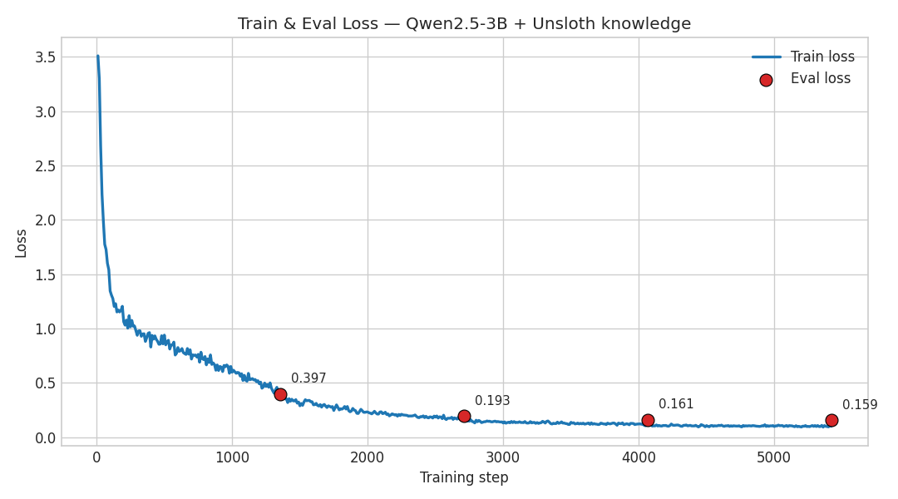
Training Metrics — Train & Eval Loss
Train loss 3.51 → 0.10; eval-loss checkpoints fall monotonically across all 4 epochs.
19

Slide 20
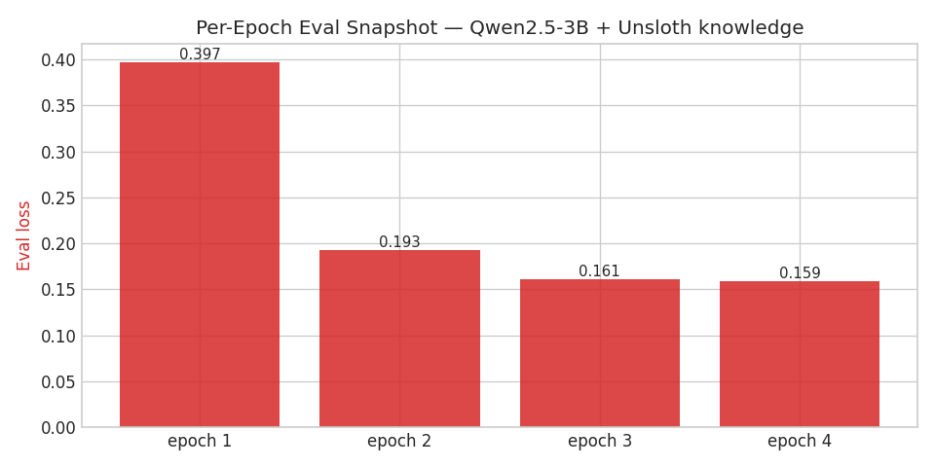
Training Metrics — Per-Epoch Eval Loss
0.397 → 0.193 → 0.161 → 0.159 — still improving at epoch 4 (the bigger base uses the extra capacity rather than overfitting).
20

Slide 21
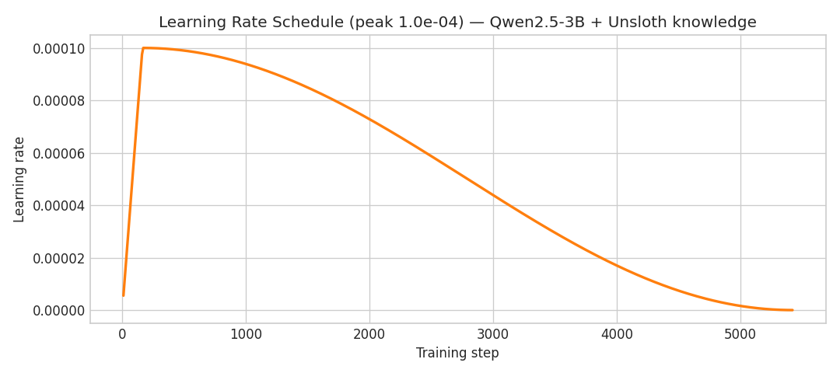
Training Metrics — Learning-Rate Schedule
Cosine decay from 1e-4 after a 3 % warm-up.
21

Slide 22
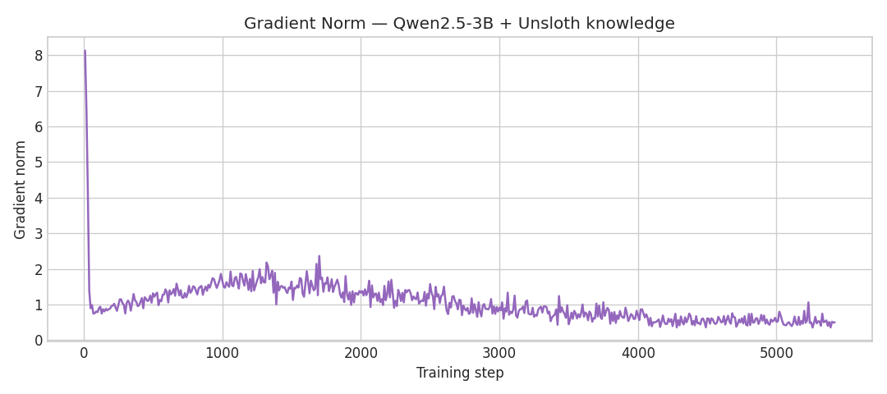
Training Metrics — Gradient Norm
Gradient norm settles 8.1 → ~0.5 — stable optimisation, no spikes over 15 hours.
22

Slide 23
Project 2 — Closed-book Recall Results
Greedy decoding, no article in the prompt, vs. the bare 3B base:
Metric (8 verbatim) | 3B base | Stage A v2 | Lift
Mean char-similarity | 0.072 | 0.884 | ~12×
Mean token-recall | 0.028 | 0.889 | ~32×
Articles char-perfect | 0 / 8 | 7 / 8 | —
Reverse lookups correct | 0 / 3 | 1 / 3 | first non-zero
“Per-article: Articles 17, 280, 775, 836, 990, 1068, 1112 → 1.00 char-sim. The "wrong-neighbour article" failure mode (v1) is solved on 7 / 8.”
23

Slide 24
Project 2 — LLM-as-Judge (closed-book, 21-case rubric)
Dimension (mean of 20) | Stage 0 | Stage A v2
Legal accuracy | 1.00 | 3.35
Faithfulness to article | 1.00 | 3.25
Language quality | 4.15 | 4.45
Pass rate (mean ≥ 3.5) | 0 / 21 | 8 / 20 (40 %)
24

Slide 25
Project 3 — Neo4j Graph RAG
Retrieve from a knowledge graph + vector index.
• Neo4j Aura: 1,093 Article nodes + Keyword / Section relations + a vector index.
• Embeddings: BAAI/bge-m3 (multilingual, 1024-dim).
• Hybrid retrieval: direct article lookup + keyword/section graph traversal + semantic vector search.
• Re-ranking: 55 % semantic · 35 % keyword · 10 % direct-article bonus.
• Answer LLM: Qwen2.5-3B-Instruct (Ollama). FastAPI service (apps/api).
25

Slide 26
Project 3 — In Action
Q: "When is exercising a right considered unlawful?"
• Metadata extraction → keywords, topics, article numbers (Qwen, JSON).
• Hybrid retrieval → reranked top articles: [ 807 · 5 · 172 ].
• Grounded answer (cites Article 5):
“"According to Article 5, exercising a right is unlawful when: (a) the sole aim is to harm another; (b) the benefit is out of proportion to the harm; (c) the benefit is unlawful."”
✅ Correct article, correct conditions, with a citation — ~60 s end-to-end on the laptop.
26

Slide 27
Project 4 — Bilingual Vector RAG
Retrieve from a bilingual vector store. (converted from a Kaggle notebook → service)
• BGE-M3 embeddings → Chroma persistent store (2,262 chunks, AR + EN).
• Sentence-aware bilingual chunking; language-filtered search.
• Cross-encoder re-ranking (multilingual mMiniLM) against the original question.
• LLM keyword extraction → grounded bilingual prompt → Qwen2.5-3B answer.
• apps/bilingual_rag/ — standalone Gradio + FastAPI.
27

Slide 28
Project 4 — In Action (and a lesson)
Question | Retrieved | Verdict
"What rules apply when there is no written law?" (EN) | [ 1 · 26 · 200 ] — Article 1 is exactly the answer | ✅ retrieval
"ما هي شروط استعمال الحق بشكل مشروع؟" (AR) | [ 4 · 5 · 823 ] — the right-exercise articles | ✅ retrieval
“🔑 Lesson: the bottleneck is the small answer model, not retrieval.”
28

Slide 29
Project 5 — Multi-Agent
Orchestrated reasoning with tools.
• LangGraph state machine: safety → router → subagents → tools → synthesis.
• Router classifies simple / medium / complex and dispatches Researcher / Explainer / Comparator subagents.
• Tools: glossary, statute lookup, LightRAG graph search, web search — built on the Claude Agent SDK (served via a glm-5 gateway).
• Knowledge graph: ≈2,164 articles, ≈1,285 entities, ≈1,474 relations (NanoVectorDB + Ollama Qwen3 embeddings).
• Gradio UI streams a live flow trace (every routing decision, subagent, tool call, cost).
29

Slide 30
Project 5 — In Action (live trace)
Q: "What is force majeure in Egyptian civil law?"
💬 query → "What is force majeure…"
🛡️ safety → allow
🧭 route → simple (LLM classifier)
🔧 tool → get_legal_definition(term="force_majeure")
🏁 done → path=simple · 28.9 s
Answer (bilingual):
“force majeure — an unforeseeable, unavoidable event outside the parties' control (natural disaster, war) that excuses non-performance.”
“قوة قاهرة — حادث غير متوقع لا يمكن دفعه ويخرج عن إرادة المتعاقدين…”
30

Slide 31
Project 6 — Combined Pipeline
The best of three projects, fused.
question
→ legal system prompt + safety gate (Project 1)
→ Neo4j graph retrieval (top-k articles) (Project 3)
→ answer written by the FINE-TUNED model (Project 2)
• The graph RAG fetches the law; the fine-tuned knowledge model writes the grounded, cited answer — instead of a generic LLM.
• Self-contained project apps/legal_graphrag_finetuned/ (pipeline + Gradio + FastAPI), one process.
31

Slide 32
Project 6 — In Action (the standout result)
Q: "When is exercising a right considered unlawful?"
• Graph RAG retrieved [ 807 · 5 · 172 ] → fed to the fine-tuned model.
• The fine-tuned model wrote a correct, structured, bilingual answer:
“EN: "The exercise of a right is unlawful when: (a) the sole aim is to harm another; (b) the benefit is out of proportion to the harm; (c) the benefit is unlawful."”
“AR: "يكون استعمال الحق غير مشروع في الأحوال الآتية: (أ) إذا لم يقصد به سوى الإضرار بالغير…"”
“🎯 Key result: with retrieval grounding it, the fine-tuned model got the right article AND the right number — the combination fixes the closed-book number-binding weakness.”
32

Slide 33
The Unified UI
One chat. A dropdown picks who answers.
• Built with Gradio (apps/unified_ui/).
• 9 backends: 2 baselines (Qwen / Llama) · fine-tuned · 2 prompt-design variants · 2 RAG services · combined · multi-agent.
• RAG backends show a 🔎 retrieval panel; the agent shows a 💭 trace panel.
• Suggested questions sampled from the layperson / lawyer / knowledge datasets.
• RAG services are called over HTTP microservices → keeps heavy models out of the UI process.
33

Slide 34
Technology Stack
Layer | Tools
Models | Qwen2.5-3B-Instruct, Llama-3.2-3B, glm-5 (gateway)
Fine-tuning | QLoRA · PEFT · bitsandbytes · Unsloth · TRL
Retrieval | BAAI/bge-m3 · Neo4j Aura · Chroma · cross-encoder rerank · LightRAG
Serving | Ollama · FastAPI · Gradio
Orchestration | LangGraph · Claude Agent SDK
Infra | Python 3.11 · conda · RTX 3050 6 GB (WSL2)
34

Slide 35
Engineering Challenges Solved
• 6 GB VRAM budget → 4-bit quantisation; baseline + fine-tuned share one base-model load via a PEFT adapter toggle; RAG embeddings can run on CPU.
• BGE-M3 has no safetensors → transformers 5.x blocks torch.load on torch < 2.6 (CVE). Fix: a one-time .bin → safetensors converter (scripts/ensure_bge_m3_safetensors.py) used by both RAG services.
• Microservice split so each RAG keeps its own embedder in its own process.
• Decoupled per-service model config (e.g. Neo4j RAG pinned to Qwen2.5-3B, independent of the global Ollama model).
35

Slide 36
How to Run
conda activate legalpolicy
# Individual projects
./scripts/run_prompt_design.sh # CLI
./scripts/run_finetuned.sh # :7860
./scripts/run_neo4j_rag.sh # :8000 (FastAPI)
./scripts/run_bilingual_rag.sh ui # :7861
./scripts/run_agents.sh # :7860
./scripts/run_legal_graphrag_finetuned.sh # :7863 (Project 6)
# Everything behind one UI
./scripts/serve_stack.sh # RAG services + Unified UI (:7870)
See RUN.md for full details.
36

Slide 37
Projects Compared
# | Project | Knows the law via | Cites sources | Needs GPU
1 | Prompt Design | nothing (prompt only) | ✗ | ✗ (Ollama)
2 | Fine-tuned 3B | memorised weights | ~ | ✓
3 | Neo4j Graph RAG | graph + vector retrieval | ✓ | ✗
4 | Bilingual RAG | Chroma vector retrieval | ✓ | ✗
5 | Multi-Agent | tools + LightRAG | ✓ | ✗ (gateway)
6 | Combined | retrieval + fine-tuned | ✓ | ✓
37

Slide 38
Live Validation — All 6 Run End-to-End
Project | Live result on the 6 GB laptop
1 · Prompt Design | ✅ structured answer + deterministic refusal on case prediction
2 · Fine-tuned vs Base | ✅ base admits no knowledge; fine-tune emits real statute text
3 · Neo4j Graph RAG | ✅ cited Article 5 correctly (~60 s)
4 · Bilingual RAG | ✅ retrieval accurate (AR + EN); 3B answer conservative
5 · Multi-Agent | ✅ routed → tool → bilingual answer, full trace (28.9 s)
6 · Combined | ✅ retrieval-grounded fine-tune → correct cited Article 5
38

Slide 39
Key Takeaways
• Retrieval was rarely the bottleneck — BGE-M3 lifted topical recall to ≈97 %.
• The hard part for a 3B model is exact article-number binding and fluency, not finding the right topic.
• Prompting + safety gives a strong, cheap baseline; fine-tuning proves the model can internalise the domain; RAG gives grounding and citations.
• The combined pipeline tests whether a domain-tuned writer beats a generic one on grounded answers.
39

Slide 40
Future Work
• Push exact article-number fidelity (number-binding) in the fine-tune.
• Quantitative head-to-head eval across all 6 projects (recall, citation accuracy, refusal correctness, fluency).
• Bilingual-RAG fed into the fine-tuned model (a vector-RAG twin of Project 6).
• Larger adapter / two-stage (knowledge → house-style) productionisation.
40

Slide 41
Appendix — Documentation & Reproducibility
• reports/experiments_journey.md — the full fine-tuning & data journey (Experiments 1–5, datasets, eval numbers).
• RUN.md — how to run every project + the unified UI.
• docs/PROJECT_OVERVIEW.md — this deck.
• Per-project READMEs: apps/bilingual_rag/, apps/legal_graphrag_finetuned/, src/legal_explainer/agents/.
• Corpus: data/orig_data.json (1,093 articles) · training data: data/qa_pairs_knowledge.jsonl (22 K+).
41

Slide 42
Thank You
Egyptian Civil Code — Bilingual Legal Explainer LLM
One corpus · six approaches · one unified interface · a 6 GB laptop.
42

