Slide 1
Video Chat Website
Using Scaledrone and WebRTC

Slide 2
ABSTRACT
Video Chat Website (VCW) is a web-based video chat application that allows users anywhere in the world to join real-time streaming video chat rooms. This product is similar to social networking sites that allow web-based video conferencing.
The main advantage of VCW compared to existing tools is that it is easy to use and does not require users to download and set up additional hardware. Since this product is a browser-based solution, it allows users from multiple platforms like Windows, Linux, or Mac to join a chat room.

Slide 3
Table of Contents
Introduction
Technology used
Architecture
Methodology
Implementation
Conclusion

Slide 4
Introduction

Slide 5
Introduction
Over the last decade, the demand for video conferencing has increased enormously. Video conferencing is a software technology that allows group of people anywhere in the world to meet in a virtual room by simply connecting to internet using their personal computer and sharing live webcam. Video conferencing has its application in online distance learning, virtual meeting rooms in business, and social networking sites.

Slide 6
Introduction
Online distance learning allows students and teachers to meet in a virtual class room without the need to waste time and money on commuting. A virtual meeting room has significant benefits in the global market where the employees anywhere in the globe can share their ideas without needing to physically present in the company.
A social networking site allows friends and families to connect and get in touch with their loved ones. Video conferencing in social networking sites allows friends and families to come together in a chat room and share their voice and video.

Slide 7
Technology Used

Slide 8
Technology used
There are ‘n’ number of possibilities to create a video chat application. But we went for simple and easy way to built this application.
We used Scaledrone and WebRTC in a simple JavaScript program.
Scaledrone is a real-time messaging service and platform. Send live updates, create chatrooms and collaborative tools. By using the Scaledrone API we created a channel, where users cant chat with others.

Slide 9
Technology used
WebRTC employs three HTML5 APIs that allow users’ browsers to capture, encode, and transmit live streams between one another, enabling two-way communication. For this reason, WebRTC is referred to as peer-to-peer technology, whereby each browser communicates directly with one another.
The beauty of WebRTC lies therein: It eliminates the need for any intermediary web servers during these exchanges, not to mention additional equipment or software. URL-based meeting rooms are an excellent example of the convenience and real-time communication delivered by WebRTC.

Slide 10

VIDEO Chat Website ARCHITECTURE

Slide 12
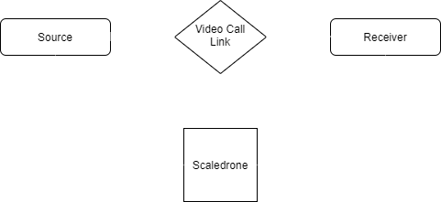
Working
Source shares the video link to the receiver.
Whenever receiver clicks on the link, their video stream goes live to each other. We limited this application to two users, but we can add more than 2 users too.

Slide 13

Methodology

Slide 14
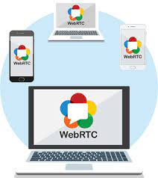
Methodology
WebRTC mainly comprises three operations: fetching or acquiring user media from a camera/microphone (both audio and video); communicating this media content over a channel; and then, finally, sending messages over the channel. Now, let’s take a look at the summarized description of each operation type

Slide 15

Implementation

Slide 16

Implementation
We used HTML page, which contains two video tags to display the source video and receiver video.
The most of the code is in the JavaScript program.

Slide 17
Implementation
// Generate random room name
if (!location.hash) {
location.hash = Math.floor(Math.random() * 0xFFFFFF).toString(16);
}
const roomHash = location.hash.substring(1);

Slide 18
Implementation
// Send signaling data via Scaledrone
function sendMessage(message) {
drone.publish({
room: roomName,
message
});
}

Slide 19
Implementation
// Adding members to the room
room.on('members', members => {
console.log('MEMBERS', members);
// If we are the second user to connect to the room we will be creating the offer
const isOfferer = members.length === 3;
startWebRTC(isOfferer);
});

Slide 20
Implementation
// Writing a function to start WebRTC
function startWebRTC(isOfferer){
/* In this function the most of the actions will be performed such as integrating the audio and video to server and displaying the remote video stream etc.*/
}

Slide 21

Conclusion

Slide 22

Our application is very simple to built and simple to use. By using this application any one can make a video call to their friends, colleagues, and family members.
The beauty is, its all can be done through a single link.

