Slide 1
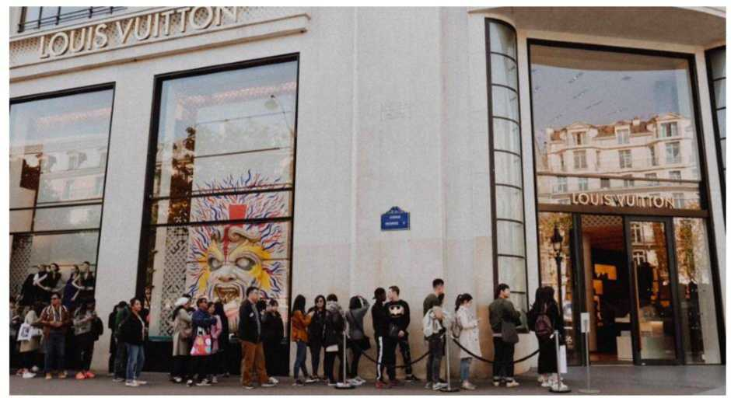
The Battle of the Neighbourhoods - Report
Suitable New Store Locations in Paris for a Fashion Retailer This Report contains multiple parts:
A description of the problem and a discussion of the background - Week 1 A description of the data and how it will be used to solve the problem - Week 1 Methodology and Exploratory Data Analysis - Week 2 Inferences and Discussion - Week 2
1 Introduction and Discussion of the Business Objective and Problem
Locations for New Fashion Stores in High Traffic Areas in Paris France
The Task At Hand

Slide 2
A digitally native vertical fashion retailer, with a substantial e-commerce footprint, has begun the rollout of brick and mortar stores as part of their omnichannel retail strategy. After rolling out stores in a few select cities by guessing where the best locations were to open, as part of their store expansion for Paris they've decided to be more informed and selective, and take the time to do some research.
I've been given the exciting task of assisting them to make data-driven decisions on the new locations that are most suitable for their new stores in Paris. This will be a major part of their decision-making process, the other being on the ground qualitative analysis of districts once this data and report are reviewed and studied.
The fashion brand is not what is considered high-end, they are positioned in upper end of the fast fashion market. As such, they do not seek stores in the premium upmarket strips like Avenue Montaigne, but rather, in high traffic areas where consumers go for shopping, restaurants and entertainment. Foursquare data will be very helpful in making data-driven decisions about the best of those areas.
Criteria
Qualitative data from another retailer that they know, suggests that the best locations to open new fashion retail stores may not only be where other clothing is located. This data strongly suggests that the best places are in fact areas that are near French Restaurants, Cafes and Wine Bars. Parisians are very social people that frequent these place often, so opening new stores in these locations is becoming popular.
The analysis and recommendations for new store locations will focus on general districts with these establishments, not on specific store addresses. Narrowing down the best district options derived from analysis allows for either further research to be conducted, advising agents of the chosen district, or on the ground searching for specific sites by the company's personnel.
Why Data?
Without leveraging data to make decisions about new store locations, the company could spend countless hours walking around districts, consulting many real estate agents with their own district biases, and end up opening in yet another location that is not ideal.
Data will provide better answers and better solutions to their task at hand.
Outcomes
The goal is to identify the best districts - Arrondissements - to open new stores as part of the company's plan. The results will be translated to management in a simple form that will convey the data-driven analysis for the best locations to open stores.
2 The Data Science Workflow Data Requirements
The main districts in Paris are divided into 20 Arrondissements Municipaux (administrative districts), shortened to arrondissements.

Slide 3
The data regarding the districts in Paris needs to be researched and a suitable useable source identified. If it is found but is not in a useable form, data wrangling and cleaning will have to be performed.
The cleansed data will then be used alongside Foursquare data, which is readily available. Foursquare location data will be leveraged to explore or compare districts around Paris, identifying the high traffic areas where consumers go for shopping, dining and entertainment - the areas where the fashion brand are most interested in opening new stores.
The Data Science Workflow for Part 1 & 2 includes the following:
Outline the initial data that is required:
District data for Paris including names, location data if available, and any other details required.
Obtain the Data:
Research and find suitable sources for the district data for Paris.
Access and explore the data to determine if it can be manipulated for our purposes.
Initial Data Wrangling and Cleaning:
Clean the data and convert to a useable form as a dataframe.
The Data Science Workflow for parts 3 & 4 includes:
Data Analysis and Location Data:
Foursquare location data will be leveraged to explore or compare districts around Paris.
Data manipulation and analysis to derive subsets of the initial data.
Identifying the high traffic areas using data visualisation and tatistical nalysis. Visualization:
Analysis and plotting visualizations.
Data visualization using various mapping libraries.
Discussion and Conclusions:
Recommendations and results based on the data analysis.
Discussion of any limitations and how the results can be used, and any conclusions that can be drawn.
2 Data Research and Preparation
Import the Paris District Data

Slide 4
Arrondissements Municipaux for Paris CSV (administrative districts)
Paris is divided into 20 Arrondissements Municipaux (or administrative districts), shortened to just arrondissements. They and normally referenced by the arrondissement number rather than a name.
Data for the arrondissements is necessary to select the most suitable of these areas for new stores.
Initially looking to get this data by scraping the relevent Wikipedia page (https://en.wikipedia.org/wiki/Arrondissements of Paris), fortunately, after much research, this data is available on the web and can be manipulated and cleansed to provide a meaningful dataset to use.
Data from Open|DATA France:
https://opendata.paris.fr/explore/dataset/arrondissements/table/?dataChart Also available from Opendatasoft:
https://data.opendatasoft.com/explore/dataset/arrondissements%40parisdata/export/
Data looks like below.
 | CAR | NAME | NSQAR | CAR.1 | CARINSEE | LAR | NSQCO | SURFACE | PERIMETRE | Geometry _X | Geometry_Y
0 | 3 | Temple | 750000003 | 3 | 3 | 3eme Ardt | 750001537 | 1170882828 | 4519264 | 48.862872 | 2.360001
1 | 19 | Buttes-Chaumont | 750000019 | 19 | 19 | 19eme Ardt | 750001537 | 6792651129 | 11253182 | 48.887076 | 2.384821
2 | 14 | Observatoire | 750000014 | 14 | 14 | I4eme Ardt | 750001537 | 5614877309 | 10317483 | 48.829245 | 2.326542
3 | 10 | Entrepot | 750000010 | 10 | 10 | 10eme Ardt | 750001537 | 2891739442 | 6739375 | 48.876130 | 2.360728
4 | 12 | Reuilly | 750000012 | 12 | 12 | 12eme Ardt | 750001537 | 16314782637 | 24089666 | 48.834974 | 2.421325
5 | 16 | Passy | 750000016 | 16 | 16 | 16eme Ardt | 750001537 | 16372542129 | 17416110 | 48.860392 | 2.261971
6 | 11 | Popincourt | 750000011 | 11 | 11 | 11 erne Ardt | 750001537 | 3665441552 | 8282012 | 48.859059 | 2.380058
7 | 2 | Bourse | 750000002 | 2 | 2 | 2eme Ardt | 750001537 | 991153745 | 4554104 | 48.868279 | 2.342803
8 | 4 | Hotel-de-Ville | 750000004 | 4 | 4 | 4eme Ardt | 750001537 | 1600585632 | 5420908 | 48.854341 | 2.357630
9 | 17 | Batignolles-Monceau | 750000017 | 17 | 17 | 17eme Ardt | 750001537 | 5668834504 | 10775580 | 48.887327 | 2.306777
10 | 18 | Buttes-Montmartre | 750000018 | 18 | 18 | I8eme Ardt | 750001537 | 5996051308 | 9916464 | 48.892569 | 2.348161
11 | 1 | Louvre | 750000001 | 1 | 1 | 1er Ardt | 750001537 | 1824612860 | 6054937 | 48.862563 | 2.336443
12 | 5 | Pantheon | 750000005 | 5 | 5 | 5eme Ardt | 750001537 | 2539374623 | 6239195 | 48.844443 | 2.350715
13 | 7 | Palais-Bourbon | 750000007 | 7 | 7 | 7eme Ardt | 750001537 | 4090057185 | 8099425 | 48.856174 | 2.312188
14 | 20 | Menllmontant | 750000020 | 20 | 20 | 20eme Ardt | 750001537 | 5983446037 | 10704940 | 48.863461 | 2.401188
15 | 8 | elysee | 750000008 | 8 | 8 | 8eme Ardt | 750001537 | 3880036397 | 7880533 | 48.872721 | 2.312554
16 | 9 | Opera | 750000009 | 9 | 9 | 9eme Ardt | 750001537 | 2178303275 | 6471588 | 48.877164 | 2.337458
17 | 13 | Gobelins | 750000013 | 13 | 13 | 13eme Ardt | 750001537 | 7149311091 | 11546547 | 48.828388 | 2.362272
18 | 15 | Vaugirard | 750000015 | 15 | 15 | 15eme Ardt | 750001537 | 8494994081 | 13678798 | 48.840085 | 2.292826
19 | 6 | Luxembourg | 750000006 | 6 | 6 | Berne Ardt | 750001537 | 2153095586 | 6483687 | 48.849130 | 2.332898
3 Methodology and Exploratory Data Analysis

Slide 5
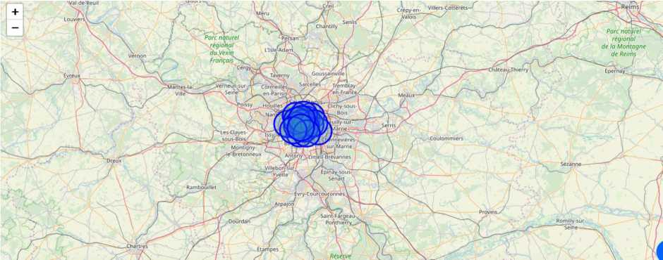
The Data Science Workflow for parts 3 & 4 includes:
• Data Analysis and Location Data:
o Foursquare location data will be leveraged to explore or compare districts around Paris.
o Data manipulation and analysis to derive subsets of the initial data. o Identifying the high traffic areas using data visualisation and tatistical nalysis.
• Visualization:
o Analysis and plotting visualizations. o Data visualization using various mapping libraries.
• Discussion and Conclusions:
o Recomendations and results based on the data analysis. o Discussion of any limitations and how the results can be used, and any conclusions that can be drawn.
Create a map of Paris with districts superimposed
Use the Foursquare API to explore the Arrondissements of Paris (Neighborhoods) Exploratory data analysis
Explore the first district in our dataframe to become familiar with the data (use the French descriptive arrondissement name)
The first arrondissement is identified as 3eme Ardt
Get the top 100 venues that are in the neighborhood 3eme Ardt within a radius of 500 meters

Slide 6
 | name | categories | lat | Ing
o | Mmmozza | Sandwich Place | 48.863910 | 2.360591
-1 | Square du Temple | Park | 48.864475 | 2.360816
2 | March6 des Enfants Rouges | Farmers Market | 48.862806 | 2.361996
3 | Chez Alain Mi am Mlam | Sandwich Place | 48.862781 | 2.362064
4 | Chez Alain Mi am Mi am | Sandwich Place | 48.862369 | 2.361950
5 | Fromagerle Jouannault | Cheese Shop | 48.862947 | 2.362530
6 | Les Enfants Rouges | Wine Bar | 48.863013 | 2.361260
7 | OKomusu | Okonomiyaki Restaurant | 48.861453 | 2.360879
8 | Hotel Jules & Jim | Hotel | 48.863496 | 2.357395
9 | Mus£e de la Chasse et de la Nature | Museum | 48.861507 | 2.358624
10 | Bontemps | Dessert Shop | 48.863956 | 2.360725
It | Strada Cafe | Caf6 | 48.862224 | 2.357379
12 | Comme un Roman | Bookstore | 48.863095 | 2.362208
13 | Paris New York | Burger Joint | 48.863843 | 2.362661
14 | SoMa | Japanese Restaurant | 48.861511 | 2.362146
15 | Les Enfants Du March6 | French Restaurant | 48.862746 | 2.361950
16 | Hank Burger | Burger Joint | 48.861340 | 2.358304
17 | Nanashi | Japanese Restaurant | 48.863702 | 2.363025
18 | The Broken Arm | Boutique | 48.864653 | 2.361433
19 | Biglove Caff& | Italian Restaurant | 48.862063 | 2.363557
Calculate how many unique venue categories there are Analyze each of the Neighbourhoods
Group rows by neighborhood and take the mean of the frequency of occurrence of each category
 | Neighborhood | Afghan Restaurant | African Restaurant | American Restaurant | Antique Shop | Argentinian Restaurant | Art Gallery | Art Museum | Arts & Crafts Store | Asian Restaurant |  | Udon Restaurant | Vegetarian / Vegan Restaurant
0 | 10eme Ardt | 0.000000 | 0.020000 | 0.000000 | 0.00 | 0.00 | 0.000000 | 0.000000 | 0.000000 | 0.020000 |  | 0.00 | 0.010000
1 | 11eme Ardt | 0.015152 | 0.015152 | 0.000000 | 0.00 | 0.00 | 0.000000 | 0.015152 | 0.000000 | 0.015152 |  | 0.00 | 0.015152
2 | 12eme Ardt | 0.000000 | 0.000000 | 0.000000 | 0.00 | 0.00 | 0.000000 | 0.000000 | 0.000000 | 0.000000 |  | 0.00 | 0.000000
3 | I3eme Ardt | 0.000000 | 0.000000 | 0.000000 | 0.00 | 0.00 | 0.000000 | 0.000000 | 0.000000 | 0.206897 |  | 0.00 | 0.000000
4 | I4eme Ardt | 0.000000 | 0.000000 | 0.000000 | 0.00 | 0.00 | 0.000000 | 0.000000 | 0.000000 | 0.000000 |  | 0.00 | 0.000000
5 | I5eme Ardt | 0.000000 | 0.000000 | 0.000000 | 0.00 | 0.00 | 0.000000 | 0.000000 | 0.015873 | 0.000000 |  | 0.00 | 0.000000
6 | 16eme Ardt | 0.000000 | 0.000000 | 0.000000 | 0.00 | 0.00 | 0.000000 | 0.090909 | 0.000000 | 0.000000 |  | 0.00 | 0.000000
7 | 17eme Ardt | 0.000000 | 0.000000 | 0.000000 | 0.00 | 0.00 | 0.000000 | 0.019608 | 0.000000 | 0.000000 |  | 0.00 | 0.000000
8 | 18eme Ardt | 0.000000 | 0.000000 | 0.000000 | 0.00 | 0.00 | 0.000000 | 0.000000 | 0.000000 | 0.000000 |  | 0.00 | 0.020000
9 | 19eme Ardt | 0.000000 | 0.000000 | 0.024390 | 0.00 | 0.00 | 0.000000 | 0.000000 | 0.000000 | 0.000000 |  | 0.00 | 0.000000
10 | ler Ardl | 0.000000 | 0.000000 | 0.000000 | 0.01 | 0.00 | 0.000000 | 0.030000 | 0.000000 | 0.000000 |  | 0.02 | 0.000000
11 | 20eme Ardt | 0.000000 | 0.000000 | 0.000000 | 0.00 | 0.00 | 0.000000 | 0.000000 | 0.000000 | 0.000000 |  | 0.00 | 0.000000
12 | 2eme Ardt | 0.000000 | 0.000000 | 0.010000 | 0.00 | 0.00 | 0.000000 | 0.000000 | 0.000000 | 0.010000 |  | 0.00 | 0.000000
13 | 3eme Ardt | 0.000000 | 0.000000 | 0.000000 | 0.00 | 0.01 | 0.020000 | 0.010000 | 0.000000 | 0.000000 |  | 0.00 | 0.020000
14 | 4eme Ardt | 0.000000 | 0.000000 | 0.000000 | 0.00 | 0.00 | 0.020000 | 0.010000 | 0.010000 | 0.000000 |  | 0.00 | 0.000000
15 | 5eme Ardt | 0.000000 | 0.000000 | 0.000000 | 0.00 | 0.00 | 0.000000 | 0.000000 | 0.000000 | 0.000000 |  | 0.00 | 0.000000
16 | 6eme Ardt | 0.000000 | 0.000000 | 0.011364 | 0.00 | 0.00 | 0.000000 | 0.011364 | 0.000000 | 0.000000 |  | 0.00 | 0.000000
17 | 7eme Ardt | 0.000000 | 0.000000 | 0.000000 | 0.00 | 0.00 | 0.000000 | 0.030000 | 0.000000 | 0.000000 |  | 0.00 | 0.010000
18 | Seme Ardt | 0.000000 | 0.000000 | 0.000000 | 0.00 | 0.00 | 0.013699 | 0.013699 | 0.000000 | 0.000000 |  | 0.00 | 0.000000
19 | 9eme Ardt | 0.000000 | 0.010000 | 0.000000 | 0.00 | 0.01 | 0.000000 | 0.000000 | 0.000000 | 0.000000 |  | 0.00 | 0.020000
Print each neighborhood with it's top 10 most common venues
----10eme Ardt----
venue freq

Slide 7
0 | French Restaurant | 0.12
1 | Hotel | 0.05
2 | Bistro | 0.04
3 | Cafe | 0.04
4 | Coffee Shop | 0.04
5 | Pizza Place | 0.03
6 | Japanese Restaurant | 0.03
7 | Indian Restaurant | 0.03
8 | Italian Restaurant | 0.03
9 | Wine Bar | 0.02
— | --11eme Ardt----
 | venue | freq
0 | French Restaurant | 0.11
1 | Restaurant | 0.06
2 | Wine Bar | 0.05
3 | Cafe | 0.05
4 | Pastry Shop | 0.05
5 | Cocktail Bar | 0.03
6 | Japanese Restaurant | 0.03
7 | Pizza Place | 0.03
8 | Bar | 0.03
9 | Bistro | 0.03
-- | --12eme Ardt----
 | venue | freq
0 | Zoo | 0.25
1 | Supermarket | 0.25
2 | Bike Rental / Bike Share | 0.25
3 | Monument / Landmark | 0.25
4 | Music Store | 0.00
5 | Nightclub | 0.00
6 | Noodle House | 0.00
7 | Office | 0.00
8 | Okonomiyaki Restaurant | 0.00
9 | Optical Shop | 0.00
 | --13eme Ardt---- venue | freq
0 | Asian Restaurant | 0.21
1 | Vietnamese Restaurant | 0.19
2 | Chinese Restaurant | 0.09
3 | Thai Restaurant | 0.09
4 | French Restaurant | 0.07
5 | Juice Bar | 0.05
6 | Japanese Restaurant | 0.03
7 | Cosmetics Shop | 0.02
8 | Sandwich Place | 0.02
9 | Gourmet Shop | 0.02
-- | --14eme Ardt----
 | venue | freq
0 | French Restaurant | 0.37
1 | Hotel | 0.10
2 | Supermarket | 0.07
3 | Bistro | 0.07
4 | Italian Restaurant | 0.03

Slide 8
5 | Convenience | Store | 0.03
6 | Pizza | Place | 0.03
7 | Fast Food Restaurant |  | 0.03
8 | Food & Drink | Shop | 0.03
9 |  | Cafe | 0.03
— | --15eme Ardt----
 | venue | freq
0 | Hotel | 0.13
1 | Italian Restaurant | 0.10
2 | French Restaurant | 0.10
3 | Coffee Shop | 0.05
4 | Indian Restaurant | 0.03
5 | Bistro | 0.03
6 | Thai Restaurant | 0.03
7 | Japanese Restaurant | 0.03
8 | Park | 0.03
9 | Bakery | 0.03
-- | --16eme Ardt----
 | venue | freq
0 | Lake | 0.18
1 | Plaza | 0.18
2 | French Restaurant | 0.09
3 | Art Museum | 0.09
4 | Pool | 0.09
5 | Boat or Ferry | 0.09
6 | Bus Station | 0.09
7 | Bus Stop | 0.09
8 | Park | 0.09
9 | Afghan Restaurant | 0.00
----17eme Ardt----
venue freq
0 | French | Restaurant | 0.22
1 |  | Hotel | 0.16
2 | Italian | Restaurant | 0.08
3 |  | Bakery | 0.08
4 |  | Cafe | 0.04
5 |  | Plaza | 0.04
6 |  | Bistro | 0.04
7 | Japanese | Restaurant | 0.04
8 |  | Bar | 0.04
9 | Grocery Store |  | 0.02
-- | --18eme Ardt----
 | venue | freq
0 | Bar | 0.16
1 | French Restaurant | 0.12
2 | Pizza Place | 0.06
3 | Coffee Shop | 0.04
4 | Convenience Store | 0.04
5 | Cafe | 0.04
6 | Theater | 0.04
7 | Hotel | 0.04
8 | Vietnamese Restaurant | 0.04
9 | Restaurant | 0.04

Slide 9
 | --19eme Ardt---- venue | freq
0 | Bar | 0.10
1 | French Restaurant | 0.10
2 | Restaurant | 0.07
3 | Japanese Restaurant | 0.05
4 | Supermarket | 0.05
5 | Seafood Restaurant | 0.05
6 | Hotel | 0.05
7 | Bistro | 0.05
8 | Beer Bar | 0.05
9 | Cafe | 0.02
-- | --1er Ardt----
 | venue | freq
0 | French Restaurant | 0.11
1 | Hotel | 0.08
2 | Cafe | 0.08
3 | Japanese Restaurant | 0.06
4 | Plaza | 0.06
5 | Exhibit | 0.04
6 | Coffee Shop | 0.04
7 | Restaurant | 0.03
8 | Bar | 0.03
9 | Art Museum | 0.03
-- | --20eme Ardt----
 |  | venue | freq
0 |  | Bakery | 0.08
1 |  | Bar | 0.08
2 | French | Restaurant | 0.08
3 |  | Cafe | 0.06
4 |  | Plaza | 0.06
5 |  | Bistro | 0.06
6 | Italian | Restaurant | 0.06
7 | Sushi | Restaurant | 0.04
8 | Indian | Restaurant | 0.04
9 | Mexican | Restaurant | 0.02
-- | --2eme Ardt----
 | venue | freq
0 | French Restaurant | 0.12
1 | Wine Bar | 0.06
2 | Bistro | 0.05
3 | Cocktail Bar | 0.05
4 | Italian Restaurant | 0.03
5 | Salad Place | 0.03
6 | Bakery | 0.03
7 | Hotel | 0.03
8 | Ice Cream Shop | 0.02
9 | Coffee Shop | 0.02
-- | --3eme Ardt----
 | venue | freq
0 | French Restaurant | 0.08
1 | Wine Bar | 0.04

Slide 10
2 | Coffee Shop | 0.04
3 | Italian Restaurant | 0.04
4 | Bistro | 0.03
5 | Cafe | 0.03
6 | Burger Joint | 0.03
7 | Moroccan Restaurant | 0.03
8 | Sandwich Place | 0.03
9 | Japanese Restaurant | 0.03
The top 10 venue categories for each neighborhood
This is a very useful results table that can provide at a glance information for all of the districts. Even once any conclusions are drawn further into the data workflow, we can refer back to this table for meaaningful insights about the top categories of businesses in all the neighbourhoods. Even without actual counts and numbers, it makes a great reference table for the client
 | Neighborhood | 1st Most Common Venue | 2nd Most Common Venue | 3rd Most Common Venue | 4th Most Common Venue | 5th Most Common Venue | 6th Most Common Venue | 7th Most Common Venue | 8th Most Common Venue | 9th Most Common Venue | 10th Most Common Venue
0 | 10eme Ardt | French Restaurant | Hotel | Coffee Shop | Cafe | Bistro | Pizza Place | Japanese Restaurant | Indian Restaurant | Italian Restaurant | Bar
1 | 11 eme Ardt | French Restaurant | Restaurant | Wine Bar | Pastry Shop | Cafe | Japanese Restaurant | Pizza Place | Bar | Bistro | Theater
2 | 12eme Ardt | Zoo | Monument / Landmark | Supermarket | Bike Rental / Bike Share | Furniture / Fiome Store | Fountain | Food & Drink Shop | Flower Shop | Fish& Chips Shop | Fast Food Restaurant
3 | 13eme Ardt | Asian Restaurant | Vietnamese Restaurant | Thai Restaurant | Chinese Restaurant | French Restaurant | Juice Bar | Japanese Restaurant | Cambodian Restaurant | Bookstore | Convenience Store
4 | 14eme Ardt | French Restaurant | Hotel | Bistro | Supermarket | Italian Restaurant | Bakery | Pizza Place | Cafe | Fast Food Restaurant | Food & Drink Shop
5 | 15eme Ardt | Hotel | Italian Restaurant | French Restaurant | Coffee Shop | Japanese Restaurant | Bakery | Park | Bistro | Lebanese Restaurant | Thai Restaurant
6 | 16eme Ardt | Lake | Plaza | Pool | Boat or Ferry | Bus Station | Bus Stop | Park | French Restaurant | Art Museum | Cupcake Shop
7 | 17eme Ardt | French Restaurant | Hotel | Italian Restaurant | Bakery | Plaza | Bar | Japanese Restaurant | Bistro | Cafe | Flower Shop
8 | I8eme Ardt | Bar | French Restaurant | Pizza Place | Convenience Store | Restaurant | Theater | Cafe | Vietnamese Restaurant | Coffee Shop | Hotel
The business types criteria specified by the client! 'French Restaurants'Cafes'and 'WineBars
Let’s look at their frequency of occurance for all the Paris neighborhoods, isolating the categorical venues
These are the venue types that the client wants to have an abundant density of in the ideal store locations. I've used a violin plot from the seaborn library - it is a great way to visualise frequency distribution datasets, they display a density estimation of the underlying distribution.

Slide 11
am mi i mill mi
mill__I_ II11111_I__I
il__I_____I__I
The Neighborhoods
So as we can see from the analysis there are 8 neighborhoods to open new stores - according to the criteria that they have the 3 specified venues in a great frequency (French Restaurants, Cafes and Wine Bars). They are as follows:
Neighborhoods
• 3eme Ardt
• 10eme Ardt
• 11eme Ardt
• 4eme Ardt
• 18eme Ardt
• 18eme Ardt
• 5eme Ardt
• 9eme Ardt
• 6eme Ardt
Let’s take this further with some exploration and Inferential Analysis
We have the 8 neighborhoods that all include the venue category criteria.
But if we included the 'Clothing_Store" venue category into the analysis, then we might be able to make some inferences based on the data, and domain knowledge of marketing and the industry, to focus the list.
Let’s look at the venue category - "Clothing Store

Slide 12
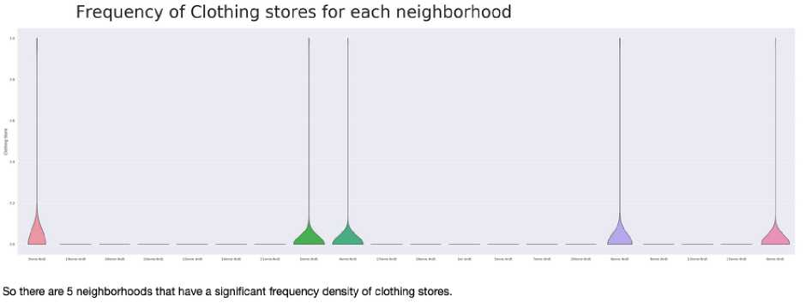
4 Inferences and Discussion Chosen Neighbourhoods - Results
Inferential analysis using the data, as well as domain knowledge of retail and marketing, allow the list to be focussed to just 3 neighbourhoods from the previous 8.
The reasoning being that if the 3 criteria have been met - identifying neighbourhoods that are lively with Restaurants, Cafes and Wine Bars - adding Clothing Stores into the mix of stores in the area is a significant bonus. Having some of the same category of stores in the same area - especially in fashion retail - is very desirable as a retailer.
So we can increase the criteria to include Restaurants, Cafes, Wine Bars and Clothing Stores
- which narrows down and focuses the suggested districts for new stores to be located, and at the same time provides better locations for the brand.
So the final 3 prospective neighborhoods for new store locations are where 4 criteria are met:
- 3eme Ardt : Arrondissement 3, Temple
- 4eme Ardt : Arrondissement 4, Hotel-de-Ville
- 6eme Ardt : Arrondissement 6, Luxembourg
Let’s look at the 3 districts on a Paris map

Slide 13
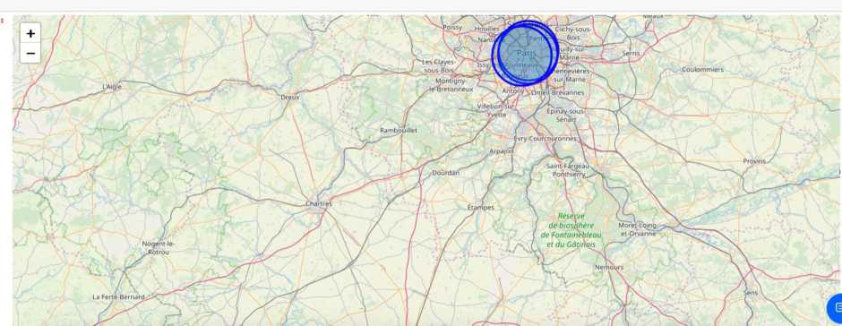
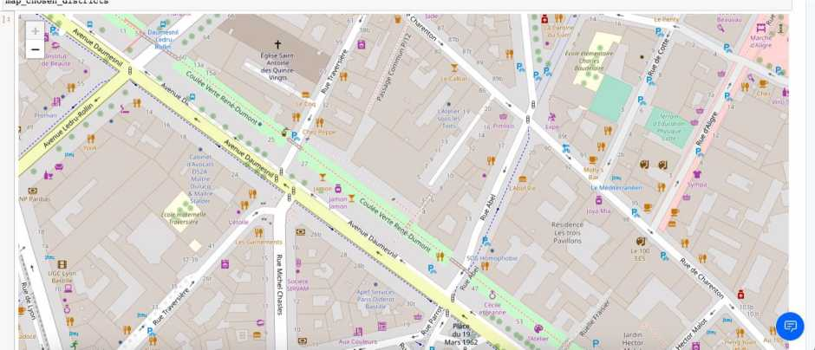
Or for a closer view of Central Paris
5 Observations
I guess it's not a surprise that these districts are all very centrally located in the circular arrangement of Paris's arrondissements. Locations fitting the criteria for popular venues would normally be in central locations in many cities of the world.
From this visualisation it is clear that on a practical level, with no data to base decisions on, the circle of the 20 districs is very large, and researching and then visiting them all would be a daunting and time consuming task. We have narrowed the search area down significantly from 20 potential districts to 3 that should suit the client's retail business.
Inferences

Slide 14
We have made inferences from the data in making the location recommendations, but that is exactly the point. There is no right or wrong answer or conclusion for the task at hand. The job of data analysis here is to steer a course for the location selection of new stores (i) to meet the criteria of being in neighbourhoods that are lively with abundant leisure venues, and (ii) to narrow the search down to just a few of the main areas that are best suited to match the criteria.
6 Conclusions
There are many ways this analysis could have been performed based on different methodolgy and perhaps different data sources. I chose the method I selected as it was a straight forward way to narrow down the options, not complicating what is actually simple in many ways -meeting the the critera for the surrounding venues, and in my case, domain knowledge I have on the subject. I originally intended to use the clustering algorythms to cluster the data, but as it progressed it became obvious that this only complicated the task at hand. The analysis and results are not an end point, but rather a starting point that will guide the next part of the process to find specific store locations. The next part will involve domain knowledge of the industry, and perhaps, of the city itself. But the data analysis and resulting recommendations have greatly narrowed down the best district options based on data and what we can infer from it.
Without leveraging data to make focussed decisions, the process could have been drawn out and resulted in new stores opening in sub-standard areas for this retailer. Data has helped to provide a better strategy and way forward, these data-driven decisions will lead to a better solution in the end.
Thanks for taking part in my Data Science journey!

