Slide 1

Corporate Onboarding & Training Intelligence Hub
Multi-Modal Agentic RAG with Division RBAC & RAGAS Observability
ENTERPRISE AI PLATFORM
V1.0 — PITCH DECK

Slide 2

The Knowledge Crisis in Enterprise
🗂️ Knowledge Silos
Training content trapped in PDFs and video recordings — unsearchable, unindexed, and inaccessible at scale.
🔓 Security Leaks
Cross-division data exposure from flat RAG architectures with no query-level access control.
💸 Uncontrolled LLM Costs
Bloated context windows and redundant inference driving unsustainable token expenditure.
❓ Untrusted Search
Hallucinated answers and low-confidence retrieval eroding user trust in AI-assisted onboarding.

Slide 3
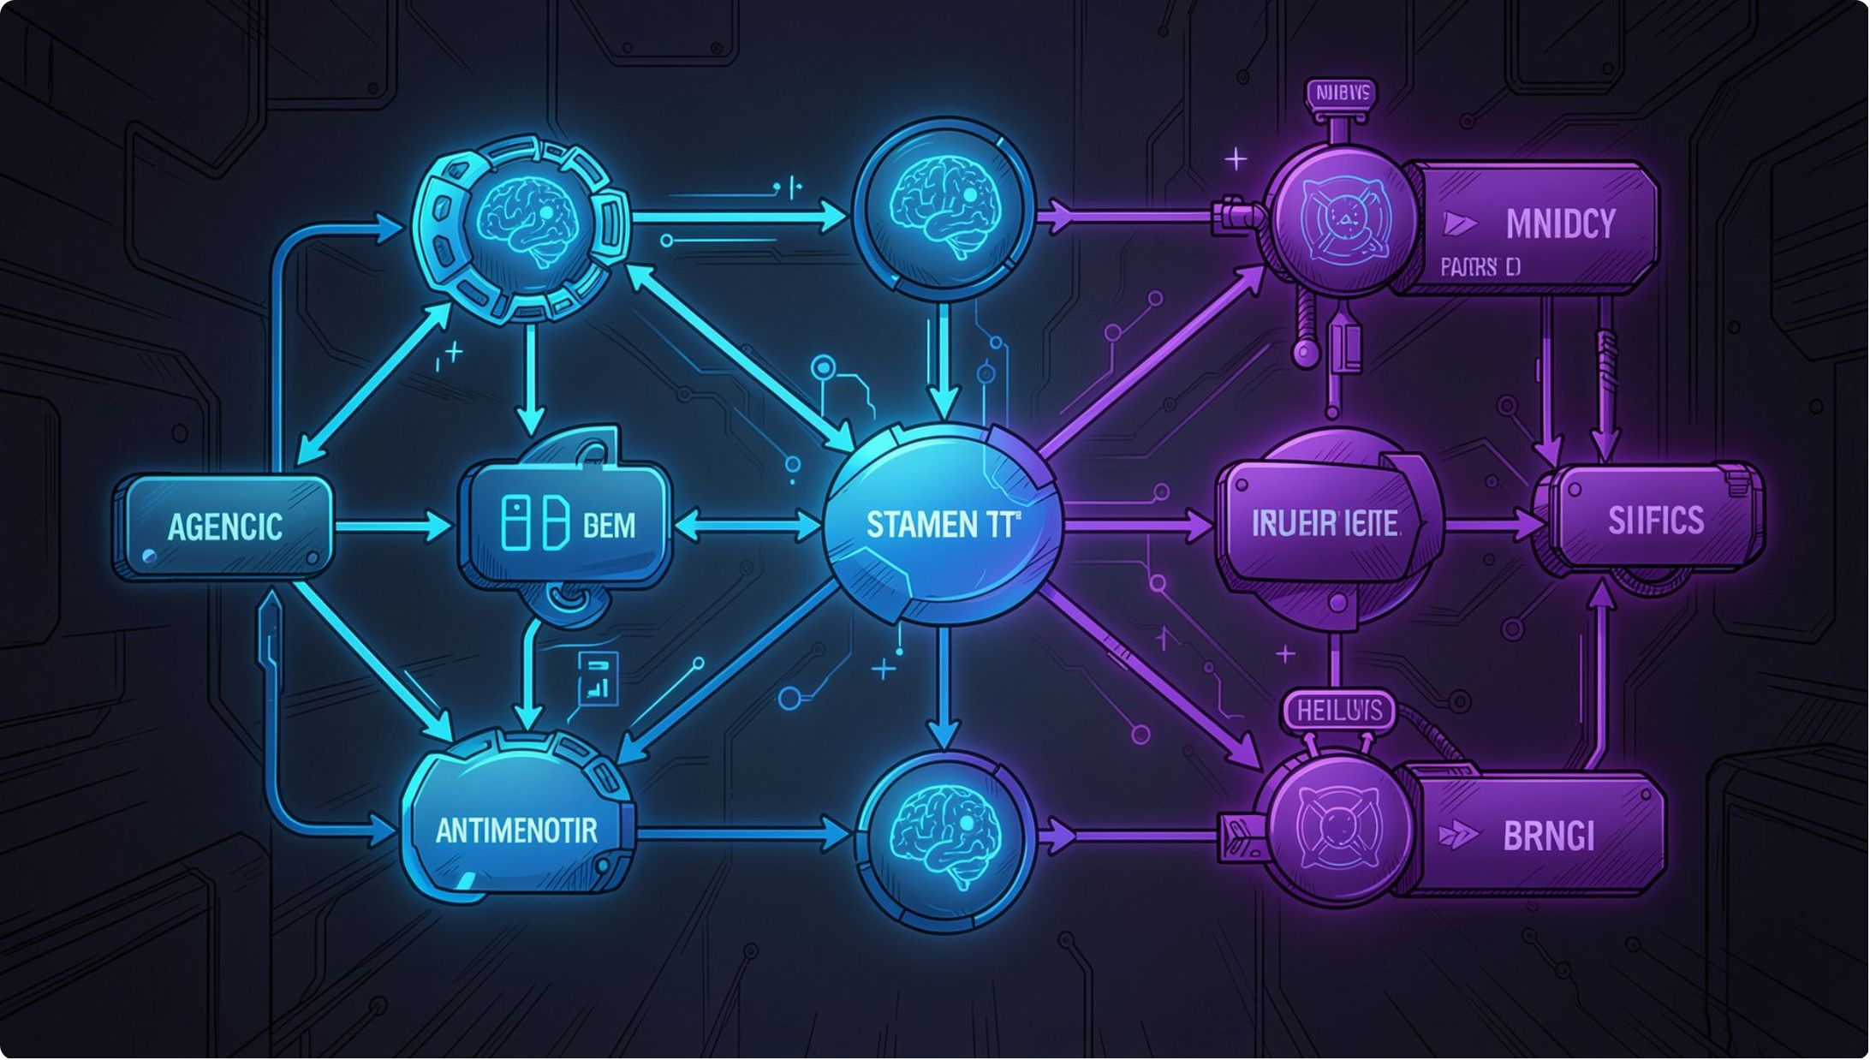
The Platform Solution
LangGraph Agentic RAG State Machine
Stateful orchestration of retrieval, routing, and generation — with explicit decision gates at every step.
Query-Level Division RBAC
Every query is scoped to division and businessLine before vector search executes. No leakage, by design.
Whisper Media Ingestion + Semantic Caching
Audio/video transcribed via Whisper, embedded lazily, and cached at user_email:query granularity — cutting redundant LLM calls by 90%.

Slide 4
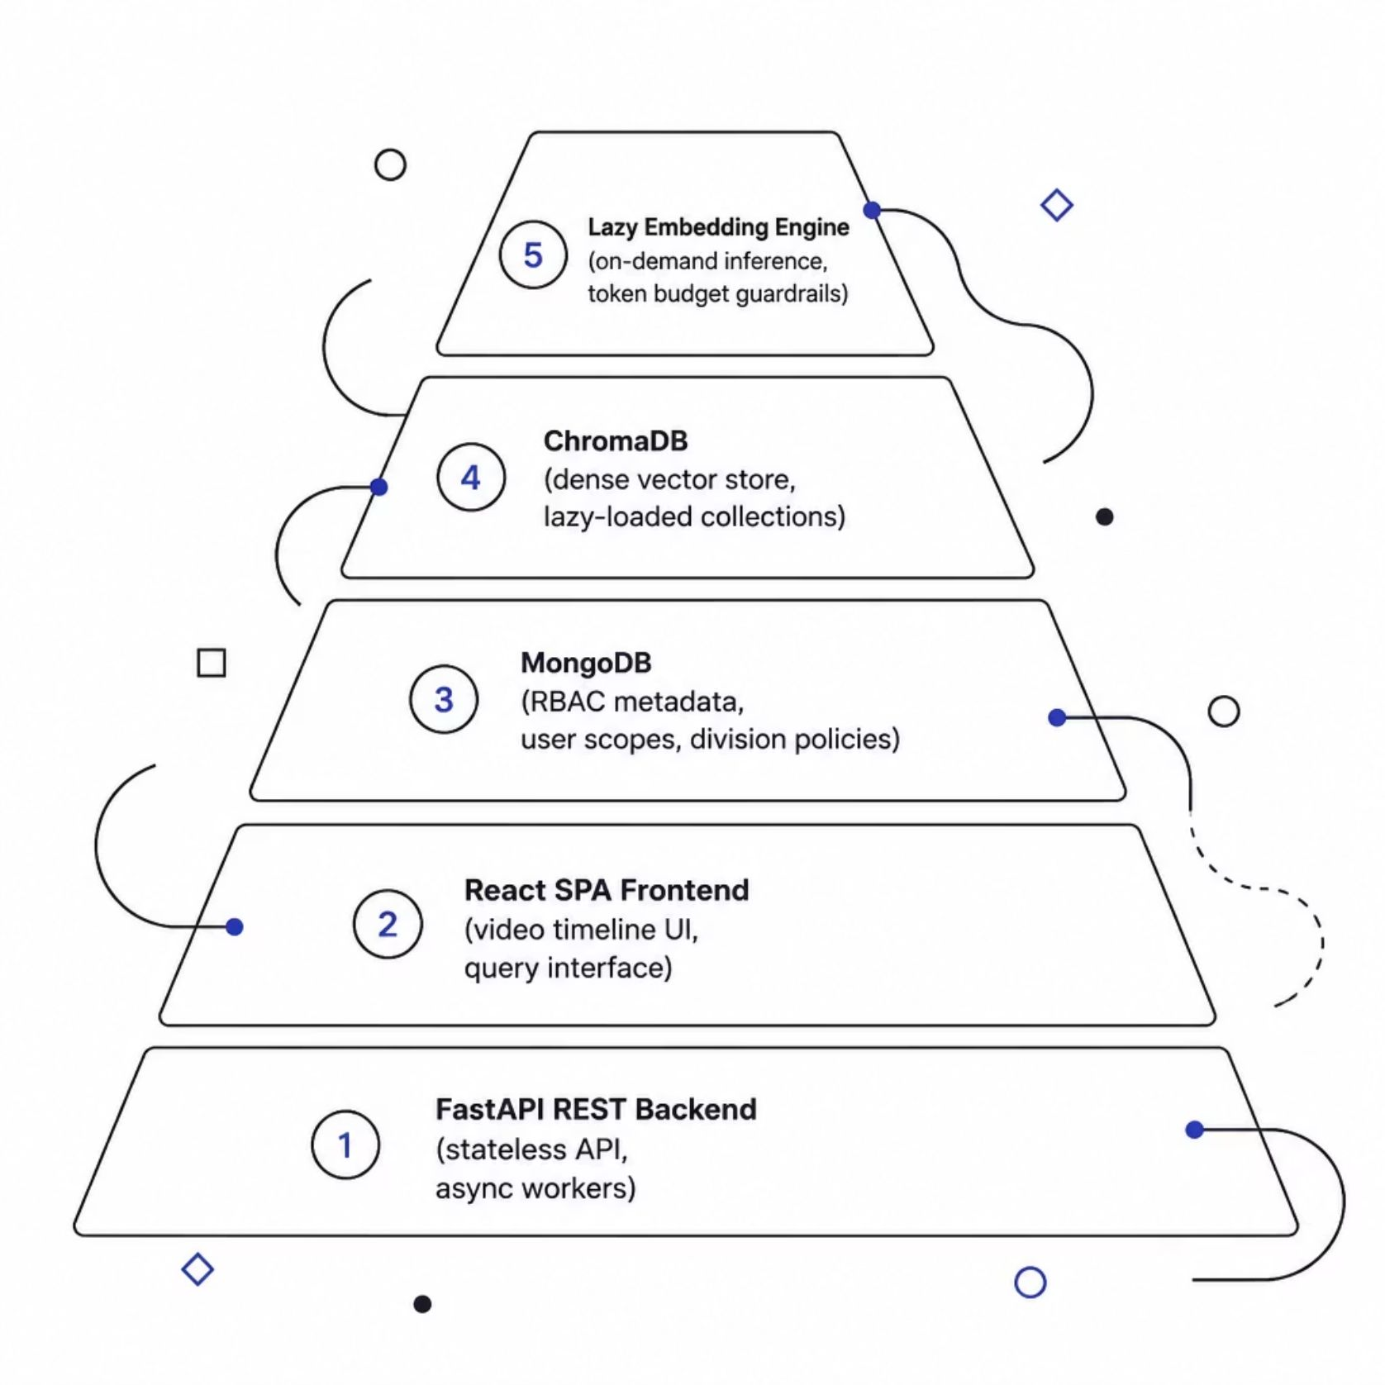
System Architecture
Layered for Scale & Security
The architecture separates concerns across five discrete layers — each independently scalable and auditable.
FastAPI handles async request routing with sub-10ms overhead
MongoDB stores RBAC policies, user scopes, and division metadata
ChromaDB manages lazy-loaded vector collections per business unit
Lazy Embedding Engine defers inference until query-time, slashing idle compute

Slide 5
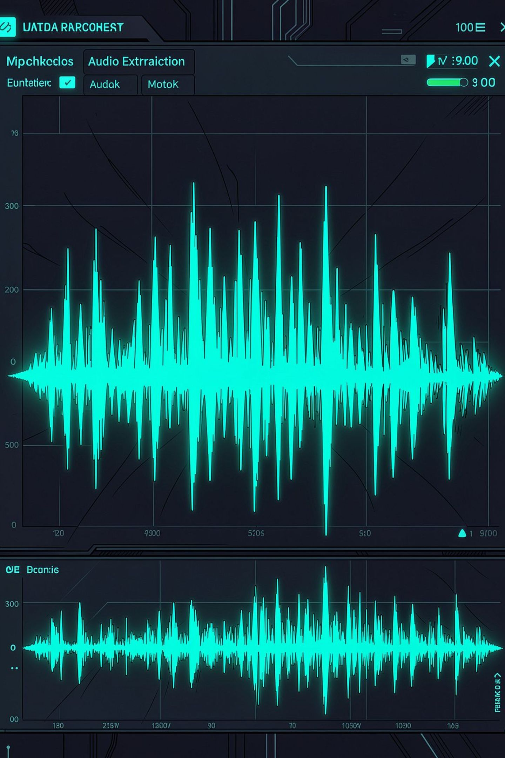




Multi-Format Ingestion Pipeline
MoviePy Extraction
Audio pulled from video in sub-0.5 seconds — no transcoding overhead.
Whisper Transcription
OpenAI Whisper converts speech to text with speaker diarization support.
Paragraph Aggregation
30–60 second timestamp windows merged into semantic chunks — 60%+ DB savings.
Lazy Embedding
Vectors generated on-demand, not at ingest — eliminating cold-storage waste.

Slide 6
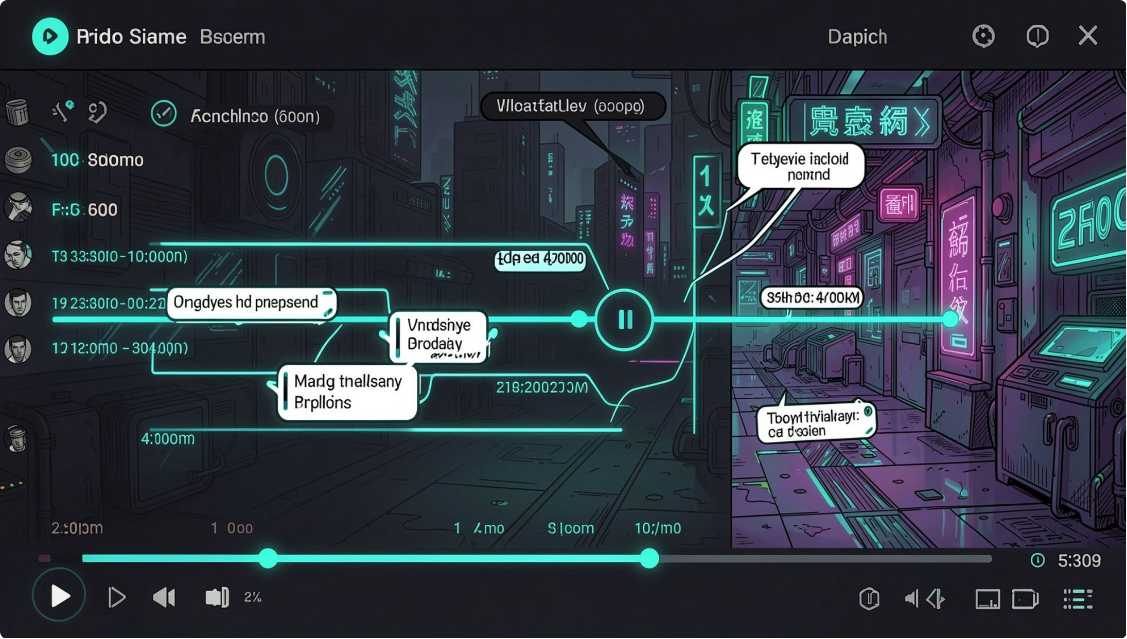

Interactive Video Timeline UI
Precision-Linked Retrieval
Users don't just get an answer — they get the exact moment in the training video where that answer was spoken.
Track Badges
Merged Intervals
Hover Speech Tooltips
Video and audio source indicators displayed inline with retrieved segments.
Continuous spans (e.g., 00:00–04:10) collapsed into single clickable regions.
Transcript snippets surface on hover — no playback required for quick scanning.

Slide 7
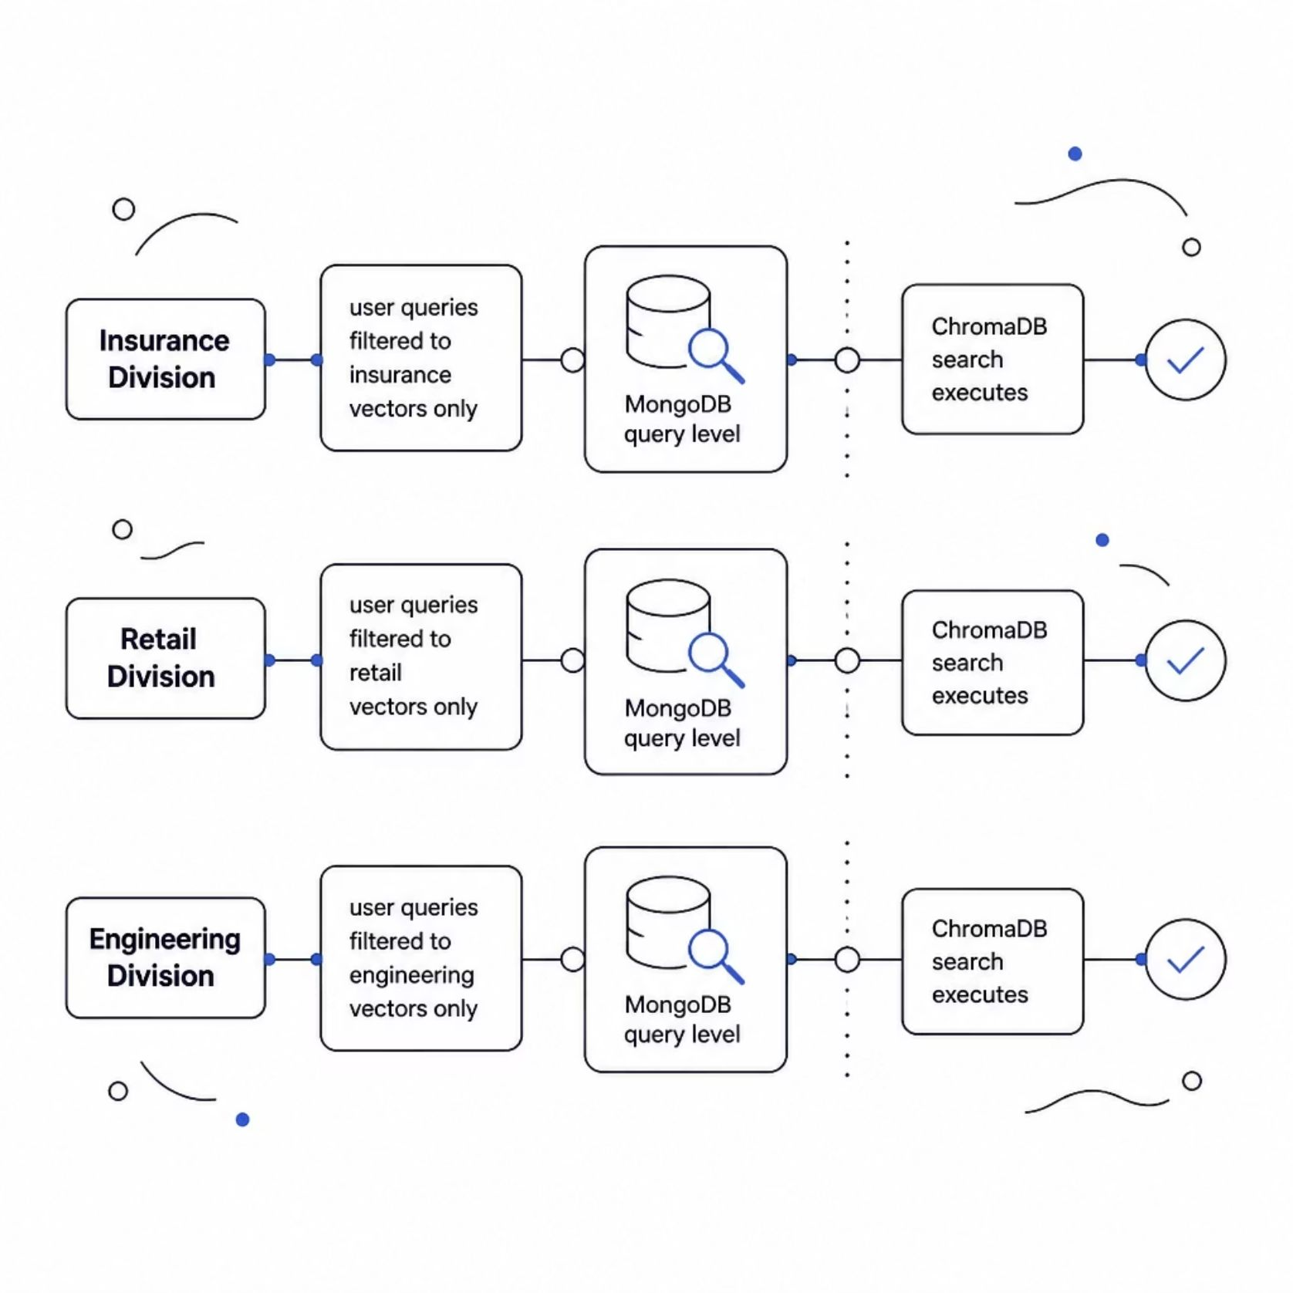
Security & User-Scoped Caching
Query-Level MongoDB Isolation
Every retrieval query is pre-filtered against the user's division and businessLine record in MongoDB. Insurance users never touch Retail vectors. Engineering never sees Finance metadata.
Semantic Cache Key: user_email:query
Identical queries from the same user hit the cache layer — bypassing embedding and LLM entirely. 90% latency reduction on repeat queries.

Slide 8
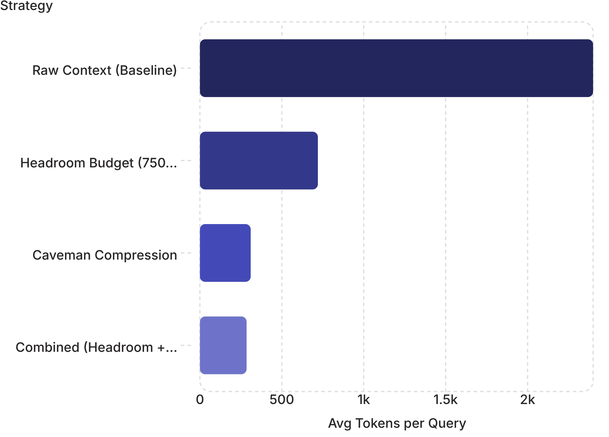

Prompt Optimization Matrix
Two-Layer Token Discipline
Headroom Context Budget enforces a hard 750-token ceiling on retrieved context — truncating low-relevance chunks before they reach the LLM.
Caveman Output Compression strips verbose LLM preamble, markdown overhead, and redundant explanations — delivering only the answer payload.
Combined strategy achieves 88% token reduction vs. baseline — directly translating to LLM cost savings at enterprise query volume.

Slide 9
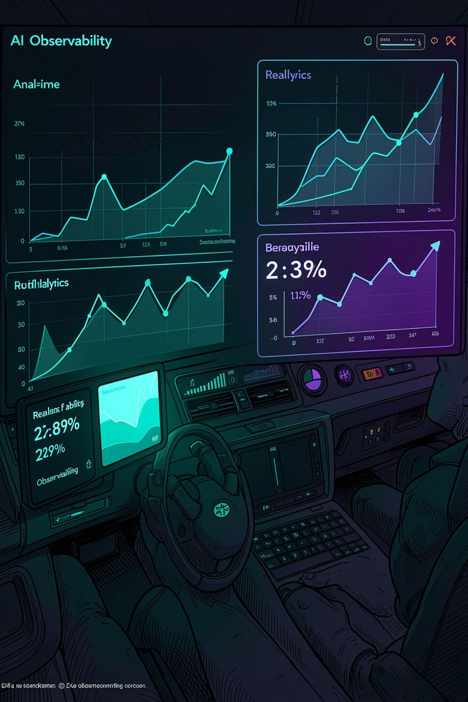




Observability & RAGAS Scoring
Faithfulness
Measures whether generated answers are grounded in retrieved context — detecting hallucination at inference time.
Context Precision
Scores whether the most relevant chunks appear at the top of the retrieval window — optimizing token budget usage.
Answer Relevancy
Evaluates whether the final response directly addresses the user's query — closing the quality feedback loop.
Langfuse Trace Logging
Full trace-level observability: every span, token count, latency milestone, and RAGAS score logged in real time.

Slide 10

Business Impact
90%
0
LLM Cost Reduction
Hallucinations
Via semantic caching, lazy embedding, and prompt compression at scale.
RAGAS Faithfulness gating blocks ungrounded answers before delivery.
100%
<0.5s
Division Isolation
Media Ingestion
Query-level RBAC ensures zero cross-division data leakage by architecture.
Audio extraction from video via MoviePy — enabling real-time onboarding content pipelines.
Enterprise-ready from day one. Multi-modal accessibility, absolute data isolation, and auditable AI — built for the compliance and scale demands of global enterprise onboarding.

