Slide 1


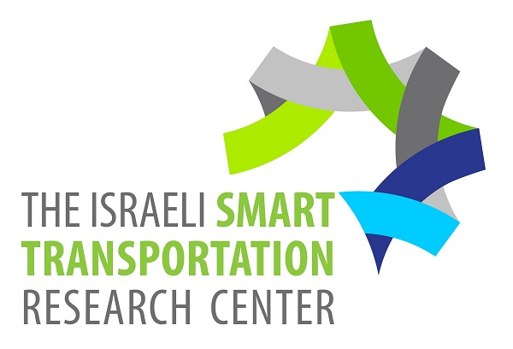
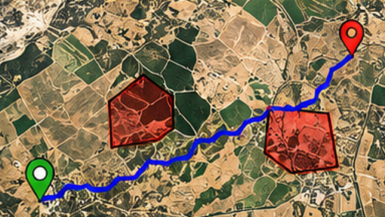
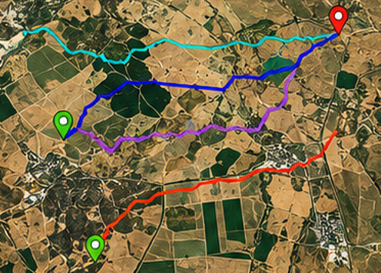
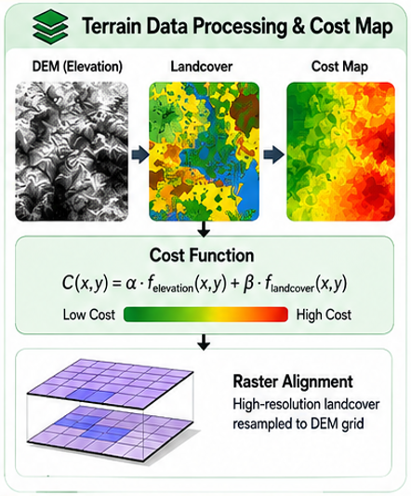
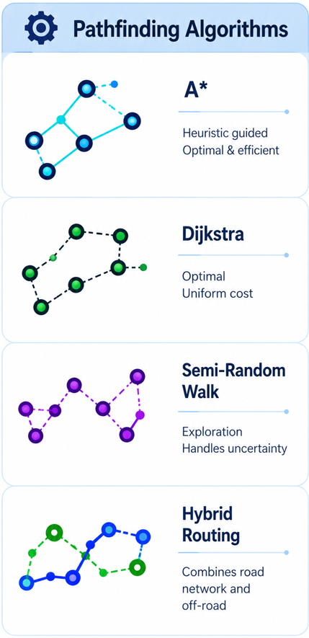
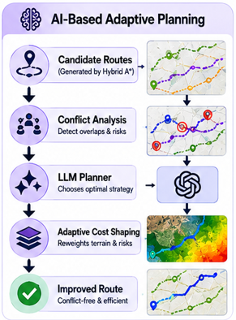
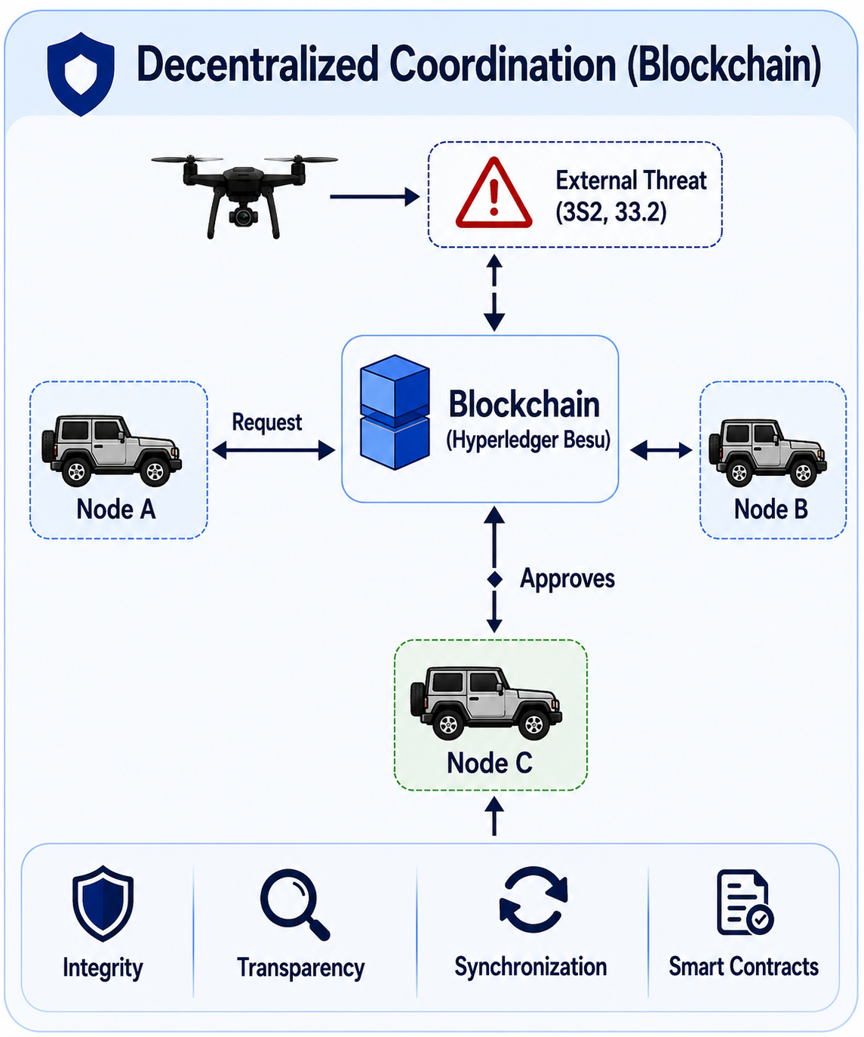
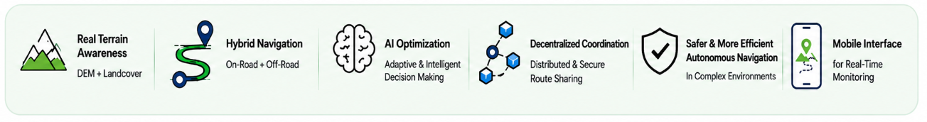
Background
Research Objective
Autonomous off-road navigation is challenging due to varying terrain conditions, environmental obstacles, and coordination between multiple autonomous vehicles.
Developing a hybrid navigation framework:
On-road and off-road routing
Geospatial Analysis
AI-driven adaptive planning
Multi-vehicle coordination
Methodology
The system generates terrain-aware cost maps using DEM and Landcover data.
Each vehicle computes candidate routes using a terrain-aware pathfinding algorithm.
An AI-based coordination agent then analyzes the routes of all vehicles, detects conflicts, and recommends an improved strategy that benefits the overall multi-vehicle system.
Route information data is shared between vehicles through a decentralized blockchain network.
Research Contribution
The proposed AI-based framework uses an LLM and Agent architecture to analyze route alternatives, optimize coordination between autonomous vehicles, and adapt navigation strategies in real time.

