Slide 1
Global warming & climate change
Causes, effects and solutions

Slide 2
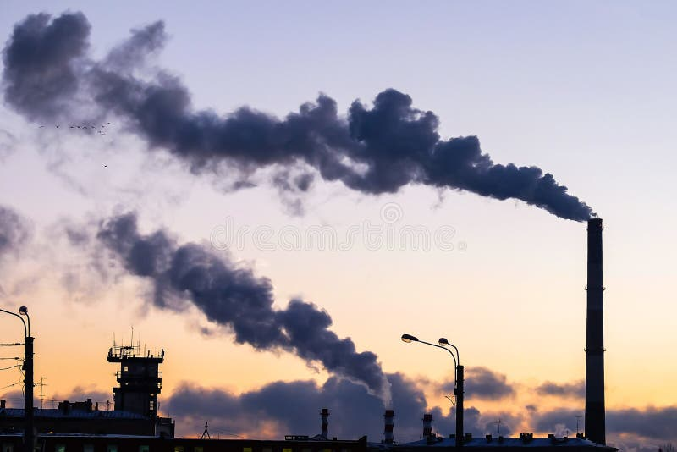
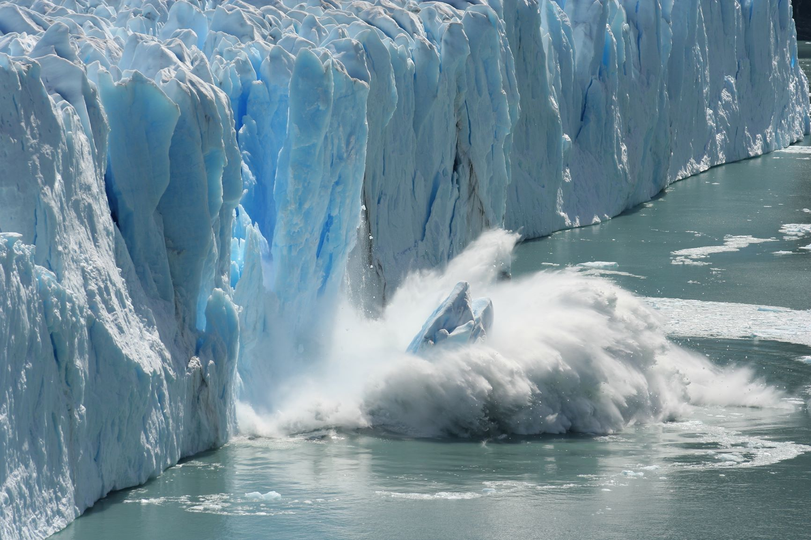
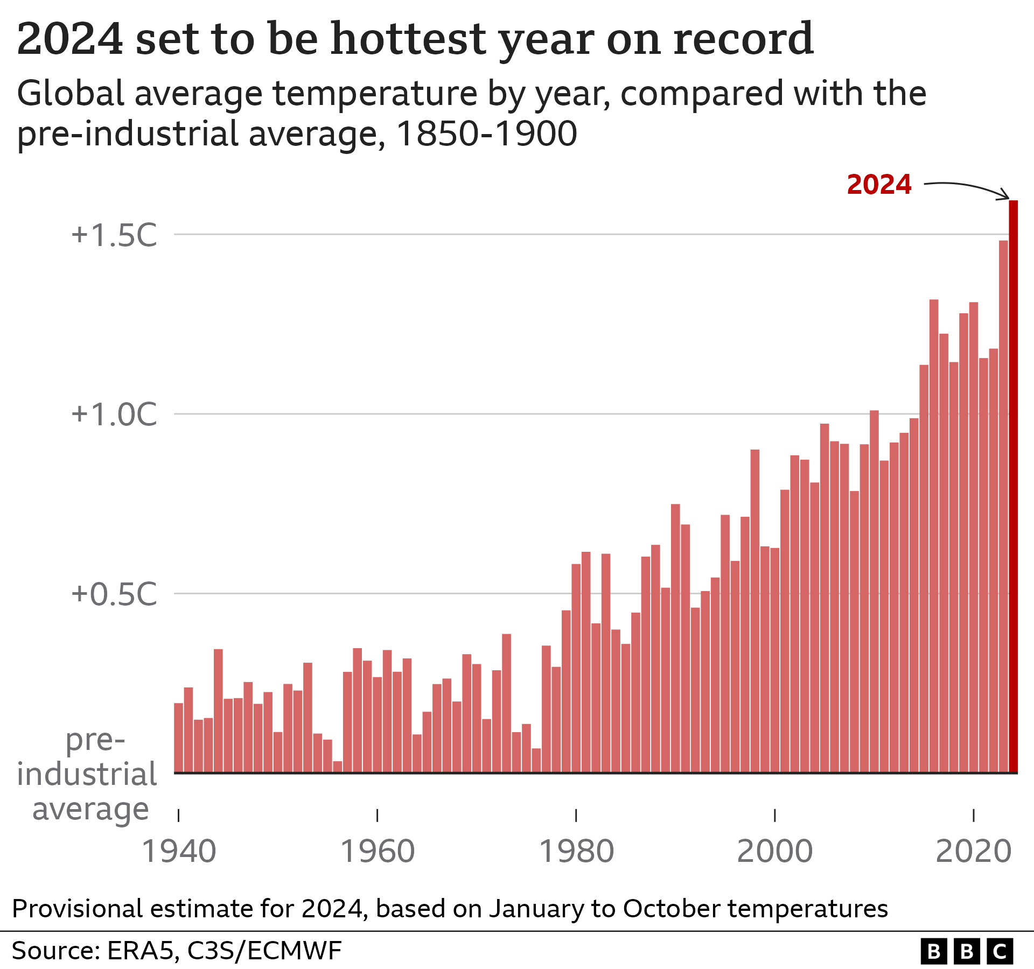
What is global warming?
Global warming means the long-term increase in earth’s average temperature.
It is mainly caused by increasing greenhouse gases.
Carbon dioxide is one of the major greenhouse gases.
Human activities are the primary cause of recent warming.

Slide 3
Major causes
CAUSE | EXAMPLE | IMPACT
BURING FOSSIL FUELS | COAL, OIL , GAS | CO2 EMISSIONS
DEFORESTATION | CUTTING FORESTS | LESS CO2 ABSORPTION
TRANSPORTATION | CARS, AIRCRAFT | GREENHOUSE GASES
INDUSTRY | FACTORIES | AIR POLLUTION
AGRICULTURE | LIVESTOCK, FERTILIZERS | METHANE AND OTHER EMISSIONS

Slide 4
EFFECTS OF CLIMATE CHANGE

Slide 5
SOLUTIONS
PLANT MORE TREES
USE RENEWABLE ENERGY
SAVE ELECTRICITY
SPREAD ENVIRONMENTAL AWARENESS
USE PUBLIC TRANSPORT & CYCLING
REDUCE, RECYCLE AND REUSE
LEARN MORE ABOUT CLIMATE CHANGE

