Slide 1
Peter Ladefoged and
Phonetics in the Field
Ian Maddieson
University of California, Berkeley
ianm@berkeley.edu

Slide 2
Among many distinctive contributions to phonetics by Peter Ladefoged is an insistence on the immense diversity of phonetic phenomena in the languages of the world, particularly at the segmental level
Because of this, Peter has maintained a flexible approach to any scheme of classification or description, adapting to both new approaches and new data
Perhaps more than any other phonetician he has always expected to find surprises, and has gone to far corners of the world in search of them

Slide 3
His ground-breaking Phonetic Study of West African Languages from 1964 laid out a template for synthesizing a large mass of data which is echoed in later works such as Preliminaries to Linguistic Phonetics and Sounds of the World’s Languages
His widely-used Course in Phonetics and other textbooks have drawn on this extensive experience and shown generations of students the richness of spoken sound
But the beginning of this thread in Peter’s work is clearly the Phonetic Study of West African Languages

Slide 4
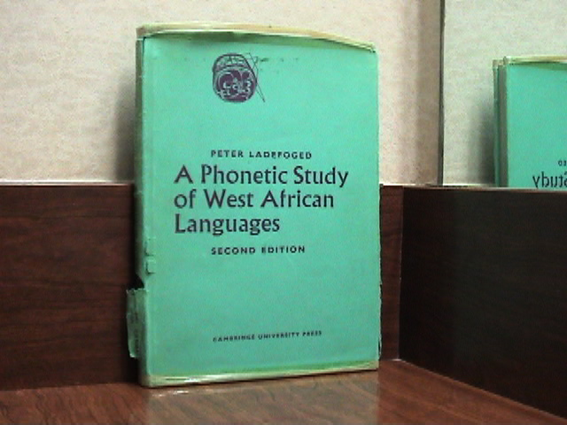
My well-used personal copy of
A Phonetic Study of West African Languages

Slide 5
Peter spent the year 1959/60 in Nigeria, ‘seconded’ from lectureship in phonetics at Edinburgh University
Met Joseph Greenberg and William Welmers scouting for projects for the Ford Foundation’s Survey of West African Languages
Proposed a phonetic study
After a year back in Edinburgh, returned to base in Ibadan for 1961/62 academic year
Collected material in Nigeria, Ghana, Sierra Leone and Senegal on 61 languages from 9 countries
By the time of publication, Peter was already at UCLA, his primary academic home ever since

Slide 6
PSWAL was unlike any previous work in the breadth of descriptive techniques brought to bear
“I do not know of any previous attempt to use data provided by palatograms, linguagrams, casts of the mouth, photographs of the lips and spectrograms all of the same utterance, supplemented by tracings of cine-radiology films and pressure and flow recordings of similar utterances of the same word” (PSWAL, Introduction, p. xvi)
To this day we do not have any comparable study of the languages of any other area of the world

Slide 7
Spectrogram of Hausa phrase containing
the word /ts’unts’a~aje~e/ “birds” (PSWAL Plate 1A)

Slide 8
Four types of stops in Owerri Igbo (PSWAL Plate 5)
Audio waveform
Oral airflow
Intraoral pressure
Spectrogram

Slide 9
Simultaneous frontal and lateral photographs of selected labial consonants of Isoko (PSWAL Plate 12)

Slide 10
Pharyngeal and oral pressure records and waveform and spectrogram of Itsekiri phrase containing bilabial and labial-velar stops /i~pE~rE~ kpo~ro~ bu!gba!/ “a big nail and a calabash” (PSWAL Plate 2A)

Slide 11
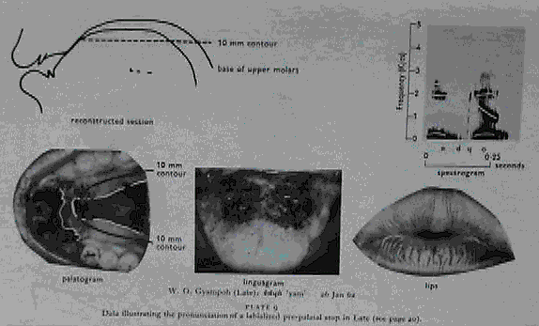
Data on Larteh voiced labial-palatalized alveolar stop in the word /e!d^{Á}o!/ “yam”. Spectrogram, palatogram, linguagram, lip position photo and reconstruction of the articulatory posture (PSWAL Plate 9)

Slide 12
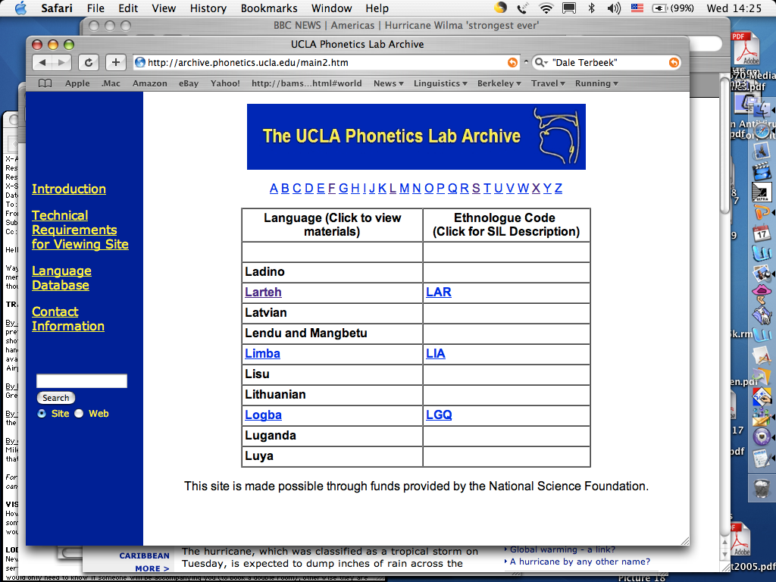
The recordings
made for PSWAL
are even now
available for
further research
on UCLA Archive
site

Slide 13
The recordings
made for PSWAL
are even now
available for
further research
on UCLA
Archive
site

Slide 14
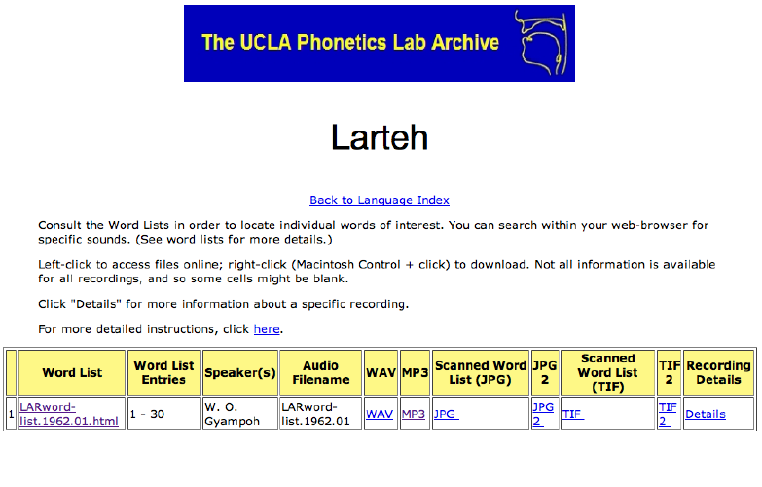

Slide 15

The field recording of Larteh — Peter Ladefoged with W. O. Gyampoh in 1962
Peter’s voice has hardly changed at all since 1962

Slide 16
Following his West African work, Peter soon started to visit other parts of the world — Mexico in 1963, India in 1965, Uganda in 1966/7
This led to the incisive survey of information on the “contrasts observable at the systematic phonetic level in a wide variety of languages” — Preliminaries to Linguistic Phonetics (1971) — proposing a universal set of articulatory and auditory features

Slide 17
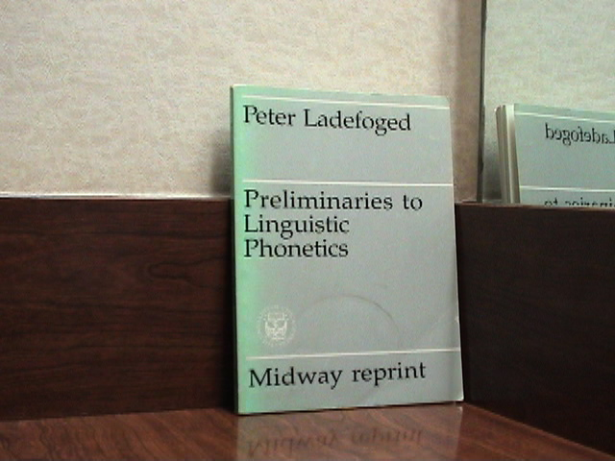
My coffee-stained personal copy of
Preliminaries to Linguistic Phonetics

Slide 18
In this work the tables of real-language examples so familiar to generations of students who have used A Course in Phonetics make their first appearance
Table of stop contrasts in Sindhi from PLP

Slide 19
A later version of the table of Sindhi stops
from the Hypercard stack Sounds of the World’s Languages and UCLA Phonetics Lab website

Slide 20
One of the tables of features proposed in PLP

Slide 21
Whereas most of the data for PSWAL had been gathered in university phonetics laboratories, Peter began to push for truly field-usable experimental phonetic equipment
By the early 1980’s Peter’s field equipment — besides tape recorders, microphones, etc — included items such as a bulky Polaroid dental camera for photographing palatography, and a heavy aluminum trunk containing a modulator/demodulater system for recording DC signals for aerodynamic and physiological experiments
Luckily, Peter was fit and strong

Slide 22
By the 1990’s ‘luggable’ computers were becoming available
In 1991 a Macintosh weighing about 16 pounds and equipped with the first version of the Macquirer/PCQuirer analysis hardware and software made the trip with us to record the East African languages with clicks
Unfortunately, the unreliable power supply in Tanzania blew the hardware to bits after only one subject had been recorded
Now much lighter equipment does more

Slide 23
By the 1990’s ‘luggable’ computers were becoming available
In 1991 a Macintosh weighing about 16 pounds and equipped with the first version of the Macquirer/PCQuirer analysis hardware and software made the trip with us to record the East African languages with clicks
Unfortunately, the unreliable power supply in Tanzania blew the hardware to bits after only one subject had been recorded
Now much lighter equipment does more, but a field-usable MRI is still in the future!

Slide 24
After many more trips, and with a few contributions from me, the most recent of Peter’s surveys of the sounds of the world’s languages appeared in 1996
But of course, he has written several books since then

Slide 25
Peter’s legacies include more than his writing — they include the development of a teaching style and the creation of the UCLA Phonetics Laboratory
As Peter puts it in the career summary on his website “For me, the people mattered more than the equipment”
Peter created a lab that remains a model of cameraderie, intellectual challenge and pragmatism

Slide 26
From managing the conflicts when there was one computer in the lab — a LINC-8 — to his status now as an inspirational guru, Peter has created a model for a research unit of its kind
He has also constantly
striven to ensure the lab
acted and was seen as
an integrated part of the
Linguistics Department
The last-ever LINC-8

Slide 27
Thankyou, Peter
and may the INS see fit to allow
you to become a citizen!

Slide 30
Cameraderie
Linguistics 5k (take off sweater to show shirt)

