Slide 1
Taking the measure of phonetic structure
Louis Goldstein
Yale University
and
Haskins
Laboratories

Slide 2
On Measurement:
“I often say that when you can measure what you are speaking about and express it in numbers, you know something about it; but when you cannot express it in numbers, your knowledge is of a meagre and unsatisfactory kind; it may be the beginning of knowledge, but you have scarcely in your thoughts advanced to the stage of science.”
—Lord Kelvin, quoted by Peter Ladefoged, ICPhS, Leeds, 1975
Notes:
Peter began his paper at the phonetics Congress in Leeds with this quote:
This captures his commitment to quantification, and his skepticism of claims made without that

Slide 3
Another Opinion
“Numbers are a scientist’s
security blanket.”
—Jenny Ladefoged
Notes:
Of course, There are other attitudes. I do recall another quote being expressed, around the time that Peter was preparing that paper... It went something like this.
In fact, this may be some truth in this view as well.

Slide 4
Describing the phonetic properties of languages
They must be determined by “valid, reliable, significant” measurements.
  measurement devices?
This commitment has led to fundamental questions.
  What are the appropriate reference frames within which to describe phonetic units?
  Is there a set of universal phonetic categories?
Notes:
Peter’s commitment to describing the phonetic properties of languages can be stated this way:
slight paraphrase from 1960 paper in Language
list of devices way too long:
map-measurer
used a succession of ingenious devices
led him and the field.
appropriate reference frames --may be more than one.

Slide 5
Reference frames for vowels
Descriptions of vowel quality in terms of the “highest point of the tongue” are not valid.
S. Jones (1929)
Notes:
Early application of this principle, and a continuing one is
reference frame issue...
His first discovery here was that...
so here are the descriptions of vowel quality (of CVs) that were couched in terms of highest point of the tongue.
Here are the highest points
They are not the same.
Interestingly the data had been around for some time... they were waiting for someone to take them seriously.

Slide 6
Auditory judgments of vowel quality
Can be reliable when produced by phoneticians who learned the cardinal vowels by rote (Ladefoged, 1960)
Gaelic Vowels
Notes:
At the same time, he showed that the
spread of 14/15 phoneticians who trained with Abercrombie or Jones...

Slide 7
Formant frequency measurements
Can be valid measures of vowel quality (Ladefoged, 1975)
Danish Vowels
Notes:
Later, he found that judgements of vowel quality matched a description in terms of Formant frequencies quite in a very detailed way. Again the data had been there a while, but.. but only someone committed to that level of detail would notice.

Slide 8
Factor Analysis of Tongue Shapes
Valid low-dimensional parameterization
Compute entire tongue shape from 2 numbers (Harshman, Ladefoged & Goldstein, 1977)
Notes:
kept searching for an articulatory description and developed a technique for factor analysis of tongue shapes with Richard Harshman

Slide 9
Reference frame comparison
Tongue factors for vowels can be computed from formant frequencies. (Ladefoged et al. 1978)
Different reference frames for different purposes?
  Phonetic specification of lexical items
    Articulatory
  Phonological patterning
    Acoustic/Auditory
  Speech production goals?
Notes:
having developed valid parameterizations in articulation and acoustics, it was possible to compare them.

Slide 10
Continuing Debate:
Acoustic vs. constriction goals
Since tongue shapes and formants for vowels are inter-convertible, difficult to address for vowels.
  Such a relation holds when the tongue produces a single constriction.
Cross-speaker variability in tongue shapes (Johnson, Ladefoged & Lindau, 1993)
  More variability than in auditory properties?
Current debate about /r/
  The relation between articulation and formants is more complex (in part because of multiple constrictions).
Notes:
Though I have to say, in my own view, the

Slide 11
But wait… Ladefoged’s (1960) experiment has more to say
One of the Gaelic vowels produced very inconsistent responses.
spread
round
Correlation of backness and rounding judgments
Effect of rounding on F2
gaoth

Slide 12
Implications for acoustic goals for vowels?
Since front-rounded and back-unrounded vowels are so auditorily similar that skilled phoneticians confuse them, we would expect that, if goals were purely acoustic, or auditory, there would be languages in which individual speakers vary as to which of these types they produce.
This doesn’t appear to be the case.

Slide 13
Further Implications
Ladefoged has argued (at various points) for a mixed specification for vowel goals:
  Rounding is specified articulatorily;
  Front-back, high-low are specified auditorily.
But front-back judgments seem to be dependent on state of lips.
McGurk experiment with phoneticians would probably have yielded different front-back judgments depending on lip display.
  But then in what sense is front-back strictly an auditory (or acoustic) property?

Slide 14
Universal phonetic categories?
Careful measurement of segments across languages, initiated by Ladefoged, reveals more distinct types than could contrast in a single language
  e.g. 8 types of coronal sibilants (Ladefoged, 2005)
If phonetic categories (or features) are universal (part of universal grammar), more of them are required than are necessary for lexical contrasts and natural class specification.
If phonetic categories are language-specific, then commonalities across languages are not formally captured.

Slide 15
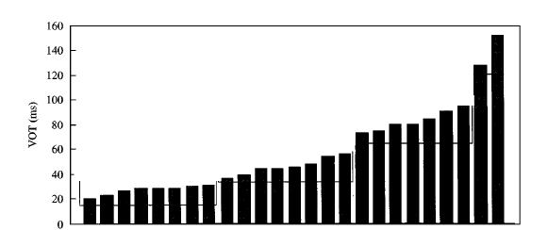
How many distinct types?
In some cases, it is not clear it is even possible to identify discrete potential categories.
VOT
Cho & Ladefoged (1999)

Slide 16
Articulatory Phonology
Some categories are universal and others are language-specific.
This follows from the nature of the constricting actions of the vocal tract and the sounds that they produce.
Universal Grammar is not required to account for universal categories.
Notes:
Look at speech in terms of gestures, then we can reconcile these in an interesting way.

Slide 17
Gestures and constricting devices
Fundamental units of phonology are gestures, vocal tract constriction actions.
Gestures control functionally independent constricting devices, or organs.
Constrictions of distinct organs count as discrete, potentially contrastive differences.

Slide 18
Universal constriction organs
All speakers possess the same constricting organs.
For a communication system to work, gestural actions must be shared by the members of the community (parity).
Work on facial mimicry (Meltzoff & Moore, 1997) shows that humans can (very early) identify equivalences between the oro-facial organs of the self and others.
Organs as the informational basis of a communication system satisfy parity.
Use of one or another organ affords a universal category, while the actions performed are measurable and may differ from lg. to lg.
Notes:
Don’t need the security blanket to distinguish organs -- qualitatively distinct.
By universal, I don’t mean that every languge uses them. But when a language does use it, it is the same category as every other language.

Slide 19
Primacy of between-organ contrasts: Adult phonology
Of course, not all contrasting categories differ in organ employed. However...
Between-organ contrasts are common and occur in nearly all languages. While not all within-organ contrasts are.
Notes:
...
.

Slide 20
Within-organ differentiation
Constriction gestures of a given organ can be distinguished by the degree and location of the constriction goal.
tick
sick
thick
Differ in
LP
lip protrusion
LA
lip aperture
TTCL
tongue tp constrict location
TTCD
tongue tip constrict degree
TBCL
tongue body constrict location
TBCD
tongue body constrict degree
VEL
velic aperture
GLO
glottal aperture
These parameters are continua.
How are they partitioned into categories?
Notes:
But now let us turn to within-organ differences..

Slide 21
Within-organ categories
Some within-organ categories are universal or nearly so.
  e.g., constriction degree:
    stop-fricative-approximant
  Same categories are employed with multiple organs.
    Stevens’ “articulator-free” features
    [continuant], [sonorant]
Other within-organ categories are
language-specific
  e.g., Ladefoged’s 8 phonetic categories for sibilants.

Slide 22
Emergence of within-organ categories through attunement
Members of a community attune their actions to one another.
Hypothesis: Shared narrow regions of a constriction continuum emerge as a consequence of attunement, thus
satisfying parity.
  Self-organization of phonological units
    deBoer, 2000
    Oudeyer, 2002
    Goldstein, 2003

Slide 23
Simulation of attunement with agents
Agent 1
Agent 2
Notes:
This is how it works. On each trial of the game,
Each agent selects a value from the constriction continuum at random.
Each agent then recovers a value or values based on the partner’s production.
If the produced value matches the recovered, then the probability of producing that value is incremented.

Slide 24
Attunement: A simulation
Agent 1
Agent 2
Notes:
This shows an example of the attunement game.
Each graph shows the probability of producing each of 50 vals along a continuum, for 2 agents.
At the beginning of the simulation, there is an equal probability of producing any val.
The probabilities evolve during attunement, and the agents converge to a narrow set of values.
Note the distributions for the two agents are not identical, but highly similar.
Noise value here is +/- 4 acoustic units == 4 constriction units in linear region.

Slide 25
Attunement & multiple modes
Attunement produces convergence to a narrow range (shared by both agents).
Multiple modes along the continuum (potentially contrasting values) can emerge in a similar fashion.
Are the modes consistent across repeated simulations (“languages”)?
  Answer depends on the mapping from constriction parameter to acoustics.
  Agents must recover constriction parameters from acoustics.

Slide 26
Constriction-acoustics maps
Nature of mapping from constriction parameter to acoustics affects the consistency of modes obtained in simulation.
Nonlinear Map (e.g. Stevens, 1989)
  stable and unstable regions
  Agents partition relatively consistently.
  possible Model of Constriction Degree (e.g., TTCD)
Linear Map
  more variability in partitioning
  possible Model of Constriction Location (e.g., TTCL)
  coronal sibilants
Notes:
In some cases the map may be fairly linear,
In other cases, as shown by Stevens, the mapping can be nonlinear,

Slide 27
Simulations
Compare simulations with these maps
  two-agent, two-action simulations
  100 times (100 “languages”)

Slide 28
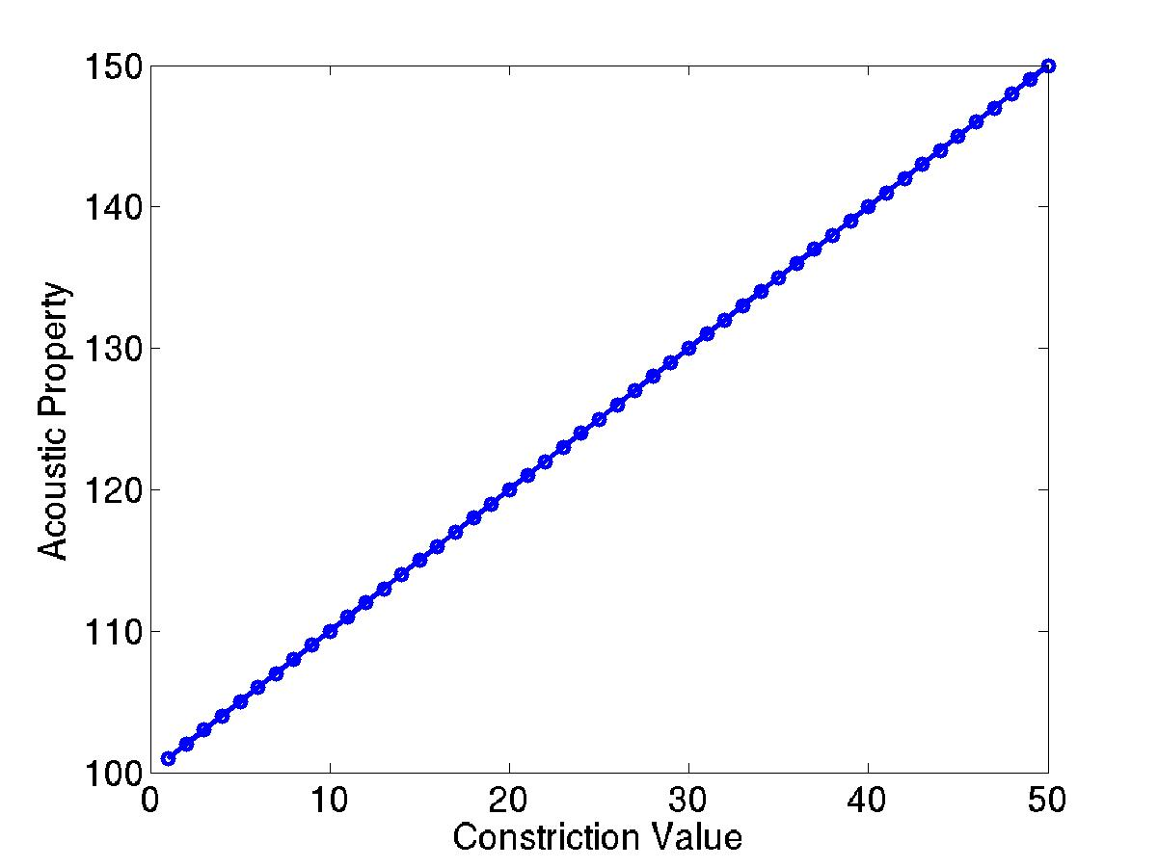
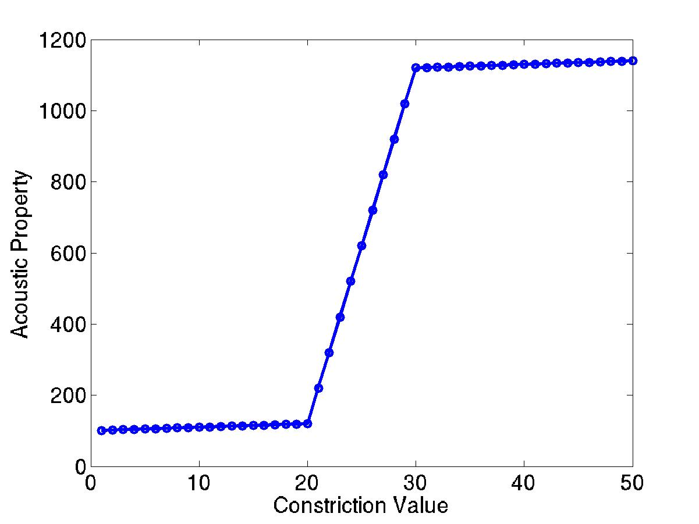
Results
fricatives
TTCL
TTCD
retroflex
alveolar
dental
stops
languages’ contrasting actions distributed over entire range
77% of languages contrast actions that span discontinuity
Notes:
This is the linear map employed.
This is the nonlinear map, showing stable regions in which small changs in constriction do not change the acoustics much, separated by a region in which small constriction changes produce large acoustic changes.
The results for the linear map show
While for the nonlinear map,
Thus the nonlinear map seems to produce results consistent how something like TTCD functions in languages, while the linear map produces results more consistent with something like TTCL

Slide 29
Organ hypothesis: phonological development
Between-organ differences
  Since neonates can already match organ selection with that of a model, we expect children’s early words to match adult forms in organ employed.
Within-organ differences
  Since these require attunement and therefore specific experience, we expect that children’s early words will not match the adult forms.

Slide 30
Experiment: children’s early words (Goldstein 2003)
Materials
  Recordings of children’s words by Bernstein-Ratner (1984) from CHILDES database
  Data from 6 children (age range 1:1 - 1:9).
Words with known adult targets were played to judges who classified initial consonants as English consonants.
Based on judges’ responses, child forms were compared to adult forms in organs employed and within-organ parameter values (CD).

Slide 31
Results
Oral constriction organ (Lips, TT, TB)
  For all 6 children, organ in child’s production matched the adult target with > chance frequency.
Glottis and Velum
  Some children show significant matching with adult targets, some do not.
Constriction Degree (stop, fricative, glide)
  No children showed matching with > chance frequency.

Slide 32
Evidence from infant speech perception
Young infants
  may not be able to distinguish all adult within-organ categories
  English /da/-/Da/ (Polka, 2001)
Older infants
  Classic decline in perception of non-native contrasts decline around 10 months of age involve within-organ contrasts
    retroflex - dental
    velar - uvular
  Between-organ contrasts may not decline in the same way (Best & McRoberts, 2004).

Slide 33
The measure of Peter’s contribution to phonetics
Not just the vast amount of knowledge he created or inspired
But also what he taught the field of linguistic phonetics about rigor.
  measurement of data
  modeling: measurable (testable) consequences of representational hypotheses

