Slide 1
Betting on bits contextual influences on the perception of ‘phonetic categories’
Sarah Hawkins
University of Cambridge
sh110@cam.ac.uk

Slide 2
Issues
Context and phoneme/word identification
Structuring a model of speech understanding
  top-down vs. bottom-up information
  abstraction vs exemplar representation
Notes:
Anecdote re MIT discussion here

Slide 3
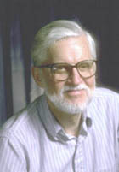
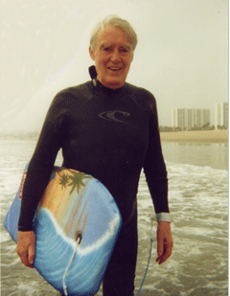
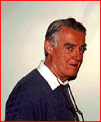
We can understand speech because there’s an invariant acoustic correlate for every one of Morris’ features
Oh yeah? So why doesn’t /wa/ sound the same in
Tahiti and Hawaii and Huntingdon?
Oh yeah? So why doesn’t /ba/ sound the same in
Lagos and Hollywood and Birmingham?
Notes:
Peter got me into this topic about 25 years ago. Ken Stevens was looking for invariant acoustic correlates of phonological distinctive features. Peter gave a seminar, at MIT and was sceptical about invariance theory, because languages, and accents of the same language, differ in the details of the ‘same’ sounds. He might say something a bit different today, but the basic message would be the same. I suggested that they were really aiming for the same thing, except Ken was looking down from above, whereas Peter was starting from the detail at the bottom. They both became very angry, saying I’d totally missed the point. I’ve been puzzling about the role of fine phonetic detail in speech ever since. This is as far as I have got, Peter.

Slide 4
Fine phonetic detail (FPD): random or systematic?
much is systematic & perceptually salient
but does NOT help to identify citation form words or phonemes

Slide 5
Fine phonetic detail indicates:
position in syllable; syllable structure
word boundaries
grammatical status
places where you can join in a conversation
discourse function of ‘the same’ words
other things crucial to a normal conversation
gross and subtle indexical information

Slide 6
Systematizing fine phonetic detail
a different way of conceptualizing
  phonetic and phonological structure (Firthian)
  the processes of understanding speech
Journal of Phonetics 31(3/4)
especially John Local; Sarah Hawkins
Hawkins & Smith (2001)
Italian Journal of Linguistics – Riv. de Ling. 13, 99-188 http://kiri.ling.cam.ac.uk/sarah/pubs.html
Notes:
Need a completely different way of structuring the linguistic information

Slide 7
Systematizing fine phonetic detail
a different way of conceptualizing
  phonetic and phonological structure (Firthian)
  the processes of understanding speech
Journal of Phonetics 31(3/4)
especially John Local; Sarah Hawkins
Hawkins & Smith (2001)
Italian Journal of Linguistics – Riv. de Ling. 13, 99-188 http://kiri.ling.cam.ac.uk/sarah/pubs.html
Notes:
focus on processes of understanding speech

Slide 8
What is a category?
A class or division in a
system of classification
(OED)

Slide 9
Structure of a category
good best
ok
poor
Quality of exemplars
Boundaries

Slide 10



✓
Thrush in summer
✓
Thrush in snow
✗
Sparrow in summer

Slide 11

Ladefoged and Broadbent (1957)
"Please say what this word is:
bit bet bat but
F1 of CARRIER
200-380 Hz
380-660 Hz
bet
bit
Ladefoged and Broadbent (1957) JASA 29, 98-104

Slide 12
“Range effects” on CP boundary
identification expt e.g.
VOT continuum
  da..........ta
when stimuli are removed from one end, the 50% id boundary shifts towards the other
X
boundary shift
100
% /d/
50
0
short VOT (d) long VOT (t)

Slide 13
What causes a boundary shift?
stimulus range
(distribution)
perceived rate of speech
lexicality/Ganong
(word~nonword)
sentence meaning
(if the task is appropriate)
100
% /d/
50
0
short VOT (d) long VOT (t)
  Summerfield (1981) JEP:HPP 7, 1074-1095
  Ganong (1980) J. Exp. Psych: HPP 6, 110-125
  Borsky, Shapiro, Tuller (2000) J. Psycholinguistic Res. 29, 155-168
Notes:
None of these things is simple, and none are to do with a phonetic code as it is ordinarily thought of. But we have to deal with them every time we understand someone speaking.

Slide 14
What causes a boundary shift?
Perception adjusts to the distribution of stimuli
&
is more forgiving
about unclear sounds
if the message makes sense
100
% /d/
50
0
short VOT (d) long VOT (t)
  Summerfield (1981) JEP:HPP 7, 1074-1095
  Ganong (1980) J. Exp. Psych: HPP 6, 110-125
  Borsky, Shapiro, Tuller (2000) J. Psycholinguistic Res. 29, 155-168
Notes:
None of these things is simple, and none are to do with a phonetic code as it is ordinarily thought of. But we have to deal with them every time we understand someone speaking.

Slide 15
CP: category goodness
Much evidence that ‘better’ instances of phonemes exert stronger perceptual effects of many types:
Samuel (P&P 1982 adaptation)
Kuhl (1992 perceptual magnet effect [PME])
And that context affects category goodness
Hawkins & Barrett (ASA 04: PME)
Allen & Miller (P&P 2001: rate and lexicality)

Slide 16
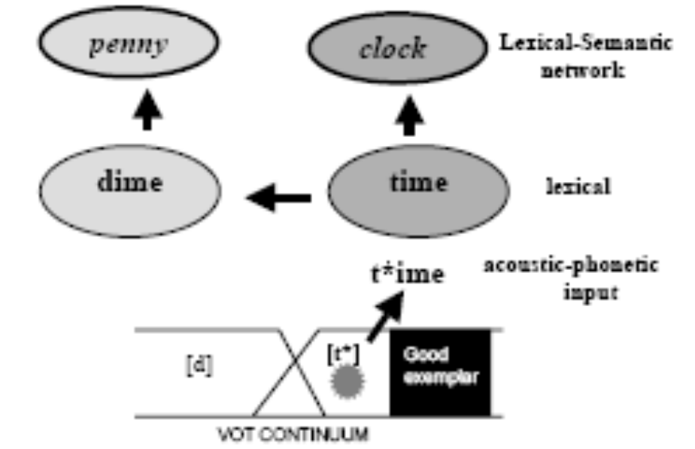
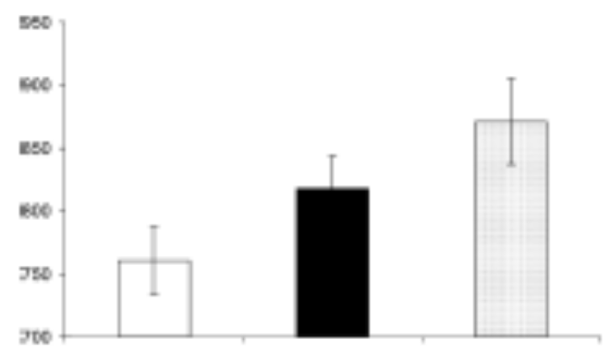
CP: category goodness
Mediated Priming in lexical decision task
A /t/ with a short VOT primes unrelated words via rhymes that have /d/ instead of /t/
Reaction times
Related Modified Neutral
t*ime primes penny via dime
  Misiurski et al. (2005) Brain & Lang. 93, 64-78

Slide 17
Linguistic categories: summary
Perception adjusts to the distribution of stimuli
and is more forgiving about unclear sounds if the message makes sense or the task encourages it
‘Units’ are functionally inseparable from ‘context’
Implication: mental representations of linguistic-phonetic categories are relational and plastic
Notes:
Phonemes are context free, so these are not the units we are initially looking for?

Slide 18
How might this plasticity occur?
An example
Plasticity of single neurons in the Primary Auditory Cortex (PAC)

Slide 19
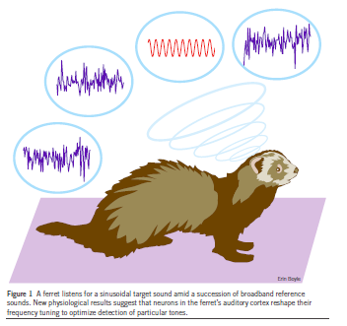
Spectro-temporal receptive fields (STRFs) in PAC
Recording from single neurons in PAC
Sensitive to particular frequency ranges and temporal relationships
Training:
  broadband noise: lick
  tone (constant frequency sine wave): don’t lick
Test: different tone frequency
Fritz, Elhilali, Shamma, et al. 2003, 2005

Slide 20
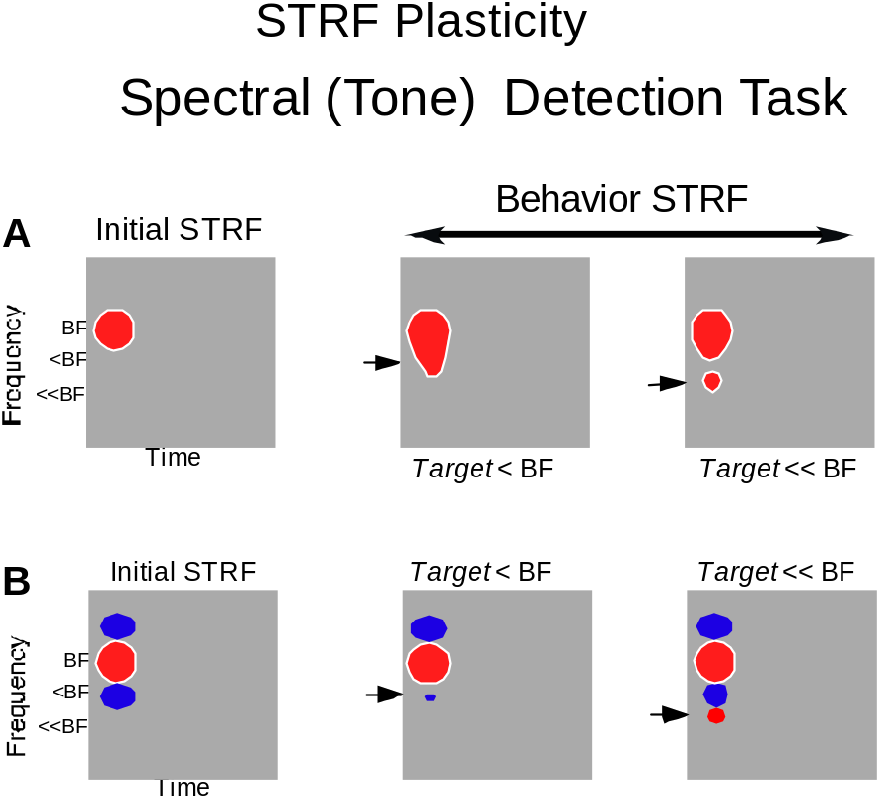
Plasticity of STRFs in PAC
Shift in excitatory response to tone of similar frequency
Additional field to yet more different tone
Only when a response is required: ‘meaning’
Poorer task performance and weaker plasticity are correlated
excitatory field
BF neuron best freq
inhibitory field
target freq

Slide 21
Summary: STRF changes in PAC
Swift (2.5-8 minutes); last several hours
Reflect
  sensory content
  changing behavioral meaning of acoustic stimuli
Consistent with facts of speech perception
Similar adaptation/learning probably occurs
earlier (lower down) in the auditory pathway

Slide 22
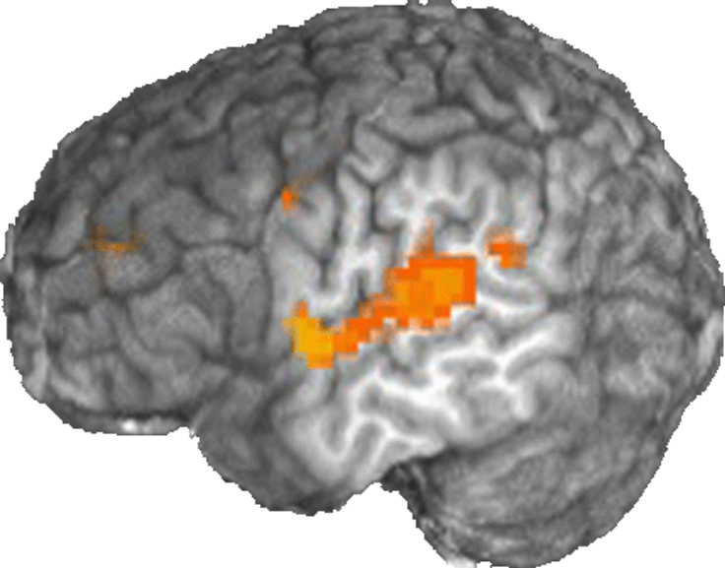
Brain activation for category boundaries
Many studies: Superior Temporal Gyrus (STG) is active when phonetic decisions are made
(+ many other areas)
STG activation does not differ when the decisions are hard (other areas do
e.g. frontal regions)
Binder et al. (2004) Nat.Neurosci. 7, 295-301
Blumstein et al. (2005) J. Cog. Neuroscience 17, 1353-1366

Slide 23
Brain activation for category boundaries: Ganong effect
STG is sensitive to change in category boundary due to lexical status: gift-kift; giss-kiss
Conclusion: lexical knowledge influences basic phonetic categorization processes
Myers & Blumstein (CNS 2005)

Slide 24
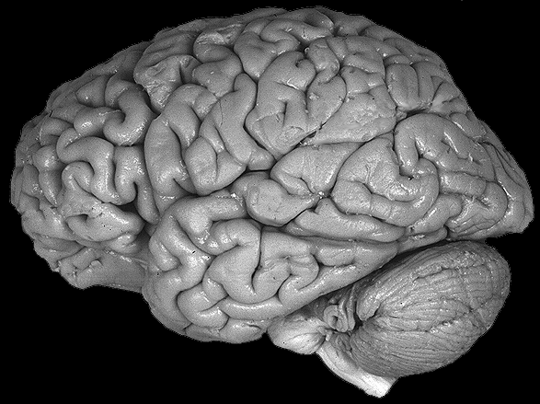
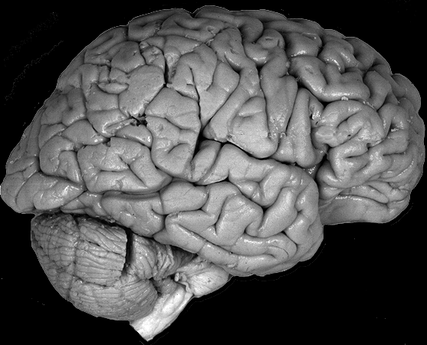
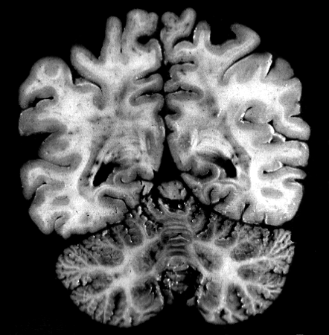
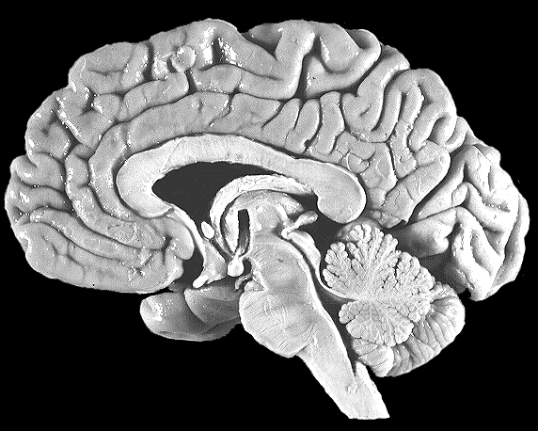
yet also.... simple ba-da continuum
brain activation differs for category centers &
boundaries (adaptation fMRI)
centers: Primary auditory cortex, left parietal
boundaries: left SMG, L middle frontal, R prefrontal,
Right cerebellum, anterior cingulate
Raizada & Poldrack (CNS 2004; in prep)

Slide 25
What does this mean?
Category boundaries and centers are analyzed in many different parts of the brain:
don’t and can’t act independently
Relationships in current signal are constantly interpreted from all available evidence:
  knowledge
  current sensation (quite detailed)
  attention

Slide 26
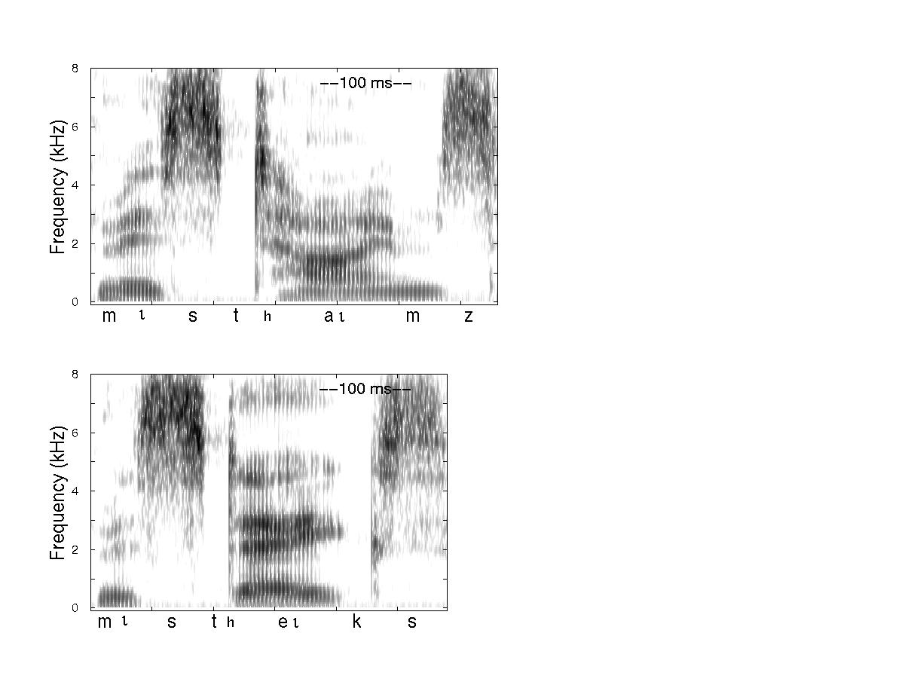
Productive
Fine phonetic detail provides all sorts of information,
not just phonological.
Here, it is grammatical.
σ σ
R
R
     ι                 ι           
Unproductive
σ σ
R
RR
C/OC/O
     ι                 ι      
Notes:
info goes in at different levels at same time; some is reliable and some is less so; some is quick, some is slow. and the end: knock out the other word before the /t/.

Slide 27
Summary
Brain is ‘opportunistic’: it uses all available information to understand a message
Fine phonetic detail can be fundamental
What listeners do with FPD depends on what they are doing at the moment
Notes:
how you structure the info

Slide 28
Modeling phonetic representation
Phonetic categories can map directly to phonological categories BUT
  relational, dynamic, self-organizing, (multi-modal), context-sensitive, task-sensitive
Sound patterns map to meaning via processes that involve complex (embodied?) structures:
  MULTIPLE UNITS of speech perception
Top-down and bottom-up information, episodic vs abstract representation, may not be distinguishable in speech communication
Notes:
phonetic categories map to much more than an abstract phonological code

