Slide 1
Honoring the Contributions of
Peter Ladefoged
Phonetic Linguistics:
Session 4aSC
October 20, 2005

Slide 2
A bit of early biography
Born Sept. 17 1925 in Surrey, England
1943-44 Cambridge University
1944-47 Royal Sussex Regiment
MA 1951, PhD 1959 in Phonetics,
U. of Edinburgh
Peter and Jenny married 1953
Asst. Lecturer/Lecturer, U. of Edinburgh 1953-61

Slide 3
Career moves
1959-60, 1961-62: Africa
Summer 1960: U. Michigan
Summer 1961: KTH (Stockholm)
1962: Moved to UCLA
1966: Within UCLA, moved from English Dept. to join the new Linguistics Dept.
1991: “retired” to become Research Linguist
2005-?: Adjunct professor at USC
This term: Leverhulme Professor, U. Edinburgh

Slide 4
First publications
3 papers in 1956: in Nature, Lingua, and Speech
5 papers in 1957, including 2 in JASA
First ASA meeting: Providence, 1960
Now 67 JASA entries for articles, published abstracts, letters

Slide 5
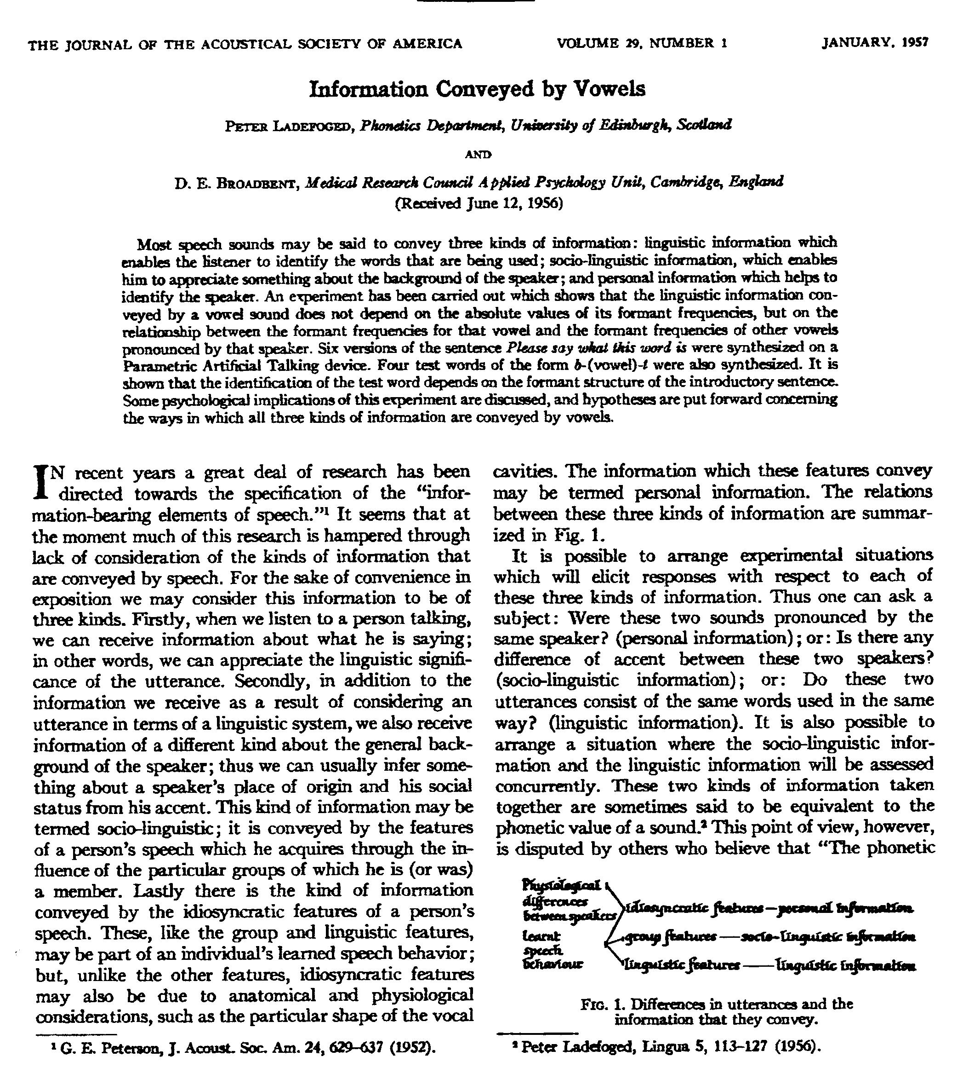
First
JASA
Paper,
1957
Notes:
Jenny will talk about some of the early papers and show you some of the many books

Slide 6
Presidencies
Linguistic Society of America, 1978
Permanent Council for the Organization of International Congresses of Phonetic Sciences, 1983-91
International Phonetic Association, 1987-91

Slide 7
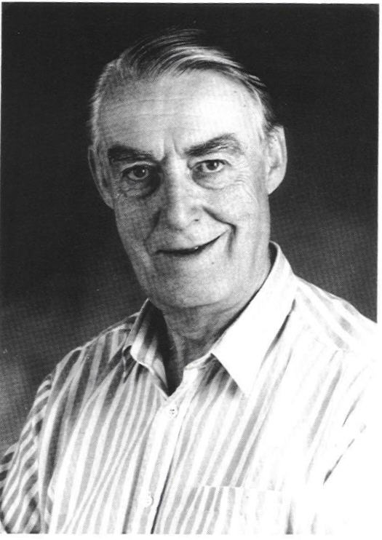
1994: ASA Silver Medal in Speech Communication
“for advancing the theory of acoustic phonetics and phonology using acoustic field data from many of the world’s languages”

Slide 8
At the end of the session
After the last paper (about 11:50), Dani Byrd and Shri Narayanan will present some birthday greetings to Peter

Slide 9
At the end of the day
After tonight’s TC meeting (about 9 pm) there will be a party in the Marquette Hotel (Marquette and 7th)

