Slide 1
Concept

Slide 2
Topics
Concept
Models and Analogy
The Website
In the Press
Business Models

Slide 3
Concept
Local Internet advertising board
An advertising board that goes with you
You are in the center and you see all the ads posted around your location and in the selected category
Come to know your close by neighbors
Use the power of consulting with, assisting to and getting assistance from your close neighbors

Slide 4


Models and Analogy
Similar Concept
Your neighborhood Community
Your friends Community
Different Community

Slide 5
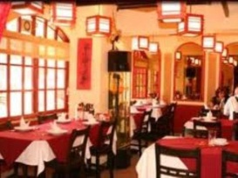


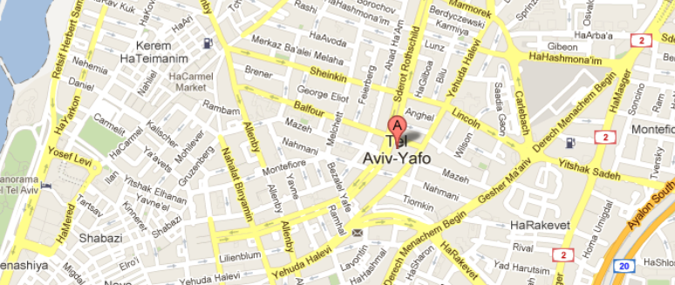
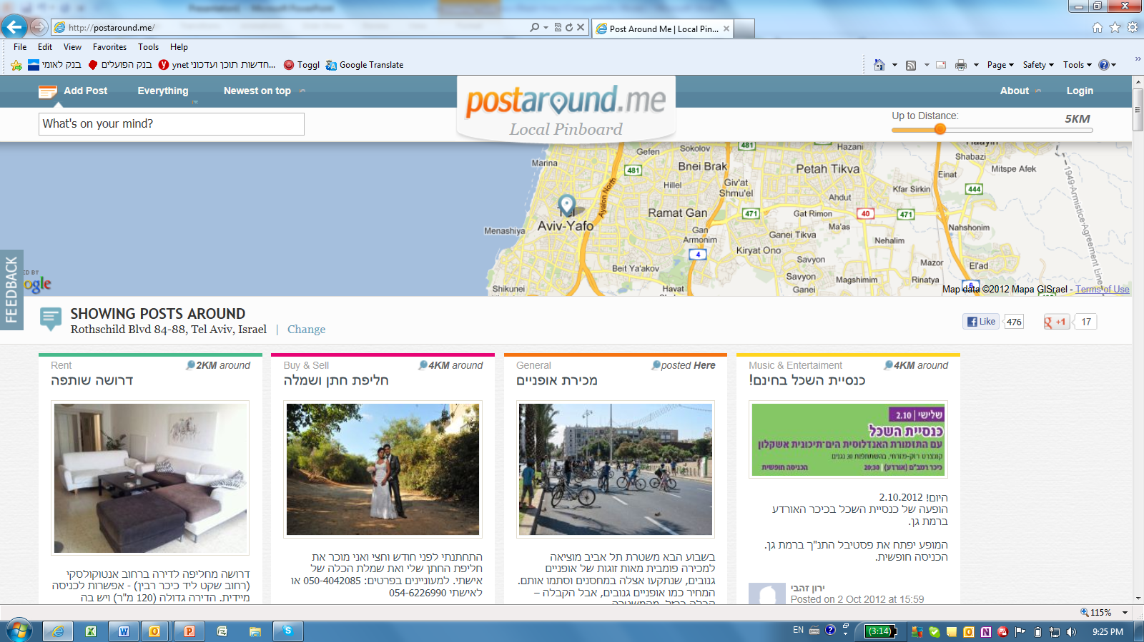


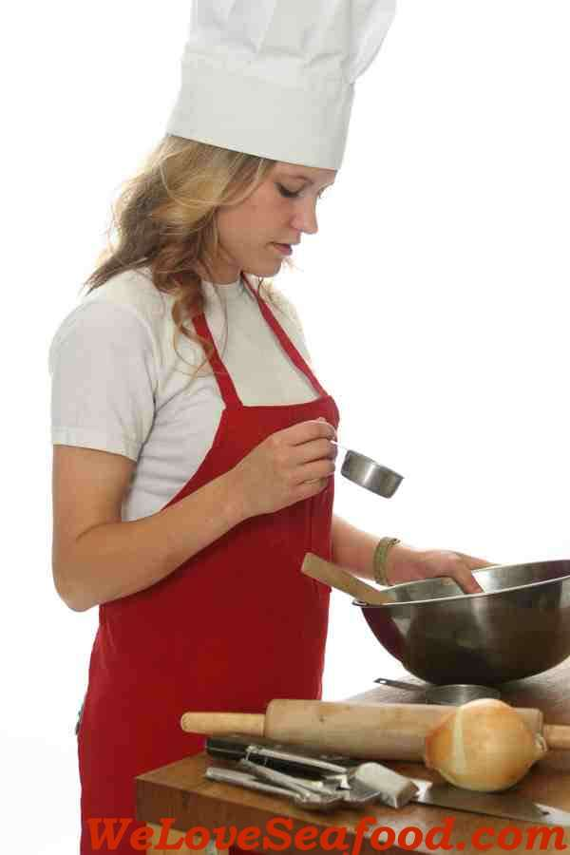
New restaurant
Seeking friends
1Km
Dancing Lessons
Dog missing/found
Marathon
Missing an egg
for a cake

Slide 6
http://postaround.me

Slide 7




In The Press
Nana10 – Popular Israeli web portal 15.8.2012
Layla Calcali – Financial TV Show in Israel 13.8.2012
Feeder – Globes' Technology Magazine 13.8.2012
Newsgeek – The largest tech blog in Israel 25.7.2012

Slide 8
Business Models
Sponsored advertisement
Premium advertisement
Enterprise board (for municipalities for example)
Private boards (for companies for example)
Other Internet Community models

Slide 9
Thank you !

