Slide 1

Shopping Customer Segmentation
Unsupervised Machine Learning Project

Slide 2
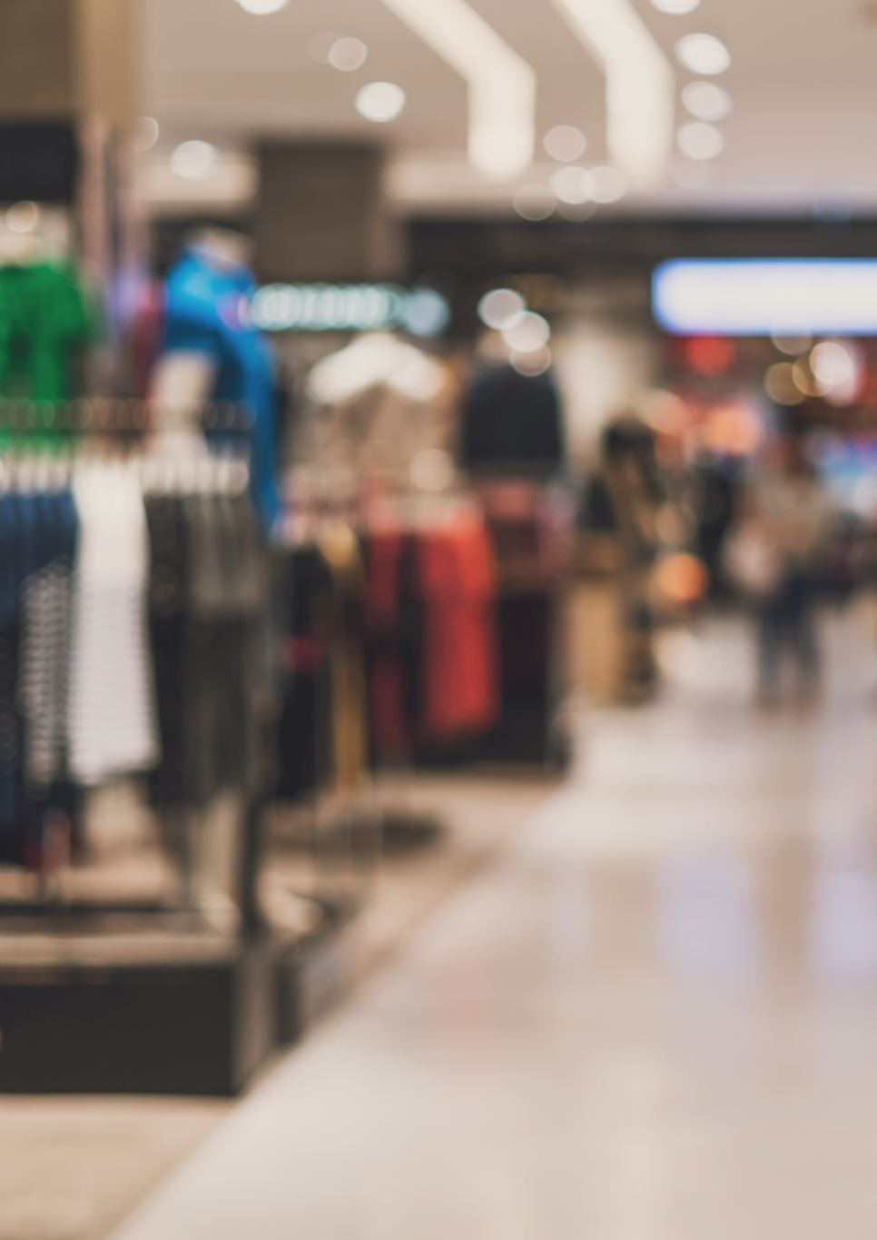
Segment Shopping Customers
Problem Statement: understand the
Target Customers for the marketing team to plan a strategy
Context: Your boss wants you to identify the most important shopping groups based on income, age, and the mall shopping score.
He wants the ideal number of groups with a label for each.

Slide 3
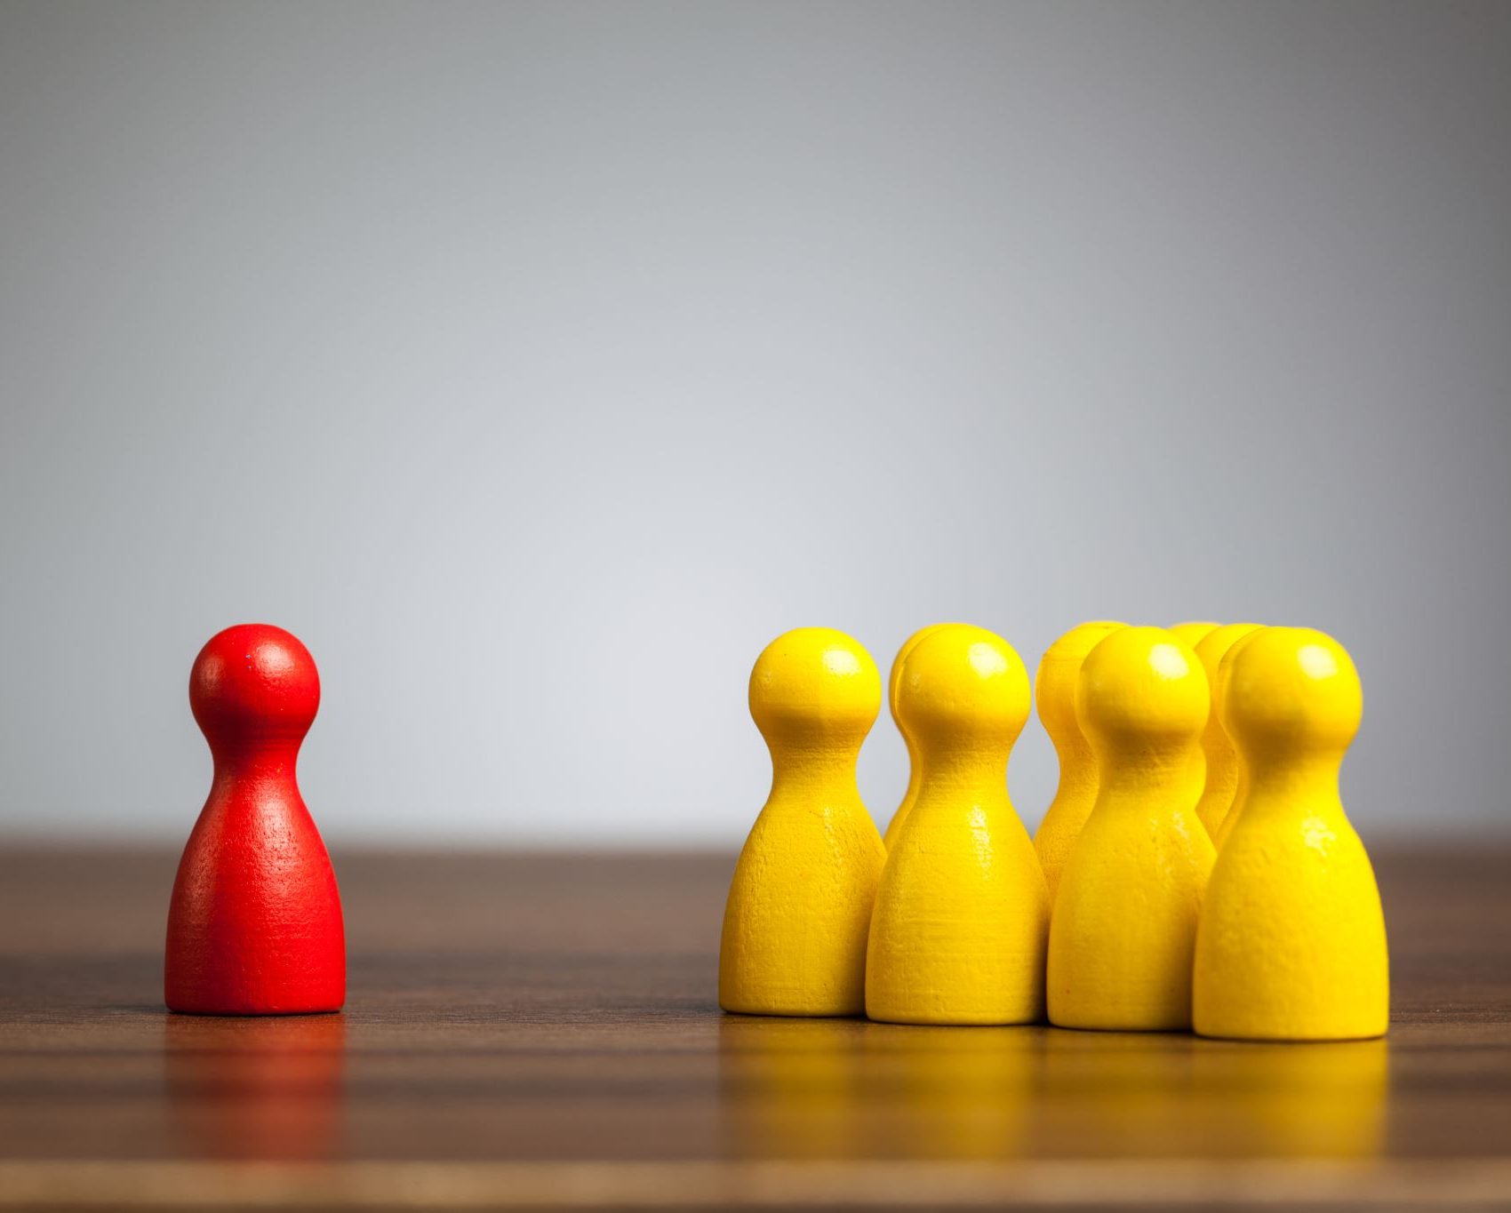
Objective Market Segmentation
Divide your mall target market into approachable groups.
Create subsets of a market based on demographics behavioural criteria to better understand the target for marketing activities.

Slide 4
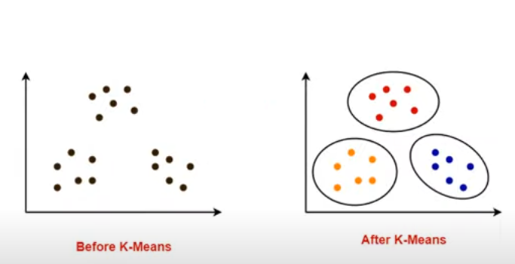
The Approach
1. Perform some quick EDA( Exploratory Data Analysis)
2. Use KMEANS Clustering Algorithm to create our segments
3. Use Summary Statistics on the clusters
4. Visualize

Slide 5
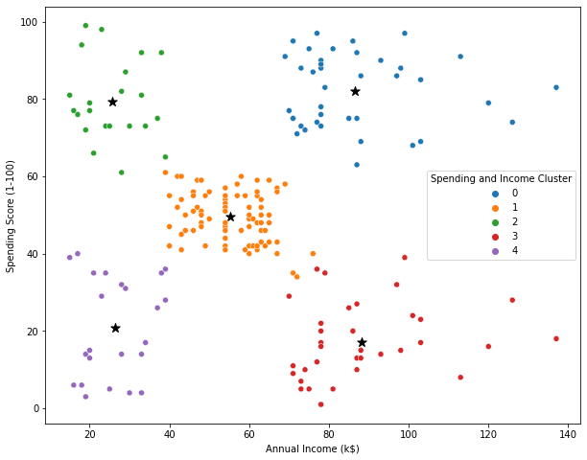
Analysis
Target group would be cluster 1 which has a high Spending Score and high income
60 percent of cluster 1 shoppers are women. We should look for ways to attract these customers using a marketing campaign targeting popular items in this cluster
Cluster 2 presents an interesting opportunity to market to the customers for sales event on popular items.

