Slide 1
🎓 COLLEGE MANAGEMENT SYSTEM
CAMPUS CONNECT
Smart College Student Portal — Mini Project (50% Frontend Phase)
PROJECT PRESENTATION DETAILS
DEPARTMENT & INSTITUTION
Student Name: [Your Full Name] Roll Number: [Your Roll Number] Class / Division: [TE Computer Engg / Div A] Academic Year: 2025 – 2026
Department: Computer Engineering College Name: [Your College / Institute Name] Project Guide: [Guide / Faculty Mentor Name] Current Status: 50% Frontend Milestone Completed ✓

Slide 2
INTRODUCTION
Project Overview & Objectives
What is Campus Connect?
Campus Connect is an integrated college student portal created to streamline common academic services, attendance tracking, examination results, study materials, and campus circulars into a single responsive platform.
1. Centralized Services
2. Multi-Role Architecture
3. 50% Milestone Focus
Brings together student attendance, marks sheets, course curriculum, and circulars into one accessible portal.
Provides specialized views tailored for Students, Faculty members, and College Administrators.
Focuses on establishing a polished, fully interactive frontend prototype with pure HTML5, CSS3, and JavaScript.
Campus Connect • Engineering Mini Project (50% Milestone)

Slide 3
USER ROLES
System Roles & Key Responsibilities
STUDENT PORTAL
FACULTY PORTAL
ADMINISTRATOR PORTAL
• View enrolled courses & syllabus coverage
• Monitor subject-wise attendance %
• Check semester examination grades & SGPA
• Download lecture notes & lab manuals
• Access campus notices & event calendar
• View assigned classes and subject teaching load
• Digital roll-call marking (Present/Absent/Late)
• Enter, evaluate and save examination marks
• Upload and share lecture notes/materials
• Post academic notices and announcements
• Manage student and faculty user directory
• Oversee college courses and curriculum
• Result Publication Control (Publish / Unpublish)
• Publish official college-wide circulars
• Monitor overall campus statistics & metrics
Campus Connect • Engineering Mini Project (50% Milestone)

Slide 4
TECHNOLOGIES USED
Frontend Architecture & Tech Stack
HTML5
CSS3
Vanilla JavaScript
Structure & Semantics
Design & Responsiveness
Logic & State Management
Creates semantic document layouts across all 14 pages. Implements accessible forms, tables, modals, and responsive containers without external templates.
Structured with CSS variables for the academic blue theme, responsive grid layouts, card containers, table styling, and mobile slide-out drawer navigation.
Handles multi-role state simulation via localStorage, dynamic sidebar builder, live course/notice search filters, and interactive roll-call toggles.
🔮 FUTURE PHASE INTEGRATION (NEXT MILESTONES)
• Backend Framework: Python Flask REST API for authentication and business logic endpoints. • Database Management: PostgreSQL relational database for persistent storage of student, faculty, and academic records. Note: Current 50% milestone focuses exclusively on complete frontend verification and interactive UI.
Campus Connect • Engineering Mini Project (50% Milestone)

Slide 5
50% MILESTONE
Summary of Completed Frontend Work
CURRENT PROJECT COMPLETION: 50% (FRONTEND PHASE COMPLETE)
14 Fully Implemented & Responsive Pages
1. College Home Landing Page
2. 3-Role Demo Login Portal
3. Registration & Validation
4. Student Dynamic Dashboard
5. Faculty Dynamic Dashboard
6. Admin Dynamic Dashboard
7. User Profile & Inline Edit
8. Course Catalog & Progress
9. Attendance & Digital Roll-Call
10. Result Management (3 Views)
11. Searchable Notice Board
12. Campus Events Calendar
13. Study Notes Repository
14. Settings & Preferences
Campus Connect • Engineering Mini Project (50% Milestone)

Slide 6
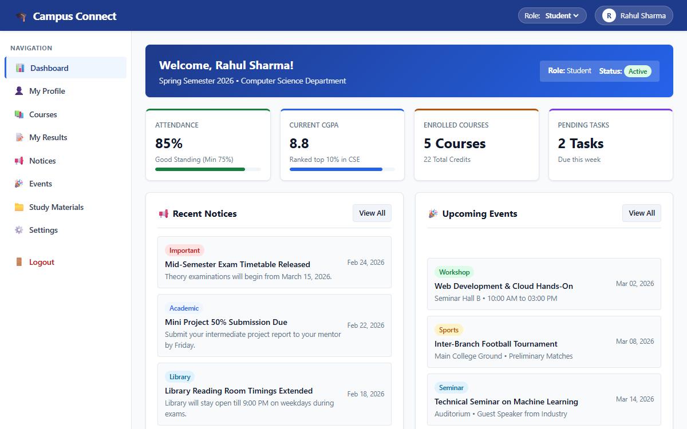
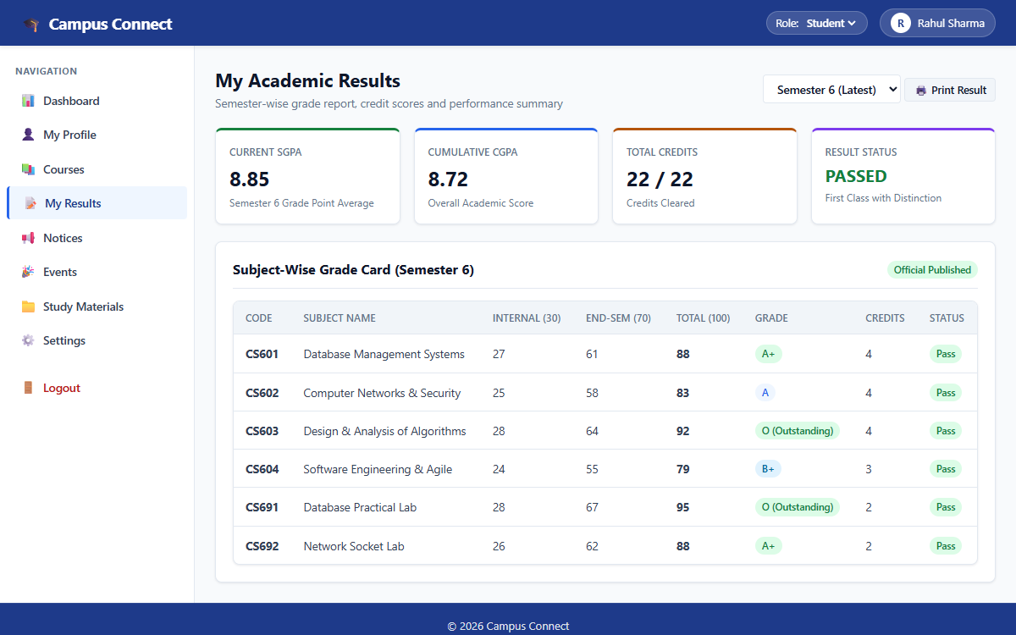
STUDENT FEATURES
Student Portal — UI & Core Modules
STUDENT CAPABILITIES & WORKFLOW
• Dashboard: Real-time overview of current attendance (85%), CGPA (8.8), enrolled courses, recent notices & upcoming events.
• Course Details: Track subject syllabus progress percentage, credits, and assigned classroom instructors.
• Attendance Analytics: Subject-wise breakdown with automated shortage alerts for attendance below 75%.
• Academic Results: Semester grade report with SGPA (8.85), CGPA (8.72), and internal/external marks breakdown.
• Study Repository: Download subject slides, lab manuals, and previous examination papers.
Campus Connect • Engineering Mini Project (50% Milestone)

Slide 7
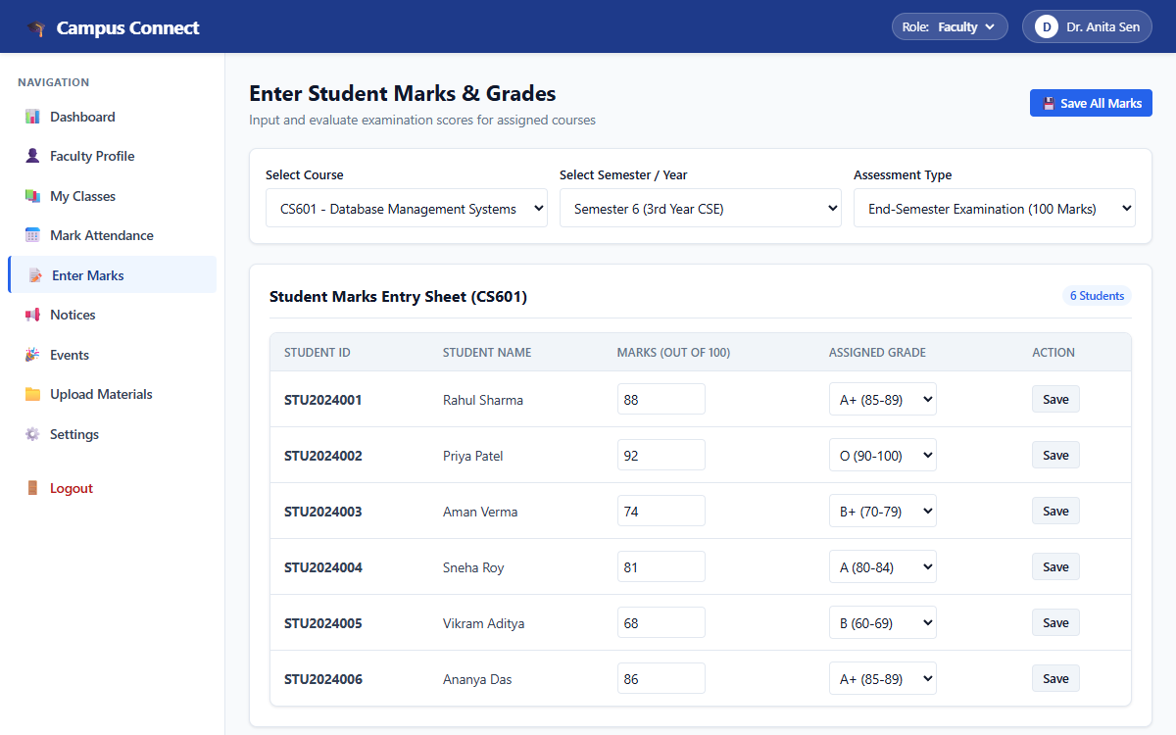
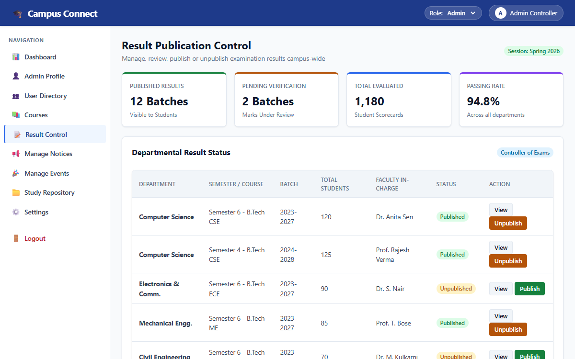
FACULTY & ADMIN FEATURES
Faculty & Administrator Portals
FACULTY & ADMIN CAPABILITIES
👨‍🏫 Faculty Role Modules:
• Digital Roll-Call: Interactive table with Present/Absent/Late status click toggles.
• Marks Entry Sheet: Input exam scores (out of 100), assign letter grades, and save student results.
• Material Upload: Share lecture notes and lab assignments.
🏛️ Administrator Role Modules:
• User Directory: Manage and filter student and faculty records by department.
• Result Publication Control: Toggle semester results between Published and Unpublished.
• Notice & Event Broadcasting: Issue campus-wide official circulars and manage calendar.
Campus Connect • Engineering Mini Project (50% Milestone)

Slide 8
ROADMAP
Project Development Roadmap
Phase 1 (25%)
Phase 2 (50%)
Phase 3 (75%)
Phase 4 (100%)
Basic Frontend Wireframe
Complete & Polished Frontend
Backend API & Database
Integrated Mini Project
COMPLETED ✓
CURRENT MILESTONE ✓
PLANNED NEXT
FINAL SUBMISSION
Initial page templates, static navigation links, and basic HTML/CSS layouts.
14 responsive pages, 3 roles, Result Management, dynamic sidebar, search filters, and roll-call toggles.
Python Flask REST API endpoints, JWT role authentication, and PostgreSQL database schema.
Full frontend-backend integration, end-to-end testing, reporting, and deployment.
📌 Academic Note: This presentation represents the 50% Frontend Mini-Project Milestone. The full mega project with advanced microservices will be developed separately next semester.
Campus Connect • Engineering Mini Project (50% Milestone)

