Slide 1
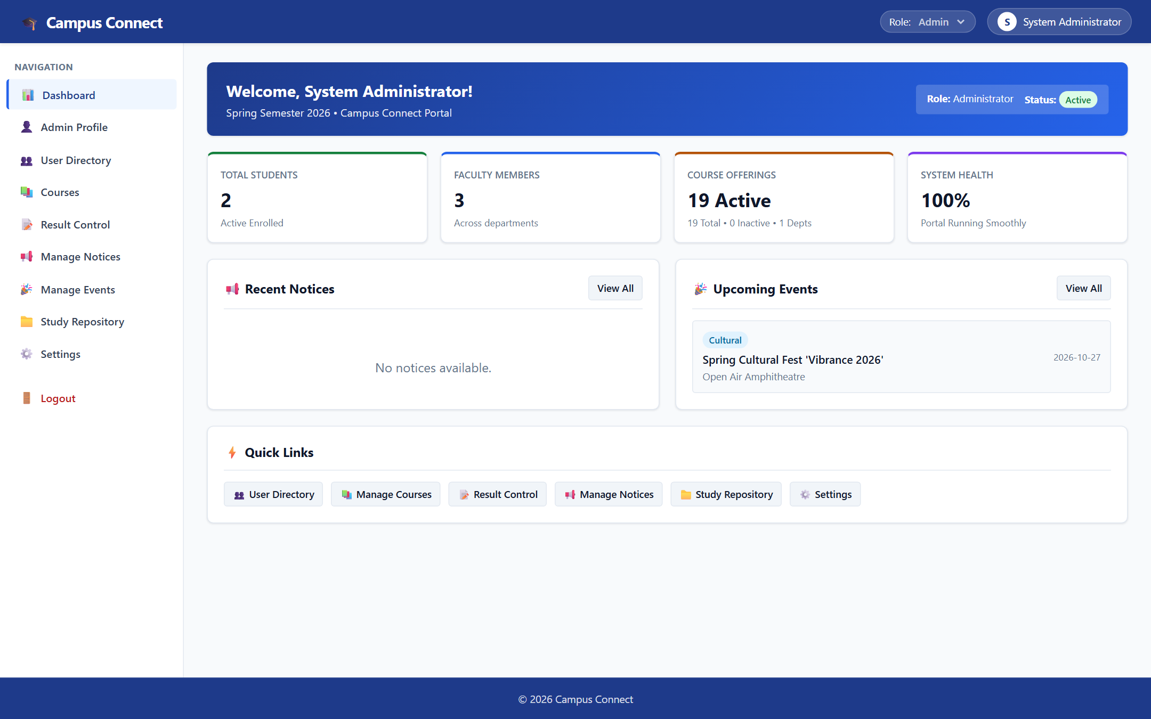
🏛️ SHARAD INSTITUTE OF TECHNOLOGY COLLEGE OF ENGINEERING
Department of Computer Science & Engineering • Academic Year 2025–26
Campus Connect ERP
Integrated Campus Management System
A centralized, role-based college portal for real-time attendance roll-calls, 4-tier examination marks entry, automated grade calculation, and coursework management.
AUTHENTIC SYSTEM DASHBOARD INTERFACE
PROJECT OVERVIEW & TECHNOLOGY STACK
• Core Technologies: Python 3.11 • Flask Web Framework • PostgreSQL • SQLAlchemy 2.0 ORM
• Developer Attribution: Ayan Mulani (Project Lead) & Project Team | SITCOE Yadrav
• GitHub Repository: https://github.com/ayanmulani4867-cyber/Campus-mini2
Verified System Architecture:
✔ Multi-Tier Role Governance: Admin, Faculty, and Student
✔ Live Cloud Database: Relational PostgreSQL Schema
✔ Demonstration Dataset: Test environment sample records
Slide 1 of 7

Slide 2
PROJECT MOTIVATION & SCOPE
Problem Statement & Project Objectives
Slide 2 of 7
🚨 OPERATIONAL CHALLENGES (PROBLEM)
• Fragmented Academic Records
Student profiles, course lists, and marks reside in disconnected physical registers and spreadsheets, causing data silos and duplication.
• Manual Attendance & Grade Tabulation
Paper-based roll-calls cause administrative delays, calculation errors, and slow identification of students falling below attendance thresholds.
• Absence of Role-Based Workspace Isolation
Unsecured access without strict Role-Based Access Control (RBAC) creates data privacy risks between administrators, faculty, and students.
🎯 CAMPUS CONNECT ERP (SOLUTION)
✔ Centralized Relational Database
Unified PostgreSQL repository managed via SQLAlchemy 2.0 ORM, integrating students, faculty, departments, and course offerings.
✔ Automated 4-Tier Evaluation Engine
Structured scoring for CA1 (20), CA2 (20), Mid-Sem (30), and End-Sem (70) with automated SGPA/CGPA grade card generation.
✔ Strict Role-Based Access Control (RBAC)
Server-side session authentication with token isolation guaranteeing dedicated, secure workspaces for Admins, Faculty, and Students.
Campus Connect ERP • Sharad Institute of Technology College of Engineering (SITCOE) • Demonstration Test Environment

Slide 3
TECHNICAL ARCHITECTURE
System Architecture & Data Flow Diagram
Slide 3 of 7
CLIENT LAYER
APPLICATION LAYER
DATA PERSISTENCE
Web Browser Interface
• HTML5 Responsive Layouts
• Vanilla CSS3 Design System
• Vanilla JavaScript (ES6 Fetch)
• Multi-Tab Session Token Isolation
Python Flask REST Backend
• Python 3.11 Microframework
• Modular Blueprints (Auth, Users, Results)
• Role-Based Access Decorators (RBAC)
• Werkzeug PBKDF2 Password Hashing
PostgreSQL Cloud Database
• PostgreSQL Relational DB (Render)
• SQLAlchemy 2.0 Declarative ORM
• Alembic Schema Version Migrations
• Foreign-Key Relational Integrity
➔
➔
CLOUD HOSTING & DEPLOYMENT PIPELINE
• Render Cloud Web Service: Automated continuous deployment configured and synchronized with the repository's main branch.
• Gunicorn WSGI Production Server: Multi-worker Python WSGI server handling concurrent HTTP requests with ProxyFix middleware.
• Zero-Mock Relational Integrity: Every application route executes authentic SQL queries against PostgreSQL tables; no hardcoded dummy data.
Campus Connect ERP • Sharad Institute of Technology College of Engineering (SITCOE) • Demonstration Test Environment

Slide 4
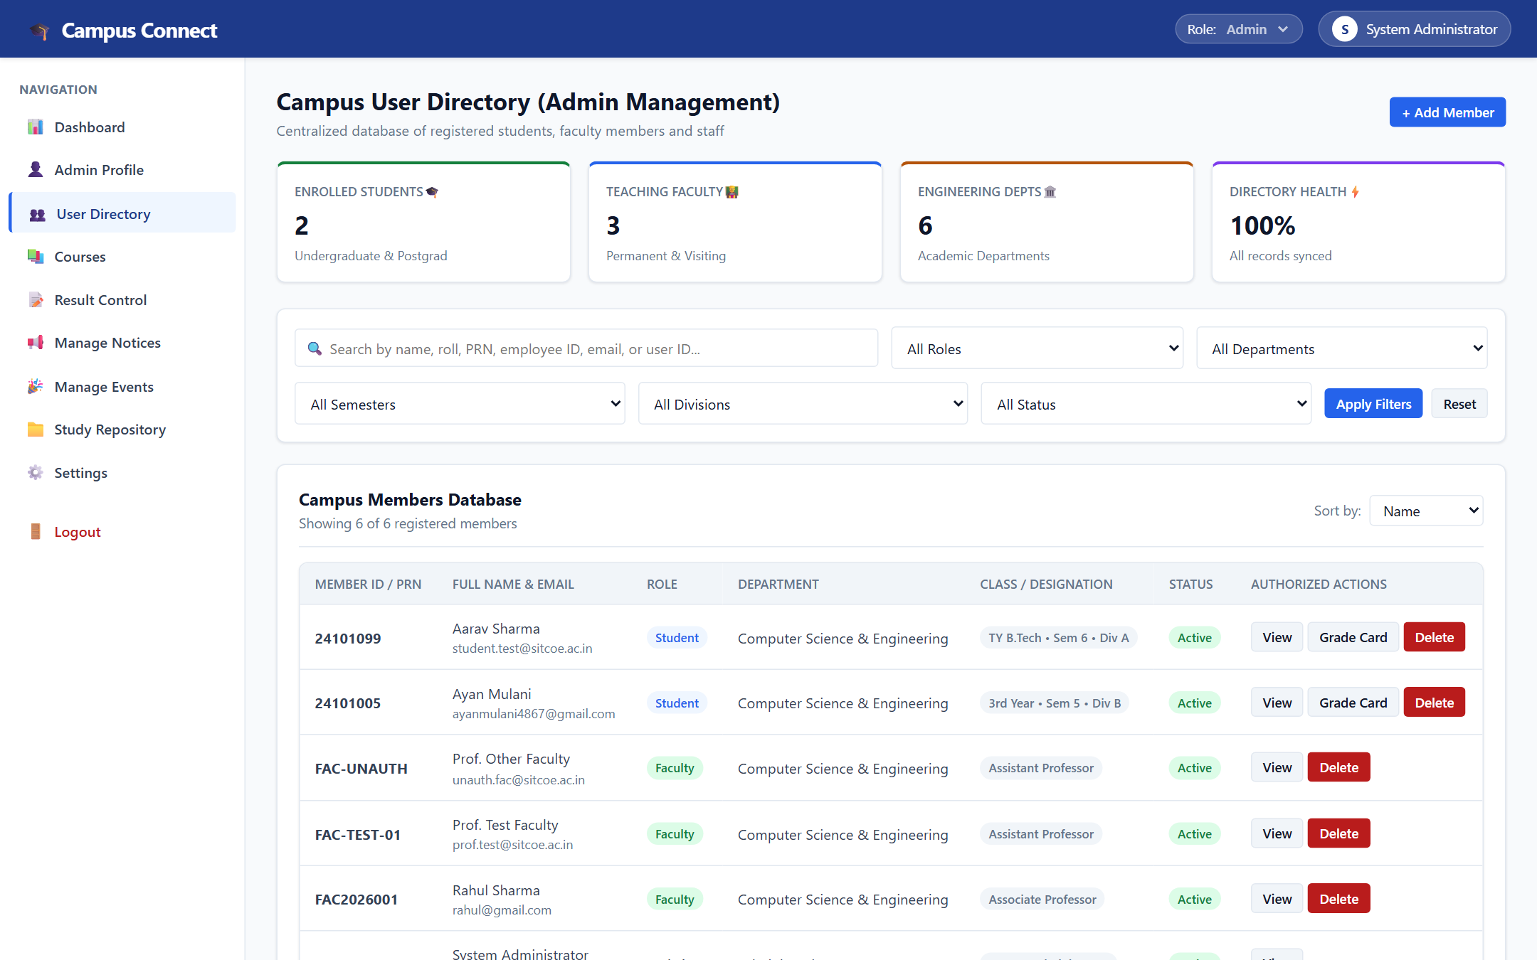
ADMINISTRATION MODULE
Administrative Dashboard & User Directory
Slide 4 of 7
VERIFIED CAPABILITIES
✔ Unified Member Ledger
Directly couples login credentials with student and faculty academic records to prevent orphan data.
✔ Multi-Field Search & Filters
Search registered members by name, roll, PRN, or employee ID; filter by department and semester.
✔ Role-Based Governance
Administrators manage account activation, inspect profiles, and trigger instant student grade cards.
* Screen captured from running ERP using demonstration test dataset.
Figure 1: Campus User Directory — Centralized account governance & profile linking
Demonstration Dataset: Role filtering (Admin, Faculty, Student) • Department search controls
Campus Connect ERP • Sharad Institute of Technology College of Engineering (SITCOE) • Demonstration Test Environment

Slide 5
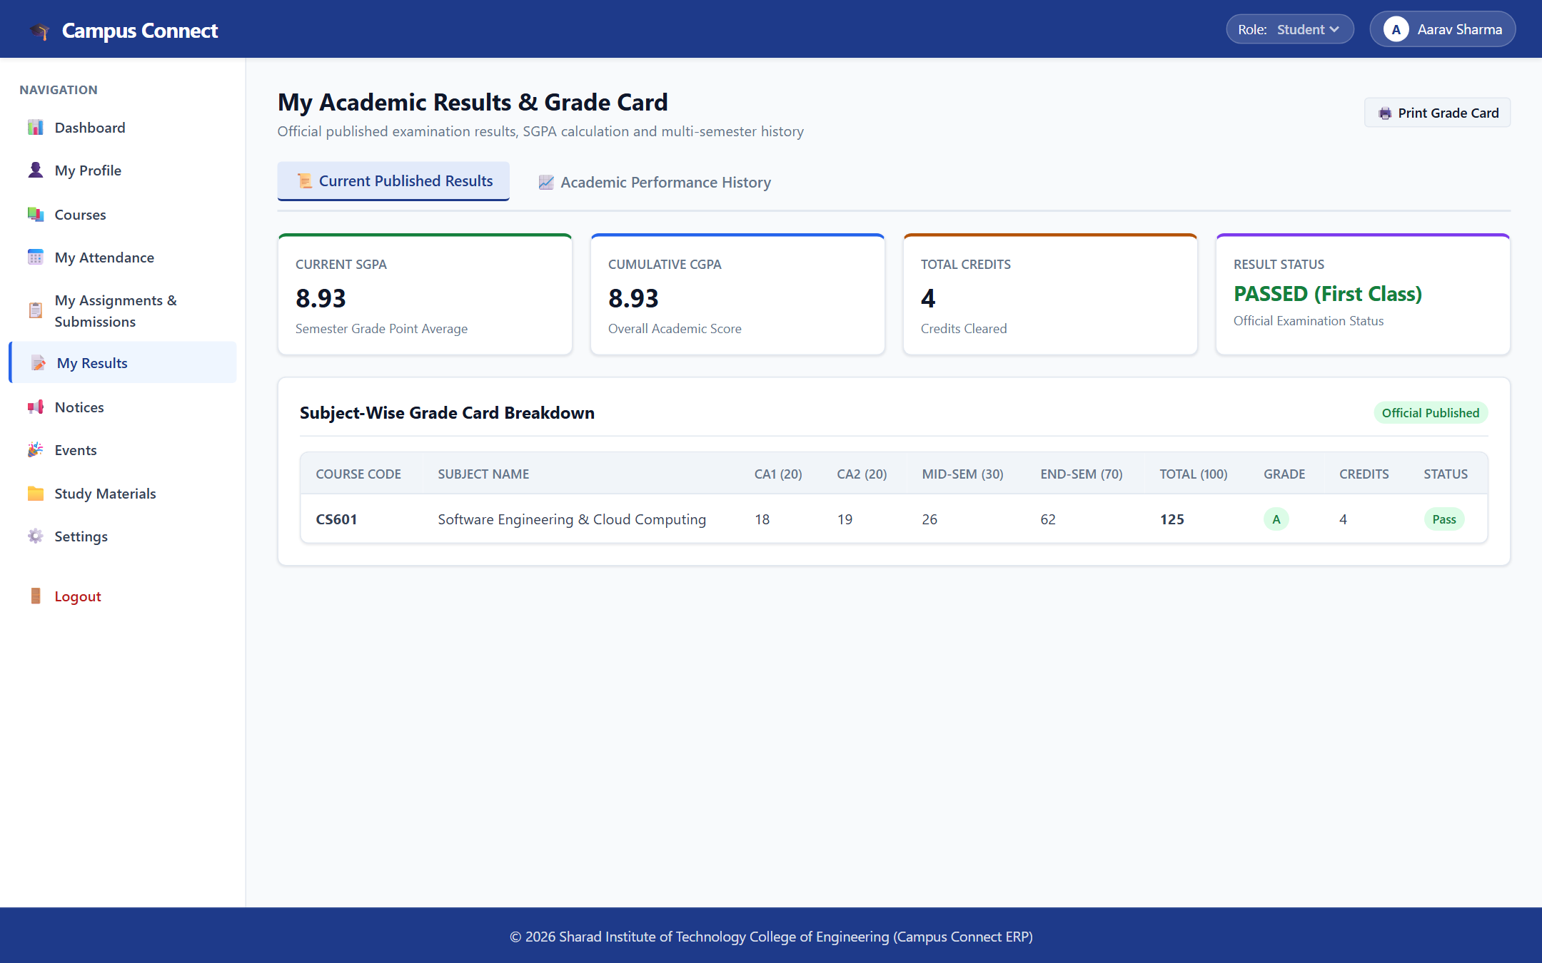
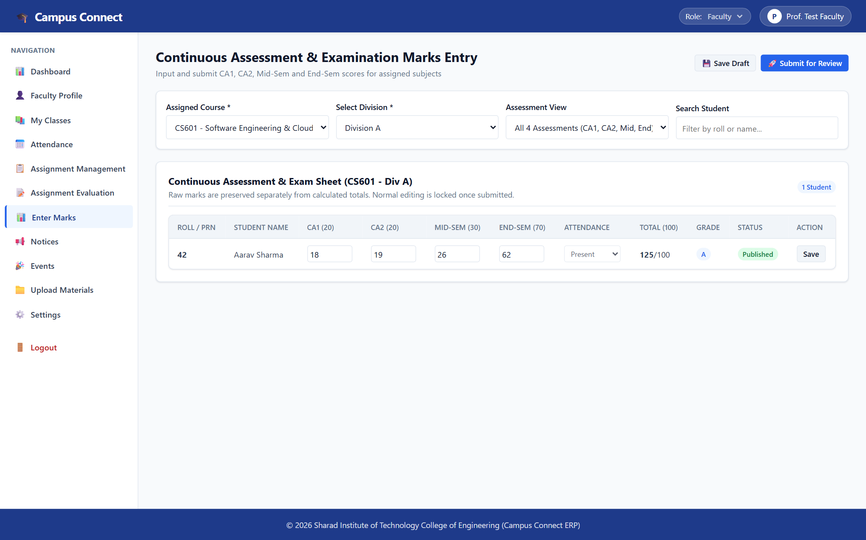
ACADEMIC LIFECYCLE
Academic Management: Attendance & Examination Results
Slide 5 of 7
Figure 2: Published Student Grade Card with SGPA & CGPA Calculation
Sample Record: CA1 (18) + CA2 (19) + Mid (26) + End (62) = 125/140 Marks • Grade A • SGPA 8.93
Figure 3: Faculty Continuous Assessment Sheet (CA1, CA2, Mid-Sem, End-Sem)
Workflow: CS601 Software Eng (Div A) • Draft Saving ➔ Review Submission ➔ Approval
MATHEMATICAL CALCULATION & VERIFIED ASSESSMENT RULES:
• 4-Tier Assessment Math: CA1 (20) + CA2 (20) + Mid-Sem (30) + End-Sem (70) = 140 Total Maximum Marks. Obtained: 125/140 = 89.29% (Grade A, Passed First Class).
• Attendance Roll-Call Ledger: Course-wise session tracking (CS601, ML, Software Testing) with automated 75% university eligibility threshold monitoring.
Campus Connect ERP • Sharad Institute of Technology College of Engineering (SITCOE) • Demonstration Test Environment

Slide 6
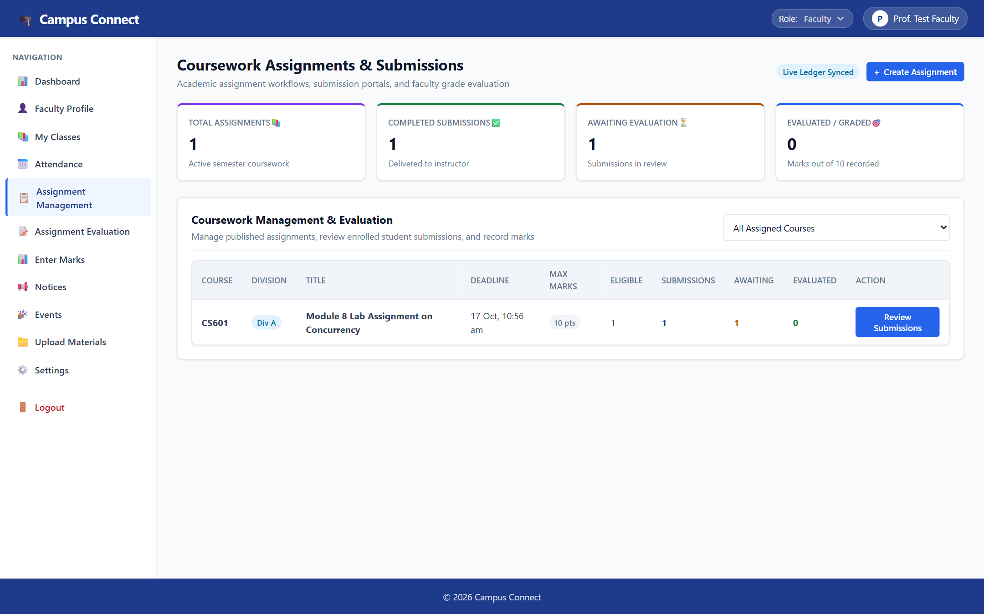
COLLABORATION & SERVICES
Coursework Lifecycle & Campus Announcements
Slide 6 of 7
COLLABORATION WORKFLOWS
✔ Assignment Publishing
Faculty create course assignments with point allocations, division targets, and strict submission deadlines.
✔ Tamper-Proof Locking
Students upload solutions via their portal; submissions are timestamped and locked against post-deadline editing.
✔ Zero-Mock Circulars
Official notices and campus events (e.g. Spring Cultural Fest 'Vibrance 2026') served directly from PostgreSQL.
* All modules query genuine database tables in the demonstration environment.
Figure 4: Coursework Assignment Management with submission locking & evaluation queue
Active Coursework: CS601 'Module 8 Lab Assignment on Concurrency' (10 pts) • 1 Delivered Submission
Campus Connect ERP • Sharad Institute of Technology College of Engineering (SITCOE) • Demonstration Test Environment

Slide 7
PROJECT SYNTHESIS & VIVA SUMMARY
Project Outcomes, Roadmap & Conclusion
Slide 7 of 7
🏁 THREE CORE PROJECT OUTCOMES
✔ Unified Academic Operations
Successfully integrated roll-call attendance, 4-tier continuous examination assessment, and official grade card publication into a single platform.
✔ Strict Role-Based Security
Enforced Role-Based Access Control (RBAC) with session token isolation, providing secure, partitioned workspaces for Administrators, Faculty, and Students.
✔ Production Relational Architecture
Implemented a robust PostgreSQL schema via SQLAlchemy 2.0 ORM with complete referential integrity and zero reliance on mock/demo data fallbacks.
🚀 TWO PLANNED FUTURE ENHANCEMENTS
★ Automated Parent SMS Alerts (Planned)
Integrate an SMS gateway (Twilio / Fast2SMS) to automatically alert parents and students when attendance drops below the 75% university eligibility threshold.
★ Accreditation & Analytics Reporting (Planned)
Build graphical department-wise analytics and automated PDF/Excel report exports for NAAC and NIRF institutional accreditation reviews.
CAMPUS CONNECT ERP • SITCOE YADRAV • THANK YOU!
GitHub Repository: https://github.com/ayanmulani4867-cyber/Campus-mini2 • Open for Viva Questions & Discussion
Campus Connect ERP • Sharad Institute of Technology College of Engineering (SITCOE) • Demonstration Test Environment

