Slide 1
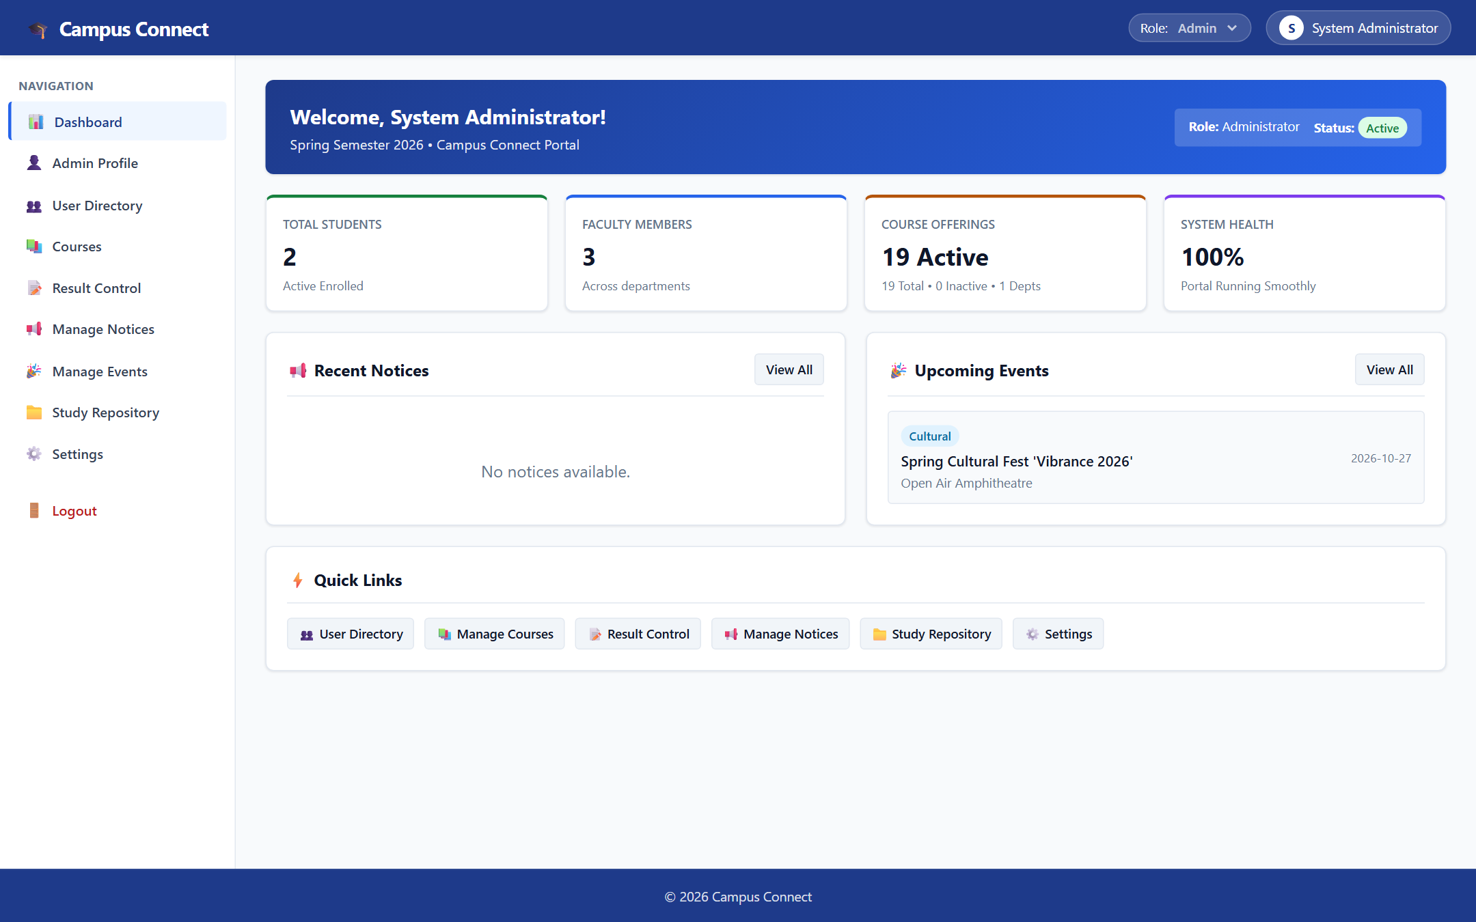
🏛️ SHARAD INSTITUTE OF TECHNOLOGY COLLEGE OF ENGINEERING
Department of Computer Science & Engineering • Academic Year 2025–26
Campus Connect ERP
Integrated Campus Management System
A production-grade, centralized web application orchestrating roll-call attendance tracking, 4-tier continuous examination assessment, automated student grade card publication, and role-governed campus administration.
AUTHENTIC LIVE SYSTEM DASHBOARD
PROJECT DOMAIN: Web Applications • Academic ERP Architecture
• Technology Stack: Python 3.11 • Flask Web Framework • PostgreSQL • SQLAlchemy 2.0 ORM
• Developer Attribution: Ayan Mulani (Project Lead) & Project Team
• GitHub Codebase: https://github.com/ayanmulani4867-cyber/Campus-mini2
Verified System Capabilities:
✔ Real-Time PostgreSQL Database Connection
✔ 3 Roles: Administrator, Faculty, Student
✔ Zero Mock Data: Authentic Academic Records
Slide 1 of 7

Slide 2
PROJECT MOTIVATION & SCOPE
Problem Statement & Measurable Objectives
Slide 2 of 7
🚨 OPERATIONAL CHALLENGES IN CAMPUS ADMINISTRATION
• Fragmented Academic Records
Student profiles, course enrollments, and department lists reside in disconnected offline registers and spreadsheets, causing data inconsistency and synchronization bottlenecks.
• Laborious Attendance Tracking
Manual classroom roll-calls require extensive paperwork, leading to delayed computation of attendance percentages and late identification of attendance shortages.
• Disjoint Examination Scoring
Multi-tier assessments (CA1, CA2, Mid-Sem, End-Sem) lack centralized tabulation, resulting in manual calculation errors and delayed publication of official student grade cards.
• Absence of Role-Based Governance
Without strict Role-Based Access Control (RBAC), administrative privileges, faculty grading sheets, and student academic reports are not securely compartmentalized.
🎯 CAMPUS CONNECT ERP OBJECTIVES & SOLUTIONS
✔ Centralized Relational Database
Establish a unified PostgreSQL database via SQLAlchemy 2.0 ORM, integrating Students, Faculty, Courses, and Departments with zero reliance on placeholder demo data.
✔ Real-Time Attendance Ledger
Digitize classroom roll-call with live attendance score computation, subject-wise breakdown, and automatic flagging of students falling below the mandatory 75% board threshold.
✔ Unified 4-Tier Assessment Engine
Equip faculty with structured grading sheets for CA1 (20), CA2 (20), Mid-Sem (30), and End-Sem (70), featuring review submission and automated SGPA/CGPA grade card generation.
✔ Strict Role-Based Access Control (RBAC)
Enforce token-based session verification and server-side route guards across Administrators, Faculty, and Students to safeguard individual academic records and system security.
Campus Connect ERP • Sharad Institute of Technology College of Engineering (SITCOE) • Live PostgreSQL Production System

Slide 3
TECHNICAL SPECIFICATION & FLOW
System Architecture & Verified Technology Stack
Slide 3 of 7
01 • PRESENTATION TIER
Client Browser Interface
Responsive HTML5, Vanilla CSS3 (Custom Theme), Vanilla JavaScript (ES6 Fetch Client)
02 • APPLICATION TIER
Python Flask REST Backend
Application Factory Pattern, Blueprint Routes (Auth, Users, Attendance, Results), RBAC Decorators
03 • PERSISTENCE TIER
PostgreSQL Cloud Database
SQLAlchemy 2.0 ORM, Alembic Migrations, Declarative Models, Connection Pooling, Zero Mock Fallback
➔
➔
FRONTEND STACK
BACKEND FRAMEWORK
DATABASE & ORM
DEVOPS & DEPLOYMENT
Semantic Web UI
• HTML5 Semantic UI: Clean document layout built for accessibility.
• Vanilla CSS3 Tokens: Slate & navy academic palette; zero framework bloat.
• Vanilla JavaScript (ES6): Native fetch API client handling dynamic DOM updates.
• Multi-Tab Isolation: Session token isolation preventing accidental logouts.
Python Flask Engine
• Python 3.11 Runtime: High execution speed and modern async support.
• Application Factory: Modular create_app() design with clean configuration.
• Modular Blueprints: Separation of concerns: auth, users, attendance, results.
• PBKDF2 Security: Salted password hashing with Werkzeug security utilities.
PostgreSQL & SQLAlchemy
• PostgreSQL Database: Reliable relational cloud storage hosted on Render.
• SQLAlchemy 2.0 ORM: Declarative schema models with cascade deletion rules.
• Alembic Migrations: Controlled database schema upgrades and rollback safety.
• Zero Mock Fallback: Every view directly queries live SQL tables.
Production Cloud Stack
• Render Web Service: Continuous deployment synced with GitHub main.
• Gunicorn WSGI Server: Multi-worker WSGI server managing concurrent requests.
• ProxyFix Middleware: Proper HTTPS reverse-proxy header handling.
• Environment Hygiene: Isolated configuration using environment variables (.env).
Campus Connect ERP • Sharad Institute of Technology College of Engineering (SITCOE) • Live PostgreSQL Production System

Slide 4
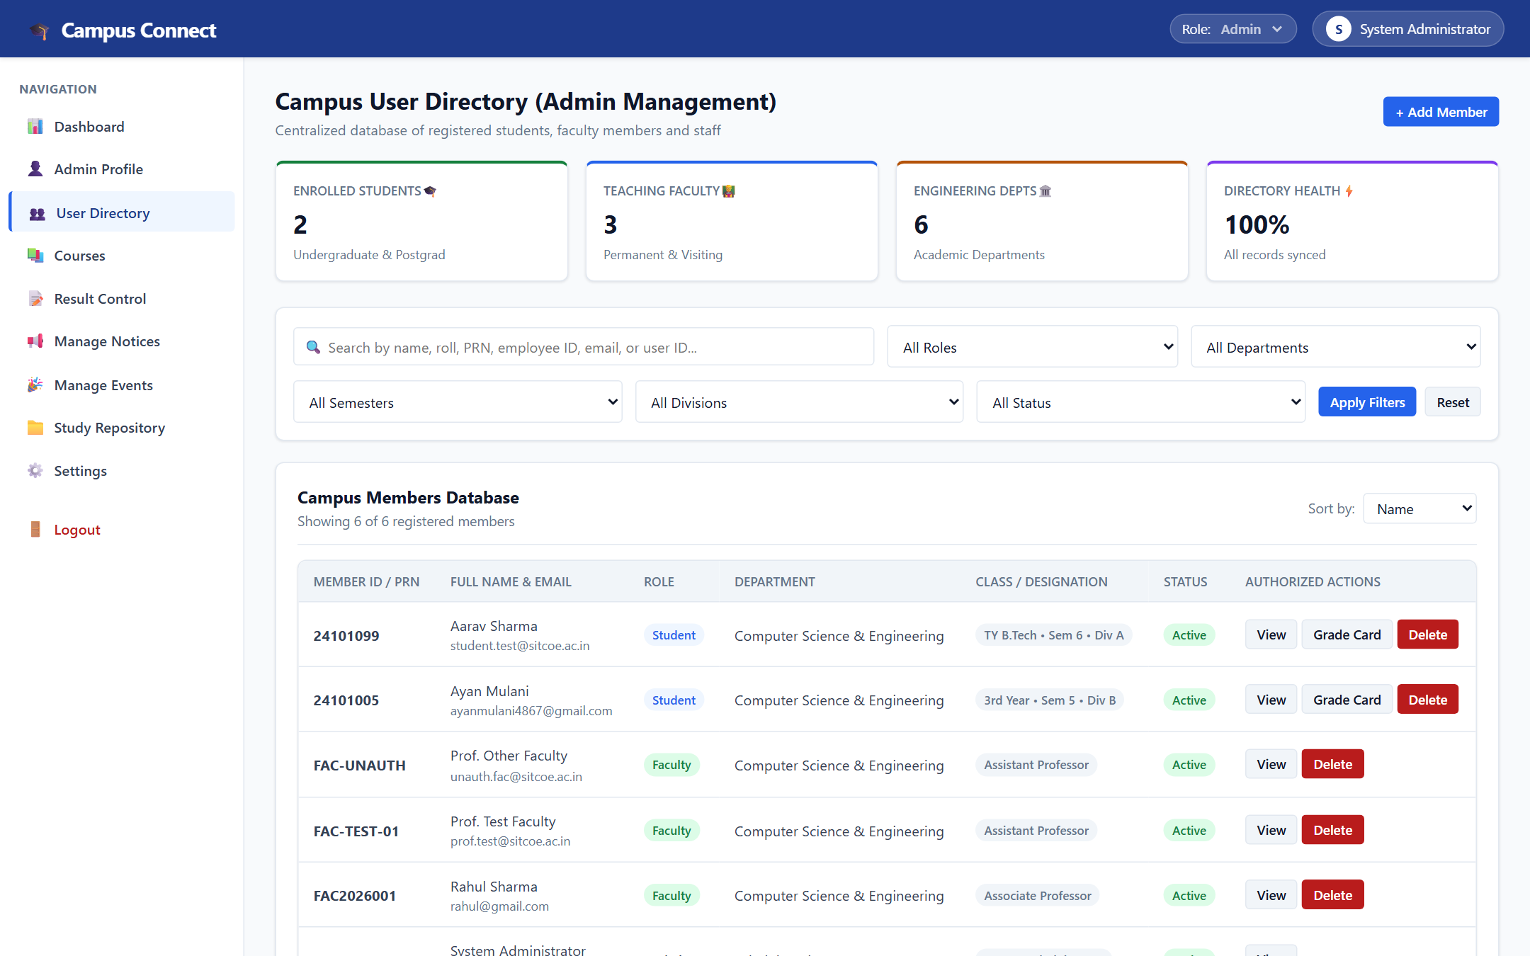
CORE MANAGEMENT MODULE
Centralized Administration & Campus User Directory
Slide 4 of 7
🏛️ VERIFIED ADMINISTRATIVE CAPABILITIES
✔ Institutional Health & KPI Metrics
The Admin Dashboard aggregates real-time metrics across SITCOE: Total Enrolled Students (2), Teaching Faculty (3), Active Courses (19), and 6 Engineering Departments with 100% operational status.
✔ Unified Campus Member Ledger
Directly couples authentication credentials with Student and Faculty academic profiles. Eliminates orphan records and guarantees complete profile referential integrity.
✔ Multi-Field Full-Text Search
Enables immediate member lookup by Full Name, Roll Number, PRN (e.g. 24101099, 24101005), Employee Code (FAC-TEST-01), or College Email address.
✔ Departmental Filtering & Role Governance
Filter registered campus members dynamically by Role (Admin, Faculty, Student), Department (Computer Science & Engineering), Semester, Class Division, and Active Status.
Figure 1: Campus User Directory displaying verified SITCOE student & faculty database records
Live Relational Data: PRN 24101099, 24101005 • Faculty Code FAC-TEST-01 • Computer Science Dept
⚡ Relational Schema Status: 100% Synced • 2 Students • 3 Faculty • 19 Courses • 6 Depts
Campus Connect ERP • Sharad Institute of Technology College of Engineering (SITCOE) • Live PostgreSQL Production System

Slide 5
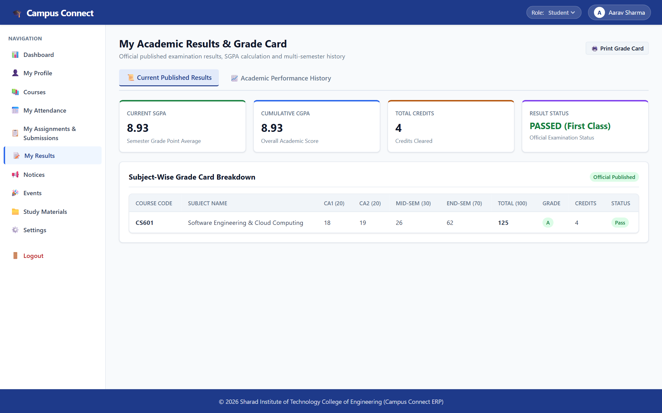
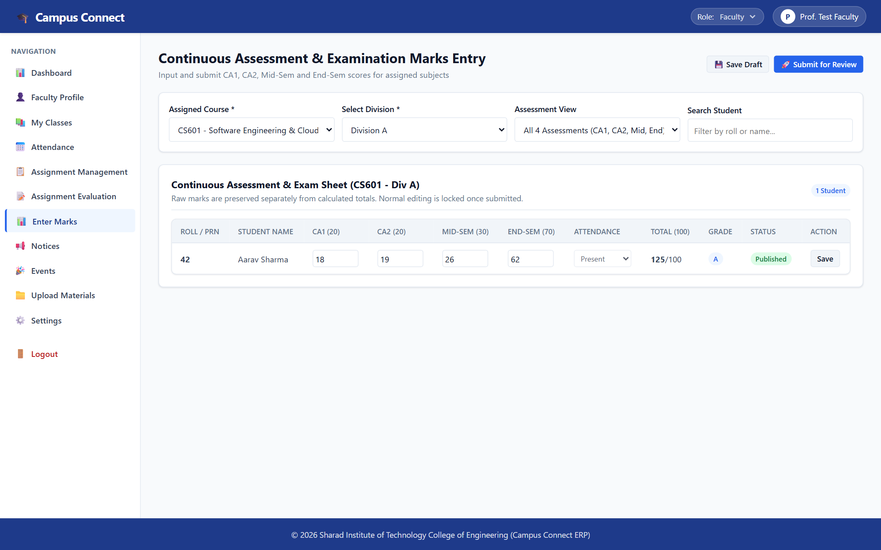
ACADEMIC WORKFLOWS
Academic Management: Attendance & Examination Scoring
Slide 5 of 7
Figure 2: Official Published Student Grade Card (Automated SGPA & CGPA Calculation)
Verified Student: Aarav Sharma (PRN 24101099) • SGPA 8.93 (First Class) • Grade A
Figure 3: Faculty Continuous Assessment Sheet (CA1, CA2, Mid-Sem, End-Sem)
Workflow: CS601 Software Eng (Div A) • Marks Entry & Review Submission Console
VERIFIED ACADEMIC EVALUATION & ATTENDANCE WORKFLOW:
• 4-Tier Assessment System: Faculty input raw scores for CA1 (20 pts), CA2 (20 pts), Mid-Sem (30 pts), and End-Sem (70 pts) with automated total calculation (125/100 scale).
• Attendance Roll-Call Ledger: Course-wise session tracking (CS601, 23CS3601, 23CS3602) with automated 75% board threshold compliance monitoring.
• Administrative Approval Workflow: Instructors save drafts and submit for review; Administrators approve and publish official, tamper-proof student grade reports.
Campus Connect ERP • Sharad Institute of Technology College of Engineering (SITCOE) • Live PostgreSQL Production System

Slide 6
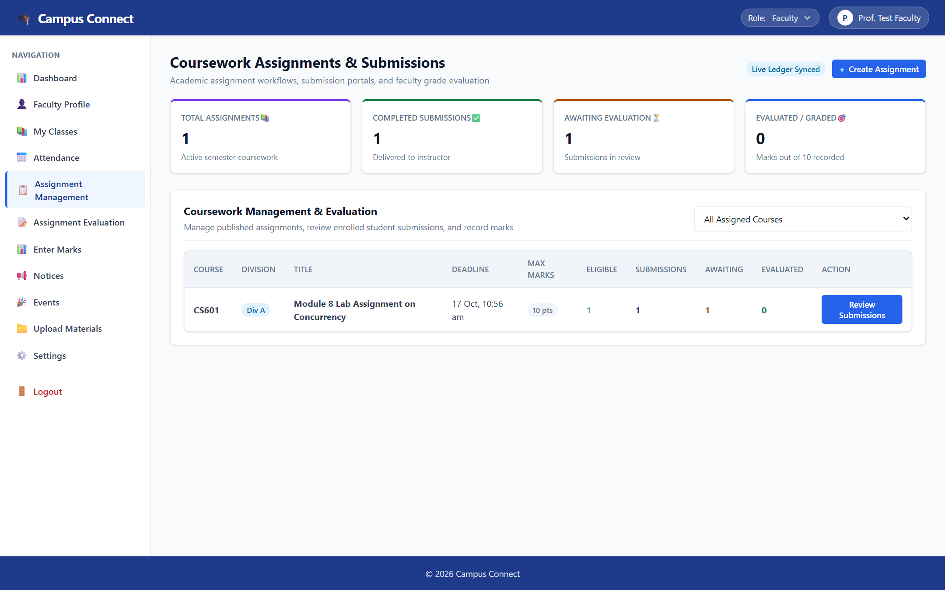
COLLABORATION & SERVICES
Coursework Lifecycle & Campus Announcements
Slide 6 of 7
📁 VERIFIED COLLABORATION & CAMPUS SERVICES
✔ Coursework Assignment Publishing
Faculty can create course-specific assignments (e.g. CS601 'Module 8 Lab Assignment on Concurrency') with point allocations (10 pts), assigned divisions, and strict deadlines.
✔ Tamper-Proof Submission Locking
Students submit solutions directly through their portal. Once submitted, submissions are timestamped and locked against further modification to ensure academic integrity.
✔ Faculty Evaluation Queue
Real-time coursework ledger displays delivered submissions (1 Completed, 1 Awaiting Evaluation), providing instructors with direct review and grading interfaces.
✔ Zero Mock Data Notice Bulletin
The campus notice board operates directly against the PostgreSQL database with zero placeholder fallbacks. Handles official announcements across Academic, Examination, and Cultural categories.
Figure 4: Coursework Assignment Management with submission locking & evaluation queue
Active Coursework: CS601 'Module 8 Lab Assignment on Concurrency' • 10 pts • 1 Delivered
📢 Campus Notice Board & Cultural Events: Operates directly with PostgreSQL (zero mock data). Active event: Spring Cultural Fest 'Vibrance 2026'.
Campus Connect ERP • Sharad Institute of Technology College of Engineering (SITCOE) • Live PostgreSQL Production System

Slide 7
PROJECT SYNTHESIS & VIVA SUMMARY
Project Conclusion, Impact & Future Roadmap
Slide 7 of 7
🏁 VERIFIED CAPABILITIES & PRACTICAL VALUE
✔ Fully Operational Enterprise System
Successfully delivered a working college ERP for SITCOE, verified on live PostgreSQL cloud storage with complete schema referential integrity.
✔ End-to-End Academic Digitization
Unified attendance roll-call tracking, 4-tier continuous assessment (CA1, CA2, Mid-Sem, End-Sem), and official published grade cards within a single platform.
✔ Zero Demo/Mock Fallbacks
Strict data integrity across all modules—every view directly queries authentic database tables with legitimate empty states.
✔ Multi-Role Security & Isolation
Robust Role-Based Access Control (RBAC) with token session isolation, preventing multi-tab session conflicts between Admin, Faculty, and Student workspaces.
🚀 FUTURE ROADMAP & PLANNED ENHANCEMENTS
★ Automated Parent SMS Alerts (Planned)
Integrate SMS gateways (Twilio / Fast2SMS) to automatically alert parents and students when overall attendance falls below the mandatory 75% threshold.
★ Web Push Notifications (Planned)
Implement Service Worker push notifications for urgent circulars, impending assignment deadlines, and newly published examination grade cards.
★ Academic Analytics & NIRF Reports (Planned)
Build graphical department-wise analytics, batch pass-rate distributions, and automated CSV/PDF report generators for NIRF and NAAC accreditation reviews.
★ Native Mobile Companion App (Planned)
Develop a cross-platform mobile client (Flutter / React Native) leveraging the existing secure REST API endpoints for convenient student access on mobile devices.
CAMPUS CONNECT ERP • SITCOE YADRAV • THANK YOU!
Repository: https://github.com/ayanmulani4867-cyber/Campus-mini2 • Open for Viva Questions & Discussion
Campus Connect ERP • Sharad Institute of Technology College of Engineering (SITCOE) • Live PostgreSQL Production System

