Slide 1
IDS517_39795_HW6
By
Ayan Pinjara
apinja2

Slide 2
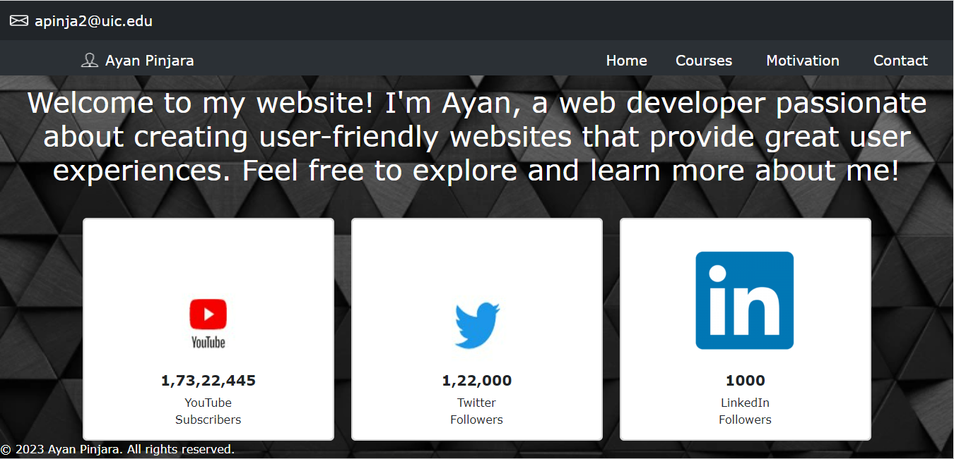
Index Page

Slide 3
Code and Function Description: Index
This page includes a header with a navigation bar, a main section with a welcome message and three cards that represent the person's YouTube subscribers, Twitter followers, and LinkedIn connections. The page also includes links to external websites for YouTube, Twitter, and LinkedIn. The Bootstrap framework is used for styling, as indicated by the inclusion of Bootstrap CSS and JavaScript files from a CDN. The page also references a custom CSS file named "index.css" for additional style

Slide 4

Course Page

Slide 5
Code and Function Description: Course
The webpage contains a navigation bar with links to different sections of the website such as Home, Courses, Motivation, and Contact. The main content of the webpage is divided into different sections using HTML tags such as <section>, <div>, and <h5>. Within each section, there are cards that contain information about different courses the person has completed. Each card contains an image, a title, and a description of the course. The webpage also includes external CSS and JavaScript files for styling and functionality, including the Bootstrap CSS and JS files for responsive design and other features.

Slide 6
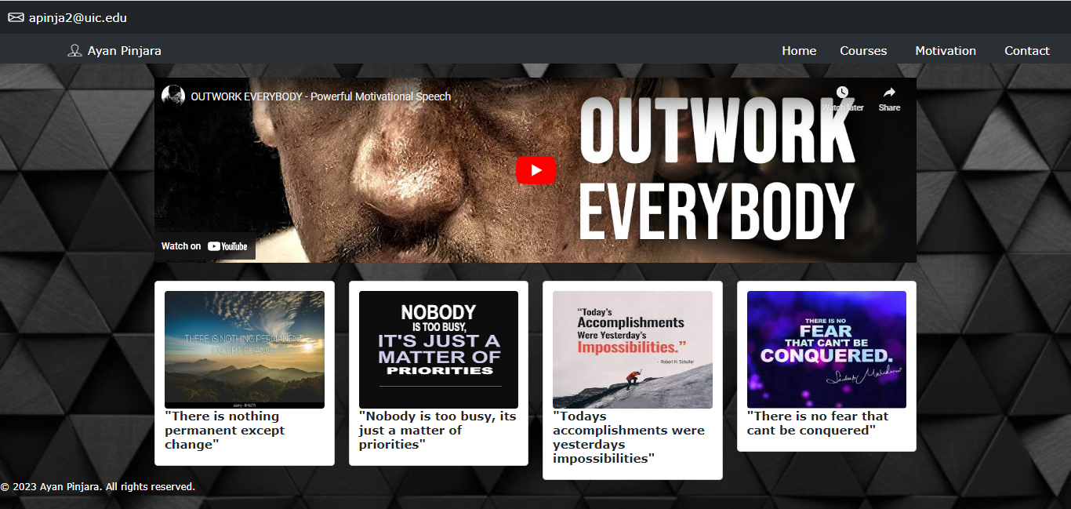
Motivation Page

Slide 7
Code and Function Description: Motivation
Page includes a navigation bar at the top of the page with links to different sections of the website such as Home, Courses, Motivation, and Contact. The page also includes a main content section with a video embedded from YouTube and a grid of four cards with images and quotes.
The HTML code uses Bootstrap, a popular CSS framework, to style the components on the page. It includes links to Bootstrap CSS and JavaScript files from a CDN (Content Delivery Network) as well as a custom CSS file named "index.css" for additional styling.
The content of the page features a video, images, and quotes. The code references several image files with file extensions such as ".png", ".jpg", and ".jpeg", which are likely used for the images displayed on the cards and in other sections of the page. The code also includes links to other HTML files for different sections of the website, such as "index.html", "course.html", "motivation.html", and "contact.html", which are likely the respective pages for the Home, Courses, Motivation, and Contact sections of the website.

Slide 8
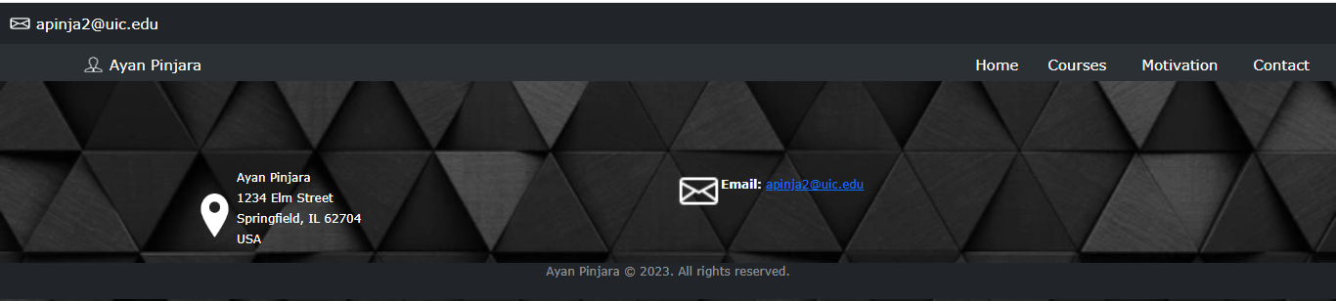
Contact Page

Slide 9
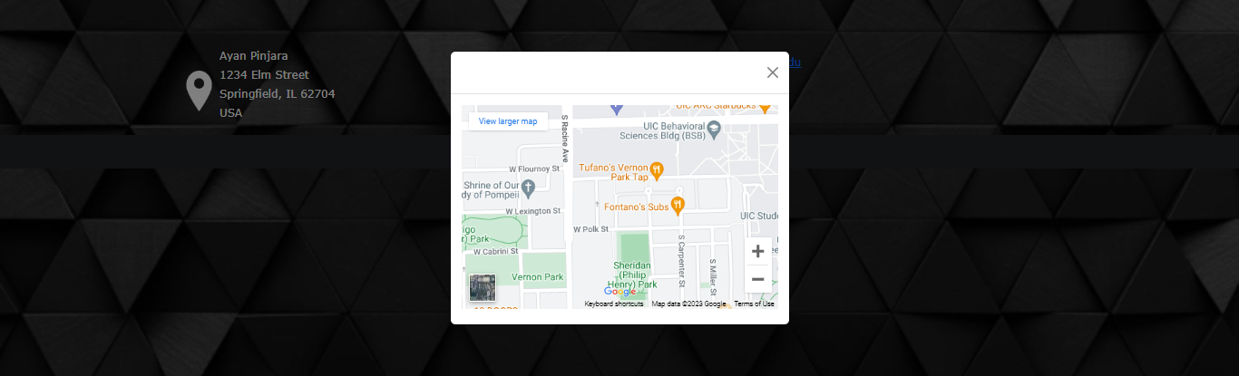
Code and Function Description: Contact
This webpage contains information about the owner (Ayan Pinjara). The webpage includes a navigation bar at the top with links to different pages such as Home, Courses, Motivation, and Contact. The webpage also includes a container with two columns that display the owner's location and email address, along with icons for location and email. There is also a modal that displays a Google Maps iframe with the owner's location when triggered by clicking on the "location" link. The webpage uses Bootstrap, a popular CSS framework, for styling and layout.

