Slide 1
On the effect of MRI field strength and spatial resolution on multivariate information decoding from visual cortex
– Ayan Sengupta

Slide 2

My Initial Reaction

Slide 3

Make it Interactive

Slide 4
On the effect of MRI field strength and spatial resolution on multivariate information decoding from visual cortex

Slide 5
Keywords
Visual Cortex
Multivariate information decoding
MRI field strength
Spatial Resolution

Slide 6
Keywords
Visual Cortex
Multivariate information decoding
MRI field strength
Spatial Resolution

Slide 7
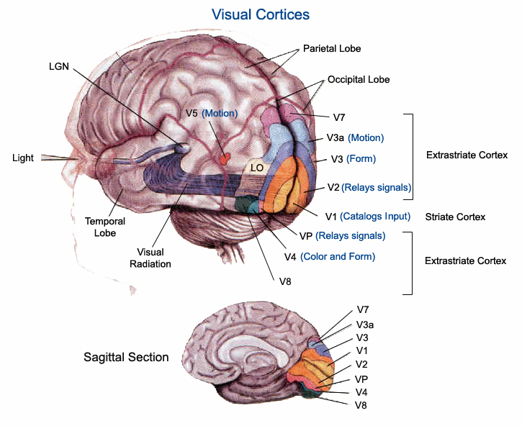
Visual Cortex

Slide 8
Only the Interesting information
Orientation Columns in V1
  The majority of cortical cells show orientation selectivity.
  Cortex can be divided vertically into columns on the basis of receptive field properties.
  In orientation columns (~50 microns in monkey cortex as stated in Sequence Regularity and Geometry of Orientation Columns in the Monkey striate cortex by DAVID H. HUBEL AND TORSTEN N. WIESEL) all orientation selective cells share the same preferred orientation.

Slide 9
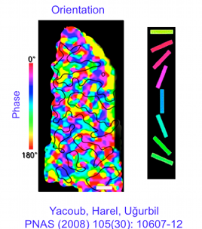
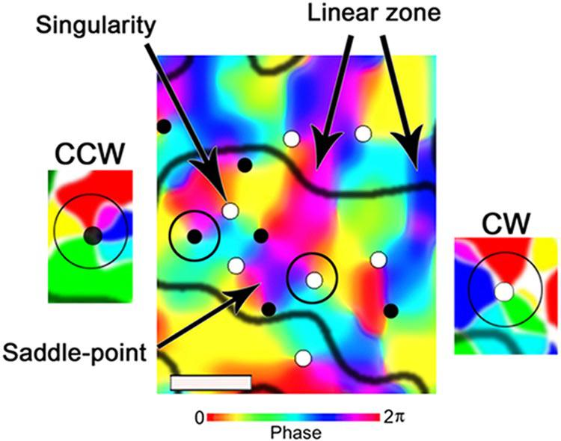
Only the Interesting information
Orientation Columns in V1

Slide 10
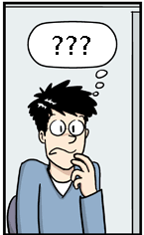
A question to yourself
Smaller the voxel size = Better Orientation Signals from the Orientation Columns

Slide 11
The GRAND debate
What is the spatial distribution Orientation Signal from the cortex?
LOCAL vs GLOBAL

Slide 12
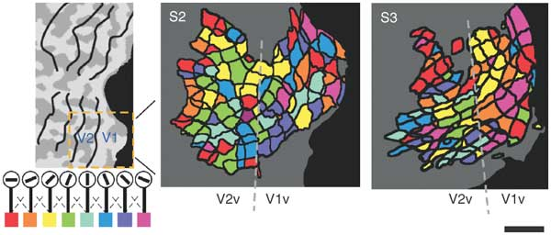
The GRAND debate
Local vs Global: The Local view
Kamitani, Yukiyasu, and Frank Tong. "Decoding the Visual
and Subjective Contents of the Human Brain."
Nature Neuroscience 8.5 (2005): 679-85.

Slide 13
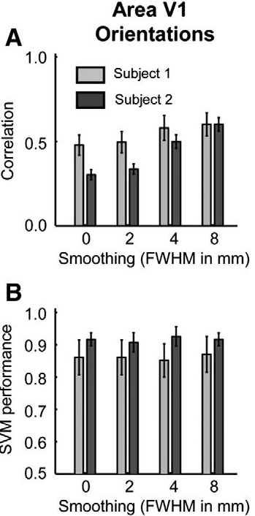
The GRAND debate
Local vs Global: The Global view
Against hyperacuity in brain reading: Spatial smoothing does not hurt multivariate fMRI analyses? Hans P. Op de Beeck

Slide 14
Keywords
Visual Cortex
Multivariate information decoding
MRI field strength
Spatial Resolution

Slide 15
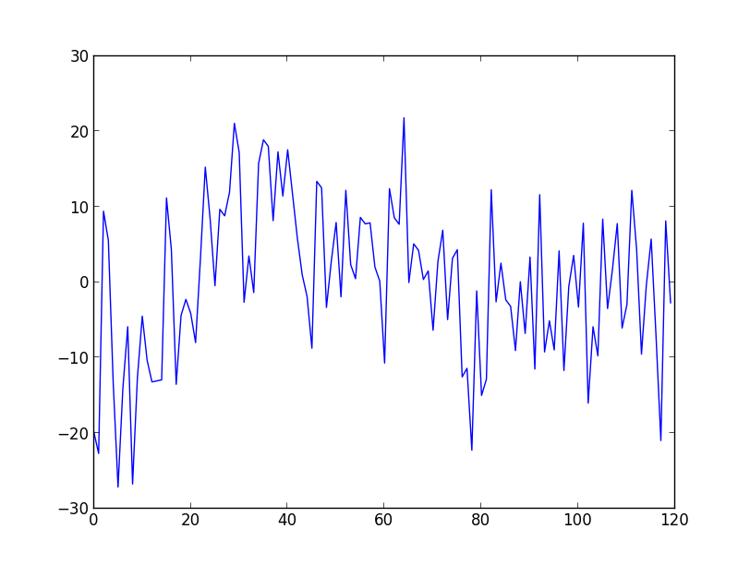
Multivariate Information Decoding
Time-series of a Voxel
Repetition time: 2 sec
No. of Volume : 120

Slide 16
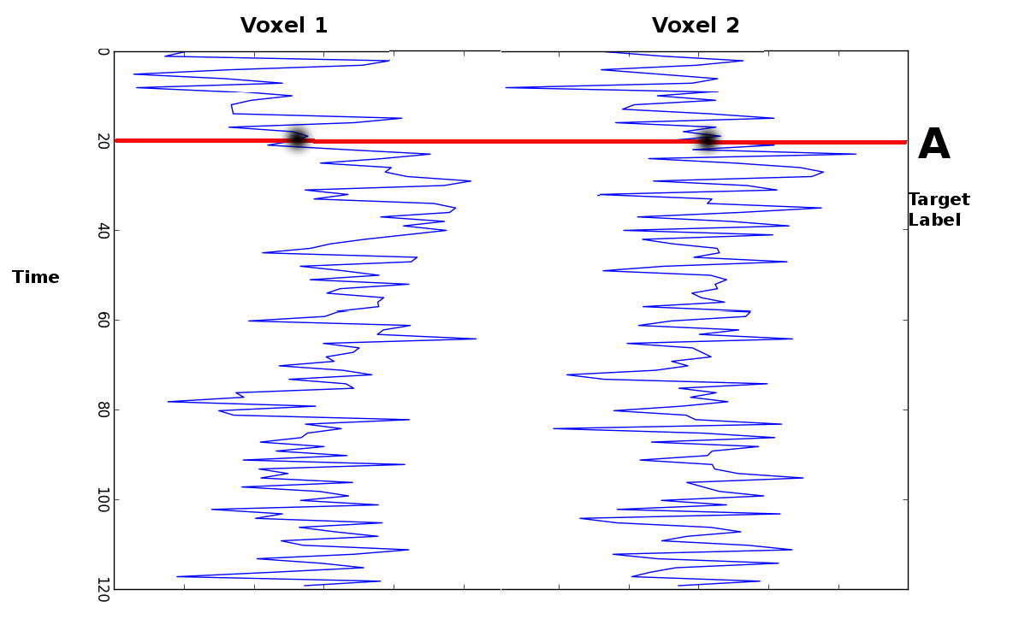
Multivariate Information Decoding

Slide 17
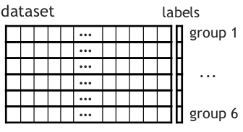
Multivariate Information Decoding

Slide 18
Multivariate Information Decoding
Concept of Classifier
Face vs Fruit

Slide 19
Multivariate Information Decoding
Concept of Classifier
Training Patterns

Slide 20

Multivariate Information Decoding
Concept of Classifier: Training Set
LABEL : Face

Slide 21

Multivariate Information Decoding
Concept of Classifier: Training Set
LABEL : Face

Slide 22

Multivariate Information Decoding
Concept of Classifier: Training Set
LABEL : Fruit

Slide 23

Multivariate Information Decoding
Concept of Classifier: Training Set
LABEL : Face

Slide 24

Multivariate Information Decoding
Concept of Classifier: Training Set
LABEL : Fruit

Slide 25

Multivariate Information Decoding
Concept of Classifier: Test Set
LABEL : ??

Slide 26

Multivariate Information Decoding
Concept of Classifier: Validation
LABEL : Face

Slide 27

Multivariate Information Decoding
Concept of Classifier: Test Set
LABEL : ??

Slide 28
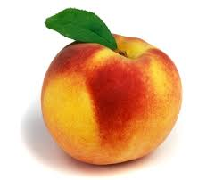
Multivariate Information Decoding
Concept of Classifier: Validation
LABEL : Fruit

Slide 29

Multivariate Information Decoding
Concept of Classifier: Test Set
LABEL : ??

Slide 30

Multivariate Information Decoding
Concept of Classifier: Validation
LABEL : Face on Fruit

Slide 31
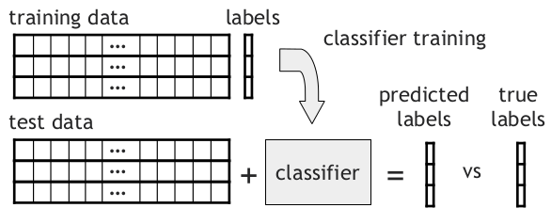
Multivariate Information Decoding

Slide 32
Multivariate Information Decoding
That's all for now about
Multivariate Decoding
Back to GRAND debate

Slide 33
The GRAND debate
What is the spatial distribution Orientation Signal from the cortex?
LOCAL vs GLOBAL

Slide 34
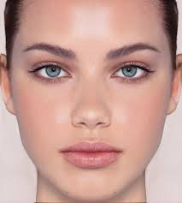
The GRAND debate
Food for thought: What is the color of the Pupil?
Answer: Blue
Answer: ????

Slide 35
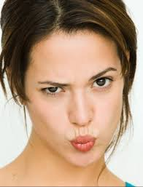

The GRAND debate
TASK: Classify based on Pupil color.
Possible
Not
Possible

Slide 36
The GRAND debate
Take Home Message:
If classification information is contained in fine-grained structures then it is not possible to classify when spatial smoothing is performed.

Slide 37
The GRAND debate
The Global view
Against hyperacuity in brain reading: Spatial smoothing does not hurt multivariate fMRI analyses? Hans P. Op de Beeck

Slide 38
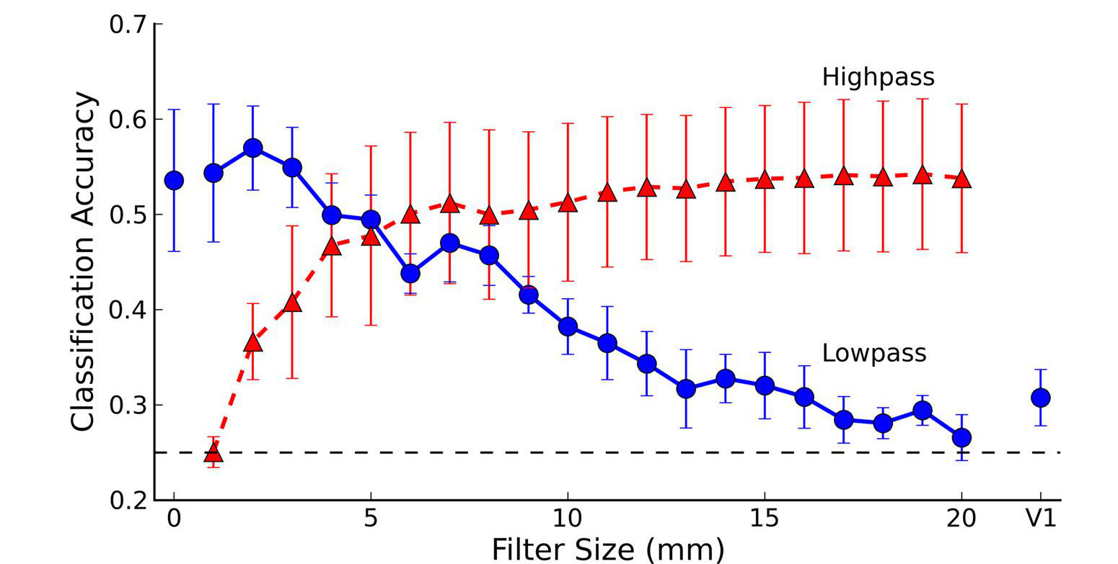
The GRAND debate
A Bit of BOTH
High Pass and Low Pass Spatial Filtering suggests that orientation classification is conveyed in both Large scale and Small scale signals.
Swisher, J. D., J. C. Gatenby, J. C. Gore, B. A. Wolfe, C.-H. Moon, S.-G. Kim, and F. Tong. "Multiscale Pattern Analysis of Orientation-Selective Activity in the Primary Visual Cortex." Journal of Neuroscience 30.1 (2010): 325-30.

Slide 39
The GRAND debate
What the GRAND debate didn't address....
All the studies discussed above, have recorded data at a particular resolution, (Op de Beeck → 3mm isotropic, J.D. Swisher → 1mm isotropic) and then applying spatial filtering and smoothed the data to different resolutions. But the data was not collected at that particular resolution itself. It is absolutely possible that spatial filtering does nullify the effect that we could have got by recording the data directly at that resolution.
The effect of field strength (7T or 3T) on the data being collected was ignored.

Slide 40

And I get to do a Ph.D. YAY!!!!!!

Slide 41
Keywords
Visual Cortex
Multivariate information decoding
MRI field strength
Spatial Resolution

Slide 42
Planned Experiments
7 Tesla
0.8 mm isotropic
1.4 mm isotropic
3.0 mm isotropic
3 Tesla
1.4 mm isotropic
3.0 mm isotropic
All scans are sequential acquisitions with 10% inter-slice gap and TR = 2s parallel to calcarine sulcus.

Slide 43
Pilot Experiments
7 Tesla
0.8 mm isotropic
1.4 mm isotropic
All scans are sequential acquisitions with 10% inter-slice gap and TR = 2s parallel to calcarine sulcus.

Slide 44
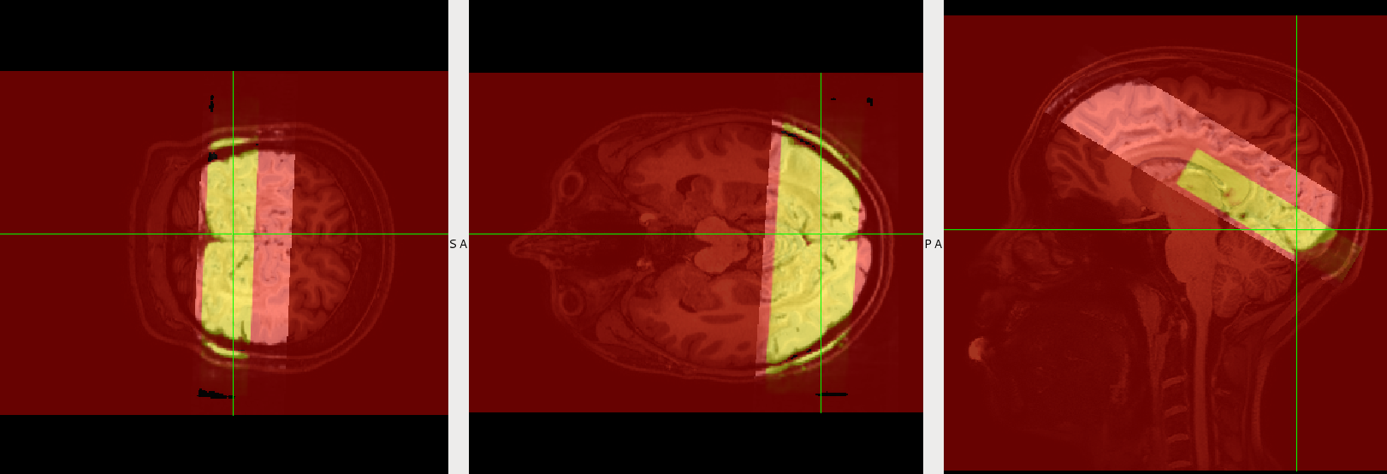
Pilot Experiments
Data acquisitions:

Slide 45
Designed Stimulus

Slide 46
Designed Stimulus
Trial time→ 8 sec
  Stimulation → 3 sec
  Inter-Stimulus Interval → 5sec
30 Trials = 1 Experimental run
Number of runs = 10
Total scan time = 40min
4 orientations in each hemifield (0,45,90 & 135) with random phase shifts

Slide 47
Designed Stimulus
Center Reading Task
    Subject reads lyrics of a song one letter at a time.
    At the end of one run s/he is asked about the artist of the song.

Slide 48
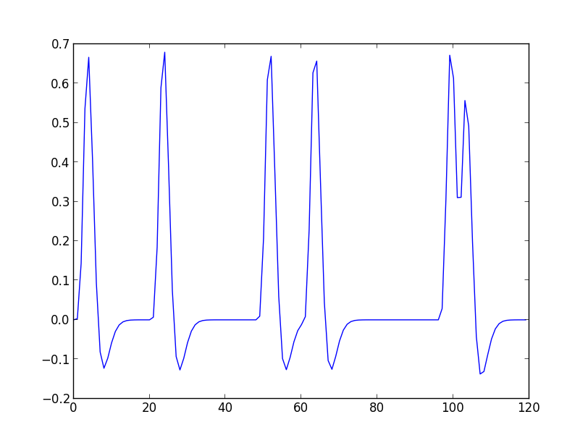
Designed Stimulus
Design HRF Estimate of regressor LH_45

Slide 49
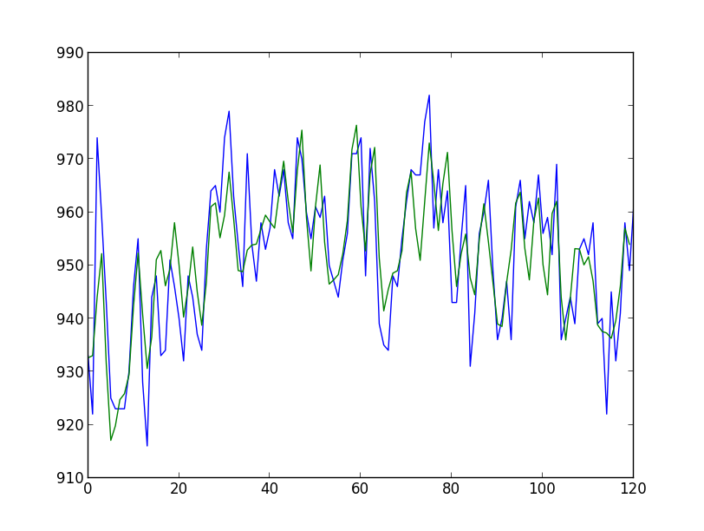
Designed Stimulus
Time Series fit of a voxel in 1.4mm data:

Slide 50
Ret-mapping Stimulus

Slide 51
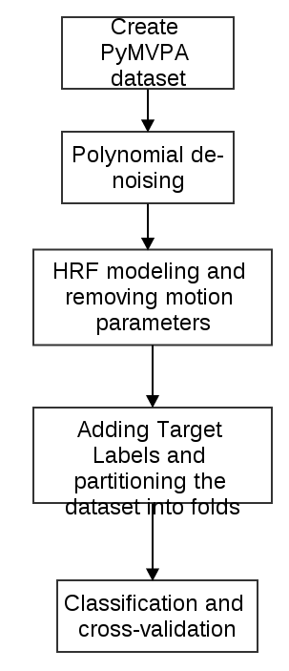
Multivariate Analysis (in PyMVPA)
Classifier type: SMLR
SMLR: Sparse Multinomial Logistic Regression

Slide 52
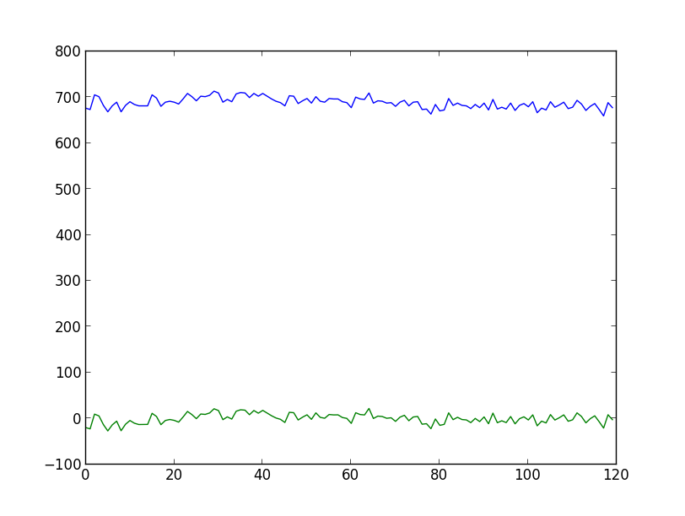
Multivariate Analysis (in PyMVPA)
Poly-Detrend

Slide 53
Multivariate Analysis (in PyMVPA)
Results and details
1.4mm data:
Right_Hemifield_right_vc -> 25.0
Right_Hemifield_left_vc -> 70.0
Left_Hemifield_right_vc -> 75.0
Left_Hemifield_left_vc -> 22.5
0.8mm data:
Right_Hemifield_right_vc -> 27.5
Right_Hemifield_left_vc -> 52.5
Left_Hemifield_right_vc -> 62.5
Left_Hemifield_left_vc -> 25.0

Slide 54
Multivariate Analysis (in PyMVPA)
Sensitivity Analysis: Sensitivity Matrix
 | Voxel1 | Voxel2 | … | Voxel 1000
LH_0 | -0.7 | 0 | ... | 0.3
LH_45 | 0.25 | 0 | ... | 0.45
LH_90 | 1.25 | 0 | ... | -0.8
LH_135 | 0.36 | 0 | ... | 0

Slide 55
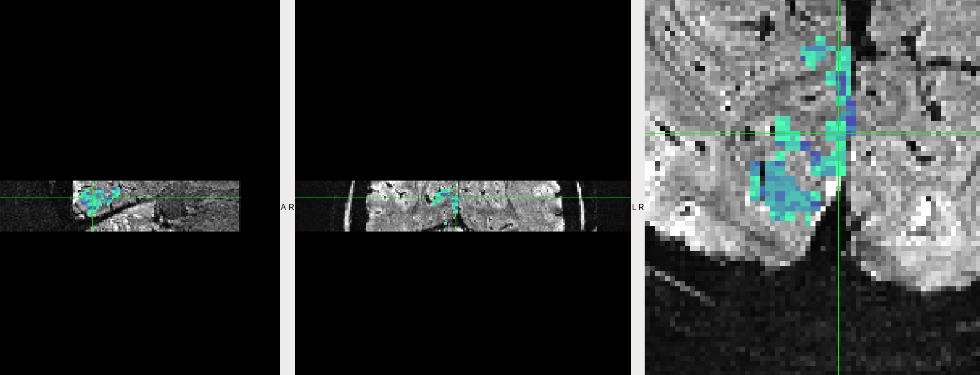
Multivariate Analysis (in PyMVPA)
Sensitivity Analysis : Voting Scheme
Voxel Similarity: ~ 28%

Slide 56
Multivariate Analysis (in PyMVPA)
Sensitivity Analysis: Feature Selection Problem
Feature Selection is must for noise reduction
Feature selection yields only BLOBS of
sensitivity maps not for the full ROI mask

Slide 57
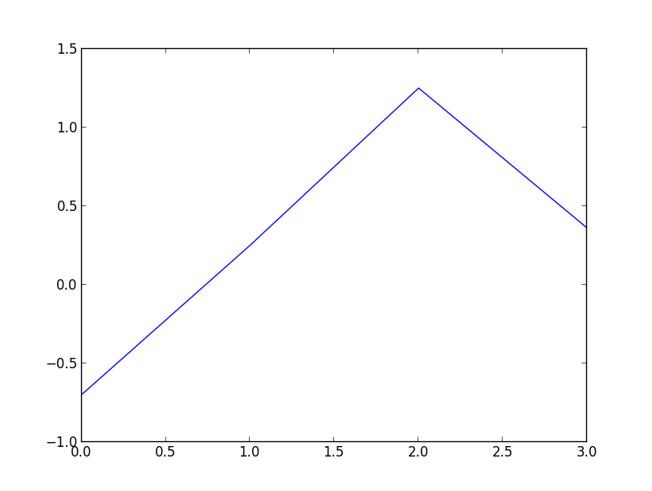
Multivariate Analysis (in PyMVPA)
Sensitivity Analysis : Phase fitting

Slide 58
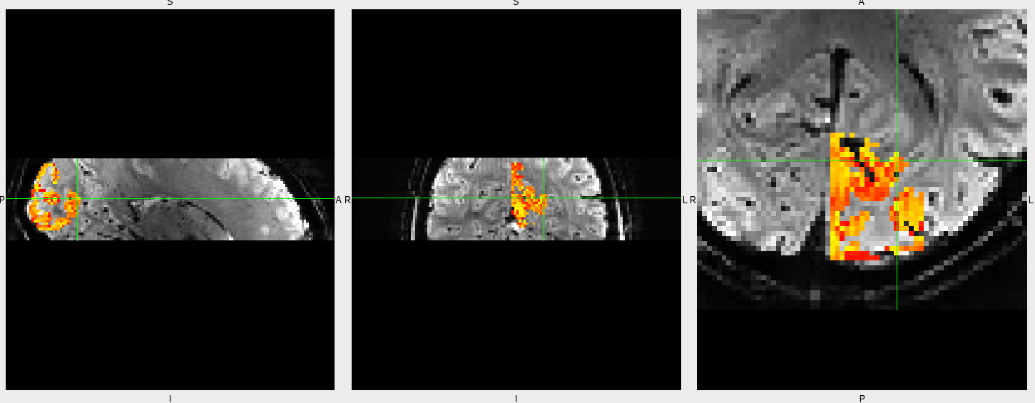
Multivariate Analysis (in PyMVPA)
Sensitivity Analysis : Phase fitting

Slide 59
At Last!!!!!!!!!!!!

