Slide 1
Finding the Optimal Resolution for Multivariate Pattern Analysis in Primary Visual Cortex in 7T
– Ayan Sengupta

Slide 2


Make it Interactive
My Initial Reaction

Slide 3
Keywords
Primary Visual Cortex
Multivariate Pattern Analysis
Optimal Resolution

Slide 4
Keywords
Primary Visual Cortex
Multivariate Pattern Analysis
Optimal Resolution

Slide 5
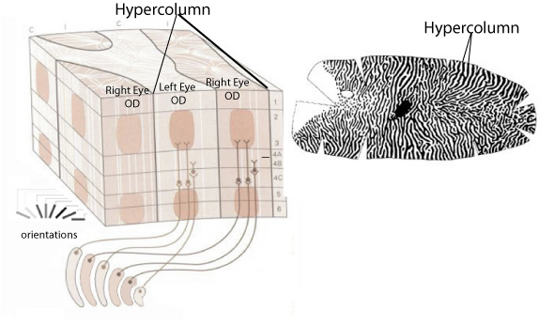
Only the Interesting information
Orientation Columns in V1

Slide 6
Only the Interesting information
Orientation Columns in V1
Hypercolumn(V1) Spatial Dimensions
  (∼1 × 1 mm in monkey and
  ∼2 × 2 mm in human)
                Hubel and Wiesel, 1963;
                Blasdel and Salama, 1986;
                Grinvald et al., 1986;
                Das and Gilbert, 1997;
                Maldonado et al., 1997;
                Ohki et al., 2006;
                Adams et al., 2007

Slide 7
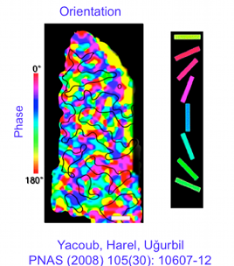
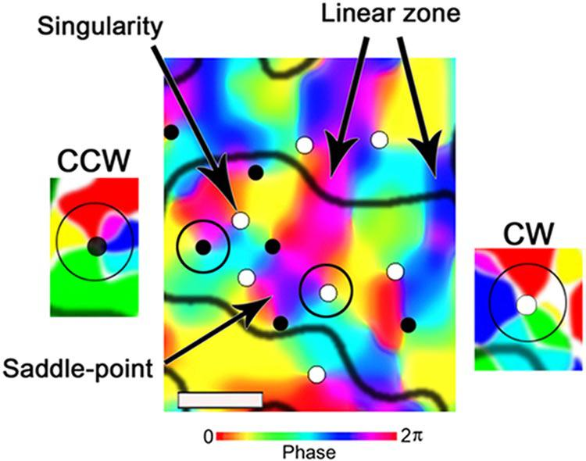
Only the Interesting information
Orientation Columns in V1

Slide 8

A question to yourself
Smaller the voxel size = Better Orientation Signals from the Orientation Columns

Slide 9
GRAND DEBATE
Reliable Orientation decoding in V1 could be performed by Multivariate Pattern Analysis at 3mm voxel
                Haynes and Rees, 2005
                Kamitani and Tong, 2005
                Kay et al., 2008).

Slide 10
GRAND debate
Controversy about the Spatial scale of Orientation Specific signals in V1

Slide 11
Keywords
Primary Visual Cortex
Multivariate Pattern Analysis
Optimal Resolution

Slide 12
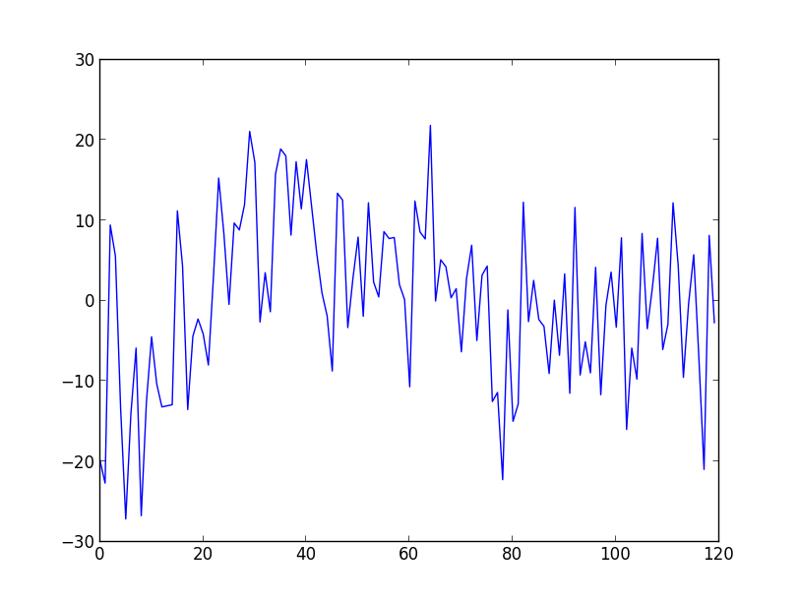
Multivariate Pattern Analysis
Time-series of a Voxel
Intensity
Time → (number of volumes)
Repetition time: 2 sec
No. of Volume : 120

Slide 13
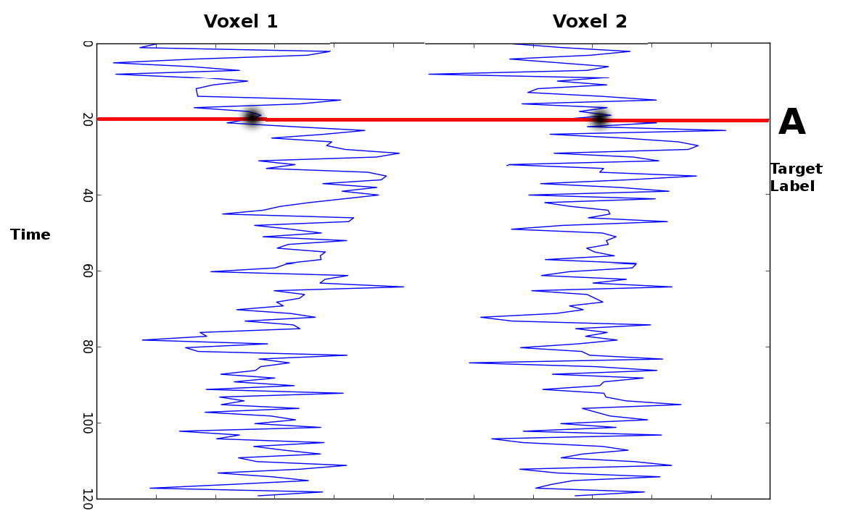
Multivariate Pattern Analysis

Slide 14
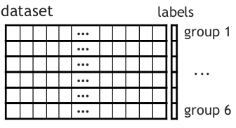
Multivariate Pattern Analysis

Slide 15
Multivariate Pattern Analysis
Concept of Classifier
Face vs Fruit

Slide 16
Multivariate Pattern Analysis
Concept of Classifier
Training Patterns

Slide 17

Multivariate Pattern Analysis
Concept of Classifier: Training Set
LABEL : Face

Slide 18

Multivariate Pattern Analysis
Concept of Classifier: Training Set
LABEL : Face

Slide 19

Multivariate Pattern Analysis
Concept of Classifier: Training Set
LABEL : Fruit

Slide 20

Multivariate Pattern Analysis
Concept of Classifier: Training Set
LABEL : Face

Slide 21

Multivariate Pattern Analysis
Concept of Classifier: Training Set
LABEL : Fruit

Slide 22

Multivariate Pattern Analysis
Concept of Classifier: Test Set
LABEL : ??

Slide 23

Multivariate Pattern Analysis
Concept of Classifier: Validation
LABEL : Face

Slide 24

Multivariate Pattern Analysis
Concept of Classifier: Test Set
LABEL : ??

Slide 25
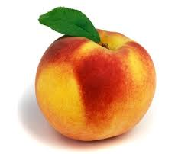
Multivariate Pattern Analysis
Concept of Classifier: Validation
LABEL : Fruit

Slide 26

Multivariate Pattern Analysis
Concept of Classifier: Test Set
LABEL : ??

Slide 27

Multivariate Pattern Analysis
Concept of Classifier: Validation
LABEL : Face on Fruit

Slide 28
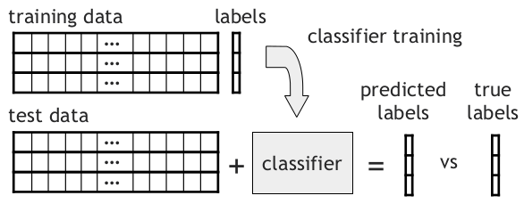
Multivariate Pattern Analysis

Slide 29
Multivariate Pattern Analysis
That's all for now about
Multivariate Decoding
Back to GRAND debate

Slide 30
GRAND debate
Controversy about the Spatial scale of Orientation Specific signals in V1

Slide 31
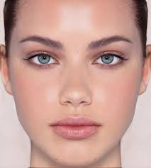
The GRAND debate
Food for thought: What is the color of the Pupil?
Answer: Blue
Answer: ????

Slide 32
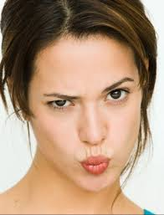

The GRAND debate
TASK: Classify based on Pupil color.
Possible
Not
Possible

Slide 33
The GRAND debate
Take Home Message:
If classification information is contained in sub-millimeter columnar structures then it is not possible to classify when spatial smoothing is performed.

Slide 34
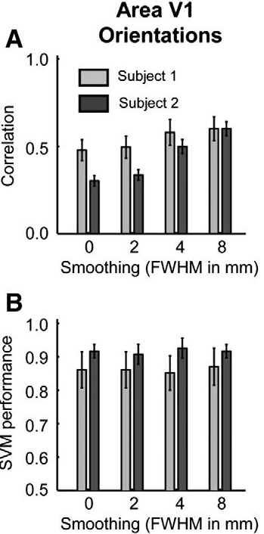
The GRAND debate
Against hyperacuity in brain reading: Spatial smoothing does not hurt multivariate fMRI analyses? Hans P. Op de Beeck

Slide 35
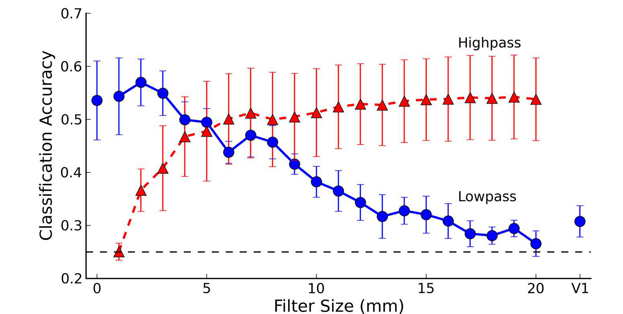
The GRAND debate
A Bit of BOTH
High Pass and Low Pass Spatial Filtering suggests that orientation classification is conveyed in both Large scale and Small scale signals.
Swisher, J. D., J. C. Gatenby, J. C. Gore, B. A. Wolfe, C.-H. Moon, S.-G. Kim, and F. Tong. "Multiscale Pattern Analysis of Orientation-Selective Activity in the Primary Visual Cortex." Journal of Neuroscience 30.1 (2010): 325-30.

Slide 36
The GRAND debate
Other Probabilities:
Aliasing of High Spatial Freq. Components into lower frequency components due to sampling by larger voxels. (Boynton et. al. 2005)
“Biased Draining Regions” of macroscopic veins captured by large voxels. (Gardner et. al. 2006, Shmuel et. al. 2010)
Random, local variations and irregularities in the functional organization contribute to decoding (Kamitani and Tong, 2005, 2006; Haynes and Rees, 2006; Kriegeskorte and Bandettini, 2007)

Slide 37
The GRAND debate
What the GRAND debate didn't address....
All the studies discussed above, have recorded data at a particular resolution, (For example: Op de Beeck → 3mm isotropic, J.D. Swisher → 1mm isotropic) and then applying spatial filtering and smoothed the data to different resolutions. But the data was not collected at that particular resolution itself. It can be possible that spatial filtering does nullify the effect that we could have got by recording the data directly at that resolution.
Number of subjects is questionable. (n=2 for Op de Beeck)
Contribution of Veins in decoding needs to be investigated further in actual fMRI data (Schmuell et.al. 2010 investigated it's contribution in simulation models).

Slide 38

And I get to do a Ph.D. YAY!!!!!!

Slide 39
Keywords
Primary Visual Cortex
Multivariate Pattern Analysis
Optimal Resolution

Slide 40
Experiment Performed
7 Tesla
0.8 mm isotropic
1.4 mm isotropic
2.8 mm isotropic
3.0 mm isotropic
All scans are sequential acquisitions with 10% inter-slice gap and TR = 2s parallel to calcarine sulcus.

Slide 41
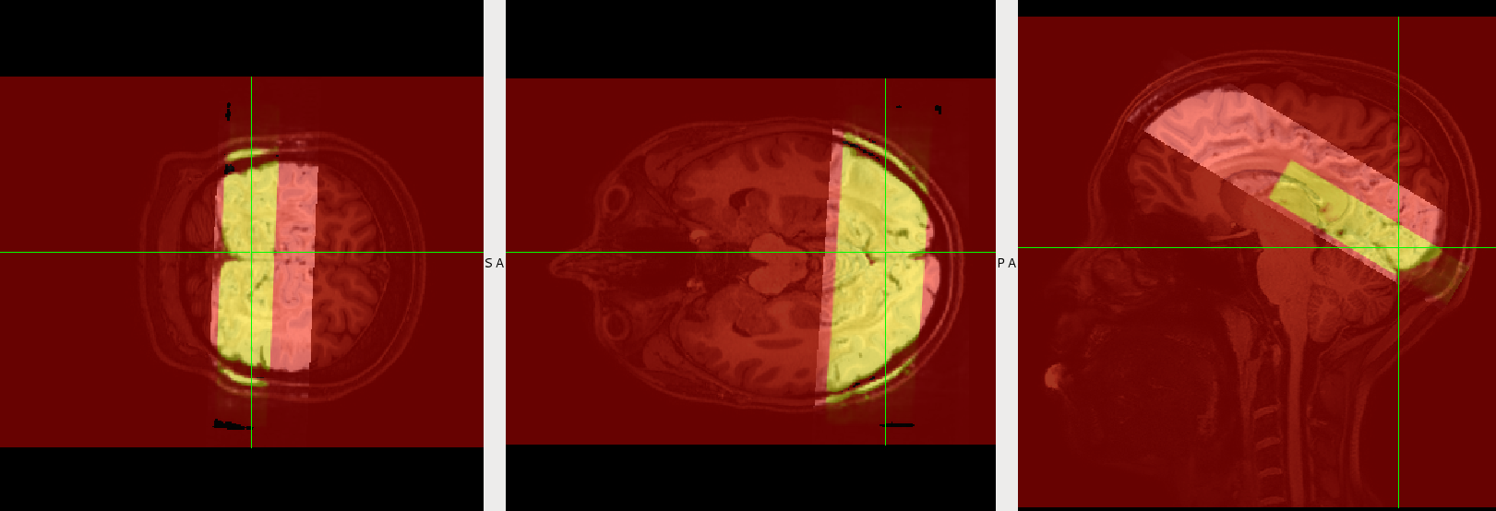
Pilot Experiments
Data acquisitions:

Slide 42
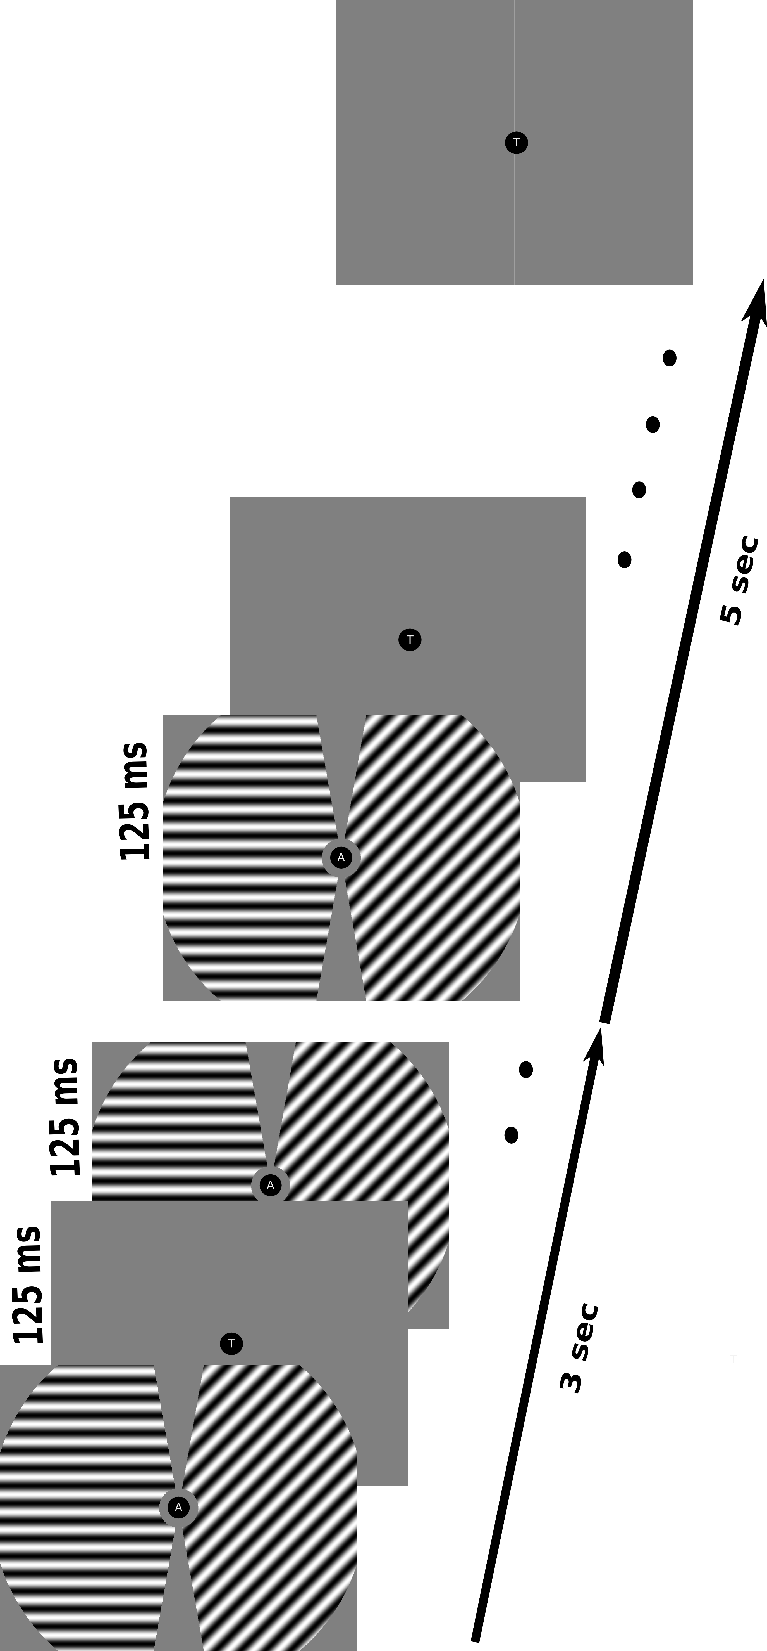
Designed Stimulus

Slide 43
Designed Stimulus
Trial time→ 8 sec
  Stimulation → 3 sec
  Inter-Stimulus Interval → 5sec
30 Trials = 1 Experimental run
Number of runs = 10
Total scan time = 40min
4 orientations in each hemifield (0,45,90 & 135) with random phase shifts

Slide 44
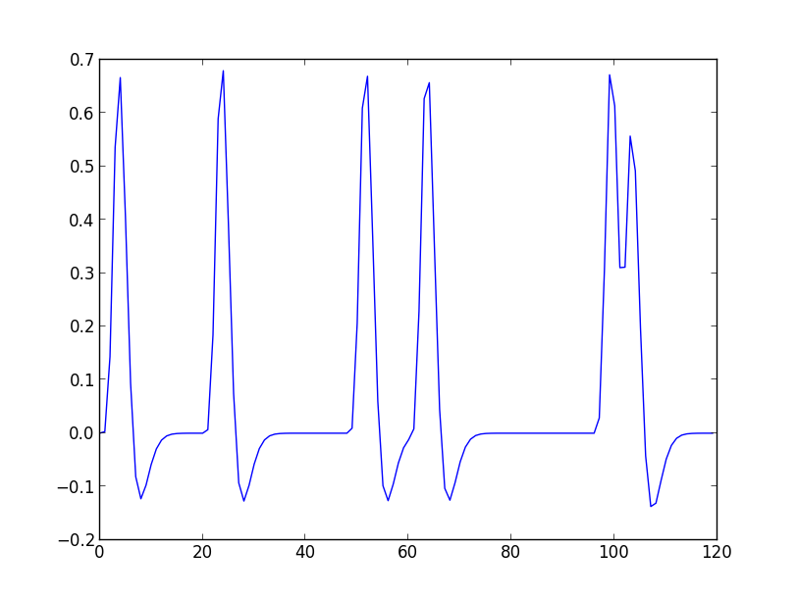
Designed Stimulus
Design HRF Estimate of regressor LH_45

Slide 45
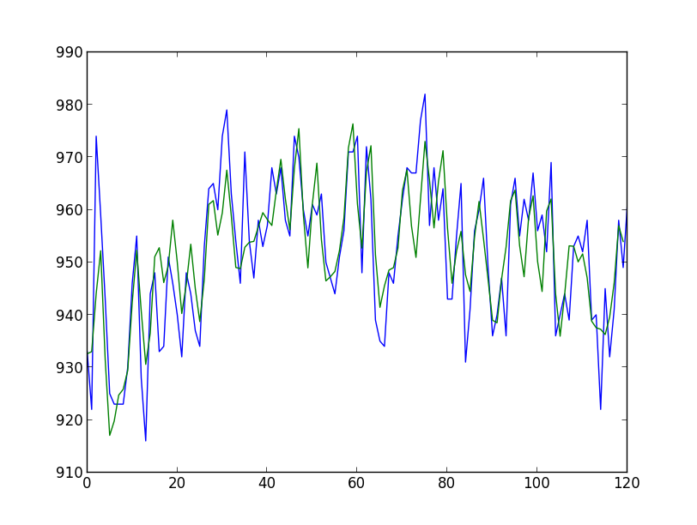
Designed Stimulus
Time Series fit of a voxel in 1.4mm data:

Slide 46
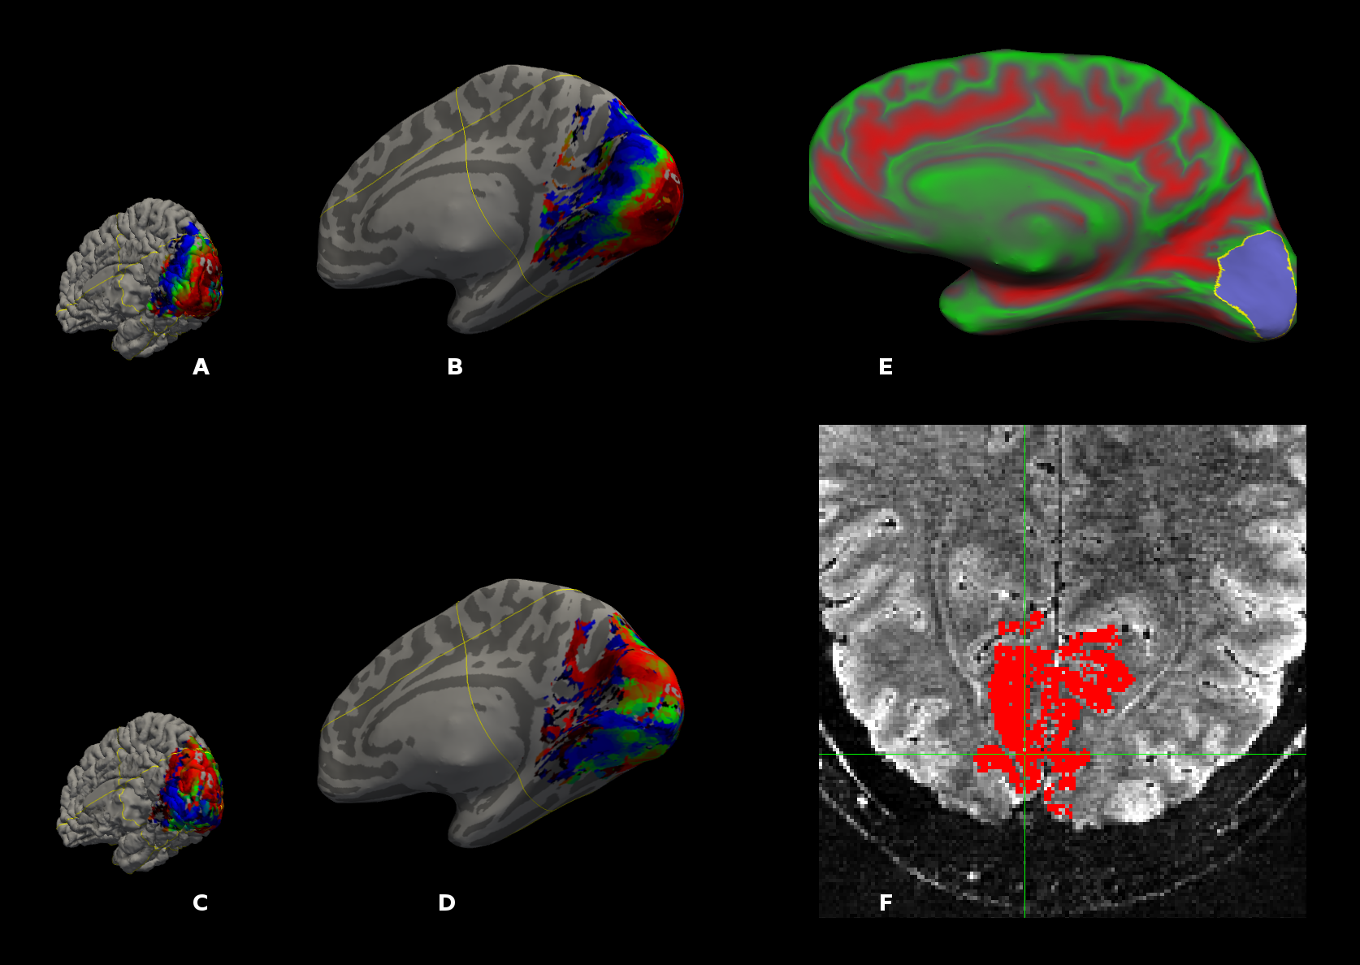
Ret-mapping Mask

Slide 47
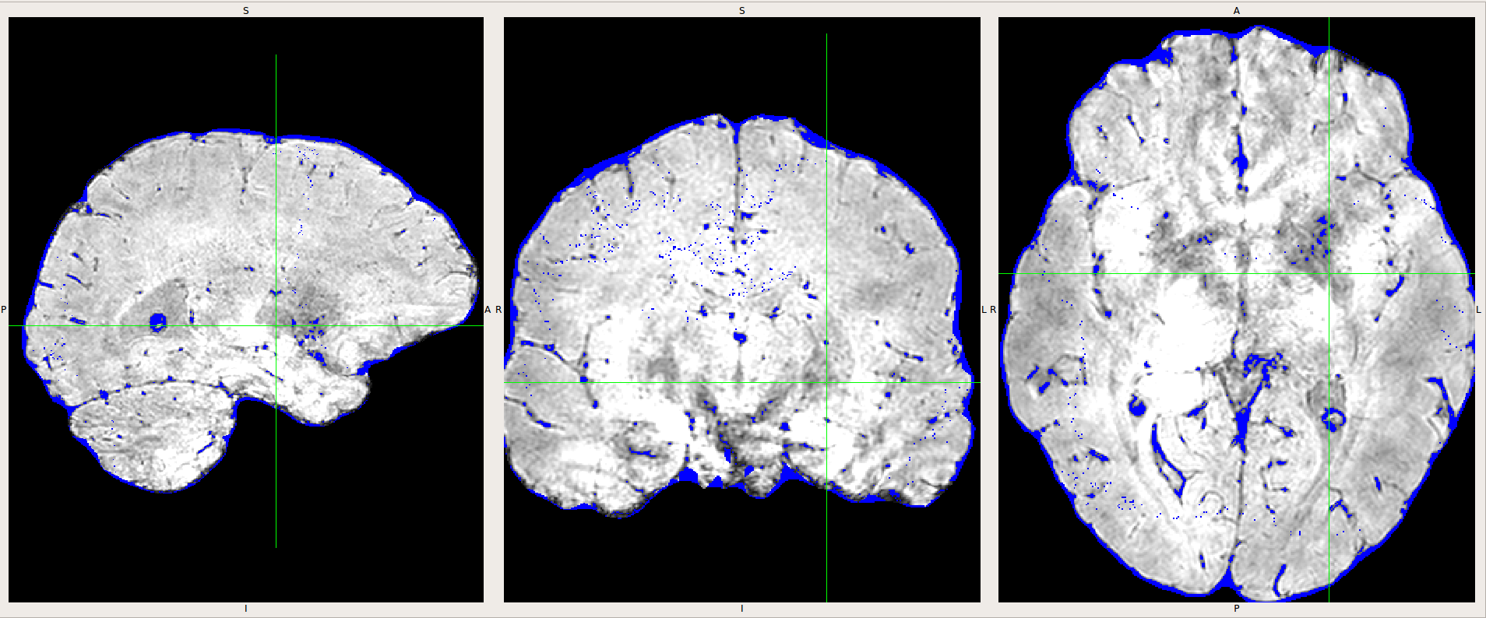
Susceptibility Weighted Images

Slide 48
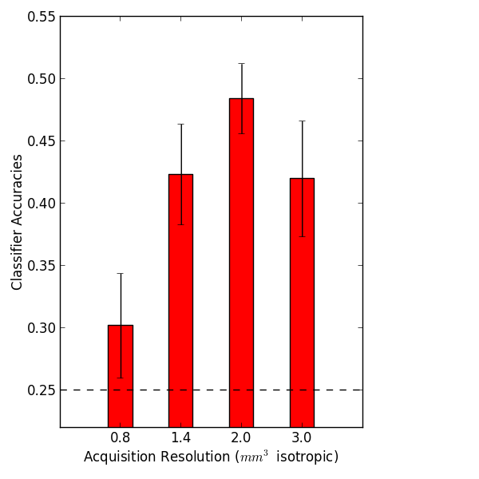
Classification Results (V1)
t-test against chance level
  0.8 mm →p=0.26
  1.4 mm →p=0.005
  2.0 mm →p=0.0001
  3.0 mm →p=0.01

Slide 49
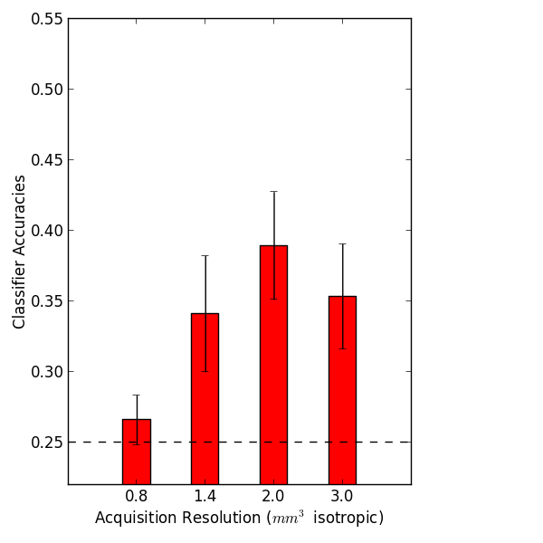
Classification Results (Fixed Number of Voxels)
300 Voxels
t-test against chance level
  0.8 mm →p=0.39
  1.4 mm →p=0.06
  2.0 mm →p=0.01
  3.0 mm →p=0.03

Slide 50
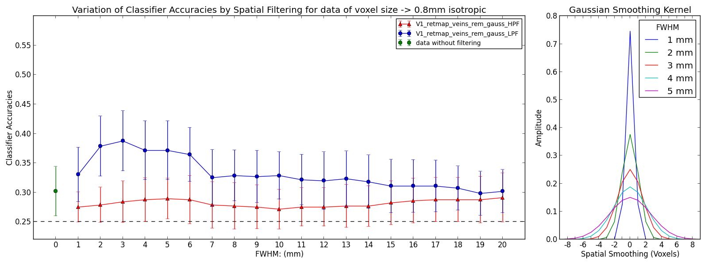
Classification Results After Spatial Smoothing
Paired t-test of unsmoothed data and 3mm FWHM kernel → 0.007
Paired t-test of 3mm FWHM kernel and 7mm FWHM kernel→ 0.01

Slide 51
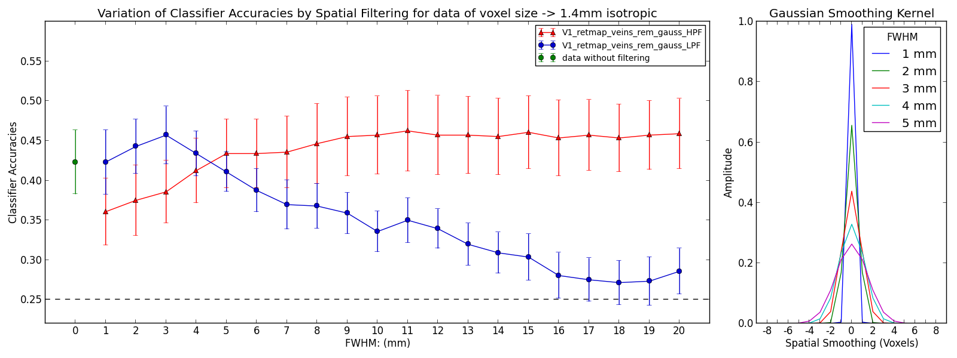
Classification Results After Spatial Smoothing
Paired t-test of unsmoothed data and 3mm FWHM kernel → 0.2
Paired t-test of 3mm FWHM kernel and 7mm FWHM kernel→ 0.03

Slide 52
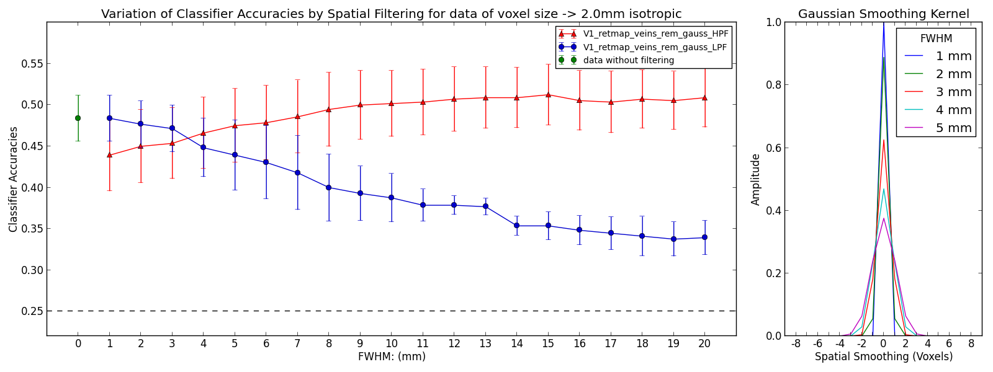
Classification Results After Spatial Smoothing
Paired t-test of unsmoothed data and 3mm FWHM kernel → 0.5
Paired t-test of 3mm FWHM kernel and 7mm FWHM kernel→ 0.06
Paired t-test of 3mm FWHM kernel and 8mm FWHM kernel→ 0.02

Slide 53
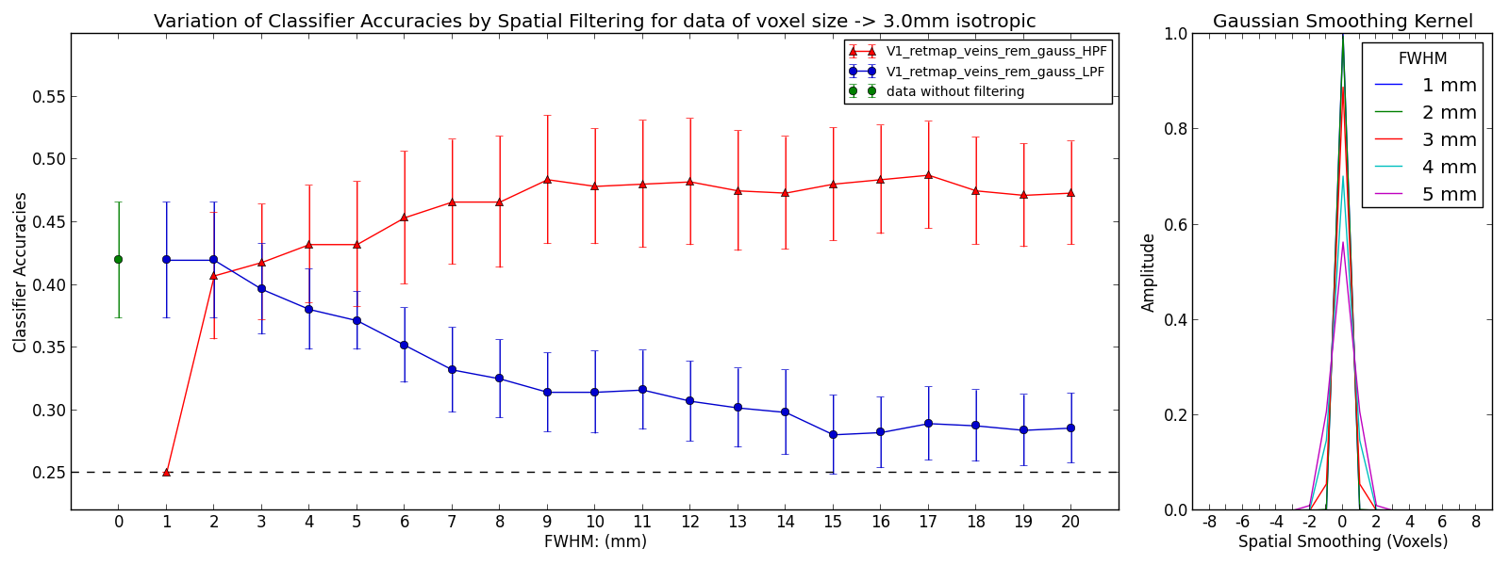
Classification Results After Spatial Smoothing
Paired t-test of unsmoothed data and 3mm FWHM kernel → 0.16
Paired t-test of 3mm FWHM kernel and 7mm FWHM kernel→ 0.0008

Slide 54
Discussion
Nyquist Criterion
  Sampling Frequency >= 2* Signal Frequency
Sampling Range | Signal Capture Range
0.8mm | 1.6mm
1.4mm | 2.8mm
2.0mm | 4.0mm
3.0mm | 6.0mm

Slide 55
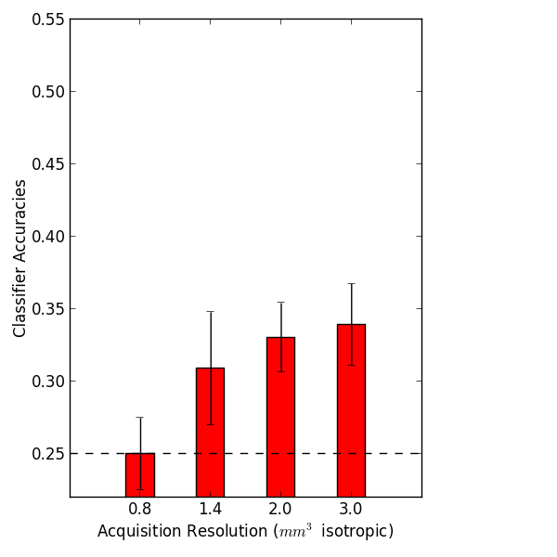
Discussion
Veins do contribute to classification but at lower spatial frequency
t-test against chance level
  0.8 mm →p=1.0
  1.4 mm →p=0.18
  2.0 mm →p=0.01
  3.0 mm →p=0.01

Slide 56
Discussion
Future Research
  Effect of Magnetic Field Strength on Multivariate classification
  Finding the effect of random functional organization in Visual cortex

Slide 57
At Last!!!!!!!!!!!!

