Slide 1



TOPIC
Charity Donation &
Beneficiary Portal
  DEPARTMENT - School of Engineering and Technology ( SOET ).
  COURSE - B.Tech
  BRANCH - CSE
  SEMESTER - 3
  SUBJECT - Database Management System.
  SUBJECT CODE - CSL0311
  TITLE - PBL ‘ ER Diagram ‘ .pptx

Slide 2

DATABASE COURSE PROJECT
Charity Donation &
Beneficiary Portal
SUBMITTED BY:
Team Name: [ TECH TOLI ]
  Member 1 (Lead): [ Ayanshu Saxena / BETN3CS26D01 ]
  Member 2: [ Abhas Saxena / BETN1CS25099 ]
SUBMITTED TO :
Dr. Geetanjali Surange

Slide 3
Project Overview
Charity Donation & Beneficiary Portal
A database-driven system managing the full lifecycle of charitable giving — donor registration, campaign creation, fund collection, and verified disbursements.
6 Features
Donor Management
Campaign Control
Register and track donors with consent
Create and approve fundraising campaigns
Pledge & Donations
Fund Transparency
Track promises and actual payments
Cleared vs disbursed funds tracked separately
Beneficiary Payouts
Full Audit Trail
Only verified beneficiaries receive money
Every action logged permanently

Slide 4


Database Requirements
Entity
Data Stored
Donor
donor_id, full_name, email, phone, is_anonymous, consent_status
Organization
org_id, name, status
Campaign
campaign_id, title, target_amount, start_date, end_date, status, cleared_funds, disbursed_total
Pledge
pledge_id, pledged_amount, pledge_date, status
Donation
donation_id, amount, channel, status, txn_reference, receipt_number, refund_amount, refund_status
Beneficiary
beneficiary_id, full_name, id_number, verification_status
Disbursement
disbursement_id, amount, purpose, status, approved_by
Audit Log
log_id, action, entity_type, logged_at
8 entities total

Slide 5
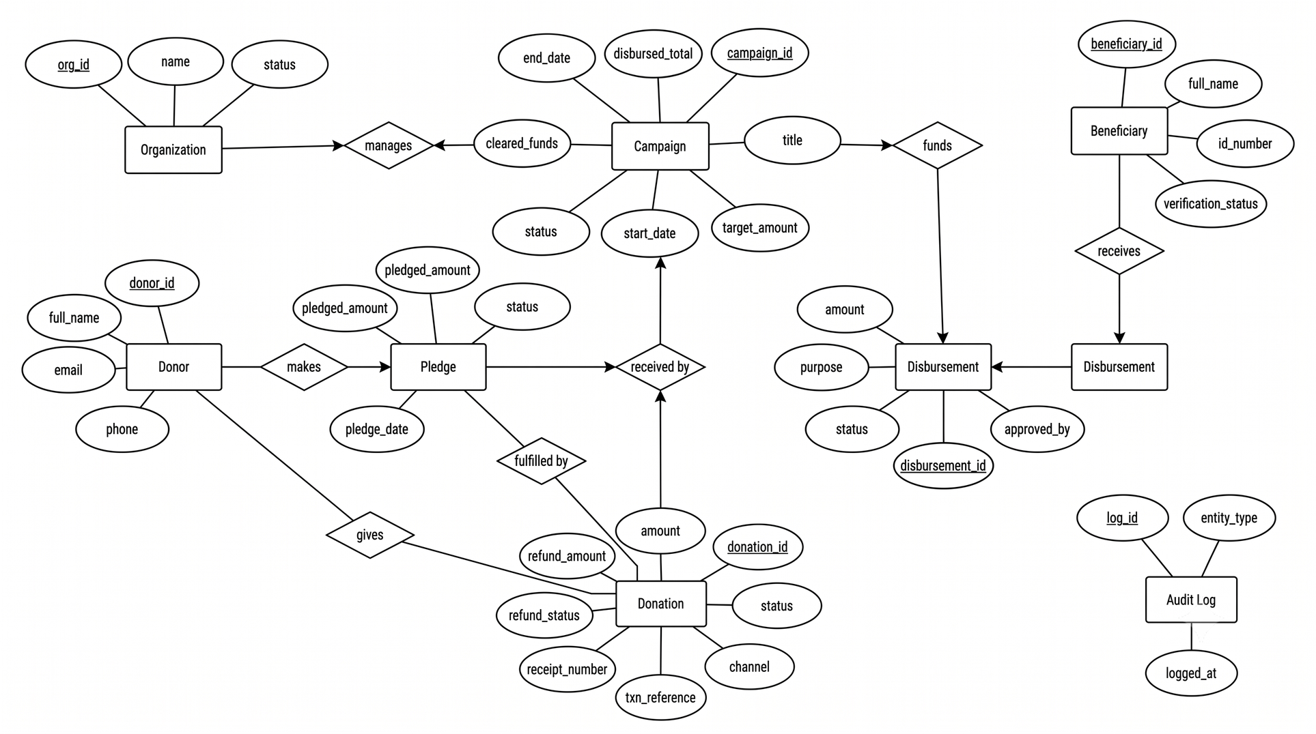
Entity Relationship Model - ER Diagram

Slide 6
ER Model to Relational Schema
5 Conversion Rules with Examples
1
Rule 1 — Entity becomes a Relation
CAMPAIGN → CAMPAIGN table
2
Rule 2 — Attribute becomes a Column
title, target_amount, start_date → columns
3
Rule 3 — Key Attribute becomes Primary Key
campaign_id → PK
4
Rule 4 — 1:N Relationship becomes Foreign Key
DISBURSEMENT contains campaign_id as FK referencing CAMPAIGN
5
Rule 5 — M:N Relationship becomes a new Relation
PLEDGE bridges DONOR and CAMPAIGN
Special merges: Online Txn and Refund merged into DONATION table; Fund Balance merged into CAMPAIGN table

Slide 7
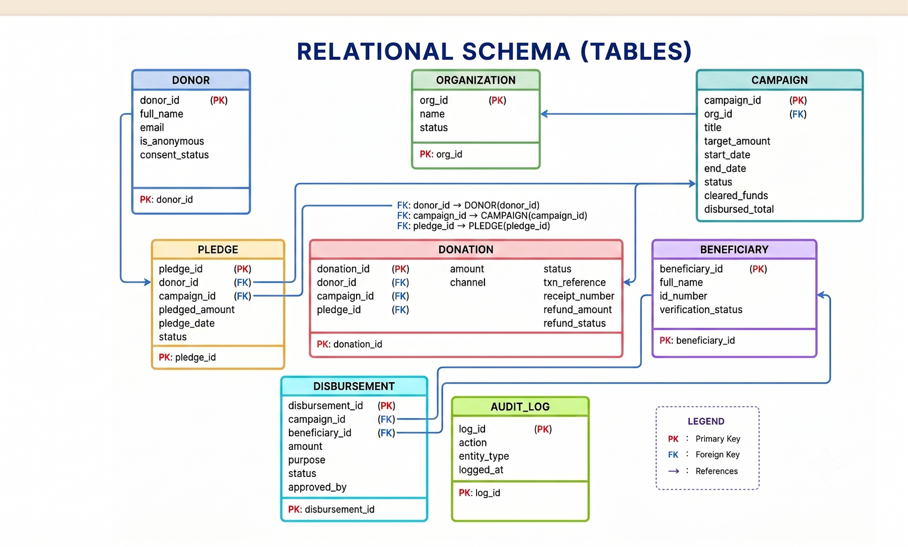

Relational Schema — Charity Donation & Beneficiary Portal
f
f
f
f
f
f
f
f
f
f
f
f
f
f
f
f
f
f

Slide 8
Major Entities & Relationships
Relationship
Meaning
manages
Organization creates and owns a campaign (1:N)
gives
Donor makes actual donations (1:N)
makes
Donor creates pledges before paying (1:N)
received by (Donation)
Campaign collects many donations (1:N)
received by (Pledge)
Campaign receives many pledges (1:N)
fulfilled by
A pledge is converted into one donation (1:1)
funds
Campaign pays out to many disbursements (1:N)
receives
Beneficiary gets multiple disbursements (1:N)
Note: fulfilled by is the only 1:1 relationship — all others are 1:N

Slide 9
Conclusion
The ER model captures the full conceptual structure of the Charity Donation & Beneficiary Portal
8 entities and their attributes were converted into 8 relational tables
Primary keys uniquely identify every record in every table
Foreign keys establish all relationships between tables
fulfilled by (Pledge → Donation) is the only 1:1 relationship — all others are 1:N
Online Txn and Refund merged into DONATION; Fund Balance merged into CAMPAIGN to reduce redundancy
The relational model gives a clean implementable database structure ready for SQL

Slide 10

Thank You
Any Questions or Queries?
CSL0311 — DATABASE MANAGEMENT SYSTEM
Database Course Project Presentation
Charity Donation & Beneficiary Portal
Designed for transparency and secure funds tracking.

