Slide 1
Lost & Found Inside Train Coach
Authors : Ayantika Gangopadhyay,Prionti Majumder,Jayjeet Dutta biswas

Slide 2
PROBLEM STATEMENT
Passengers lose items inside moving trains.
No precise location tracking
• Train keeps moving → difficult to identify where item was lost
• No coach-level location data
• No real-time map visualization

Slide 3
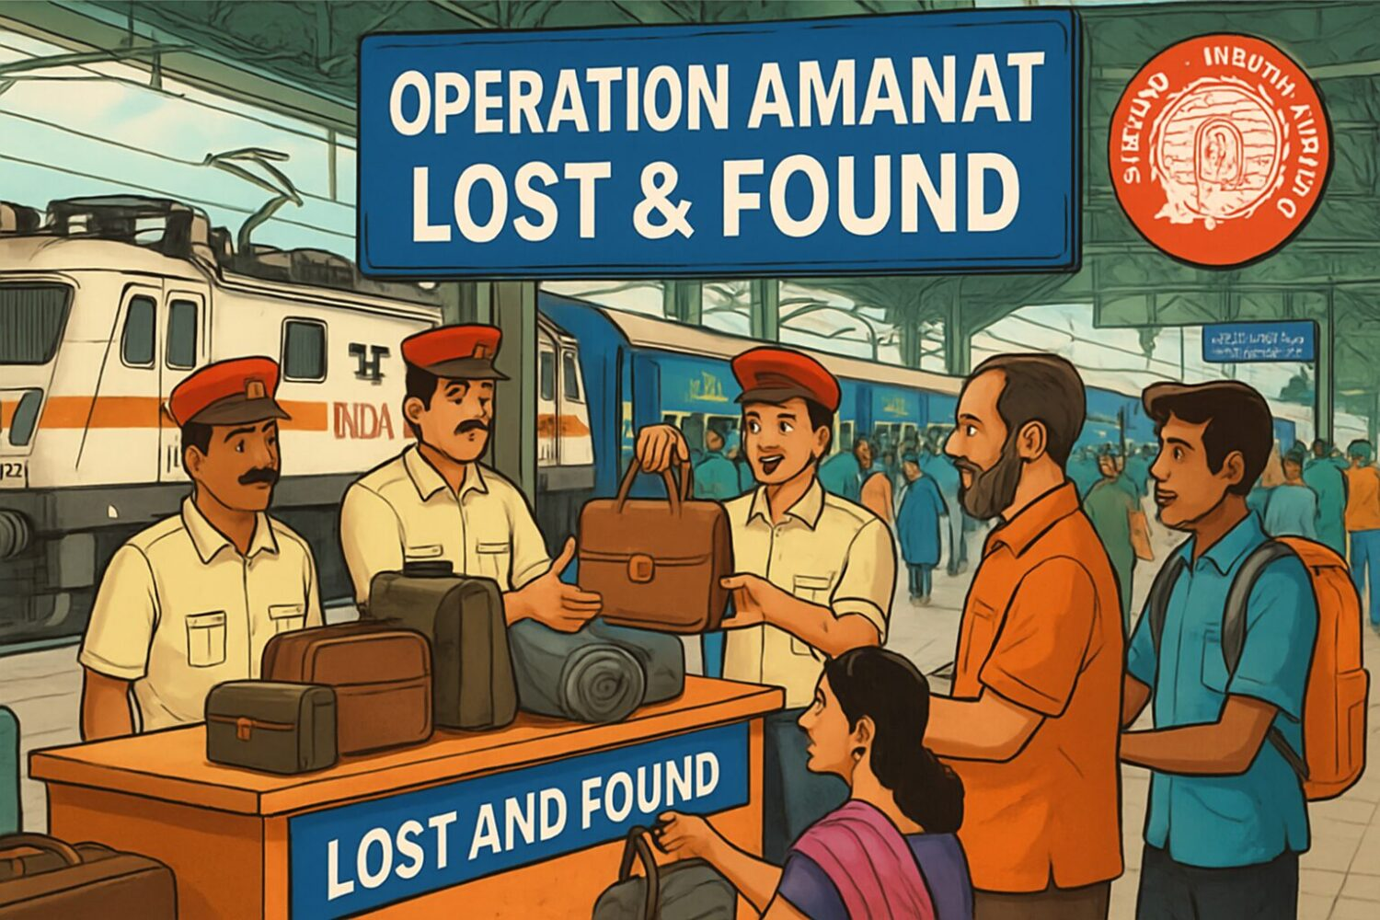
PROPOSED SMART SOLUTION
Each coach has:
Low-cost GPS module
QR code for reporting
Offline map stored in app
When passenger reports item:
System captures:
•Coach number
•Seat number
•Real-time GPS coordinates
•Timestamp
•Location stored in database
•Even if internet disconnects → offline data saved & synced later

Slide 4
AS-IS VS TO-BE PROCESS MAP
Feature | As-Is (Current) | To-Be (Proposed)
Reporting | Physical visit or phone calls. | Instant report via App/QR code on seat.
Tracking | Manual ledger entries/Paperwork. | Centralized Cloud Database.
Identification | Vague descriptions. | Image-based AI matching.
Return | Must return to the specific station. | Option for "Courier-to-Home" (Paid).

Slide 5
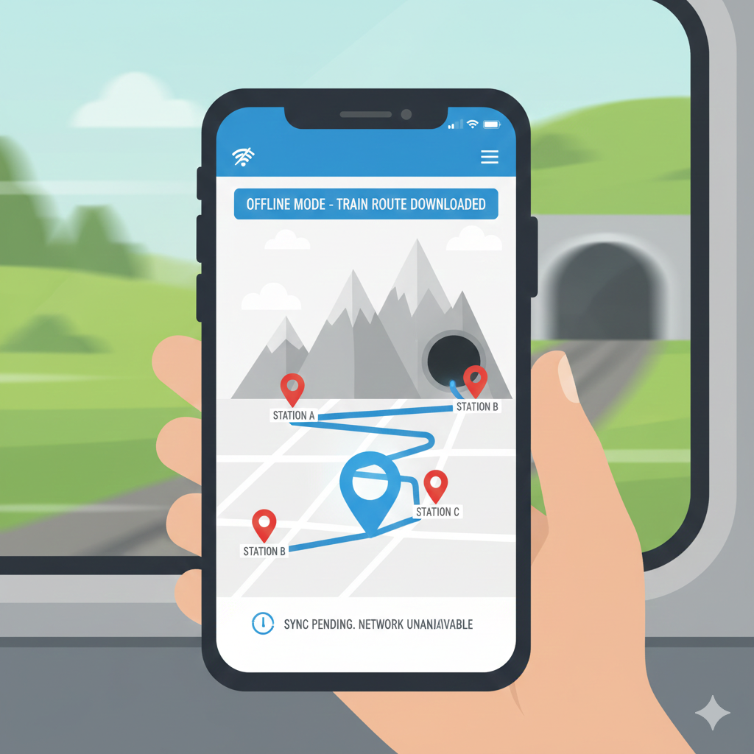
OFFLINE MAP CONCEPT
Just like Google Maps offline download:
Passenger downloads train route map before journey
•App stores:
•Train route path
•Station coordinates
•During journey:
•GPS works without internet
•Data syncs when network available
This avoids:
Network dependency in tunnels
Rural area connectivity issues

Slide 6
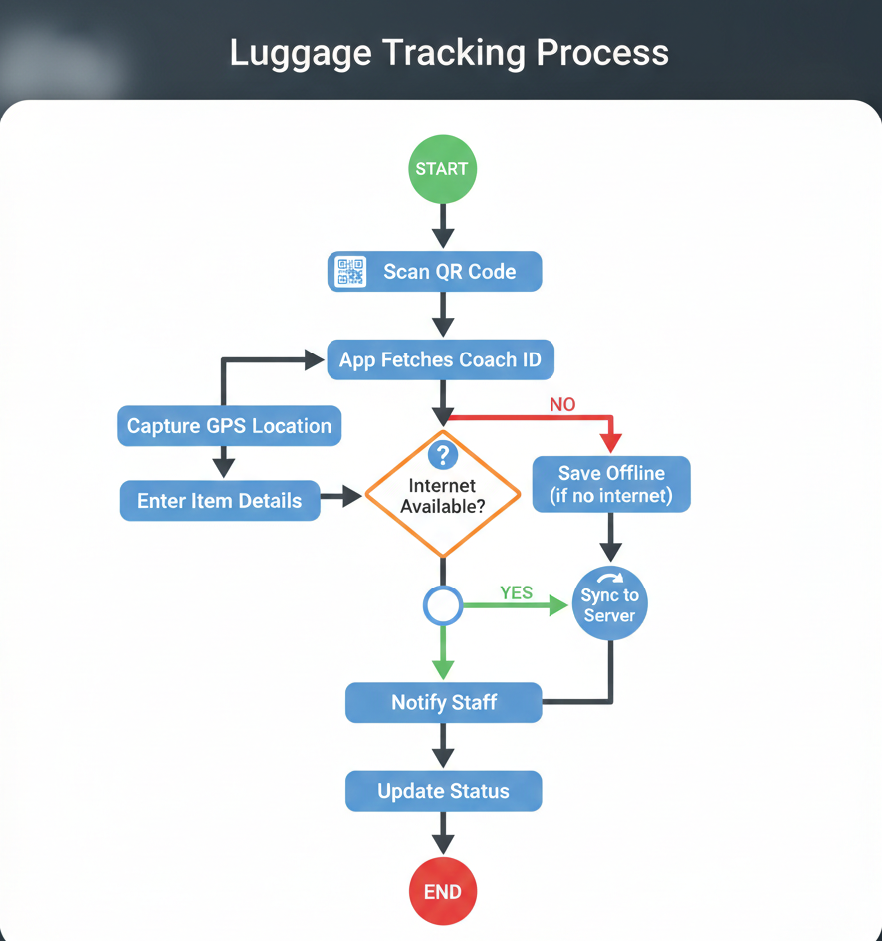
FLOWCHART (GPS Version)
Initialization: The process begins by scanning a QR code, which allows the app to automatically fetch the specific Coach ID.
Data Collection: The system captures the current GPS location and prompts the user to manually enter item details.
Connectivity Check: A decision point determines if the internet is available; if not, the data is saved offline to the device.
Data Synchronization: Once a connection is established, the saved information is synced to the server to ensure record accuracy.
Communication: Upon successful sync, the system notifies the staff members responsible for the luggage.
Finalization: The item’s status is updated in the database, and the tracking workflow concludes.

Slide 7
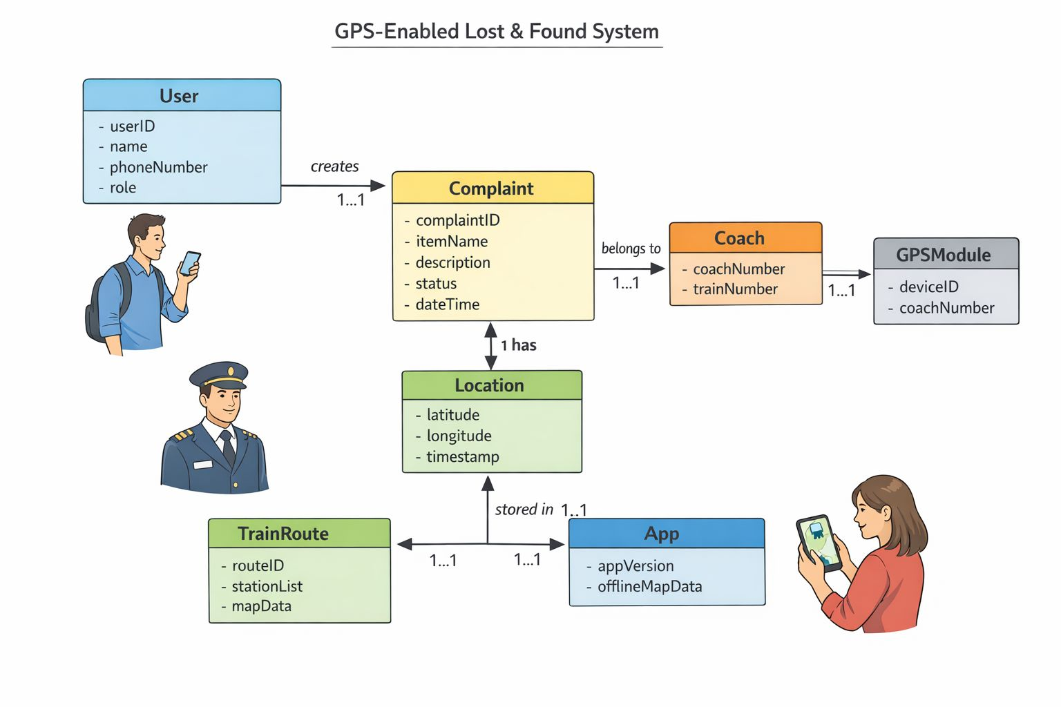
UNITED MODELING LANGUAGE
Relationship Summary:
One User → many Complaints
One Complaint → one Location
Many Complaints → one Coach
One Coach → one GPSModule
One TrainRoute → stored in App

Slide 8
BUDGET CONTROL
Instead of expensive hardware:
Option A (Low Budget):
•Use passenger mobile GPS only
No extra hardware
•Just QR code stickers in coach
Option B (Advanced):
•Install ₹1500–₹2000 GPS device per coach

Slide 9
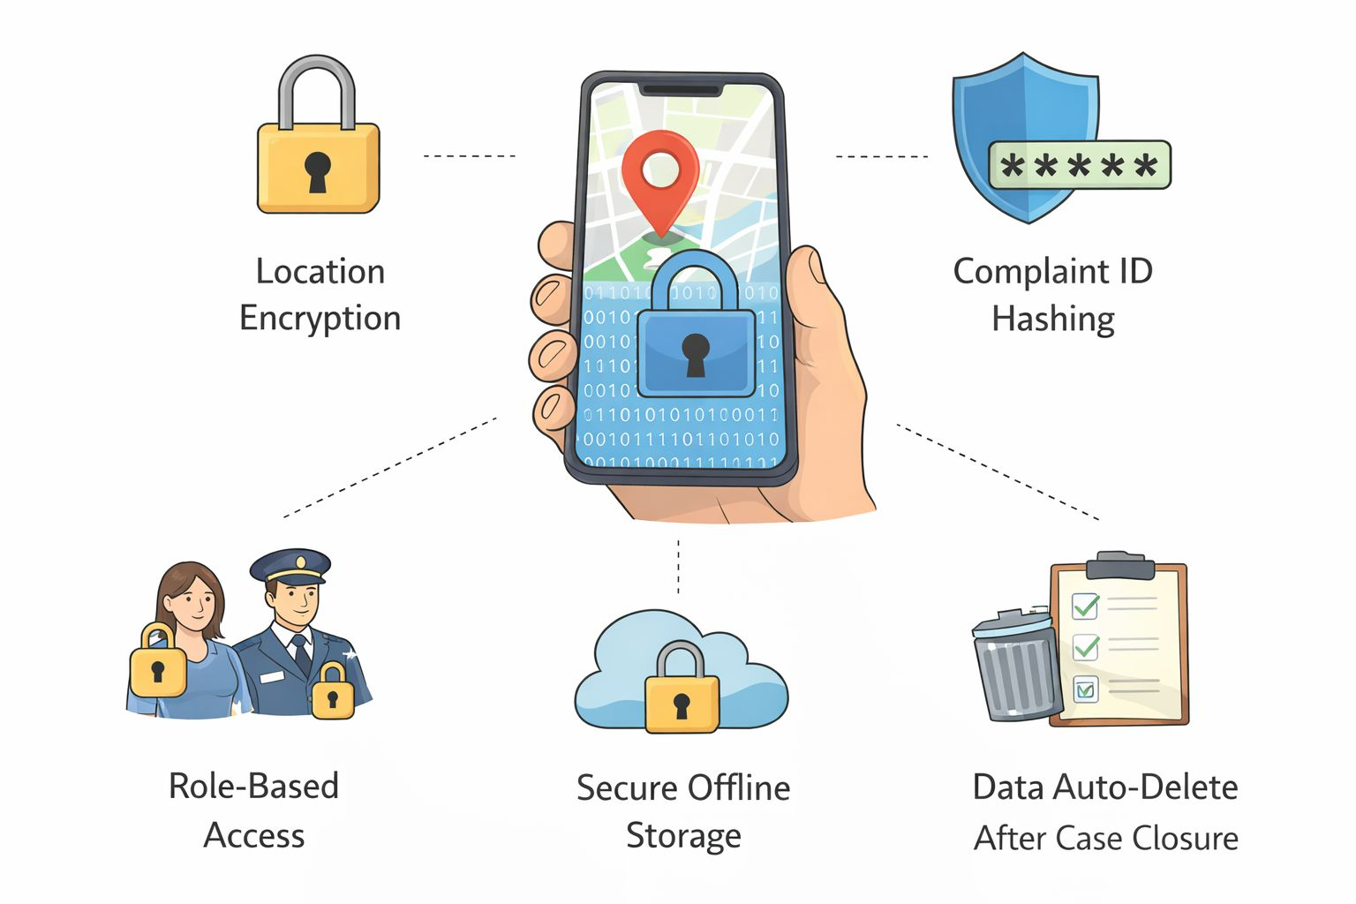
SECURITY ASPECTS
Location encryption
Complaint ID hashing
Role-based access
Secure offline storage
Data auto-delete after case closure

Slide 10
CONCLUSION
The GPS-Enabled Lost & Found System enhances passenger safety, transparency, and efficiency within Indian Railways by integrating real-time GPS tracking, offline route maps, and secure digital complaint management. The system ensures accurate location tagging, structured resolution processes, and strong data protection through encryption, role-based access, and automatic data deletion. By combining innovation with cost-effective implementation, this solution modernizes the traditional lost-and-found process, improves accountability, and significantly enhances the overall passenger experience.

Slide 11
THANK YOU

