Slide 1

DIJKSTRA’S ALGORITHM

Slide 2
DEFINITION
First Developed by “Edsger W, Dijkstra” in 1956.
Implements Greedy Approach.
Single Source Shortest Paths (SSSP).
Every Edge comes with a cost.
Generates shortest path from source to all available destinations.
Applications:
  Google Maps
  Routing packets on the Internet
  Social Networks

Slide 3
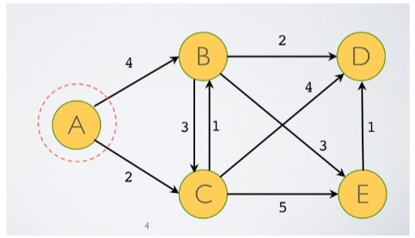
Graph View

Slide 4
SSSP Review
Follows the direction as single source.
Arrows represents privileges for all nodes.
Directed Graph.
[A], [B] and [C] posses' freedom to traverse through most nodes.
[E] only take one route.
[D] gets visited by every node.

Slide 5
Shortest Path Operation.
Not all vertices includes shortest path.
Beginning Source [A], Weight = infinity
Source [A] to [B], Weight =4
Source [A] to [C], Weight = 2
Source [A] to [D], Weight = infinity (no direct paths)
Uses Neighbour nodes as a gateway.
Source [A] to [D] via [B] Weight = 6
Source [A] to [D] via [C], Weight = 6
Source [A] to [D] via [C],[E], Weight = 8
Picks Route via [B] or [C] (low cost)

Slide 6
Python Pseudocode
Def dijsktra (graph, initial):
visited = {initial: 0}
path = {}
nodes = set(graph.nodes)
while nodes:
min_node = None
for node in nodes:
if node is visited:
if min_node is None:
min_node = node
elif visited[node[ < visited[min_node]:
min_node = node
if min_node is None:
break
nodes.remove(min_node)
current_weight = visited[min_node]
for edge in graph.edges[min_node]:
weight = current-weight + graph.distance[(min_node, edge)]
if edge not in visited or weight < visited[edge]:
visited[edge] = weight
path[edge] = min_node
return visited, path
https://gist.github.com/econchick/4666413

Slide 7
PRIM’S ALGORITHM

Slide 8
DEFINITION
First developed by Mathematician “Vojtecg Jarnik” in 1930.
Also Implements Greedy Approach like Dijkstra’s Algorithm.
Minimum Spanning Tree.
Every Edge comes with a cost.
Generates shortest path from source to all available destinations.
Algorithm fails if created a cycle.

Slide 9
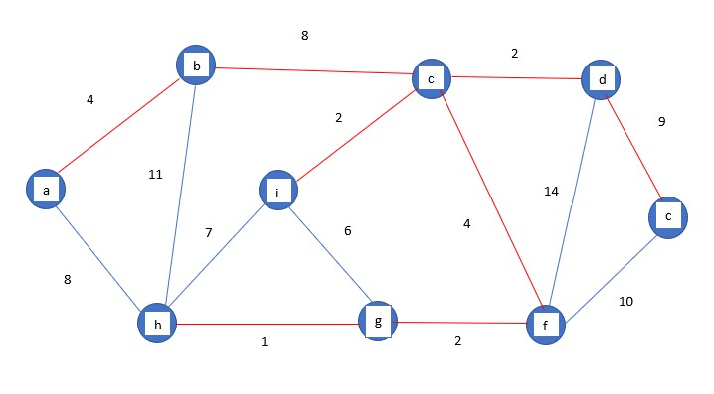
Graph View

Slide 10
MST Review
Time Complexity O (E log V).
Can Traverse through any direction from any source to destination.
Undirected Graph.
Algorithm Fails (Must not create cycles ).
Uses concept of cut graph theory.

Slide 11
Shortest Path Operation.
Not all vertices includes shortest path.
Beginning Source Node [a], Weight = Infinity
Node [a] to Node[b], Weight = 4
Node[a] to Node[c] via Node[b], Weight = 12
Considers all edges with minimum cost.
Traversing while satisfying the conditions.

Slide 12
Python Pseudocode
def primmest(self):
key = [sys.maxint]*self.V
parent = [None]*self.V
key[0] = 0
mstSet = [False]*self.V
parent[0] = -1
for cout in range(self.V):
u = self.minKey(key, mstSet)
mstSet[u] = True
for v in range (self.V):
if self.graph[u][v]>0 and mstSet[v] == False and key[v] > self.graph[u][v]:
key[v] = self.graph[u][v]
parent[v] = u
self.printMST(parent)
https://www.geeksforgeeks.org/prims-minimum-spanning-tree-mst-greedy-algo-5/

