Slide 1
Digital Portfolio
STUDENT NAME: ARISH KUMAR
REGISTER NO:bruau2422K1169
NMID:D2E58D04ED84BC8B7304E73DD30C95C9
DEPARTMENT: II-B.Sc(Computer Science)
COLLEGE : Government Arts and Science College (Co
-Education), Avinashi

Slide 2
INTERACTIVE PORTFOLIO WEBSITE USING HTML,CSS,AND JAVASCRIPT

Slide 3
AGENDA
1.
2.
3.
4.
5.
6.
7.
8.
9.
Problem Statement
Project Overview
End Users
Tools and Technologies
Portfolio design and Layout
Features and Functionality
Results and Screenshots
Conclusion
Github Link

Slide 4
Problem Statement
Title: The Need for a Personal Portfolio Website
• Many students and professionals struggle to present their skills and projects effectively
• Traditional resumes are static and do not showcase creativity
• Recruiters and clients prefer an interactive and visually appealing portfolio
• Need for a personal website to display achievements, projects, and contact details

Slide 5
Title: Portfolio Website for Arish Kumar K.
Bullet Points:
• A personal portfolio website designed for Arish Kumar K.
• Showcases skills, education, services, and projects
• Provides a centralized platform for networking and professional identity
• Built with modern web technologies and design principles

Slide 6
Title: Who Will Use It?
Bullet Points:
• Recruiters / Employers → To evaluate skills and projects
• Clients → To check services like web development, UI/UX design
• Peers / Students → To collaborate and learn
• General Audience → Anyone interested in your work

Slide 7
Title: Tech Stack Used
Bullet Points:
• Frontend: HTML5, CSS3, Bootstrap, React.js
• Programming Languages: JavaScript, Python, C, C++
• Database: MySQL, SQLite
• Design Tools: Figma, Canva, Adobe XD
• Version Control: Git & GitHub

Slide 8
Portfolio Design and Layout
Sections Included:
1. Navigation Bar
2. Hero / Intro Section
3. About Me
4. Skills
5. Services
6. Education & Experience
7. Projects
8. Contact Information
9. Footer
Design Focus:
• Clean UI
• Responsive design
• Easy navigation

Slide 9
• Smooth scrolling & animations
• Interactive navigation bar
• Skill showcase with categories
• Projects with description & demo links
• Contact section with email, phone, LinkedIn, GitHub
• Fully responsive layout (mobile, tablet, desktop)
Features and Functionality

Slide 10
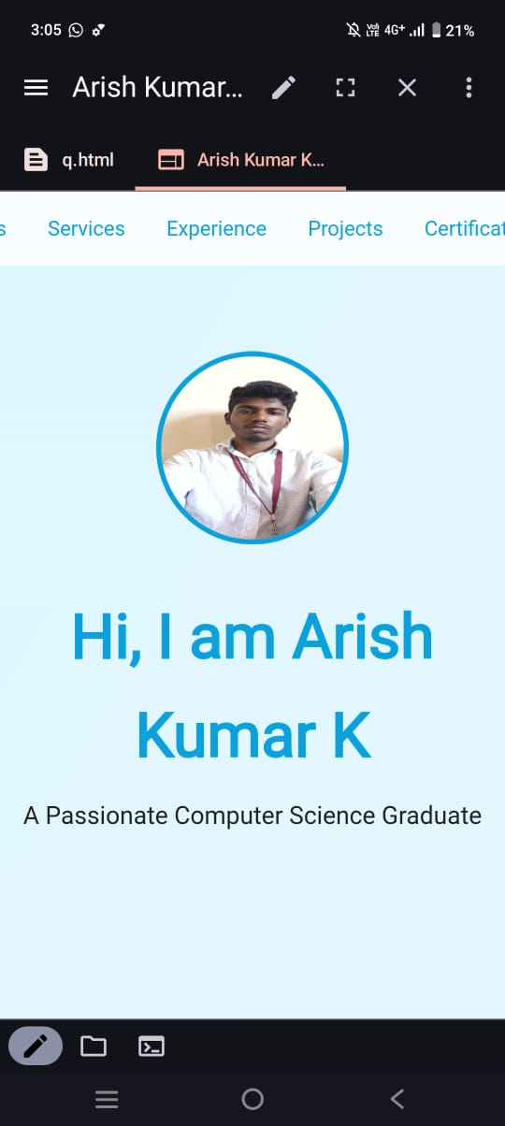
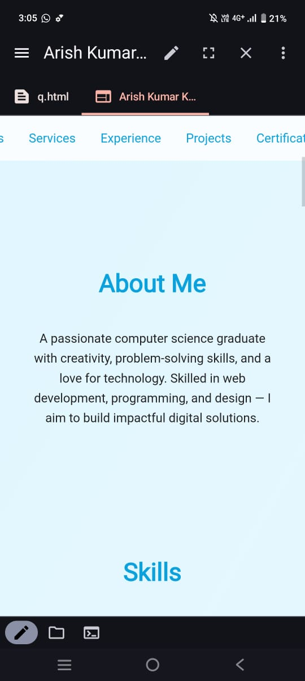
RESULT AND SCREENSHOTS

Slide 11
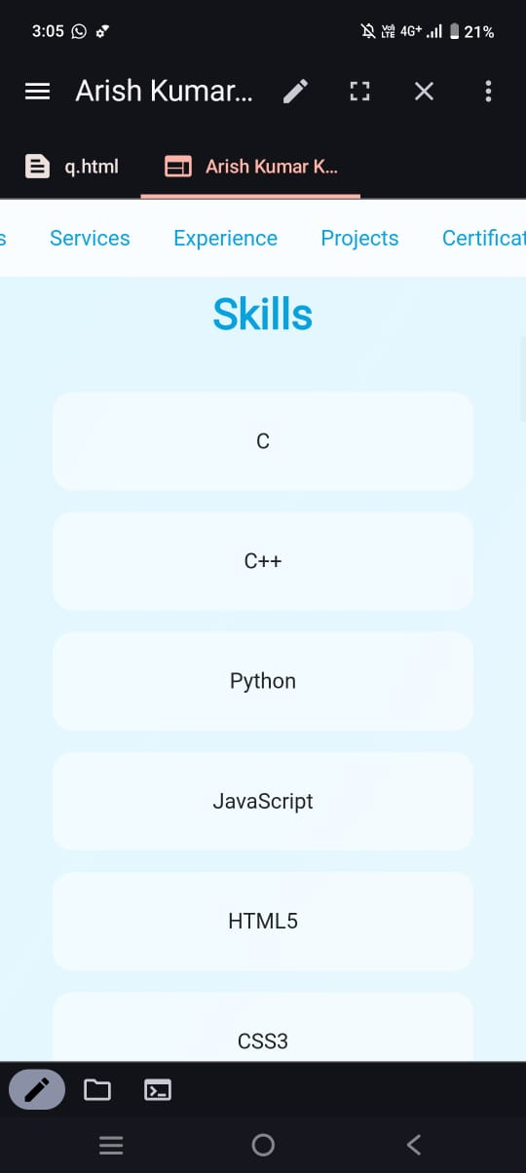
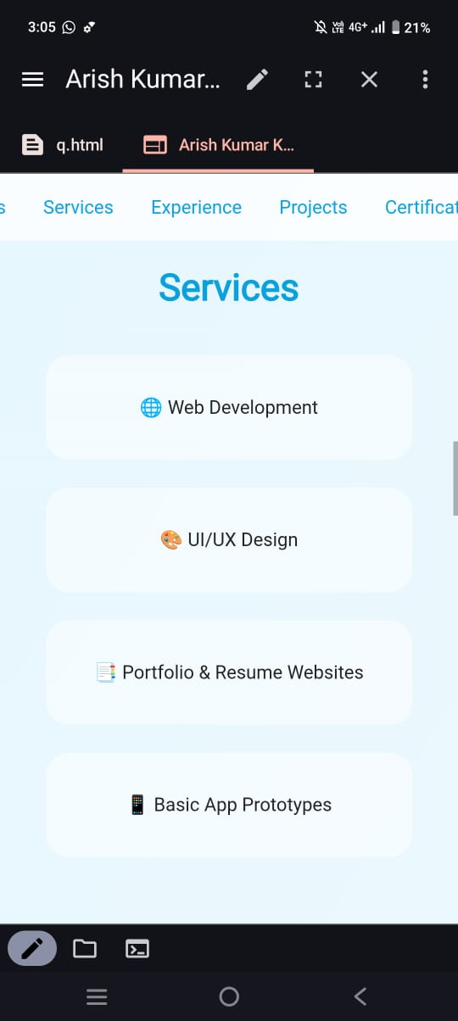

Slide 12
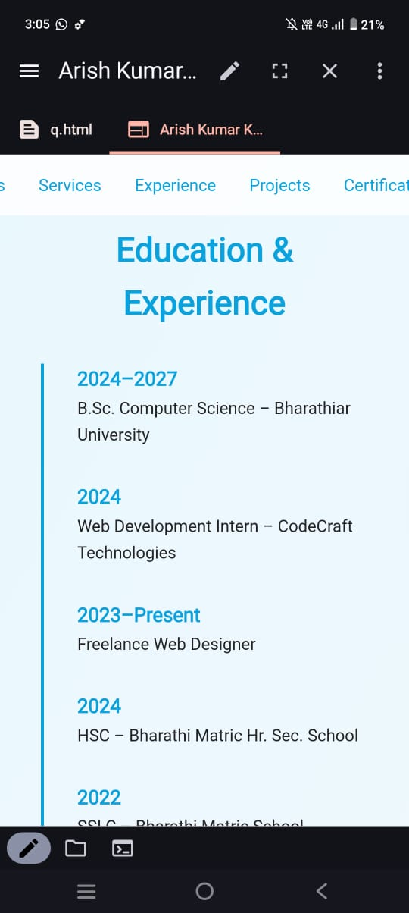
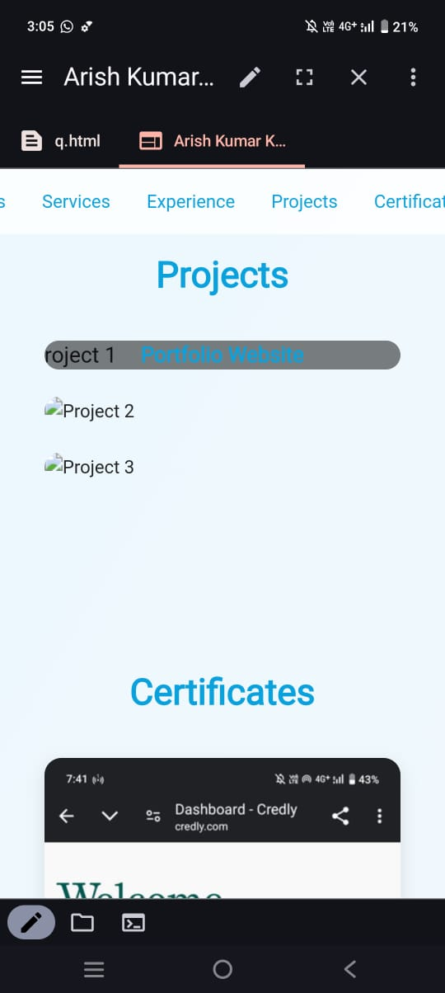

Slide 13
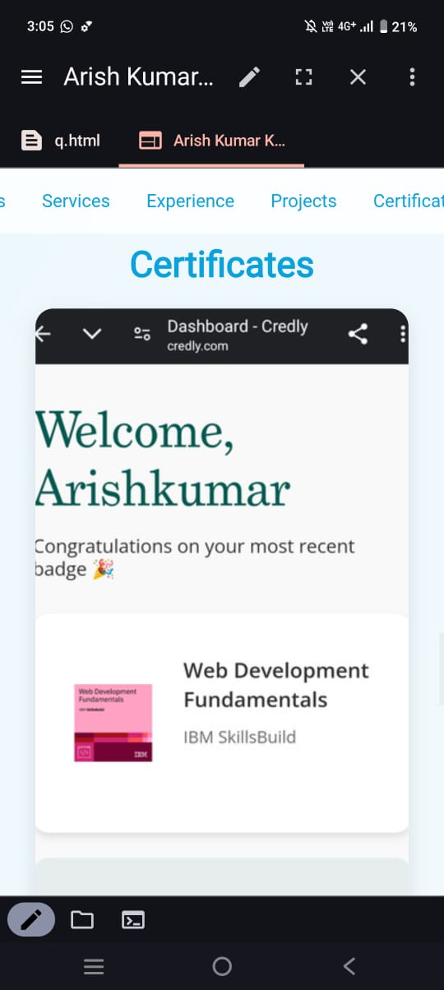
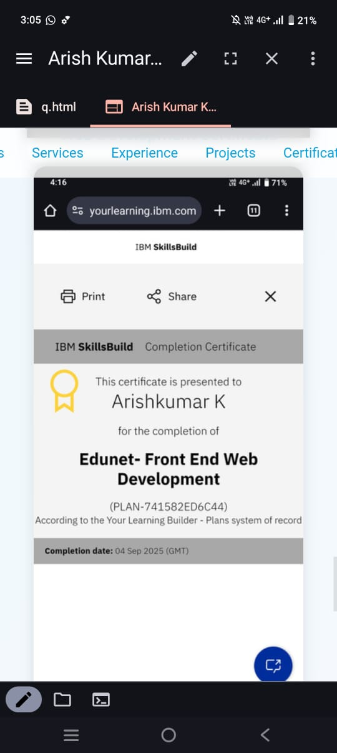

Slide 14
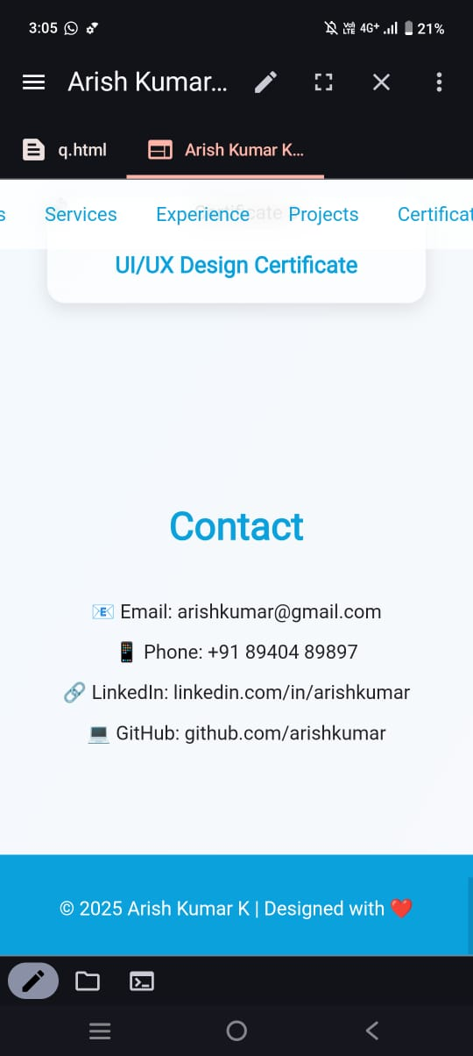

Slide 15
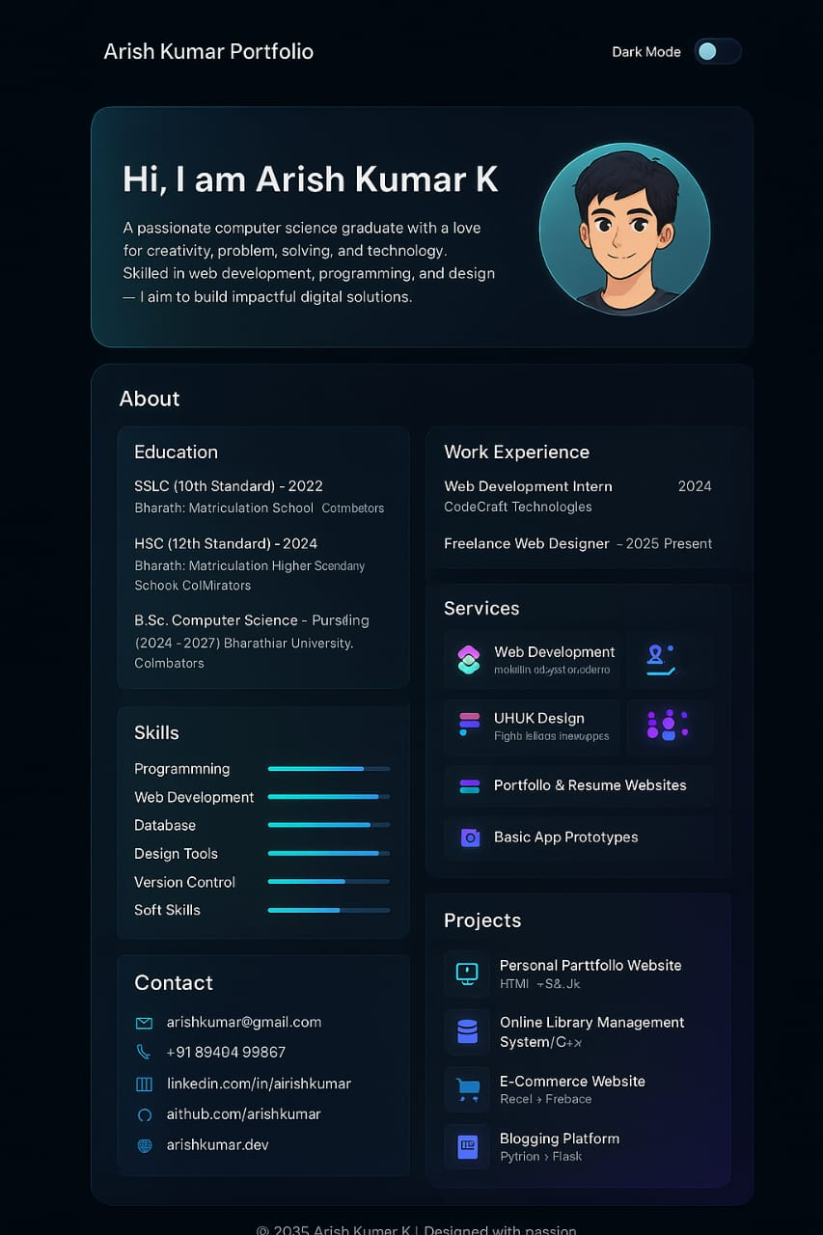
RESUME

Slide 16
Conclusion
Portfolio provides a digital identity.
Helps in career growth, freelancing, and networking
.Demonstrates technical + design skills.
Acts as a living resume that can be updated anytime.

Slide 17
Thank you

