Slide 1
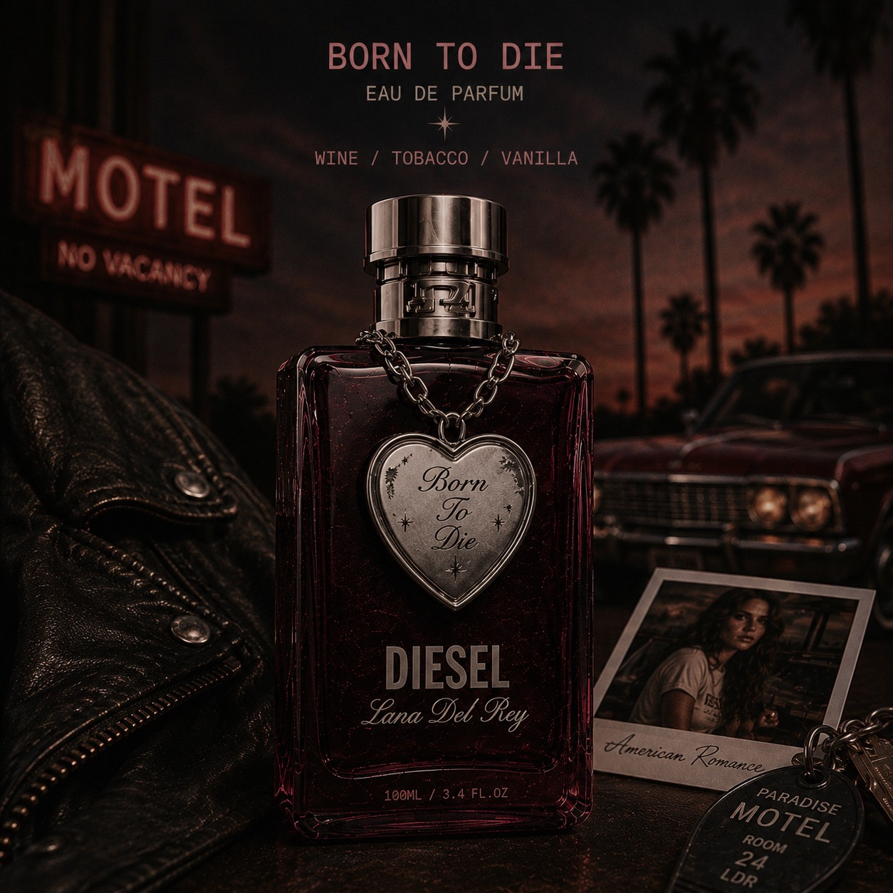
BORN TO REBEL.
A melancholic American dream reimagined through distressed denim, vintage glamour, and rebellious femininity.

Slide 2
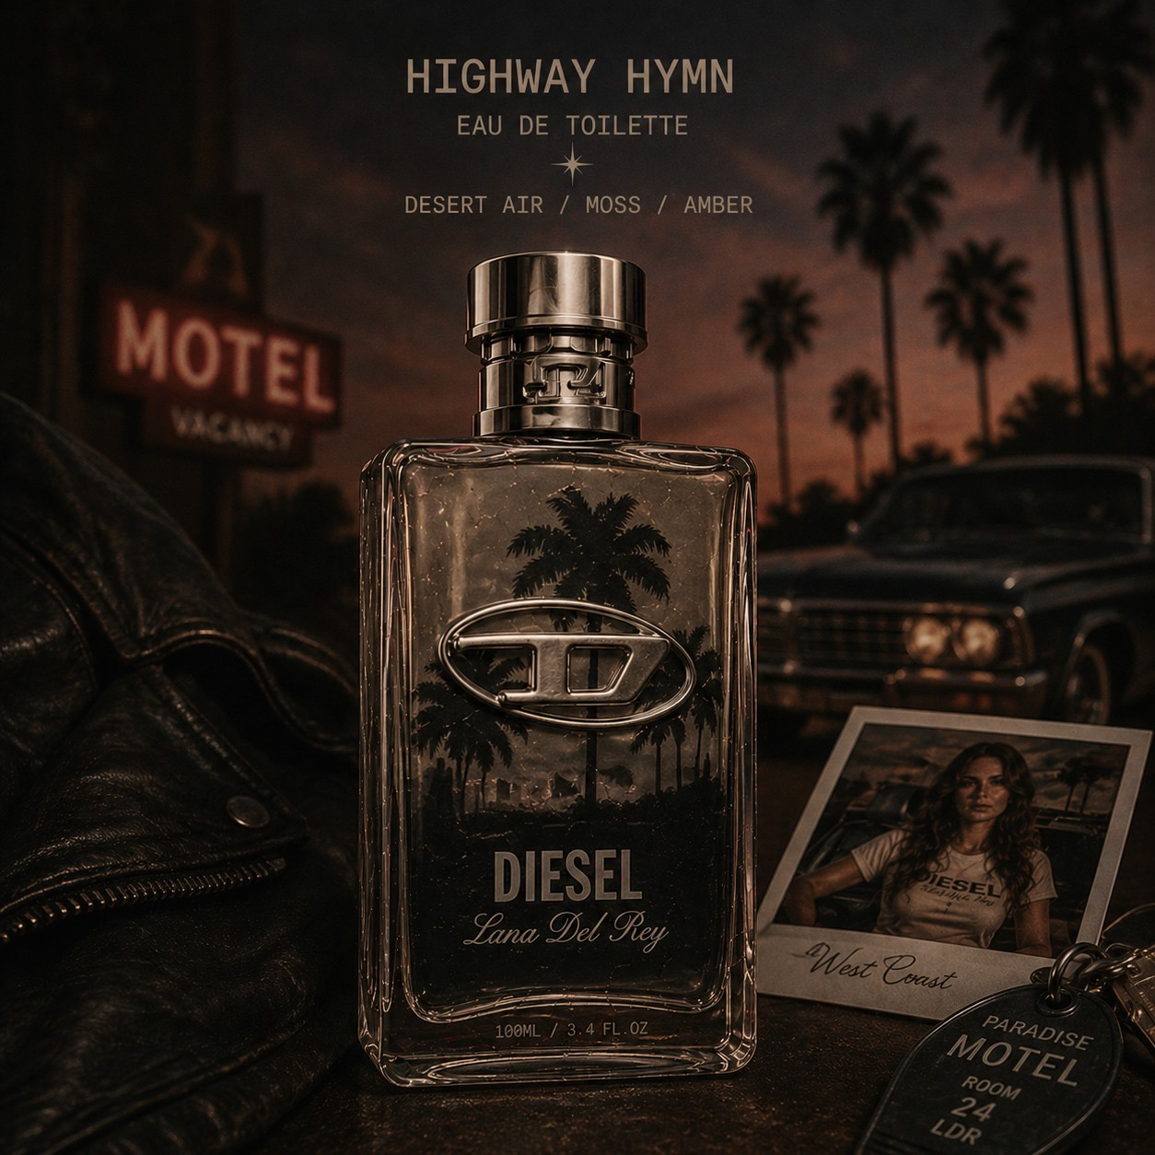
01 / EXECUTIVE SUMMARY
The Concept
Limited-edition collaboration between Lana Del Rey and Diesel blending Americana nostalgia, Y2K rebellion, luxury grunge and dark cinematic aesthetics.

Slide 3
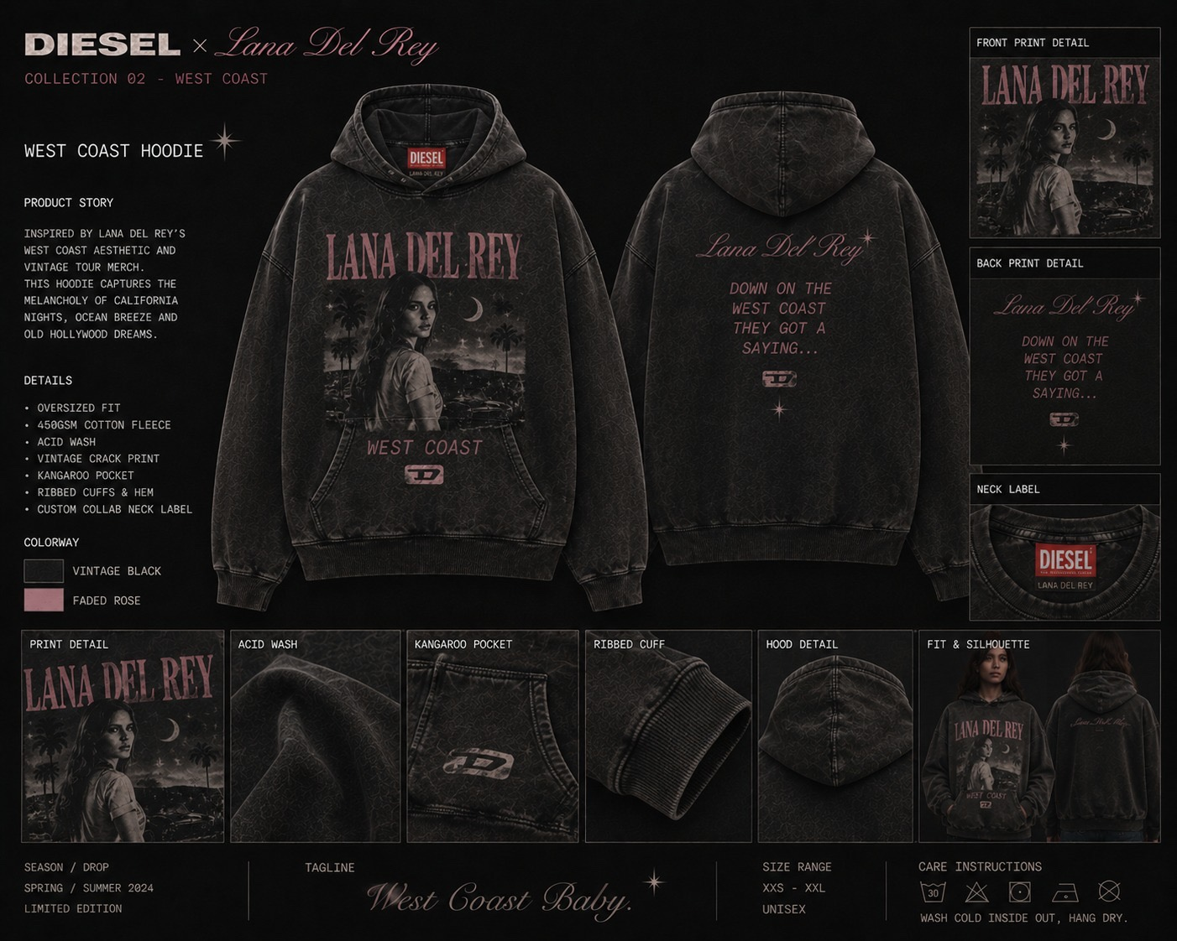
02 / BRAND ALIGNMENT
Two Icons. One Vision.
Lana Del Rey represents timeless online aesthetic culture while Diesel owns edgy Gen-Z Y2K fashion territory.

Slide 4
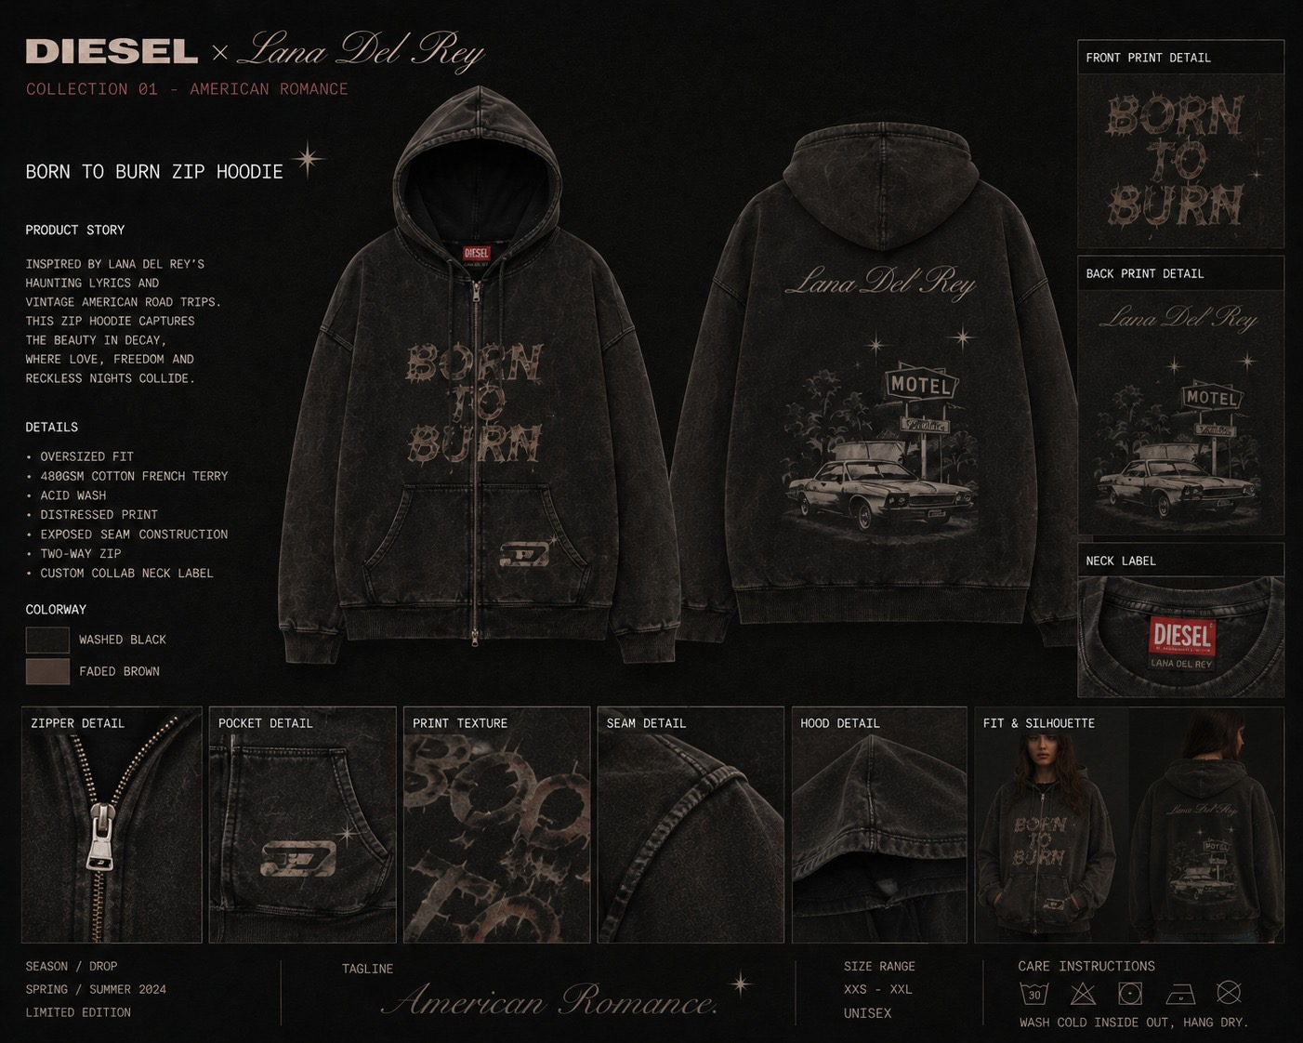
03 / TARGET AUDIENCE
Who Wears The Dream?
Gen Z and young millennials driven by aesthetic identity, nostalgia culture, exclusivity and individuality.

Slide 5
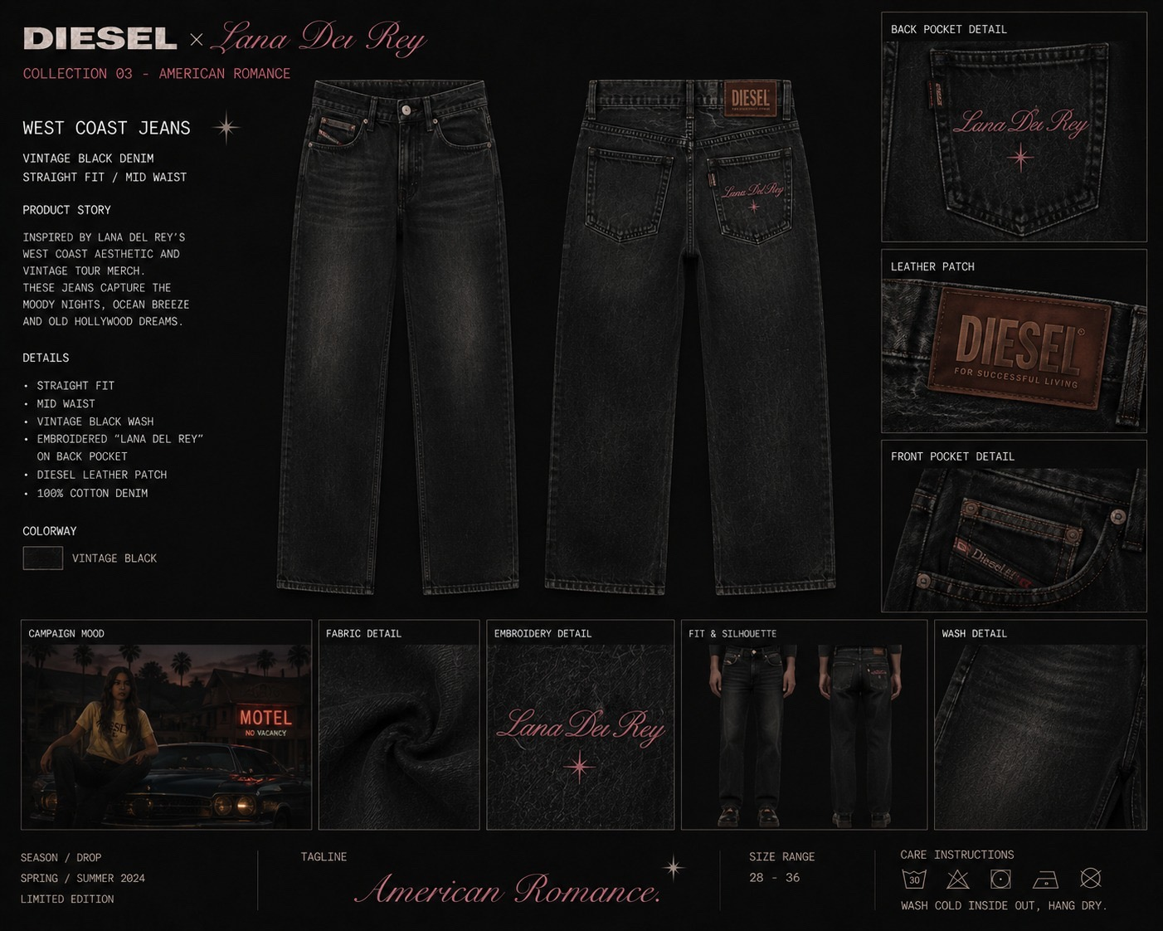
04 / MARKET OPPORTUNITY
Why Now?
Y2K revival, celebrity collaborations, vintage denim resurgence and TikTok aesthetic culture create the perfect timing.

Slide 6
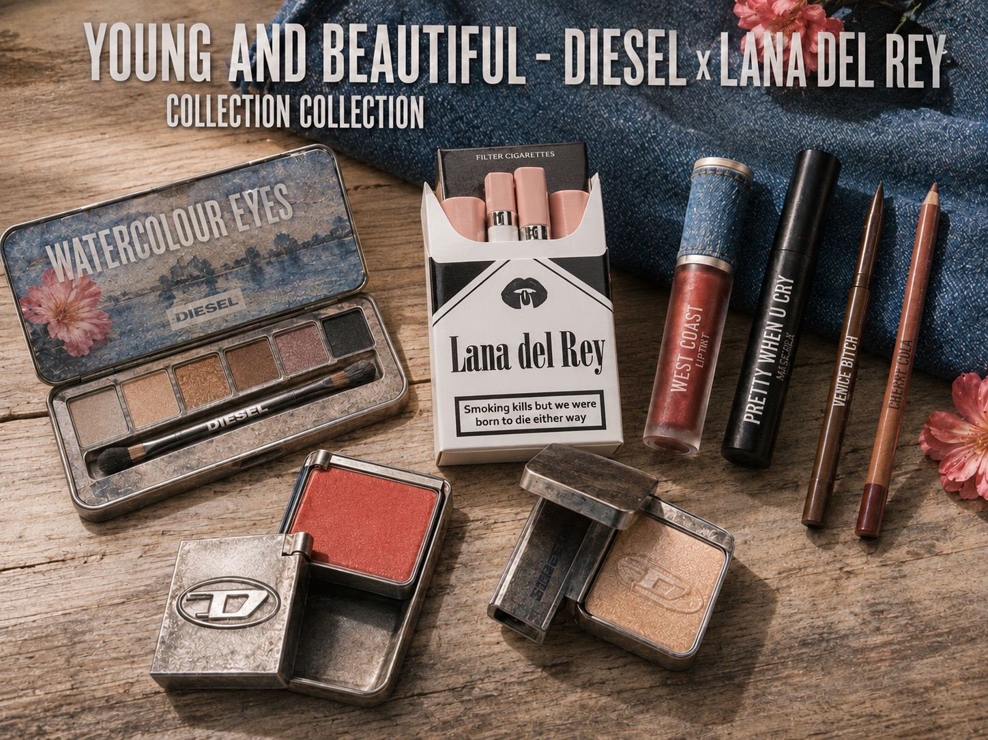
05 / PRODUCT LINE
Capsule Collection
Distressed denim, biker jackets, corsets, motel hoodies, accessories and collectible fashion pieces.

Slide 7
06 / MARKETING
Sad Girls Rule The World
TikTok edits, motel-inspired photography, influencer collaborations and immersive pop-up experiences.

Slide 8
07 / SWOT ANALYSIS
Strategic Positioning
Strong cult fanbase and viral potential balanced against premium pricing and niche positioning.

Slide 9
08 / FINANCIALS
The Numbers
$7.5M investment with projected Year-1 revenue of $31M and 35–40% estimated profit margins.

Slide 10
09 / LAUNCH TIMELINE
From Vision To Reality
7-month launch plan covering design, teaser campaigns, social rollout and global release.

Slide 11
10 / FUTURE EXPANSION
Beyond Fashion
Expansion into fragrances, handbags, festival collections and immersive fashion-film projects.

Slide 12
11 / COMPETITOR ANALYSIS
Competitive Landscape
Brand | Strength | Weakness | Position
SKIMS | Massive visibility | Less artistic identity | Mainstream
Adidas × Artists | Streetwear dominance | Oversaturated | Commercial
Mugler × Pop Stars | High fashion appeal | Less accessible | Luxury
Lana × Diesel | Strong storytelling | Niche emotional branding | Cult Luxury

Slide 13
Born to Rebel. Designed to Remember.
A collaboration the world is already waiting for.

