Slide 1
Secret-Key Encryption

Slide 2
Advanced Encryption Standard (AES)
AES is a block cipher
128-bit block size.
Three different key sizes: 128, 192, and 256 bits

Slide 3
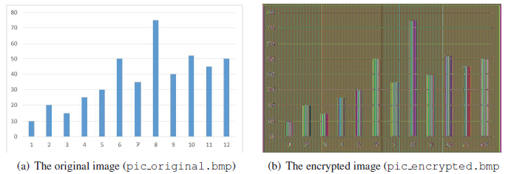
Encryption Modes

Slide 4
Encryption Modes
Encryption mode or mode of operation refers to the many ways to make the input of an encryption algorithm different.
Examples include:
  Electronic Codebook (ECB)
  Cipher Block Chaining (CBC)
  Propagating CBC (PCBC)
  Cipher Feedback (CFB)
  Output Feedback (OFB)
  Counter (CTR)

Slide 5
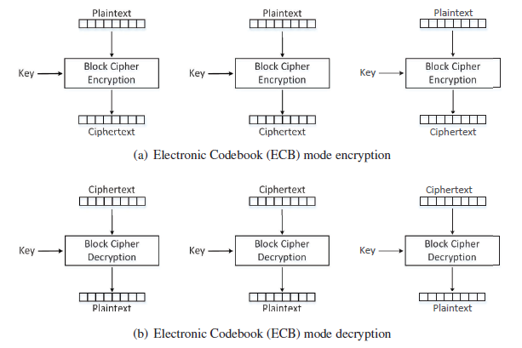
Electronic Codebook (ECB) Mode

Slide 6

Electronic Codebook (ECB) Mode
Using openssl enc command:
We use the 128-bit (key size) AES algorithm
The -aes-128-ecb option specifies ECB mode
The -e option indicates encryption
The -d option indicate decryption
The -K option is used to specify the encryption/decryption key

Slide 7
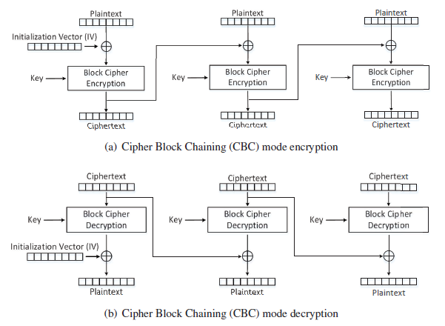
Cipher Block Chaining (CBC) Mode
The main purpose of IV is to ensure that even if two plaintexts are identical, their ciphertexts are still different, because different IVs will be used.
Decryption can be parallelized
Encryption cannot be parallelized

Slide 8
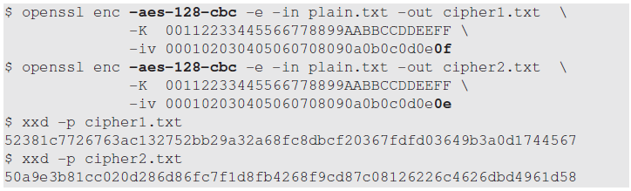
Cipher Block Chaining (CBC) Mode
Using openssl enc command to encrypt the same plaintext, same key, different IV:
We use the 128-bit (key size) AES algorithm
The -aes-128-cbc option specifies CBC mode
The -e option indicates encryption
The -iv option is used to specify the Initialization Vector (IV)

Slide 9
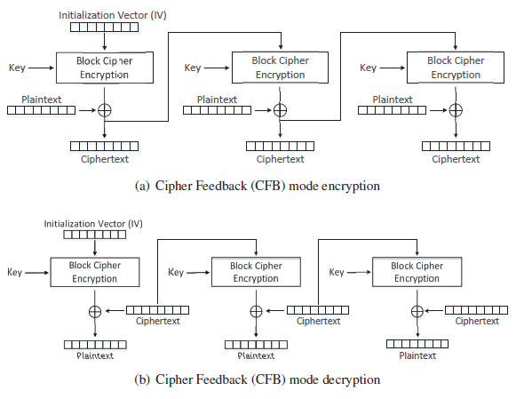
Cipher Feedback (CFB) Mode
A block cipher is turned into a stream cipher.
Ideal for encrypting real-time data.
Padding not required for the last block.
decryption using the CFB mode can be parallelized, while encryption can only be conducted sequentially

Slide 10
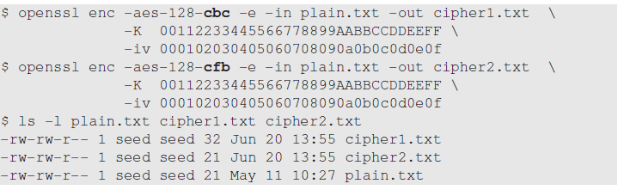
Comparing encryption with CBC and CFB
Plaintext size is 21 bytes
CBC mode: ciphertext is 32 bytes due padding
CFB mode: ciphertext size is same as plaintext size (21 bytes)

Slide 11
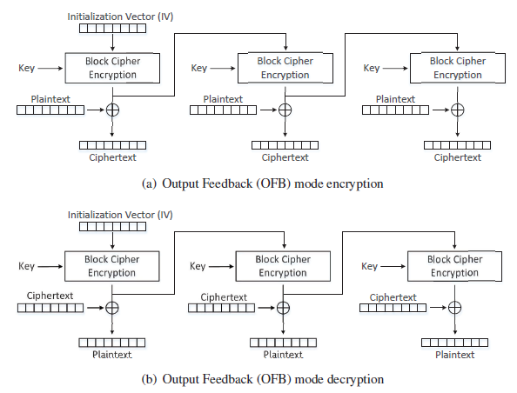
Output Feedback (OFB) Mode
Similar to CFB
  Used as stream cipher
  Does not need padding
  Decryption can parallelized
Encryption in the OFB mode can be parallelized

Slide 12
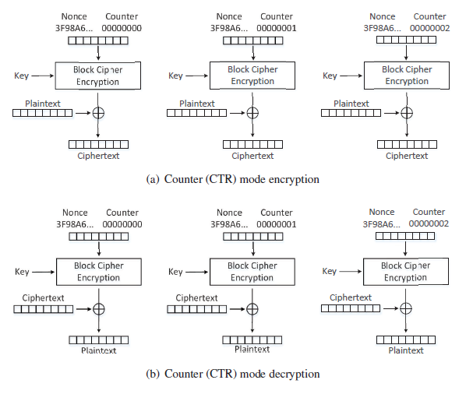
Counter (CTR) Mode
It basically uses a counter to generate the key streams
no key stream can be reused, hence the counter value for each block is prepended with a randomly generated value called nonce
This nonce serves the same role as the IV does to the other encryption modes.
both encryption and decryption can be parallelized
the key stream in the CTR mode can be calculated in parallel during the encryption

Slide 13
Modes for Authenticated Encryption
None of the Encryption modes discussed so far cannot be used to achieve message authentication
A number of modes of operation have been designed to combine message authentication and encryption.
Examples include
  GCM (Galois/Counter Mode)
  CCM (Counter with CBC-MAC)
  OCB mode (Offset Codebook Mode)

Slide 14
Padding
Block cipher encryption modes divide plaintext into blocks and the size of each block should match the cipher’s block size.
No guarantee that the size of the last block matches the cipher’s block size.
Last block of the plaintext needs padding i.e. before encryption, extra data needs to be added to the last block of the plaintext, so its size equals to the cipher’s block size.
Padding schemes need to clearly mark where the padding starts, so decryption can remove the padded data.
Commonly used padding scheme is PKCS#5

Slide 15
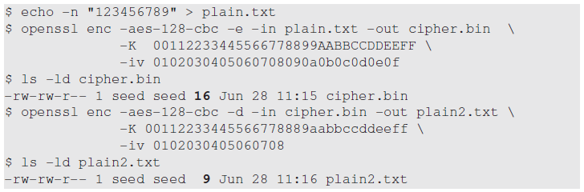
Padding Experiment
Plaintext size is 9 bytes.
Size of ciphertext (cipher.bin) becomes 16 bytes

