Slide 1



Cybersecurity basics

Slide 2
outlines
  Intro
    Key Milestones in the Evolution of Cybersecurity
    Definition of Terms
    Security Levels
    Assets
    Organizations and projects in cybersecurity
  Security Attributes
  Security process
  Malware
  Attacks
  Hackers

Slide 3
impact of 9/11/2001
  Security Reminder
  Attackers used the network and the dark web
  Chaos increased and hackers launched many attacks via email, defamation or denial of service
  Security was considered an isolated technical problem before this stage
  Enacting laws and taking preventive measures

Slide 4
Corona effect
  More from the virtual world
  Phishing
  Home networks are not protected and users do not run security software on their computers
  Ransomware attacks
  Training and awareness have increased.

Slide 5
Artificial Intelligence as a Threat Factor in Information Security
    Artificial Intelligence (AI) has significantly expanded and intensified the cyber threat landscape through automation, personalization, and self-learning capabilities.
    Key Threats:
    Intelligent Phishing and Social Engineering: AI generates personalized and highly convincing messages.
    AI-Driven Malware: Automated generation and optimization of exploit codes.
    Deepfakes: Used to breach trust, manipulate identities, and conduct fraud.
    Adversarial and Data Poisoning Attacks: Targeting AI models themselves to disrupt or deceive detection systems.
    According to Microsoft (2024) and ENISA (2024), AI has become a force multiplier for attackers in modern cybersecurity.

Slide 6
Artificial Intelligence as a Tool for Defense and Protection
  AI is increasingly used to enhance predictive threat detection and automated incident response.
  Main Applications:
  Behavioral Analysis and Early Anomaly Detection: Identifying irregular activity across networks and data systems.
  Automated Response (SOAR): Reduces incident response time and human error.
  Enhanced Phishing and Fraud Detection: Improves accuracy and reduces false positives.
  Continuous Learning: Enables adaptive defense against evolving attacks.
  Based on the NIST AI Risk Management Framework (2024), AI is now a cornerstone of modern cybersecurity defense.

Slide 7
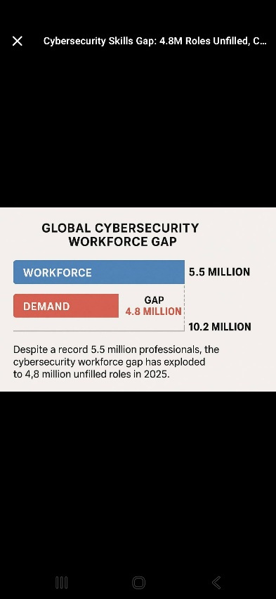

Slide 8
Definition of terms
  Cyber: The term is defined as everything related to the Internet or computers in general.
  Assets:
  Tangible: buildings, people, equipment
  Intangible: codes, data, etc.
Notes:
Asset protection involves:
Prevention.
Detection.
Reaction.
8

Slide 9
Protection levels
  Hardware level.
  Operating system level.
  Network level.
  Application level.
  People level.

Slide 10
  Hardware Level
    User and Supervisor (Kernel) modes on processors
    Memory protection (partially implemented in the processor instruction set architecture)
  Operating System Level
    The O.S. can provide:
    Per-user or per-group protections on files, processes, ports, and devices .
    Encryption of password files .

Slide 11
Network Level
    Firewalls
    Smart router software
    Implementation of protocols such as IPsec (at the network layer), SSL (at transport layer), secure ethernet and wireless security (at link layer), and PGP and friends (at application layer)
    Use of VPNs
Notes:
Network Level
Firewalls (allow packets through based on rules such as origin, type, size, port)
Smart router software that can detect denial of service attempts and even check the content of packets looking for known malware patterns
Implementation of protocols such as IPsec (at the network layer), SSL (at transport layer), secure ethernet and wireless security (at link layer), and PGP and friends (at application layer).
Use of VPNs
11

Slide 12
  Application Level
  Applications should have security in their design (authentication, authorization, permissions, roles, etc.) and should implement range checks, disallow weak passwords, and handle password-reset properly. They might even expire passwords and support security questions, but these two things are very controversial.
  The Human Level
  Be wary about phishing and other personal scams. People can pretend to be someone else (misrepresentation) and just ask you for credentials or even money. These may incidentally use a network but can also happen over other communication channels, including face-to-face.

Slide 13
the big questions
  What needs protection (buildings, people, data, etc.) and they represent the resources we talked about previously (assets)
  Why do we want protection (to achieve confidentiality, integrity, etc.)
  do we protect from (physical attack, data theft) and they represent the types of threats
  How do we protect (using encryption, building strong buildings, etc.) and they are the security measures

Slide 14
Organizations and projects in cybersecurity
  National Institute of Standards & Technology (NIST)
  The Open Web Application Security Project(OWASP)
  Information Systems Security Association(ISSA)

Slide 15

National Institute of Standards & Technology (NIST)
  Established by the US Senate in 1901
  A laboratory and non-regulatory agency of the US Department of Defense
  Goals to promote innovation and industrial competitiveness.
Notes:
مخبر ووكالة غير تنظيمية تابعة لوزارة الدفاع الأمريكية
هدفه تعزيز الابتكار والقدرة التنافسية الصناعية .
يشمل العديد من المجالات مع الجانب المعلوماتي.
15

Slide 16

OWASP
  A non-profit organization that aims to increase the security of software applications.
  Through community-driven open source software projects
  The ultimate resource for developers and programmers to secure the web.
  Provides
    Tools and resources
    A community for collaboration and a network for communication
    Education and training
Notes:
منظمة غير ربحية تهدف لزيادة أمن التطبيقات البرمجية.
من خلال مشاريع برمجية مفتوحة المصدر مقادة من قبل المجتمع
المصدر الاساسي للمطورين والمبرمجين لتأمين الويب.
توفر
أدوات وموارد
مجتمع للتعاون وشبكة للتواصل
تعليم وتدريب
16

Slide 17

ISSA
  Non-profit organization
  Organizes international cybersecurity professionals whose goal is to enhance individual capabilities, manage cyber risks, and protect critical information and infrastructure
  Provides educational forums, publications, and member interaction opportunities that enhance the knowledge, skills, and professional growth of its members
Notes:
منظمة غير ربحية
تظم محترفيين دوليين في الأمن السيبراني هدفهم تعزيز القدرات الفردية, ادراة المخاطر الالكترونية، حماية المعلومات الهامة والبنى التحتية
توفر منتديات تعليمية ومنشورات وفرص تفاعل بين الأعضاء التي تعزز المعرفة والمهارة والنمو المهني لأعضائها
17

Slide 18
Security Attributes

Slide 19
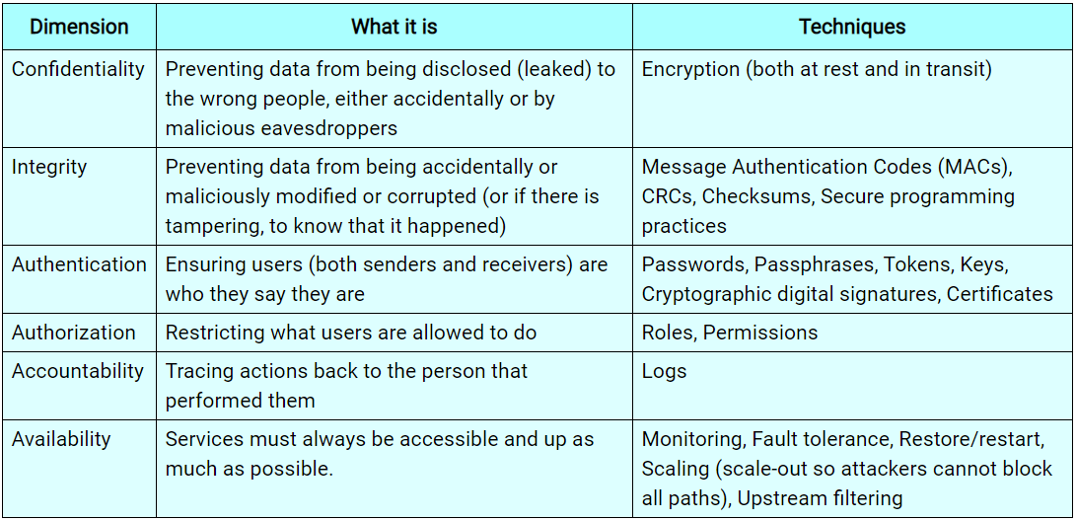

Slide 20
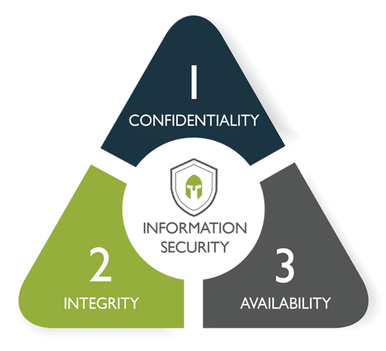
triad CIA
  confidentiality
  Integrity
  Availability

Slide 21

AAA
  Authentication
  Authorization
  Accounting

Slide 22
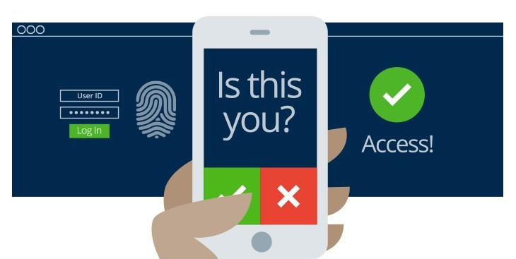
Authentication
  Confirming the identity of the user that he is indeed the person he claims to be

Slide 23
Authorization
  The right level of access that a user can have according to his responsibilities and the role he performs.
  Giving too many and inappropriate permissions opens the way for misuse of the system
  Example:An employee of the human resources department in a company should not see the accounting records

Slide 24

Accounting
  Track what users do while using the system
  Record only important events
  Monitor logs to detect suspicious actions and breaches

Slide 25

Do we implement security policies that ensure all standards?
Notes:
نطبق ما نحتاجه فقط لأن الأمن مكلف ماديا وعلى صعيد الأداء يسبب البطء.
مثال:
مكتب رئاسة جامعة يربط مجموعة من الجامعات سويا
يستلم من الجامعات درجات الطلاب بعد صدورها واطلاع الطلاب عليها في جامعاتهم
اثناء ارسال الدرجات لا يهم السرية لان الطالب اطلع على درجته لكن من المهم السلامة لضمان عدم تعديل الدرجات.
25

Slide 26
  Exercise: Describe a scenario in which Authentication and Integrity are required but Confidentiality is not.

Slide 27
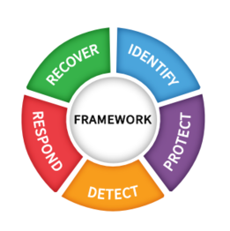
Security process
  Contains 5 steps
    Identify
    Protect
    Detect
    Response
    Recover

Slide 28
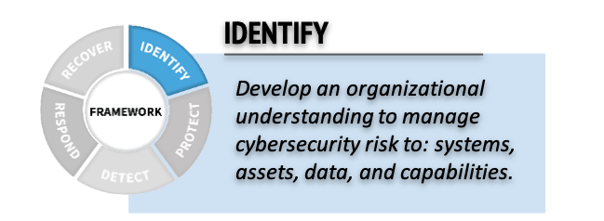
Identify
Notes:
تطوير فهم عام عند المؤسسة لانظمتها ومعداتها وبياناتها وامكانياتها المتاحة في ادارة المخاطر.
تحديد البيانات والمعدات الحرجة
تحديد الإمكانات من كوادر مؤهلة
وامكانات مادية
28

Slide 29
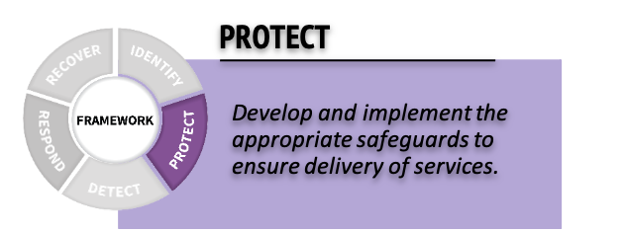
protect
Notes:
تطوير وتطبيق الضمان الأمني المناسب.
السياسات والاجراءات الأمنية المناسبة لمتطلبات الأمن في المرحلة السابقة.
29

Slide 30
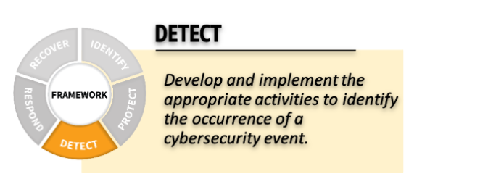
detect
Notes:
تطوير وتطبيق الآليات المناسبة لضمان كشف الهجوم عند حدوثه.
يساعد في تحديد وتطبيق الحلول عن عند حدوث الخطر.
التأخر في اكتشاف الهجوم يزيد الأضرار.
30

Slide 31
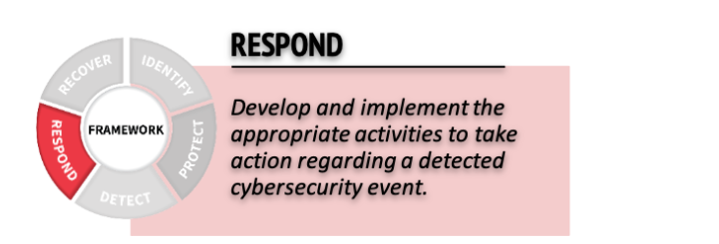
respond
Notes:
تطوير وتطبيق الآليات المناسبة لاتخاذ الاجراء الأمثل عند حدوث الهجوم الأمني.
تقليل الأثر الناتج عن الهجوم لاقصى حد.
31

Slide 32
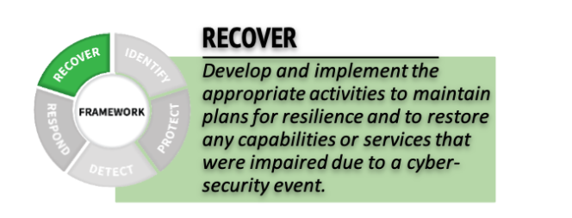
Recover
Notes:
تطوير وتطبيق الآليات المناسبة للإصلاح واستعادة الخدمات المتضررة بشكل مرن لا يؤثر على عمل المؤسسة.
32

Slide 33
Vulnerability, threat and risk
  A vulnerability is a weakness or flaw in an operating system, network, or application,
  vulnerabilities can arise for many reasons, including misconfigurations, design flaws, outdated software versions, weak Credentials, malicious Insiders or Phishing-Prone Users

Slide 34
Vulnerability, threat and risk
  A threat is a malicious event that takes advantage of a vulnerability and has the potential to damage the asset
  virus – worm – ransomware – brute force attack – denial of service - man in the middle - phishing.

Slide 35
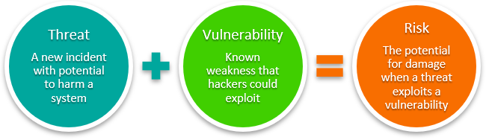
Vulnerability, threat and risk
    Risk is the potential for loss or damage to an organization's assets due to external or internal threat

Slide 36
Hackers
  Hackers Definition
  Hackers Motives
  Hackers Types

Slide 37
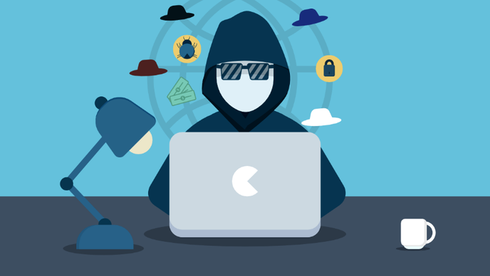
Hackers Definition
  Anyone who discovers ways to penetrate defenses and exploit vulnerabilities in computer systems and networks
  With extensive knowledge of hardware and software

Slide 38
Hackers Motives
  Money Goal
    81% of hackers according to studies
  Fame Goal
    Amateur Hackers
    Information Security Specialists
  Curiosity Goal
Notes:
هدف المال
يشكلون نسبة 81% من القراصنة وفق الدراسات
هدف الشهرة
مخترقون هواة
مختصين بأمن المعلومات
هدف الفضول
38

Slide 39
  Political goals
    State-sponsored hacking (national espionage, sabotage)
  Terrorist goals
    Former employees seeking revenge
    Competitors recruiting employees for theft or sabotage
Notes:
أهداف سياسية
القرصنة التي ترعاها الدولة( تجسس وطني، تخريب)
اهداف ارهابية
من الداخل
موظفون سابقون يسعون للانتقام
شركات منافسة تجند موظفين بغرض السرقة أو التخريب
39

Slide 40
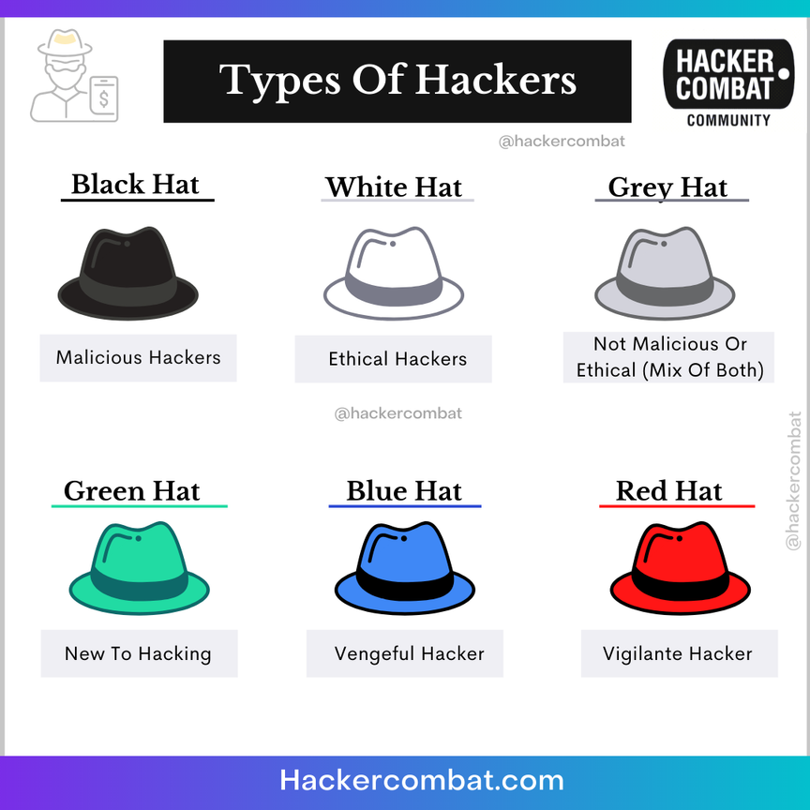
Hackers Types
  White Hats
  Black Hats
  Grey Hats
  Green Hats
  Red Hats
  Blue Hats
  Hacktivists

Slide 41
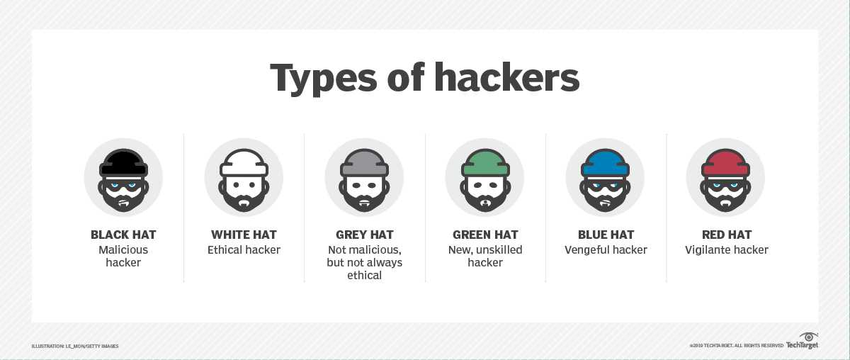
white hats
  Ethical hackers
  Their goal is to discover vulnerabilities to help fix them, and to prevent the threat from malicious hackers.
  They are hired by organizations to enhance security
  They do not publish discovered vulnerabilities before they are fixed.
Notes:
القراصنة الاخلاقيون ethical hackers
هدفهم اكتشاف الثغرات للمساعدة في اصلاحها، ودفع الخطر من القراصنة الخبيثين.
يتم توظيفهم من قبل المؤسسات لتعزيز الأمن
لا ينشرون الثغرات المكتشفة قبل ان يتم اصلاحها.
41

Slide 42
black hats
  Known as cracker, they do malicious acts, with the aim of stealing, selling data or sabotaging for personal purposes
  They develop their own tools
  It is difficult to detect their hacks because they have great knowledge
  They can carry out non-sabotage attacks without leaving a trace
  Their actions are illegal and lead to arrest and imprisonment
Notes:
يعرفون باسم cracker، يقومون باعمال خبيثة، بغرض السرقة، بيع البيانات أو التخريب لأغراض شخصية
يقومون بتطوير أدواتهم الخاصة
يصعب جدا اكتشاف اختراقاتهم لأنهم يمتلكون معرفة عظيمة
يستطيعون تنفيذ الهجومات الغير تخريبية دون ترك أثر
أفعالهم غير قانونية وتؤدي للاعتقال والسجن
42

Slide 43
grey hats
  Hacking for fun or curiosity.
  Their actions may lead to sabotage or reform.
  They have no personal benefit but it remains illegal
Notes:
الاختراق بغرض المرح أو الفضول.
قد تؤي أفعالهم للتخريب أو الاصلاح.
ليس لهم منافع فردية لكنه يبقى غير قانوني
43

Slide 44
green hats
  Script kiddies
  They use pre-written and prepared programs and mechanisms.
  They learn hacking through websites and educational courses
Notes:
القراصنة المبتدئون يعرفون أيضا باسم اطفال المخطوطات Script kiddies
يستخدمون برامج وآليات مكتوبة ومعدة سابقا .
يتعلمون الاختراق من خلال مواقع الانترنت والدورات التعليمية
44

Slide 45
red hats
  They are similar to white hats but the mechanism is different
  They look for black hats
  They do illegal actions towards black hats and massive attacks on them in order to disable their mechanisms

Slide 46
blue hats
  They use hacking as a social force for personal purposes
  Revenge hacking
  Defaming people for example, stealing data, sabotaging...etc.
Notes:
يستخدمون الاختراق كقوة اجتماعية لأغراض شخصية
الاختراق الانتقامي
تشويه سمعة اشخاص مثلا، سرقة معطيات، تخريب ...الخ
46

Slide 47
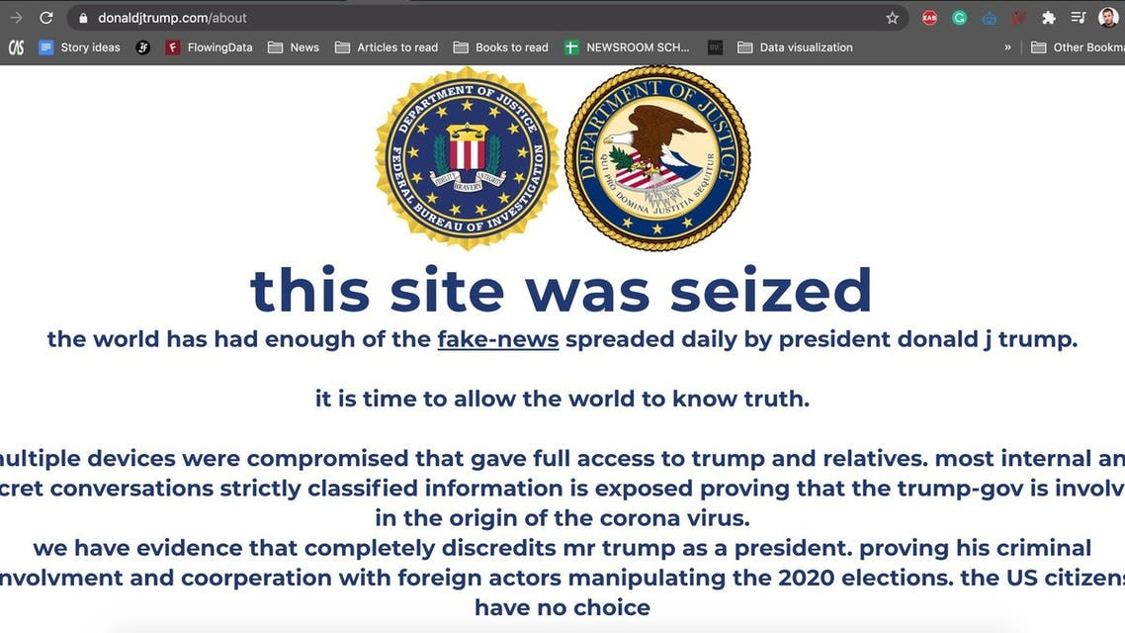
Hacktivists
  They use hacking to draw public opinion towards various issues.
  They hack social media such as television, radio or well-known social media sites.

Slide 48
What Can Attackers Do?
  Eavesdrop: Tap into a communication line and steal information.
  Spoof: Modify data in transit, replace the source IP address, or change purchase shipping address to the attacker’s secret PO Box.
  Deny service: Preventing data from getting to the target (rerouting the packets), or flooding one of the hosts or routers with so many packets nothing effectively gets through.
  Break In: Install a keylogger or other malware on a device that records everything the victim does.

Slide 49
Required Framework
  https://seedsecuritylabs.org/labsetup.html

