Slide 1
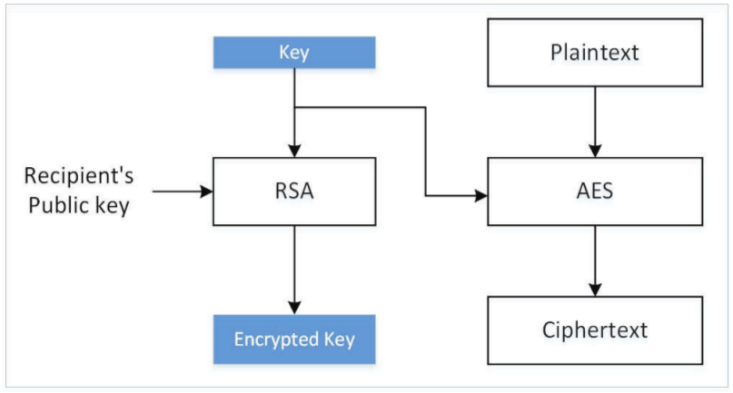
Hybrid Encryption
High computation cost of public-key encryption
Public key algorithms used to exchange a secret session key
Key (content-encryption key) used to encrypt data using a symmetric-key algorithm

Slide 2
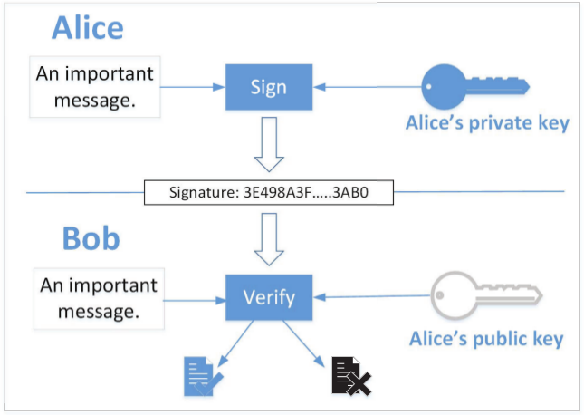
Digital Signature
Goal: provide an authenticity proof by signing digital documents
Diffie-Hellman authors proposed the idea, but no concrete solution
RSA authors developed the first digital signature algorithm

Slide 3
Digital Signature using RSA
Apply private-key operation on m using private key, and get a number s, everybody can get the m back from s using our public key
For a message m that needs to be signed:
Digital signature = m^{d} mod n
In practice, message may be long resulting in long signature and more computing time
Instead, we generate a cryptographic hash value from the original message, and only sign the hash

Slide 4
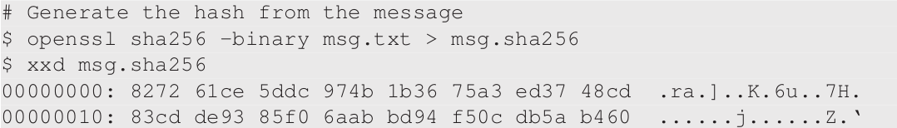
Digital Signature using RSA (Contd.)
Generate message hash

Slide 5
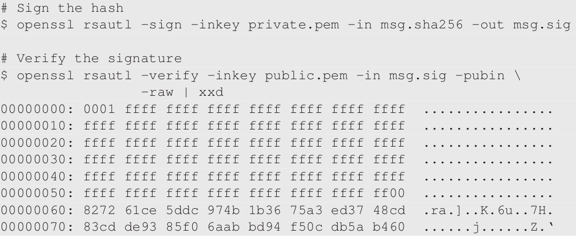
Digital Signature using RSA (Contd.)
Generate and verify the signature

Slide 6
Attack Experiment on Digital Signature
Attackers cannot generate a valid signature from a modified message because they do not know the private key
If attackers modifies the message, the hash will change and it will not be able to match with the hash produced from the signature verification
Experiment: modify 1 bit of signature file msg.sig and verify the signature

Slide 7
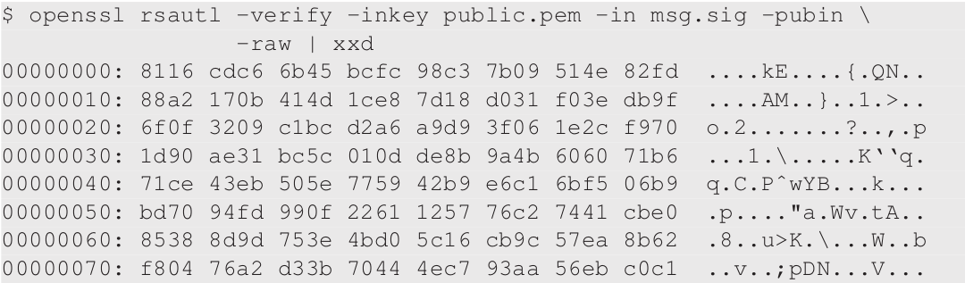
Attack Experiment on Digital Signature (Contd.)
After applying the RSA public key on the signature, we get a block of data that is significantly different

