Slide 1
Public Key Infrastructure

Slide 2
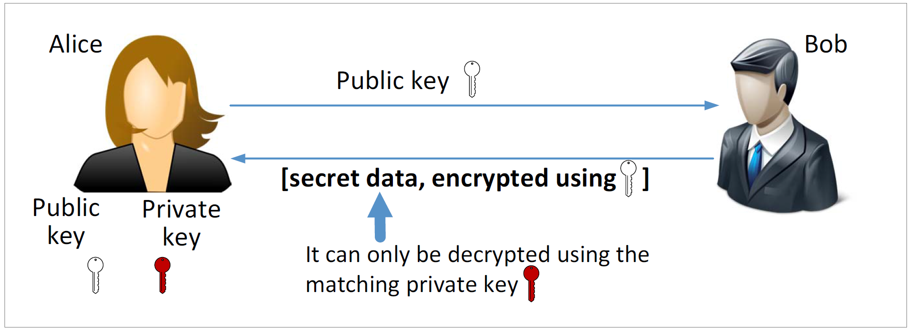
Public Key Cryptography

Slide 3
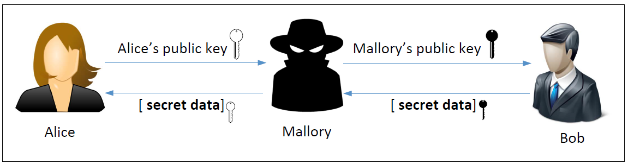
Man-in-the-Middle (MITM) Attack

Slide 4
What Is the Fundamental Problem?
Fundamental Problem: Bob has no way to tell whether the public key he has received belongs to Alice or not.
Solution:
  Find a trusted party to verify the identity
  Bind an identity to a public key in a certificate
  The certificate cannot be forged or tampered with (using digital signature)
Notes:
Alice can not trust the certificate signing to be done over the internet as that may also be under attack by a MITM. She has to go in person.
After sending the certificate to Bob, even if Mallory intercepts the traffic; she cannot replace Alice’s public key with her own, as that would invalidate the DMV’s signature
There is no way for Mallory to get a certificate from DMV for her public key with Alice’s name as the DMV will not approve it

Slide 5
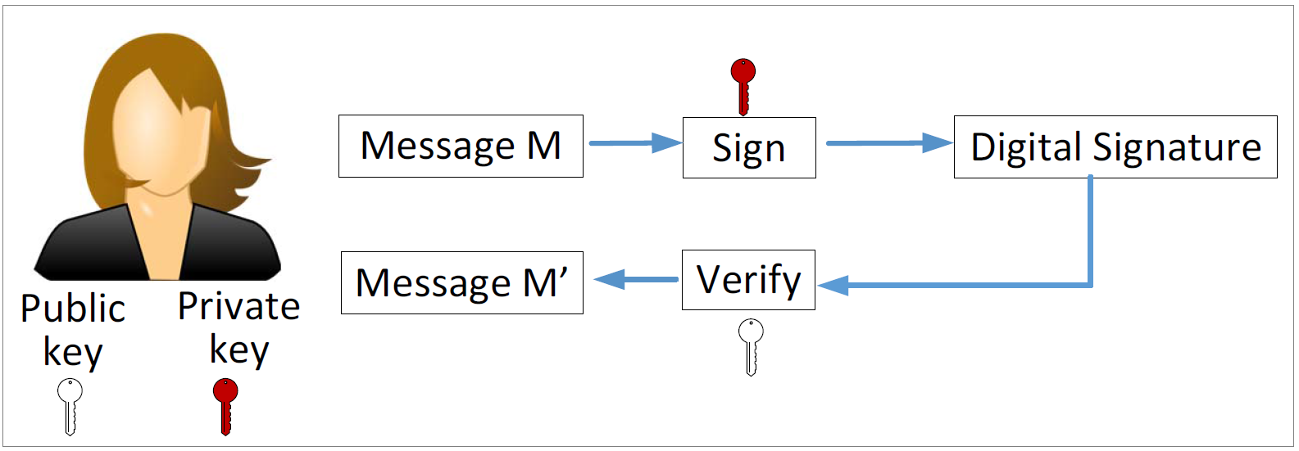
Digital Signature
If the signature is not tampered with, M’ will be the same as M
Only Alice can sign (she has the private key)
Everybody can verify (public key is known publically)

Slide 6
Defeating MITM Attacks using Digital Signature
Alice needs to go to a trusted party to get a certificate.
After verifying Alice’s identity, the trusted party issues a certificate with Alice’s name and her public key.
Alice sends the entire certificate to Bob.
Bob verifies the certificate using the trusted party’s public key.
Bob now knows the true owner of a public key.

Slide 7
Public Key Infrastructure
Certificate Authority (CA): a trusted party, responsible for verifying the identity of users, and then bind the verified identity to a public keys.
Digital Certificates: A document certifying that the public key included inside does belong to the identity described in the document.
  X.509 standard

Slide 8
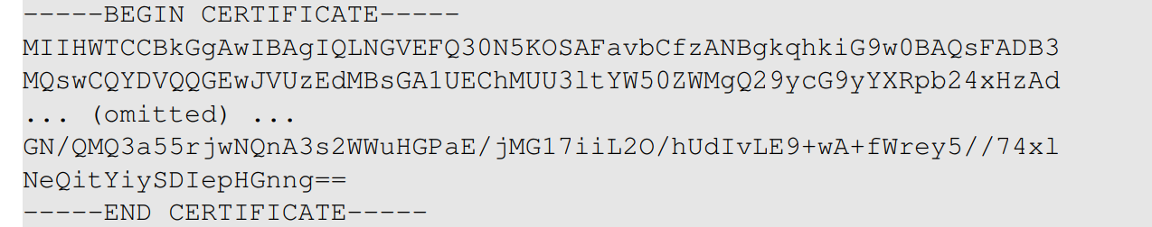
Digital Certificate
Let’s get paypal’s certificates
Save the above data to paypal.pem, and use the following command decode it (see next slide)
Notes:
An Actual X.509 certificate contains binary data. Therefore when stored in files, X.509 certificates use encoders.
A common scheme used here is Base64 encoder and are usually saved in a file with PEM extension (Privacy Enhanced Mail)
We can copy and paste the content into a file (paypal.pem) and run another openssl command to decode it.
The following commands decodes it to raw binary data, but we cannot view it using a text editor. We should use something like ghex :
Openssl x509 –in paypal.pem –outform der > paypal.der
The best way to view an X.509 certificate it to convert PEM to text :
openssl x509 –in paypal.pem –text -noout

Slide 9
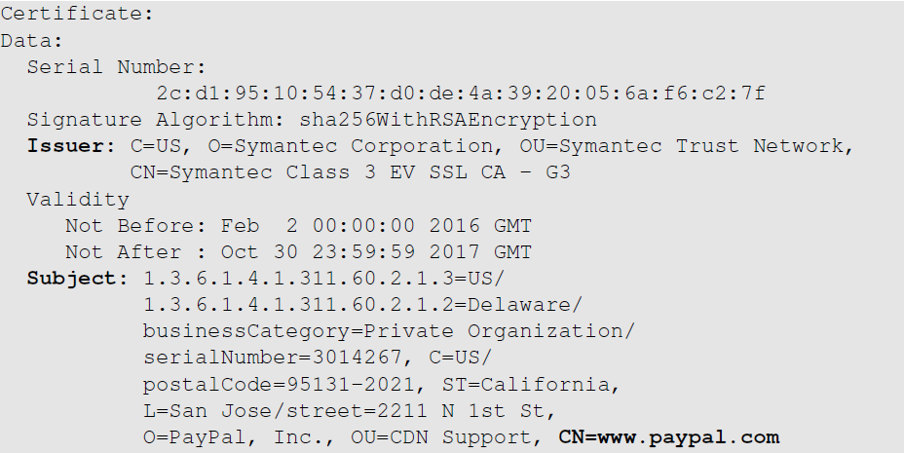
Example of X.509 Certificate (1st Part)
The CA’s identity
(Symantec)
The owner of the certificate
(paypal)

Slide 10
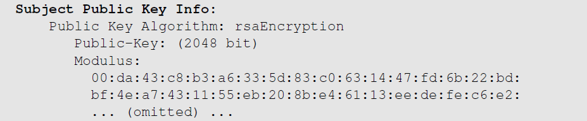
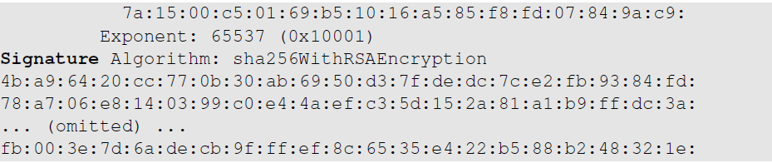
Example of X.509 Certificate (2nd Part)
Public key
CA’s signature

Slide 11
The Core Functionalities of CA
Verify the subject
  Ensure that the person applying for the certificate either owns or represents the identity in the subject field.
Signing digital certificates
  CA generates a digital signature for the certificate using its private key.
  Once the signature is applied, the certificate cannot be modified.
  Signatures can be verified by anyone with the CA’s public key.
Notes:
Verify the subject
CA needs to check whether the application owns the domain or not
For example applicant wants to get a certificate for www.example.com to verify whether the applicant owns the domain or not, the CA may give the applicant a randomly generated number and ask the applicant to put it on the website http://www.example.com/proof.txt
If the applicant is able to do that, the domain ownership will be verified
Some of the verification can be done using online sources such as WHOIS etc
Not all information is available online, therefore sometimes legal experts or authorities, such as lawyers and government officials may be involved

Slide 12
Being a Certificate Authority
Let’s go through the process
  How a CA issues certificates
  How to get a certificate from a CA
  How to set up a web server using a certificate
Notes:
Scenario:
A bank needs a X.509 certificate and it will have to go to a CA. We will use ModelCA to refer to this CA in our emulation.

Slide 13
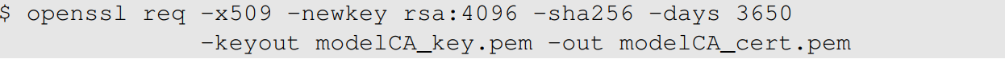
CA Setup
Our CA will be called ModelCA
We need to set up the following for ModelCA:
  Generate public/private key pair
  Create a X.509 certificate (who is going to sign it?)
  We assume ModelCA is a root CA, so it is going to sign the certificate itself, i.e. self-signed.
The following command generates a self-signed X.509 certificate

Slide 14
Discussion Question
Question: If the ModelCA’s certificate is self-signed, how do we verify it?
Answer: There is no way to verify it. We just make sure that the certificate is obtained in a trusted way
  Come with the operating system (if we trust OS, we trust the cert.)
  Come with the software (if we trust the software, we trust the cert.)
  Manually added (if we trust our own decision, we trust the cert.)
  Sent to us by somebody whom we don’t trust (don’t trust the cert.)

Slide 15
Get a Certificate from CA: Step 1
Step 1: Generate a public/private key pair
RSA key size
Encrypt the ouput file using AES (128-bit)
Contains both private and public keys

Slide 16
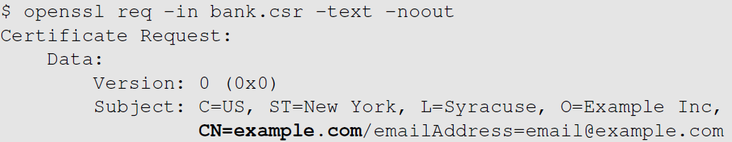
Get a Certificate from CA: Step 2
Step 2: Generate a certificate signing request (CSR); identity information needs to be provided
CA will verify this subject information
Notes:
It should be noted that the signature in the request is generated by the requesters using its own private key
The purpose of this signature is to prevent an entity from requesting a bogus certificate of someone else’s public key

Slide 17
CA: Issuing X.509 Certificate
We (the bank) need to send the CSR file to ModelCA.
ModelCA will verify that we are the actual owner of (or can represent) the identity specified in the CSR file.
If the verification is successful, ModelCA issues a certificate
The CSR file
The X.509 certificate will be saved here
ModelCA’s self-signed certificate
ModelCA’s private key
Notes:
In the real world, the bank would submit its CSR file to a CA, who will issue a signed certificate after verifying the information in the CSR
If openssl refusesd to generate certificates, it is very likely that some of the fields in the request do not match with those of the CA
Matching rules are specified in /usr/lib/ssl/openssl.cnf
By default we see “policy=policy_match”
We can change it to “policy=policy_anything”

Slide 18
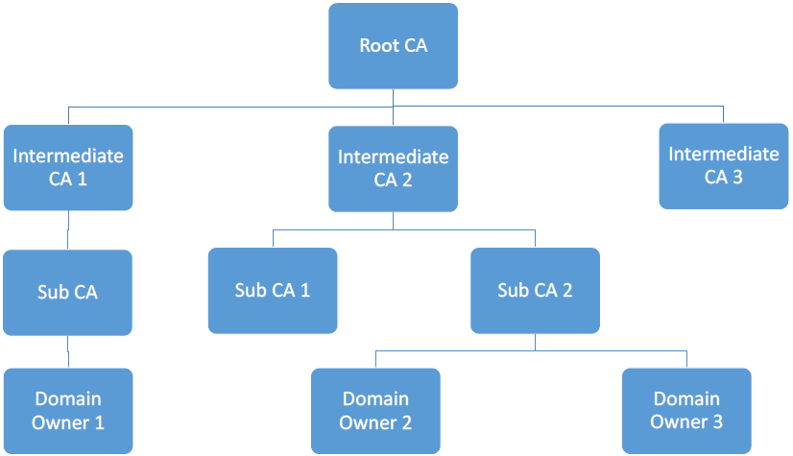
Root and Intermediate Certificate Authorities
There are many CAs in the real world, and they are organized in a hierarchical structure.

Slide 19
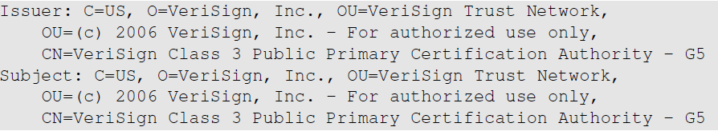
Root CAs and Self-Signed Certificate
A root CA’s public key is also stored in an X.509 certificate. It is self-signed.
Self-signed: the entries for the issuer and the subject are identical.
How can they be trusted?
  Public keys of root CAs are pre-installed in the OS, browsers and other software
Same
Notes:
As long as we trust the software, we are trusting the public keys that come with it.

Slide 20
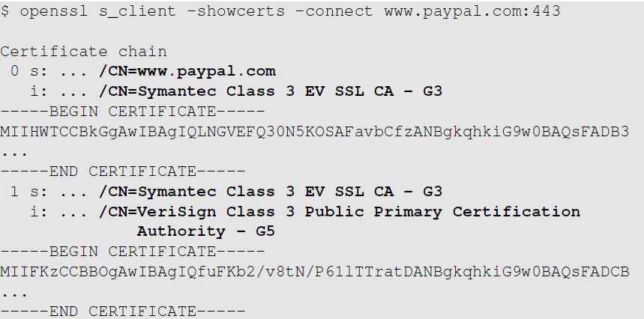
Intermediate CAs and Chain of Trust
Paypal’s certificate
B
A is used to verify B
Intermediate CA’s certificate
A
Something else is need to verify A (certificate from another intermediate CA or root CA)
Notes:
Root CA vouches for intermediate CA
Intermediate CA can then issue certificate for other users.
In the figure,
Certificate chain is obtained from Paypal:
It contains two certificates. First one payapal’s certificate, issued by a CA called “Symantec Class 3 EV SSL CA –G3”
This is an intermediate CA which is certified by another CA “VeriSign Class 3 Public Primary CA G5”
VeriSign-G5 is the root CA

Slide 21
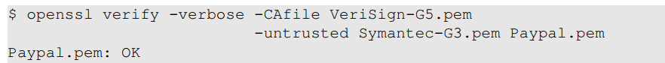
Manually Verifying a Certificate Chain
Paypal.pem: Save Paypal’s certificate to a file called
Symatec-g3.pem: Save certificate from “Symantec Class 3 EV SSL CA – G3”
VeriSign-G5.pem: Save the VeriSign-G5’s certificate from the browser
Root CA’s certificate
Chain of certificates
Notes:
In the command used, the untrusted option provides a certificate chain, the last of which has to be the domain server’s certificate
The CAfile option specifies a trusted CA
If everything works fine, an OK will be printed out

Slide 22
How PKI Defeats the MITM Attack
Assume that Alice wants to visit https://example.com
When the server sends its public key to Alice, an attacker intercepts the communication. The attacker can do the following things:
  Attacker forwards the authentic certificate from example.com
  Attacker creates a fake certificate
  Attacker sends his/her own certificate to Alice

Slide 23
Attacker Forwards the Authentic Certificate
Attacker (Mike) forwards the authentic certificate
Alice sends to the server a secret, encrypted using the public key.
The secret is used for establishing an encrypted channel between Alice and server
Mike doesn’t know the corresponding private key, so he cannot find the secret.
Mike can’t do much to the communication, except for DoS.
MITM attack fails.

Slide 24
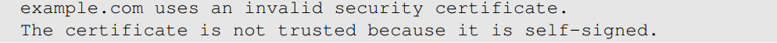
Attacker Creates a Fake Certificate
Attacker (Mike) creates fraudulent certificate for the example.com domain.
Mike replaces the server’s public with his own public key.
Trusted CAs will not sign Mike’s certificate request as he does not own example.com.
Mike can sign the fraudulent certificate by himself and create a self-signed certificate.
Alice’s browser will not find any trusted certificate to verify the received certificate and will give the following warning:
MITM attack fails if the user decide to terminate the connection
Notes:
Attacker has to compromise a CA to get a valid signature; this is not easy.
The attack will be successful if the user ignores the warnings and continues.

Slide 25
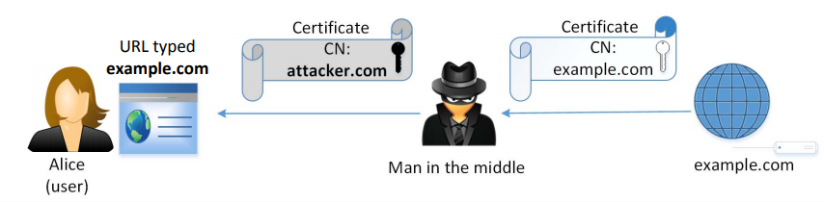
Attacker Sends His/Her Own Certificate
Attacker’s certificate is valid.
Browser checks if the identity specified in the subject field of the certificate matches the Alice’s intent.
  There is a mismatch: attacker.com ≠ example.com
Browser terminates handshake protocol: MITM fails

