Slide 1
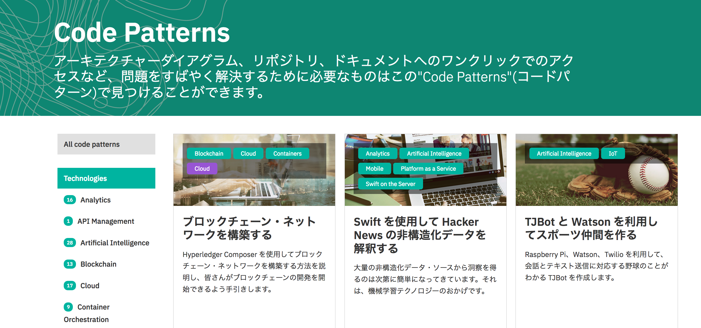
https://ibm.biz/ibmcodejp

