Slide 1
SERC, FIRST SURVEY (~2014)
DECOMPOSITION … there are three degrees of decay distinguished for the deadwood measured:
“H”value – hard: the species is still recognizable, the stem usually still has bark (not necessarily) and relatively healthy and hard wood (still hard woody biomass is the main distinctive feature). → 1 (?)
“T”value – touchwood: the species can usually still be identified, the wood is not compact any more along the entire stem length with the core or outer mantle subjected to rot. Touchwood is relatively widely defined class, in practice everything that does not belong to ‘hard’ neither ‘disintegrated’ class. → 2 (?)
“D” value – disintegrated: the wood is at a stage of advanced rot, the species cannot be identified any more, a kick into a stem results in stem breakage, there are often just “little graves” with the patchy vegetation. Note: When the disintegrated deadwood lost the cylindrical shape, the diameters are estimated only if it is the first census of the deadwood. In case of re-measurement, the diameters of the previous census are used. The deadwood length is always (re)calculated (from re-measured bottom and top coordinates). → 3 (?)
If one stem or fragment exhibits more degrees of decay, the predominant decay degree is decisive.

Slide 2
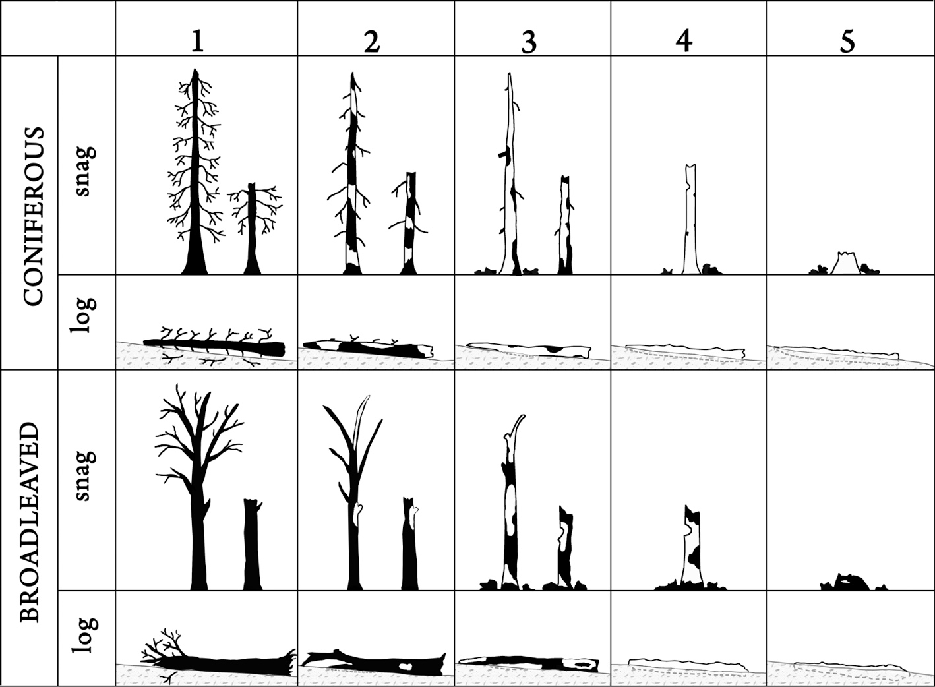
SERC, SECOND SURVEY (~2017)
Fig. 2. Decay classes for standing and fallen coniferous and broadleaved trees. For decay classes 1, 2 and 3, the left snag is ‘Complete’ and the right snag is ‘Fragmented’. The fragmented stem would be joined by a piece of log on the ground somewhere. When individual pieces of deadwood appear to have characteristics of two decay classes, the class should be determined based on the closest fit to the descriptions.

Slide 3
SERC, SECOND SURVEY (~2017)
Snag Decay class (SDC, Fig. 2) – this field is a numeric integer value with a foreign key to the snag decay class table (containing the definitions). Maintained in Snag table.
1- Freshly dead (0-5 years for many species); branches of 3rd order are present; the full height of stem is present unless there was damage prior to the mortality event or caused during the mortality event; fully barked (usually ≥80 % of stem surface); usually trees that died from suppression, bark beetle outbreak (coniferous), fungal infection (broadleaved), or those killed but not burned by fire. The species is still recognizable;
2- Branches of the first order are present; full tree height unless there was damage prior to or during the mortality event; partly barked (usually <80 % of stem surface; broadleaved trees should be still fully barked); the species can usually still be identified;
3- Only short basal rests of main branches; full height unless there was damage prior to the mortality event; bark missing or absent (usually ≤ 20 % of stem surface) in the case of coniferous;
4- No branches or small basal rests; height ≤80 % of even height curve (according to DBH); bark missing or absent (usually ≤20 % of stem surface) in the case of coniferous;
5- Stumps or short snags; the wood is at a stage of advanced rot.

Slide 4
SERC, SECOND SURVEY (~2017)
Log Decay Classes - There are five degrees of decomposition distinguished for standing and down deadwood, illustrated separately for coniferous and broadleaved tree species (Fig. 2). Decay class is recorded in the Log Table.
1- Freshly fallen tree (usually windthrow or a basal rot); texture – wood intact; branches of 2nd order are attached; fully barked (usually ≥80% of stem surface); species is still recognizable;
2- Texture – wood intact to partly hard or soft; branches of first order are partly attached; partly barked; the species can usually still be identified;
3- Texture – wood hard but in large pieces; the wood is not compact any more along the entire stem length with the core or outer mantle subjected to rot. The genus can often be recognized, but species identification is difficult;
4- Texture – wood chunks small, soft, and blocky; the wood is not compact and the cross-section is either elliptical or circular;
5- The wood is at a stage of advanced rot; texture – wood chunks soft and powdery; deadwood no longer has a cylindrical shape; the species cannot be identified any more, a kick into a stem results in stem breakage, there are often just “little graves” with the patchy vegetation.

