Slide 1
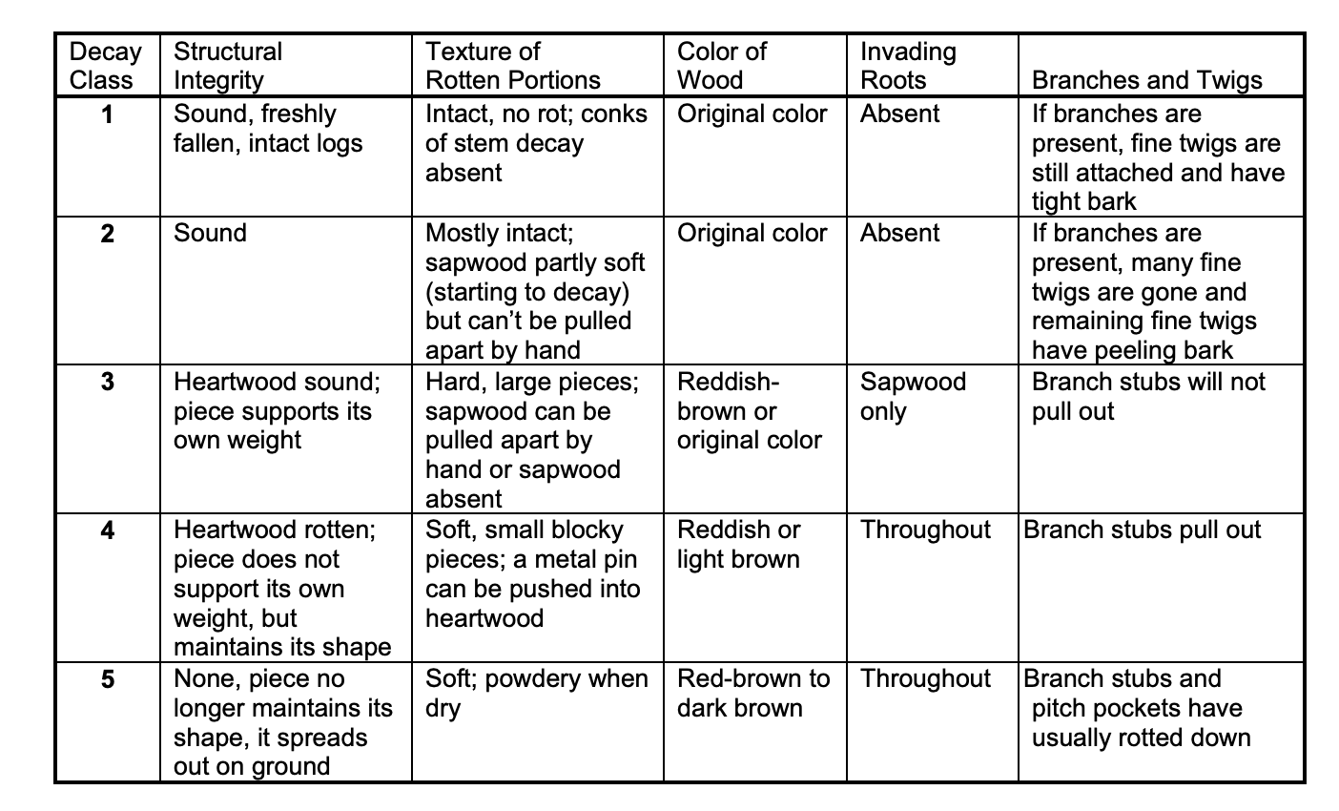
dw protocols
FIA: use 5 tier system (developed based on doug fir)

Slide 2
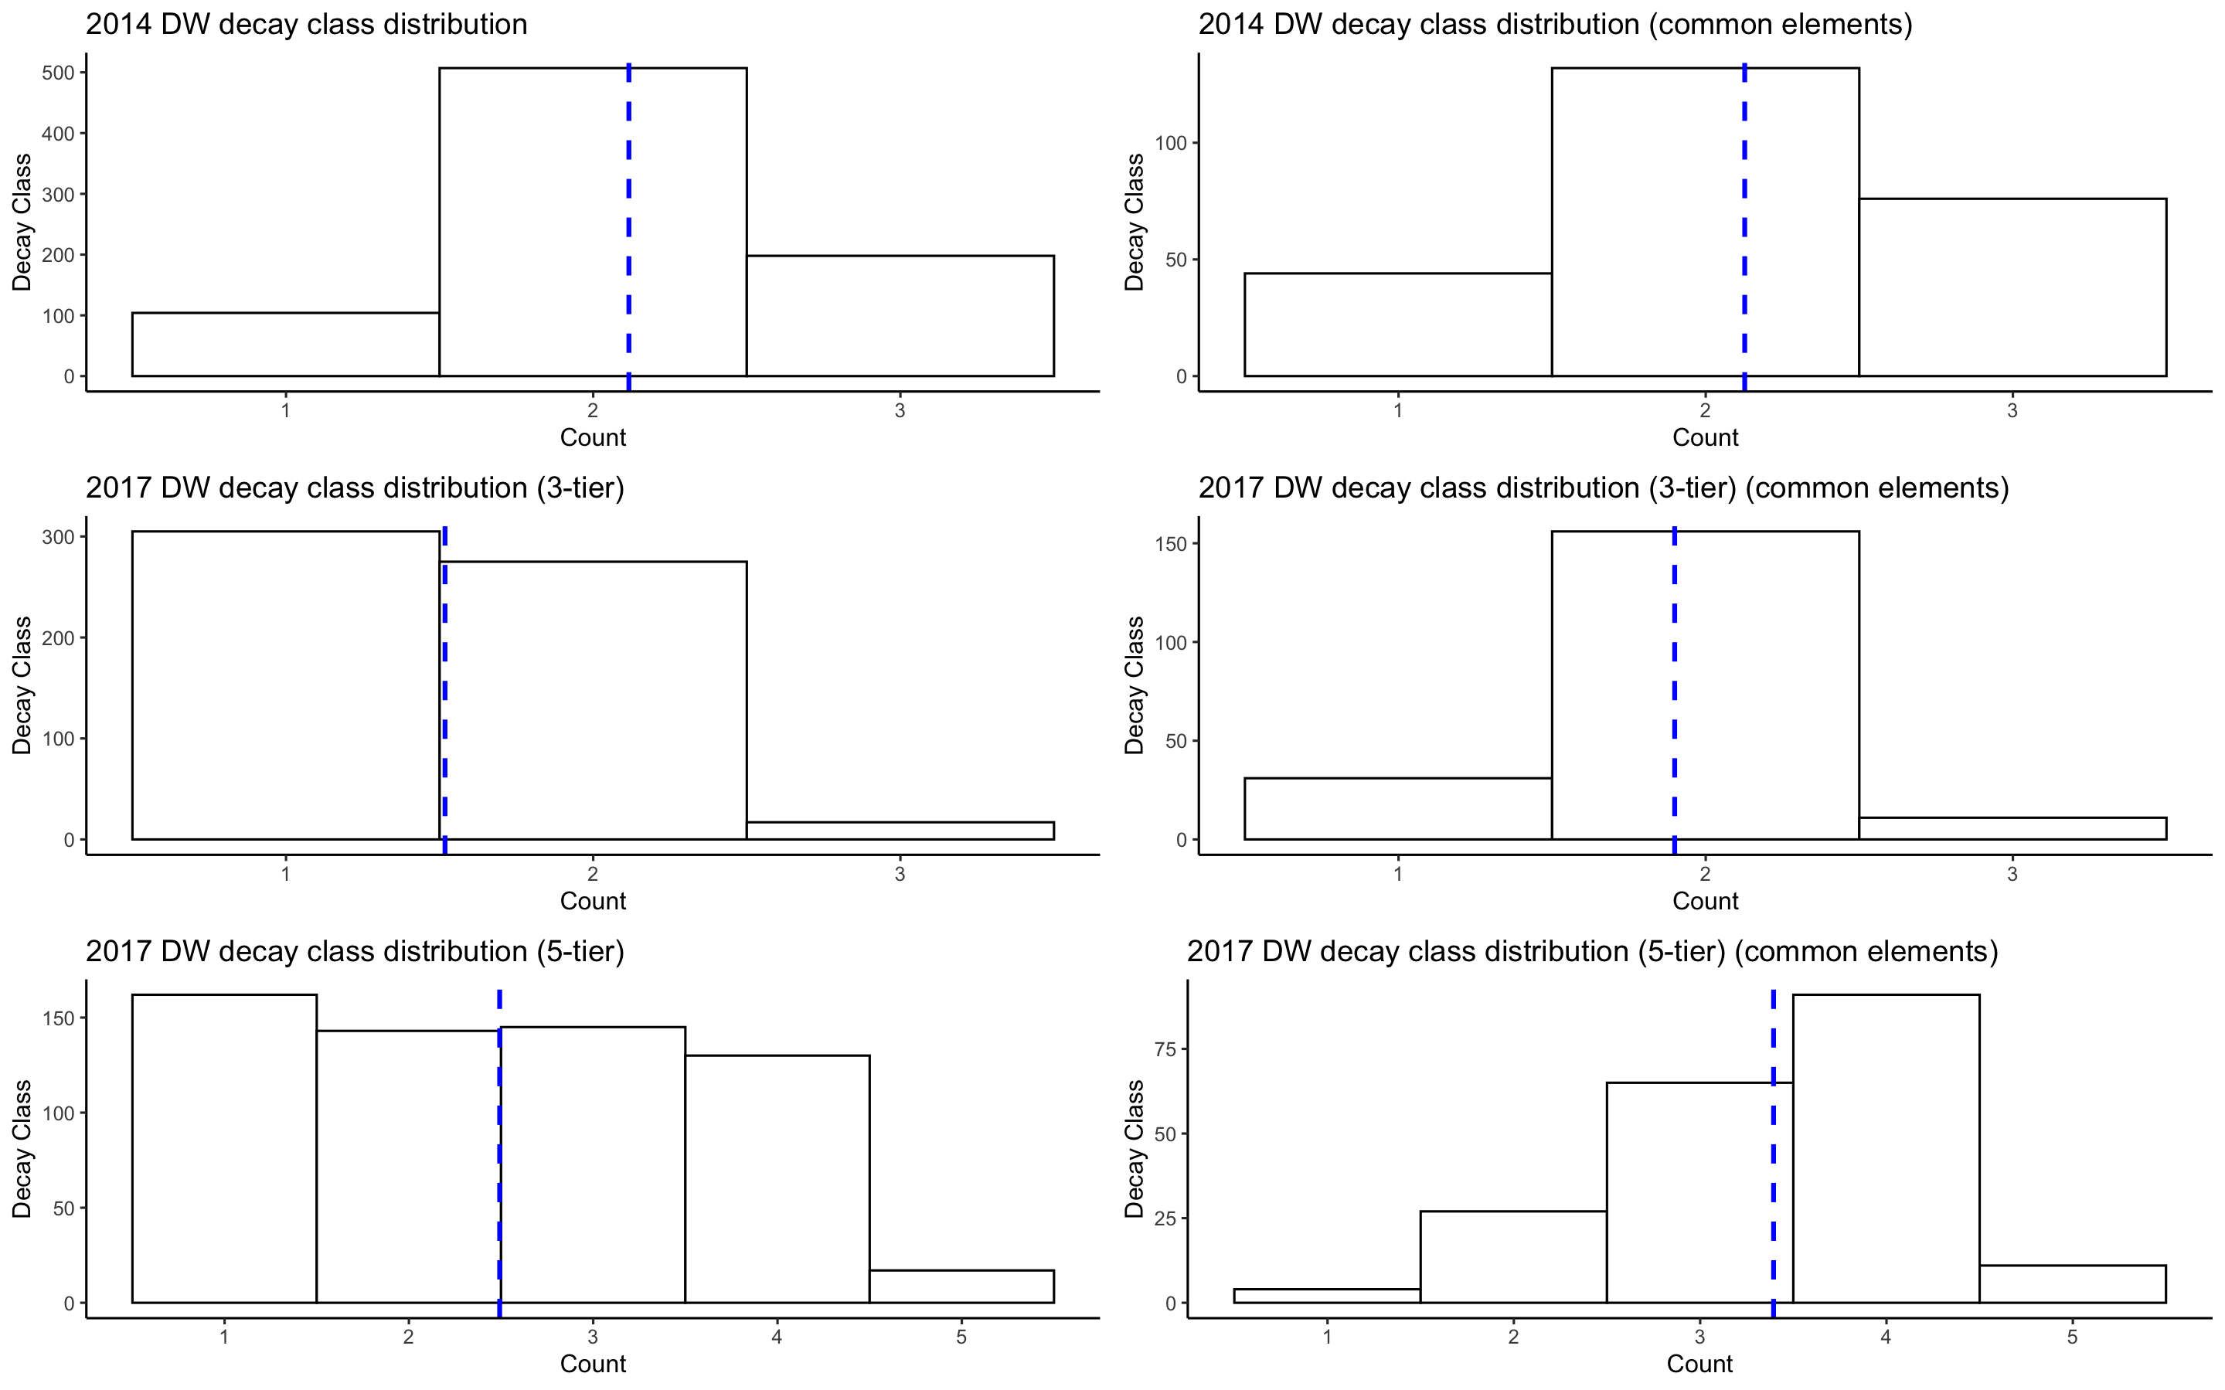
Notes:
2017 DW decay class 3 tier – look into species for decay class 1 (more ash? Represent EAB activity?) --> ‘new recruit class’
Using first survey – to record if 2014ers were alive in ‘08-’11

Slide 3
tagpiece
Not all 2017 pieces are tagged down to the piece specificity that is recorded in 2014
Makes sense because there are more elements in 2014 compared to 2017
This means that the stem tag ids match, but there are more individual pieces allocated to 2014
Notes:
Chris woodall – suggestions (possibly consult)
“That’s the way the forest crumbles!”
Coords, species, size class → alternative ways to visualize what is going on

Slide 4
questions
Follow only ‘a’ pieces between the 2014 – 2017 surveys?
Don’t leave out the Bs and Cs (if possible) → important info for decay rate and size
How to compare / graphically represent decay class changes between the two years
Time series?
Notes:
Decay class shift – 3x3 matrix – boxes are percentages of movements between years
For different size classes
Species
Wet v dry (moisture availability)
Reference papers (look into)

