Slide 1
«Програмування та підтримка веб-застосувань»
Львівський національний університет імені Івана Франка
факультет прикладної математики та інформатики
кафедра Інформаційних систем
Огляд курсу. Огляд Front-end розробки.
Вовк Олександр Володимирович
vovk@windowslive.com
2022

Slide 2
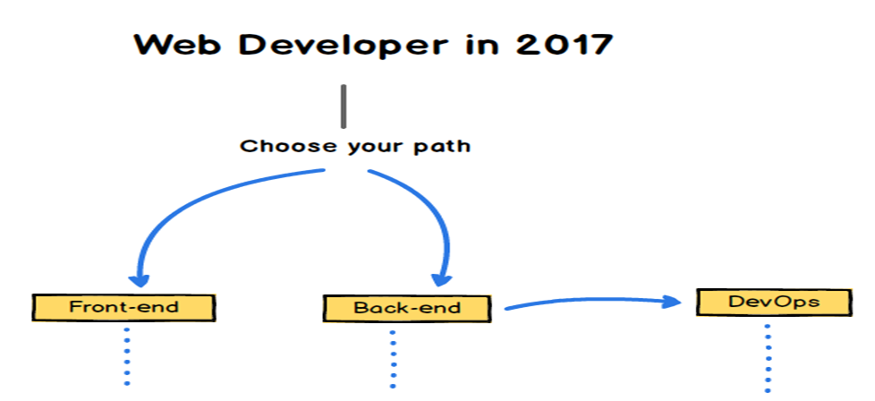
Web Developer Overview
medium.freecodecamp.org
Notes:
Front-End vs Back-End vs Full Stack
http://blog.udacity.com/2014/12/front-end-vs-back-end-vs-full-stack-web-developers.html
MERN is a scaffolding tool which makes it easy to build universal apps using Mongo, Express, React and NodeJS. It minimises the setup time and gets you up to speed using proven technologies.
http://mern.io
https://angular-fullstack.github.io/get-started/
MEAN is an opinionated fullstack javascript framework - which simplifies and accelerates web application development.
http://mean.io/
MEAN.JS is a full-stack JavaScript solution that helps you build fast, robust, and maintainable production web applications using MongoDB, Express, AngularJS, and Node.js.
http://meanjs.org/
The MEAN stack is MongoDB, Express.js, AngularJS (or Angular), and Node.js. Because all components of the MEAN stack support programs are written in JavaScript, MEAN applications can be written in one language for both server-side and client-side execution environments.
https://en.wikipedia.org/wiki/MEAN_(software_bundle)

Slide 3
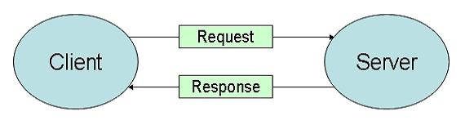
Web Developer Overview
medium.freecodecamp.org

Slide 4
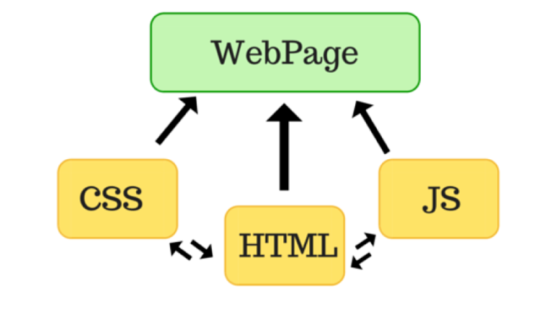
Web Developer Overview
medium.freecodecamp.org
Notes:
Стрімкий розвиток від статичних html сторінок, які містили css
Складно залишатись на вістрі цього розвитку
A Final Note about the Front-End
In order to more fully explain the process of the information’s return — but without going too deep into the mechanisms of the front-end, since they are complex and deserve to be explored in a separate post — we should clarify that there are two “layers” that comprise the front-end:
One layer is directly related to the OS in which our app has been developed. The nature of this part is logical, and it is in charge of transforming the language of the data delivered from the API’s language to that of the specific OS.
The other layer is directly related to the app’s aesthetic design, and which is, by nature, visual. This visual part is the one mentioned at the beginning of this article, the one with which users can see and interact.
The logical layer, although considered a part of the front-end, is not seen by the final user. Very informally, we could call it the “back-end part of the front-end.” But more on that in a future post.

Slide 5
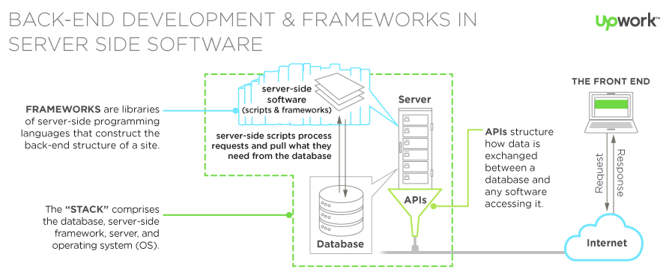
Web Developer Overview
Notes:
http://thinkapps.com/blog/development/basics-back-end-development/
Its job is to
access the information that users require through the app,
combine and transform such information
return the information in its new shape to the requester.

Slide 6
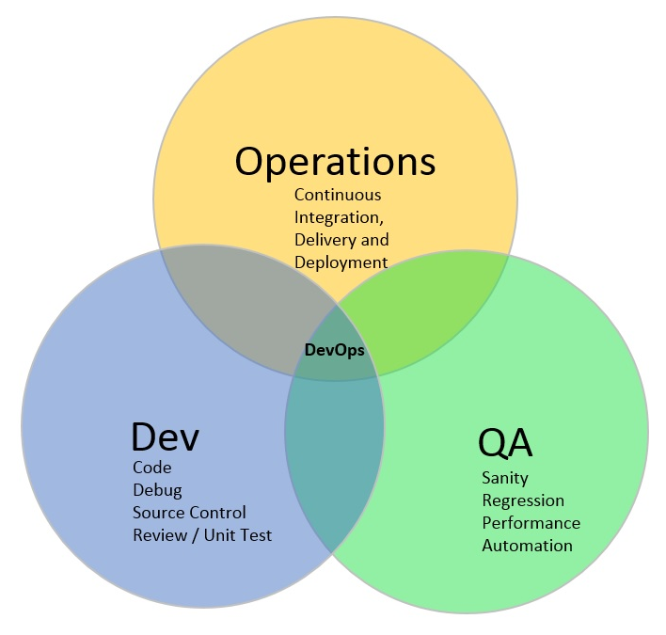
Web Developer Overview
The major benefits of DevOps:
Increased business agility
Reduced time to market cycle
Reduced cost of quality
Increased quality and confidence in code
Increased Productivity
Reduced cost
Increase in customer satisfaction
Increased Application / Product up time
Development (Software Engineering)
Quality Assurance (QA)
Technology Operations
Notes:
Code — разработка и анализ кода, инструменты контроля версий, слияние кода;
Build — инструменты непрерывной интеграции, статус сборки;
Test — инструменты непрерывного тестирования, которые обеспечивают обратную связь по бизнес-рискам;
Пакет — репозиторий артефактов, предварительная установка приложения;
Release — управление изменениями, официальное утверждение выпуска, автоматизация выпуска;
Конфигурация — Конфигурация и управление инфраструктурой, Инфраструктура как инструменты кода;
Мониторинг — мониторинг производительности приложений, опыт работы с конечным пользователем.
Регрессио́нное тести́рование (англ. regression testing, от лат. regressio — движение назад) — собирательное название для всех видов тестирования программного обеспечения, направленных на обнаружение ошибок в уже протестированных участках исходного кода. Такие ошибки — когда после внесения изменений в программу перестаёт работать то, что должно было продолжать работать, — называют регрессионными ошибками
https://www.linkedin.com/pulse/what-devops-how-does-work-subodh-jain
https://www.quora.com/Does-the-concept-of-a-full-stack-engineer-run-counter-to-the-DevOps-culture-mindset
Traditionally, web developer roles were broken into back end (working with databases and server logic) and front end (designing and implementing the user facing components of a web application). A Full Stack Engineer has some level of competence in both. Thanks to powerful web development frameworks like Node.js/Express.js, Ruby on Rails, and Python Django, it's reasonable to expect all web developers to be able to build full apps without assistance from front-end or back-end specialists. For example, I am a full stack engineer, and I touch the front end, the back end, and some aspects of "operations", such as writing scripts to dump my database to Amazon S3. But I am absolutely not a SysAdmin or a DevOps. DevOps and Full Stack Engineers are complementary roles. The DevOps is an expert in bash scripting, using tools like Vagrant, Chef, Docker, and other esoteric infrastructure that is beyond my interest and comprehension. The same can be said for Quality Assurance Engineer roles. Sure, Full Stack Engineers write automated tests. But QA Engineers are experts at finding weaknesses in code. For a startup, you can just use Heroku instead of hiring a DevOps. Your Full Stack Engineers can pile in on a "QA cycle", which obviates the need for dedicated QA Engineer. Your code quality and infrastructure won't be as good, but it's often a worthwhile economic tradeoff. But it would be a mistake to build a large team consisting only of Full Stack Engineers. You would need DevOps and QA Engineers as well. The ratio of QA Engineers to DevOps to full stack engineers also depends on what you're doing. For example, Google's web products divisions might have 10 Full Stack Engineers for every one QA Engineer. They make extensive use of Google App Engine, so they need fewer DevOps (though their App Engine team probably has a ton of DevOps). It's worth pointing out that Google also has dedicated front-end and back-end engineers. At Platform-as-a-Service companies like Heroku, though, I suspect they'd have a much higher ratio of DevOps to Full Stack Engineers.

Slide 7
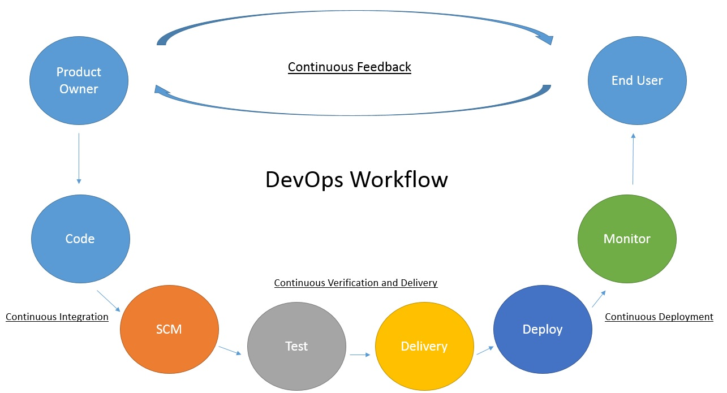
Notes:
https://habr.com/ru/company/piter/blog/343270/
Непрерывная интеграция, непрерывная доставка, непрерывное развертывание: просто матрешка
https://www.linkedin.com/pulse/what-devops-how-does-work-subodh-jain
DevOps is the set of practices which can help organisation to reduce their go to market cycle time by improving and enhancing everything from inception to delivery, if planned properly DevOps can help companies up to 50% of cycle time reduction to their delivery pipeline. DevOps can help companies to release features faster also ensuring the better quality to their customers.
DevOps helps in better co-ordination between the multiple stakeholders mostly categorised as Operations, Development and QA team, Here it can not only helps in better co-ordination and communication between them but also adds better integration and faster development hence enable companies to faster deployment of their products and features with better quality and less bugs.
To understand the concept better we can refer to the below
Automation / Integration which is one of essential feature of DevOps helps companies to achieve continues integration, verification, delivery and deployment thus reduces the go to market time and cost drastically. Use of various tools and practices as part of DevOps also helps companies and teams to be more productive.
---------------
SCM (Source Code Management) – GitHub, GitLab, Bitbucket, Mercurial
Source Code Management (Version Control Systems) are just that, software that provides versioning functionality (Git, Subversion, TFS Version Control) all fall into this category.
Software Configuration Management is a broader term that encompasses all the processes needed to build, package, and deploy software -- this includes Version Control Systems. It does not refer to software per se

Slide 8
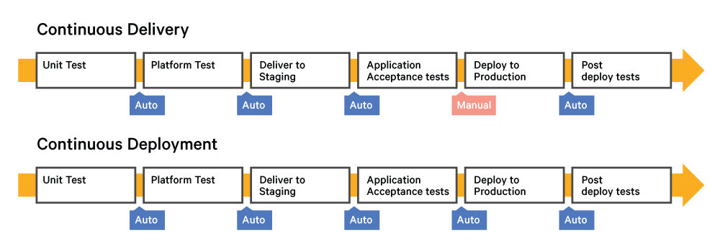
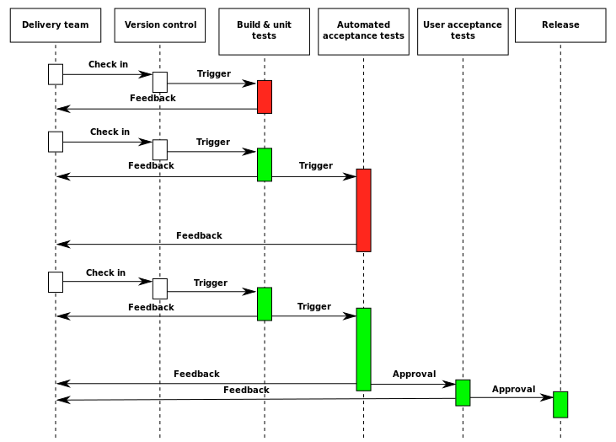
Notes:
Непрерывная интеграция (CI): короткоживущие функциональные ветки, команда сливает их с основной веткой разработки по несколько раз в день, процессы сборки и тестирования полностью автоматизированы, результат имеем в пределах 10 минут; развертывание выполняется вручную.
Непрерывная доставка (CD): автоматизируется CI + весь процесс релиза ПО. Может состоять из нескольких этапов. Развертывание в продакшен выполняется вручную.
Непрерывное развертывание: CI + CD + полностью автоматизированное развертывание в продакшен.

Slide 9
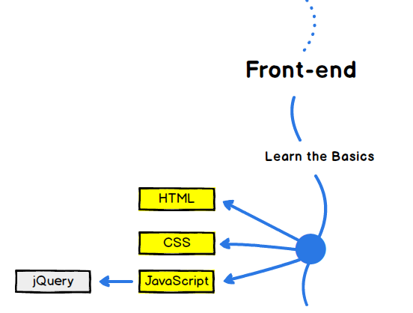
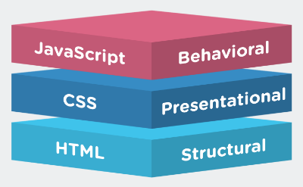
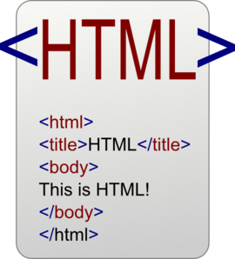
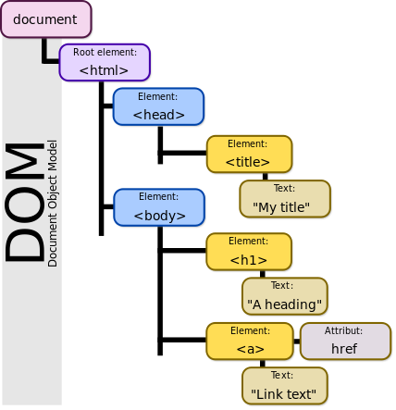
Notes:
https://www.w3schools.com/css/css_syntax.asp

Slide 10
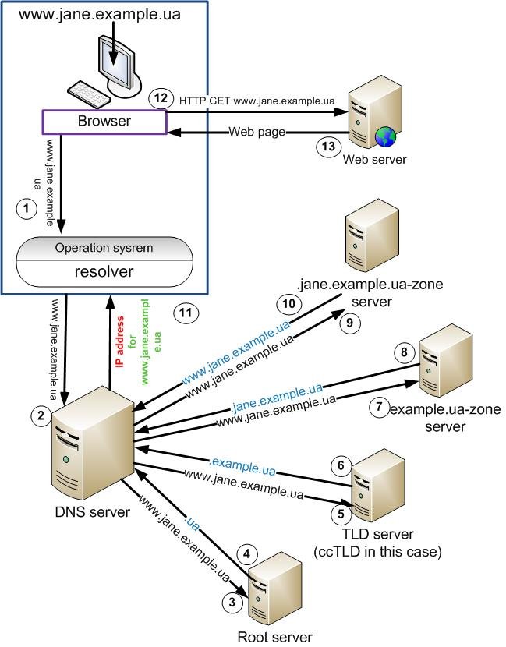
Domain Name System (DNS)
Translates more readily memorized domain names to the numerical IP addresses
Recursive queries
Once you have typed character address in the URL field of your browser, it accesses the function Winsock GetHostByName (if it is a platform win32), which in this case is the DNS resolver.
Resolvers sends recursive query to the local DNS-server that asks to identify IP-address “www. jane.example.ua”
Local server looks whether the content of the database of its own zones of responsibility can provide answer the question . If yes - resolver sends a response.
If not - the local server sends the root DNS-server question about the node “www. jane.example.ua”
Root server actually do not know anything about the hosts and can report only the address of the server responsible for the .ua-zone.
Local server continues to send queries one by one to the servers that are responsible for . ua-zone, .example.ua-zone and finally comes to the server responsible for the .jane.example.ua-zone.
Domain server jane.example.ua finds in its database and returns the required host and sends to local server the IP-address which corresponds to the name.
In the end your browser can use the IP address and show you the desired page.
en.wikiversity.org/wiki/User:Jane_Kruch/DNS:_what_is_it_and_how_it_works
Notes:
http://info.nic.ru/st/14/out_45.shtml
https://pikabu.ru/story/ochen_primernaya_skhema_rabotyi_dns_4351369

Slide 11
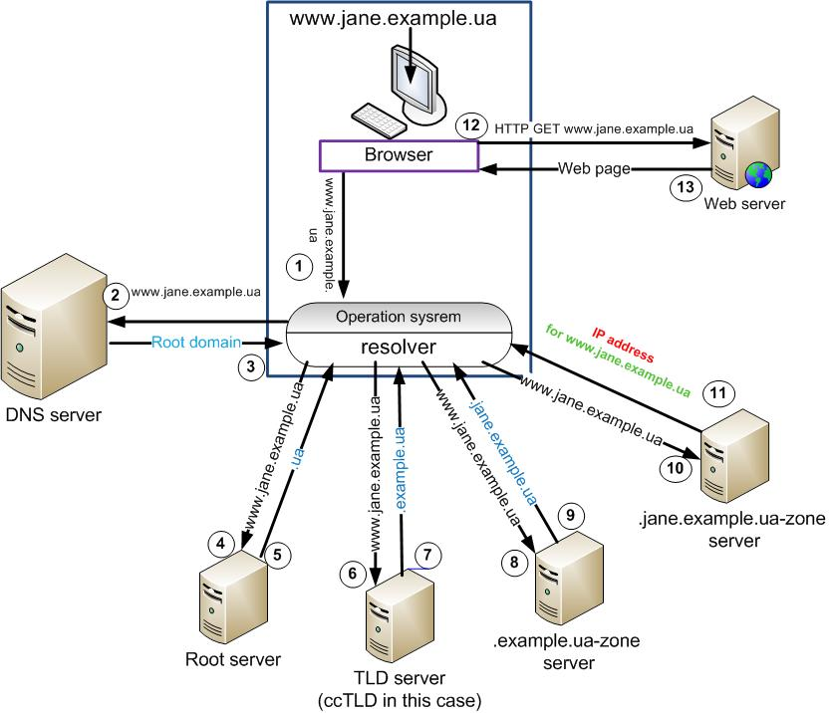
Non-recursive (iterative) queries (DNS)
Once you type the address in the search bar and access the DNS resolver.
DNS resolver sends the query to the locally configured DNS server. The DNS server looks up for “www.jane.example.ua” in its cache and finds, then server sends the answer immediately.
But if there is no answer, server replies that you should send your query to the root-servers.
Resolver sends query to a root-server asking for the IP address for “www.jane.example.ua”.
The root server in its order doesn’t know about the “www.jane.example.ua” and redirects you to the TLD server which in our case is .ua-zone (ccTLD).
After the receiving information from root-server, the resolver sends queries in turn to the .ua-zone, after to .example.ua, then to .jane.example.ua and finally gets the IP address for “www.jane.example.ua” in the last server.
The resolver gets the IP address and can provide your browser with it.
en.wikiversity.org/wiki/User:Jane_Kruch/DNS:_what_is_it_and_how_it_works
Notes:
http://info.nic.ru/st/14/out_45.shtml
https://en.wikiversity.org/wiki/User:Jane_Kruch/DNS:_what_is_it_and_how_it_works

Slide 12
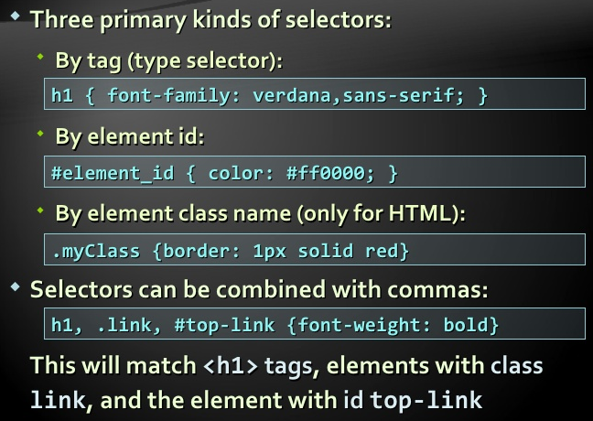
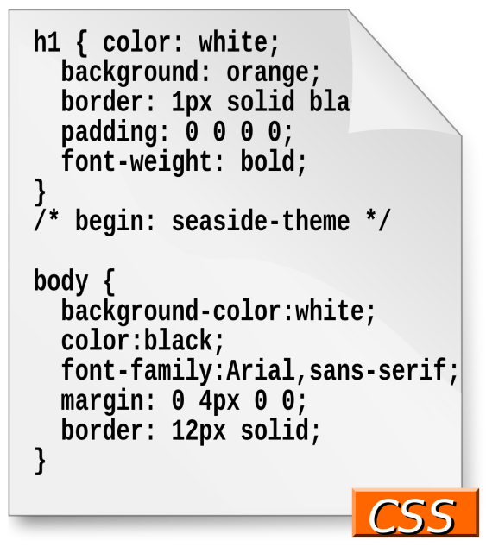
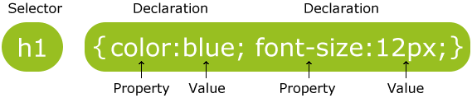
www.w3schools.com/css/css3_intro.asp
Notes:
https://www.w3schools.com/css/css_syntax.asp

Slide 13

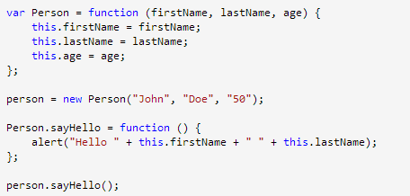

jQuery features:
DOM manipulation − The jQuery made it easy to select DOM elements, traverse them and modifying their content by using cross-browser open source selector engine called Sizzle.
Event handling − The jQuery offers an elegant way to capture a wide variety of events, such as a user clicking on a link, without the need to clutter the HTML code itself with event handlers.
AJAX Support − The jQuery helps you a lot to develop a responsive and feature-rich site using AJAX technology.
Animations − The jQuery comes with plenty of built-in animation effects which you can use in your websites.
Notes:
https://www.w3schools.com/css/css_syntax.asp

Slide 14
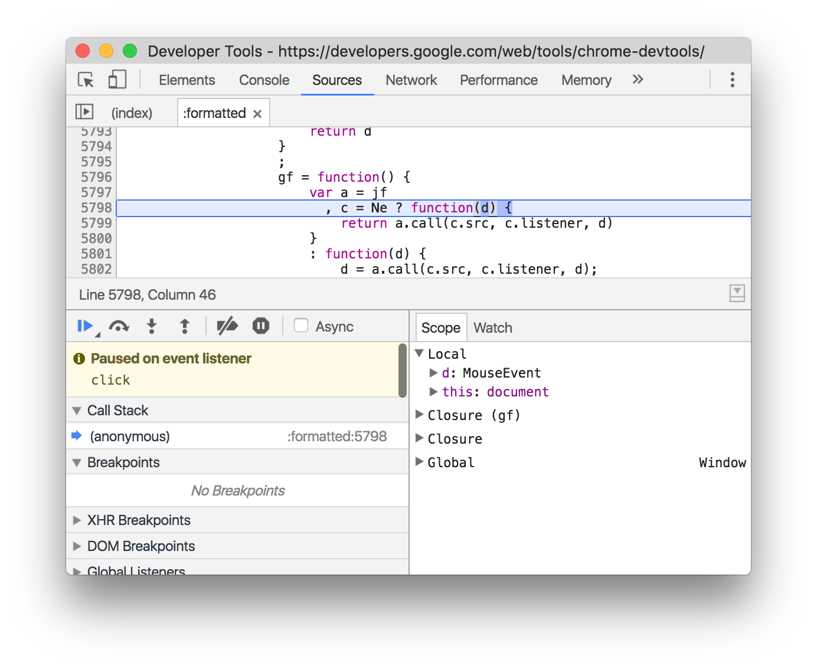
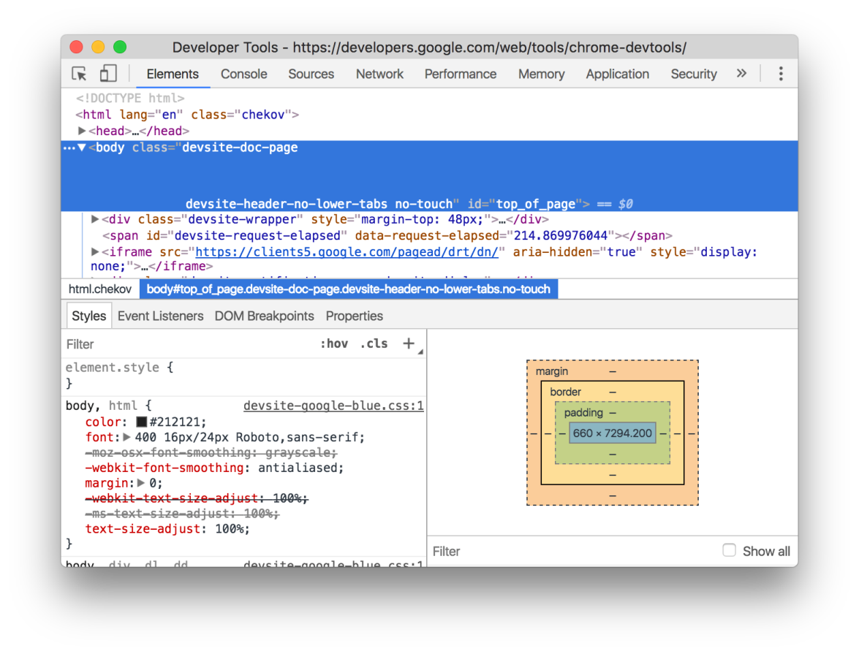
Chrome DevTools (Ctrl+Shift+I)
developers.google.com/web/tools/chrome-devtools
Sources panel
Debug your JavaScript using breakpoints or connect your local files via Workspaces to use DevTools as a code editor.
Elements panel
Iterate on the layout and design of your site by freely manipulating the DOM and CSS.
Notes:
http://inspirationalpixels.com/tutorials/creating-an-accordion-with-html-css-jquery

Slide 15
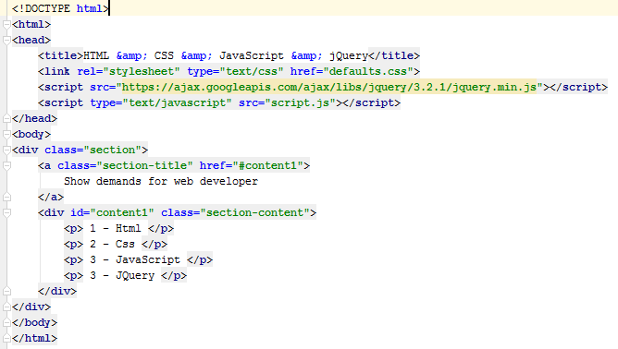

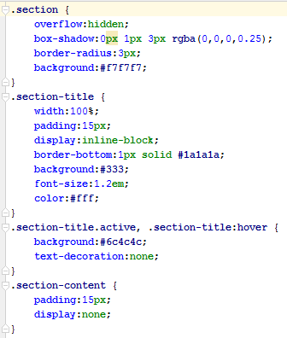
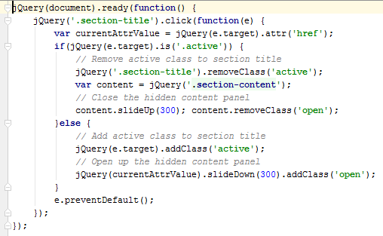
Preview
Notes:
http://inspirationalpixels.com/tutorials/creating-an-accordion-with-html-css-jquery

Slide 16
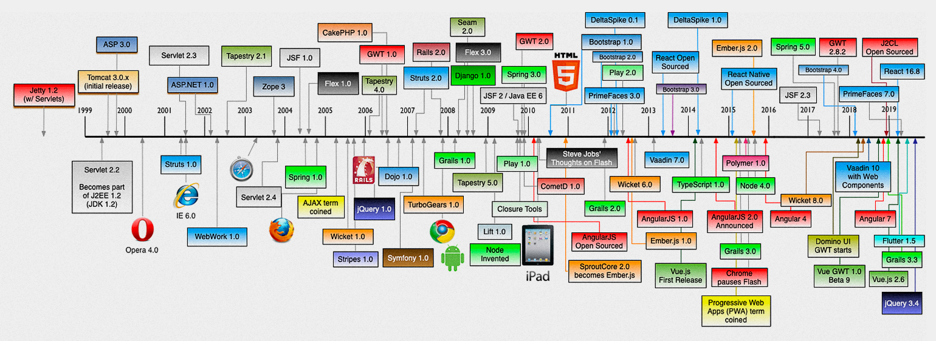
Web Timeline

Slide 17
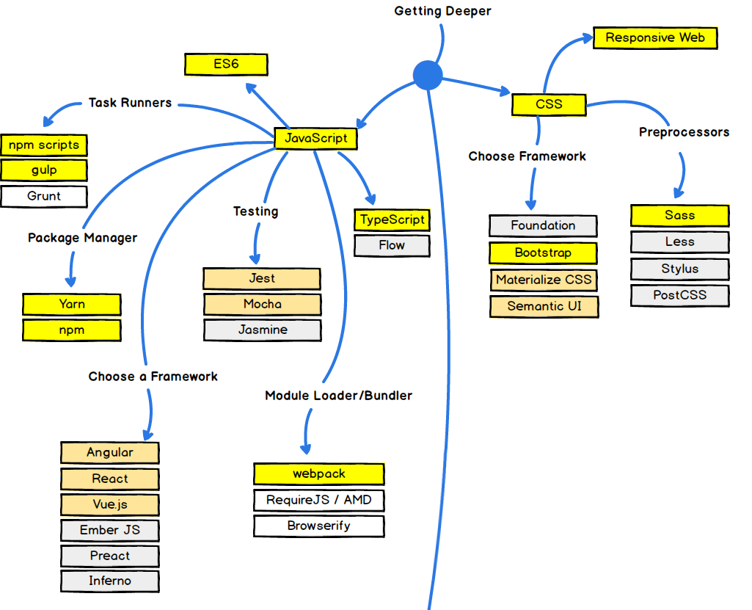
Qooxdoo
CreateJS
medium.freecodecamp.org
Notes:
https://learn.javascript.ru/screencast/webpack

Slide 18
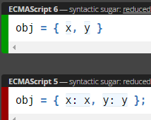
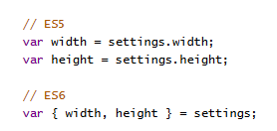
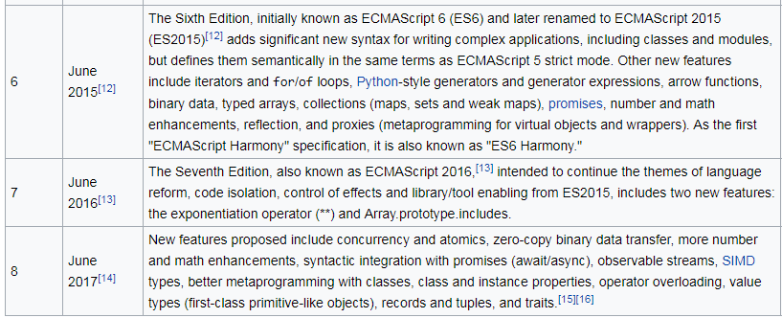
New Features: Overview & Comparison:
es6-features.org
ECMAScript:
www.ecma-international.org
en.wikipedia.org/wiki/ECMAScript
Notes:
jQuery
https://www.tutorialspoint.com/jquery/jquery-overview.htm

Slide 19
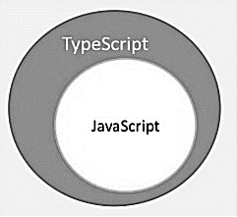
Features of TypeScript (www.typescriptlang.org):
TypeScript is just JavaScript. Typescript adopts the basic building blocks of your program from JavaScript. Hence, you only need to know JavaScript to use TypeScript. All TypeScript code is converted into its JavaScript equivalent.
TypeScript supports other JS libraries. TypeScript-generated JavaScript can reuse all of the existing JavaScript frameworks, tools, and libraries.
JavaScript is TypeScript. This means that any valid .js file can be compiled with other TypeScript files.
TypeScript is portable. TypeScript is portable across browsers, devices, and operating systems.
Benefits of TypeScript:
Compilation − JavaScript is an interpreted language. Hence, it needs to be run to test that it is valid. Hence, you have to spend hours trying to find bugs in the code. The TypeScript transpiler provides the error-checking feature. TypeScript will compile the code and generate compilation errors.
Strong Static Typing − JavaScript is not strongly typed. TypeScript comes with an optional static typing and type inference system through the TLS (TypeScript Language Service). The type of a variable, declared with no type, may be inferred by the TLS based on its value.
TypeScript supports type definitions for existing JavaScript libraries. TypeScript Definition file (with .d.ts extension) provides definition for external JavaScript libraries. Hence, TypeScript code can contain these libraries.
TypeScript supports Object Oriented Programming concepts like classes, interfaces, inheritance, etc.

Slide 20

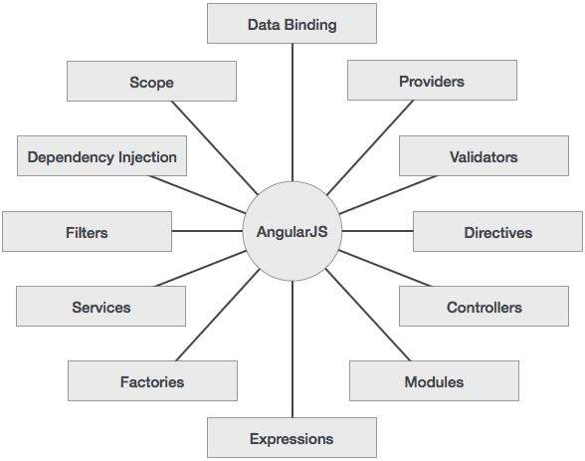
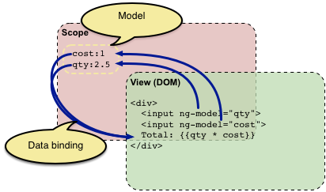

Some features of AngularJS (www.angularjs.org):
Data-binding − It is the automatic synchronization of data between model and view components.
Controller − These are JavaScript functions that are bound to a particular scope.
Directives − Directives are markers on DOM elements (such as elements, attributes, css, and more). These can be used to create custom HTML tags that serve as new, custom widgets. AngularJS has built-in directives (ngBind, ngModel...)
Templates − These are the rendered view with information from the controller and model. These can be a single file (like index.html) or multiple views in one page using "partials".
MVC (Model, View and Controller). AngularJS does not implement MVC in the traditional sense, but rather something closer to MVVM (Model-View-ViewModel).
Notes:
https://docs.angularjs.org/guide/concepts
https://www.tutorialspoint.com/angularjs/angularjs_overview.htm
AngularJS is a structural framework for dynamic web apps. It lets you use HTML as your template language and lets you extend HTML's syntax to express your application's components clearly and succinctly. Angular's data binding and dependency injection eliminate much of the code you currently have to write. And it all happens within the browser, making it an ideal partner with any server technology.

Slide 21
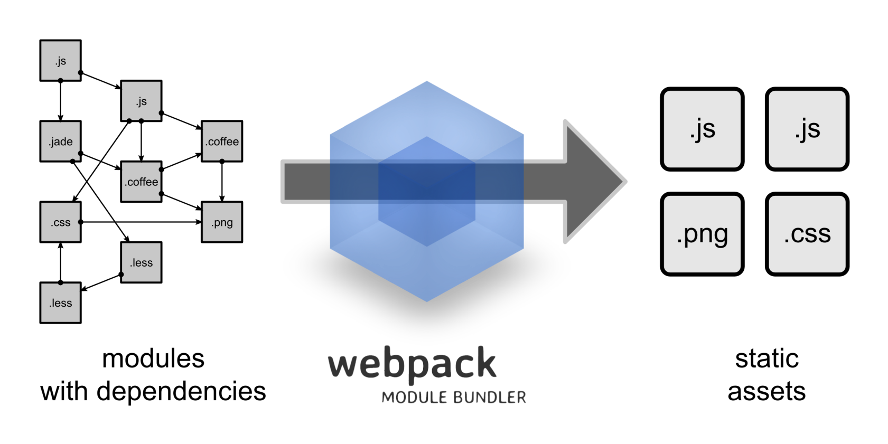
Two basic principles of webpack (webpack.js.org):
With Webpack, everything can be a module. This includes JS files, CSS, images, and HTML. Consequently, any artifact may be divided into small, manageable chunks for reuse.
Webpack only loads what you need when you need it. Other module bundlers typically combine all of the modules to generate a single, large bundle.js file. Such files can be as large as 15MB for dynamic web apps, which will take ages to load. In contrast, Webpack generates several smaller “bundle” files, which allows it to load parts of an app asynchronously. Therefore, users don’t have to wait for unnecessarily long load times to start using the app.
Notes:
https://www.keycdn.com/blog/webpack/
https://learn.javascript.ru/screencast/webpack
http://browserify.org/

Slide 22
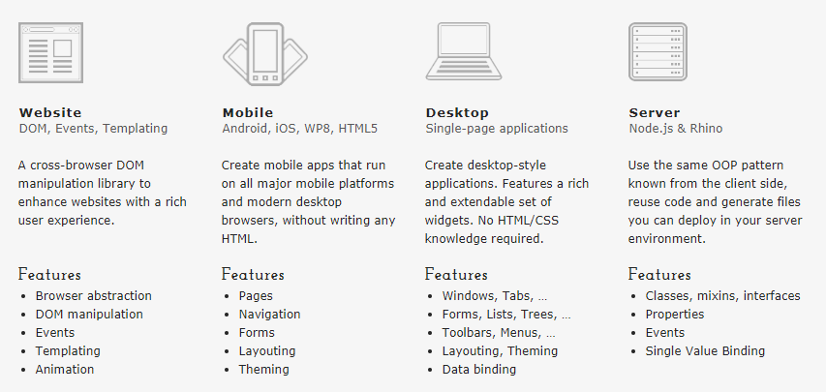
Qooxdoo (www.qooxdoo.org)

Slide 23
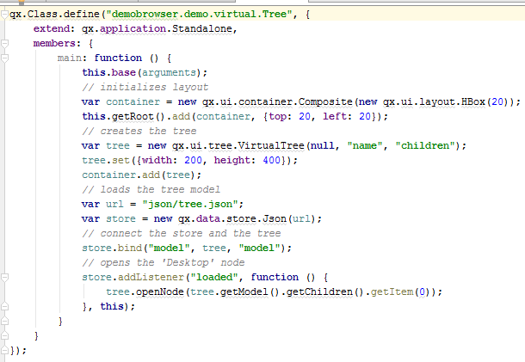
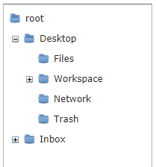
Qooxdoo. Tree Example.
(www.qooxdoo.org/current/demobrowser/#virtual~Tree.html)

Slide 24
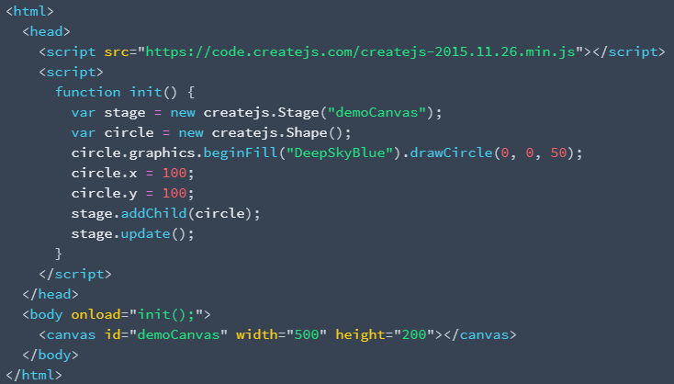

CreateJS (createjs.com). Html 5. Canvas.

Slide 25
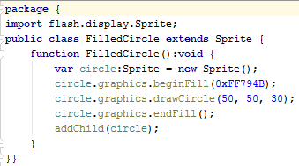
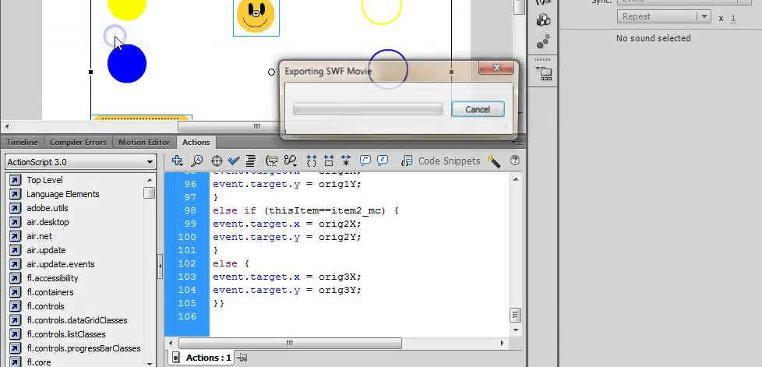
Adobe Flash. ActionScript 3.0
www.adobe.com/
devnet/actionscript.html,
help.adobe.com/
en_US/as3/dev/as3_devguide.pdf

Slide 26
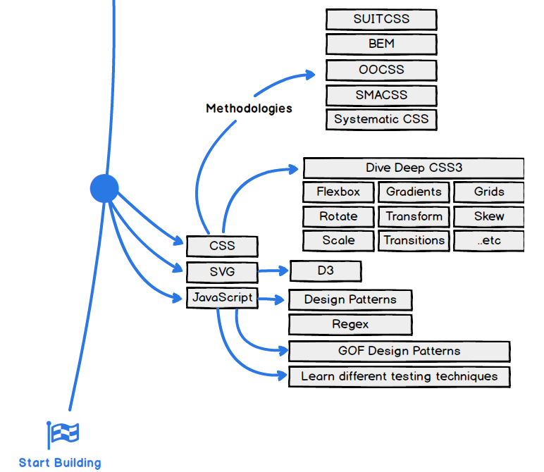
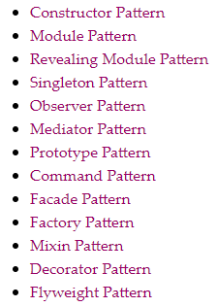
Addy Osmani. Learning JavaScript Design Patterns. 2015

Slide 27
Самостійне опрацювання:
Література та ресурси:

