Slide 1
«Програмування та підтримка веб-застосувань»
Львівський національний університет імені Івана Франка
факультет прикладної математики та інформатики
кафедра Інформаційних систем
Огляд Back-end розробки
Вовк Олександр Володимирович
vovk@windowslive.com
2022

Slide 2
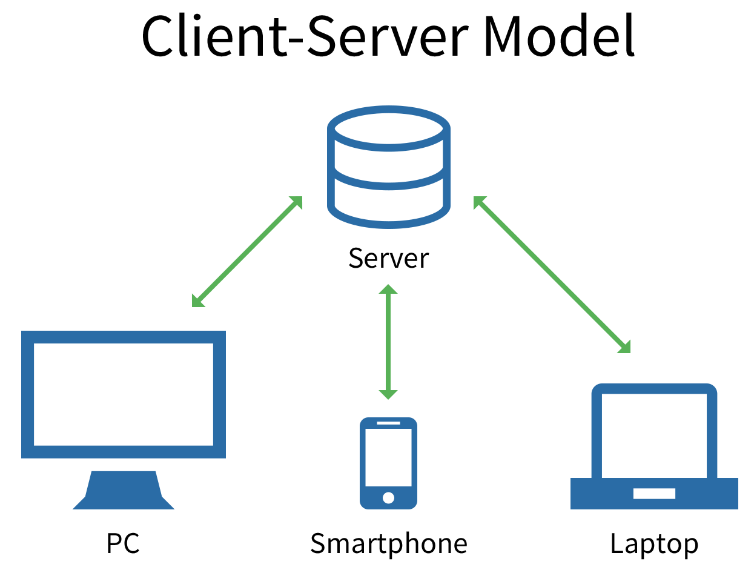
The client-server model is a distributed application structure that partitions tasks or workloads between the providers of a resource or service, called servers, and service requesters, called clients.
Examples of servers: a web server, a file server.
Communications protocol is the language and rules of communication
Client-host and server-host have subtly different meanings than client and server.
Notes:
Front-end:
beletsky.net/2015/04/npm-for-everything.html
Browserify lets you require('modules') in the browser by bundling up all of your dependencies.
http://browserify.org/

Slide 3
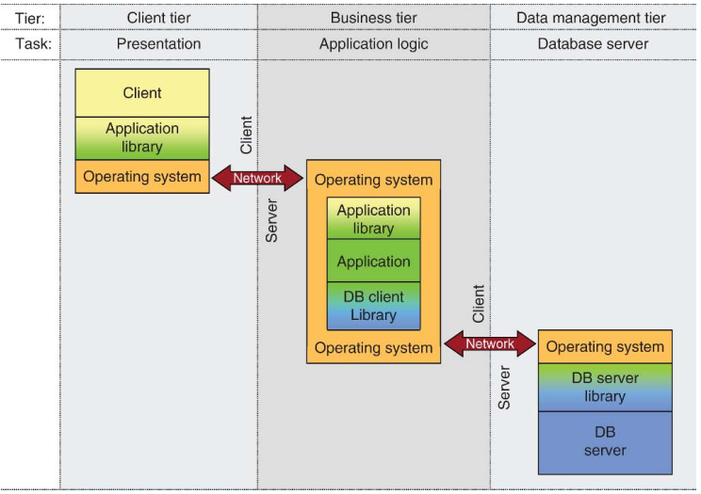
Three-tier architectures
fat client/thin server architectures
thin client/fat server architectures
Three-tier architectures: both client and database server are freed from providing business logic
Conceptually, a multi-tier architecture results from a repeated application of the client/server paradigm.
Notes:
https://www.oreilly.com/ideas/software-architecture-patterns/page/2/layered-architecture
The layers of isolation concept means that changes made in one layer of the architecture generally don't impact or affect components in other layers: the change is isolated to the components within that layer, and possibly another associated layer (such as a persistence layer containing SQL). If you allow the presentation layer direct access to the persistence layer, then changes made to SQL within the persistence layer would impact both the business layer and the presentation layer, thereby producing a very tightly coupled application with lots of interdependencies between components. This type of architecture then becomes very hard and expensive to change.
https://link.springer.com/referenceworkentry/10.1007%2F978-0-387-39940-9_652
Historical Background Early generation software systems have been built in a monolithic way. This means that all the different tasks for implementing a particular application and presenting the results to a user are provided by a single dedicated software component. With the advent of client/server architectures in the 1980s, different tasks could be separated and possibly even be distributed across network boundaries. In a client/server architecture (two tier architecture), the client is responsible for presenting the application to the user while the server is in charge of data management. For the provision of business logic, two alternatives have emerged. First, in so-called fat client/thin server architectures, the client also provides business logic, in addition to presentation and user interfaces. This can be realized by using SQL against the underlying database server in the application program run by the client, either by embedding SQL into a higher programming language or by using the database server’s call level interface (e.g., JDBC, ODBC). Second, in thin client/fat server architectures, the database server also provides business logic while the client solely focuses on presentation issues. Fat servers can be realized by using persistent stored modules or stored procedures inside the database server. In the case of evolving business logic, fat client architectures, although being the most common variant of client/server systems, impose quite some challenges when new client releases need to be distributed in large deployments. In addition, a fat client architecture usually comes along with a high
network load since data is completely processed at the client side. Fat servers, in contrast, impose a single point of failure and a potential performance bottleneck. Three-tier architectures thus are the next step in the evolution of client/server architectures where both client and database server are freed from providing business logic. This task is taken over by an application layer (business tier) between client and database server. In multi-tier architectures, additional tiers are introduced, such as for instance a web tier between client and application layer.
Foundations Multi-tier systems follow an architectural paradigm that is based on separation of concerns. The architecture considers a vertical decomposition of functionality into a stack of dedicated software layers. Between each pair of consecutive layers, a client/server style of interaction is applied, i.e., the lower layer acts as server for the next higher layer (see Fig. 1). Typical tiers in a three-tier architecture are data management, business and client tier. Multi-tier architectures consider additional layers, such as a web tier which hosts servlet containers and a web server and which is located between client tier and application tier.

Slide 4
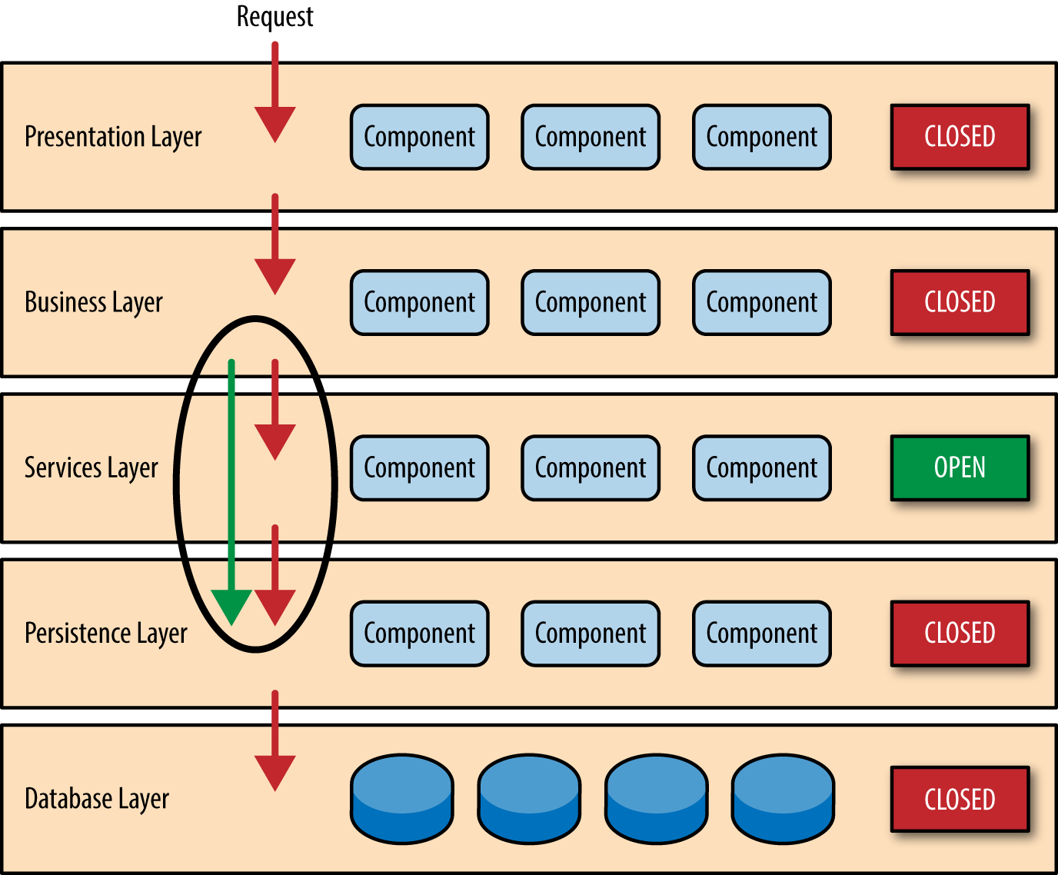
Multi-tier architectures
Additional layers
Horizontal distribution within tiers.
Load balancing within tiers,
Distributed transaction
ACID (atomicity, consistency, isolation, durability)
Two-phase commit protocol
Multi-level transactions
Caching at the application tier
Notes:
https://www.oreilly.com/ideas/software-architecture-patterns/page/2/layered-architecture
The layers of isolation concept means that changes made in one layer of the architecture generally don't impact or affect components in other layers: the change is isolated to the components within that layer, and possibly another associated layer (such as a persistence layer containing SQL). If you allow the presentation layer direct access to the persistence layer, then changes made to SQL within the persistence layer would impact both the business layer and the presentation layer, thereby producing a very tightly coupled application with lots of interdependencies between components. This type of architecture then becomes very hard and expensive to change.
https://link.springer.com/referenceworkentry/10.1007%2F978-0-387-39940-9_652
Historical Background Early generation software systems have been built in a monolithic way. This means that all the different tasks for implementing a particular application and presenting the results to a user are provided by a single dedicated software component. With the advent of client/server architectures in the 1980s, different tasks could be separated and possibly even be distributed across network boundaries. In a client/server architecture (two tier architecture), the client is responsible for presenting the application to the user while the server is in charge of data management. For the provision of business logic, two alternatives have emerged. First, in so-called fat client/thin server architectures, the client also provides business logic, in addition to presentation and user interfaces. This can be realized by using SQL against the underlying database server in the application program run by the client, either by embedding SQL into a higher programming language or by using the database server’s call level interface (e.g., JDBC, ODBC). Second, in thin client/fat server architectures, the database server also provides business logic while the client solely focuses on presentation issues. Fat servers can be realized by using persistent stored modules or stored procedures inside the database server. In the case of evolving business logic, fat client architectures, although being the most common variant of client/server systems, impose quite some challenges when new client releases need to be distributed in large deployments. In addition, a fat client architecture usually comes along with a high
network load since data is completely processed at the client side. Fat servers, in contrast, impose a single point of failure and a potential performance bottleneck. Three-tier architectures thus are the next step in the evolution of client/server architectures where both client and database server are freed from providing business logic. This task is taken over by an application layer (business tier) between client and database server. In multi-tier architectures, additional tiers are introduced, such as for instance a web tier between client and application layer.
Foundations Multi-tier systems follow an architectural paradigm that is based on separation of concerns. The architecture considers a vertical decomposition of functionality into a stack of dedicated software layers. Between each pair of consecutive layers, a client/server style of interaction is applied, i.e., the lower layer acts as server for the next higher layer (see Fig. 1). Typical tiers in a three-tier architecture are data management, business and client tier. Multi-tier architectures consider additional layers, such as a web tier which hosts servlet containers and a web server and which is located between client tier and application tier. In addition to vertical decomposition and distribution across tiers, in many cases multi-tier architectures also leverage horizontal distribution within tiers. For the data management tier, this means that several distributed database servers can be used. Most commonly, horizontal distribution is applied at the business tier, i.e., providing several application server instances [7]. The main benefit of multi-tier applications is that each tier can be deployed on different heterogeneous and distributed platforms. Load balancing within tiers, especially for the application tier, is supported by distributing requests across the different application server instances. This can be implemented by a dispatcher which accepts calls from the next higher layer and distributes them accordingly (this is done, for instance, in TP Monitors which allow to distribute requests among application processes at the middle tier in a three-tier architecture). When multi-tier architectures are used in a business context, they have to support transactional interactions. Due to the inherent distribution of software components across layers and potentially even within layers, distributed transactions are needed. This is usually implemented by a two-phase commit protocol (2PC) [5] (depending on the application server and the middleware used, this can be done, for instance, via CORBA OTS, the Java Transaction Service JTS, etc.). While 2PC provides support for atomicity in distributed transactions, it does not take into account the layered architecture where transactions at one layer are implemented by using services and operations of the next lower layer. Multi-level transactions [11] take this structure into account. SAP ERP [4], for instance, applies multi-level transactions by jointly considering the application server and data management tier. Asynchronous interactions between components in a multi-tier architecture require a message-oriented middleware (MOM). In this case, transactional semantics can be supported by persistent queues and queued transactions [1]. In order to increase the performance of multi-tier systems and to improve response times, caching is used at the application tier. For this, different database technologies such as replication, materialized views, etc. can be applied outside the DBMS [6].
A distributed transaction is a database transaction in which two or more network hosts are involved. Usually, hosts provide transactional resources, while the transaction manager is responsible for creating and managing a global transaction that encompasses all operations against such resources. Distributed transactions, as any other transactions, must have all four ACID (atomicity, consistency, isolation, durability) properties, where atomicity guarantees all-or-nothing outcomes for the unit of work (operations bundle).

Slide 5
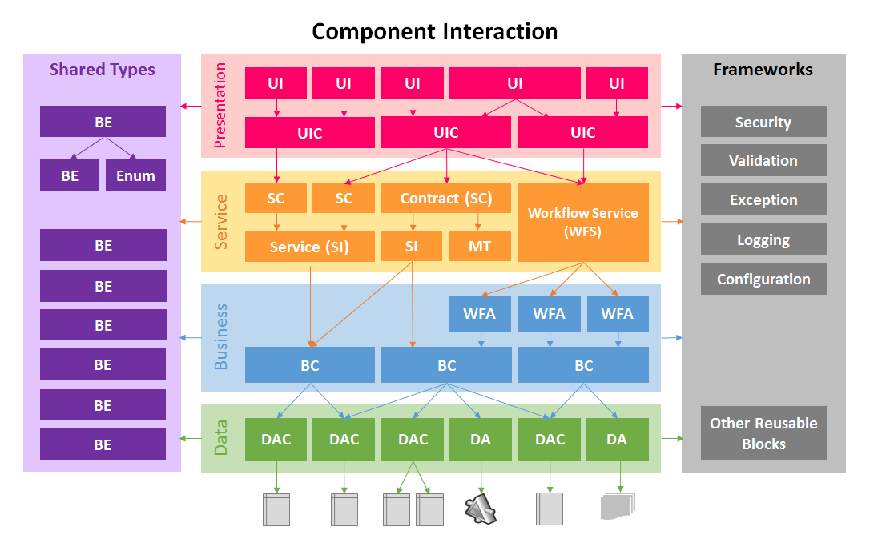
serena-yeoh.blogspot.com/2014/01/layered-architecture-components.html
BE | = | Business Entity | BC | = | Business Component | SI | = | Service Implementation
Enum | = | Enumerations | WFA | = | Workflow Activity | MT | = | Message Type
DAC | = | Data Access Component | WFS | = | Workflow Service | UIC | = | User Interface Controller
DA | = | Data Agent | SC | = | Service Contract | UI | = | User Interface
Notes:
http://serena-yeoh.blogspot.com/2014/01/layered-architecture-components.html
The Layered Architecture principle states that components in one layer should only know and interact with components that are in the layer directly below it, and that components in each layer, should only serve components that are in the layer directly above it. This means that in a strict-layering practice, layers will communicate in a top-down fashion from Presentation -> Services -> Business -> Data.
It is often easier said in theory but spells a lot of confusion to developers, especially to beginner practitioners, when it comes to implementation. To help visualize the components' relationships and interactions better, I have developed the following diagram and provided some basic guidelines.

Slide 6
Layered Architecture
Shared
An entity may contain other entities. i.e. Order with a List<OrderItem>
An entity may use one or more enumerations for its properties.
All components in the layer can reference entities and enumerations.
Data
A data access component should refer to a Table or View in the database.
A data access component may manage more than one related tables i.e. Orders and OrderItems.
A data agent should be used to manage the access to external services (known as Service Agent)
A data agent should be used to manage access to files (known as File Agent)
Business
A business component should call more than one data access components. One-to-one mapping of business component to data access component is an early indication of something is amiss.
A business component may call a mixed of data access components and data agents which may also be called by other business components.
A business component may have some or all of its methods exposed as workflow activities.
A workflow activity should map to one business component method (although mapping to more than one is OK but not recommended).
Services
A service may call one or more business components.
A workflow service usually contains more than one workflow activities to construct workflows.
A workflow service may contain workflow activities that are exposing methods from different business components.
A contract exposes a service (if using WCF).
A service may have more than one contracts (if using WCF).
A contract may use message types to consolidate data into request or response messages. In this case, they can be data contracts or message contracts. Message Types can also be used for WEB API.
Presentation
A controller may call one or more services through contracts (If using WCF).
A controller may call into a service (when WCF is not used).
A controller may call a mixed of contracts and workflow services. (WFS are actually WCF).
A controller may be called by more than one user interfaces.
A user interface may call one or more controllers which may be called by other user interfaces.
Notes:
Front-end:
beletsky.net/2015/04/npm-for-everything.html
Browserify lets you require('modules') in the browser by bundling up all of your dependencies.
http://browserify.org/

Slide 7
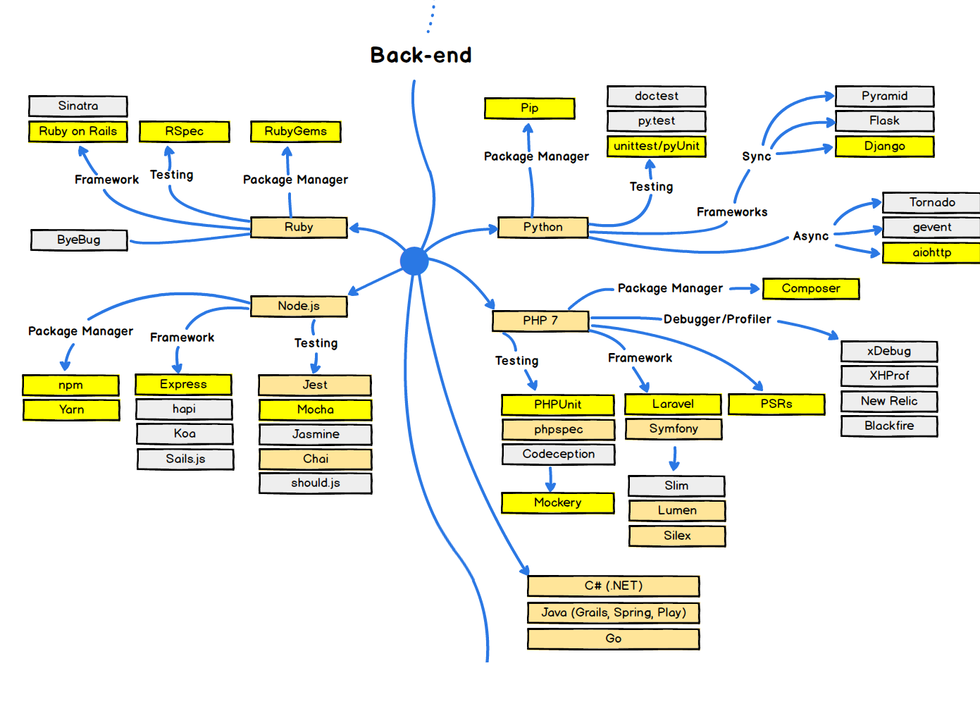
medium.freecodecamp.org

Slide 8
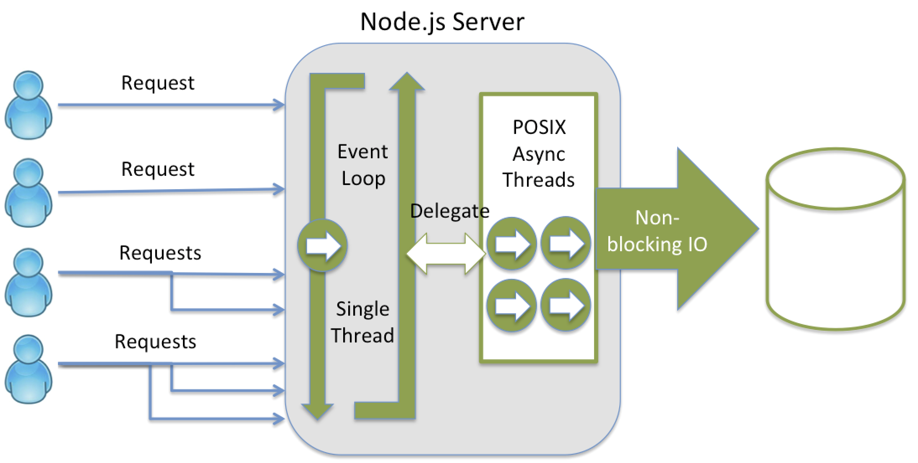
Node.js – “server-side javascript”
V8 open source JavaScript engine developed by Google
There aren’t client side JavaScript (e. g. DOM model)
Single-thread, Event-driven, Non-blocking I/O
Notes:
https://www.slideshare.net/vikasing/introduction-to-nodejs-11730771
Node.js Best Practices
https://www.codementor.io/mattgoldspink/nodejs-best-practices-du1086jja

Slide 9
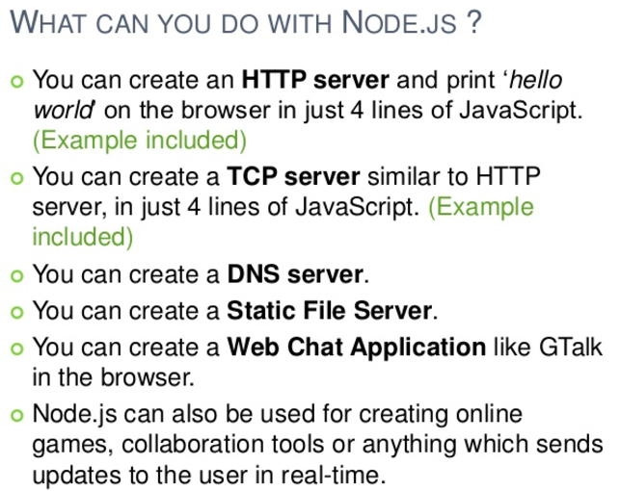
Notes:
Front-end:
beletsky.net/2015/04/npm-for-everything.html
Browserify lets you require('modules') in the browser by bundling up all of your dependencies.
http://browserify.org/

Slide 10
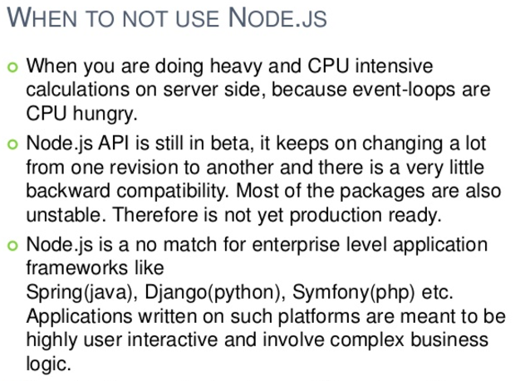
Notes:
Front-end:
beletsky.net/2015/04/npm-for-everything.html
Browserify lets you require('modules') in the browser by bundling up all of your dependencies.
http://browserify.org/

Slide 11
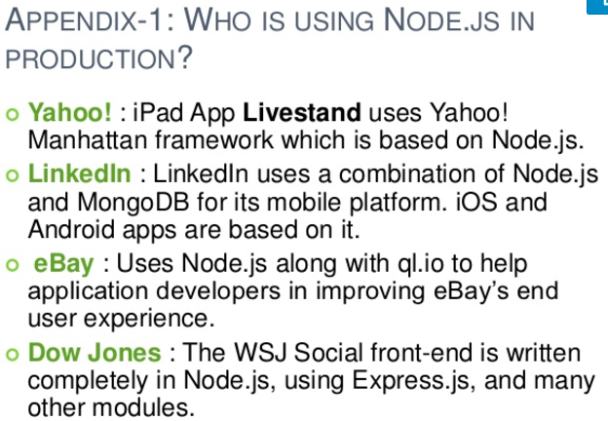
Notes:
Front-end:
beletsky.net/2015/04/npm-for-everything.html
Browserify lets you require('modules') in the browser by bundling up all of your dependencies.
http://browserify.org/

Slide 12
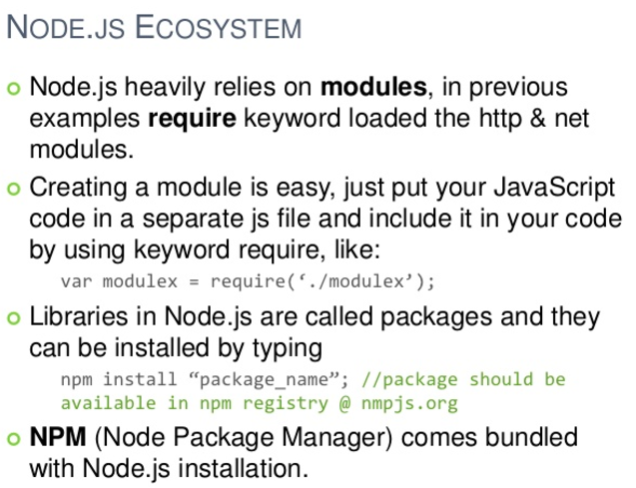
Notes:
Front-end:
beletsky.net/2015/04/npm-for-everything.html
Browserify lets you require('modules') in the browser by bundling up all of your dependencies.
http://browserify.org/

Slide 13

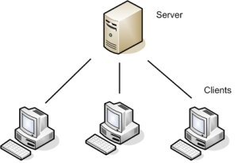
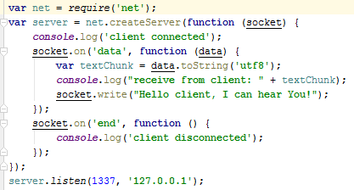
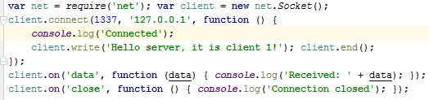
Develop simple Client and Server via Nodejs
Server
Client
Notes:
Front-end:
beletsky.net/2015/04/npm-for-everything.html
Browserify lets you require('modules') in the browser by bundling up all of your dependencies.
http://browserify.org/

Slide 14


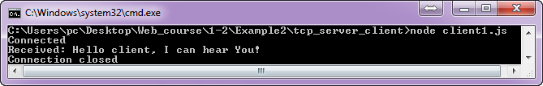
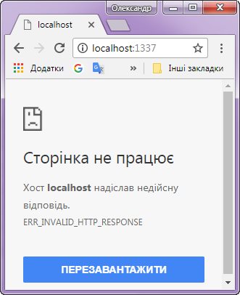
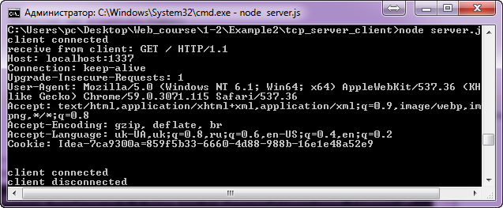
Test client server connection via tcp protocol
Server (TCP)
response
Client (TCP) request
Server (TCP) response (3 times)
Client (HTTP) request
TCP is a transport-layer protocol, and HTTP is an application-layer protocol that runs over TCP.
Notes:
Front-end:
beletsky.net/2015/04/npm-for-everything.html
Browserify lets you require('modules') in the browser by bundling up all of your dependencies.
http://browserify.org/

Slide 15

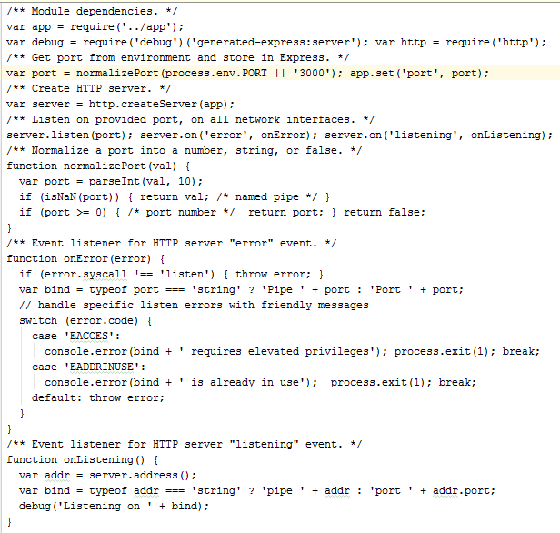
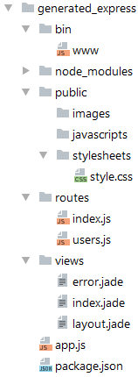
$ npm install -g express-generator
Run Server
Generate application template
$ node www
$ express generated_express
$ npm install -d
Run Web client
Notes:
http://jsman.ru/express/

Slide 16
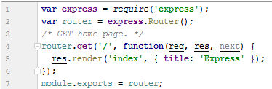

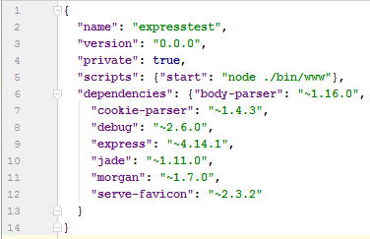
Generate application template
Run Server
$ node www
$ express generated_express
$ npm install -d
Run Web client
Notes:
http://jsman.ru/express/

Slide 17
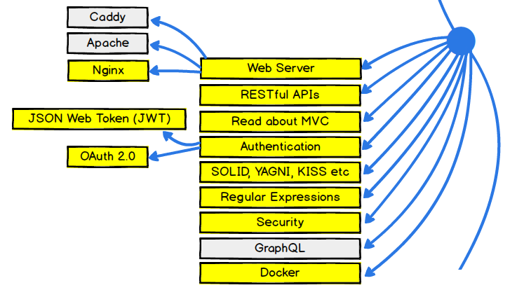
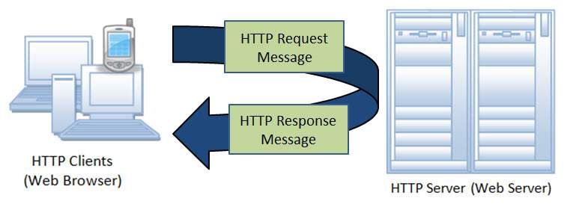
Web Sever

Slide 18
HTTP 1.1 Protocol
TCP is a transport-layer protocol, and HTTP is an application-layer protocol that runs over TCP.
(Telnet program to test HTTP)
HTTP 1.1 Method and Description:
GET. The GET method is used to retrieve information from the given server using a given URI. Requests using GET should only retrieve data and should have no other effect on the data.
HEAD. Same as GET, but transfers the status line and header section only.
POST. A POST request is used to send data to the server, for example, customer information, file upload, etc. using HTML forms.
PUT. Replaces all current representations of the target resource with the uploaded content.
DELETE. Removes all current representations of the target resource given by a URI.
CONNECT. Establishes a tunnel to the server identified by a given URI.
OPTIONS. Describes the communication options for the target resource.
TRACE. Performs a message loop-back test along the path to the target resource.
Notes:
https://www.tutorialspoint.com/http/http_methods.htm

Slide 19
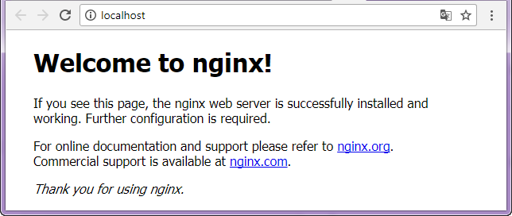
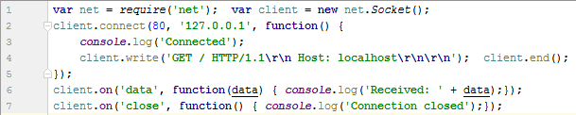
Run Nginx Web Server for test
Notes:
https://habrahabr.ru/post/215117/

Slide 20
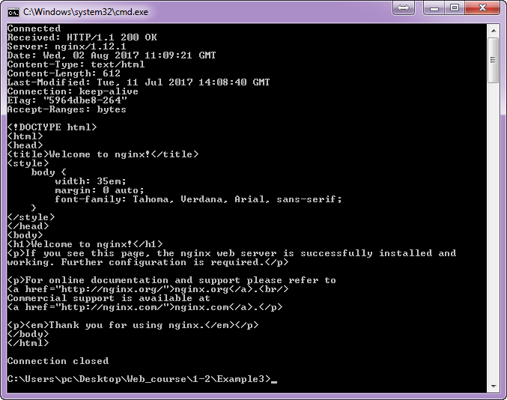

Slide 21

Nginx Web Server core features:
Event-driven is an approach to handling various tasks as events. For example, an incoming connection is an event, disk read is an event, and so on. The idea is not to waste server resources unless there's an event to handle.
NGINX users' connections are processed in highly efficient runloops inside a limited number of single-threaded processes called workers. Each worker can handle thousands of concurrent connections and requests per second.
NGINX does not create a new process or thread for every connection.
Asynchronous means the runloop doesn't get stuck on particular events.
Single-threaded means that many user connections can be handled by a single worker process, which in turn helps to avoid excessive context switching, and leads to more efficient usage of memory and CPU.
According to the project site, NGINX powers 40 percent of the Internet's 10,000 busiest sites and more than 20 percent of all web sites, including Dropbox, Github, and Zappos.
The NGINX community edition has all the required features and capabilities to help build web sites and services requiring performance, scalability, and reliability.
NGINX PLUS adds enterprise-ready features such as load balancing, session persistence, health checks, monitoring, and advanced management.
Notes:
https://kuroikaze85.wordpress.com/2010/01/19/using-nginx-with-node-js/
https://habrahabr.ru/post/267721/
core features
Event-driven is an approach to handling various tasks as events. For example, an incoming connection is an event, disk read is an event, and so on. The idea is not to waste server resources unless there's an event to handle. Modern operating systems can notify the web server about initiation or completion of a task, which in turn enables NGINX workers to use proper resources in an organized way. Server resources can be allocated and released dynamically on demand, which results in optimized usage of network, memory, and CPU.
NGINX users' connections are processed in highly efficient runloops inside a limited number of single-threaded processes called workers. Each worker can handle thousands of concurrent connections and requests per second.
NGINX does not create a new process or thread for every connection. A worker process accepts the new requests from a shared listen queue and executes a highly efficient runloop across them to process thousands of connections per worker. The worker gets notifications about events from the mechanisms in the operating system kernel. When NGINX is started, an initial set of listening sockets is created. Workers then start to accept, read from, and write to sockets when processing HTTP requests and responses.
Asynchronous means the runloop doesn't get stuck on particular events. It sets conditions for alarms from the operating system about particular events and continues to monitor the event queue for alarms. When an alarm is raised, the runloop triggers actions. In turn, specific actions always try to utilize non-blocking interfaces to the operating system so that the worker doesn't stop on handling a particular event. This way, NGINX workers can use available shared resources concurrently in the most efficient manner.
Single-threaded means that many user connections can be handled by a single worker process, which in turn helps to avoid excessive context switching, and leads to more efficient usage of memory and CPU.
According to the project site, NGINX powers 40 percent of the Internet's 10,000 busiest sites and more than 20 percent of all web sites, including Dropbox, Github, and Zappos.
The NGINX community edition has all the required features and capabilities to help build web sites and services requiring performance, scalability, and reliability. NGINX PLUS takes this to next level by providing enhanced features and capabilities that will help users build a high-performance, trusted web server, and an application delivery solution that adds enterprise-ready features such as load balancing, session persistence, health checks, monitoring, and advanced management. The company site includes a page that explains what's included in the different editions.

Slide 22
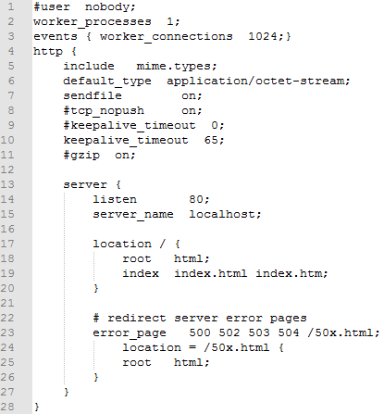
Run
Config’s essential:
Edit
To start nginx, run nginx.exe.
Nginx can be controlled by the -s parameter.
$ nginx -s signal
Where signal may be:
stop — fast shutdown
quit — graceful shutdown (waiting for the finish of serving current requests)
reload — reloading the configuration file
Test
Installation folder
Reload
Stop

Slide 23
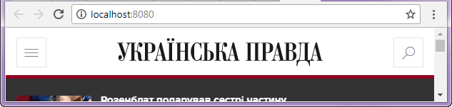
Nginx, Simple Proxy Server
Edit config
#insert into config new proxy server
server
{
listen 8080;
location /
{
proxy_pass http://www.pravda.com.ua:80;
}
}
Reload config
test
Stop
Notes:
https://nginx.org/en/docs/beginners_guide.html#control

Slide 24
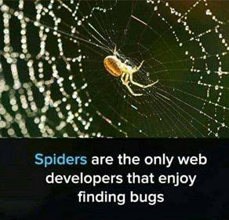
Самостійне опрацювання:
Література та ресурси:

