Slide 1
«Програмування та підтримка веб-застосувань»
Львівський національний університет імені Івана Франка
факультет прикладної математики та інформатики
кафедра Інформаційних систем
Огляд BackEnd 2.
Вовк Олександр Володимирович
vovk@windowslive.com
2022

Slide 2

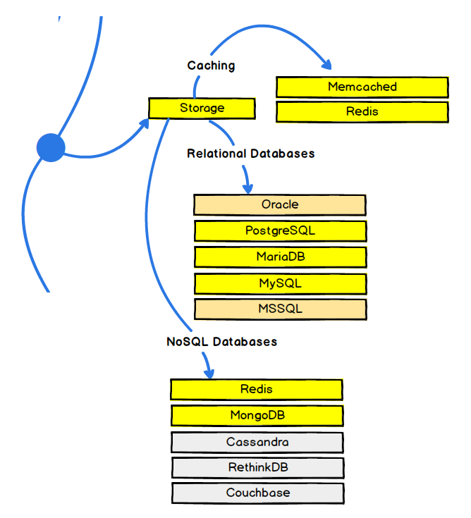
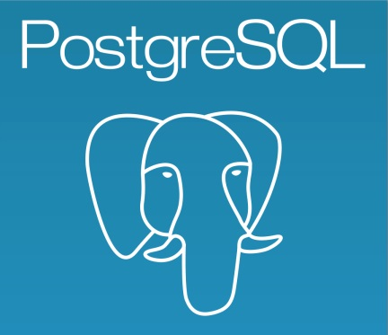

www.mysql.com
$ npm install mysql
www.postgresql.org
$ npm install pg
www.mongodb.com
$ npm install mongodb
Notes:
http://expressjs.com/ru/guide/database-integration.html
https://www.slideshare.net/anandology/ten-reasons-to-prefer-postgresql-to-mysql

Slide 3
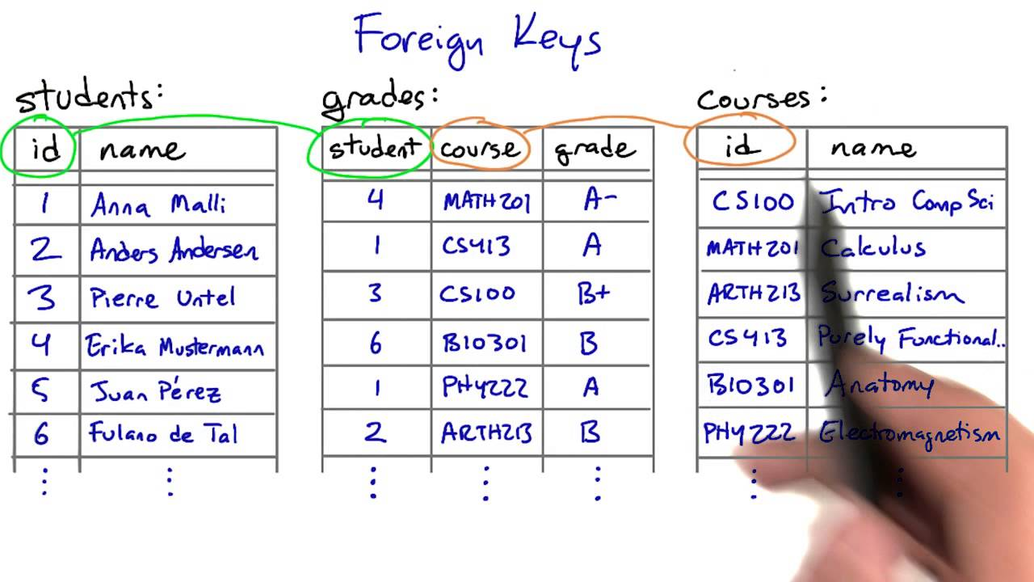
Relational databases
A relational database is a digital database whose organization is based on the relational model of data, as proposed by E. F. Codd in 1970. Codd's view of what qualifies as an RDBMS is summarized in Codd's 12 rules (en.wikipedia.org/wiki/Codd%27s_12_rules).
Almost all relational database systems use SQL (Structured Query Language) as the language for querying and maintaining the database
Notes:
https://www.youtube.com/watch?v=xpUP6aQ4Mnk

Slide 4
PostgreSQL vs. MySQL
ANSI Standard Compatible?
The philosophy behind MySQL is that they’ll support non-standard extensions if the customers like them. But with PostgreSQL, the standards were built into the platform from the start, whereas MySQL added them later.
Subqueries Can Be Problematic
Subqueries were one of MySQL’s major weaknesses for a long time; it was notorious for losing its way with two or more levels of sub-queries. Since 5.6.5, though, there have been major improvements—but PostgreSQL is still considered better for joins especially as MySQL doesn’t support Full Outer Joins.
JSON Support and NoSQL
This is a recent addition to PostgreSQL, and it does make the platform more appealing to anyone who wants to try out NoSQL and store JSON (JavaScript Object Notation) files in the database. It gives greater flexibility on how data is stored compared to traditional relational databases; with PostgreSQL, you can have the best of all worlds.
Better Licensing
PostgreSQL has a MIT-style license that allows you to do anything, including commercial use in open or closed source. With MySQL, on the other hand, the client library is GPL, so you must pay a commercial fee to Oracle or supply the source code of your application.
Extending the Server
Both databases allow you to extend the server. MySQL has a plugin API for C/C++ or any C-compatible language. PostgreSQL has a similar system but also supports a wide variety of languages including C/C++, Java, .Net, Perl, Python, Ruby, Tcl, ODBC and others.
Notes:
https://www.tutorialspoint.com/postgresql/postgresql_environment.html
http://insights.dice.com/2015/03/19/why-i-choose-postgresql-over-mysqlmariadb/

Slide 5


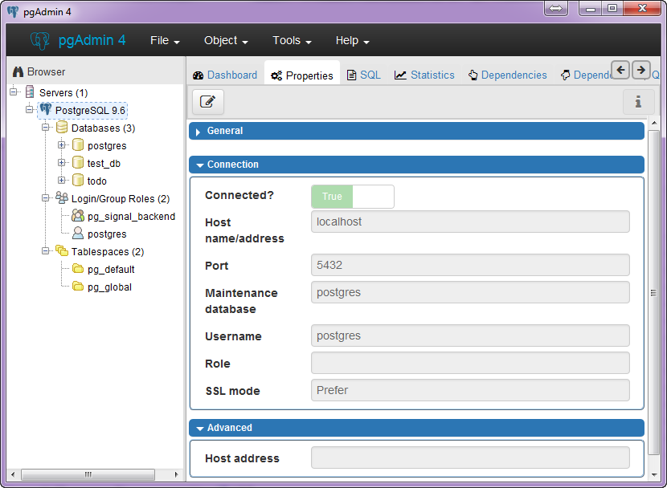
CRUD application with Node, Express, Angular, and PostgreSQL
Description: http://mherman.org/blog/2015/02/12/postgresql-and-nodejs
Sources: https://github.com/mjhea0/node-postgres-todo
Clone project from source
Install dependencies: $ npm install
Start your Postgres server and create a database called "todo"
Notes:
https://www.youtube.com/watch?v=1wvDVBjNDys

Slide 6

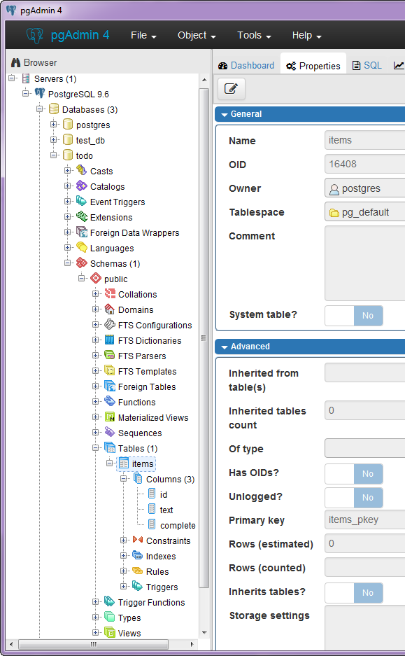
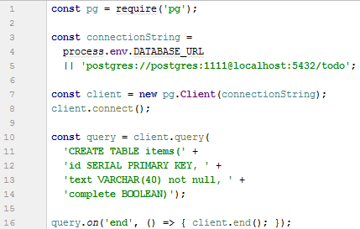
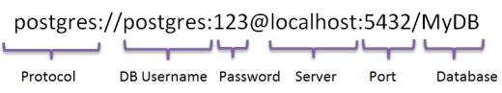
Create the database tables:
$ node server/models/database.js
Connection String:
Notes:
https://www.youtube.com/watch?v=1wvDVBjNDys

Slide 7
Create the database tables:
$ node server/models/database.js
Connection String:
Notes:
https://www.youtube.com/watch?v=1wvDVBjNDys

Slide 8
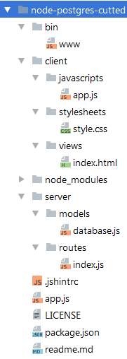
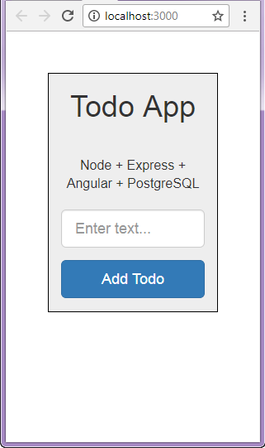
Run server: $ node bin\www
Source
Test
Notes:
https://www.youtube.com/watch?v=1wvDVBjNDys

Slide 9
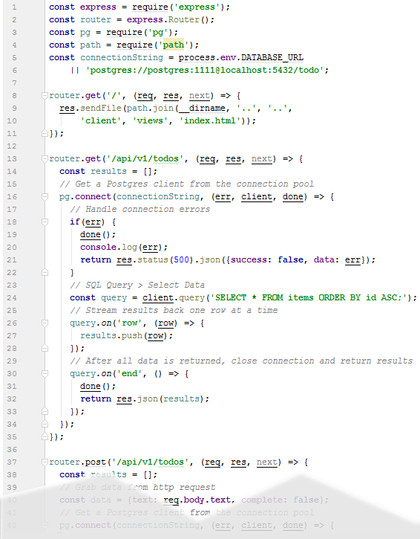
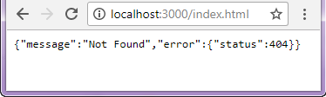
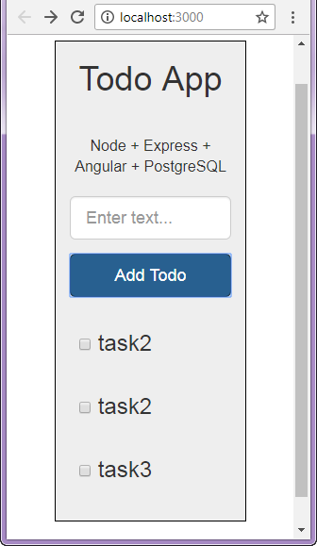
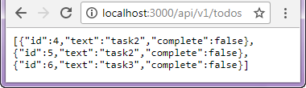
\server\routes\index.js
Project source
Test
Notes:
https://www.youtube.com/watch?v=1wvDVBjNDys

Slide 10
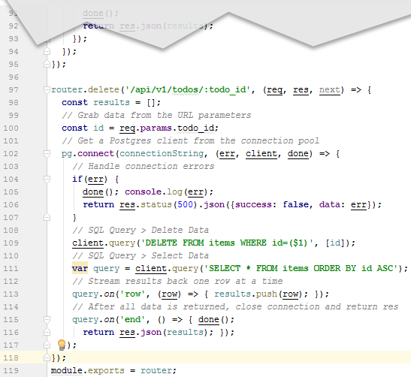

\server\routes\index.js
Notes:
https://www.youtube.com/watch?v=1wvDVBjNDys

Slide 11
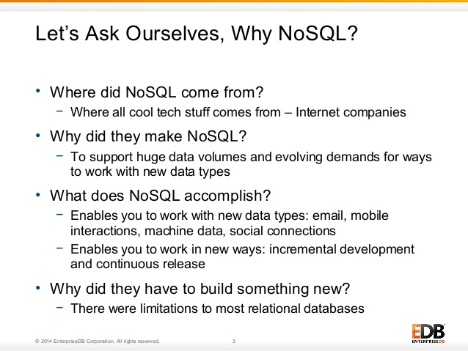
Notes:
https://www.tutorialspoint.com/http/http_methods.htm

Slide 12
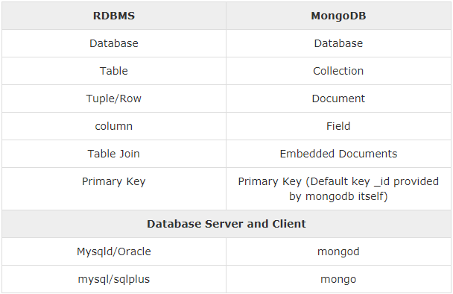
Relational DataBase Management System (RDBMS)
https://www.mongodb.com/cloud/stitch?jmp=homepage

Slide 13
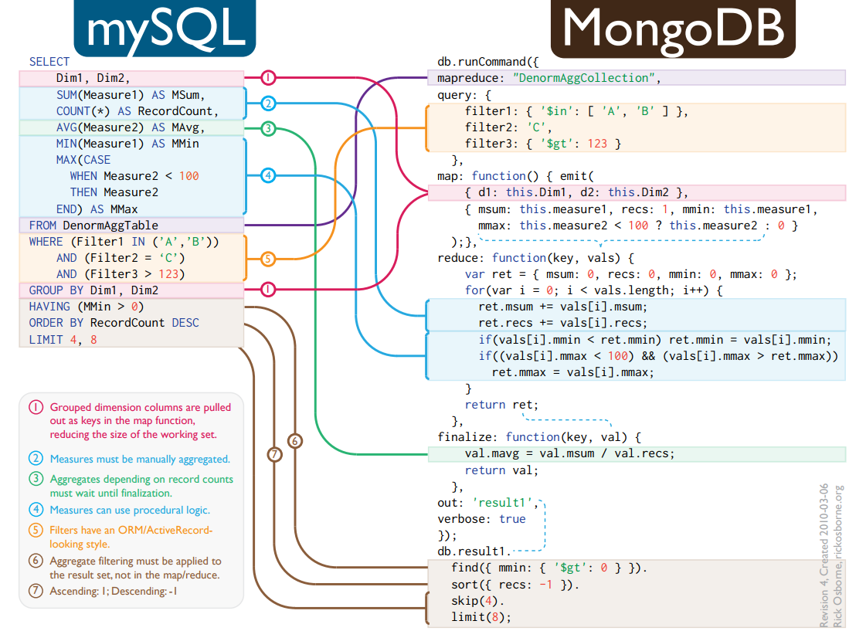
rickosborne.org/blog/2010/02/infographic-migrating-from-sql-to-mapreduce-with-mongodb
Notes:
https://rickosborne.org/blog/2010/02/infographic-migrating-from-sql-to-mapreduce-with-mongodb/
https://blog.serverdensity.com/map-reduce-and-mongodb/

Slide 14
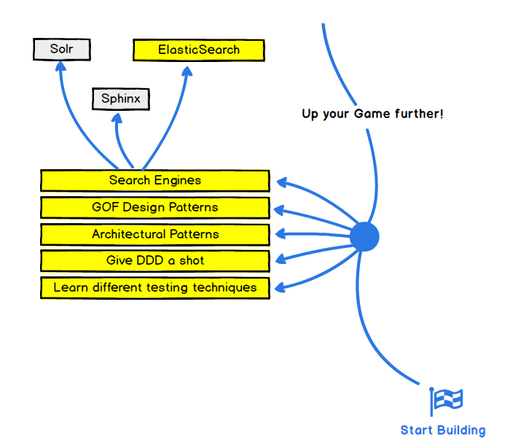
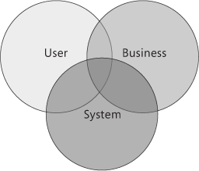
Shaw and Garlan 1996 define
software architecture as:
“Software architecture encompasses the set of significant decisions about the organization of a software system including the selection of the structural elements and their interfaces by which the system is composed;
behavior as specified in collaboration among those elements; composition of these structural and behavioral elements into larger subsystems; and an architectural style that guides this organization. Software architecture also involves: functionality, usability, resilience, performance, reuse, comprehensibility, economic and technology constraints, tradeoffs and aesthetic concerns.”
Notes:
https://msdn.microsoft.com/en-us/library/ee658098.aspx
http://www.diva-portal.se/smash/get/diva2:347686/FULLTEXT01.pdf
There are different tools and platforms that can be used for building an application. However, these tools and platforms may not decide for designing your applications based on the requirements and specifications. Without good consideration of the key requirements, design for any particular problem etc, can lead your application to fail. This risk can be caused because of not good understanding of architecture which involves: unstable, difficulty on deployment and hard management for software
http://www.diva-portal.se/smash/get/diva2:347686/FULLTEXT01.pdf
There are some more issues that are needed to have in consideration for a system: it is important to understand the relationship between these components and connectors and trying to find a way of building new system from the variations of different older systems, there is a risk that components may change over time as long as requirements change, but having a stable architecture in place lead to a successful software system and brings possibility for engineers’ to make different choices in the process of design, it is essential for large and complex system to have an architectural representation etc get/diva2:347686/FULLTEXT01.pdf

Slide 15
Key Principles of Software Architecture
Separation of concerns. Divide your application into distinct features with as little overlap in functionality as possible. The important factor is minimization of interaction points to achieve high cohesion and low coupling. However, separating functionality at the wrong boundaries can result in high coupling and complexity between features even though the contained functionality within a feature does not significantly overlap.
Single Responsibility principle. Each component or module should be responsible for only a specific feature or functionality, or aggregation of cohesive functionality.
Principle of Least Knowledge (also known as the Law of Demeter or LoD). A component or object should not know about internal details of other components or objects.
Don’t repeat yourself (DRY). You should only need to specify intent in one place. For example, in terms of application design, specific functionality should be implemented in only one component; the functionality should not be duplicated in any other component.
Minimize upfront design. Only design what is necessary. In some cases, you may require upfront comprehensive design and testing if the cost of development or a failure in the design is very high. In other cases, especially for agile development, you can avoid big design upfront (BDUF). If your application requirements are unclear, or if there is a possibility of the design evolving over time, avoid making a large design effort prematurely. This principle is sometimes known as YAGNI ("You ain’t gonna need it").
https://msdn.microsoft.com/en-us/library/ee658124.aspx
Notes:
http://www.diva-portal.se/smash/get/diva2:347686/FULLTEXT01.pdf
There are some more issues that are needed to have in consideration for a system: it is important to understand the relationship between these components and connectors and trying to find a way of building new system from the variations of different older systems, there is a risk that components may change over time as long as requirements change, but having a stable architecture in place lead to a successful software system and brings possibility for engineers’ to make different choices in the process of design, it is essential for large and complex system to have an architectural representation etc get/diva2:347686/FULLTEXT01.pdf

Slide 16
An architectural pattern (architectural style) is a general, reusable solution to a commonly occurring problem in software architecture.
Architectural patterns are similar to software design pattern but have a broader scope.
The architectural patterns address various issues in software engineering, such as computer hardware performance limitations, high availability and minimization of a business risk.
Some architectural patterns have been implemented within software frameworks.
Architecture style | Description
Client/Server | Segregates the system into two applications, where the client makes requests to the server. In many cases, the server is a database with application logic represented as stored procedures.
Component-Based Architecture | Decomposes application design into reusable functional or logical components that expose well-defined communication interfaces.
Domain Driven Design | An object-oriented architectural style focused on modeling a business domain and defining business objects based on entities within the business domain.
Layered Architecture | Partitions the concerns of the application into stacked groups (layers).
Message Bus | An architecture style that prescribes use of a software system that can receive and send messages using one or more communication channels, so that applications can interact without needing to know specific details about each other.
N-Tier / 3-Tier | Segregates functionality into separate segments in much the same way as the layered style, but with each segment being a tier located on a physically separate computer.
Object-Oriented | A design paradigm based on division of responsibilities for an application or system into individual reusable and self-sufficient objects, each containing the data and the behavior relevant to the object.
Service-Oriented Architecture (SOA) | Refers to applications that expose and consume functionality as a service using contracts and messages.
https://msdn.microsoft.com/en-us/library/ee658117.aspx
Notes:
http://www.sei.cmu.edu/library/assets/presentations/nelson-saturn2013.pdf

Slide 17

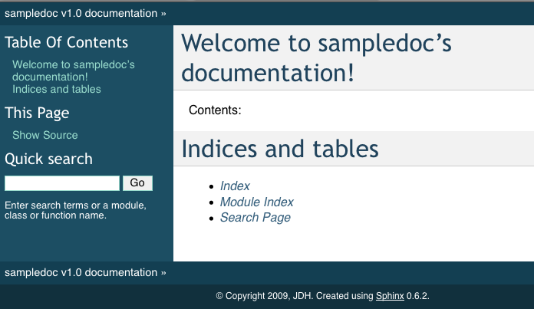
Sphinx is a tool that makes it easy to create intelligent and beautiful documentation, written by Georg Brandl and licensed under the BSD license.
http://shimizukawa-sphinx.readthedocs.io/en/1.3.3/tutorial.html
Tutorial:
http://matplotlib.org/sampledoc/
Install sphinx:
http://www.sphinx-doc.org/en/stable/install.html
Notes:
https://msdn.microsoft.com/en-us/library/ee658098.aspx
http://www.diva-portal.se/smash/get/diva2:347686/FULLTEXT01.pdf
There are different tools and platforms that can be used for building an application. However, these tools and platforms may not decide for designing your applications based on the requirements and specifications. Without good consideration of the key requirements, design for any particular problem etc, can lead your application to fail. This risk can be caused because of not good understanding of architecture which involves: unstable, difficulty on deployment and hard management for software
http://www.diva-portal.se/smash/get/diva2:347686/FULLTEXT01.pdf
There are some more issues that are needed to have in consideration for a system: it is important to understand the relationship between these components and connectors and trying to find a way of building new system from the variations of different older systems, there is a risk that components may change over time as long as requirements change, but having a stable architecture in place lead to a successful software system and brings possibility for engineers’ to make different choices in the process of design, it is essential for large and complex system to have an architectural representation etc get/diva2:347686/FULLTEXT01.pdf

Slide 18
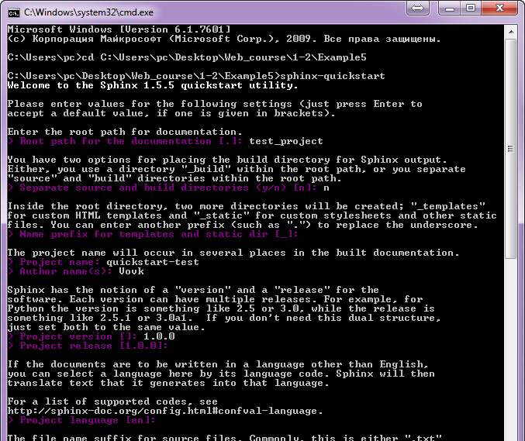
Sphinx Quick Start
Generate
initial
project:
$ sphinx-quickstart
Open
initial
project
Notes:
http://matplotlib.org/sampledoc/getting_started.html#installing-your-doc-directory

Slide 19
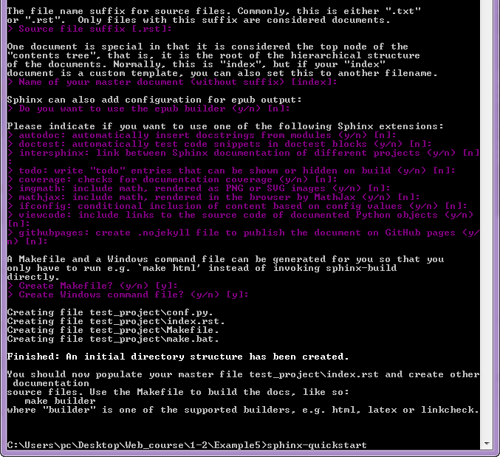
Open
initial
project
Edit
index.rst

Slide 20
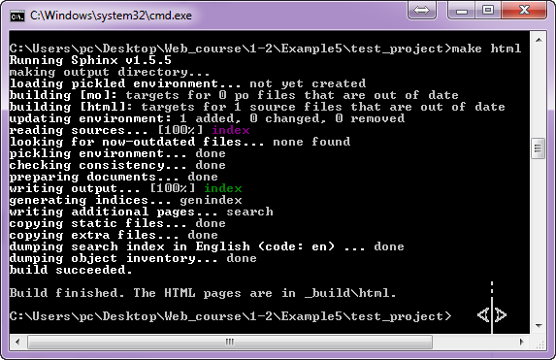
Generate html documentation
Make html docs: $ make html
Open _build\html

Slide 21
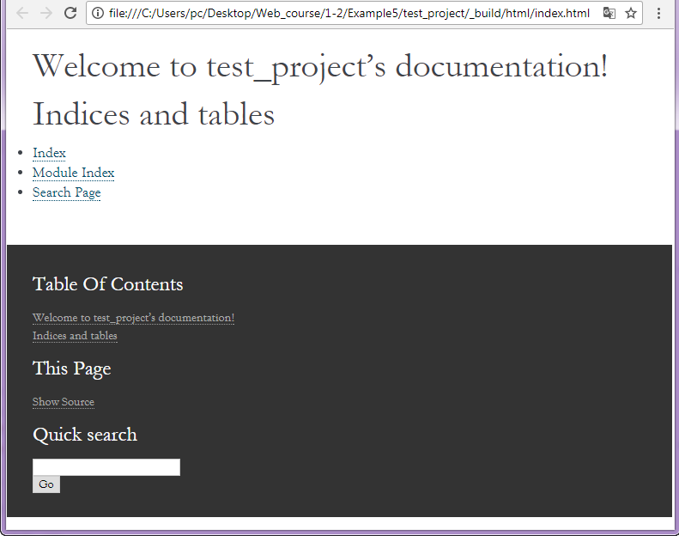
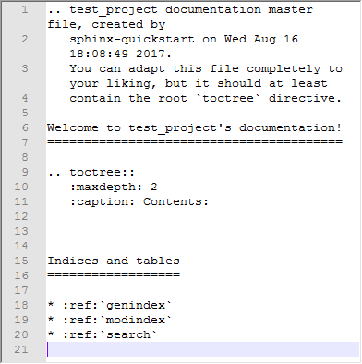
Test generated documentation
Open index.html in _build\html
Edit index.rst

Slide 22
Самостійне опрацювання:
Література та ресурси:

