Slide 1
«Програмування та підтримка веб-застосувань»
Львівський національний університет імені Івана Франка
факультет прикладної математики та інформатики
кафедра Інформаційних систем
DevOps
Вовк Олександр Володимирович
vovk@windowslive.com
2021

Slide 2
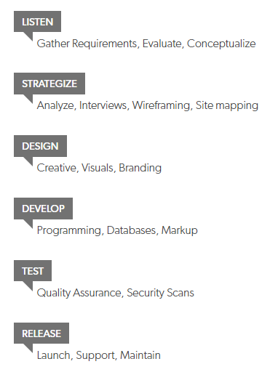
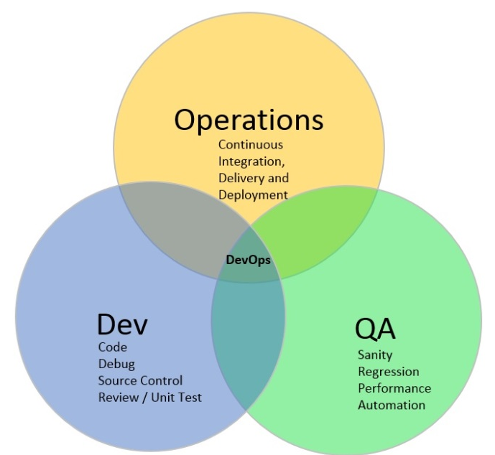
DEVOPS
www.codenewbie.org/blogs/what-is-source-control

Slide 3
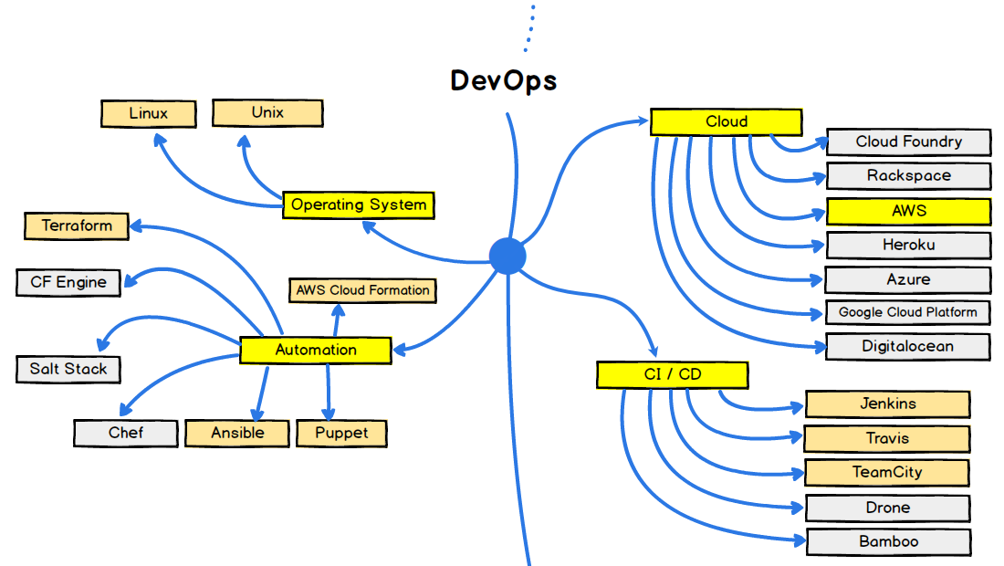
The end goal is to deploy software updates to production
as frequently as possible
COMPLEXITY KILLS PRODUCTIVITY
medium.freecodecamp.org

Slide 4
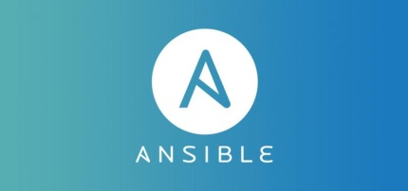
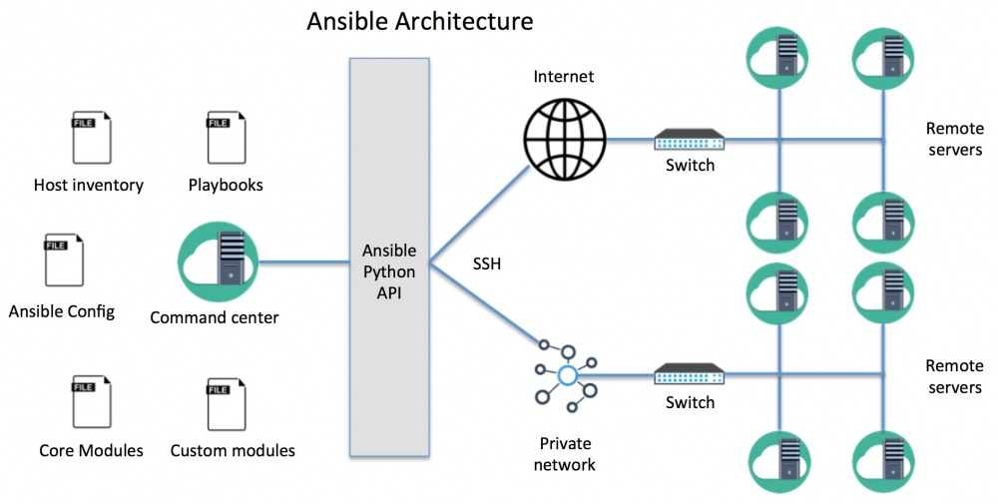
Ansible is the simple, yet powerful IT automation engine that thousands of companies are using to drive complexity out of their environments and accelerate DevOps initiatives.
www.ansible.com
Ansible can be used for a number of functions:
Configuration Management - configure a server/network devices
Deployments - deploying new software over the distributed infrastructure.
Orchestration - deploying changes in a specific order, like web server first, sql db, … etc.
Provisioning - provision new servers on the public cloud like Rackspace, EC2 or Azure.

Slide 5
Ansible manages Linux/Unix machines using SSH (by default)
SSH provides a secure channel over an unsecured network in a client-server architecture. Common applications include remote command-line login and remote command execution.
Ansible manages Windows machines using PowerShell
PowerShell is a task-based command-line shell and scripting language designed especially for system administration. Built on the .NET Framework, PowerShell helps IT professionals and power users control and automate the administration of the Windows and applications that run on Windows.
Ansible uses playbooks (in YAML format), which are the main scripts.
Playbooks reference hosts to configure using ordered list of tasks. Task execution is performed for all hosts in parallel.
Based on the playbook, Ansible generates python scripts.
Ansible uses the Jinja2 tempting language.
Some other advantages of Ansible are:
Using YAML for playbook, easy to read and understand.
No plugins or agents require on the remote hosts.
Servers need ssh and Python 2.5+ only.
Push-based configuration management, where new configs are pushed to the devices without their agents checking in periodically.
Notes:
https://technet.microsoft.com/en-us/library/cc732114(v=ws.10).aspx
http://docs.ansible.com/ansible/latest/intro_windows.html
https://habrahabr.ru/post/195048/
http://systemx.lenovofiles.com/help/index.jsp?topic=%2Fcom.lenovo.switchmgt.ansible.doc%2Fansible_overview.html
https://www.ansible.com/how-ansible-works
https://www.ansible.com/devops-tools
https://www.ansible.com/get-started
http://wiki.kemot-net.com/ansible-overview

Slide 6
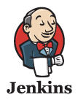
Jenkins is a software that allows
continuous integration (CI)
extreme programming (XP)
https://jenkins.io/index.html
Notes:
https://en.wikipedia.org/wiki/Continuous_integration
https://en.wikipedia.org/wiki/Extreme_programming
In software engineering, continuous integration (CI) is the practice of merging all developer working copies to a shared mainline several times a day.^{[1]} Grady Booch first named and proposed CI in his 1991 method,^{[2]}although he did not advocate integrating several times a day. Extreme programming (XP) adopted the concept of CI and did advocate integrating more than once per day – perhaps as many as tens of times per day.

Slide 7
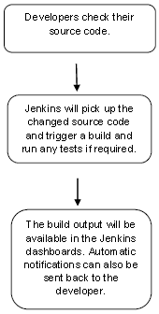
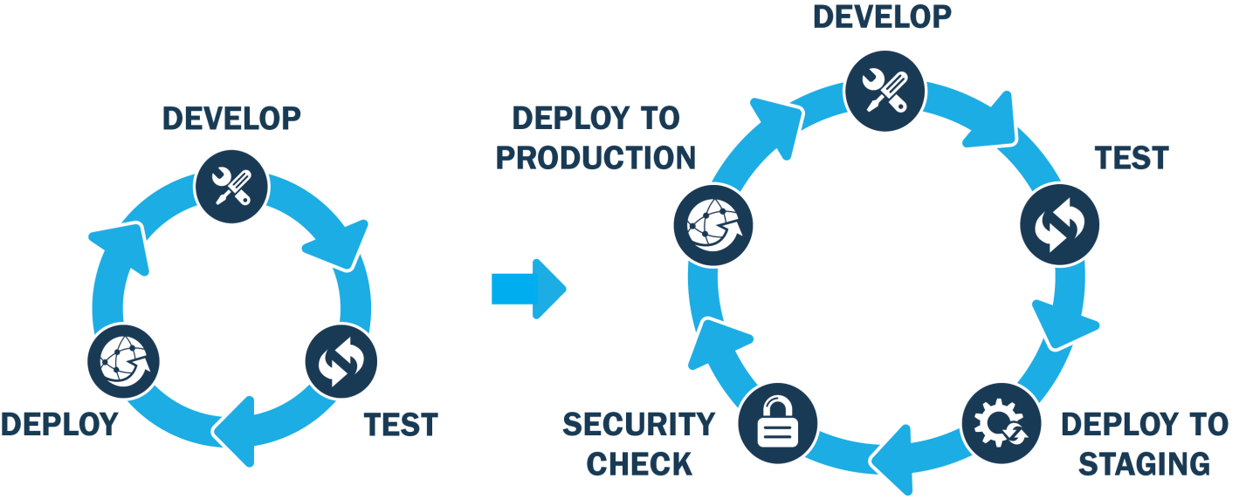
The main aim of CI is to prevent integration problems
the concept introduces build servers, which automatically run the unit tests periodically or even after every commit and report the results to the developers. The use of build servers (not necessarily running unit tests) had already been practized by some teams outside the XP community. Nowadays, many organizations have adopted CI without adopting all of XP.
Builds can be triggered for example by commit in a version control system
Jenkins (creator is Kohsuke Kawaguchi) is open source automation server written in Java.
Notes:
https://mikeciblogs.wordpress.com/tag/continuous-integration/

Slide 8
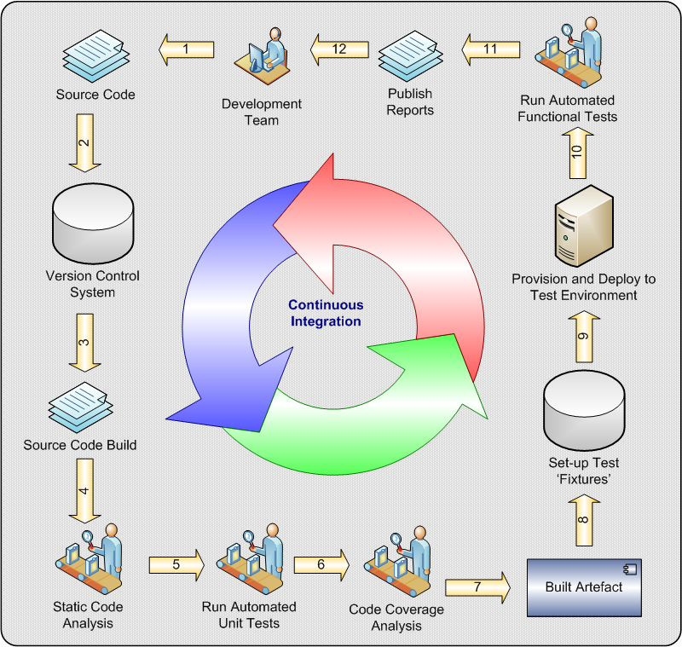
https://mikeciblogs.wordpress.com/tag/continuous-integration/
Notes:
https://mikeciblogs.wordpress.com/tag/continuous-integration/
Developers work to transform the requirements or stories into source code using the programming language of choice.
They periodically check-in (commit) their work into a version control system (VCS)
The CI server is polling the VCS for changes. It initiates the build process when it encounters a change. The build is executed using a dedicated tool for the job such as Maven, Ant or Rake etc. Depending upon the language used, the source code may need to be compiled.
Static analysis is performed on the source code, to ensure compliance with coding standards and to avoid common causes of bugs.
Automated unit tests are executed.
The percentage of the production code exercised by the unit tests is measured using a coverage analysis tool.
A binary artefact package is created. At this point we might want to assist derivation and provenence by including some additional metadata with the artefact e.g. a build timestamp, or the source code repository revision that was used to produce it.
Prepare for functional testing by setting up the test fixtures. For example, create the development database schema and populate it with some data.
Prepare for functional testing by provisioning a test environment and deploying the built artefact.
Functional tests are executed. Post-execution, tear down any fixtures or environment established in 8 and 9.
Generate reports to display the relevant metrics for the build. E.g. How many tests passed? What is the number and severity of coding standard violations?
The process is continuous of course! So rinse…and repeat….

Slide 9
Clouds
Cloud computing is a computing infrastructure and software model for enabling ubiquitous access to shared pools of configurable resources (e.g., computer networks, servers, storage, applications and services), which can be rapidly provisioned with minimal management effort, often over the Internet.
Deployment models: private cloud, public cloud, hybrid cloud.
Notes:
Cloud computing is a computing infrastructure and software model for enabling ubiquitous access to shared pools of configurable resources (e.g., computer networks, servers, storage, applications and services),^{[1][2]} which can be rapidly provisioned with minimal management effort, often over the Internet. Cloud computing allows users, and enterprises, with various computing capabilities to store and process data in either a privately owned cloud, or on a third-party server located in a data center in order to make data accessing mechanisms more efficient and reliable.^{[3]} Cloud computing relies on sharing of resources to achieve coherence and economy of scale, similar to a utility.

Slide 10
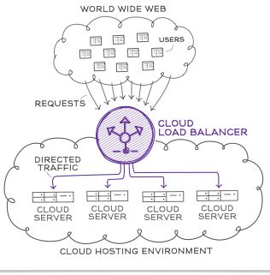
The National Institute of Standards and Technology's define "five essential characteristics":
On-demand self-service. A consumer can unilaterally provision computing capabilities, such as server time and network storage, as needed automatically without requiring human interaction with each service provider.
Broad network access. Capabilities are available over the network and accessed through standard mechanisms that promote use by heterogeneous thin or thick client platforms (e.g., mobile phones, tablets, laptops, and workstations).
Resource pooling. The provider's computing resources are pooled to serve multiple consumers using a multi-tenant model, with different physical and virtual resources dynamically assigned and reassigned according to consumer demand.
Rapid elasticity. Capabilities can be elastically provisioned and released, in some cases automatically, to scale rapidly outward and inward commensurate with demand. To the consumer, the capabilities available for provisioning often appear unlimited and can be appropriated in any quantity at any time.
Measured service. Cloud systems automatically control and optimize resource use by leveraging a metering capability at some level of abstraction appropriate to the type of service (e.g., storage, processing, bandwidth, and active user accounts). Resource usage can be monitored, controlled, and reported, providing transparency for both the provider and consumer of the utilized service.
Service models
https://www.rackspace.com/en-gb
Notes:
https://en.wikipedia.org/wiki/Cloud_computing
https://ru.wikipedia.org/wiki/%D0%9E%D0%B1%D0%BB%D0%B0%D1%87%D0%BD%D1%8B%D0%B5_%D0%B2%D1%8B%D1%87%D0%B8%D1%81%D0%BB%D0%B5%D0%BD%D0%B8%D1%8F

Slide 11
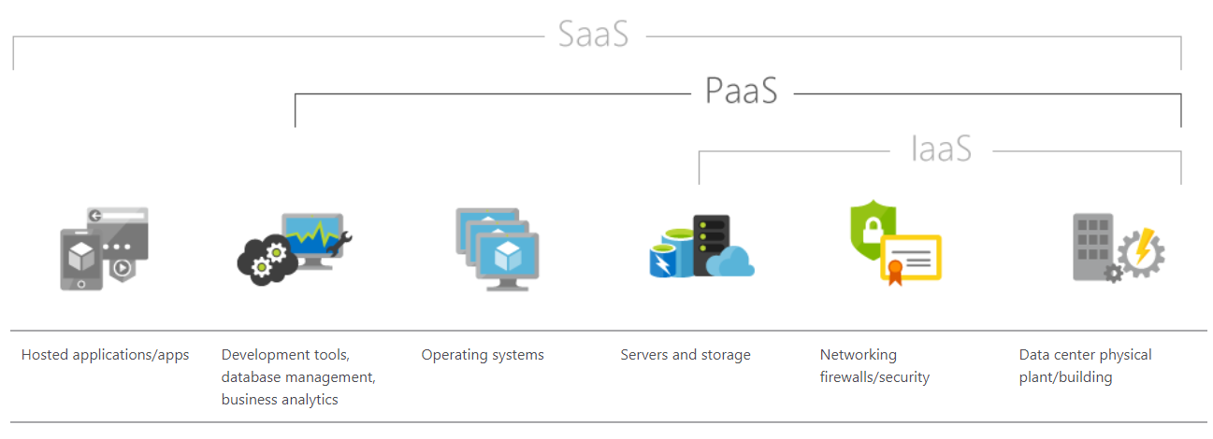
The National Institute of Standards and Technology's define "five essential characteristics":
Infrastructure as a service (IaaS). The capability provided to the consumer is to provision processing, storage, networks, and other fundamental computing resources where the consumer is able to deploy and run arbitrary software, which can include operating systems and applications.
Platform as a service (PaaS). The capability provided to the consumer is to deploy onto the cloud infrastructure consumer-created or acquired applications created using programming languages, libraries, services, and tools supported by the provider.
Software as a service (SaaS).The capability provided to the consumer is to use the provider's applications running on a cloud infrastructure. The applications are accessible from various client devices through either a thin client interface, such as a web browser (e.g., web-based email), or a program interface.
Notes:
https://en.wikipedia.org/wiki/Cloud_computing
https://ru.wikipedia.org/wiki/%D0%9E%D0%B1%D0%BB%D0%B0%D1%87%D0%BD%D1%8B%D0%B5_%D0%B2%D1%8B%D1%87%D0%B8%D1%81%D0%BB%D0%B5%D0%BD%D0%B8%D1%8F

Slide 12
The National Institute of Standards and Technology's define "five essential characteristics":
Security as a service (SECaaS). The business model in which a large service provider integrates their security services into a corporate infrastructure on a subscription basis more cost effectively than most individuals or corporations can provide on their own, when total cost of ownership is considered (these security services often include authentication, anti-virus, anti-malware/spyware, intrusion detection, and security event management)
Mobile "backend" as a service (MBaaS). Web app and mobile app developers are provided with a way to link their applications to cloud storage and cloud computing services with application programming interfaces (APIs) exposed to their applications and custom software development kits (SDKs). Services include user management, push notifications, integration with social networking services[91] and more.
Serverless computing is a cloud computing execution model in which the cloud provider dynamically manages the allocation of machine resources. Pricing is based on the actual amount of resources consumed by an application, rather than on pre-purchased units of capacity. It is a form of utility computing.
Notes:
https://en.wikipedia.org/wiki/Cloud_computing
https://ru.wikipedia.org/wiki/%D0%9E%D0%B1%D0%BB%D0%B0%D1%87%D0%BD%D1%8B%D0%B5_%D0%B2%D1%8B%D1%87%D0%B8%D1%81%D0%BB%D0%B5%D0%BD%D0%B8%D1%8F

Slide 13
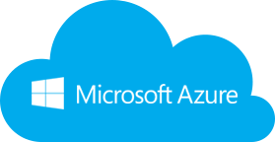
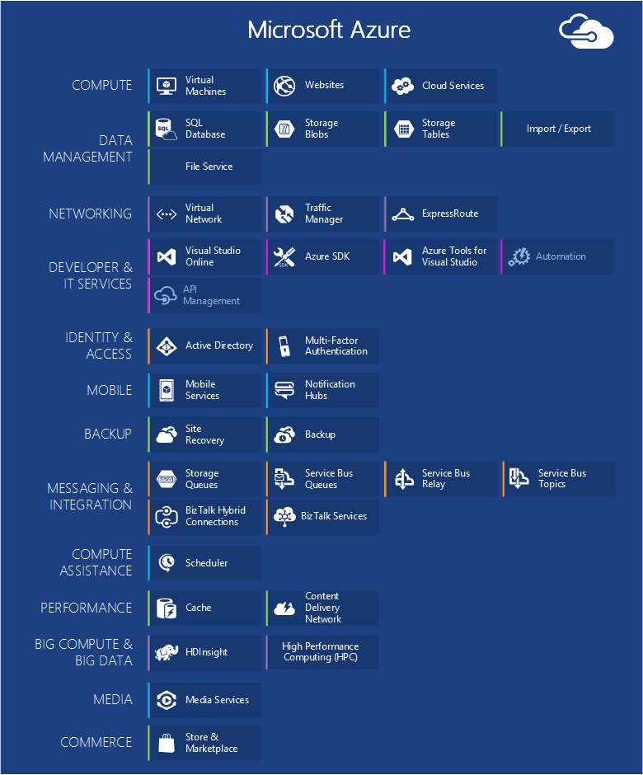
https://azure.microsoft.com
https://www.youtube.com/watch?v=_ElhzkYYQpM
https://docs.microsoft.com/en-us/azure/fundamentals-introduction-to-azure
Notes:
Cloud computing is a computing infrastructure and software model for enabling ubiquitous access to shared pools of configurable resources (e.g., computer networks, servers, storage, applications and services),^{[1][2]} which can be rapidly provisioned with minimal management effort, often over the Internet. Cloud computing allows users, and enterprises, with various computing capabilities to store and process data in either a privately owned cloud, or on a third-party server located in a data center in order to make data accessing mechanisms more efficient and reliable.^{[3]} Cloud computing relies on sharing of resources to achieve coherence and economy of scale, similar to a utility.

Slide 14
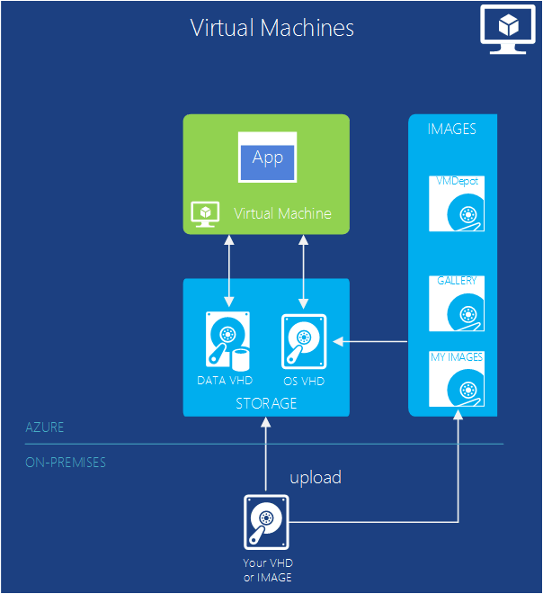
The ability to create a virtual machine on demand, whether from a standard image or from one you supply, can be very useful. This approach, commonly known as Infrastructure as a Service (IaaS), is what Azure Virtual Machines provides
Notes:
Cloud computing is a computing infrastructure and software model for enabling ubiquitous access to shared pools of configurable resources (e.g., computer networks, servers, storage, applications and services),^{[1][2]} which can be rapidly provisioned with minimal management effort, often over the Internet. Cloud computing allows users, and enterprises, with various computing capabilities to store and process data in either a privately owned cloud, or on a third-party server located in a data center in order to make data accessing mechanisms more efficient and reliable.^{[3]} Cloud computing relies on sharing of resources to achieve coherence and economy of scale, similar to a utility.

Slide 15
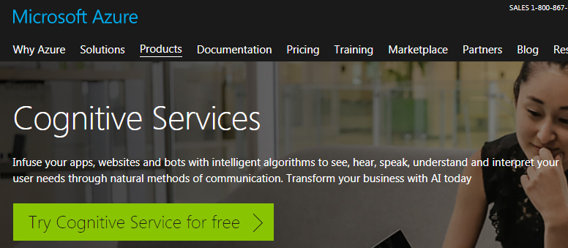
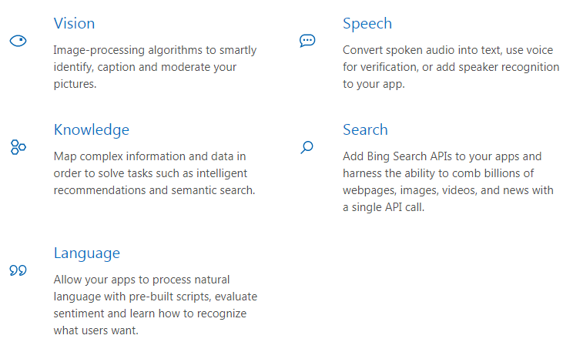

Slide 16
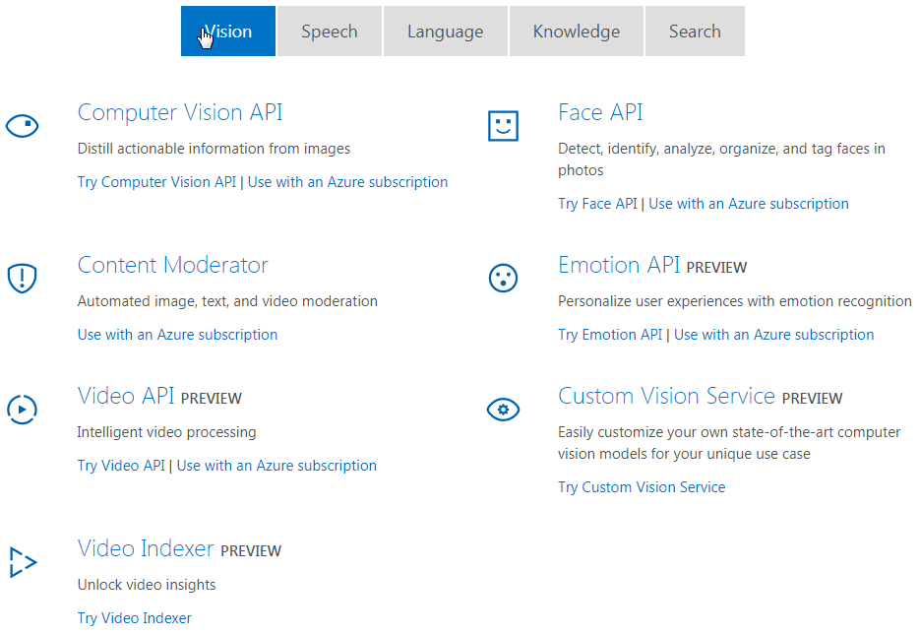

Slide 17
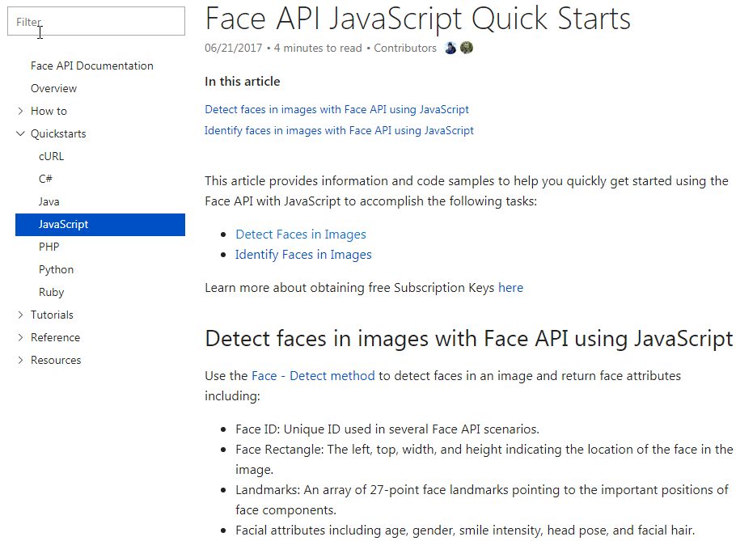

Slide 18
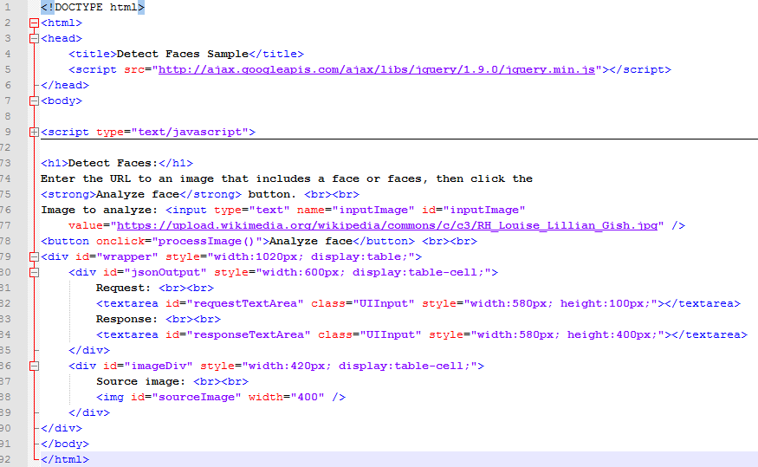
Preview

Slide 19
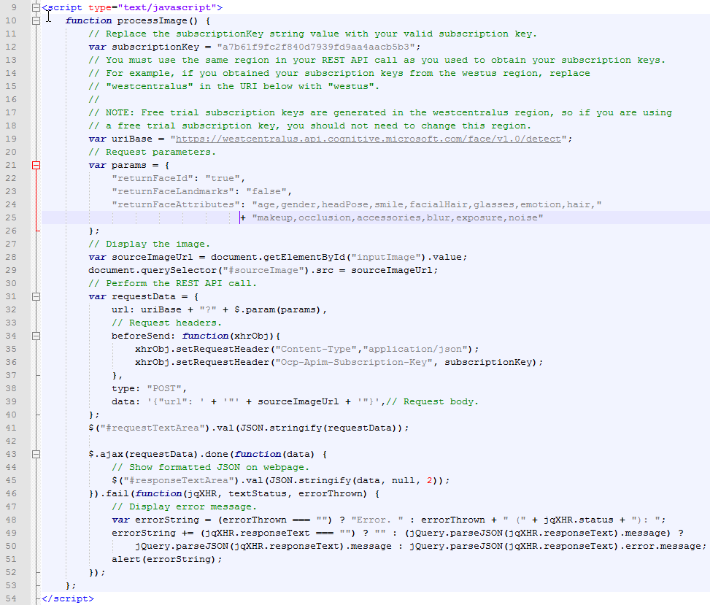

Slide 20
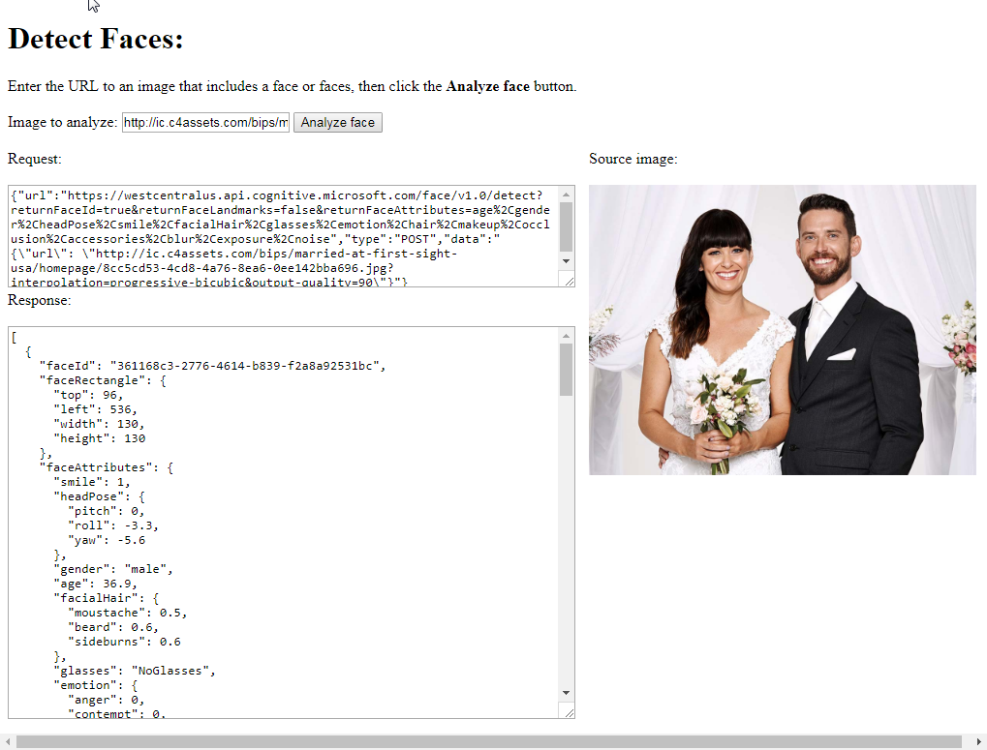

Slide 21
RESPONSE
[
{
"faceId": "361168c3-2776-4614-
b839-f2a8a92531bc",
"faceRectangle": {
"top": 96,
"left": 536,
"width": 130,
"height": 130
},
"faceAttributes": {
"smile": 1,
"headPose": {
"pitch": 0,
"roll": -3.3,
"yaw": -5.6
},
"gender": "male",
"age": 36.9,
"facialHair": {
"moustache": 0.5,
"beard": 0.6,
"sideburns": 0.6
},
"glasses": "NoGlasses",
"emotion": {
"anger": 0,
"contempt": 0,
"disgust": 0,
"fear": 0,
"happiness": 1,
"neutral": 0,
"sadness": 0,
"surprise": 0
},
"blur": {
"blurLevel": "low",
"value": 0.08
},
"exposure": {
"exposureLevel": "goodExposure",
"value": 0.66
},
"noise": {
"noiseLevel": "medium",
"value": 0.59
},
"makeup": {
"eyeMakeup": false,
"lipMakeup": false
},
"accessories": [],
"occlusion": {
"foreheadOccluded": false,
"eyeOccluded": false,
"mouthOccluded": false
},
"hair": {
"bald": 0.12,
"invisible": false,
"hairColor": [
{ "color": "black",
"confidence": 1 },
{ "color": "brown",
"confidence": 0.94},
{ "color": "other",
"confidence": 0.28 },
{"color": "gray",
"confidence": 0.13 },
{"color": "red",
"confidence": 0.1},
{"color": "blond",
"confidence": 0.02 }
]
}
}
},
{
"faceId": "87c2346c-d56e-46d6-
9778-b6f7d3d8f48d",
"faceRectangle": {
"top": 137,
"left": 296,
"width": 121,
"height": 121
},
"faceAttributes": {
"smile": 1,
"headPose": {
"pitch": 0,
"roll": -7.1,
"yaw": -5.3
},
"gender": "female",
"age": 36.3,
"facialHair": {
"moustache": 0,
"beard": 0,
"sideburns": 0
},
"glasses": "NoGlasses",
"emotion": {
"anger": 0,
"contempt": 0,
"disgust": 0,
"fear": 0,
"happiness": 1,
"neutral": 0,
"sadness": 0,
"surprise": 0
},
"blur": {
"blurLevel": "low",
"value": 0
},
"exposure": {
"exposureLevel": "goodExposure",
"value": 0.5
},
"noise": {
"noiseLevel": "medium",
"value": 0.66
},
"makeup": {
"eyeMakeup": true,
"lipMakeup": true
},
"accessories": [],
"occlusion": {
"foreheadOccluded": false,
"eyeOccluded": false,
"mouthOccluded": false
},
"hair": {
"bald": 0.03,
"invisible": false,
"hairColor": [
{"color": "black",
"confidence": 1 },
{"color": "other",
"confidence": 0.9 },
{"color": "brown",
"confidence": 0.88},
{"color": "gray",
"confidence": 0.06},
{"color": "red",
"confidence": 0.04},
{"color": "blond",
"confidence": 0.02 }
]
}
}
}
]

Slide 22
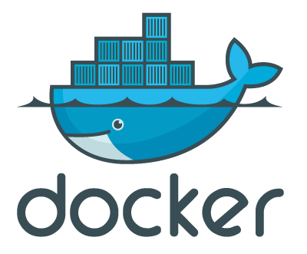
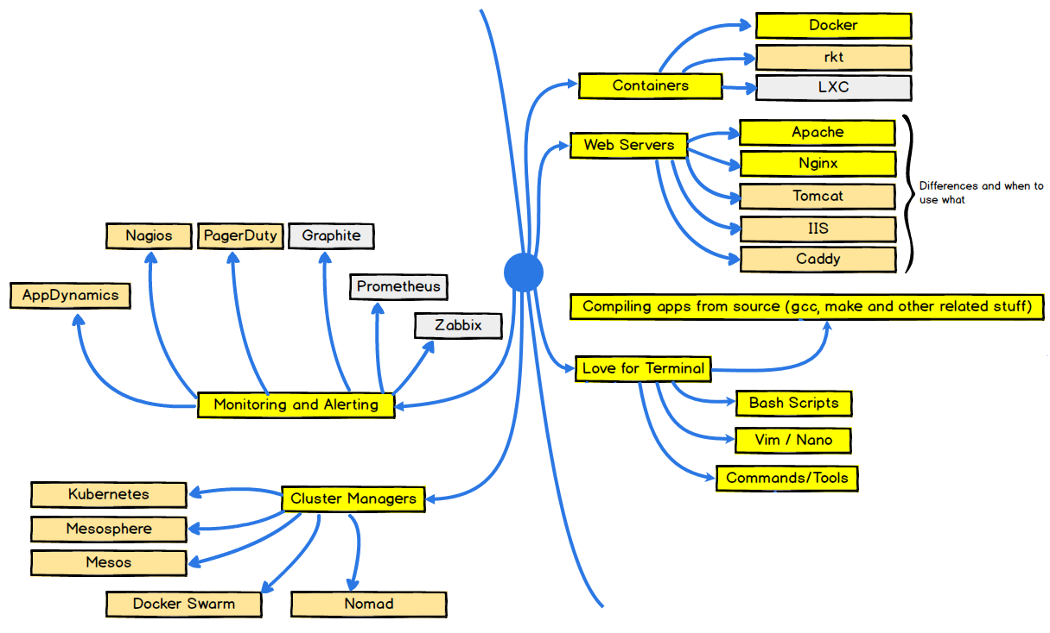
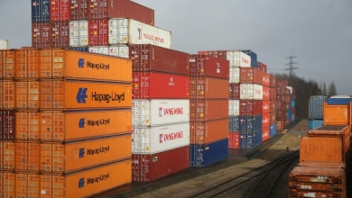
Containers are a method for running software inside isolated environments.
Containerized apps offer more portability and easier deployability.
To use containers effectively in real-world environments, you need an orchestration tool, which automate most of the tasks involved in spinning containers up and managing them once they're running.
medium.freecodecamp.org
Notes:
http://thevarguy.com/open-source-application-software-companies/understanding-containers-docker-coreos-lxd-and-container-

Slide 23
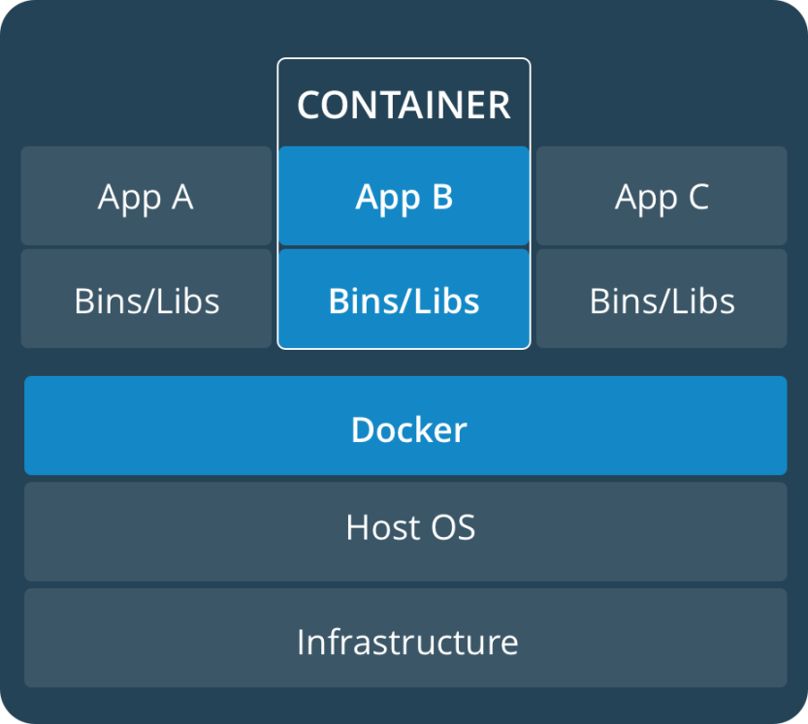
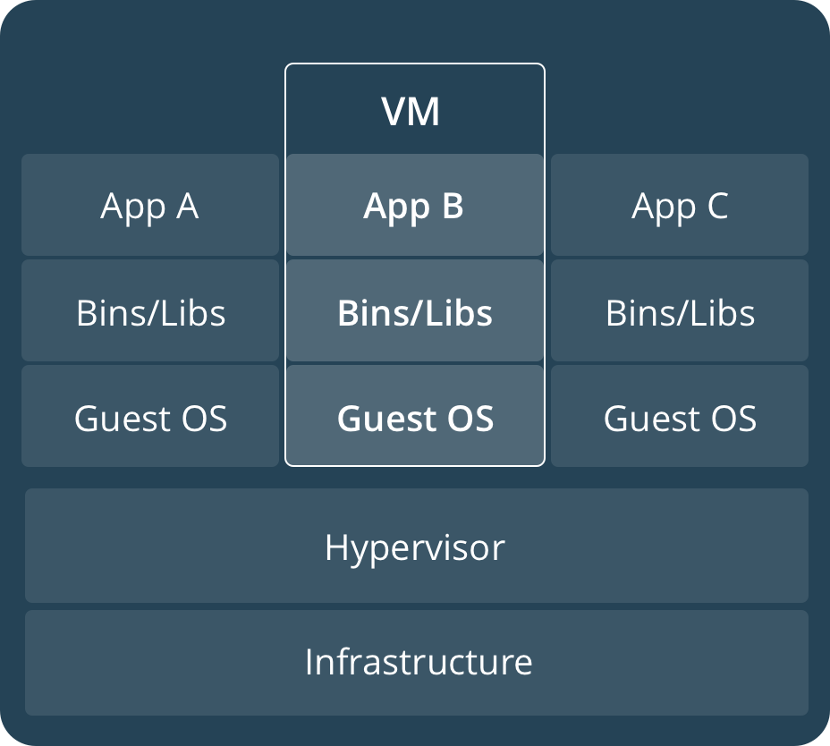
https://www.docker.com/what-container
Containers and virtual machines have similar resource isolation and allocation benefits, but function differently because containers virtualize the operating system instead of hardware, containers are more portable and efficient.
CONTAINERS
Containers are an abstraction at the app layer that packages code and dependencies together. Multiple containers can run on the same machine and share the OS kernel with other containers, each running as isolated processes in user space. Containers take up less space than VMs (container images are typically tens of MBs in size), and start almost instantly.
VIRTUAL MACHINES
Virtual machines (VMs) are an abstraction of physical hardware turning one server into many servers. The hypervisor allows multiple VMs to run on a single machine. Each VM includes a full copy of an operating system, one or more apps, necessary binaries and libraries - taking up tens of GBs. VMs can also be slow to boot.
Notes:
https://sreeninet.wordpress.com/2015/02/02/containers-docker-lxc-and-rocket/

Slide 24
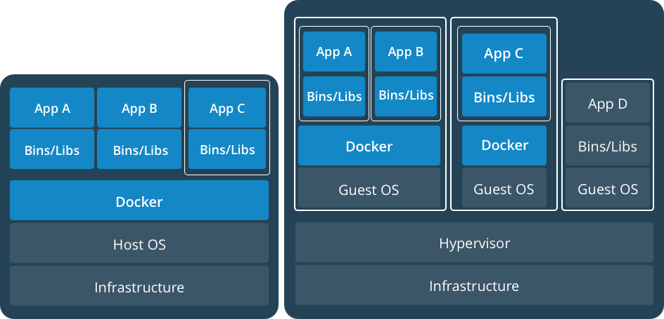
Containers and Virtual Machines Together
https://www.docker.com/what-container
Containers and VMs used together provide a great deal of flexibility in deploying and managing apps.
Notes:
https://sreeninet.wordpress.com/2015/02/02/containers-docker-lxc-and-rocket/

Slide 25
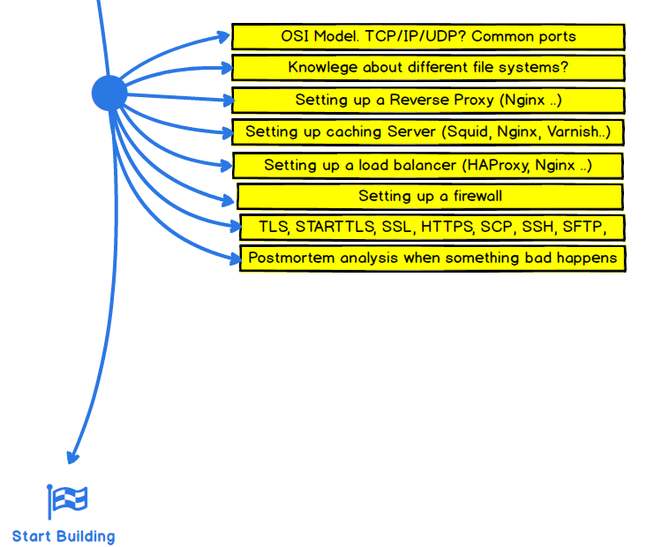
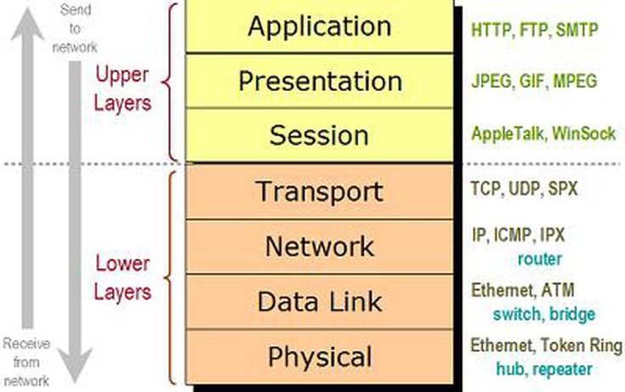
The Open Systems Interconnection model (OSI model) is a conceptual model that characterizes and standardizes the communication functions of a telecommunication or computing system without regard to their underlying internal structure and technology. Its goal is the interoperability of diverse communication systems with standard protocols. The model partitions a communication system into abstraction layers.
Notes:
Модель OSI (ЕМВВС) (базова еталонна модель взаємодії відкритих систем, англ. Open Systems Interconnection Basic Reference Model, 1978 р.) — абстрактна мережева модель для комунікацій і розробки мережевих протоколів. Представляє рівневий підхід до мережі. Кожен рівень обслуговує свою частину процесу взаємодії. Завдяки такій структурі спільна робота мережевого обладнання й програмного забезпечення стає набагато простішою, прозорішою й зрозумілішою.
На даний час основним використовуваним стеком протоколів є TCP/IP, розробка якого не була пов'язана з моделлю OSI і до того ж була здійснена до її прийняття. За увесь час існування моделі OSI вона не була реалізована, і, очевидно, не буде реалізована ніколи. Сьогодні використовується тільки деяка підмножина моделі OSI. Вважається, що модель занадто складна, а її реалізація займе занадто багато часу.
Окремі фахівці стверджують також, що історія моделі OSI являє типовий приклад невдалого й відірваного від життя проекту.

Slide 26
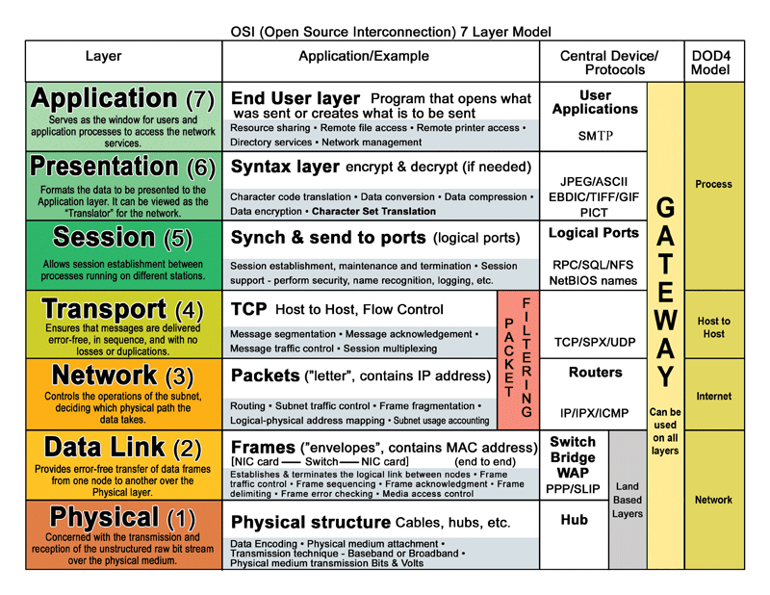
Layering of this type does have various conceptual and structuring advantages. However, in the data networking context structured layering implies that the functions of each layer are carried out completely before the protocol data unit is passed to the next layer. This means that the optimization of each layer has to be done separately. Such ordering constraints are in conflict with efficient implementation of data manipulation functions. One could accuse the layered model (e.g., TCP/IP and ISO OSI) of causing this conflict. In fact, the operations of multiplexing and segmentation both hide vital information that lower layers may need to optimize their
datatracker.ietf.org/doc/html/rfc3439#section-3 uk.wikipedia.org/wiki/IETF
Notes:
Модель OSI (ЕМВВС) (базова еталонна модель взаємодії відкритих систем, англ. Open Systems Interconnection Basic Reference Model, 1978 р.) — абстрактна мережева модель для комунікацій і розробки мережевих протоколів. Представляє рівневий підхід до мережі. Кожен рівень обслуговує свою частину процесу взаємодії. Завдяки такій структурі спільна робота мережевого обладнання й програмного забезпечення стає набагато простішою, прозорішою й зрозумілішою.
На даний час основним використовуваним стеком протоколів є TCP/IP, розробка якого не була пов'язана з моделлю OSI і до того ж була здійснена до її прийняття. За увесь час існування моделі OSI вона не була реалізована, і, очевидно, не буде реалізована ніколи. Сьогодні використовується тільки деяка підмножина моделі OSI. Вважається, що модель занадто складна, а її реалізація займе занадто багато часу.
Окремі фахівці стверджують також, що історія моделі OSI являє типовий приклад невдалого й відірваного від життя проекту.

Slide 27
Самостійне опрацювання:
Література та ресурси:

